Slide 1

Project - 3 Exploratory Data Analysis (EDA) for Real Estate Pricing
NextHikes IT Solutions
Presented by:
Khushnaz

Slide 2
Introduction
• Exploratory Data Analysis (EDA) on real estate pricing dataset.
• Identifying key variables influencing house prices.
• Utilizing data visualization and statistical methods.

Slide 3
Dataset Overview
• Housing Data.csv
• Key Features:
- Location, Size (sq ft, bedrooms, bathrooms)
- Amenities (garage, pool, garden)
- Market trends & historical pricing data.

Slide 4
Data Cleaning Process
• Handled missing values and outliers.
• Removed duplicate records.
• Standardized categorical and numerical data.

Slide 5
EDA: Univariate & Multivariate Analysis
• Examined individual variable distributions (histograms, boxplots).
• Identified correlations between key factors (scatter plots, heatmaps).
• Insights on location, size, and amenities affecting prices.

Slide 6

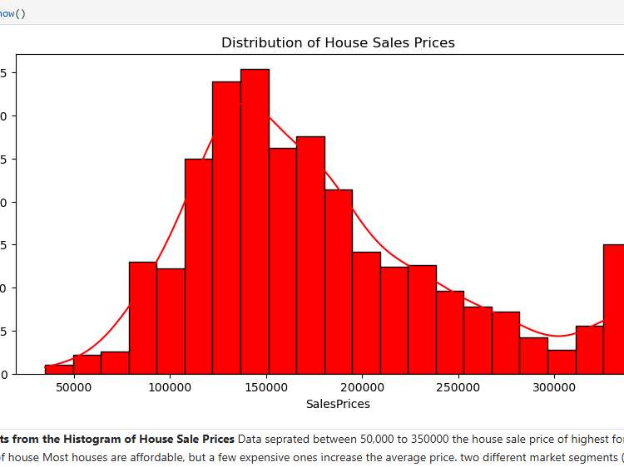
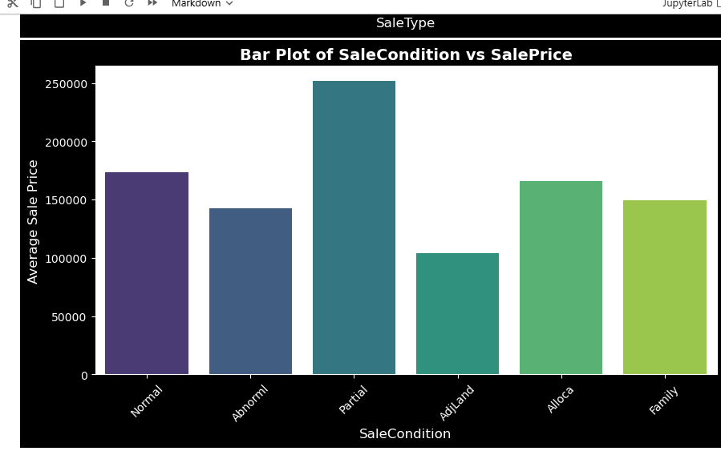
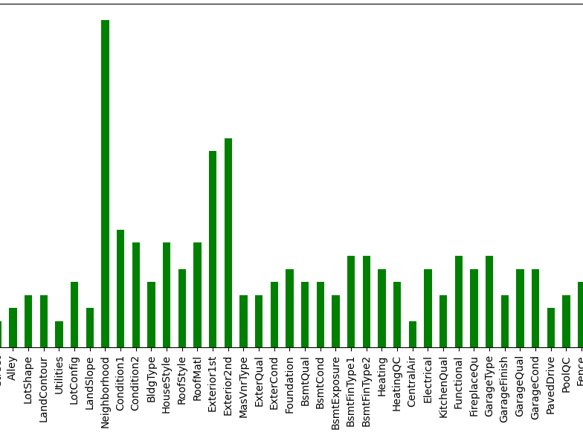
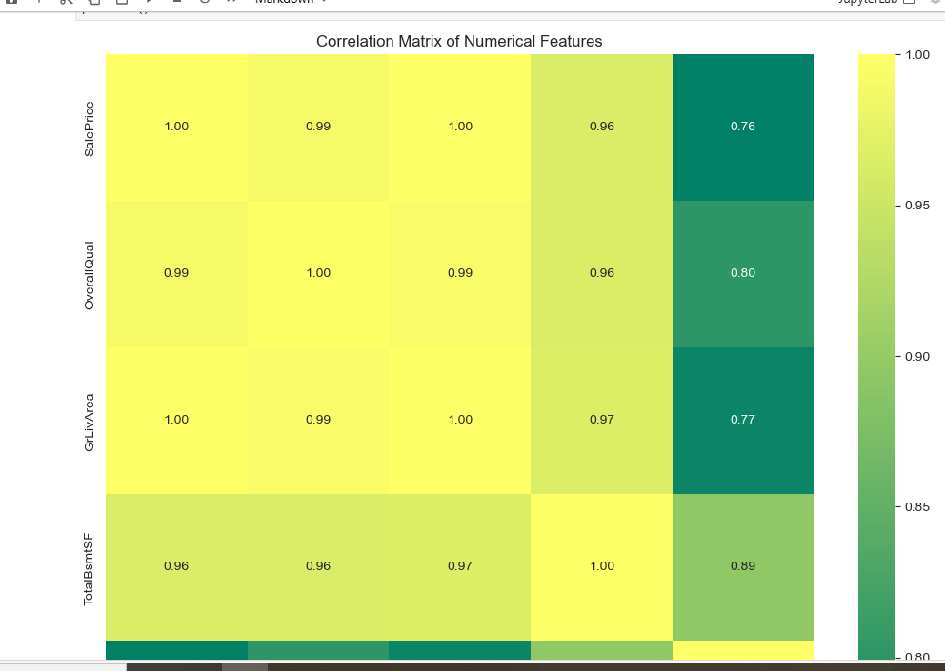
EDA Univariate & Multivarite

Slide 7
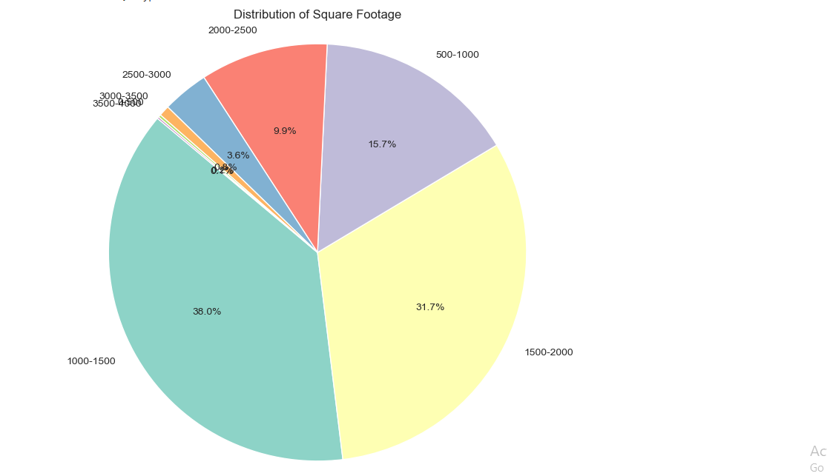
Feature Engineering
• Created new variables like:
- Price per square foot
- Property age
• room density analysis and predictive modeling.

Slide 8
Market Trends & Pricing Patterns
• Analyzed historical price changes over time.
• Identified seasonality and economic impact on pricing.
• Used time-series visualizations for trend detection.

Slide 9
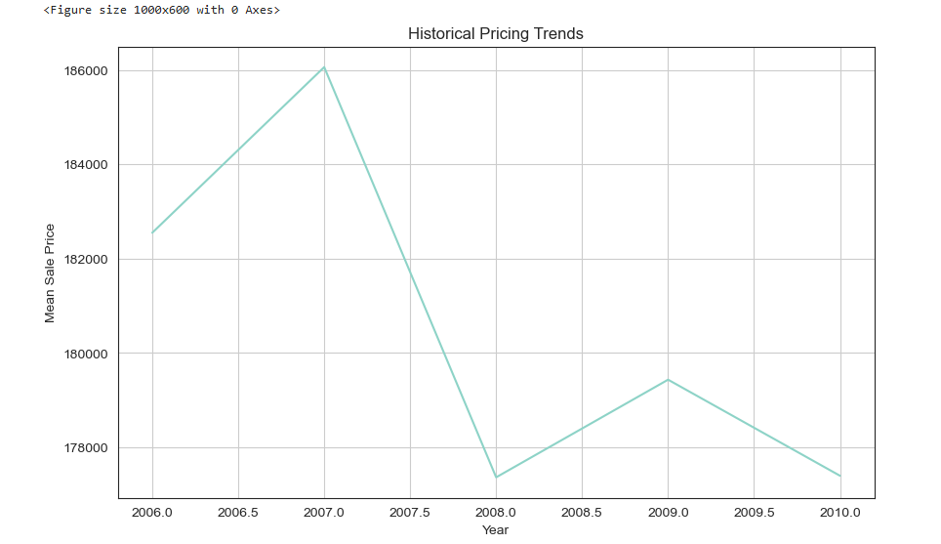
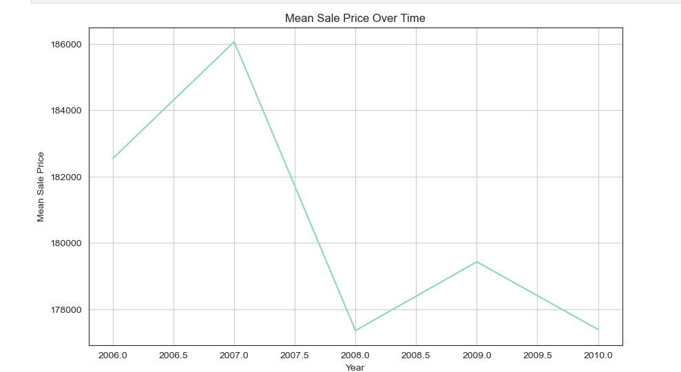
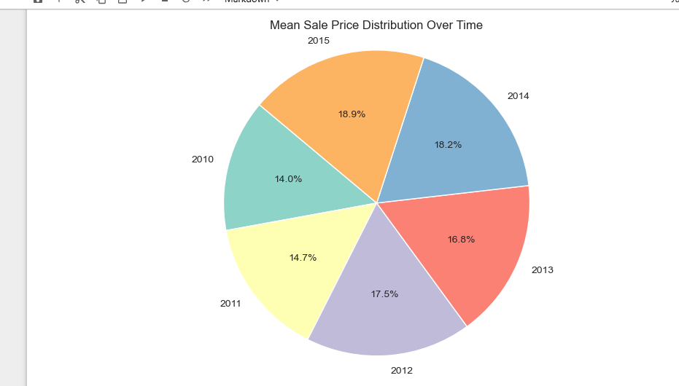
Market trainding and pricing
Time series
Economic impact

Slide 10

Customer Preferences & Amenities
• Evaluated the impact of amenities (pool, garden, parking) on pricing.
• Clustered properties based on feature similarities.
• Found premium amenities significantly influencing prices.

Slide 11

Key Insights & Findings
loading the data
cleaining and preprocessing
Checking the outlier with the help of boxplot.
Handeling the outlier for the numeric column only
Removing the outlier useing the median method
All numerical column removed outlier

Slide 12
Recommendations
• Adjust pricing based on location and key features.
• Utilize clustering for targeted marketing strategies.
• Incorporate predictive models for future price estimation.

Slide 13
Conclusion
• EDA provided valuable insights into real estate pricing.
• Future work: Implement machine learning models for price predictions.
• Data-driven strategies enhance business decisions.

Slide 14
Thank you

