Slide 1

Project - 5 User Analytics in the Telecommunication Industry
Next Hikes IT Solutions
Presented by:
Khushnaz
Submission by :
24/04/2025

Slide 2

Situational Overview
Business Need: Analysis for a wealthy investor considering purchasing TellCo.
Objective: Provide insights and recommendations based on user data.

Slide 3

Data Overview
Data Source: Aggregated xDR data from a month.
Features: User behavior on applications like Social Media, Google, Email, YouTube, Netflix, Gaming, and Others.

Slide 4
Task 1 - User Overview Analysis
Objective: Understand user behavior and identify key handsets and manufacturers.
Steps:
- Identify top 10 handsets.
- Identify top 3 handset manufacturers.
- Identify top 5 handsets per manufacturer.
- Recommendations for marketing teams.

Slide 5
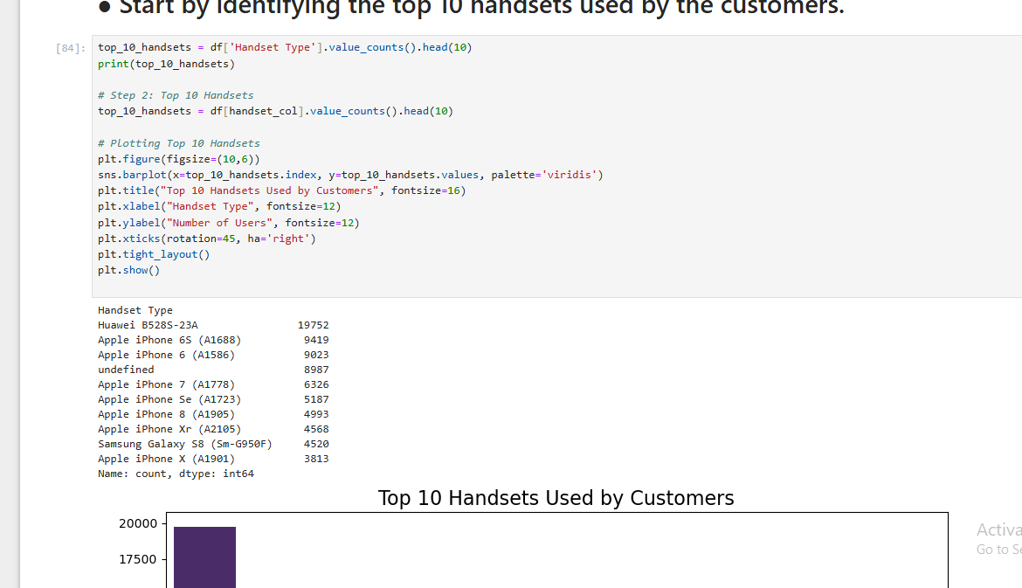
top 10 handsets.

Slide 6
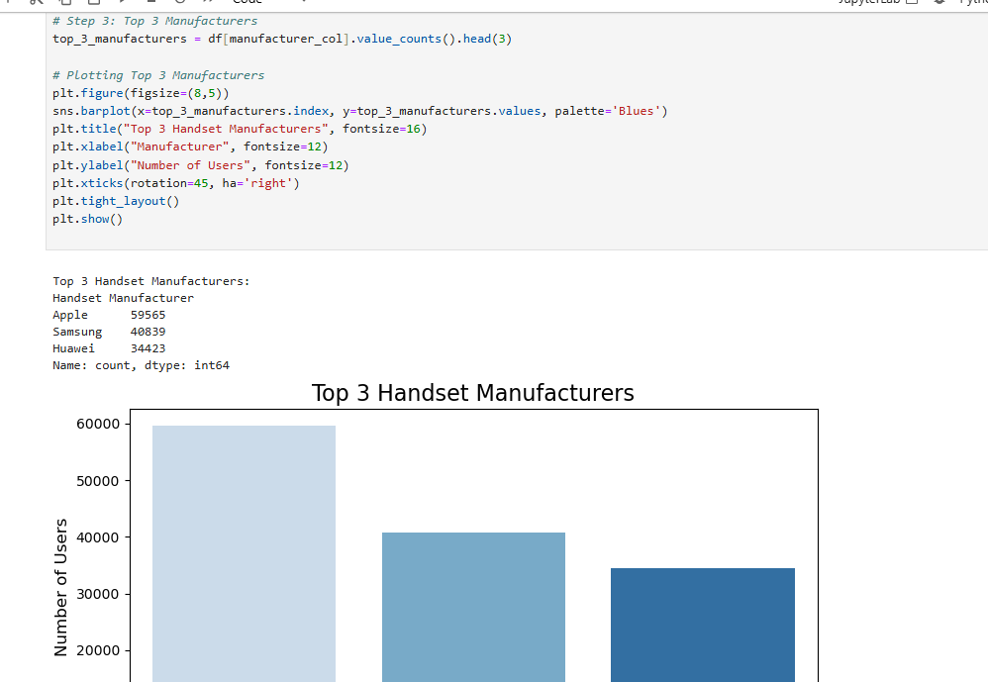
- Identify top 3 handset manufacturers.

Slide 7
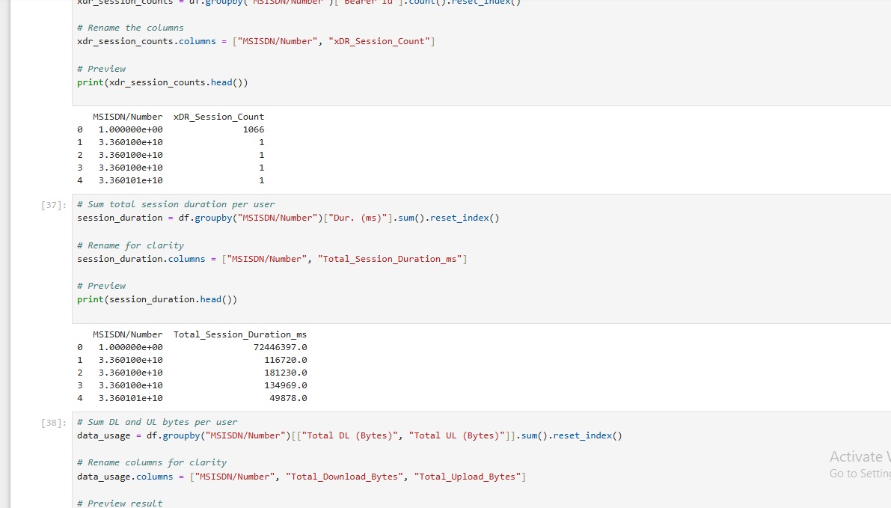
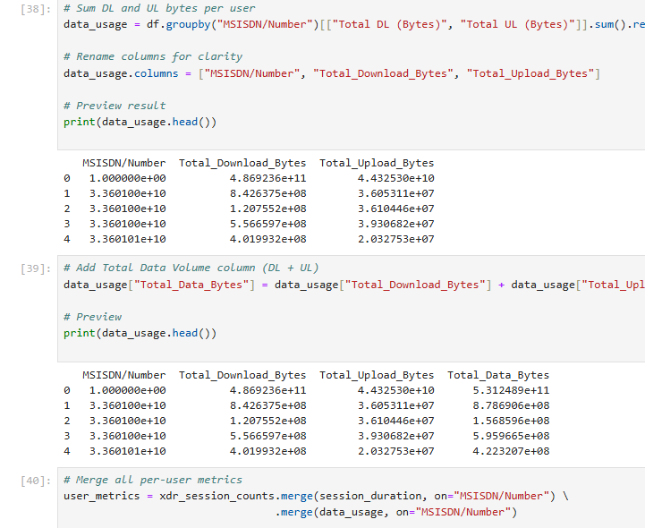
Task 1.1 - User Behavior on Applications
Metrics: Number of xDR sessions, session duration, total download/upload data, total data volume.
Steps:
- Aggregate data per user.
- Conduct exploratory data analysis.

Slide 8
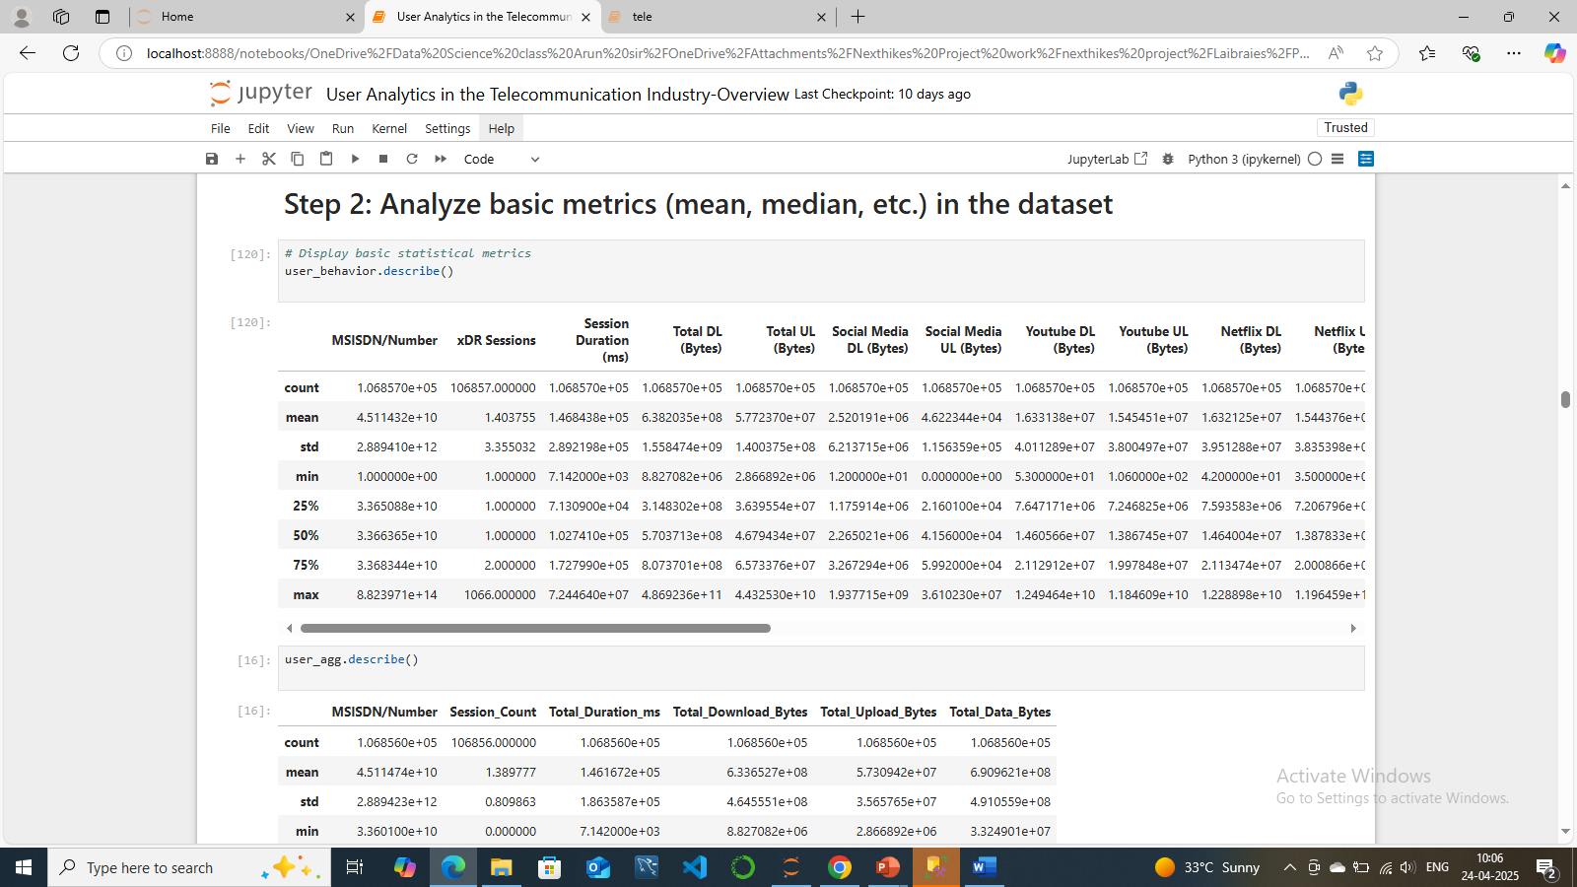
Task 1.2 - Exploratory Data Analysis
Steps:
- Describe variables and data types.
- Analyze basic metrics (mean, median, etc.).
- Conduct univariate and bivariate analysis.
- Perform variable transformations and correlation analysis.
- Dimensionality reduction using PCA.

Slide 9
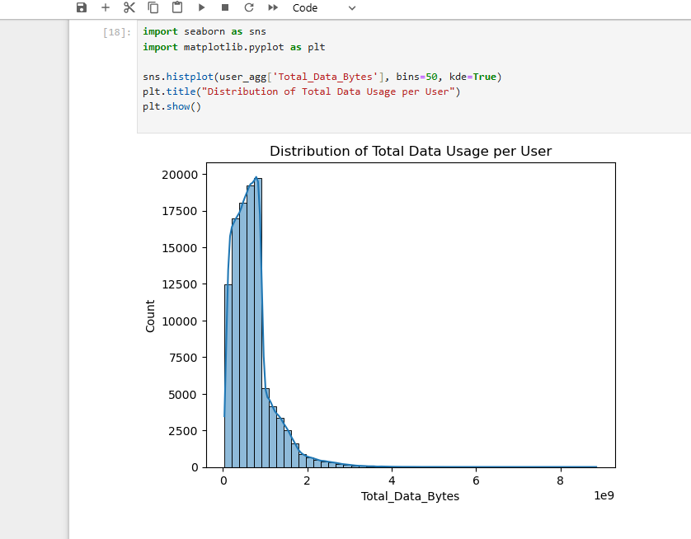
- Conduct univariate and bivariate analysis.

Slide 10
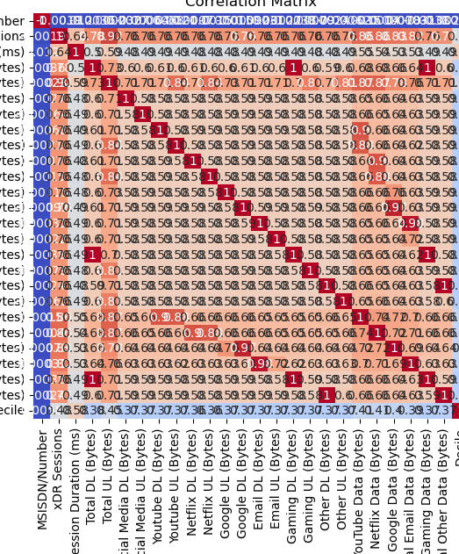
correlation analysis
# Insights:** Identifying Relationships:** The correlation matrix provides a comprehensive view of the relationships between different variables in the dataset. High positive or negative correlations indicate strong relationships, while values close to zero suggest weak or no relationships.Key Variables: Variables with high correlations can be identified as key factors influencing user behavior. For example, if session duration has a high positive correlation with total data usage, it indicates that longer sessions are associated with higher data consumption.Predictive Modeling: Understanding the correlations between variables can help in building predictive models. Variables with strong correlations can be used as predictors in regression models to forecast user behavior or data usage. Feature **Selection:** The correlation matrix can aid in feature selection by identifying redundant variables. Highly correlated variables may provide similar information, and one of them can be excluded to simplify the model without losing significant information.Anomaly Detection: Unusual correlations can indicate potential anomalies or data quality issues. For example, if a variable that should logically have a strong correlation with another shows a weak or negative correlation, it may warrant further investigation.

Slide 11
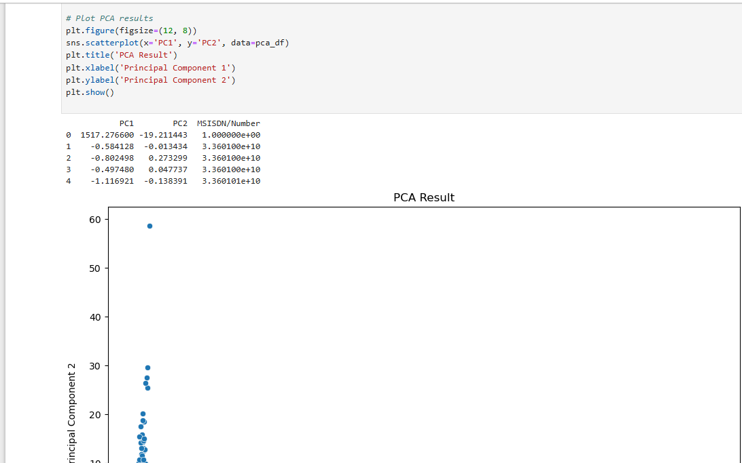
PCA

Slide 12
Task 2 - User Engagement Analysis
Objective: Track user engagement and activity.
Metrics: Session frequency, duration, total traffic.
Steps:
- Aggregate metrics per customer.
- Normalize metrics and run k-means clustering.
- Analyze engagement per application.

Slide 13
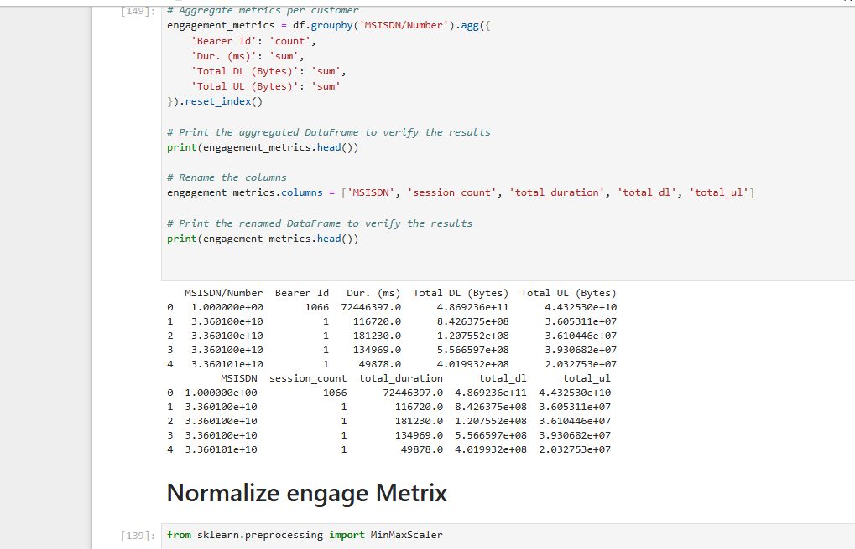

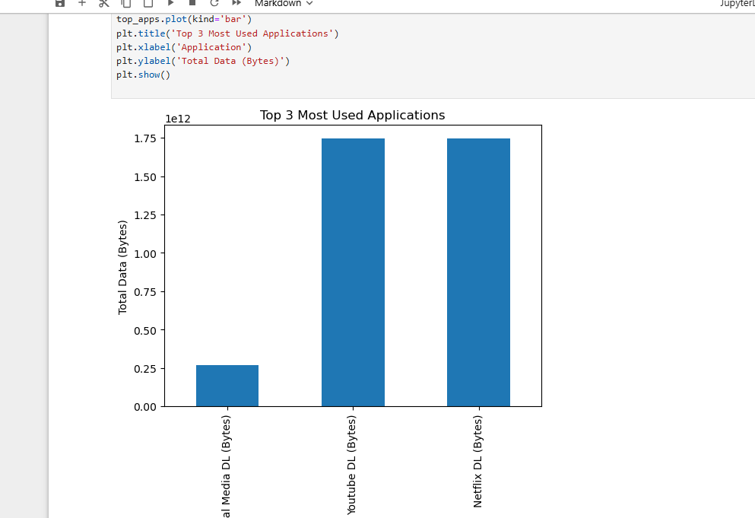
Task 2.1 - Engagement Metrics Analysis
- Report top 10 customers per engagement metric.
- Visualize engagement clusters.
- Plot top 3 most used applications.

Slide 14
Task 3 - Experience Analytics
Objective: Evaluate user experience based on network parameters and device characteristics.
Metrics: TCP retransmission, RTT, throughput, handset type.
Steps:
- Aggregate data per customer.
- Compute and list top, bottom, and most frequent values.
- Analyze distribution per handset type.

Slide 15
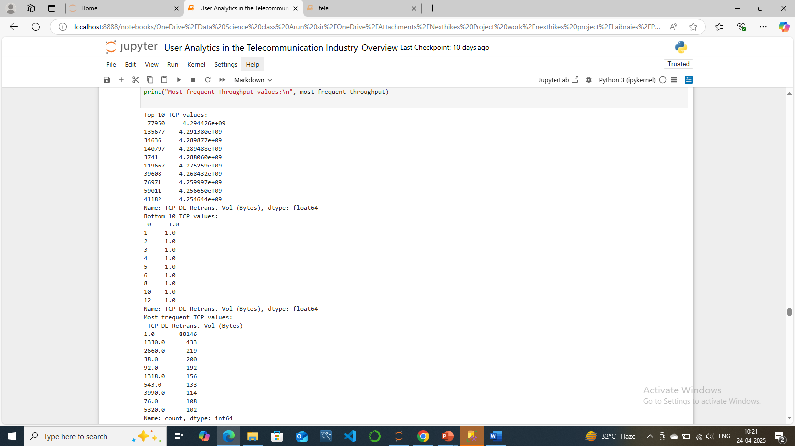
Top bottom

Slide 16
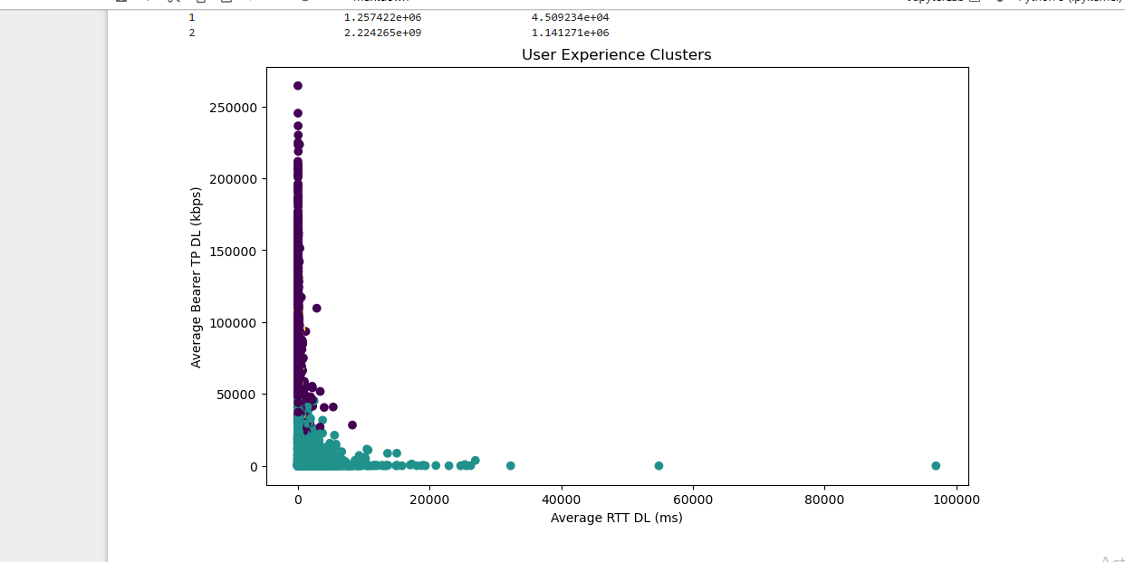
Task 3.1 - User Experience Analysis
- Perform k-means clustering on experience metrics.
- Describe each user experience cluster.

Slide 17
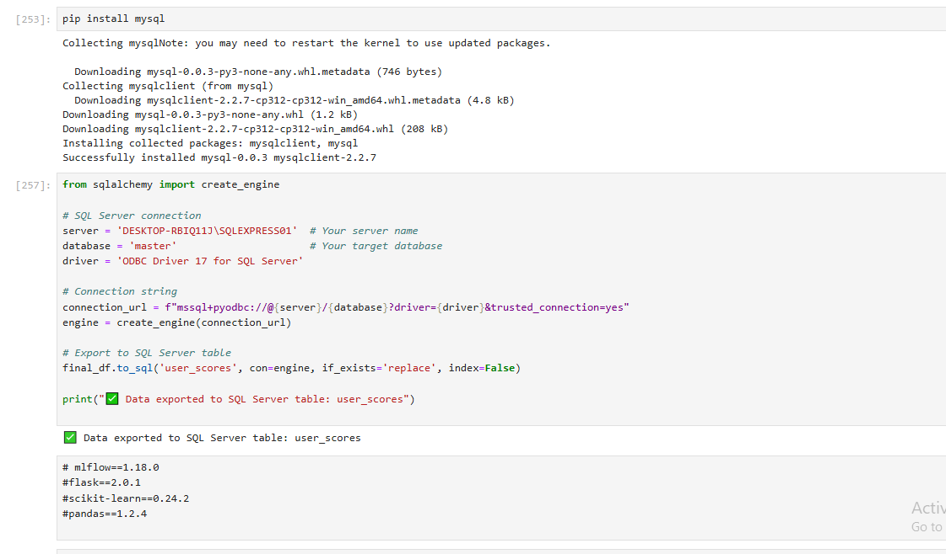
Task 4 Satisfaction Analysis
Write a python program and then convert enagements analysis experiaces and satisfaction score both are one group in sql server uploaded

Slide 18
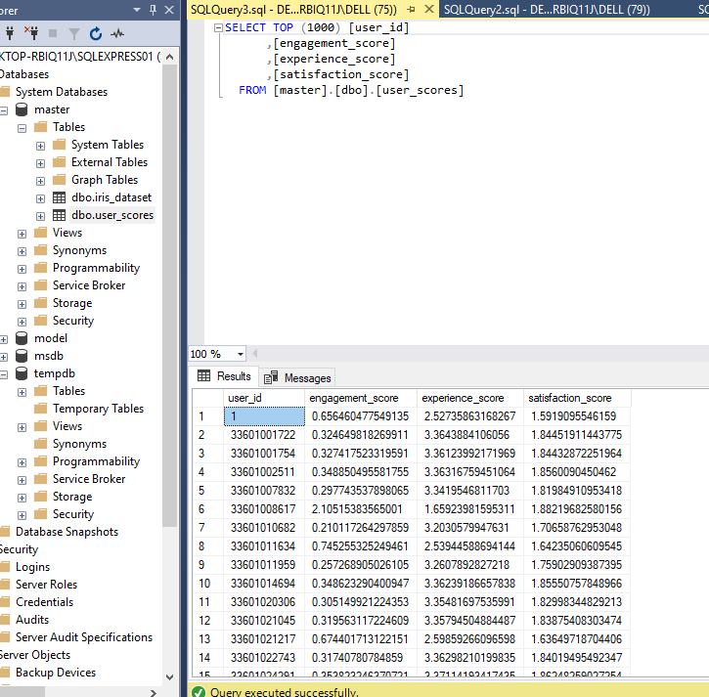
SQL Server

Slide 19

Thank you

