Slide 1
INNOPOLIS UNIVERSITY · B22 · COMPUTER SCIENCE
Memory-Assisted
LLM as a Judge
via Knowledge Graphs
for Evaluating Agents.
When does memory help — and how do we trust the measurement?
A U T H O R
Khush Pradipbhai Patel
S U P E R V I S O R
Bader Rasheed
P R O G R A M
09.03.01 — Data Science & AI
D E F E N S E
2 June 2026
MEMORY-ASSISTED LLM AS A JUDGE VIA KNOWLEDGE GRAPHS
1 / 36 · K. PATEL · 2026

Slide 2




LITERATURE REVIEW · THREE LINES OF PRIOR WORK
What came before.
L L M - A S - A - J U D G E
M E M O R Y - A U G M E N T E D
EVALUATION VALIDITY
Automatic evaluators.
Models with state.
Leakage is real.
MT-Bench · G-Eval · Prometheus.
RAG · MemGPT · Reflexion · Generative Agents.
Balloccu et al. · PoisonedRAG.
And the
known biases
they carry — position, length,
None of them study memory as a
leakage source
.
Contamination silently
inflates
reported scores.
self-preference.
MEMORY-ASSISTED LLM AS A JUDGE VIA KNOWLEDGE GRAPHS
2 / 36 · K. PATEL · 2026

Slide 3
PROPOSED SOLUTION · MOTIVATION
LLMs are now graded by other LLMs.
Ranking chatbots. Scoring agents.
Reward signals.
USE
Stateless judges have no consistency mechanism.
PROBLEM
Give the judge a
persistent memory
of past evaluations.
IDEA
MEMORY-ASSISTED LLM AS A JUDGE VIA KNOWLEDGE GRAPHS
3 / 36 · K. PATEL · 2026

Slide 4
PROPOSED SOLUTION · BUILD #1 · MAJ
A typed knowledge graph.
Policy
Attempt
Issue
GRADING RULE
PAST VERDICT
P R O B L E M
Fix
Semantic
C O R R E C T I O N
ABSTRACT CLASS
SATISFIES Attempt
→
Policy
CAUSES Attempt
→
Issue
RESOLVES Fix
→
Issue
ABSTRACTS_TO Issue
→
Semantic
MEMORY-ASSISTED LLM AS A JUDGE VIA KNOWLEDGE GRAPHS
4 / 36 · K. PATEL · 2026

Slide 5
PROPOSED SOLUTION · WHAT THE JUDGE SEES
An end-to-end example.
I N P U T
Task:
"Explain key methods for determining the pre-money valuation of a tech startup before a Series A round."
Response:
a 4-paragraph candidate answer covering DCF, comparable-company, and VC method.
RETRIEVE · 1
Contrastive Attempts
· cosine
≥
0.85
Returned:
2 past responses that passed on similar valuation questions, 1 that failed.
RETRIEVE · 2
Similar Issues
· cosine
≥
0.90
Returned:
"missed discount-rate justification", "vague comparable-company criterion".
RETRIEVE · 3
Semantic Patterns
· cosine
≥
0.90
Returned:
recurring category — "incomplete-methodology" — observed across 4 past attempts.
A S S E M B L E
All three stages are formatted into a single context block — examples, issues, patterns — and prepended to the judge's prompt alongside the task and rubric.
J U D G E
GPT-4o receives
task + rubric + retrieved context + candidate response
, and returns a structured verdict (
pass / fail
+ reasoning).
MEMORY-ASSISTED LLM AS A JUDGE VIA KNOWLEDGE GRAPHS
5 / 36 · K. PATEL · 2026

Slide 6
PROPOSED SOLUTION · THE ASSEMBLED PROMPT
What the judge literally receives.
[TASK]
Explain key methods for determining the pre-money valuation
of a tech startup before a Series A round.
[RUBRIC]
DCF (future cash flows, projections); Comparable analysis
(similar-co. multiples); VC method (rev × multiple − post-$);
founder's share matters; strategic buyers pay more.
[RETRIEVED MEMORY CONTEXT]
IMPORTANT: these are REFERENCE examples only. Each case is UNIQUE.
Do NOT assume this case will have the same outcome as similar past
cases. Judge THIS response on its own merits against the rubric.
SUCCESSFUL EXAMPLES (similar responses that passed):
1. [similarity: 91%] Response excerpt: "DCF projects future cash flows
at a stage-appropriate discount rate, while VC method back-solves..."
Why it passed: "covers all three methods, names discount-rate trade-off."
2. [similarity: 88%] Response excerpt: "Valuation triangulates DCF +
comparable + VC; founder dilution drives the negotiation..."
Why it passed: "explicit on founder share."
FAILED EXAMPLES (similar responses that failed):
1. [similarity: 93%] Response excerpt: "Pre-money valuation is the
value of the company before investment..."
Why it failed: "tautological; never names a method."
SIMILAR ISSUES OBSERVED:
· "missed discount-rate justification" (sim 0.91)
· "vague comparable-company criterion" (sim 0.90)
Reconstructed from
judge.py · _format_memory_context()
. Real run on EvalsBench item #41.
MEMORY-ASSISTED LLM AS A JUDGE VIA KNOWLEDGE GRAPHS
6 / 36 · K. PATEL · 2026

Slide 7
PROPOSED SOLUTION · BUILDS #2 & #3
Two MCTS extensions.
BUILD #2 · RETRIEVAL LAYER
BUILD #3 · REASONING LAYER
MCTS-Retrieval
MCTS-Judge
Tree search over
7 retrieval actions
on the graph — four of them
multi-hop traversals
Decomposes evaluation into 5–7
task-specific subtasks
. Each rollout selects subtasks
(Issues
→
Fixes, Semantics
→
Issues, Policy
→
Attempts, Attempts
→
Semantics).
via UCT + LLM self-assessment. Final verdict aggregates the best trajectory.
Trajectories scored by relevance, diversity, volume.
Combined into
six evaluation modes
, ablating memory and search independently.
MEMORY-ASSISTED LLM AS A JUDGE VIA KNOWLEDGE GRAPHS
7 / 36 · K. PATEL · 2026

Slide 8
PROPOSED SOLUTION · MCTS-JUDGE · WALKTHROUGH
How tree-search reasoning runs.
I N P U T
Task + Response.
Same EvalsBench item as before.
D E C O M P O S E
LLM dynamically generates
5–7 task-specific subtasks
— each probes the response from a different angle.
e.g. "Does it cover DCF?" · "Is the discount-rate logic correct?" · "Does it mention founder share?"
S E A R C H
4 rollouts, max depth 5. At each step, the child node maximising
UCT + LLM self-assessment
is selected. Each leaf scores the response from that subtask's perspective.
A G G R E G A T E
Best trajectory's
majority vote
+ a
global synthesis
over all visited subtasks.
V E R D I C T
Structured output:
{ verdict: pass | fail, reasoning: ... }
MEMORY-ASSISTED LLM AS A JUDGE VIA KNOWLEDGE GRAPHS
8 / 36 · K. PATEL · 2026

Slide 9
PROPOSED SOLUTION · MCTS-JUDGE · TREE EXPANSION
One rollout, traced.
ROOT
(task + response)
│
├──
[subtask 1] "DCF coverage?" Q=0.92 N=4 UCT=1.18
←
selected
│
│
│
├──
[subtask 3] "Discount rate?" Q=0.88 N=2
←
selected
│
│
│
│
│
└──
→
[subtask 5] "Comparable co.?" Q=0.85 N=1
PASS
│
│
│
└──
[subtask 4] "Founder share?" Q=0.71 N=1
←
unselected
│
├──
[subtask 2] "VC method?" Q=0.60 N=1
←
unselected
└──
[subtask 6] "Strategic buyer?" Q=0.55 N=1
←
unselected
→
→
final trajectory: 1
3
5 · majority = PASS · global synthesis = PASS
UCT balances
Q(s)
(mean reward) with an exploration bonus that decays as
N(s)
grows.
MEMORY-ASSISTED LLM AS A JUDGE VIA KNOWLEDGE GRAPHS
9 / 36 · K. PATEL · 2026

Slide 10
PROPOSED SOLUTION · EARLY SIX-MODE BENCHMARK
And then — a surprise.
M O D E
A C C U R A C Y
L A T E N C Y
Stateless
60.0%
3.8 s
MAJ (memory)
63.3%
6.4 s
MCTS-Judge (no memory)
56.7%
126.7 s
MCTS-Judge + Memory
60.0%
51.2 s
MCTS-Retrieval + Judge
60.0%
3.4 s
Full MCTS
46.7%
48.6 s
Early benchmark, 30 samples, un-audited.
Reported in the thesis as a
motivating observation
, not a verified result.
But the qualitative picture was clear: something was wrong.
Either the system is broken — or the measurement is.
MEMORY-ASSISTED LLM AS A JUDGE VIA KNOWLEDGE GRAPHS
10 / 36 · K. PATEL · 2026

Slide 11
PROPOSED SOLUTION · PART 3
Can we trust the numbers?
The first numbers were too good.
The next numbers were too strange.
So I went back to the measurement.
MEMORY-ASSISTED LLM AS A JUDGE VIA KNOWLEDGE GRAPHS
11 / 36 · K. PATEL · 2026

Slide 12
PROPOSED SOLUTION · THE LEAKAGE PROBLEM
Two leakage channels.
CHANNEL I
CHANNEL II
Paired-item leakage
Write-back leakage
Question Q
t=0 score A
→
write to memory
├─
Q.PASS
→
train
t=1 score B (related to A)
└─
Q.FAIL
→
test
memory now contains A's verdict
The judge sees Q.PASS in memory
Every early write contaminates
while scoring Q.FAIL.
every later read.
MEMORY-ASSISTED LLM AS A JUDGE VIA KNOWLEDGE GRAPHS
12 / 36 · K. PATEL · 2026

Slide 13
PROPOSED SOLUTION · BUILD #4 · THE PROTOCOL
Closing both channels.
Split by
question
, not row.
FIX I
Freeze
memory during the test.
FIX II
A claim is not a proof.
How do I prove the freeze actually held?
MEMORY-ASSISTED LLM AS A JUDGE VIA KNOWLEDGE GRAPHS
13 / 36 · K. PATEL · 2026

Slide 14
PROPOSED SOLUTION · THE TWO-LAYER AUDIT
SHA-256 + runtime write-blocker.
LAYER 1 · AFTER-THE-FACT
LAYER 2 · DURING THE RUN
SHA-256 fingerprint
Runtime write-blocking
before = sha256(graph)
graph.create = guard
... run evaluation ...
graph.link = guard
after = sha256(graph)
graph.upsert = guard
assert before == after
FrozenMemoryViolation if called
MEMORY-ASSISTED LLM AS A JUDGE VIA KNOWLEDGE GRAPHS
14 / 36 · K. PATEL · 2026

Slide 15
PROPOSED SOLUTION · THE AUDIT · WALKTHROUGH
How the audit runs.
Take a deterministic
snapshot
: count nodes & edges by type, hash sorted node IDs + edge triples
SHA-256 fingerprint
B E F O R E
→
.
D U R I N G
Patch every write method on the graph:
create · link · upsert
. Any attempted write raises
FrozenMemoryViolation
.
RUN EVAL
All 80 test items judged. Memory should be read-only.
A F T E R
Take another snapshot. Compare to "before".
V E R D I C T
Pass
only if
: fingerprints match exactly
AND
no FrozenMemoryViolation was raised. Otherwise the run is rejected.
MEMORY-ASSISTED LLM AS A JUDGE VIA KNOWLEDGE GRAPHS
15 / 36 · K. PATEL · 2026

Slide 16
PROPOSED SOLUTION · THE AUDIT · SNAPSHOT DIFF
Before vs. after — two outcomes.
✓
AUDIT PASSES
✗
AUDIT FAILS
nodes: 412
→
412
nodes: 412
→
492 (+80)
edges: 831
→
831
vs.
edges: 831
→
1003 (+172)
fingerprint:
fingerprint:
a3f1...8c2b
a3f1...8c2b
== a3f1...8c2b
≠
d9e2...0f17
The right side
is
what happened on the first run. The audit forced the bug into the open — and into the fix that followed.
MEMORY-ASSISTED LLM AS A JUDGE VIA KNOWLEDGE GRAPHS
16 / 36 · K. PATEL · 2026

Slide 17
E V A L U A T I O N
Re-evaluation under the audit.
Now — with the audit passing — what do the six modes really do?
MEMORY-ASSISTED LLM AS A JUDGE VIA KNOWLEDGE GRAPHS
17 / 36 · K. PATEL · 2026

Slide 18
EVALUATION · DATASET
EvalsBench.
samples · finance / startup QA.
160
unique questions — each appearing twice.
80
balanced PASS / FAIL.
50/50
a natural stress test for leakage.
PAIRED
MEMORY-ASSISTED LLM AS A JUDGE VIA KNOWLEDGE GRAPHS
18 / 36 · K. PATEL · 2026

Slide 19




EVALUATION · STATISTICAL METHODOLOGY
How significance is decided.
Every accuracy is reported with a
two-sided Wilson 95% CI
. Mode-versus-mode comparisons are paired and
assessed with the
exact McNemar test
.
(3.4)
(3.5)
A difference is declared significant only when the McNemar p-value < 0.05 and the paired bootstrap CI excludes zero.
= discordant pairs.
MEMORY-ASSISTED LLM AS A JUDGE VIA KNOWLEDGE GRAPHS
19 / 36 · K. PATEL · 2026

Slide 20
EVALUATION · AUDITED RESULTS
Under the audited protocol.
M O D E
A C C U R A C Y
95% WILSON CI
VS. STATELESS
Stateless
70.0%
[59.2, 78.9]
— baseline —
MAJ (memory)
65.0%
[54.1, 74.5]
−5.0 pp · p = 0.29
MCTS-Judge
70.0%
[59.2, 78.9]
±0.0 pp
MCTS-Judge + Memory
71.8%
[61.0, 80.6]
+1.8 pp · p = 0.80
Every CI overlaps the baseline. No paired difference is significant (McNemar & paired bootstrap, α = 0.05).
MEMORY-ASSISTED LLM AS A JUDGE VIA KNOWLEDGE GRAPHS
20 / 36 · K. PATEL · 2026

Slide 21


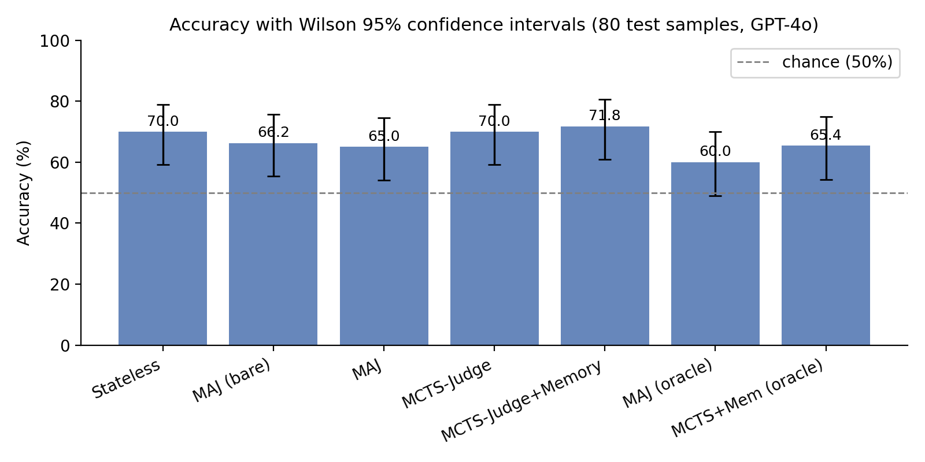
EVALUATION · VISUAL
Every error bar overlaps.
PER-MODE ACCURACY · WILSON 95% CI · N = 80 · GPT-4O
MEMORY-ASSISTED LLM AS A JUDGE VIA KNOWLEDGE GRAPHS
21 / 36 · K. PATEL · 2026

Slide 22
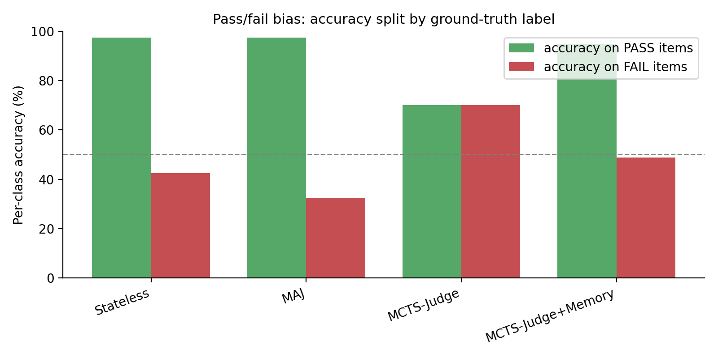
EVALUATION · CLASS-CONDITIONAL ERRORS
All modes share a pass-oriented bias.
PER-CLASS ACCURACY · GPT-4O · ATTACHING MEMORY DOES NOT CORRECT THE BIAS
MEMORY-ASSISTED LLM AS A JUDGE VIA KNOWLEDGE GRAPHS
22 / 36 · K. PATEL · 2026

Slide 23
EVALUATION · A CAUGHT ARTIFACT
What looked like a collapse, wasn't.
UN-AUDITED HARNESS
AUDITED HARNESS · RETRIED
21.2%
65.4%
→
Network errors silently counted as wrong answers.
Identical to oracle. No collapse.
A spurious fragility — like a spurious benefit — is a property of the harness, not the system.
MEMORY-ASSISTED LLM AS A JUDGE VIA KNOWLEDGE GRAPHS
23 / 36 · K. PATEL · 2026

Slide 24
PROPOSED SOLUTION · BUILD #5 · THE RELIABILITY HARNESS
Three independent stress tests.
EXPERIMENT B
EXPERIMENT C
EXPERIMENT D
Stochastic Stability
Label-Flip Discrimination
Defense Filter
95% 90%
65% / 70% / 65%
64.8% 65.0%
Same item, judged twice. MAJ and MCTS-
Invert PASS
↔
FAIL and check the judge flips with it. All
Similarity-threshold filter under 50% poisoned memory.
Judge+Memory agree with themselves on the great
modes discriminate above chance — and similarly to
The filter does not help.
An honest negative result,
majority of items.
The modes are stable.
each other.
reported as such.
MEMORY-ASSISTED LLM AS A JUDGE VIA KNOWLEDGE GRAPHS
24 / 36 · K. PATEL · 2026

Slide 25
PROPOSED SOLUTION · RELIABILITY HARNESS · WALKTHROUGH
How each experiment runs.
STABILITY · B
For each item: judge it
twice
with the same memory.
Measure:
agreement rate. "Does the system give the same answer to the same question?"
LABEL-FLIP · C
For each item: generate an
inverted
response (LLM rewrites it to clearly fail), then judge the inverted version.
Measure:
how often the verdict correctly flips PASS
→
FAIL.
DEFENSE · D
Build a
50%-poisoned memory
. Compare two configurations: judge with the raw poisoned memory, vs. judge with a
similarity-threshold filter
applied on retrieved nodes.
Measure:
does the filter recover accuracy?
V E R D I C T S
B: 95% / 90% — modes are stable.
C: 65% / 70% / 65% — all modes discriminate.
D: 64.8% vs 65.0% — the filter does not help.
MEMORY-ASSISTED LLM AS A JUDGE VIA KNOWLEDGE GRAPHS
25 / 36 · K. PATEL · 2026

Slide 26


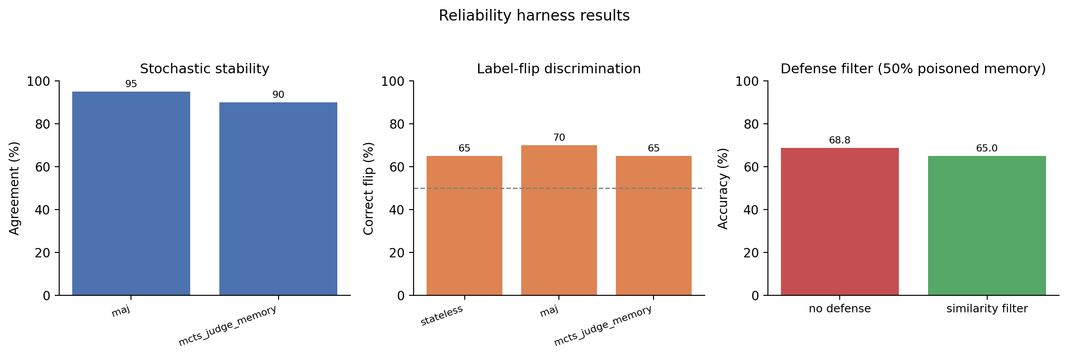
PROPOSED SOLUTION · RELIABILITY HARNESS · VISUAL
Stability · discrimination · defense.
THREE ORTHOGONAL RELIABILITY EXPERIMENTS · AUDITED PROTOCOL
MEMORY-ASSISTED LLM AS A JUDGE VIA KNOWLEDGE GRAPHS
26 / 36 · K. PATEL · 2026

Slide 27
FINDINGS · DISCUSSION
Why no help, no harm.
A null result is only credible if it is explained.
MEMORY-ASSISTED LLM AS A JUDGE VIA KNOWLEDGE GRAPHS
27 / 36 · K. PATEL · 2026

Slide 28
DISCUSSION · MECHANISM
Three pieces of evidence.
Oracle labels don't beat self-written.
EVIDENCE I
Bare schema matches the full schema.
EVIDENCE II
GPT-4o sits
near its reasoning ceiling
on this task.
HYPOTHESIS
A weaker judge model — future work.
TEST
MEMORY-ASSISTED LLM AS A JUDGE VIA KNOWLEDGE GRAPHS
28 / 36 · K. PATEL · 2026

Slide 29


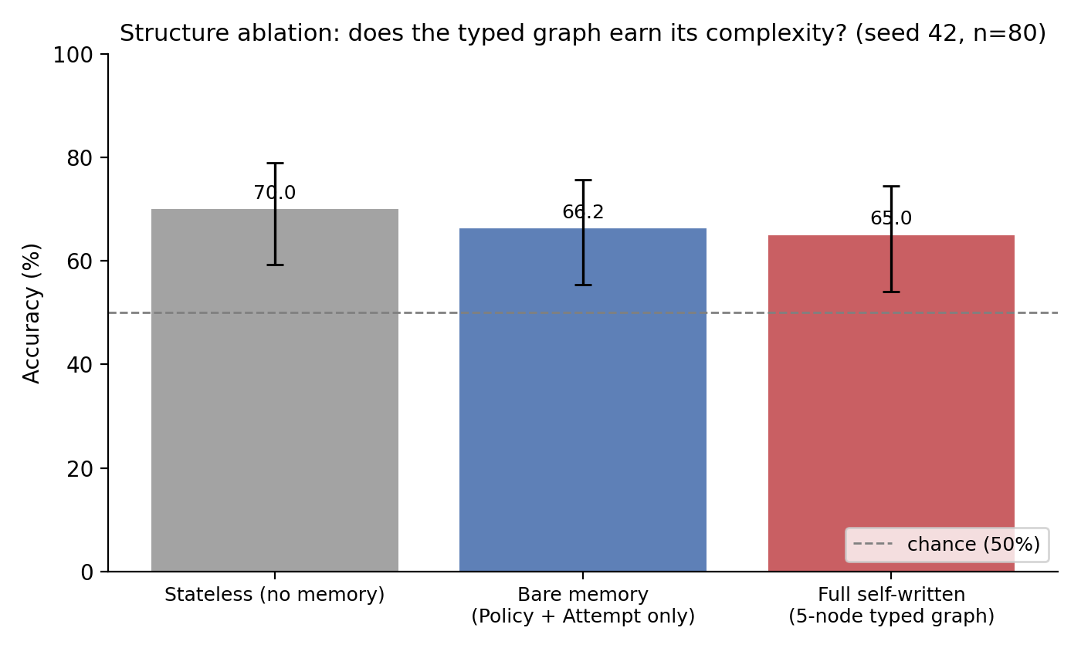
DISCUSSION · EVIDENCE II
Bare schema = full schema.
STATELESS · BARE MEMORY (POLICY + ATTEMPT) · FULL 5-NODE TYPED GRAPH · WILSON 95% CI
MEMORY-ASSISTED LLM AS A JUDGE VIA KNOWLEDGE GRAPHS
29 / 36 · K. PATEL · 2026

Slide 30
DISCUSSION · COST OF THE MCTS MODES
The cost trade-off.
M O D E
A C C U R A C Y
MEAN LATENCY
VS. STATELESS
Stateless
70.0%
3.6 s
— baseline —
MAJ (memory)
65.0%
4.5 s
1.3×
MCTS-Judge
70.0%
31.8 s
8.8×
MCTS-Judge + Memory
71.8%
33.3 s
9.2×
MCTS modes cost ~9× more latency for no significant accuracy gain.
Hence: reported as
exploratory
, not recommended.
MEMORY-ASSISTED LLM AS A JUDGE VIA KNOWLEDGE GRAPHS
30 / 36 · K. PATEL · 2026

Slide 31
DISCUSSION · THREATS TO VALIDITY · §5.9
Where the null holds — and where it doesn't.
S C O P E
P O W E R
One judge model.
n = 80, MDE
12–15 pp.
≈
All audited results use GPT-4o. A weaker model may have headroom for memory to
Powered to detect the conventional 6–10 pp claim, and didn't. A small genuine effect
help; a stronger one may not.
of a few points cannot be excluded — hence "no effect detected at this scale".
D O M A I N
WHAT HOLDS
One benchmark, one task.
The protocol itself.
EvalsBench: rubric-graded QA in finance/startup. Open-ended or creative tasks may
The leakage-free audit is benchmark- and model-agnostic. The methodological
behave differently.
contribution is independent of the empirical finding.
MEMORY-ASSISTED LLM AS A JUDGE VIA KNOWLEDGE GRAPHS
31 / 36 · K. PATEL · 2026

Slide 32
IN SUMMARY
What this thesis contributes.
MEMORY-ASSISTED LLM AS A JUDGE VIA KNOWLEDGE GRAPHS
32 / 36 · K. PATEL · 2026

Slide 33
C O N T R I B U T I O N S
Four deliverables. One year.
01 · SYSTEM
02 · METHODOLOGY
MCTS-MAJ
Leakage-free protocol
Typed Neo4j memory graph + 3-stage retrieval + two MCTS extensions. Six
Question-level split + frozen memory. Closes both leakage channels by construction.
evaluation modes.
03 · ENGINEERING
04 · FINDING
Two-layer cryptographic audit
A corrective null result
SHA-256 fingerprint + runtime write-blocker.
Proves
the absence of leakage on every
Audited protocol overturns the +10 pp gain & the poisoning collapse. Reliability
run.
harness shows the system is consistent — but the schema isn't doing extra work.
MEMORY-ASSISTED LLM AS A JUDGE VIA KNOWLEDGE GRAPHS
33 / 36 · K. PATEL · 2026

Slide 34
THE VERDICT
Without the audited protocol,
this thesis would have reported a
+10 pp gain
and a
catastrophic poisoning collapse
.
Both were artifacts.
The audit made the truth visible.
MEMORY-ASSISTED LLM AS A JUDGE VIA KNOWLEDGE GRAPHS
34 / 36 · K. PATEL · 2026

Slide 35
FUTURE WORK
What comes next.
→
Replicate on weaker & stronger judges.
Scale n by 5–10× (MDE: 13 pp
4 pp).
→
→
→
Release the audit as a reusable tool.
MEMORY-ASSISTED LLM AS A JUDGE VIA KNOWLEDGE GRAPHS
35 / 36 · K. PATEL · 2026

Slide 36
BACHELOR'S THESIS DEFENSE · 2 JUNE 2026
Thank you.
Questions are welcome.
CODE github.com/khushpatel2002/MCTS-MAJ
BENCHMARK EvalsBench · Vibrant Labs AI · Apache-2.0
METHODS Wilson CI · McNemar · paired bootstrap (10,000)
MEMORY-ASSISTED LLM AS A JUDGE VIA KNOWLEDGE GRAPHS
36 / 36 · K. PATEL · 2026

