Slide 1
Front End Engineering
Crypto Tracker
Dhruv Sood (2210990279)
Dhruv Shukla (2210990278)
Divanshu Garg (2210990289)
Khushdeep Sharma (2210990509)
Team Details:
Faculty Coordinator:
Parul Gehelot
Chitkara University Institute of Engineering and Technology,
Chitkara University, Punjab

Slide 2
Contents
Introduction
Problem Statement
Technical Details
Key Features
Project Highlights
Conclusion
References/Links used

Slide 3
Introduction
CRYPTO CURRENCY PORTFOLIO TRACKER
Made By:
Dhruv Sood (2210990279)
Dhruv Shukla (2210990278)
Divanshu Garg (2210990289)
Khushdeep Sharma (2210990509)

Slide 4
Problem Statement
Developing a cryptocurrency portfolio tracker integrating real-time data via APIs.
Creating a cryptocurrency portfolio tracker with real-time data fetched from APIs poses several challenges. Ensuring data accuracy, security, and user-friendly interface are key concerns. Additionally, managing portfolio features, optimizing performance, handling errors, and complying with regulations are critical. Scalability and providing comprehensive documentation and support further add complexity to the project. Addressing these issues effectively is crucial for delivering a successful crypto portfolio tracker

Slide 5

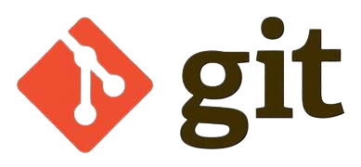
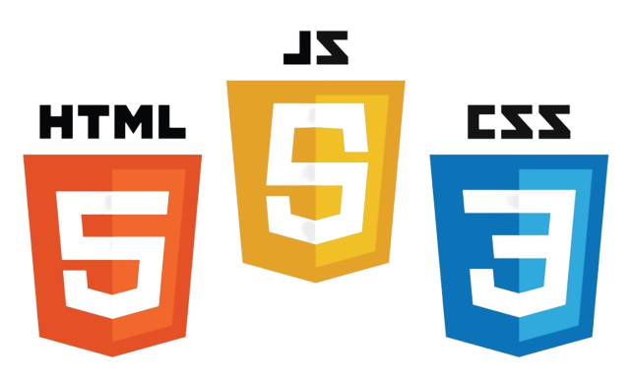
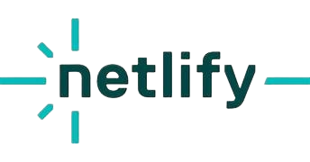

Technical Details
HTML, CSS, JavaScript, and React are essential tools in web development.
HTML structures content, CSS styles it, and JavaScript adds interactivity.
React simplifies building user interfaces with reusable components and efficient state management.
Our choice of editor was Visual Studio Code, and we utilized Git and GitHub for collaborative work.

Slide 6
Key Features
1.Real-time Data Updates: Seamless integration with cryptocurrency exchange APIs to provide users with up-to-date information on prices, market trends, and portfolio values.
2. Performance Tracking: Tools to monitor portfolio performance over time, including metrics such as ROI (Return on Investment), profit/loss, and percentage change.
3. Price Alerts: Customizable price alert notifications to keep users informed about significant price movements for specific cryptocurrencies in their portfolio.
4.Multi-currency Support: Support for tracking portfolios denominated in various fiat currencies and cryptocurrencies, enabling users to manage diverse investment portfolios.
5.Charting and Visualization: Interactive charts and graphs to visualize portfolio composition, asset allocation, and historical performance trends.

Slide 7
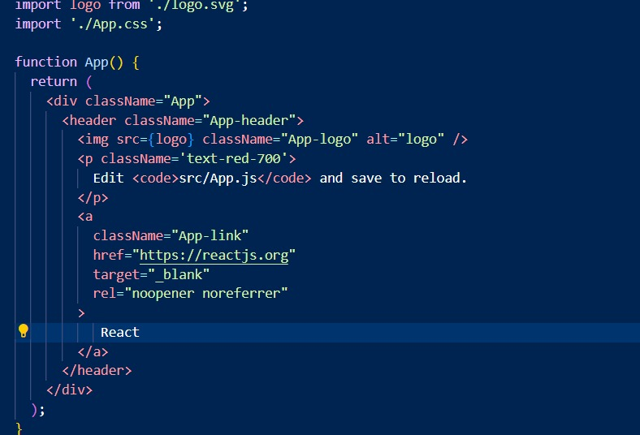
Project Highlights 1
CODE SNIPPETS:

Slide 8
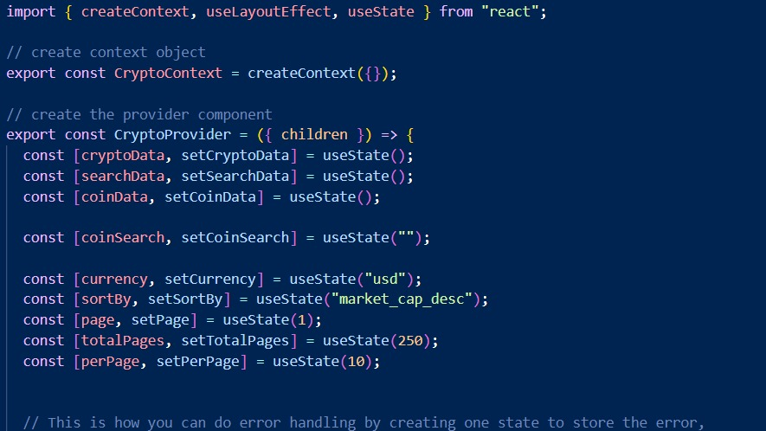
Project Highlights 2
CSS CODE SNIPPETS:

Slide 9
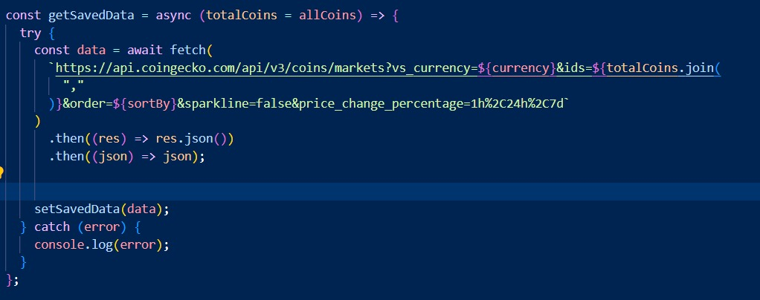
Project Highlights 3

Slide 10
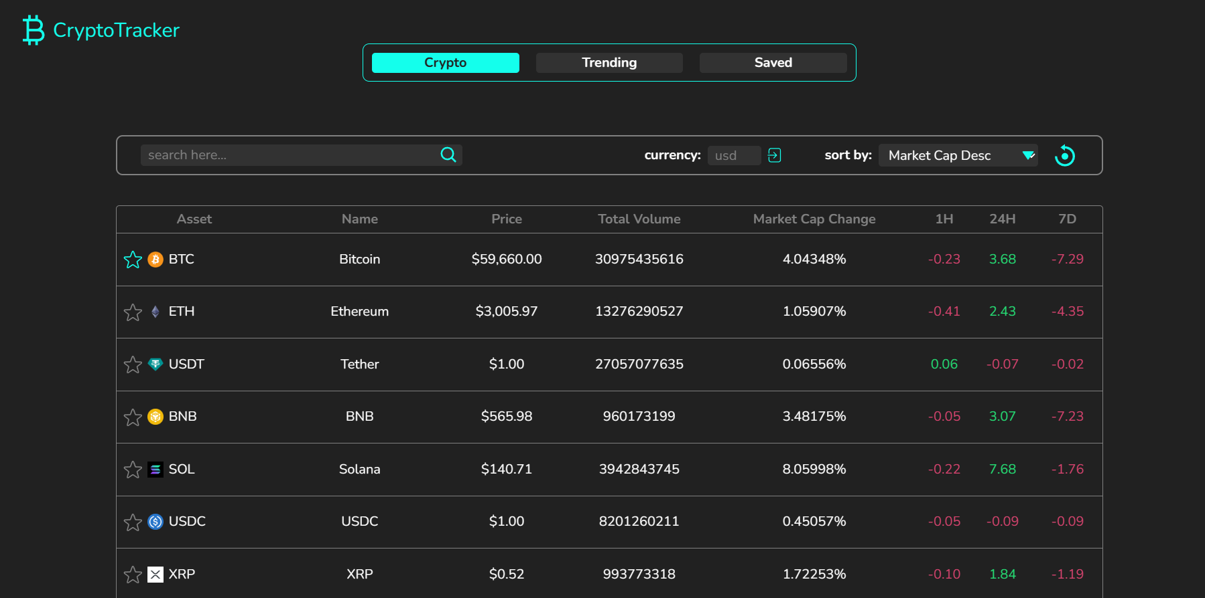
Conclusion

Slide 11
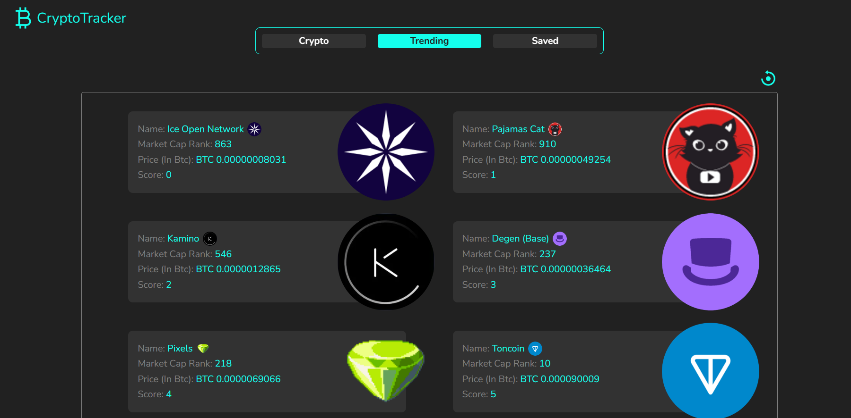
Conclusion

Slide 12
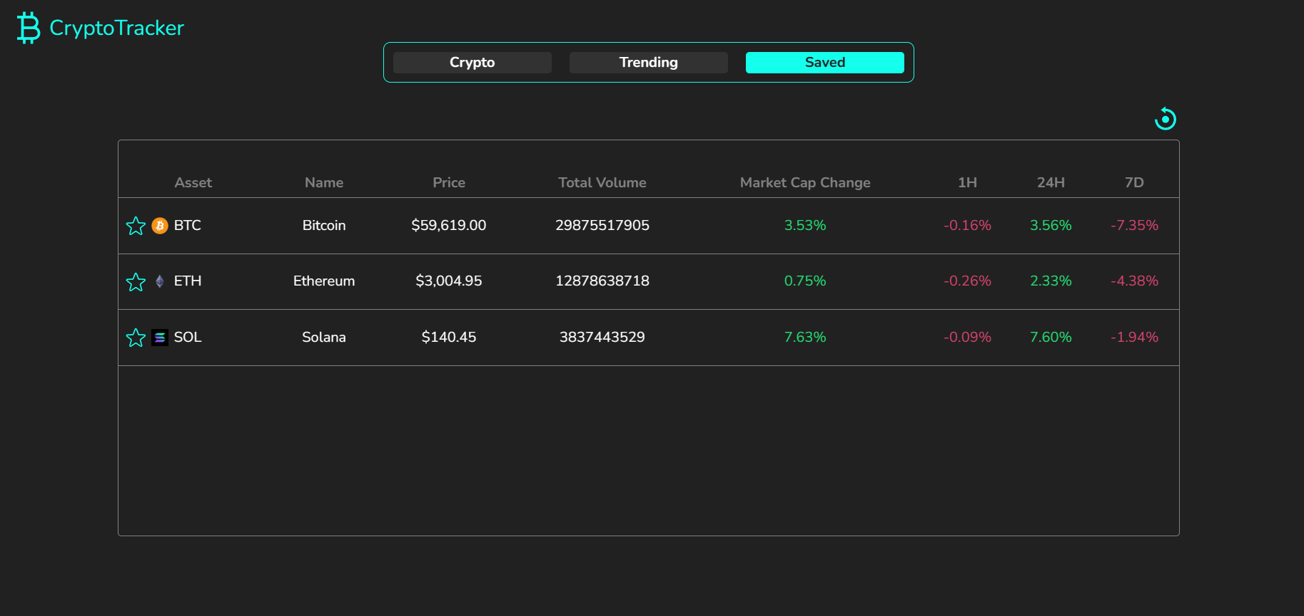

Slide 13
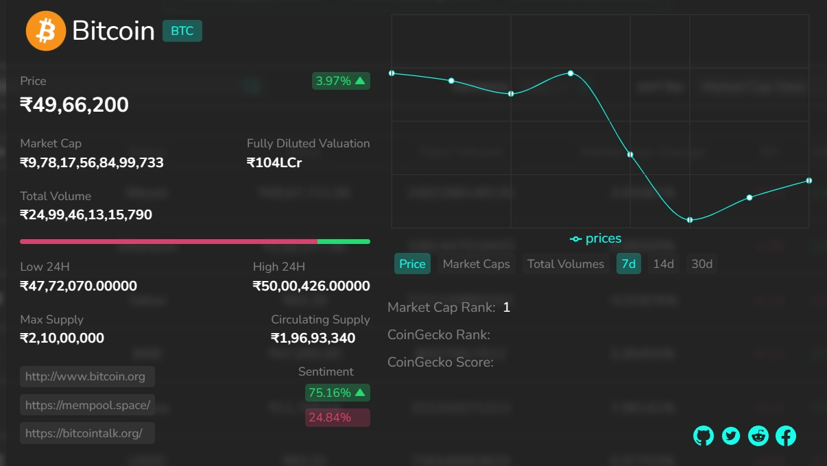

Slide 14
References/Links used
Web APIs (w3schools.com)
Explore 3000+ Free UI Elements: CSS & Tailwind (uiverse.io)
https://www.coingecko.com/
www.Recharts.org/
https://iconify.design/
https://fonts.google.com/

Slide 15
Thank You

