Slide 1
Person Detection
CSE541 - Computer Vision Project
Group-9 members:
No. | Name | IDs
1 | Zalak Shah | AU2040217
2 | Dhruvam Bhalodiya | AU2040041
3 | Freyal Shah | AU2040228
4 | Khush Soni | AU2040239

Slide 2
Introduction and Problem statement
Introduction:
Person detection using object detection involves developing a system that can accurately identify and locate people in images or video frames using object detection algorithms. There are a variety of object detectors that are employed for the purpose of object detection, most important of them include RCNN, faster RCNN, and YOLO.
Problem Statement:
To create a computer vision model that can distinguish people from other objects in an image or video and accurately detect their location within the frame by drawing a bounding box around them.

Slide 3
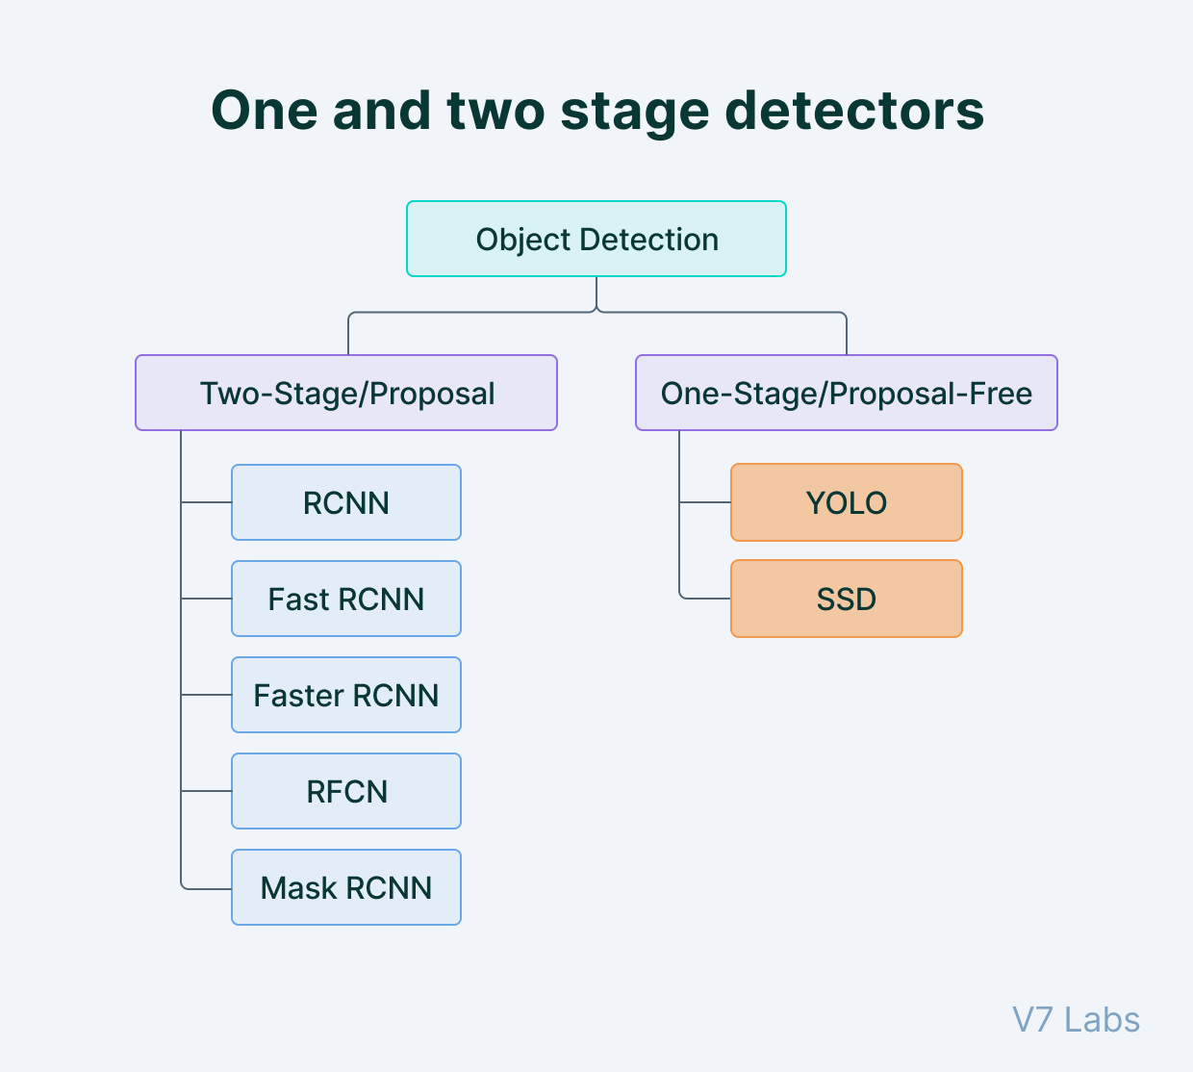
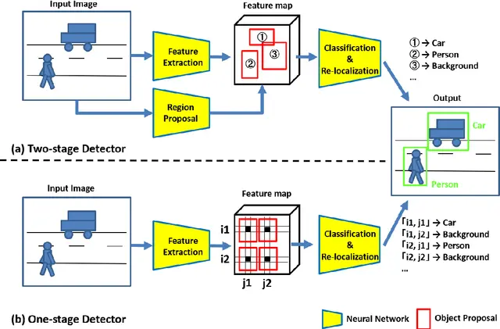
Existing Body of work

Slide 4
Our Approach
YOLO is a real-time object detection algorithm that works by dividing an image into a grid of cells and predicting the bounding boxes and class probabilities for each cell. It then uses a single neural network to predict object locations and their class probabilities. This algorithm is fast and accurate, making it a popular choice for real-time applications.
Why YOLOv8?
YOLOv8 model is very fast and can detect objects in real-time.
It can achieve state-of-the-art performance on variety of datasets.
It can detect objects in different environments and scenarios.

Slide 5

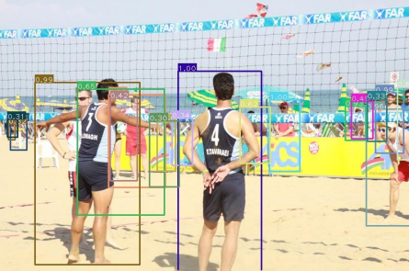
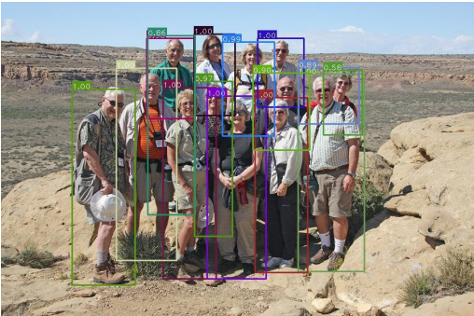
Dataset
The CrowdHuman dataset contains over 15,000 images with more than 350,000 labeled pedestrians.
The images in the dataset were collected from a variety of sources, including surveillance cameras, internet images, and other public sources. The images depict a wide range of crowded scenes, such as streets, parks, and public events.
Each image in the dataset is annotated with bounding boxes around each person in the scene, along with additional attributes such as occlusion, truncation, and crowd density.
In terms of density, on average there are around 22.6 persons per image in the dataset.

Slide 6
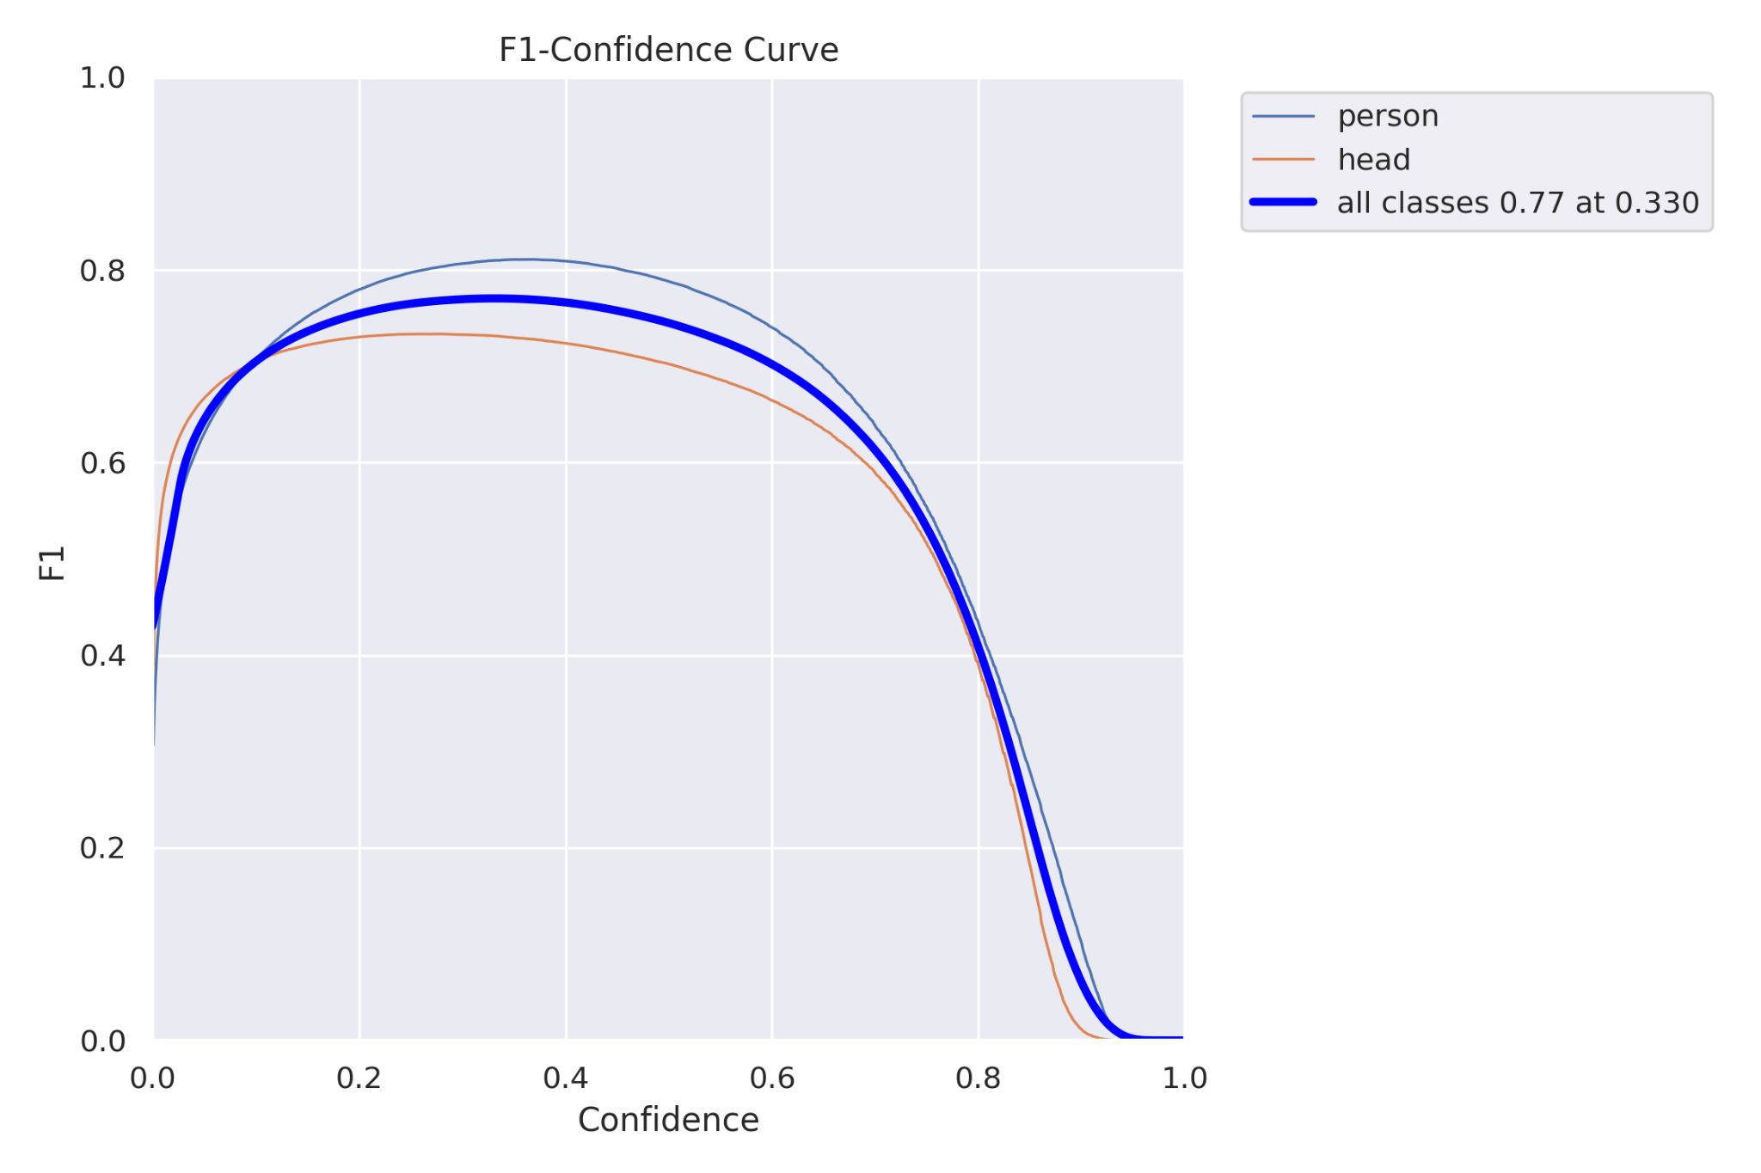
Initial Results
The F1 confidence curve plots the F1 score as a function of the confidence threshold used by the model. The confidence threshold is the minimum level of confidence required for the model to classify a given instance as positive.
As the confidence threshold increases, the precision of the model will increase while the recall will decrease.
By examining the F1 confidence curve, the optimal confidence threshold can be specified, here the confidence value that optimizes the precision and recall is 0.33 with the f1 score of 0.77.

Slide 7
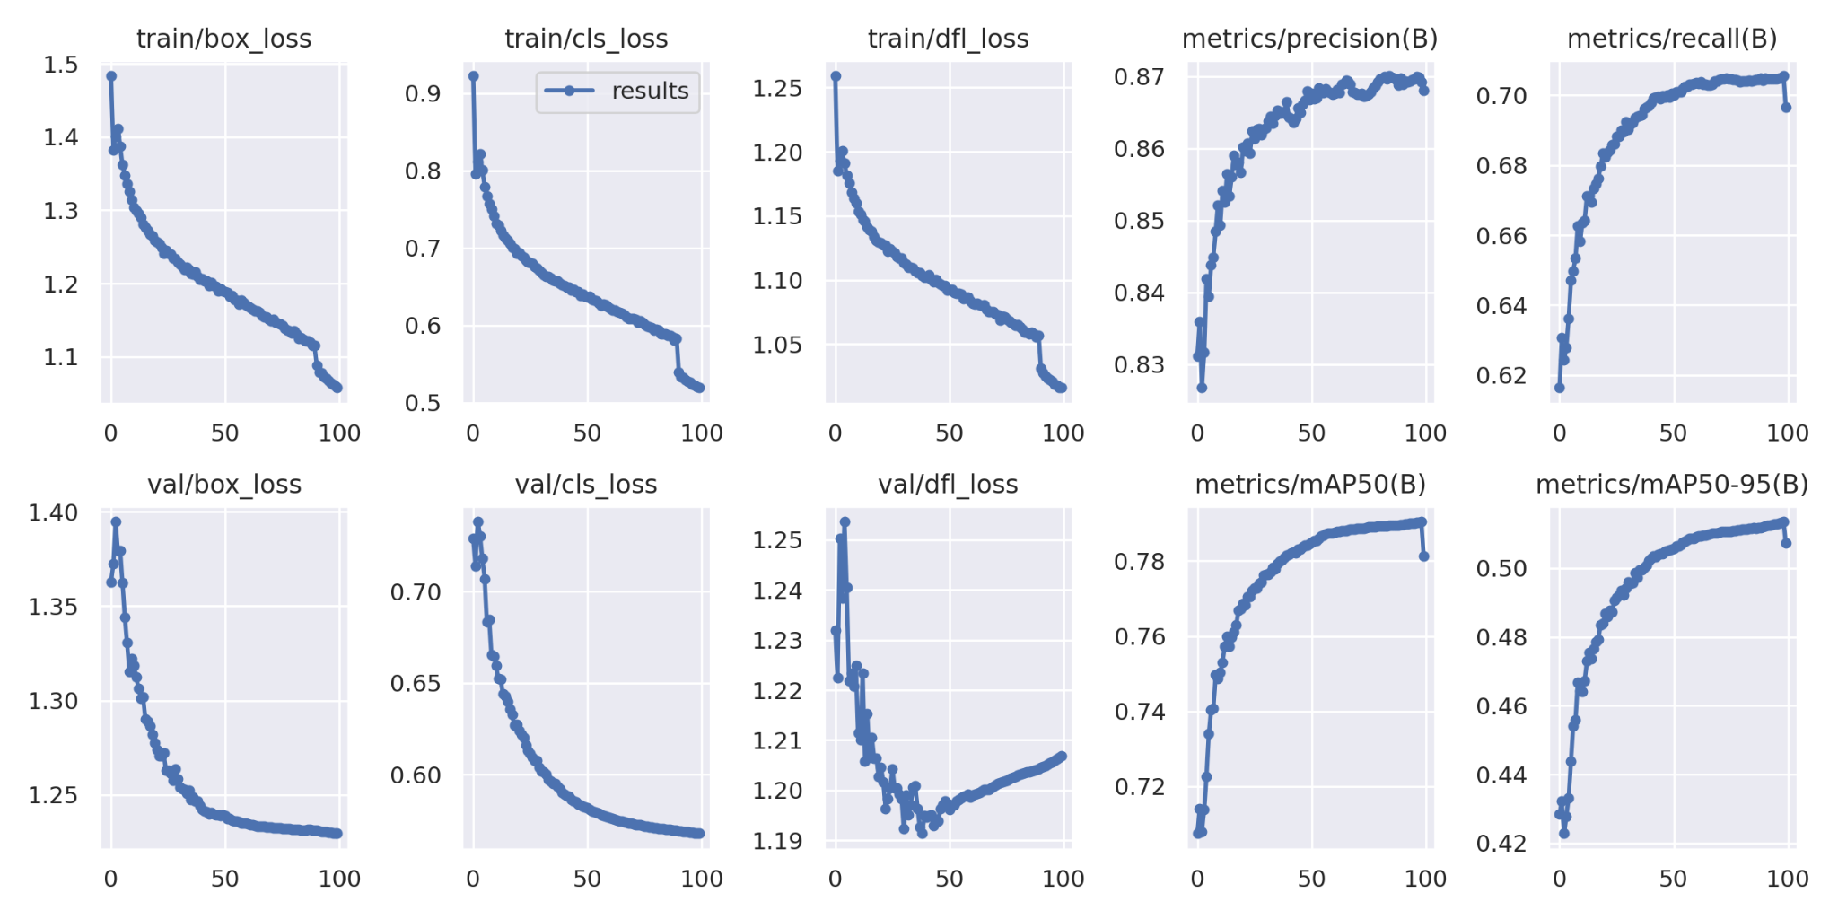
Initial Results(Continued)

Slide 8
Role of each group member in the project
Freyal Shah - Writing and preparing reports that accurately and concisely summarize the group's findings and progress.
Zalak Shah - Implementation of code and preparation of presentation.
Khush Soni - Analyzed results and assisted with implementation of code.
Dhruvam Bhalodiya - Helped in making presentations and reports. Helped with analyzing of information.

Slide 9
Future work
As we faced difficulties like occlusion, viewpoint challenges, scaling, and inter-class variation, we will try to improve our dataset in future in order to train better and get more accurate results.

Slide 10
References
[1] P. Viola and M. Jones, “Rapid object detection using a boosted cascade of simple features,” in CVPR, vol. 1. IEEE, 2001, pp. I–I.
[2] P. Viola and M. J. Jones, “Robust real-time face detection,” International journal of computer vision, vol. 57, no. 2, pp. 137–154, 2004.
[3] J. R. Uijlings, K. E. Van De Sande, T. Gevers, and A. W. Smeulders, “Selective search for object recognition,” International journal of computer vision, vol. 104, no. 2, pp. 154–171, 2013.
[4] J. Redmon, S. Divvala, R. Girshick, and A. Farhadi, “You only look once: Unified, real-time object detection,” in CVPR, 2016, pp. 779–788.
[5] Crowd Saliency Detection via Global Similarity Structure,M.K. Lim, V.J. Kok, C.C. Loy and C. S. Chan, Proceedings of 22nd International Conference on Pattern Recognition, pp. 3957-3962, 2014 (ICPR 2014)

