Slide 1

WEEK 6 · VAPT BASICS
Web Security & Vulnerability
Testing (VAPT)
Assessing DVWA using Burp Suite and OWASP ZAP
Prepared by Khushveer | Cybersecurity Internship | 14 September 2026
Notes:
Title slide. Introduce yourself, the project (VAPT on DVWA), and the two tools used: Burp Suite and OWASP ZAP.

Slide 2


What is VAPT?
Vulnerability Assessment (VA)
Penetration Testing (PT)
Broad, automated discovery of possible weaknesses.
Answers: “What could be wrong?”
Manual, active exploitation to prove real-world impact.
Answers: “Can it actually be broken?”
Notes:
VA = breadth via automated scanners (ZAP). PT = depth via manual exploitation (Burp). A full VAPT engagement uses both together.

Slide 3




Vulnerabilities Covered
From the OWASP Top 10
SQL Injection
Malicious SQL manipulates backend queries to leak or alter data.
A03
Cross-Site Scripting (XSS)
Injected scripts execute in a victim's browser — reflected or stored.
Injection is the common
thread behind SQLi & XSS —
the #1 exploited class in
real-world breaches.
Broken Authentication
Weak session/credential handling allows account takeover.
Security Misconfiguration
Insecure defaults, verbose errors, and unpatched software.
Notes:
These four categories were chosen because they are the most common and highest-impact vulnerabilities found in real-world web apps, and DVWA has a dedicated module for each.

Slide 4


Tools Used
Burp Suite CE
OWASP ZAP
DVWA
XAMPP / Docker
Intercepting proxy to capture, inspect and replay HTTP requests/responses.
Automated scanner — spiders the app then actively tests every parameter.
Deliberately vulnerable PHP/MySQL app used as the test target.
Local server stack used to host and run DVWA.
Notes:
Burp for manual/interactive testing, ZAP for automated scanning, DVWA as the deliberately vulnerable target, XAMPP/Docker to host it locally.

Slide 5
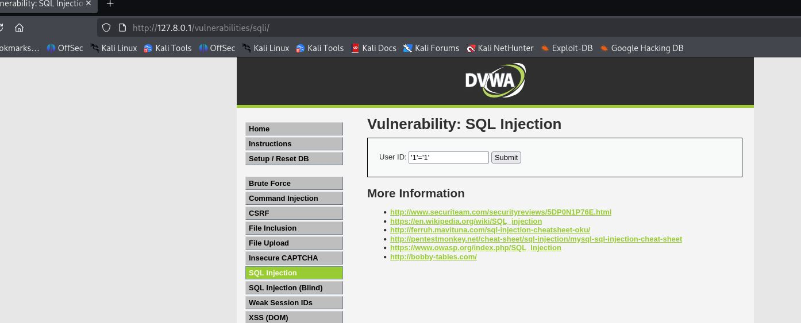
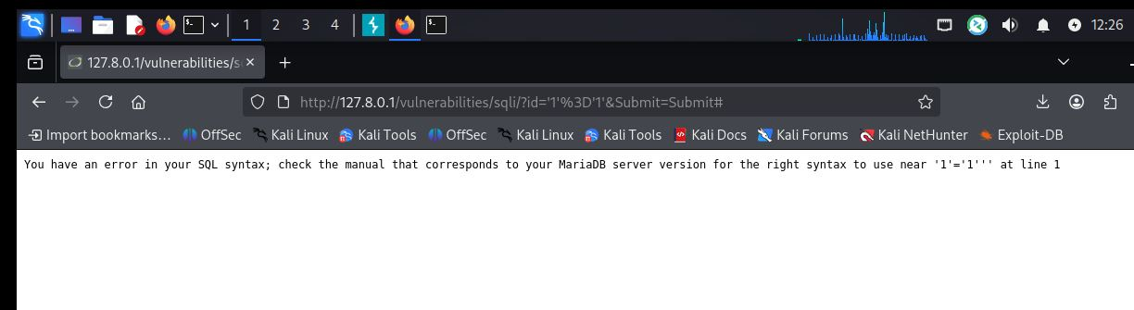
Payload Tested
'1'='1'
SQL Injection
Live Evidence
DVWA — SQL Injection module
Submitting an unescaped quote into the User ID field broke the backend query and returned a raw database error — confirming the input reaches SQL unsanitized.
Resulting SQL error
Payload entered in DVWA
Impact: the error discloses the MariaDB backend and echoes the broken query fragment — enough for an attacker to iteratively craft a working UNION-based injection to extract data.
Captured live in Burp Suite Proxy — see full request/response in the project report.
Notes:
The screenshots show the actual payload tested (a single quote-equals-quote) and the raw SQL error it produced — evidence that user input reaches the query unsanitized. Burp captured the full request/response, shown in the written report.

Slide 6
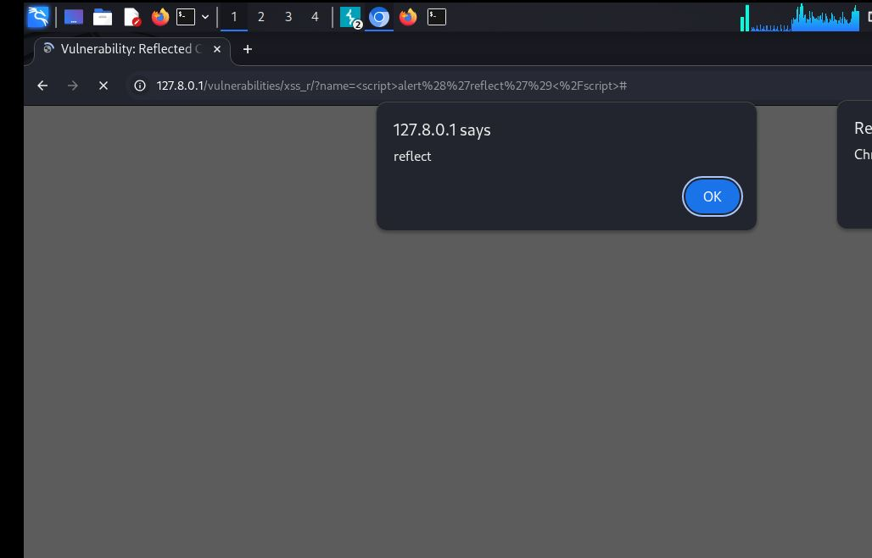
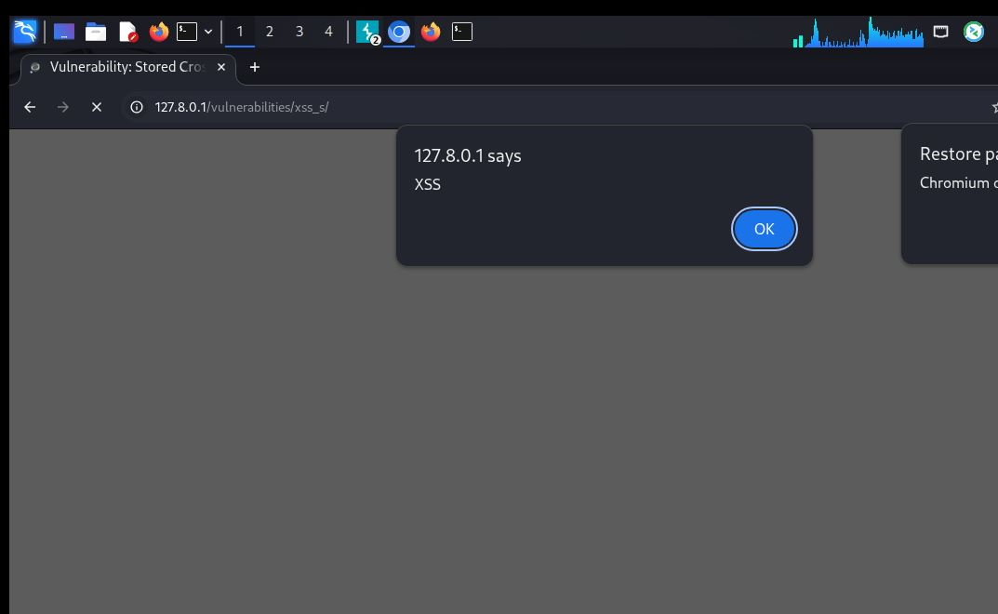
Cross-Site Scripting (XSS)
Reflected XSS
Stored XSS
<script>alert('reflect')</script>
<script>alert('XSS')</script>
Alert fires immediately — payload is echoed back, not stored. Affects only the request that carries it (e.g. a crafted link).
Alert fires automatically on page load — payload is persisted in the guestbook database and hits every visitor.
Severity: High
Severity: Critical
Notes:
Both alerts shown are real, captured live on DVWA. Reflected XSS needs a victim to click a crafted link; stored XSS persists and hits every viewer automatically, which is why it's rated more severe.

Slide 7
Broken Authentication & Misconfiguration
Broken Authentication
Security Misconfiguration
No account lockout after repeated failed logins
Default credentials left active (admin/password)
Predictable / long-lived session tokens
Verbose PHP errors reveal stack traces
Session IDs not protected with HttpOnly / Secure flags
Missing security headers (CSP, X-Frame-Options)
Tested via DVWA's Brute Force module, login page, and manual review of HTTP response headers.
Notes:
Both classes were confirmed by manual review rather than payload injection — checking configuration and behavior rather than exploiting an input field.

Slide 8
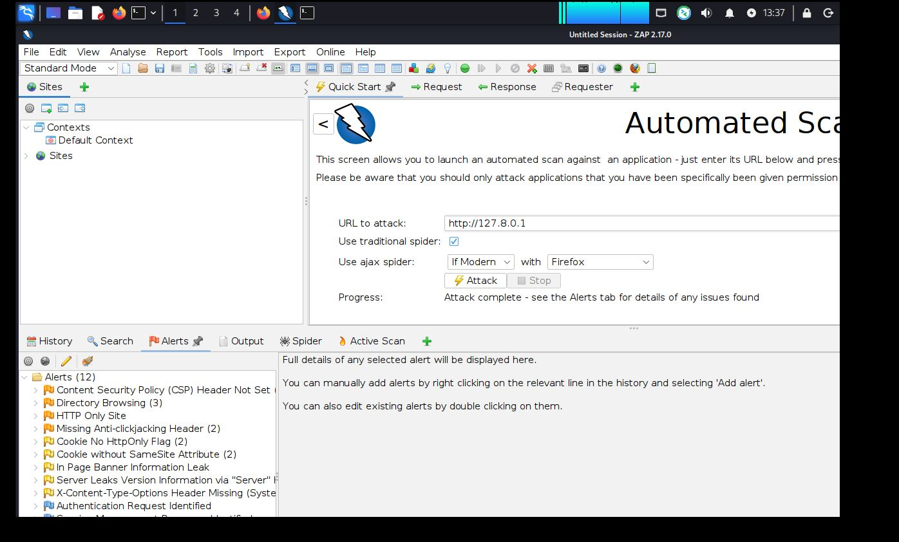
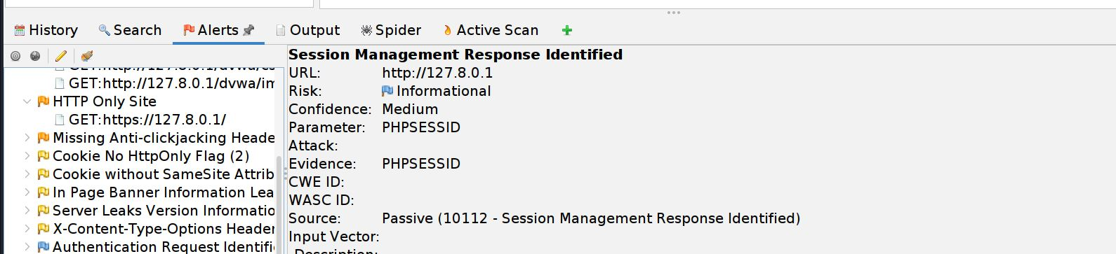
Automated Scanning with OWASP ZAP
01
02
03
04
Spider
Active Scan
Alerts
Export
Crawl every reachable page & parameter.
Inject test payloads automatically.
12 findings ranked by risk level.
Full results saved for the report.
Live Scan Evidence
Session Management Response Identified — PHPSESSID flagged
Result: 12 alerts raised, corroborating the manually-confirmed SQLi finding and cross-validating the session-handling weakness noted under Broken Authentication.
ZAP Quick Start — attack complete, 12 alerts raised
Notes:
Walk through the four-stage ZAP workflow, then show the live scan screenshot and the session management alert — the same PHPSESSID weakness discussed on the Broken Authentication slide.

Slide 9
Findings Summary
Vulnerability | Severity | OWASP Category
SQL Injection (Error-based) | Critical | A03: Injection
Stored XSS | Critical | A03: Injection
Session Mgmt Weakness (PHPSESSID) | Medium | A07: Auth Failures
Reflected XSS | High | A03: Injection
Broken Authentication | High | A07: Auth Failures
Security Misconfiguration | Medium | A05: Misconfiguration
Missing Security Headers | Low | A05: Misconfiguration
Notes:
Seven confirmed findings across four OWASP categories, with two rated Critical due to direct data exposure.

Slide 10
Mitigation & Key Takeaways
SQL Injection
XSS
Auth
Misconfig
Parameterized queries + least-privilege DB accounts
Output encoding + Content Security Policy + HttpOnly cookies
MFA, account lockout, secure session token rotation
Patch systems, disable verbose errors, set security headers
Manual testing (Burp) finds depth; automated scanning (ZAP) finds breadth — a complete VAPT process needs both.
Thank you | Khushveer | Full report, screenshots, and ZAP export available in the project repository
Notes:
Close with the core lesson: neither tool alone is sufficient — combining automated and manual testing is what makes a VAPT engagement credible.

