Slide 1


Telco Customer Churn Analysis
Strategic Insights for Customer Retention
STRATEGY
Khusi Khanra
Business Intelligence & Automation Consultant
khusikhanra

Slide 2




Churn: A Critical Challenge for Telecom Growth
25-95%
The Problem
Increase in profitability with just a 5% reduction in churn
High customer churn directly impacts revenue and significantly increases customer acquisition costs (CAC).
Source: Harvard Business Review
Industry Context
The telecom sector faces fierce competition, making retention more cost-effective than acquiring new users.
Strategic Objective
Identify primary churn drivers and develop data-driven strategies to improve customer loyalty and lifetime value.

Slide 3





Data Foundation
A Holistic View of 7,043 Unique Customers
Demographics
Services
Gender, age range (senior citizens), and family status including partners and dependents.
Phone, multiple lines, internet (DSL/Fiber), online security, backup, and streaming.
Account Info
Financials
Tenure (months), contract type (Monthly/Annual), payment method, and billing preference.
Monthly charges and total charges accumulated. Target: The "Churn" flag (Yes/No).

Slide 4


Analytical Framework
01
02
03
04
Data Cleaning
Feature Engineering
Exploratory Analysis
Modeling Approach
Handled missing values in "TotalCharges" and standardized categorical variables for consistency.
Encoded categorical features and normalized numerical scales to prepare data for machine learning.
Conducted bivariate analysis to identify correlations between customer attributes and churn.
Evaluated Logistic Regression, Random Forest, and XGBoost to find the most accurate model.
From Raw Data to Actionable Intelligence: A Systematic Approach to Churn Prediction

Slide 5

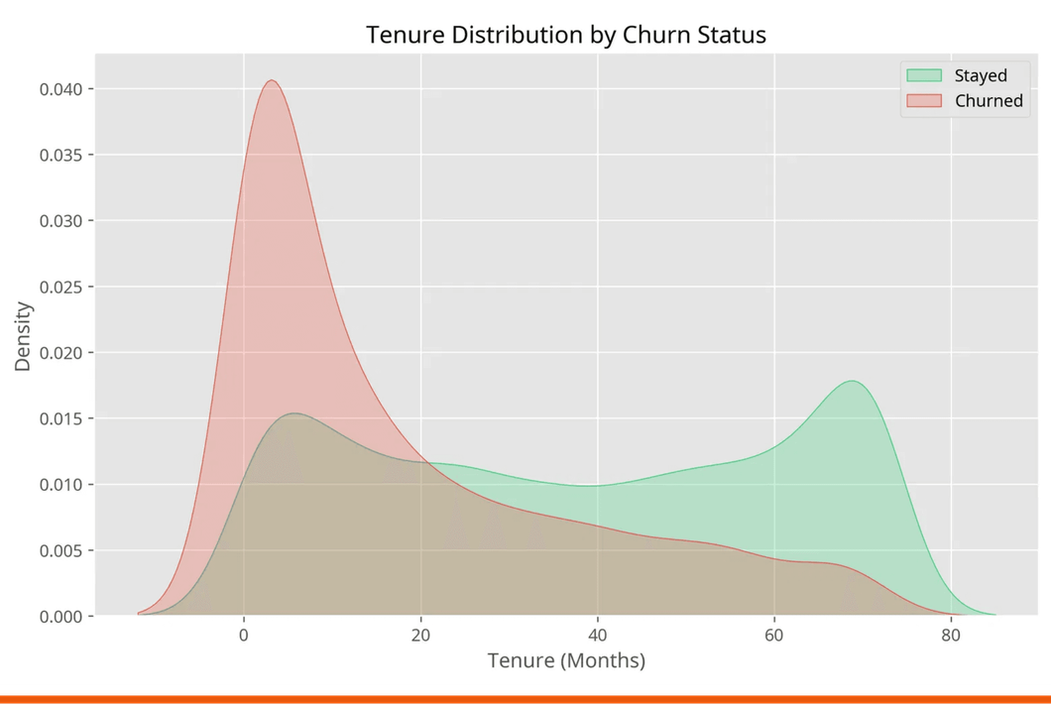
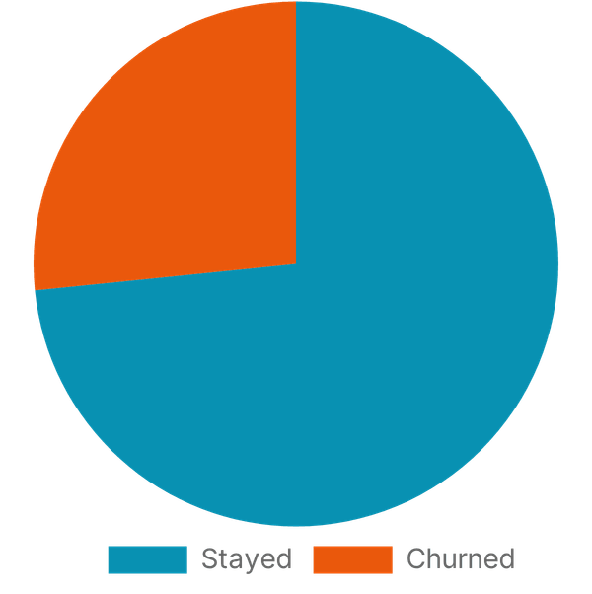
Visualizing the Problem
26.6% Churn Rate Demands Immediate Strategic Action
Tenure Impact:
Churned customers average 18 months vs 38 for loyal ones.
Current State:
Over a quarter of the customer base is churning.
Service Gap:
Fiber optic users show significantly higher churn rates.
Financial Driver:
Higher monthly charges correlate with higher churn.

Slide 6
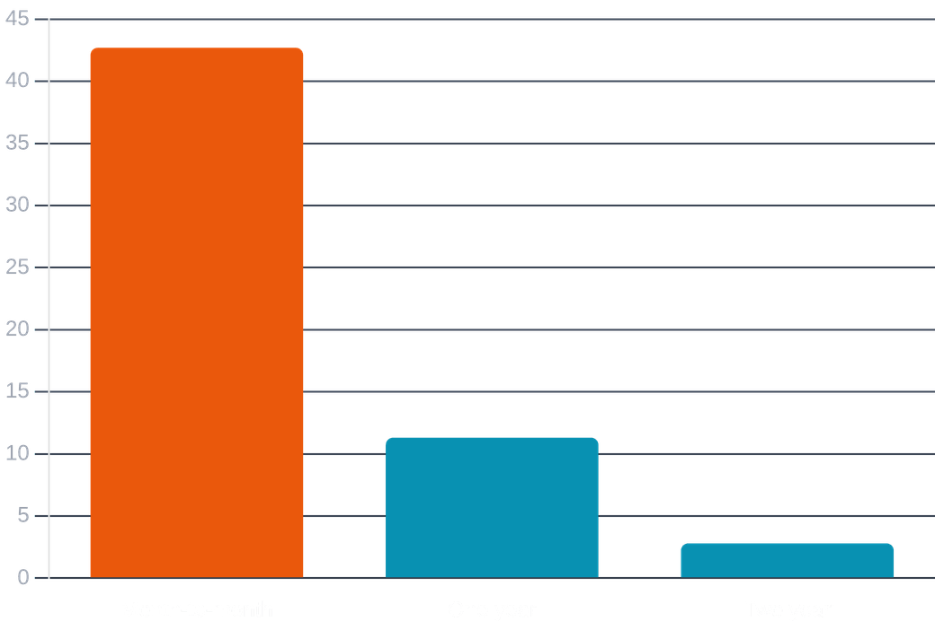




Contract Type Impact
Primary Churn Drivers
Contract Risk
Month-to-month contracts account for 42.7% churn, while two-year contracts remain extremely stable at 2.8%.
Price Sensitivity
Customers with higher monthly bills are significantly more likely to leave, especially in early tenure stages.
Service Gaps
Lack of "Tech Support" and "Online Security" features are strongly associated with higher attrition rates.
The "Danger Zone"
The first 6 months of a customer's tenure are the most critical for proactive retention efforts.
Data indicates a direct correlation between short-term commitment and high churn propensity.

Slide 7



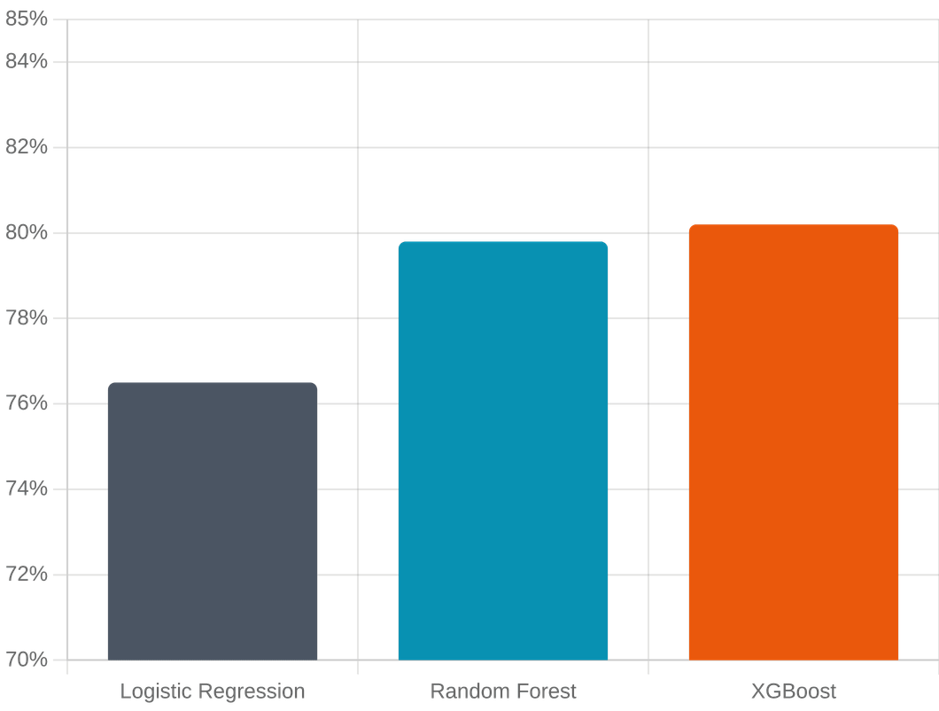


Algorithm Performance
Forecasting Risk
Random Forest and XGBoost outperformed Logistic Regression by capturing complex, non-linear customer behaviors.
Accuracy Metrics
The final ensemble model achieved ~80% accuracy, providing a robust foundation for proactive retention strategies.
Precision vs. Recall
Optimized to minimize false negatives, ensuring high-risk customers are not overlooked by the system.
Deployment Ready
Model can be integrated into CRM workflows to flag at-risk accounts for immediate intervention.
* Accuracy comparison across validated models

Slide 8



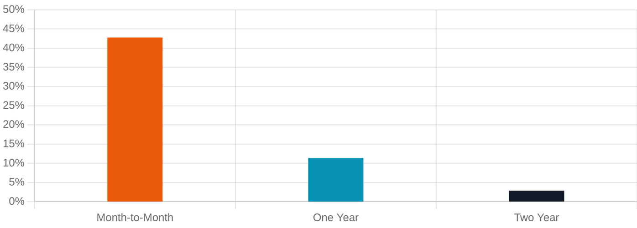
Operational Intelligence
REAL-TIME CUSTOMER HEALTH MONITORING
Last Updated: June 21, 2026
TOTAL CUSTOMERS
CHURN RATE
REVENUE AT RISK
HIGH RISK SEGMENTS
7,043
26.6%
$139.1K
3
Churn Probability by Contract Type
High Risk Profiles
Fiber Optic / Monthly
CRITICAL
New Customers (< 6m)
HIGH
Electronic Check Users
ELEVATED
No Tech Support Plan
MEDIUM
*Based on XGBoost Prediction Model

Slide 9





Strategic Action Plan
Incentivize Long-Term Contracts
Enhance Fiber Optic Value
Offer tiered discounts or value-added services to transition month-to-month customers to annual plans, reducing churn by up to 40%.
Investigate service quality issues for fiber optic users. Justify premium pricing through improved reliability and exclusive content bundles.
Targeted Onboarding
Bundle Security Services
Implement high-touch engagement during the critical first 6 months. Proactive support calls can significantly reduce early-stage attrition.
Integrate "Online Security" and "Tech Support" into standard packages. These "sticky" services are proven to increase customer lifetime value.
Data-Driven Retention: Transforming Predictive Insights into Sustainable Revenue Growth

Slide 10




Impact of Analysis
Driving Business Value
Strategic Roadmap
Provides a clear, data-driven path for reducing churn and protecting annual recurring revenue (ARR).
Portfolio Value
Transforming raw customer data into a strategic roadmap for sustainable growth and retention.
Demonstrates end-to-end data science proficiency—from complex data cleaning to executive-level insights.
Future Scope
Potential for integrating customer sentiment analysis and competitor pricing data for deeper predictive power.

Slide 11




Thank You.
Open for discussions on data-driven business transformation.
Khusi Khanra
BUSINESS INTELLIGENCE & AUTOMATION CONSULTANT
khusikhanra
Contact via GitHub
LinkedIn /khusikhanra

