Slide 1
Effect of Predicates’ Valence and Arousal on Projectivity of Embedded Clause
Khuyen Le, Judith Degen

Slide 2
Outline
Background
Hypothesis
Methods
Results: with project’s data, MegaVeridicality and CommitmentBank dataset
Potential computational explanation with UID?
Next steps

Slide 3
Background
What is projective content?
“I regret that I broke the vase.” vs “I did not regret that I broke the vase.” → It is true that I broke the vase.
“I believed that John broke the vase.” vs “I did not believe that John broke the vase.”
“Factivity category” view: predicates are either factive, non-factive, or semi-factive.
Does not explain projectivity variability among predicates within the same factivity group.
Gradient Projection Principle (Tonhauser, Beaver & Degen, 2018):
Content projects to the extent that it is not at-issue
What are other factors affecting projectivity variability?

Slide 4
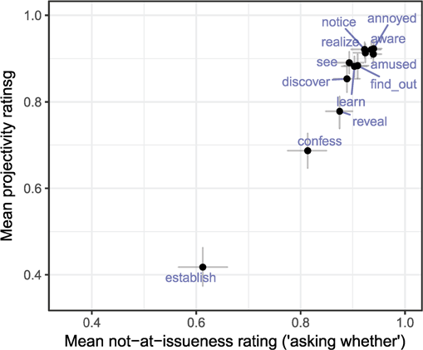
Tonhauser, Beaver & Degen (2018)
Participants: 250 mTurkers
Collect at-issueness and projectivity rating
Example stimuli:
Patrick asks: Was Martha’s new car, a BMW, expensive?
‘certain that’ question (projectivity): Is Patrick certain that Martha’s new car is a BMW?
‘asking whether’ question (at-issueness): Is Patrick asking whether Martha’s new car is a BMW?

Slide 5
Hypothesis
Methods
Higher relative valence and/or higher arousal corresponds with higher projectivity.
Valence and arousal ratings: Warriner et al. (2013)
Exploratory projectivity ratings: MegaVeridicality dataset from White & Rawlins (2018)
Collected projectivity ratings from mTurkers (n=300)

Slide 6
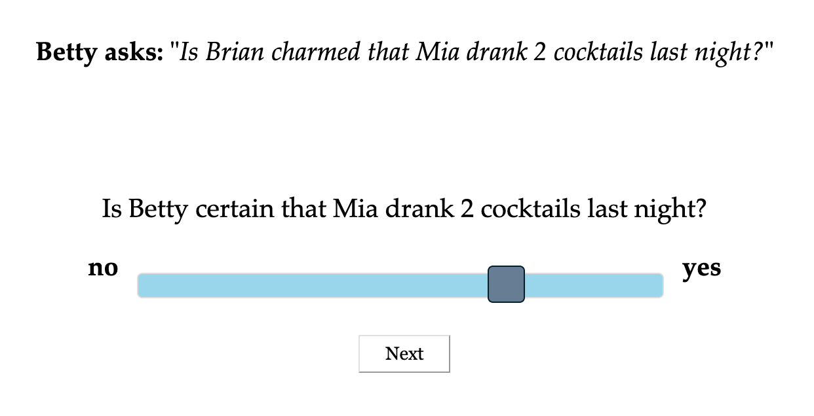
Methods
A asks: “Is / Does [name] [predicate] [that-clause]?”
Is A certain [that-clause]?
9 predicate groups x 6 predicates / group = 54 predicates = 54 stimuli
6 controls
Predicate groups: high negative / high positive / low valence x high / medium / low arousal (high / medium / low is relative to the list of predicates in the MegaVeridicality dataset)

Slide 7
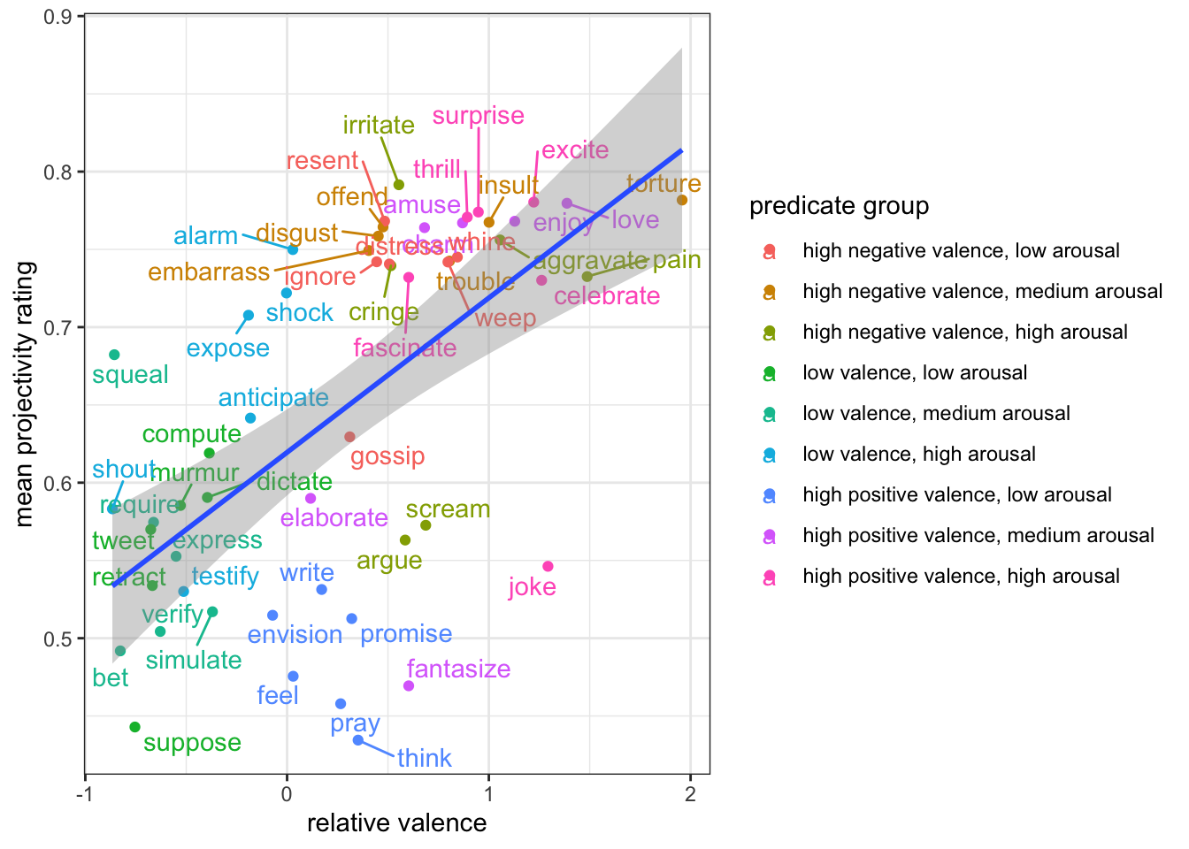
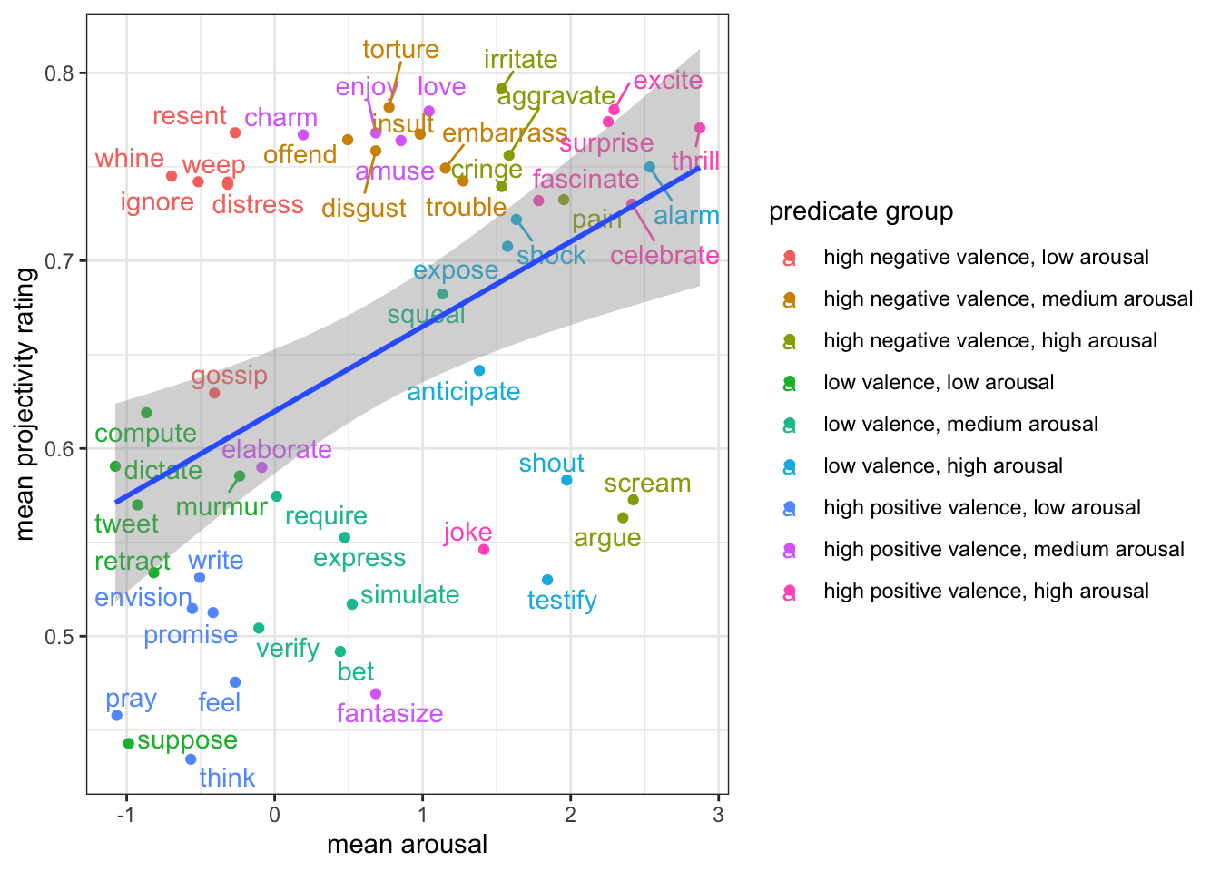
Results

Slide 8
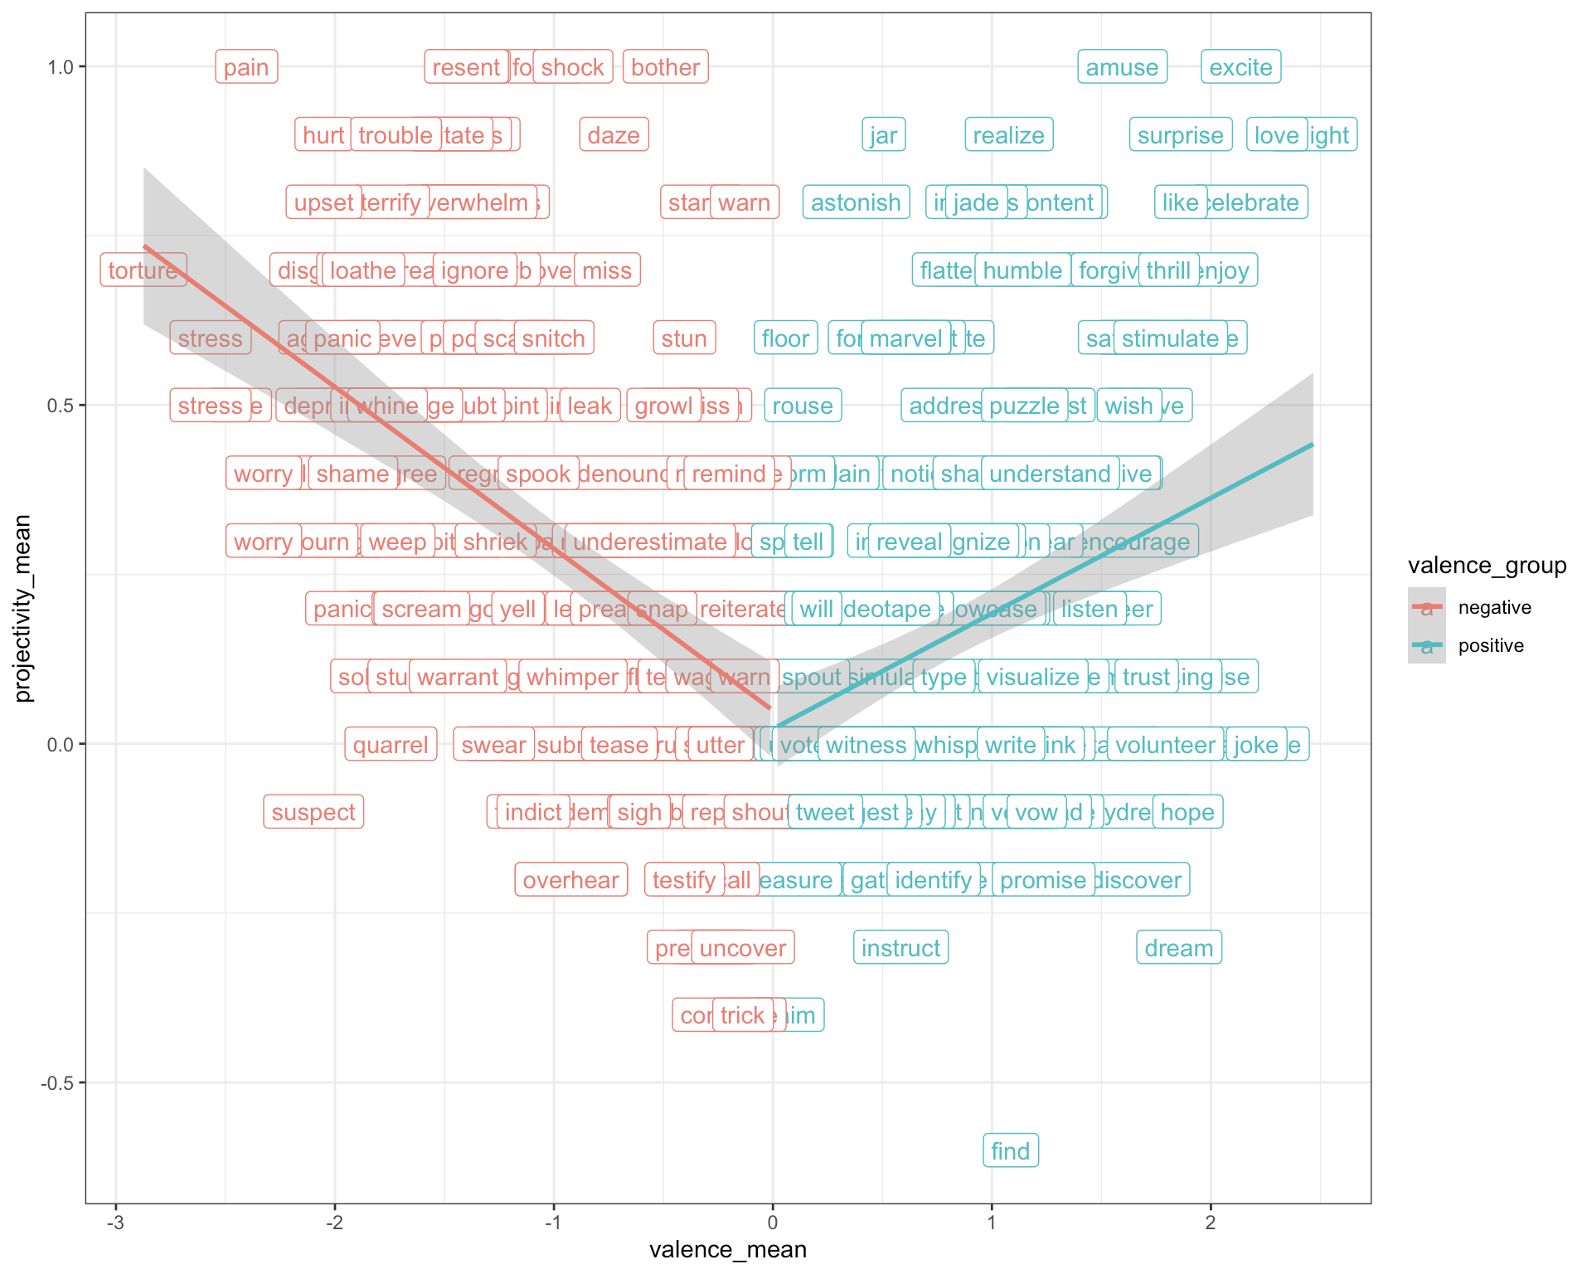
With MegaVeridicality dataset

Slide 9
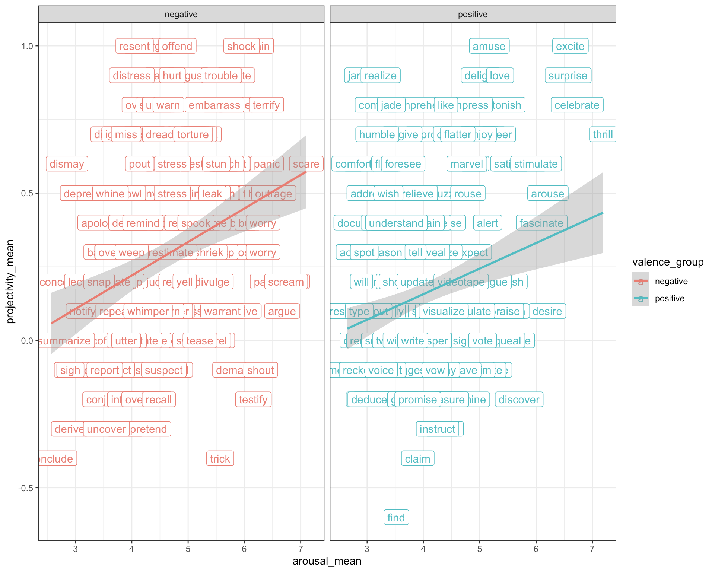
With MegaVeridicality dataset

Slide 10
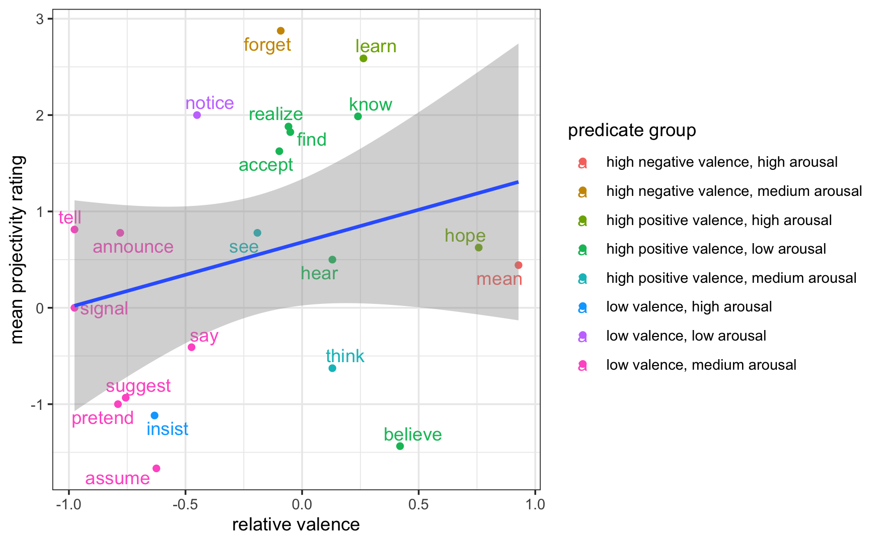
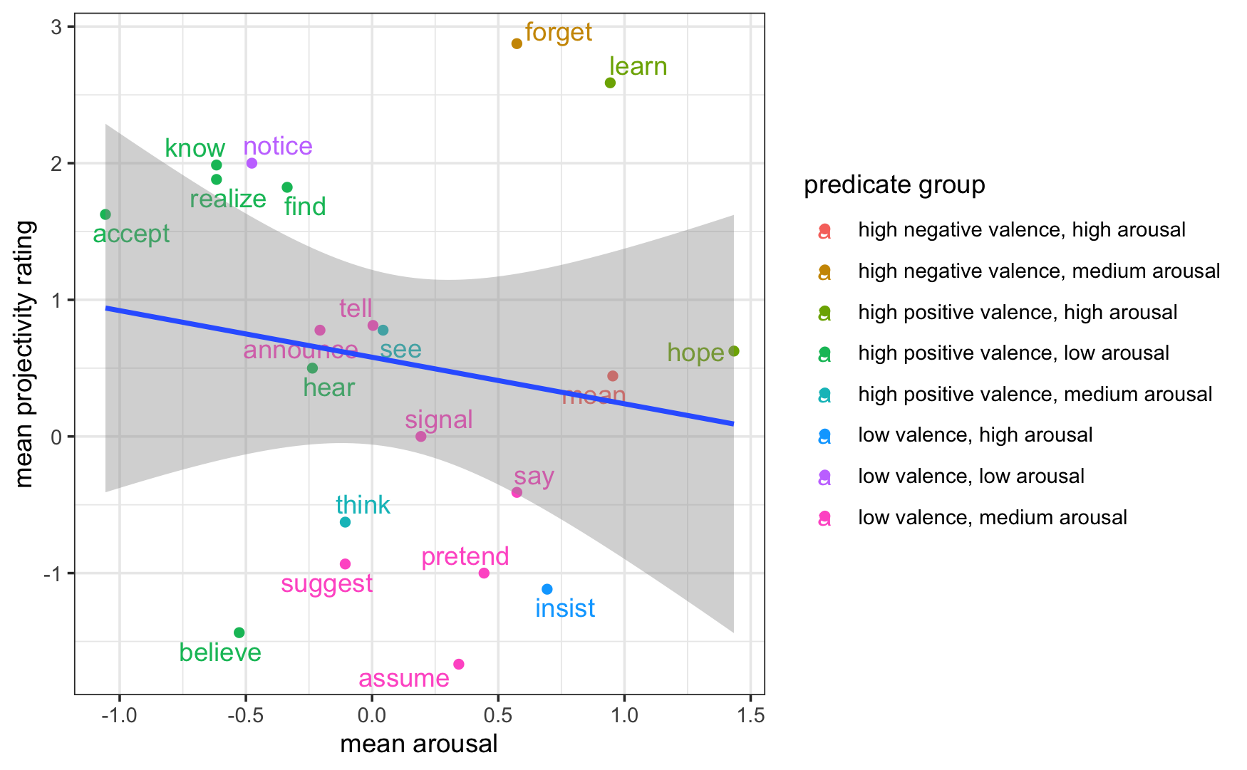
With Commitment Bank data (Marneffe, Simons & Tonhauser, 2019)

Slide 11
With Commitment Bank data (Marneffe, Simons & Tonhauser, 2019)
Why the discrepancy?
Example from Commitment Bank:
“He had deceived her utterly from start to finish, and such calculated deceit was a downright insult! Why had he insisted there was no one else when it was perfectly obvious that there was?”

Slide 12
With Commitment Bank data (Marneffe, Simons & Tonhauser, 2019)
Why the discrepancy?
Example from Commitment Bank:
“He had deceived her utterly from start to finish, and such calculated deceit was a downright insult! Why had he insisted there was no one else when it was perfectly obvious that there was?”
“Insist” is low valence, high arousal → we would predict this to be more projective.
But context cues are stronger in naturally occurring discourse.

Slide 13
Potential computational explanation - UID?
“Speakers distribute information density across the signal evenly” (Levy and Jaeger, 2007)
How is this related to listeners’ projectivity judgement?
Assumption: higher valence, higher arousal predicates → higher information density (ID)

Slide 14
Potential computational explanation - UID?
Hypotheses:
Listeners expect speakers to follow UID. An increase in ID at a word (e.g. thrilled) would signify to listeners that there is no alternative that would make information density more uniform. This word answers the QUD. Assume only 1 QUD / sentence → embedded clause is not answering QUD, so is not at-issue and thus projects.
Hearing higher ID words means listeners are quicker to run out of cognitive resources to process alternatives to the embedded clause (i.e. that speaker is not committed to the embedded clause).

Slide 15
Next steps
Test hypothesis 2: If effect is due to cognitive resource limitations, effect would be bigger if we limit the time people can spend on one question → binary forced choice, speed accuracy paradigm
How much of projective variability is due to valence & arousal vs at-issueness (is the valence & arousal effect on projective variability mediated by at-issueness?)

