Slide 1
JOB_OVERFLOW DATABASE
By,
HARSHA VARDHANRAM KALYANARAMAN : 001472407
FALL 2019 – INFO 6210
Notes:
A very good morning every one we are group 14 here to present our project which is job overflow database team members Harsha Navin and ganesh.

Slide 2
BUSSINESS PROBLEMS ADDRESSED IN THIS PROJECT
Provide students a pathway to their desired job by giving them a stack of skills that they have to equip to meet the demands of the competitive job market.
Allows career advisors to generate descriptive reports and to analyze the skill sets of the students.
Analyze the present trends of the job market and constantly update the database based on the skills requirements provided by organizations.
Notes:
From time to time students doesn’t know what are their career options available, even if they know the destination they don’t know what skills to develop, so enter our database JOB_Overflow. Students provide their desired job and students a pathway to their desired job by giving them a stack of skills that they have to equip to meet the demands of the competitive job market
career advisors to generate descriptive reports and to analyze the skill sets of the students.
Analyze the present trends of the job market and constantly update the database based on the skills requirements provided by organizations.

Slide 3
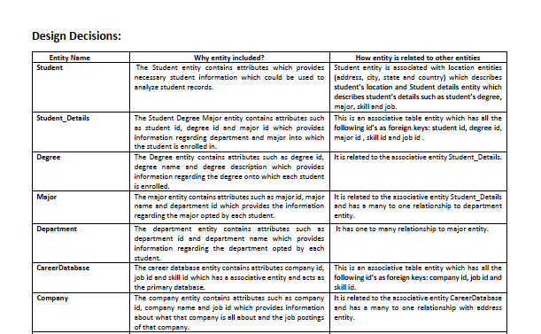
Design Document

Slide 4
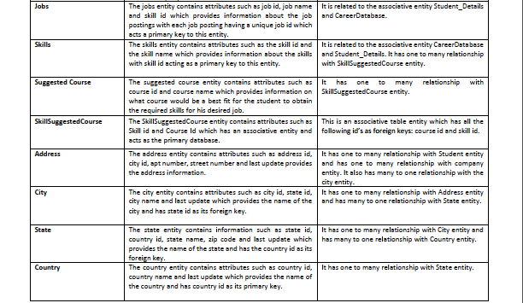
Design Document contd.

Slide 5
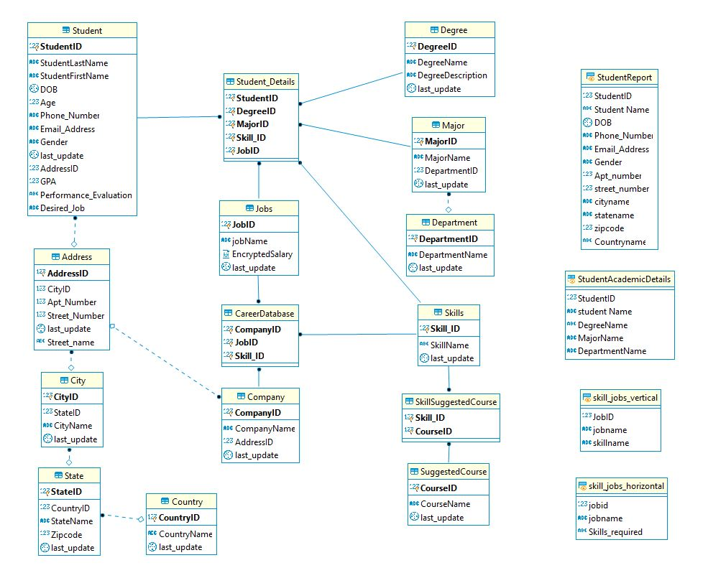
ENTITY RELATIONSHIP DIAGRAM for JOB_OVERFLOW DATABASE
Notes:
We made use of 15 tables and 4 views to achieve our goals. The database could be divided into 4 parts. The first column represents students and his location details. The 2nd column represents jobs and its career database. The third columns represents academic details and skills, jobs and course that teach that particular skills. This also includes 4 reports, which will be explained in detailed later.

Slide 6
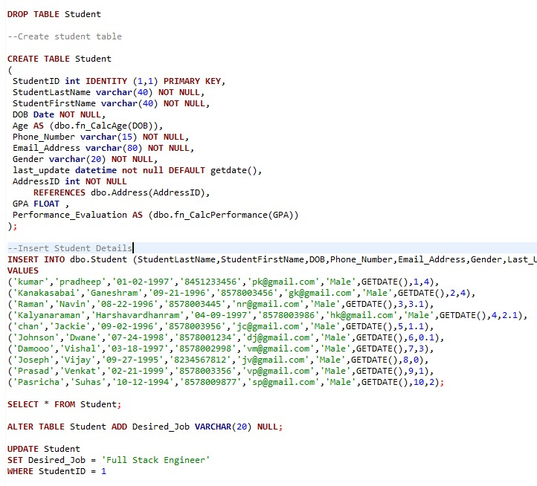
SQL DDL STATEMENTS USED
CREATE : Creates an object
DROP : This DDL commands helps to delete objects
ALTER : Used to alter the existing database or its object structure
Notes:
These are some of the DDL Data Definition Language actually consists of the SQL commands that can be used to define the database schema.

Slide 7

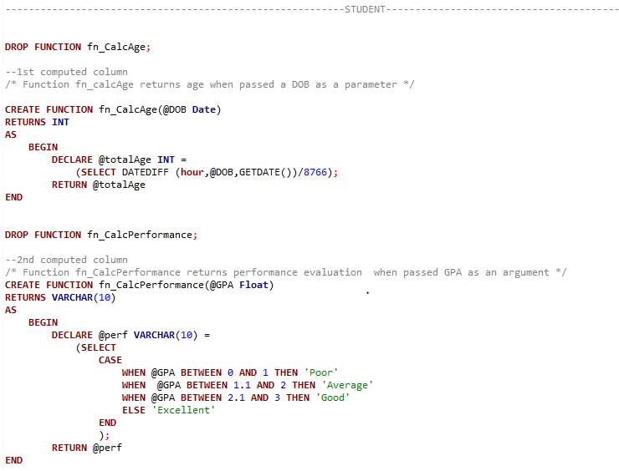
Computed Columns based on a function
Notes:
We implemented 2 computed columns 1 to calc age and another to calculate the performance of the student to keep track of their academic standings.

Slide 8
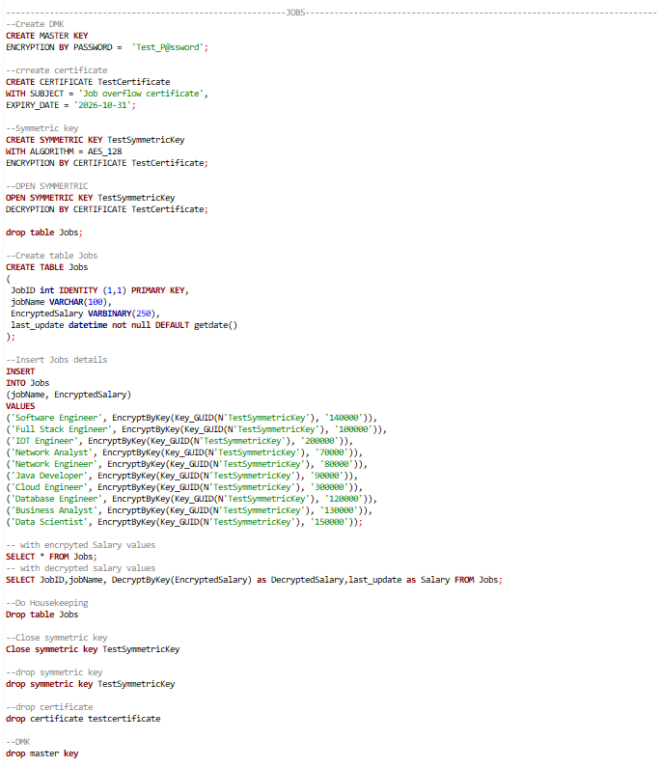
Column Data Encryption
Notes:
We implemented encryption to encrypt the average salary offered by various companies.

Slide 9
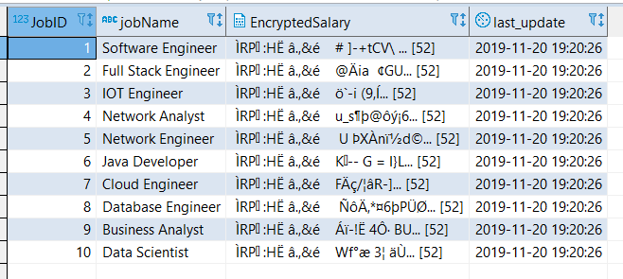
Output of Encrypted Salary column
Notes:
This is our encrypted column.

Slide 10
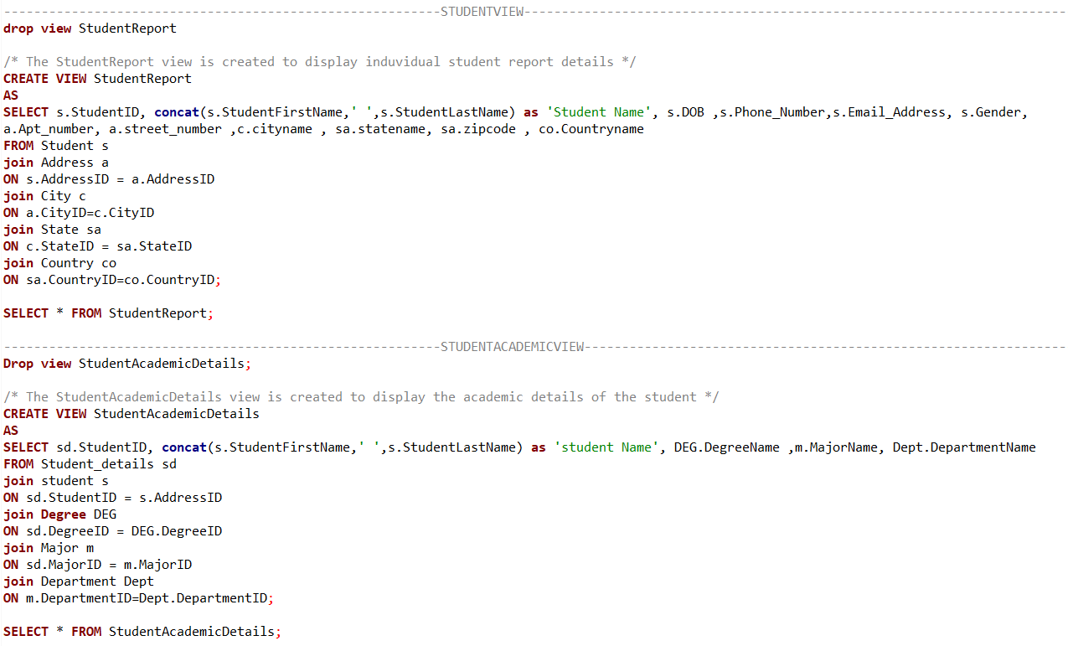
STUDENTVIEW & STUDENTACADEMICVIEW
Notes:
Coming to the views our database consists of 4 of them. 1. It is the student report which gives a detailed view of student including his DOB, PHoneno and place of stay
2. The second view gives the report of the students academic details including student Degree major dept

Slide 11
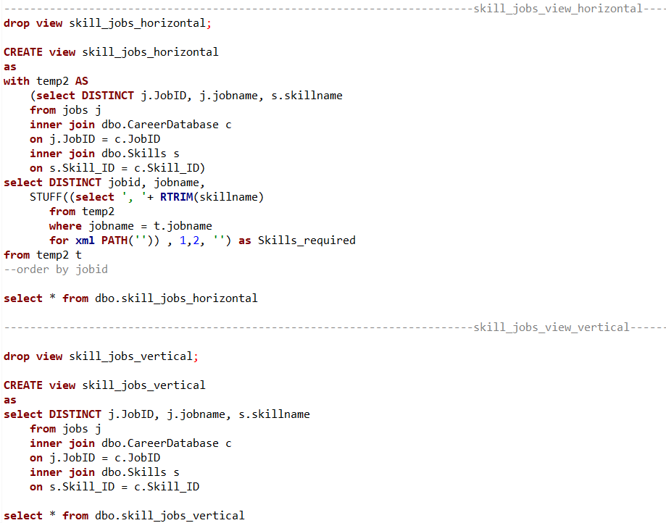
Skill_Jobs view
Notes:
The third view and 4th view are identical except we made use of horizontal format to make the view pleasing for eyes. The views gives a report of the jobname and the list of skills required in vertical format and horizontal format.

Slide 12
Reports
Created using PowerBI
Notes:
Now lets move to the reports.

Slide 13
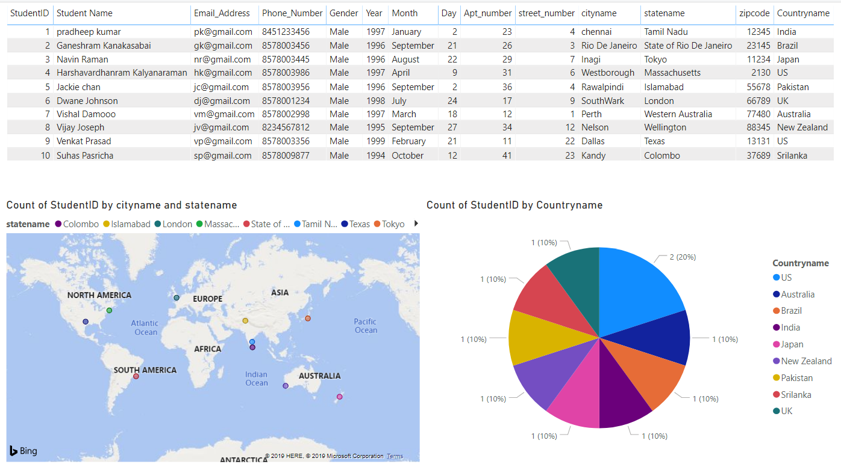
Student Info Visualization
Notes:
In this visualization the table represents the report of the students details, which is generated by a view explained earlier and the first graph represents country where each students live by city and the pie chart represents the count of students that register from each country.

Slide 14
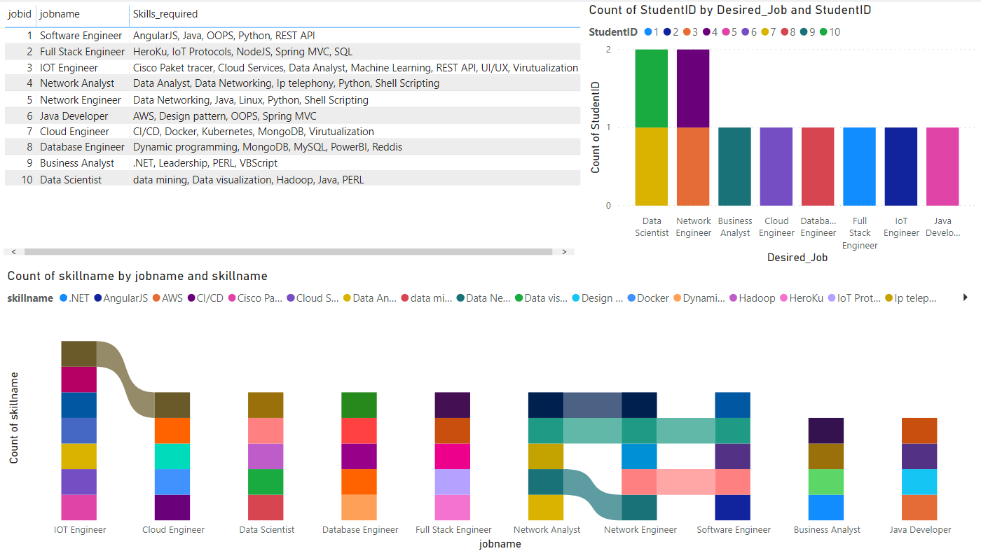
Job:Skills & Student:Skills Visualization
Notes:
This visualization represents the crux of our business logic. This represents the job and their skills required in horizontal format. The first stacked graph represents the number of students who have opted for a particular job this is useful for analyzing the present job trends. The 2nd graph represents the skills vs job name to analyze the common skill name and also to keep track of the skills stack of each job.

Slide 15
THANK YOU
ANY QUESTIONS OR COMMENTS !!!!!!!
Notes:
Thank you, please feel free to ask any questions.

