Slide 1


Airbnb Trend Analysis for Sydney, Australia
By: Jalal

Slide 2
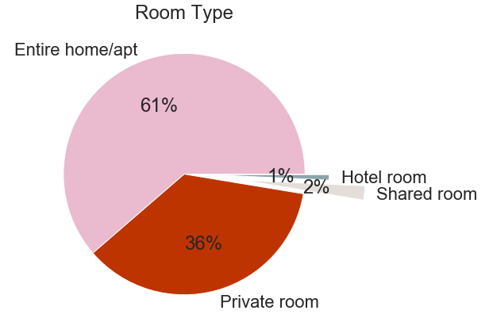
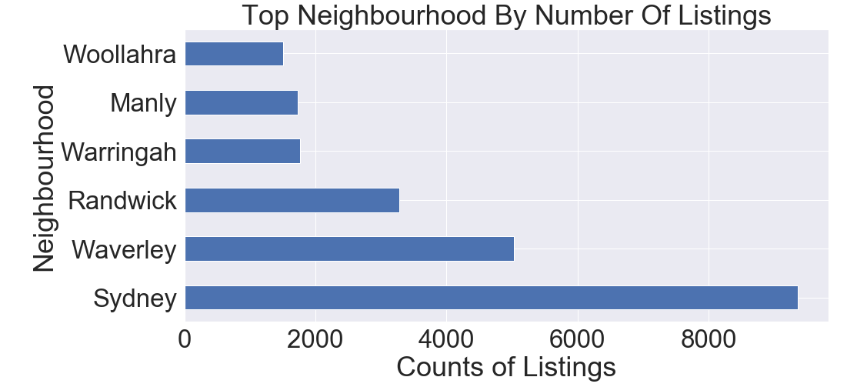
Listed six neighborhoods makes 60% of all the listings, so it is better to focus with these neighborhoods.
It is better to focus on Entire home/apt and Private room.

Slide 3
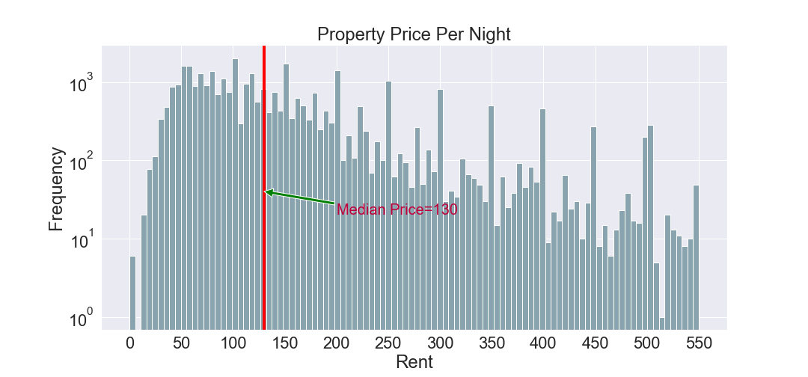
93% Of the prices lies between the range of 0-550$, and median rent for a property is 130$. It is better to have the rents within this range.

Slide 4
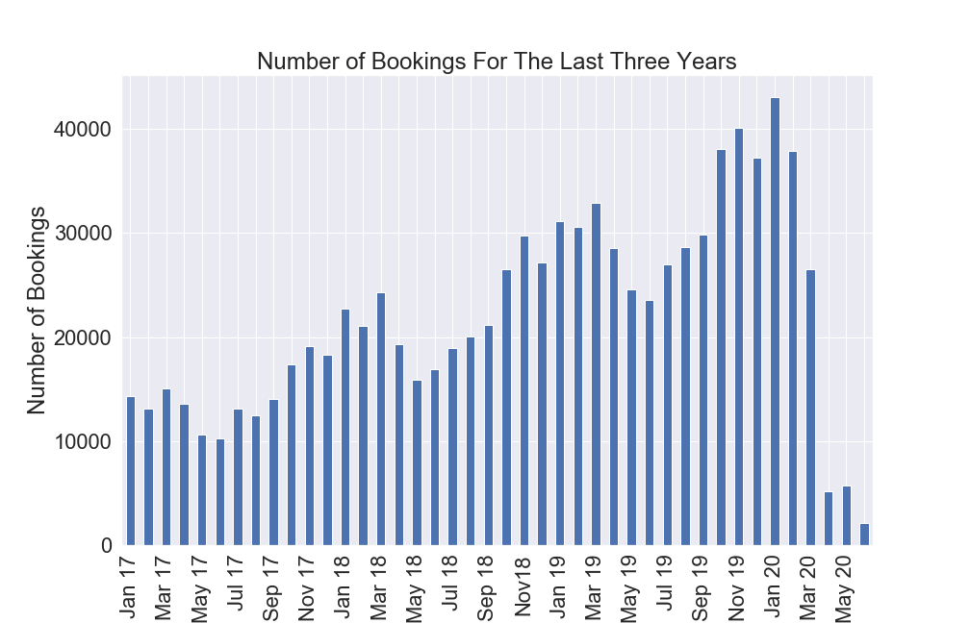
Nov., Dec., Jan., Feb., and Mar. are the busiest months with the most numbers of bookings.
Assumption: Airbnb’s claim that 50% of guests review their stay.

Slide 5
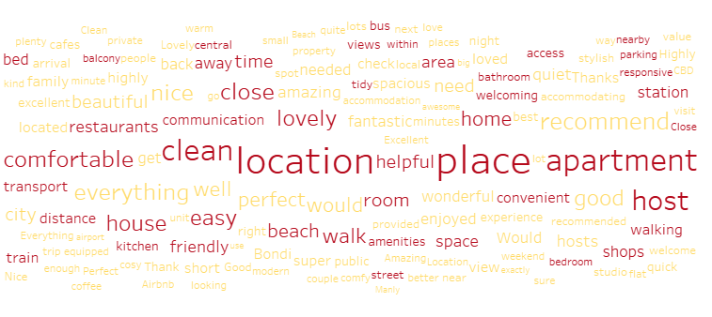
Guests Feedback
Guests are giving preference to closeness to beaches, buses, trains, cafes, restaurants and shops.

Slide 6
Conclusion:
Takeaways:
Vrbo should focus on:
Neighbourhoods with most listings
Entire home/apt and Private room
Having the rents around 130$.
The months of year with higher number of bookings
What Will I Do Next:
Amenities analysis
Occupancy analysis

