Slide 1
Smart Theatre Monitoring System
Name: Khyathi Vemula
Student ID: 24336963
Mail ID: x24336963@student.ncirl.ie

Slide 2
Project Objectives
Designed and implemented a three-layer architecture (Sensor–Fog–Cloud) to monitor and process real-time environmental data.
Simulated sensor data (temperature, smoke, motion, noise, light) and processed it at the fog layer using MQTT and data processing modules.
Built a scalable cloud backend using AWS SQS and Lambda to handle real-time data processing and monitoring.
Developed a dashboard with backend storage (SQLite/EC2) to visualize system metrics, trends, and alerts.

Slide 3
AWS Services Used
AWS Simple Queue Service (SQS)
AWS Lambda
AWS CloudWatch
AWS EC2

Slide 4
System Architecture Overview
Sensor Layer – Collects real-time environmental data (temperature, smoke, motion, noise, light).
Fog Layer – Uses MQTT(pub/sub) broker and fog node to process, filter, and generate structured real-time data.
Cloud Layer – Utilizes Amazon SQS and AWS Lambda for scalable event processing and integrates with EC2 backend.
Backend Layer – EC2 with SQLite stores and manages processed data
Frontend & Monitoring – Dashboard visualizes data and CloudWatch monitors logs and system performance

Slide 5
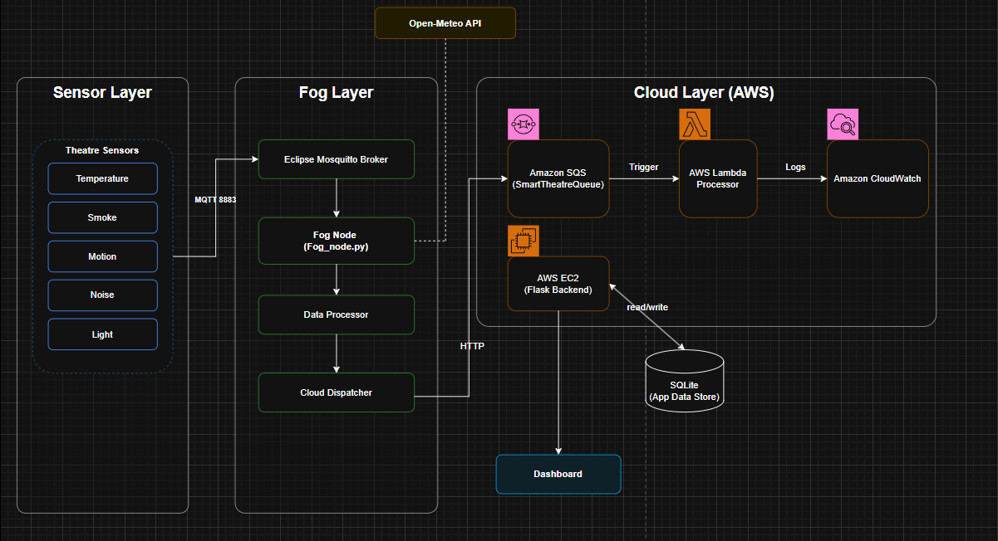
Architecture Diagram

Slide 6
Key Features
Application deployed using AWS EC2: http://23.22.182.204/
Temperature Sensor: Can be placed inside the theatre hall to maintain audience comfort, live data fetched from Open-Meteo Weather API
Smoke Sensor: Can be Installed near seating or ceiling areas to detect air quality/safety issues, live data fetched from Open-Meteo Air Quality API
Motion Sensor: Can be positioned near entrances to detect unnecessary movement and ensure minimal disturbance during movie playback. And an mmWave sensor senses even tiny movements and shows how active you are (in %) during movie mode.
Light Sensor: Can be placed inside the theatre to monitor brightness levels and ensure a dark environment for better viewing experience.
Noise Sensor: Can be placed within the hall to track sound levels and maintain optimal audio conditions for audience comfort.

Slide 7
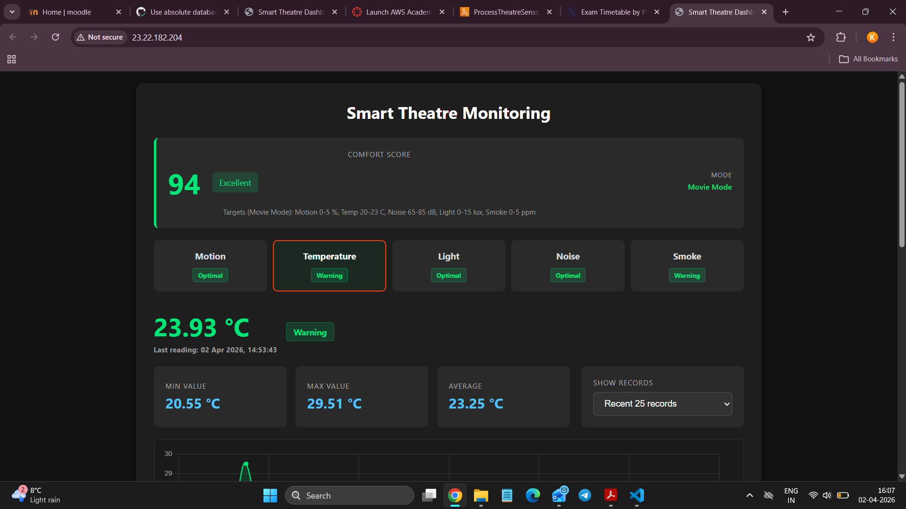
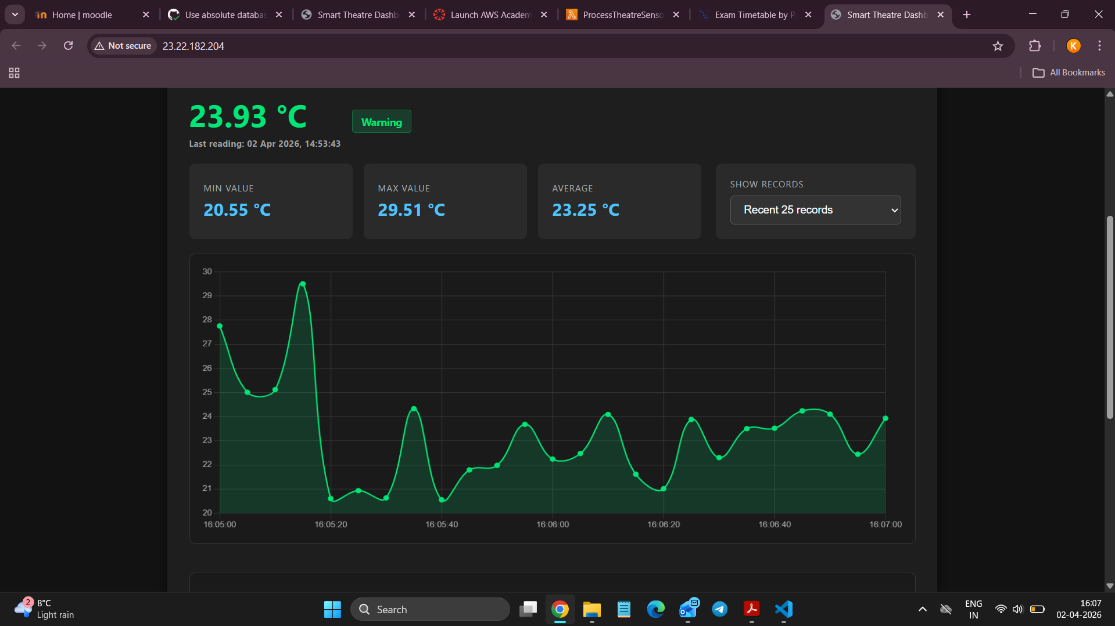
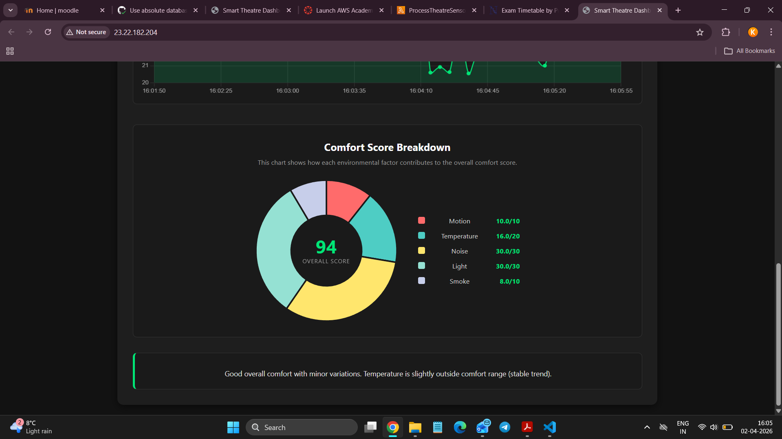
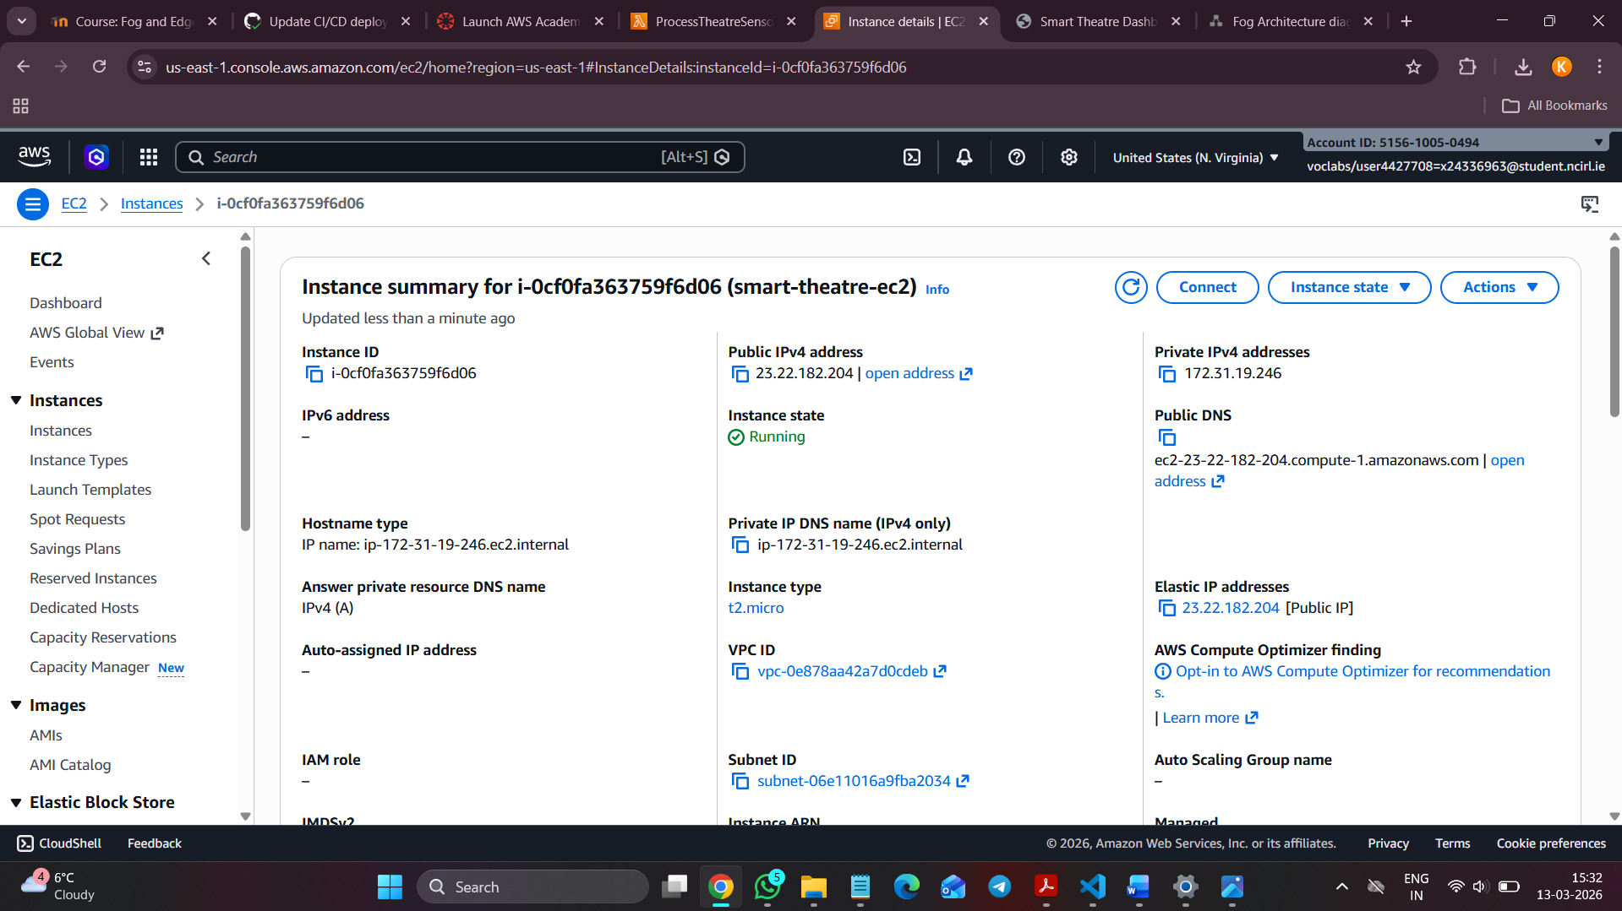

Slide 8
Dashboard Overview
Real-time monitoring dashboard displaying live environmental sensor data.
Comfort score calculation (0–100) based on multiple factors like temperature, noise, light, motion, and smoke.
Sensor status indicators (Optimal / Warning / Critical) for quick understanding of environment quality.
Comfort score breakdown (donut chart) to illustrate contribution of each sensor to the overall score.
Insight card providing simple interpretation of current conditions.

Slide 9
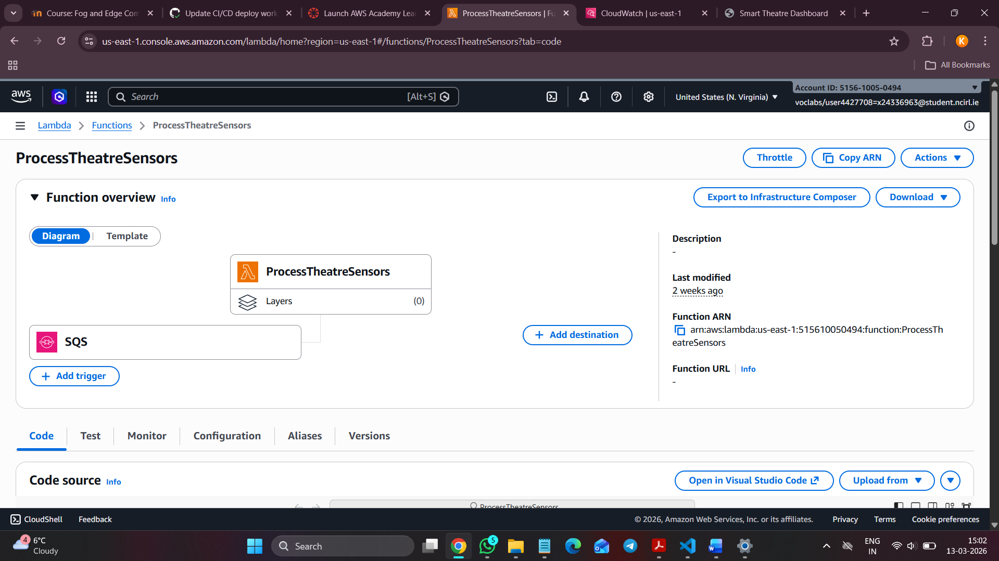
Lambda + SQS Trigger
Amazon SQS acts as a message queue to receive sensor data from the fog layer in JSON format.
AWS Lambda (ProcessTheatreSensors) is automatically triggered by SQS to process incoming sensor data.
Lambda performs real-time processing and transformation before storing data in the database.

Slide 10
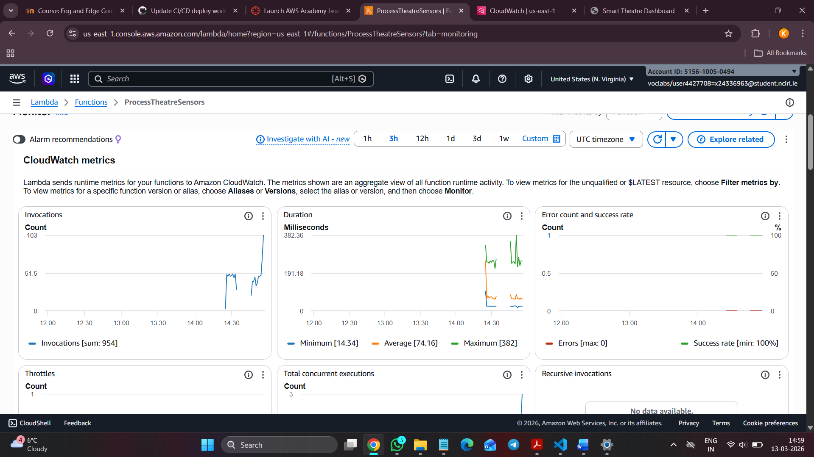
CloudWatch Monitoring
Invocations: Tracks how many times Lambda is executed
Duration: Measures execution time
Errors & Success: Monitors failures & success rate

Slide 11
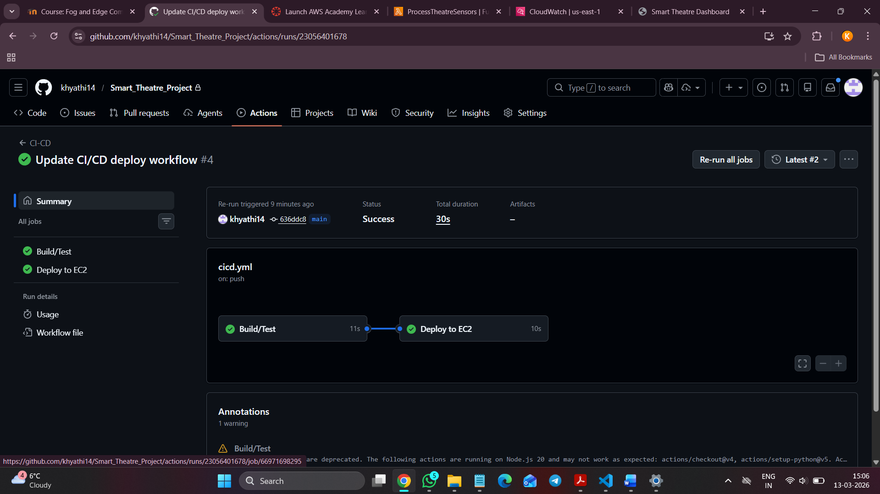
CI/CD Pipeline GitHub Actions
GitHub push triggers workflow
Source code checkout
Install dependencies
Automated tests execution
Deploy to AWS EC2

Slide 12
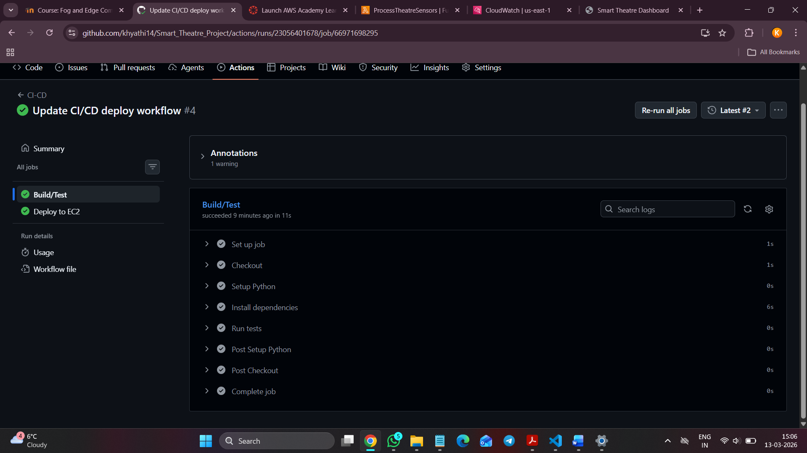
Build/Test Step

Slide 13
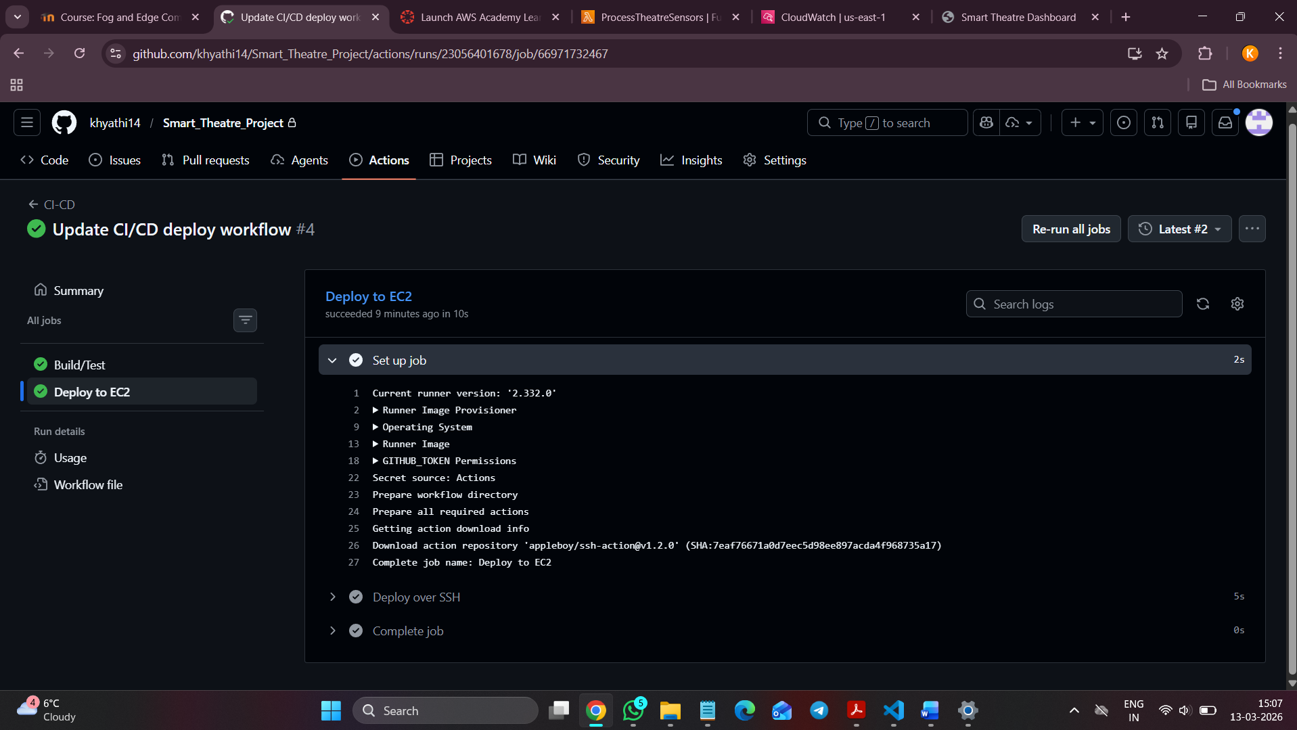
Deploy with AWS EC2 Step

Slide 14
Problems faced
Issues Found & Fixes:
AWS permission errors – Faced issues connecting SQS and Lambda due to missing IAM roles/permissions. → IAM Fix
Data delay issues – Delay in data flow from Fog → SQS → Lambda caused slight lag in dashboard updates. → Batch Tuning
Deployment issues (EC2) – Errors with environment setup, ports, and dependencies during deployment. → Env Setup

Slide 15
Thank You

