Slide 1
Lucky Number Game Project
Mini Project Presentation

Slide 2
Group Contributors
Contributor Name:
KHYATHI TEJA.K
CDS/2025/1318
SECTION -4

Slide 3
Libraries Used
• Flask – Web framework
• Random – Generate random numbers
• Session handling from Flask
• HTML templates using render_template

Slide 4
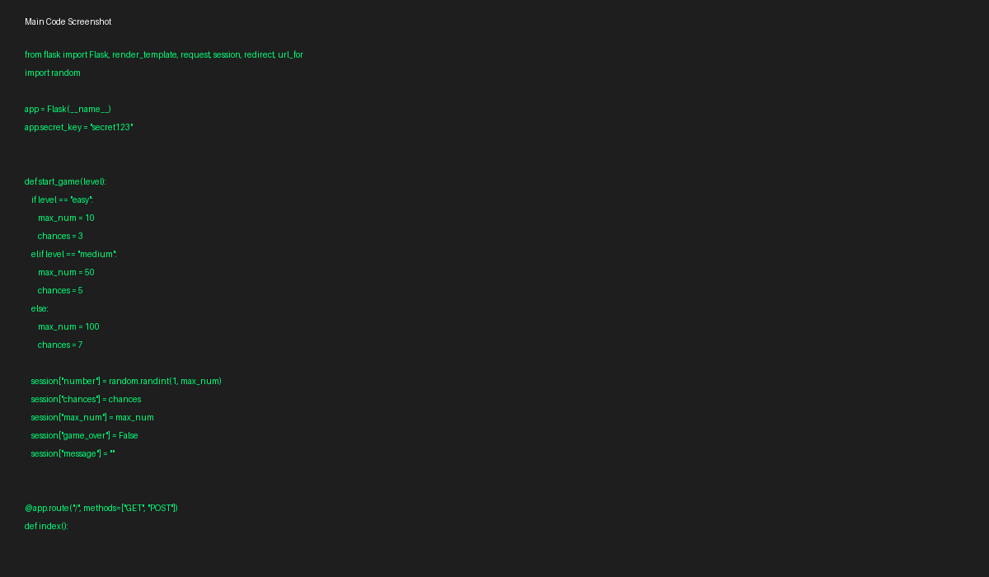
Main Code

Slide 5
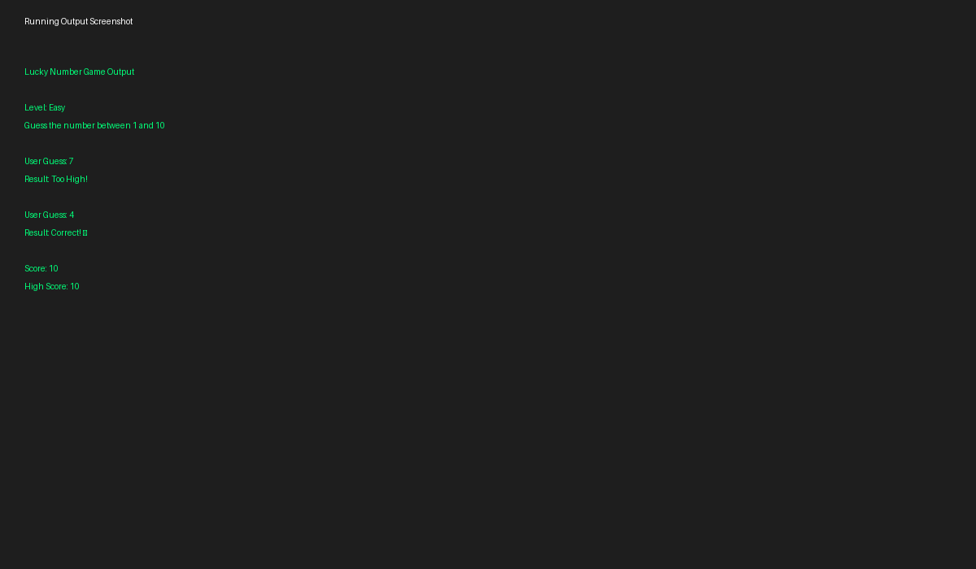
Running Output

Slide 6
Learning Outcomes
• Learned Flask web application development
• Understood session management in Python
• Implemented random number generation
• Improved problem-solving and debugging skills
• Learned frontend-backend interaction

