Slide 1
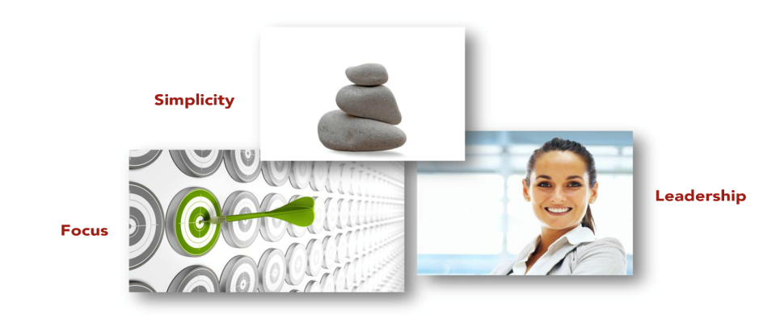
FY 14 Goal Themes

Slide 2

Delivery
To get BAVA certification for SWSC applications on Quarterly basis.
I have learnt the detailed level functional and technical aspects of BAVA Scan from getting the access to getting it review followed by certification and taken ownership of tracking it on quarterly basis.
To develop knowledge management material for (JIGSAW,E-DELIVERY ,E-LIBRARY,SWIFT) Software supply chain applications ,Itemhub and CCW- completed
Gained knowledge from different tracks and documented all the configuration details (Codebase,GIT link Application URL ,JVM)for all SWSC Applications.
To start working on enhancements on multiple projects under SSC and deliver with < 5% (S1,S2) defects and 0 issues. - completed
PANDA Phase-1 - Chinese localization support- successfully delivered deliverables with 0 defects.
OSCAR- Fixed more than 200 security vulnerability issues in OSCAR Application and handeled complete release
SWIFT- NPI process from Infosys Team and run test cases for June release. Ready to participate in a release.
BOM- Technical requirements for Q1FY15.

Slide 3

Innovation
To make dynamic and interactive workflow diagrams for SWSC applications so that time for learning our business processes gets reduced by >20%- Completed.
As an Innovation goal developed KMAP (Knowledge management Application) which is robust, scalable web based interactive tool which will help new comers to get good functional and technical aspects of our System processes and presented that idea to senior leadership (Prassana, Eric, Vijay pokumati, Tony Mannino, Manoj, Sairam, Ravi hirematad) and it lead to extend it for other teams as well.
Creating a useful mobile Application by learning and using HTML5 .- done in Android , Working on Licensing App for mobile- In Progress

Slide 4
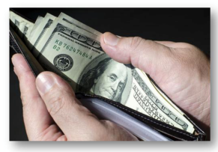
Productivity
To understand BAVA scan process and apply it to reduce the cycle time by atleast 5%.- completed
Tracking BAVA expiry and POC for SWSC Applications so we get the certification before it expires.
To acquire the knowledge of Business process model for SWSC applications. –completed
I have taken Video Trainings, Cisco docs learnings, sessions with different teams to gain domain knowledge of SWSC Applications
To gain knowledge of CSW.
Understood the technology Stack.
Created documentation for local set up for the team.

Slide 5

Value
To build team values by organizing fun events .
I am the core team member of FUN Team and we created a google plus community named Fun Fall @ First floor and truly depicts its meaning we had many fun events since then started with Dumb charades,Christmas Decoration ,Holi celebration, Ugadi Potluck,Duseera Potluck,Popcorn break,Summer social etc. It was great to see everybody’s participation as team and will continue to be a part of it.
To understand BSD and Apollo applications under Software Track. – completed
Had sessions from Software team to gain cross track knowledge on their Applications.

