Slide 1
Iphone 12 - pro
By – Khyati Gupta
C4 | Vidhya Skill School

Slide 2
CONTENTS
Project Scope
Project features
Website structure
Website demo

Slide 3
SCOPE
Design the page of iPhone12-Pro
Use vanilla html 5 and css and javascript
Site is not SEO-friendly

Slide 4





FEATURES
The design used following web features –
Single page design
Video tag
Keyframe animation
Sass
Java-script

Slide 5
WEBSITE STRUCTURE

Slide 7
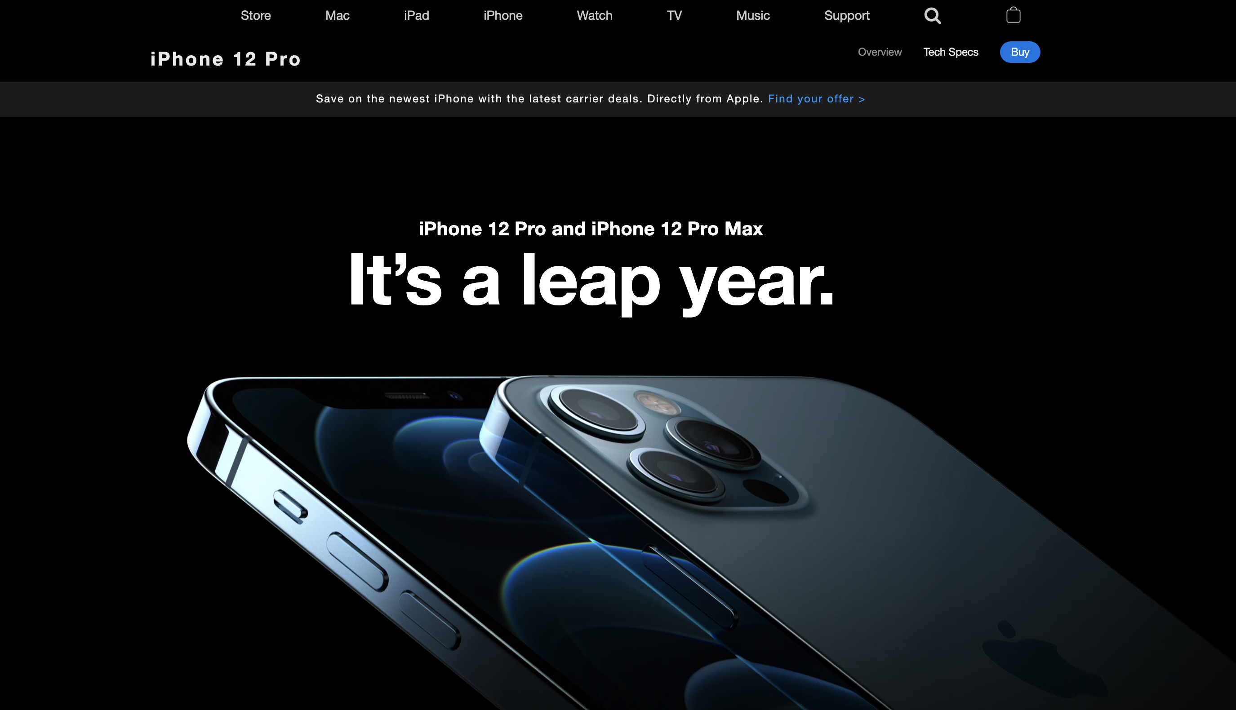
DEMO
URL : http://127.0.0.1:5500/index.html

Slide 8
Thank You!
Khyati Gupta

