Slide 1
Coursera
Opening a new Bakery in the Torronto city
IBM DATA SCIENCE CAPSTONE
by Khyati Jha
Feb 2020

Slide 2
Business Problem
The objective of this capstone project is to analyse and select the best locations in the city of Toronto, Canada to open a new Bakery. Using data science methodology and machine learning techniques like clustering, this project aims to provide solutions to answer the business question: In the city of Toronto, Canada, if someone is looking to open a new Bakery, where would you recommend that they open it?

Slide 3
To solve the problem, we will need the following data:
1. List of neighborhoods in Toronto. This defines the scope of this project which is confined to the city.
2. Latitude and longitude coordinates of those neighborhoods. This is required in order to plot the map and also to get the venue data.
3. Venue data, particularly data related to Bakery. We will use this data to perform clustering on the neighborhoods.

Slide 4
Method
Web scraping using Beautiful Soup
Used Geocoder module for latitude and longitude
Used Foursquare api to get venue data
Calculated frequency of venues
Filtered venue by Bakery
Clustering using k-means clustering
Visulaization using folium

Slide 5
Results
The results from the k-means clustering show that we can categorize the neighbourhoods into 3 clusters based on the frequency of occurrence for “Bakery”:
Cluster 0: Neighborhoods with almost no bakeries.
Cluster 1: Neighborhoods with good number of Bakeries
Cluster 2: Neighborhoods with highest concentration of Bakeries
Cluster 3: Neighborhoods with Low concentration of Bakeries

Slide 6
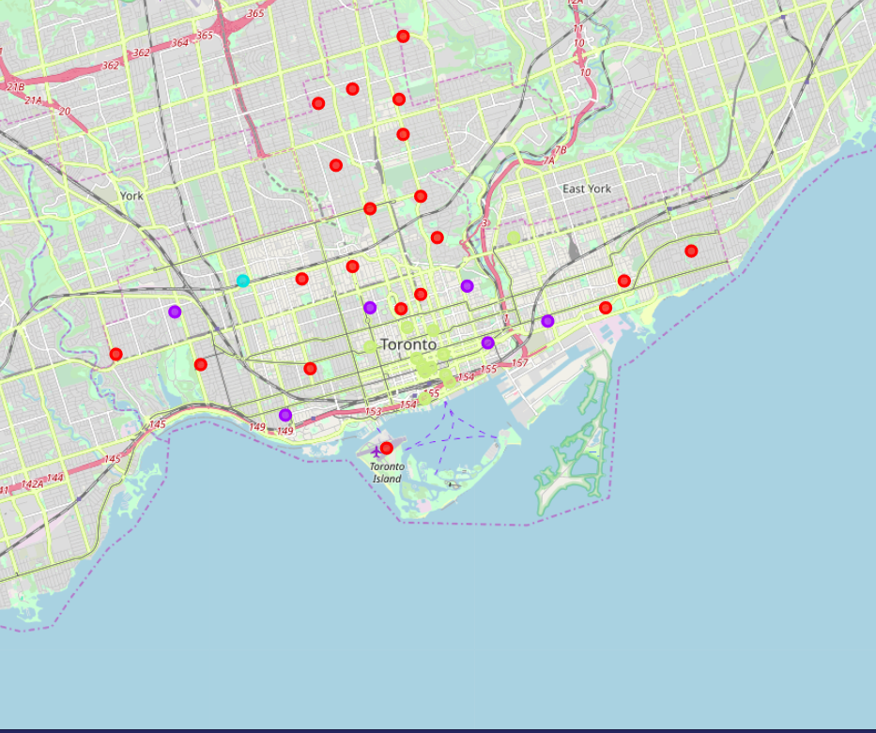
Map representation

Slide 7
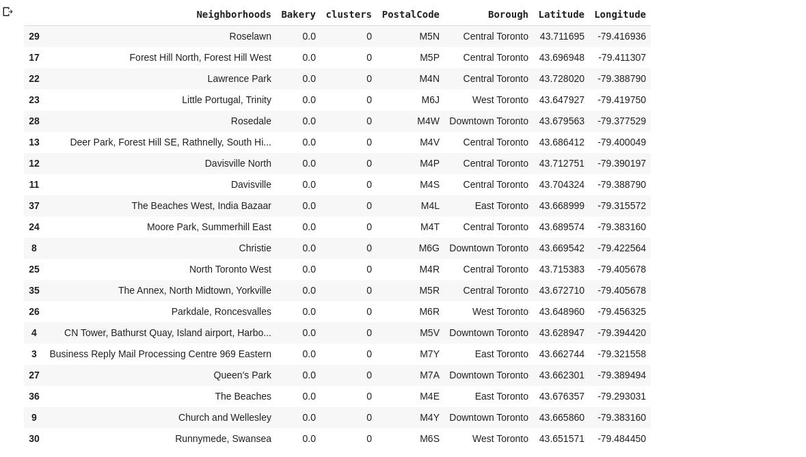
Cluster 0

Slide 8
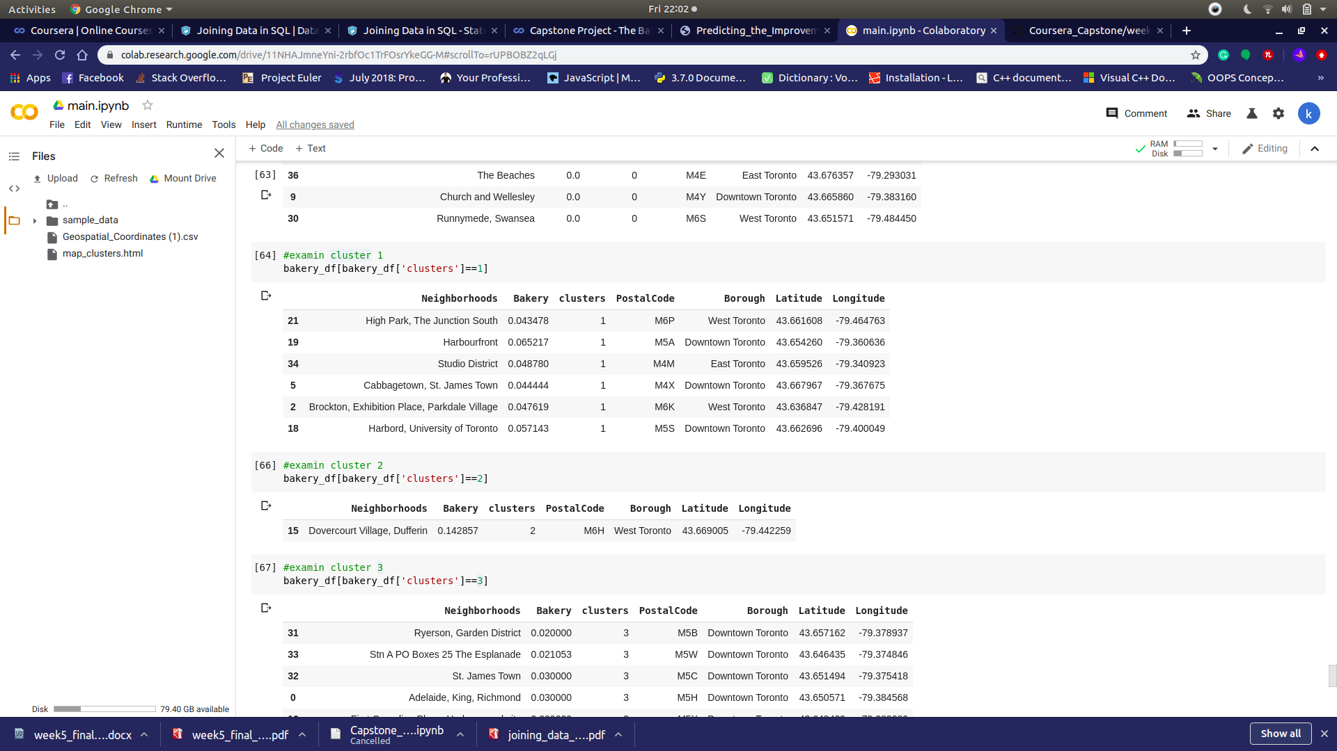
Cluster 1,2

Slide 9
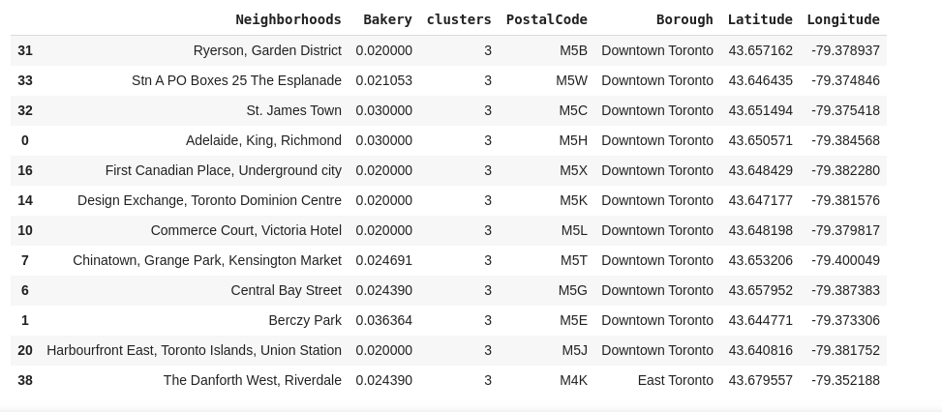
Cluster 3

Slide 10
Refrence
Category:Suburbs in Toronto. Wikipedia. Retrieved from
( https://en.wikipedia.org/wiki/List_of_postal_codes_of_Canada:_M )
Foursquare Developers Documentation.Foursquare. Retrieved from https://developer.foursquare.com/docs

