Slide 1
Introduction and Background

Slide 2
Data Use Case and Design Process

Slide 3
Interaction Design
User
Python Interface
Date Finder
Plot
ML Model
Company selection
Company and current date
Date of Quarter start and expected end for company
Date of Quarter start and expected end for company
Date of Quarter start and expected end for company
Likelihood of Stock price increase
Plot of Keywords searches
And Stock performace
Keywords selected by LASSO

Slide 4
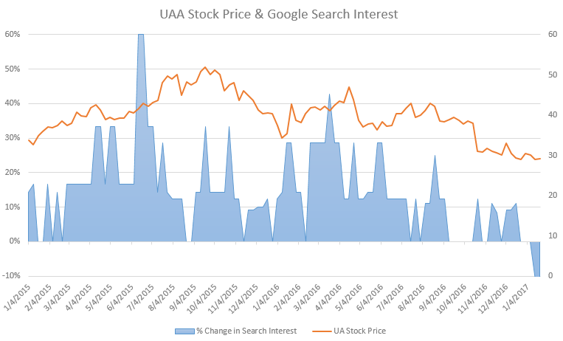
Control Logic – EarningsReport Module
Based on Google trend search data collected each day of a quarter, can we predict the direction of stock price change after a technology company reports quarterly earnings?
To do this, we need:
the start and end dates of each quarter to parse our Google trends data
the date company reports quarterly earnings to know when to make a prediction

Slide 5
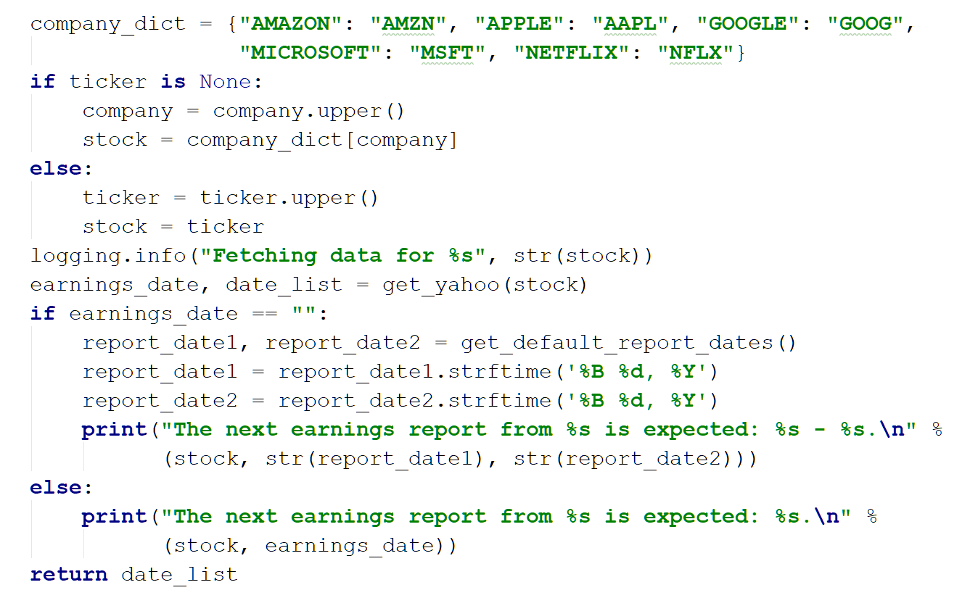
Control Logic – EarningsReport Module
get_earnings_data(company, ticker=None):
Get earnings release date from Yahoo finance
Company argument used to lookup ticker
If N/A, then get default dates

Slide 6
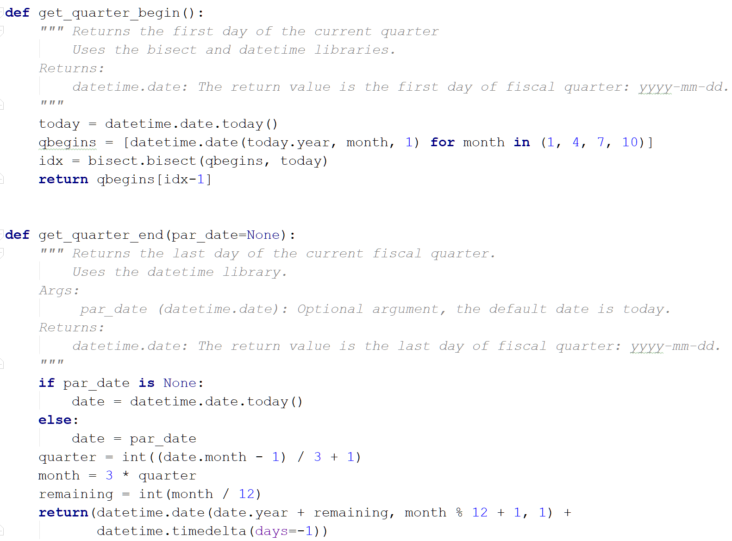
Control Logic – EarningsReport Module
Constructing dates for 1st day of Jan., April, July, & Oct. of current year
get_quarter_begin():
get_quarter_end(par_date=None):
Constructing end dates is trickier b/c sometimes the year, month & day all change

Slide 7
Control Logic – Prediction Model Module

Slide 8
Control Logic – Historical Plot Module

Slide 9
Demo and Conclusion

