Slide 1

Enhance Efficiency Of Classification By Improving Iterative Dichotomiser 3
Prepared By: Guided By:
Khyati Naik Asst. Prof. Arpit Rana
Enrollment Number: 110370702013 Computer Science & Engineering
Semester: III, ME(Computer Engineering) PIET , Waghodia
PIET, Waghodia

Slide 2
Presentation Outline
Objective
Introduction
Problem Definition
Literature Review
Proposed Work
Conclusion
Future Work
Action Plan
References

Slide 3
Objective
Providing efficient approach for classification by improving Iterative Dichotomiser 3
Improvements in terms of time complexity and accuracy.

Slide 4
Introduction
Computer technology enhanced
People’s ability to collect and produce data is increased
How to analyze this large amount of data?
Data Mining – Extracting or mining knowledge from large amount of data
Discovering interesting knowledge from databases, data warehouses and other repository
Also known as knowledge discovery from data, knowledge extraction, data/pattern analysis, data archeology and data dredging

Slide 5
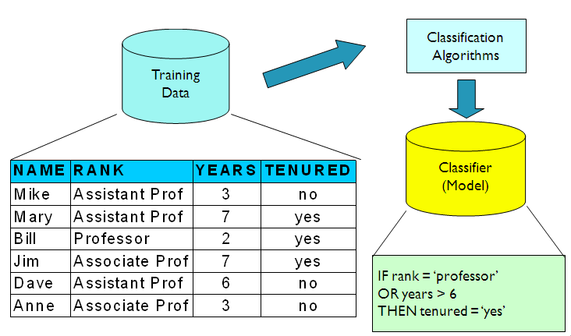
Introduction
Classification – model or classifier is constructed to predict categorical labels
Used to extract models describing important data classes
Batter understanding of data
Many algorithms exist – Decision Tree

Slide 6
Decision Tree
A flow-chart-like tree structure
Internal node denotes a test on an attribute
Branch represents an outcome of the test
Leaf nodes represent class labels or class distribution
Use of decision tree: Classifying an unknown sample
Test the attribute values of the sample against the decision tree

Slide 7
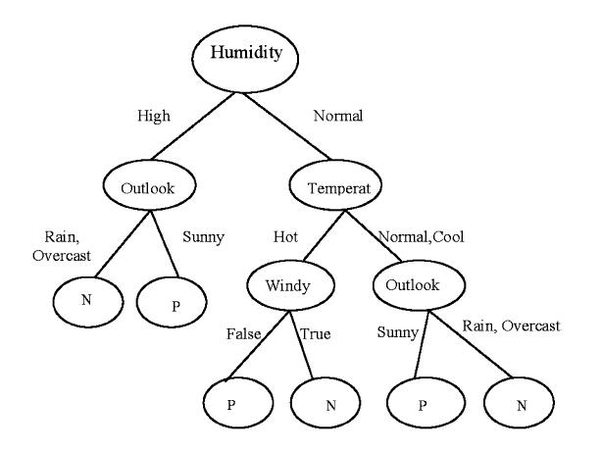
Decision Tree

Slide 8

Iterative Dichotomiser 3
A mathematical algorithm for building the decision tree.
Invented by J. Ross Quinlan in 1979.
Uses Information Theory invented by Shannon in 1948.
Builds the tree from the top down, with no backtracking.
Entropy(s) = - p+log2 (p+) -p-log2 (p-) for a sample of negative and positive elements.
The formula for entropy is

Slide 9
Information Gain
The information gain is based on the decrease in entropy after a dataset is split on an attribute.
First the entropy of the total dataset is calculated.
The entropy for each branch is calculated. Then it is added proportionally, to get total entropy for the split.
The resulting entropy is subtracted from the entropy before the split.
The result is the Information Gain, or decrease in entropy.

Slide 10
Information Gain
The attribute that yields the largest IG is chosen for the decision node
A branch set with entropy of 0 is a leaf node.
Otherwise, the branch needs further splitting to classify its dataset.
The ID3 algorithm is run recursively on the non-leaf branches, until all data is classified.

Slide 11










Person | Hair Length | Weight | Age | Class
Homer | 0” | 250 | 36 | M
Marge | 10” | 150 | 34 | F
Bart | 2” | 90 | 10 | M
Lisa | 6” | 78 | 8 | F
Maggie | 4” | 20 | 1 | F
Abe | 1” | 170 | 70 | M
Selma | 8” | 160 | 41 | F
Otto | 10” | 180 | 38 | M
Krusty | 6” | 200 | 45 | M
Comic | 8” | 290 | 38 | ?

Slide 12
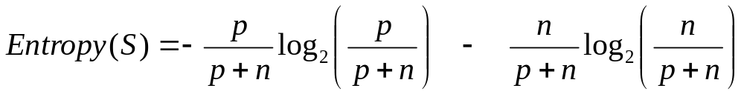
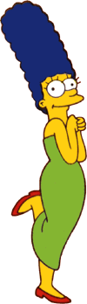


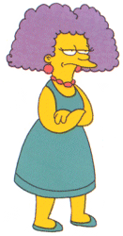
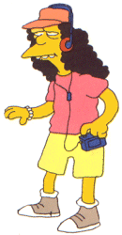
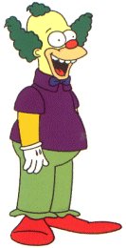


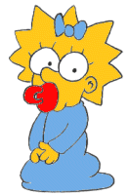
Entropy(4F,5M) = -(4/9)log₂(4/9) - (5/9)log₂(5/9)
= 0.9911
yes
no
Hair Length <= 5?
Let us try splitting on Hair length
Entropy(1F,3M) = -(1/4)log₂(1/4) - (3/4)log₂(3/4)
= 0.8113
Entropy(3F,2M) = -(3/5)log₂(3/5) - (2/5)log₂(2/5)
= 0.9710
Gain(Hair Length <= 5) = 0.9911 – (4/9 * 0.8113 + 5/9 * 0.9710 ) = 0.0911

Slide 13
Entropy(4F,5M) = -(4/9)log₂(4/9) - (5/9)log₂(5/9)
= 0.9911
yes
no
Weight <= 160?
Let us try splitting on Weight
Entropy(4F,1M) = -(4/5)log₂(4/5) - (1/5)log₂(1/5)
= 0.7219
Entropy(0F,4M) = -(0/4)log₂(0/4) - (4/4)log₂(4/4)
= 0
Gain(Weight <= 160) = 0.9911 – (5/9 * 0.7219 + 4/9 * 0 ) = 0.5900

Slide 14
Entropy(4F,5M) = -(4/9)log₂(4/9) - (5/9)log₂(5/9)
= 0.9911
yes
no
age <= 40?
Let us try splitting on Age
Entropy(3F,3M) = -(3/6)log₂(3/6) - (3/6)log₂(3/6)
= 1
Entropy(1F,2M) = -(1/3)log₂(1/3) - (2/3)log₂(2/3)
= 0.9183
Gain(Age <= 40) = 0.9911 – (6/9 * 1 + 3/9 * 0.9183 ) = 0.0183

Slide 15
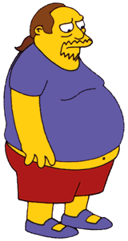
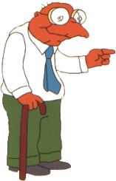

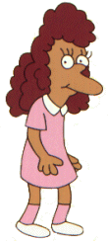
Weight <= 160?
We need don’t need to keep the data around, just the test conditions.
yes
no
How would these people be classified?
Hair Length <= 2?
Male
yes
no
Male
Female

Slide 16
Weight <= 160?
It is trivial to convert Decision Trees to rules…
yes
no
Hair Length <= 2?
Male
yes
no
Male
Female
Rules to Classify Males/Females
If Weight greater than 160, classify as Male
Elseif Hair Length less than or equal to 2, classify as Male
Else classify as Female

Slide 17
Advantages of Iterative Dichotomiser 3
Understandable prediction rules are created from the training data.
Builds the fastest tree.
Builds a short tree.
Only need to test enough attributes until all data is classified.
Finding leaf nodes enables test data to be pruned, reducing number of tests.
Whole dataset is searched to create tree.

Slide 18
Disadvantages of Iterative Dichotomiser 3
Data may be over-fitted or over-classified, if a small sample is tested which leads to have less accuracy.
It biased toward tests with many outcomes. It prefers to select attribute having a large number of values
Only one attribute at a time is tested for making a decision.
Classifying continuous data may be computationally expensive, as many trees must be generated to see where to break the continuum.

Slide 19
Problem Definition
Improving accuracy of Iterative Dichotomiser 3
Solving the problem of over classification
Increasing efficiency of classification

Slide 20
Literature review
Paper Title | Publication | Year | Description
An improved decision tree classification algorithm based on ID3 and the application in score analysis | IEEE | 2009 | Taylor Series Time complexity reduced by 65 seconds and accuracy increased by 3%
Research and application of the improved algorithm C4.5 on decision tree | IEEE | 2009 | The basic concepts of classifier, the principle of decision tree and algorithm ID3, analyses the algorithm C4.5 and The improved C4.5 algorithm is 20 second faster than the original C4.5

Slide 21
Literature review
Paper Title | Publication | Year | Description
Application of cart hepatitis disease diagnosis | IEEE | 2011 | C4.5 algorithm, ID3 algorithm and CART algorithm
Re Optimization of ID3 and C4.5 Decision Tree | IEEE | 2010 | Prepruning and rainforest approach
Study of Data Mining Algorithm Based on Decision Tree | IEEE | 2010 | Introduce weighted and simplified entropy into decision tree algorithm
A Knowledge Discovery Using Decision Tree By Gini Coefficient | IEEE | 2011 | Gini co-efficient is used for creatiing binary tree Always generate binary tree

Slide 22


Proposed Work
The formula for entropy
Modified formula^{[1]}
It reduces execution time by 65 seconds
But accuracy problem remains

Slide 23
Accuracy Function
To improve accuracy, a function will define
Based on difference between number of tuples that belongs to class 1 and number of tuples that belongs to class 2
Apply to each attribute
Normalized value will
Normalized value will be applied to Information Gain obtained using ID3 algorithm

Slide 24
Publication
Sr No | Paper / Journal Title | National / International Conference | Place | Accepted/ Published/Presented
1 | Enhance Efficiency Of Classification By Improving Iterative Dichotomiser 3 | International | International Journal of Computer Science and Information Technology & Security Vol. 2, No. 6, 2012 | Published
2 | Enhance Efficiency of Iterative Dichotomiser 3 | International |  | Accepted

Slide 25
Work Flow
.
Calculation Of Entropy
Calculation Of Function for accuracy
Calculation Of Information Gain
Calculation Of Modified Information Gain using accuracy function
Creation of decision tree

Slide 26
Implementation Methodology
Front End: C#. Net
Back End: SQL Server

Slide 27
Action Plan
Month | Activity
August- September | Project Search
September - October | Study of classification methods
October | Finding limitation of specified method & Designing new method
November – January | Implementation
February-March | Result Analysis
April | Writing Thesis

Slide 28
Conclusion
Using concept of association function, we can increase accuracy of Iterative Dichotomiser 3 as well as the time complexity will also reduce.

Slide 29
References
An improved decision tree classification algorithm based on ID3 and the application in score analysis By Huang Ming1, NiuWenying1, Liang Xu
Research and Application of the improved Algorithm C4.5 on Decision Tree By Zhu Xiaoliang , Yan Hongcan
ID3 Optimization Algorithm Based on Interestingness Gain By Liu zhongtao
Study of Data Mining Algorithm Based on Decision Tree by Linna Li & Xuemin Zhang, International Conference On Computer Design And Appliations, 2010

Slide 30
References
Re Optimization of ID3 and C4.5 Decision Tree”, by Devashsish Thakur, Nisarga Markandaiah, and Sharan Raj D, International Conference on Computer & Communication Technology, 2010
A Knowledge Discovery Using Decision Tree By Gini Coefficient” by S.Sivagama sundhari ,International Conference on Business, Engineering and Industrial Applications,2011
Data Mining, Concepts and Techniques, Jiawei Han and Michline Kamber, 2nd edition,2010

