Slide 1
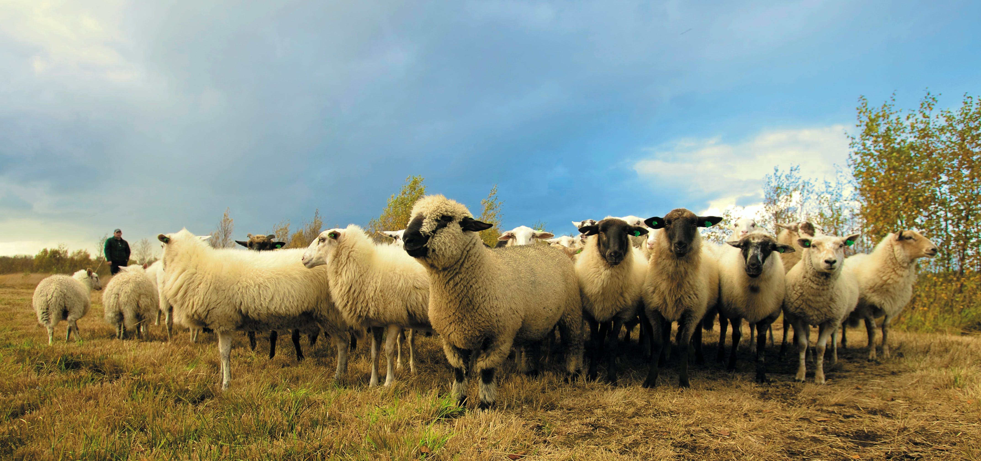
Collective Behavior Optimal Shepherding
Franziska Weber Franz Muszarsky Kimberley Frings
Iztok Lebar Bajec | izredni professor | mentor

Slide 2

Optimal Shepherding
Franziska Weber Franz Muszarsky Kimberley Frings
Collective Behaviour
Iztok Lebar Bajec | izredni professor | mentor

Slide 3
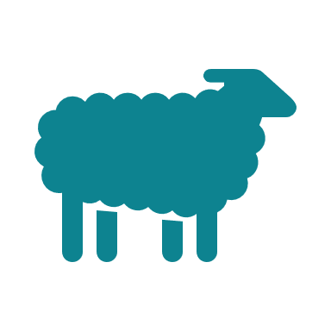


Agenda
Shepherding
Introduction
Theory
Practice
Extension
Results

Slide 4



Introduction: Shepherding Problem
Introduction
Ziel

Slide 5
Introduction: Shepherding Problem
Introduction
Ziel

Slide 6
Introduction: Shepherding Problem
Introduction
Ziel
“The problem of guiding a flock of several autonomous agents using repulsion force exerted by a smaller number of agents.

Slide 7
Overview
Introduction
Theory
Practice
Extensions
Results

Slide 8
Model Description
Theory
Shephearding
Shepheard / Dog
Movement based on objective Function
Initially only one Shepheard
Agents / Sheeps / Herd
Consists of N Agents
Move in a two dimensional field
Movement based on Reynolds’ boids model
*Optimal Shepherding and Transport of a Flock by A. Ranganathan, A. Heyde, A. Gupta, and L. Mahadevan

Slide 9

Model Description – Behaviour of Agents
Theory
Agent Behaviour
Local alignment to herd
Attraction to herd center
Local repulsion
Repulsion from shepherd
Agent-agent interactions
Agent-shepherd interaction
$$α, β,γ,δ are weights$$
*Optimal Shepherding and Transport of a Flock by A. Ranganathan, A. Heyde, A. Gupta, and L. Mahadevan

Slide 10

Model Description – Behaviour of Shepherd
Theory
Shepherd Behaviour
Goal
Transport entire herd to target position
Move herd to target
Don‘t lose any agents in the process
Keep agents and target in alignment to maintain line of sight
Conditions
Objective Function
W_{mean}, W_{std}, W_{col}$are weights$
*Optimal Shepherding and Transport of a Flock by A. Ranganathan, A. Heyde, A. Gupta, and L. Mahadevan

Slide 11
Agenda
Shephearding
Introduction
Theory
Practice
Extension
Results

Slide 12
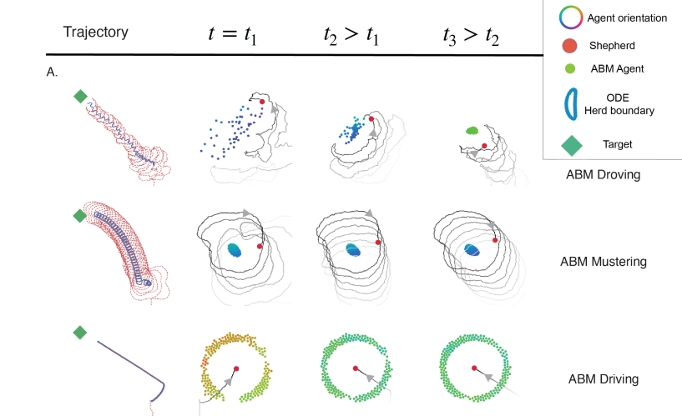
Findings
Practice
3 Strategies emerged for the shepherd
Droving
Mustering
Driving
*Optimal Shepherding and Transport of a Flock by A. Ranganathan, A. Heyde, A. Gupta, and L. Mahadevan

Slide 13
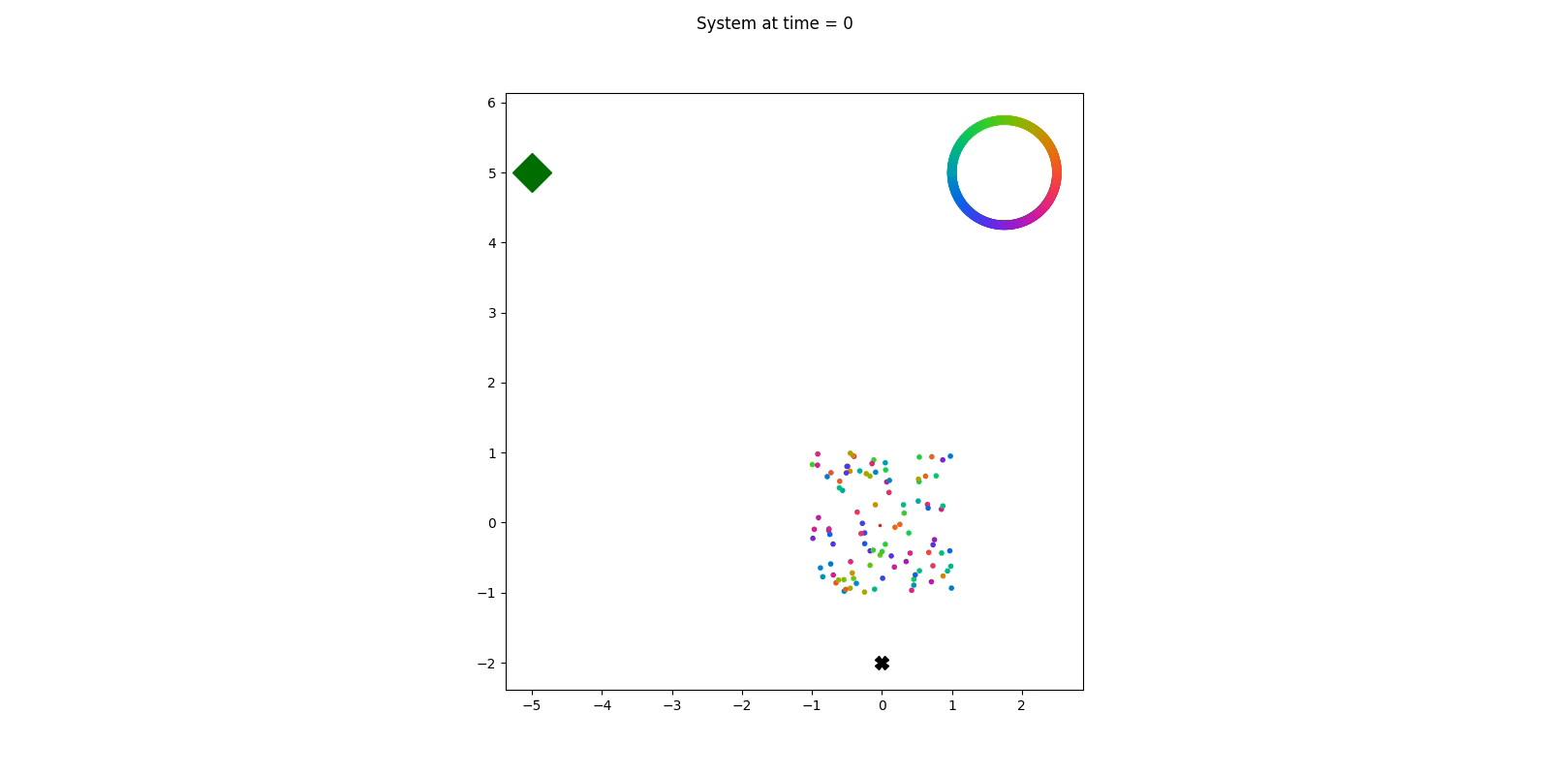
Videoexample: Mustering
Practice
3 Strategies emerged for the shepherd

Slide 14
Overview
Shephearding
Introduction
Theory
Practice
Extensions
Results

Slide 15

Model Extensions
Extensions
Fence
Second shepherd
Required modifications:
Min/max x and y coordinates
Potential future Extension
Actual repulsion force from fence
Required modifications:
Repulsion between shepherds
Repulsion of agents as sum of each individual shepheards repulsion
Potential future extension
Enable multiple shephrds
*Optimal Shepherding and Transport of a Flock by A. Ranganathan, A. Heyde, A. Gupta, and L. Mahadevan

Slide 16
Overview
Shepherding
Introduction
t
Theory
Practice
Extensions
Results

Slide 17
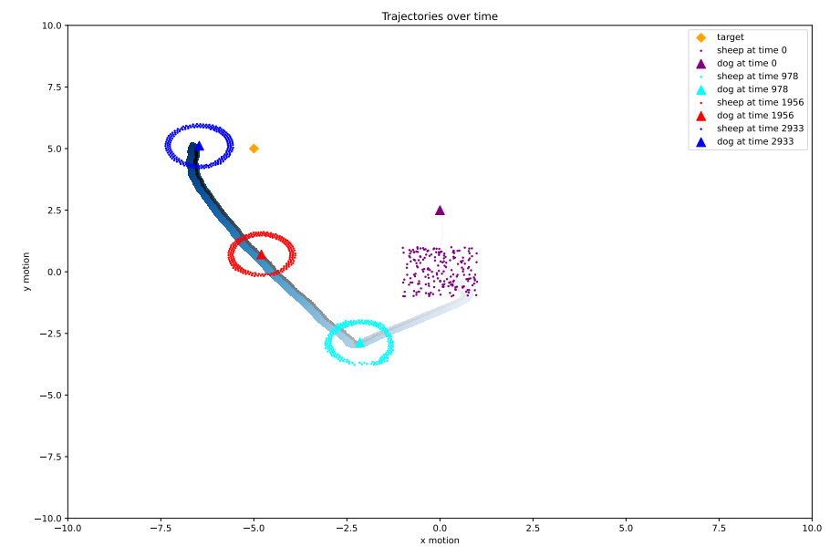
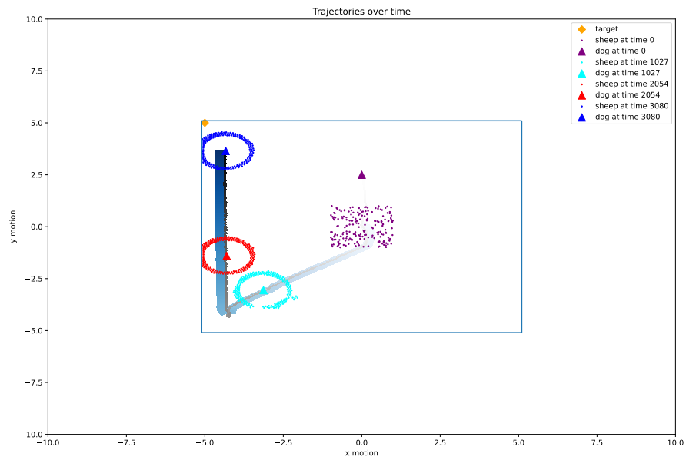
Results
Results
Trajectory plot
Without Fence
With Fence

Slide 18
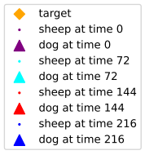

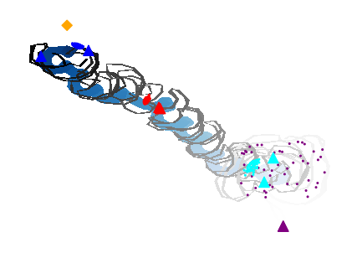
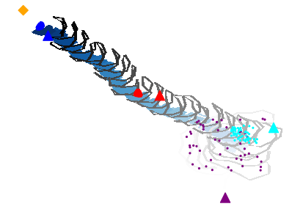
Results
Results
Trajectory plot
One Shepherd
Two Shepherds

Slide 19
Thank you for your attention!
Franziska Weber, Franz Muszarsky, Kimberley Frings

