Slide 1
AIRLINE RESERVATION SYSTEM
CMPE 226
By
Team Include
Gokul, Harsha, Kiran & Navdeep

Slide 2
Agenda
Technologies Used
Data Selection
Operational Model
Data operations of the operational tables.
User Application
Analytical Model
Data Warehousing Operations

Slide 3
Technologies & Tools Used
HTML,CSS,JavaScript
MySQL
RDBMS
Data Warehousing Concepts
PHP
Ajax
Jquery
XAMPP
Cisco Information Server
Tableau + Google Maps API

Slide 4
Data Selection
We have used following datasets and API’s from the followings websites:
http://www.cleartrip.com/api/docs/air-api/
https://flightaware.com/commercial/flightxml/
http://openflights.org/data.html
http://flightwise.com/
3 large and extensive datasets have been used to perform queries and run transactions
Route database - has 65000 records of routes information.
Airport database- has 8700 records of Airport information.
Airline database- has 6000 records of Airlines information.
2 more database were created manually.
Transaction
customer

Slide 5
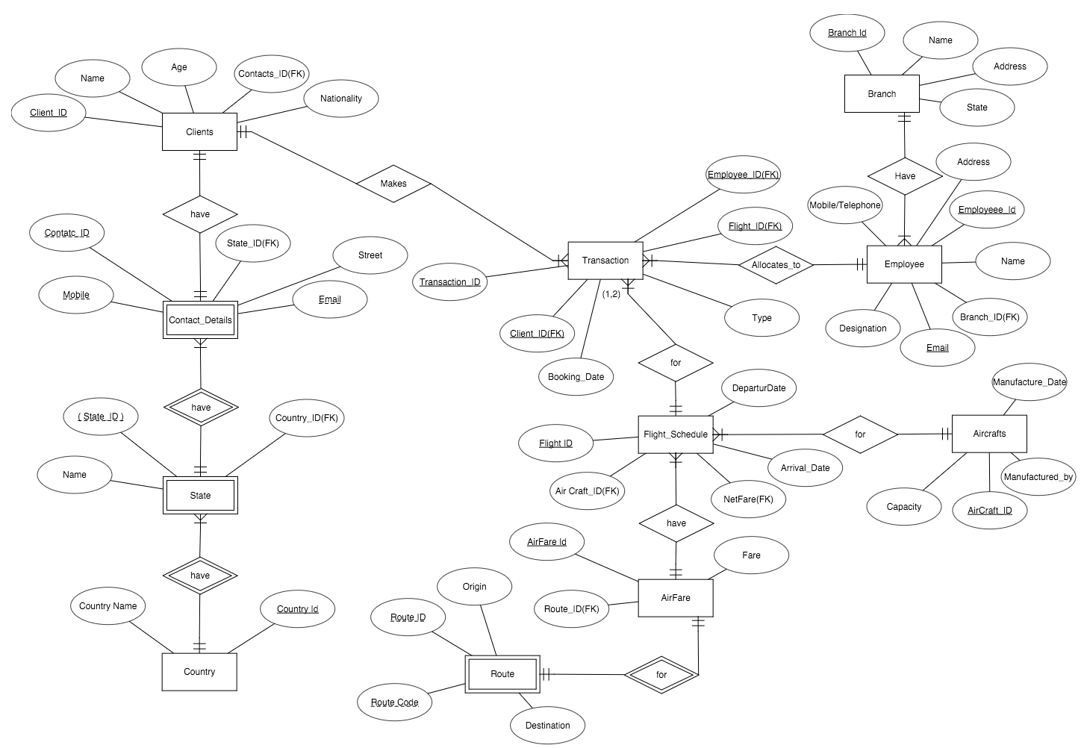
Operational Model - ER Diagram

Slide 6
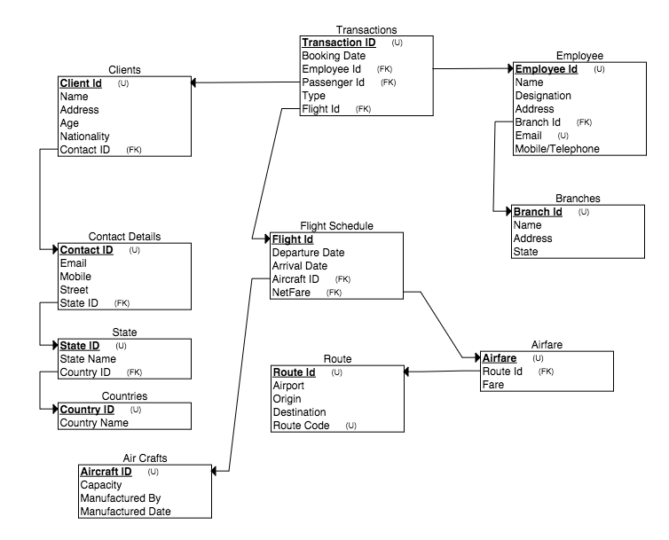
Operational Model (Contd..) - Relational Schema

Slide 7
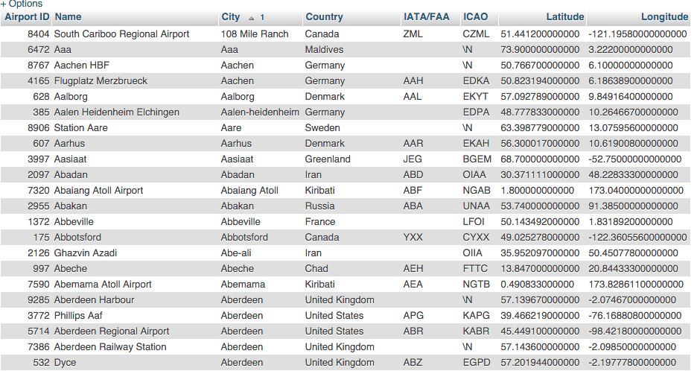
Sample data from Airport table

Slide 8
SQL Operations Performed on Operational Model
The following operation schemes have been implemented on the datasets:
Inner Join
Outer joins
Create Views & Tables
1:M, M:N relationships
Normalization - 3NF

Slide 9
Queries used
Query to fetch flight details:
SELECT r.Name as AirlineID, s.`Airport ID` as SourceID, d.`Airport ID` as DestinationID FROM Airports s, Airports d, Finalroutes r WHERE s.City = "San Francisco" and d.City = "Chicago" and s.`Airport ID` = r.`Source ID` and d.`Airport ID` = r.`Destination ID`
Query to fetch route details:
$sql = "SELECT r.Name as `Airline Name`, s.City, s.Name as `Origin Airport Name`,d.City,d.Name as `Destination Airport Name` FROM Airports s, Airports d, Finalroutes r WHERE s.City = '$origin' and d.City = '$destination' and s.`Airport ID` = r.`Source ID` and d.`Airport ID` = r.`Destination ID` "
Query to fetch airport details:
$sql = "SELECT * from airports where name = '$name' ";

Slide 10
Queries Used(Contd..)
4. Query to fetch Airline details:
$sql = "SELECT * from airlines where name = '$name' "

Slide 11

Haversine Formula
Haversine formula is an important equation used in navigation to determine distance between two places using their latitudes and longitudes.
We use it to compute the fare between two locations.

Slide 12
Features
Fare calculation according to distance
Large Dataset used for detailing on airports.
Autocomplete feature with the help of jquery and ajax.
Generates itinerary for each successful transaction.
Pictorial representation of data.
Works like a real time reservation setup.

Slide 13
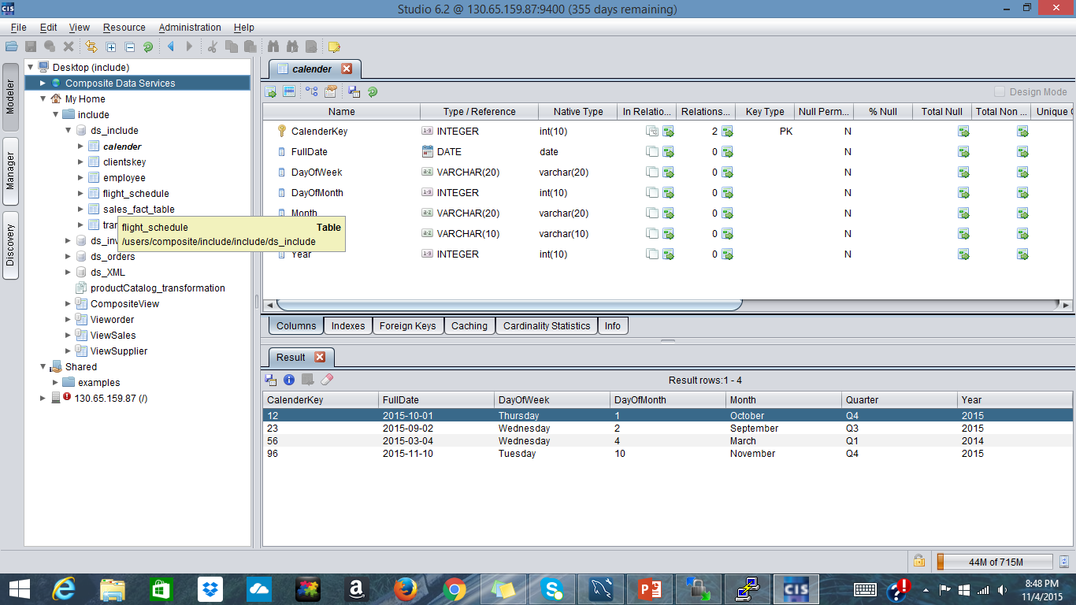
CIS database upload part

Slide 14
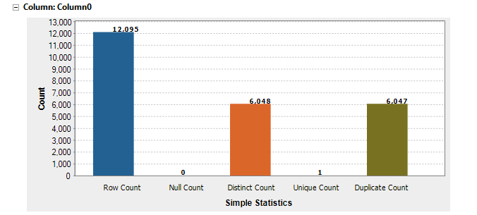
Data Validation

Slide 15
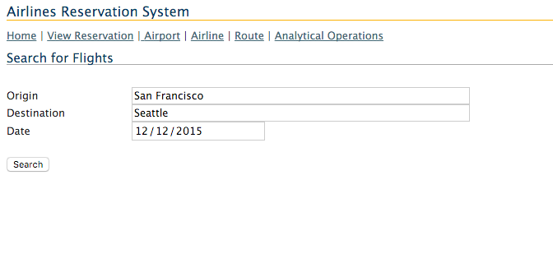
Application

Slide 16
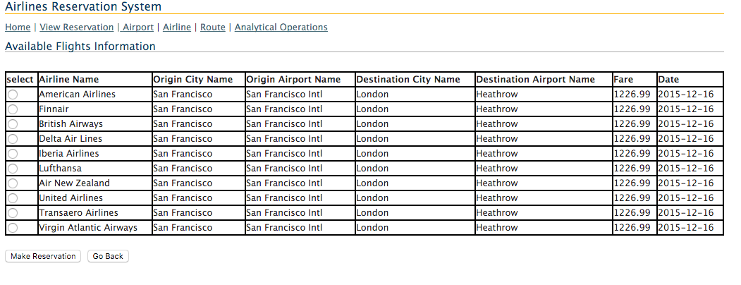
Application(Contd..)

Slide 17
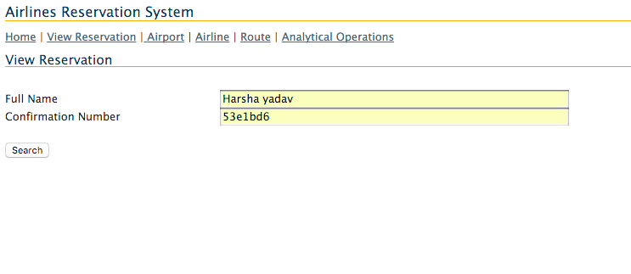
Application(Contd..)

Slide 18
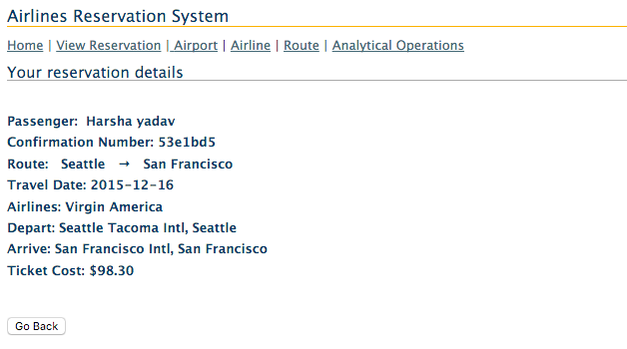
Application(Contd..)

Slide 19
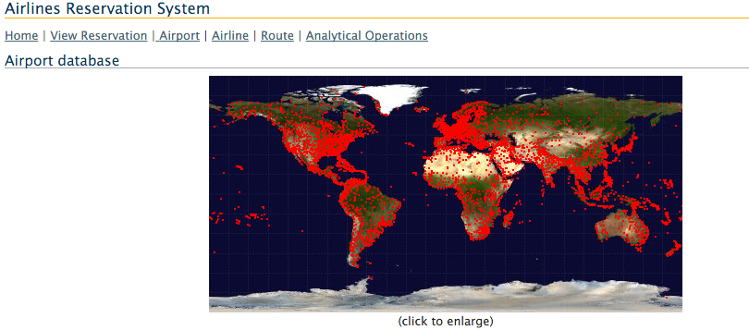

Application(Contd..)

Slide 20
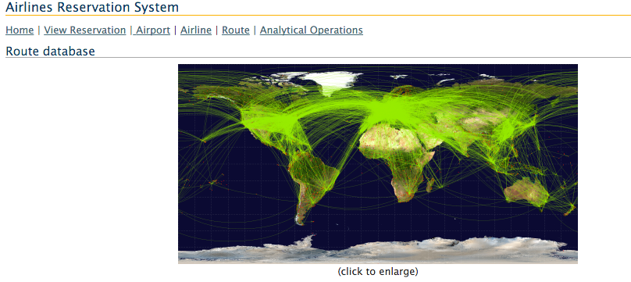
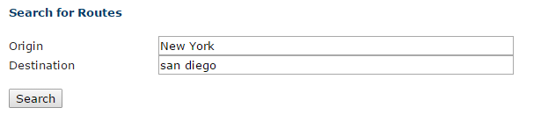
Application(Contd.)

Slide 21
Application Demo

Slide 22
How Data fed to Analytical Model from Operational Model
We have Created Analytical Model From the Operational Model Tables By Joining The Tables in the Operational Model and Pulled the Data from the Joined Tables and Used that data for the Analytical Model by creating new Tables with data from it.

Slide 23
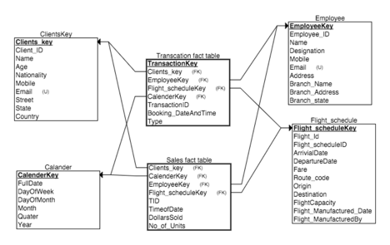
Analytical Model - Dimensional Model with Star Schema

Slide 24
Analytical Model Operations
Drill Down - Revenue Generated in a Year to Quarter
Drill up - Revenue Generated in a Month to Quarter
Slice - Select one value of a dimension attribute
Dice - Select attribute values from two or more dimensions
Pivot - Reorganize query results by rotation

Slide 25
Analytical Model Operations Demo

Slide 26


