Slide 1


The needs : make an automatic backup of websites
The results : save time and make a redundant task automatic
easyBackup software
Guillaume BUISSON
Alain de CHRISTEN
Loubna KRIBII
ISEP Students
in Information Systems
Save more than data
1/2

Slide 2
Project presentation
The aim : automatically back-up websites and databases with a shell script
How to do it ?
1 – Connect to the server via SSH
2 – Write a script to backup the files by FTP
3 - Write a script to backup the SQL files by FTP

Slide 3
Connect to the server via SSH
Add your public key to a specific file on the distant server :
/.ssh/authorized_keys
Then you won’t have to give the password anymore!
Run command « username@server.ext » on your console
You will be connected to the server
Using a Linux system in our case (mutualized OVH)
You will be able to remote scripts on the server (depends on the server permissions)

Slide 4
Script to synchronize folders
Use the command rsync to synchronise folders
rsync –arv sourceFolder/ backupFolder/
sourceFolder and backupFolder can be local or on the server
Optional : save logs reports (including errors) in a separate logFTP.txt file in the same folder than the FTP script
scriptFTP.sh &> logFTP.txt

Slide 5
SQL script
Initialize the variables user=”username” password=”password” host=”server” db_name=”databaseName”
Define in a variable a folder in which to save the BDD dumb backup_path="backups/” date=$(date +"%d-%b-%Y")
Accord permissions to the owner only (we set “1”) umask 177
Dump the SQL database mysqldump --user=$user --password=$password --host=$host $db_name > $backup_path/$db_name-$date.sql

Slide 6
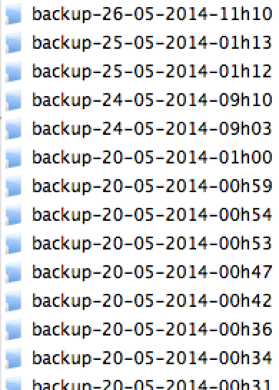
Backups destination
The backups are saved into a well organized folder
mkdir -m 705 $allbackups/backup-$date
The variable $allbackups refers to our backup folder
A new folder is created at each script execution
The date and hour are added to the created folders

Slide 7

Execute the script from local
Our problem : OVH does not authorized distant access to their SQL servers
The solution : Use a local script which will create and execute a distant script on the server
Local shell
FTP shell
FTP shell
execute script which will create a script on the server
execute new script
run backup
FTP shell
Connect to
Store the files at the destination folder you want !
send back the files to the local computer

Slide 8
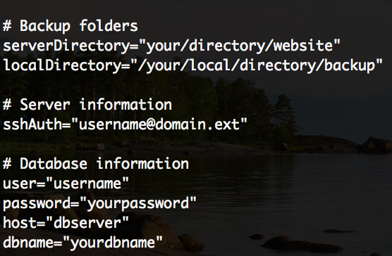
Easy configurable script
Why : script composed to be easily adaptable according to users FTP and SQL profiles : just set variables and run it !

Slide 9
Solved problems
Make a script executable using the chmod command :
chmod +x script.sh
Access to OVH databases from local computer
OVH does not authorize external access to its databases
Run a script on OVH
OVH does not authorize some script commands

Slide 10
To do next
Combine the scripts into a unique one
Develop the script with further functions :
Delete backups dated more than X days
Send an e-mail when the backup is done
Remote the OVH scripts from a local script (to let users run manually the scripts without being connected to OVH) and download files locally from the server (DONE)
Make the script running as a cron task to plan daily/weekly backups (already effective with OVH)

Slide 11
Thank you
Do not forget to see our video demonstration about easyBackup VS FileZilla (on Github) !
- Thanks -

