Slide 1
Bash Dictionary Project
Eva BENOIT – Ariane BERTRAND – Guillaume FORMEY DE SAINT LOUVENT – Ang LI

Slide 2
Table of contents
I. Project presentation
II. Stardict: offline dictionary
1) Stardict presentation
2) How to install Stardict
3) How to launch Stardict
III. Shelldict: online dictionary
1) Shelldict presentation
2) Main functions
3) Problems and solutions
4) Structure of the program
5) Result
IV. Conclusion

Slide 3
I. Project Presentation

Slide 4
I. Project presentation
We wanted a user to be able to look for the meaning of a word without having to search for a dictionary website, only using a command-line dictionary.
It should be available both:
Offline
Online
It should be simple, easy to use and accessible for all
Solution chosen:
Use the existing Linux OS offline dictionary Stardict
Create our own Bash application Shelldict
We choose to use only english dictionaries

Slide 5
II. Stardict – Offline dictionary
Stardict presentation
How to install Stardict
How to launch Stardict

Slide 6

II.1 Stardict presentation
What is Stardict
An international dictionary shell
Also serves as a translator
Actual version: 3.0.2
Cross-platform operating system
Linux, Windows, Mac OS X…
Also compatible with mobile platforms
Android, iOS, Windows phone…
Why use Stardict
Has an efficient offline dictionary
Provides a great choice of dictionaries
Easy to access
Free graphical user interface

Slide 7
II.2 How to install Stardict
How to install Stardict
Install the dictionary
Command line : sudo apt-get insntall sdcv
Sdcv is the console version of Stardict
Download dictionary files
At first, Stardict doesn’t have any dictionary.
Go to http://abloz.com/huzheng/stardict-dic/dict.org/ and download the dictionary you need.
Install downloaded dictionaries
Command lines
Sudo mkdir –p /usr/stardict/dic/
Sudo tar –xvjf downloaded.tar.bz2 –C /usr/share/stardict/dic

Slide 8
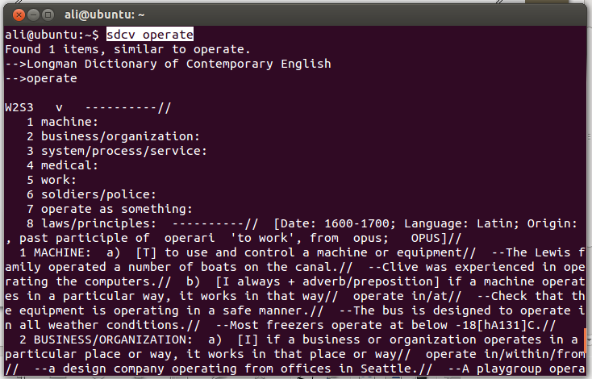
II.3 How to launch Stardict
How to launch Stardict in a terminal
Command line: sdcv word
Word is the word to be searched for definition

Slide 9
III. Shelldict – Online dictionary
Shelldict presentation
Main functions
Problems and solutions
Structure of the program
Result

Slide 10

III.1 Shelldict presentation
We created our own Bash dictionary: Shelldict
It uses an already existing online dictionary
Oxford Dictionaries : http://www.oxforddictionaries.com/
Reference in terms of english dictionaries
Has been making dictionaries for 150 years

Slide 11
III.2 Main functions
Commands used
Curl: grab the full HTML code of a web page thanks to its URL.
curl http://www.oxforddictionaries.com/definition/english/hello get the HTML code of the specific web page.
Sed: can be used to find some portions of the code or even replace them by another string thanks to the flag –i.
sed -i "s/<\/section>/\n/g“ replaces every occurrence of <section> by a line break.
Grep: look for some portions of the code given by a regex. The flag –o is used to display only the parts found and a filename needs to be specified to make it work.
grep -o '<section class="senseGroup">.*' lineCode.txt finds all the lines of the document lineCode.txt which start by the string <section class=“senseGroup”>.

Slide 12
III.3 Problems and solutions
Difficulties we had
Find a way to grab the definitions of a word without making too many commands
Make the code work for every Linux systems
Test the code for many words
Solutions we found
We’ve called the command sed many times to isolate the parts that interested us by using several regex
At first, we were using the command egrep to grab some parts of the code. Finally, we decided to use grep so that the code could work with the Linux systems we were working with
We needed to test the code many times to see if it was returning the right definitions and that there wasn’t any HTML code in it, such as links with <a></a> tags.

Slide 13
III.4 Structure of the program
Structure of the program (first part)
Grab the word entered by the user in the terminal
read word picks up the word entered by the user on his keyboard and puts it in a variable named word.
Take the HTML code of the right web page
wordUrl=$dictionaryUrl and $wordcurl $wordUrl > pagecode.txt grabs the HTML code from the URL associated to the word and puts the entire code in a .txt file named pagecode.txt.
Delete blank lines to make the web-scraping easier
We used the command tr to delete blank lines with the flag –d.
Get all definitions of the word in the code page
Thanks to the two commands sed and grep, we’ve isolate the tags that interested us for finding the meanings of the word, such as <span class=“iteration”></span> and <span class=“definition”></span>.

Slide 14
III.4 Structure of the program
Structure of the program (second part)
Delete links which can be contained in some definitions
We’ve used the command sed with its replace function to do this.
Read the content of the file containing the definitions and print them for the user in the terminal
Using a loop, we read the lines of the file and print it for the user.
Delete all the files used for the program
Made using the command rm.

Slide 15
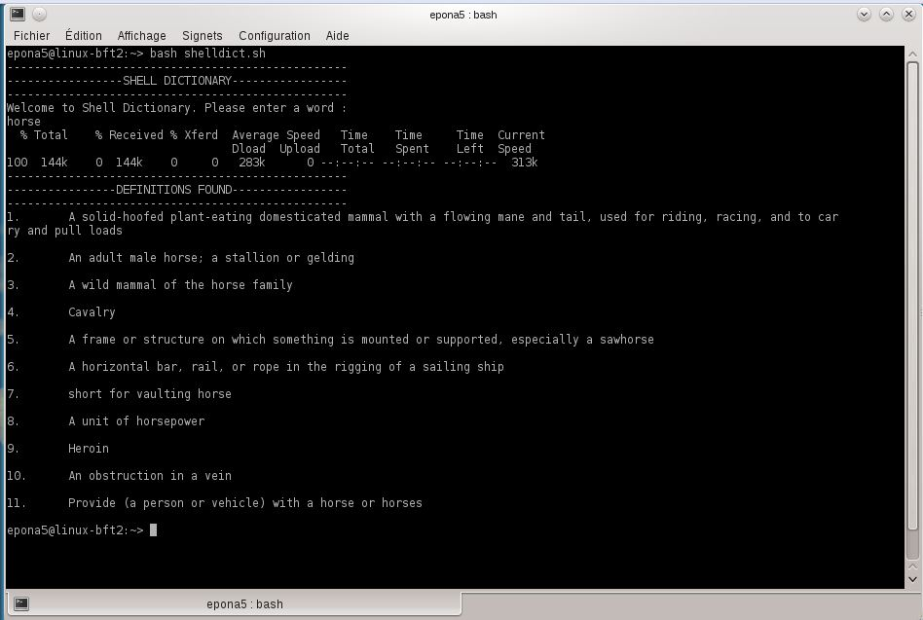
III.5 Result

Slide 16
IV. Conclusion

Slide 17
IV. Conclusion
At the end of this project a user is now able to find definitions of words in both online and off line dictionaries.
This experience allowed us to use what we learned theoretically during this class.
More details about the code lines are presented above.
If we had more time we would have liked to create a graphic interface.
An other implementation could have been to send a mail to a web service that will call the dictionary and receive a mail back with the definition of the word.

