Slide 1
Project 1 : Find me a recipe
Download a bunch of recipes on marmiton.org and organise them by time of cooking
Amélie Marichal
Lucas Baylé
Augustin Guillaud

Slide 2

Project : The main ideas
big database of recipes
print the main lines of a recipe
sort them by time of cooking -sed / regex
find new recipes on a website
retrieve the url of a recipe ranked n°1

Slide 3
How we proceeded
Phase 1
When we discovered bash and had to try out commands without really knowing where we were going.
Phase 2
When we started to understand how a script works and where to put our regex thingies.
It shows for the most part the latest advancement for our bash script.
Phase 3
It’s our TO-DO list. We modify it every time we succeed into doing something (achievements are transferred to phase 2) and it shows our next goals.

Slide 4

Progress status (phase 1)
DONE:
sed -n "1 p" ~/recipe.txt → first line of the recipe book
grep “^.*$” recipe.txt → distinguish each line
sed -n "1 p;5 p" → print the lines 1 and 5
sed -n "5p" recipe.txt | sed -e "s/\(.*personnes)\).*$/\1/" | sed -e "s/.*\([0-9]\{2\}\).*\([0-9]\{2\}\).*/[\1,\2]/" → print [15,30]
TO DO:
script that :
show the first and fifth lines of each recipes
retrieve time of cooking and time of preparation
organise them by time of cooking

Slide 5
Progress status (phase 2)
DONE:
$ ./marmiton.sh→ Launches the script in the bash shell
for i in {0..50..10}
do
curl -s http://www.marmiton.org/recettes/recherche.aspx?aqt=$1\&start=$i >> /tmp/raw
done
→ Loop retrieving the HTML content of the first six pages result and stores it in a temp file
/.*<div class="m_search_titre_recette"><a href=.*>\(.*\)<\/a><\/div>/ { s//\1/p;}
→ Research in the HTML content the elements corresponding to this regex.Same thing for preparation time, cooking time, type of recipe and votes. Differs from the regex for the number of persons

Slide 6

Progress status (phase 2)
DONE:
...{ s//\1\r\n\2/;H;} g s/\r\n/;/gp (example)
→ Changing every regex with the use of the hold buffer and pattern buffer via h, H and g
sed -n -f total.sed /tmp/raw
→ Extract the wanted data from the HTML retrieved using the total.sed file. total.sed contains every regex
sort --field-separator=';' -rn --key=$2 |column -t -s ";"
→ Sort decreasingly the data by votes, separating each element belonging to a certain column by a ‘;’
echo "What recipe are you searching for? :"
read recipe
→ Ask the user to type in the thing he wants to prepare. Read retrieves the words. Same thing for the sorting out.

Slide 7
Progress status (phase 2)
DONE:
re='^[1-6]$'
→ Introducing the variable re, in order to specify the range possible (1 to 6)
while ! [[ $num =~ $re ]]; do
→ The re variable is used into a regex to prevent errors (wrong element entered by the user)
echo "You didn't enter the right command, please try again!";
read num;
done
→ The loop allows us to ask the user an unlimited number of time to enter the right command until he does it so
case $num in
1)
sed -n -f total.sed /tmp/raw | sort --field-separator=';' --key=1 |column -t -s ";"
;;
2)
…
esac
→ According to what the user wanted to sort by, it launches the right command. It is more scalable that way

Slide 8
Progress status (phase 2)
DONE:
recipe=$(iconv -f utf8 -t ascii//TRANSLIT <<< "$recipe")
→ Managing the special characters such as '^', taking utf8 characters in entry and translating them into ascii
recipe=${recipe// /-}
→ Managing the possible blanks between words, replacing them by '-' (used on marmiton.org)
while [[ $(curl -s http://www.marmiton.org/recettes/recherche.aspx?aqt=$recipe | grep "Aucun résultat") ]]; do
echo "No results found. Please try again.";
read recipe;
recipe=$(iconv -f utf8 -t ascii//TRANSLIT <<< "$recipe")
recipe=${recipe// /-}
done
→ $() executes the command curl and retrieves the results
→ The while loop allows us to manage the error when no result was found and asks again the user what he wants to search for

Slide 9

Testing Phase
Launch the marmiton.sh script : $ ./marmiton.sh
Enter the recipe that you’re looking for ex: ratatouille
Then sort the results by : title, votes, time …
See the how_to_marmiton file for more details

Slide 10
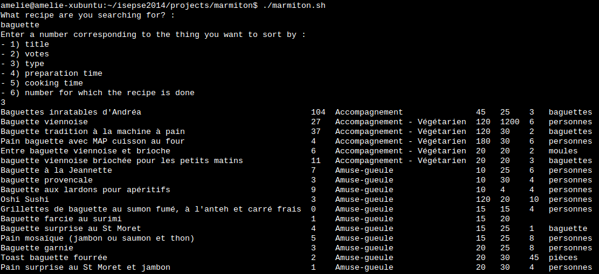
Script using baguette

Slide 11

Progress status (phase 3)
Retrieve the recipe’s page corresponding to the best result considering the user’s choices (by storing the sorted results in another file and using regex into the URL used to display recipes on Marmiton)
Add up preparation time and cooking time in order to ask how much time the user has to cook (not mandatory)
We will most likely not have enough time to do those but they are possible evolutions/ameliorations to our script.

