Slide 1


OS PROJECT - ALLOCINE
DEVELOPED BY
Saïd Daher
Samy Abtout
Nassim Afrete
Baptiste Chegaray

Slide 2
SUMMARY
GOALS
TASKS PERFORMED
THE RESULTS
HOW TO LAUNCH THE SCRIPT ?
SENDING MAILS CONFIGURATION : THE STEPS
OUR PROBLEMS

Slide 3
GOALS
Allow the user to quickly get a selection of the best movies of Box-Office of the website Allocine.com
OR
Allow him to search for a movie by entering one or more keywords.
Once the script is completed, an email (type HTML) is sent to the user with the result of his search.

Slide 4
TASKS PERFORMED (1/3)
Step 1
A menu allowing the user to choose between doing a search or get movies of Box-Office
echo -e "Faites votre choix\n 1) Récupérer les meilleurs films du Box-Office\n 2) Rechercher un film" read choice case $choice in 1) …;; 2) …;; *) …;; esac
Step 2
To get movies we used :
wget -O allMovies.html http://www.allocine.fr/boxoffice/france/ AND wget -O pageRecherche.html http://www.allocine.fr/recherche/?q=$keywords

Slide 5
TASKS PERFORMED (2/3)
Step 3
We used a function to get the HTML page content to get descriptions, title and images of movies.
And we used grep and sed to get the differents informations.
function getDescription(){ for movie in $(cat $pageLinks) do wget -O pageMovie.html $movie title=`tr -d '\n' < pageMovie.html | grep -o -E '<meta property="og:title" content="([^"]+)" />' | sed 's/^.*content="\([^"]*\)".*$/\1/' | sed "s/&#39;/'/g" | sed 's/&quot;/"/g'` … done }

Slide 6
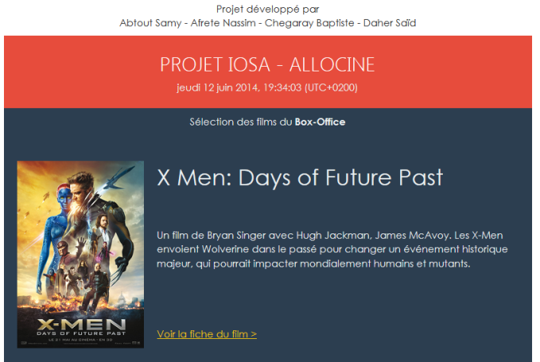
TASKS PERFORMED (3/3)
Step 4
Send a mail with the result in a HTML document to the user with the function mailx.
mailx -a "Content-Type: text/html" -s "Projet IOSA - ALLOCINE" $adressesMail < content.html

Slide 7
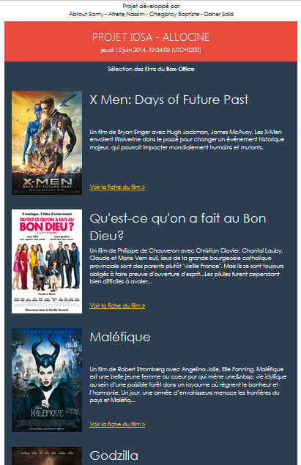
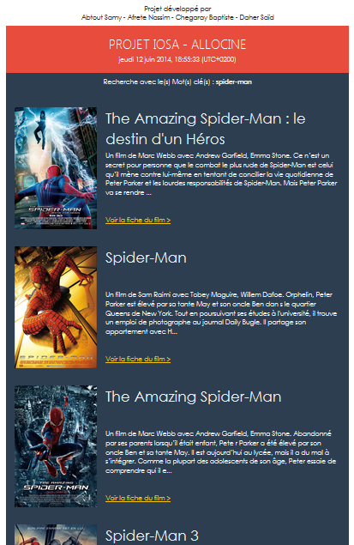
THE RESULTS
Movies of Box-Office
Search with keyword « spider-man »

Slide 8
HOW TO LAUNCH THE SCRIPT ?
We wrote the script into a text file with the .sh extension
We make it executable with the chmod command :
chmod +x fileName.sh
To use the created script:
./fileName.sh (if we are in the same folder)
../fileName.sh (if we are in a below folder)
Then following the instructions to get movies (make a choice, enter an email and/or write some keywords)

Slide 9
SENDING MAILS CONFIGURATION : THE STEPS
sudo apt-get install postfix mailutils libsasl2-2 ca-certificates libsasl2-modules
vim /etc/postfix/main.cf
relayhost = [smtp.gmail.com]:587 smtp_sasl_auth_enable = yes smtp_sasl_password_maps = hash:/etc/postfix/sasl_passwd smtp_sasl_security_options = noanonymous smtp_tls_CAfile = /etc/postfix/cacert.pem smtp_use_tls = yes
vim /etc/postfix/sasl_passwd
[smtp.gmail.com]:587 USERNAME@gmail.com:PASSWORD
sudo chmod 400 /etc/postfix/sasl_passwd sudo postmap /etc/postfix/sasl_passwd
cat /etc/ssl/certs/Thawte_Premium_Server_CA.pem | sudo tee -a /etc/postfix/cacert.pem
sudo /etc/init.d/postfix reload

Slide 10
OUR PROBLEMS
We had some problems to use the grep and sed commands to get informations in the HTML document but finally we managed to get all the information we wanted.
And we had problems setting up sending mails because we didn't know the differents steps to follow and different parameters to configure like the "Relayhost" for example.

