Slide 1
What is Astropy
http://www.astropy.org
Well-organized community effort to create a vetted, well-documented set of astronomical libraries for python
Will ultimately be like idlastro for IDL on steroids
Currently at version 0.2.3
Python + numpy + matplotlib + astrolib is a fairly complete, free alternative to IDL
Main leaders are Erik Tollerud (Yale), Thomas Robitaille (MPIA), Perry Greenfield (STSci)
Perry Greenfield is the software lead at STSci, has STSci programmers contributing
Paper on AstroPy submitted two days ago (to A&A)!

Slide 2
Installation
Easiest with pip (see http://www.pip-installer.org/en/latest/installing.html#python-os-support)
pip install astropy
To upgrade: pip install astropy –upgrade
Manual install:
Download tarball from http:///astropy.org
Or use git for bleeding-edge version (requires Cython also):
git clone git://github.com/astropy/astropy.git
python setup.py build
python setup.py install

Slide 3
Packages - Core
Constants (astropy.constants)
Units (astropy.units)
N-dimensional datasets (astropy.nddata)
Data Tables (astropy.table)
Time and Dates (astropy.time)
Astronomical Coordinate Systems (astropy.coordinates)
World Coordinate System (astropy.wcs)

Slide 4
Packages – Data I/O & Computation
FITS File handling (astropy.io.fits)
ASCII Tables (astropy.io.ascii)
VOTable XML handling (astropy.io.votable)
Miscellaneous Input/Output (astropy.io.misc)
Cosmological Calculations (astropy.cosmology)
Astrostatistics Tools (astropy.stats)

Slide 5
Heritage
Several packages are direct ports from established libraries:
import pyfits
import vo
import pywcs
from astropy.io import fits as pyfits
from astropy.io import vo
from astropy import wcs as pywcs

Slide 6
Examples taken from astropy paper…

Slide 7
Tables
Create an empty table and add columns
>>> from astropy.table import Table, Column
>>> t = Table()
>>> t.add_column(Column(data=["a", "b", "c"], name="source"))
>>> t.add_column(Column(data=[1.2, 3.3, 5.3], name="flux"))
>>> print t
source flux
------ ----
a 1.2
b 3.3
c 5.3
Read a table from a file
>>> t1 = Table.read("catalog.vot")
>>> t1 = Table.read("catalog.tbl", format="ipac”)
Select all rows from t1 where the flux column is greater than 5
>>> t2 = t1[t1["flux"] > 5.0]
Manipulate columns
>>> t2.remove_column("J_mag")
>>> t2.rename_column("Source", "sources")
Write a table to a file
>>> t2.write("new_catalog.hdf5")
>>> t2.write("new_catalog.tex")

Slide 8
FITS
Read in a FITS file from disk
>>> from astropy.io import fits
>>> hdus = fits.open("sample.fits")
Access the header of the first HDU:
>>> hdus[0].header
SIMPLE = T
BITPIX = -32
NAXIS = 3
NAXIS1 = 200
NAXIS2 = 200
NAXIS2 = 10
EXTEND = T
...
Access the shape of the data in the first HDU:
>>> hdus[0].data.shape
(10, 200, 200)
Update/add header keywords
>>> hdus[0].header["TELESCOP"] = "Mt Wilson"
>>> hdus[0].header["OBSERVER"] = "Edwin Hubble"
Multiply data by 1.2
>>> hdus[0].data *= 1.2
Write out to disk
>>> hdus.writeto("new_file.fits")

Slide 9
Constants
Access physical constants:
>>> from astropy import units as u
>>> from astropy import constants as c
>>> print c.G
Name = Gravitational constant
Value = 6.67384e-11
Error = 8e-15
Units = m3 / (kg s2)
Reference = CODATA 2010
Combine quantities and constants:
>>> F = (c.G * (3 * c.M_sun) * (2 * u.kg) /
... (1.5 * u.au) ** 2)
>>> F.to(u.N)
<Quantity 0.01581795428812989 N>

Slide 10
Quantities
Define a quantity from scalars and units:
>>> from astropy import units as u
>>> 15.1 * u.m / u.s
<Quantity 15.1 m / s>
Convert a distance:
>>> (1.15e13 * u.km).to(u.pc)
<Quantity 0.372689618289 pc>
Make use of the unit equivalencies:
>>> e = 130. * u.eV
>>> e.to(u.Angstrom, equivalencies=u.spectral())
<Quantity 95.37245609234003 Angstrom>
Combine quantities:
>>> x = 1.4e11 * u.km / (0.7 * u.Myr)
>>> x
<Quantity 2e+11 km / Myr>
Convert to SI and CGS units:
>>> x.si
<Quantity 6.33761756281 m / s>
>>> x.cgs
<Quantity 633.761756281 cm / s>
Use units with NumPy arrays
>>> import numpy as np
>>> d = np.array([1, 2, 3, 4]) * u.m
>>> d.to(u.cm)
<Quantity [ 100. 200. 300. 400.] cm>
>>> d * 1. / 50. * u.s ** -1
<Quantity [ 2. 4. 6. 8.] cm / s>

Slide 11
Example
Read in an HST FITS image
Display it
Convert galaxy center position in RA/Dec. to pixel coordinates
Display only small region around center
Plot pixel values in a cut through the center
Extra (with pyds9 also installed):
Send image to DS9
Send box region to DS9 corresponding to displayed central region

Slide 12
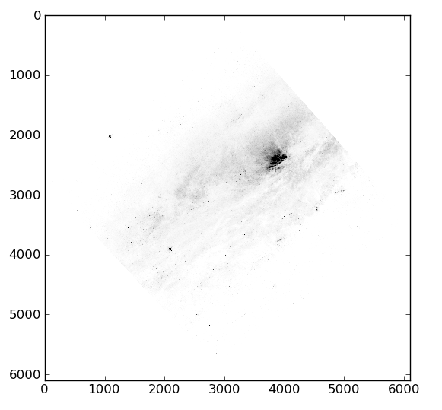
Read and Display Image
from astropy.io import fits as pyfits
import matplotlib.pyplot as plt
f = pyfits.open("HST_10915_98_ACS_WFC_F814W_drz.fits")
im = f[1].data
h = f[1].header
imgplot = plt.imshow(im)
imgplot.set_cmap("Greys")
imgplot.set_clim(0, 10)
plt.show()
Note images display upside down (odds are there is a way around this I haven’t found yet)

Slide 13
Convert galaxy center position to pixels
Gets name from SIMBAD
import astropy.coordinates as coords
m = coords.ICRSCoordinates.from_name("ngc 253")
# <ICRSCoordinates RA=11.88833 deg, Dec=-25.28806 deg>
import astropy.wcs as wcs
pixcrds = w.wcs_world2pix([[m.ra.degrees, m.dec.degrees]], 1) # 1 = FITS rather than C convention)
x,y = pixcrds[0]
In [188]: print x,y
3922.71258601 2450.46998371
Right now wcs is based on a c library, makes for a bit of an awkward interface, e.g., position ra, dec in degrees is extracted from coords object as an array with (ra, dec) and returns an array of coordinates (hence x,y = pixcrds[0])
Later wcs will be a “first-class” Python package that will take astropy coordinates

Slide 14
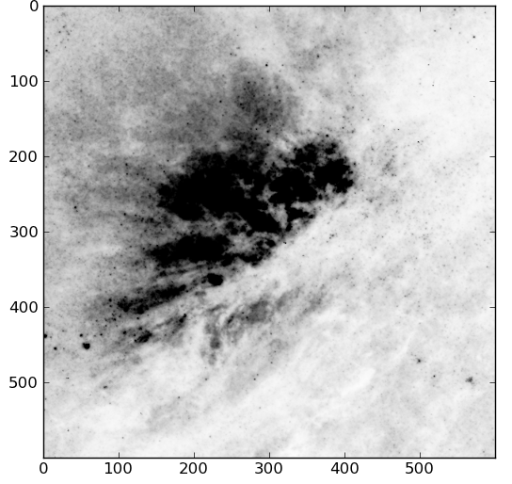
Display only small region around center
subim = im[y-300:y+300, x-300:x+300]
imgplot = plt.imshow(subim)
imgplot.set_clim(0,10)
imgplot.set_cmap("Greys")
plt.show()
N.B., y index first!

Slide 15
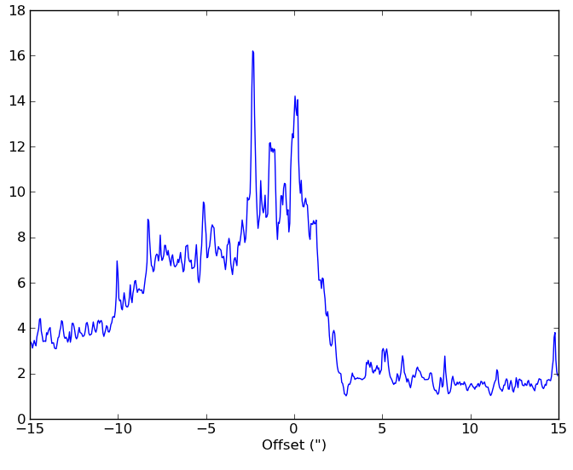
Plot pixel values in a cut through the center
Not a good approach
plate_scale = h["CD2_2"]*3600.
offset = (numpy.arange(600)-300.)*plate_scale
plot(offset, subim[300,:])
xlabel("Offset (\")")

Slide 16
pyds9
Communicates with ds9 instance using XPA
Download
http://hea-www.harvard.edu/saord/ds9/site/Download.html
Seems to have some weird conflict with pylab (import ds9 hangs when tried within “ipython –pylab”), importing ds9 first before pylab works though

Slide 17
Display image using ds9 and draw box
from ds9 import *
ds = ds9()
ds.set_pyfits(f)
reg = 'fk5; box(%f,%f,30",30",0.)' % \
(m.ra.degrees,m.dec.degrees)
# reg = fk5; box(11.888330,-25.288060,30",30",0.)
ds.set("regions", reg)

Slide 18
pyfits
ds9

Slide 19
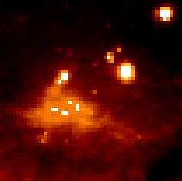
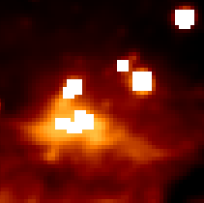
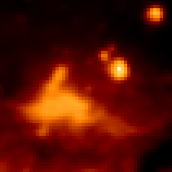
Convolution
Both scipy and astropy have convolution routines, but astropy handles Not-a-Number (NaN):
Original
SciPy
AstroPy
http://docs.astropy.org/en/latest/nddata/convolution.html

Slide 20
Potential of AstroPy (once its fully functional and operational)
Virtual Observatory queries of data (tables, images, spectra)
Tabular data from VO and/or journal papers, CDS, etc.
Automatically recognize coordinates and units
Collecting SEDs:
Some papers give fluxes, some give luminosities, some sources only have archival data
Astropy versions of common tasks like aperture photometry
Given STSci’s buy in of python and astropy, JWST analysis will probably be doable mostly or entirely in python
Model fitting
LSST processing software written in C++ with python wrappers using SWIG, some functionality may be added to astropy (maybe just as an “external library”)

