Slide 1
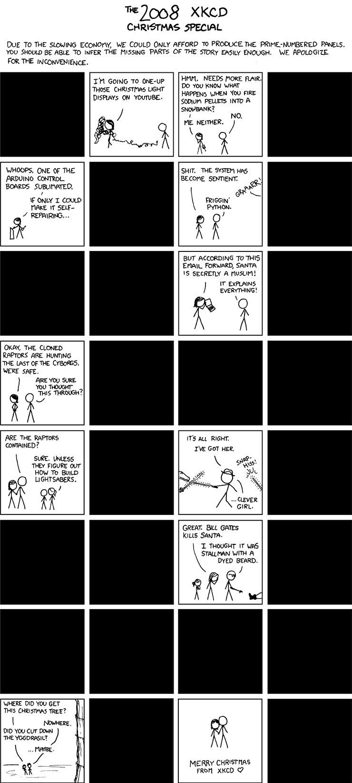
Advanced Interactions
What if we could get the code to write itself?
‘How could you possibly think typing ‘import skynet’ was a good idea?’
That’s So Meta!
Notes:
Self-generating code?

Slide 2
Lambda Functions
(anonymous functions)
from Lisp & functional programming
Allow functions to be defined without an (explicit) identifier:
>>> tmp = lambda x: x**2
>>> type(tmp)
<type 'function'>
>>> tmp(2)
4
>>> (lambda x,y: x**2+y)(2,4.5) # forget about creating a new function name...just do it!
8.5
>>> ## create a list of lambda functions
>>> lamfun = [lambda x: x**2, lambda x: x**3, \
lambda y: math.sqrt(y) if y >= 0 else "Really? I mean really? %f" % y]
>>> for i in lamfun: print i(-1.3)
1.69
-2.197
Really? I mean really? -1.300000
Practically speaking…
lambda functions are meant to be short one liners. If you need more complex functions, it’s probably better just to name them.

Slide 3
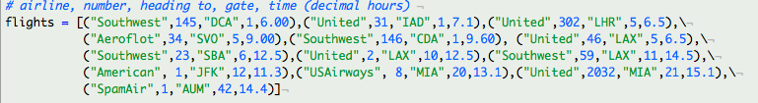
Sorting Lists
>>> help(flights.sort)
L.sort(cmp=None, key=None, reverse=False) -- stable sort *IN PLACE*; cmp(x, y) -> -1, 0, 1
>>> #sort flights by time:
>>> flights.sort(key=lambda x: x[4])
>>> flights
[('Southwest', 145, 'DCA', 1, 6.0),
('United', 302, 'LHR', 5, 6.5),
('United', 46, 'LAX', 5, 6.5),
('United', 31, 'IAD', 1, 7.1),
('Aeroflot', 34, 'SVO', 5, 9.0),
('Southwest', 146, 'CDA', 1, 9.6),
('American', 1, 'JFK', 12, 11.3),
('Southwest', 23, 'SBA', 6, 12.5),
('United', 2, 'LAX', 10, 12.5),
('USAirways', 8, 'MIA', 20, 13.1),
('SpamAir', 1, 'AUM', 42, 14.4),
('Southwest', 59, 'LAX', 11, 14.5),
('United', 2032, 'MIA', 21, 15.1)]

Slide 4
Multiple column sorting
operator.itemgetter(item[, args...])¶
Return a callable object that fetches item from its operand using the operand’s __getitem__() method. If multiple items are specified, returns a tuple of lookup values.
http://docs.python.org/library/operator.html#module-operator
>>> #sort flights by time, then number, then airline:
>>> import operator
>>>flights.sort(key=operator.itemgetter(4,1,0))
>>> flights
[('Southwest', 145, 'DCA', 1, 6.0),
('United', 46, 'LAX', 5, 6.5),
('United', 302, 'LHR', 5, 6.5),
('United', 31, 'IAD', 1, 7.1),
('Aeroflot', 34, 'SVO', 5, 9.0),
('Southwest', 146, 'CDA', 1, 9.6),
('American', 1, 'JFK', 12, 11.3),
('United', 2, 'LAX', 10, 12.5),
('Southwest', 23, 'SBA', 6, 12.5),
('USAirways', 8, 'MIA', 20, 13.1),
('SpamAir', 1, 'AUM', 42, 14.4),
('Southwest', 59, 'LAX', 11, 14.5),
('United', 2032, 'MIA', 21, 15.1)]

Slide 5
Multiple column sorting
operator.itemgetter(item[, args...])¶
Return a callable object that fetches item from its operand using the operand’s __getitem__() method. If multiple items are specified, returns a tuple of lookup values.
http://docs.python.org/library/operator.html#module-operator
>>> #sort flights by time, then number, then airline:
>>> import operator
>>>flights.sort(key=operator.itemgetter(4,1,0))
>>> flights
[('Southwest', 145, 'DCA', 1, 6.0),
('United', 46, 'LAX', 5, 6.5),
('United', 302, 'LHR', 5, 6.5),
('United', 31, 'IAD', 1, 7.1),
('Aeroflot', 34, 'SVO', 5, 9.0),
('Southwest', 146, 'CDA', 1, 9.6),
('American', 1, 'JFK', 12, 11.3),
('United', 2, 'LAX', 10, 12.5),
('Southwest', 23, 'SBA', 6, 12.5),
('USAirways', 8, 'MIA', 20, 13.1),
('SpamAir', 1, 'AUM', 42, 14.4),
('Southwest', 59, 'LAX', 11, 14.5),
('United', 2032, 'MIA', 21, 15.1)]
>>> #sort flights by time:
>>> flights.sort(key=lambda x: x[4])
>>> flights
[('Southwest', 145, 'DCA', 1, 6.0),
('United', 302, 'LHR', 5, 6.5),
('United', 46, 'LAX', 5, 6.5),
('United', 31, 'IAD', 1, 7.1),
('Aeroflot', 34, 'SVO', 5, 9.0),
('Southwest', 146, 'CDA', 1, 9.6),
('American', 1, 'JFK', 12, 11.3),
('Southwest', 23, 'SBA', 6, 12.5),
('United', 2, 'LAX', 10, 12.5),
('USAirways', 8, 'MIA', 20, 13.1),
('SpamAir', 1, 'AUM', 42, 14.4),
('Southwest', 59, 'LAX', 11, 14.5),
('United', 2032, 'MIA', 21, 15.1)]

Slide 6




filter, map, reduce, zip
Filter is a certain way to do list comprehension
filter(function, sequence) returns a sequence consisting of those items from the sequence for which function(item) is true.
>>>#Create a list for which numbers between 0 and 100 are even and divisible by 11
>>> mylist=[num for num in xrange(101) if (num % 2 == 0.0) and (num % 11 == 0.0)]
>>> print mylist
[0, 22, 44, 66, 88]
>>> def f(num): return (num % 2 == 0.0) and (num % 11 == 0.0)
>>> mylist = filter(f,xrange(101))
[0, 22, 44, 66, 88]
if the input is a string, so is the output...
>>> # also works on strings...try it with lambdas!
>>> a="Charlie Brown said \"!@!@$@!\"” ; a
'Charlie Brown said "!@!@$@!"'
>>> # Get just the alphabetical characters:
>>> import string
>>> filter(lambda c: c in string.ascii_letters,a)
'CharlieBrownsaid’

Slide 7
Iterable xrange()
xrange() is an iterable version of range():
range(10) creates a 10-element list,
xrange(10) creates an iterable object which returns 0 the first time it’s called, 1 the next time, etc.
Computational advantage?
Time how long it takes with the ipython magic %timeit:
>>> def f(num): return (num % 2 == 0.0) and (num % 11 == 0.0)
>>> %timeit len(filter(f,range(1L)))
100000 loops, best of 3: 5.63 us per loop
>>> %timeit len(filter(f,xrange(1L)))
100000 loops, best of 3: 4.94 us per loop
>>> # try more
>>> %timeit len(filter(f,range(10000000L)))
1 loops, best of 3: 5.2 s per loop
>>> %timeit len(filter(f,xrange(10000000L)))
1 loops, best of 3: 4.33 s per loop
Note: xrange (like range) can be reversed
>>> for i in reversed(xrange(1,10,2)): print i,
9 7 5 3 1

Slide 8
filter, map, reduce, zip
Map is just another way to do list comprehension
map(function, sequence) calls function(item) for each of the sequence's items and returns a list of the return values
>>> def cube_it(x): return x**3
>>> map(cube_it, xrange(1,10))
[1, 8, 27, 64, 125, 216, 343, 512, 729]
>>> map(lambda x: x**3, xrange(1,10))
[1, 8, 27, 64, 125, 216, 343, 512, 729]
Reduce returns one value
reduce(function, sequence) returns a single value constructed by calling the binary function function on the first two items of the sequence, then on the result and the next item, and so on:
>>> reduce(lambda x,y: x + y, xrange(1,11)) # sum from 1 to 10
55
>>> %timeit reduce(lambda x,y: x + y, xrange(1,11))
100000 loops, best of 3: 2.18 us per loop
>>> %timeit sum(xrange(1,11)) # sum() is a built in function...it’s bound to be faster
1000000 loops, best of 3: 655 ns per loop

Slide 9
filter, map, reduce, zip
zip()
built in function to pairwise concatenate items in iterables into a list of tuples
>>> zip(["I","you","them"],["=spam","=eggs","=dark knights"])
[('I', '=spam'), ('you', '=eggs'), ('them', '=dark knights')]
>>> zip(["I","you","them"],["=spam","=eggs","=dark knights"],["!","?","#"])
[('I', '=spam', '!'), ('you', '=eggs', '?'), ('them', '=dark knights', '#')]
>>> zip(["I","you","them"],["=spam","=eggs","=dark knights"],["!","?"])
[('I', '=spam', '!'), ('you', '=eggs', '?')]
>>> questions = ['name', 'quest', 'favorite color']
>>> answers = ['lancelot', 'the holy grail', 'blue']
>>> for q, a in zip(questions, answers):
... print 'What is your %s? It is %s.' % (q, a)
What is your name? It is lancelot.
What is your quest? It is the holy grail.
What is your favorite color? It is blue.
not to be confused with zipfile module which exposes file compression

Slide 10

Try/Except/Finally
Billy: Let's keep going with "Airplanes", for $200.
Bobby Wheat: "Airplanes" for $200: "And what is the Deal With the Black Box?" [ Tommy buzzes in ] Tommy!
Tommy: It's the only thing that survives the crash - why don't they build the whole plane out of the Black Box!
http://snltranscripts.jt.org/91/91rstandup.phtml
Notes:
two perfectly fine ways of doing this!

Slide 11
Wrap volatile code in try/except/finally
>>> tmp = raw_input("Enter a number and I'll square it: ")
>>> print float(tmp)**2
Enter a number and I'll square it: monty
ValueError: invalid literal for float(): monty
Python error generates an “exception”
instead....
try:
tmp = raw_input("Enter a number “ + \
and I'll square it: ") print float(tmp)**2
except:
print "dude. I asked you for a number and " + \
"%s is not a number." % tmp
finally:
print "thanks for playing!"
volatile stuff!
upon error, jump here inside except and execute that code
regardless of whether you hit an error, execute everything inside the finally block

Slide 12
Wrap volatile code in try/except/finally
>>> tmp = raw_input("Enter a number and I'll square it: ")
>>> print float(tmp)**2
Enter a number and I'll square it: monty
ValueError: invalid literal for float(): monty
instead....
>>> def f():
try:
tmp = raw_input("Enter a number and I'll square it: ")
print float(tmp)**2
except:
print "dude. I asked you for a number and %s is not a number." % tmp
finally:
print "thanks for playing!"
>>> f()
Enter a number and I'll square it: 3
9.0
thanks for playing!
>>> f()
Enter a number and I'll square it: monty
dude. I asked you for a number and monty is not a number.
thanks for playing!

Slide 13
exec & eval
exec executes strings as if they were Python code
>>> a = "print 'checkit' "
>>> exec a
Checkit
>>> a = "x = 4.56"
>>> exec a
>>> print x
4.56
>>> exec "del x"
>>> print x
------------------------------------------------------------
Traceback (most recent call last): File "<ipython console>", line 1, in <module>NameError: name 'x' is not defined
dynamically create Python code (!)
execute that code w/ implication for current namespace

Slide 14
exec & eval
>>> import math
>>> while True:
bi = raw_input("what built in function would you like me to coopt? ")
nn = raw_input("what new name would you like to give it? ")
exec "%s = %s" % (nn,bi)
what built in function would you like me to coopt? math.sin
what new name would you like to give it? monty_sin
what built in function would you like me to coopt? Range
what new name would you like to give it? python_range
>>> monty_sin (math.pi/2)
1.0
>>> python_range(3)
[0, 1, 2]

Slide 15
exec & eval
eval evaluates strings as Python expressions
>>> x = eval('5') ; x
5
>>> x = eval('%d + 6' % x) ; x
11
>>> x = eval('abs(%d)' % -100) ; x
100
>>> x = eval('print 5')
# INVALID: print is a statement, not an expression (in Python 2.x).
------------------------------------------------------------
File "<string>", line 1
print 5
^SyntaxError: invalid syntax
>>> exec "print 5”
5
>>> x = eval('if 1: x = 4')
# INVALID: if is a statement, not an expression.
------------------------------------------------------------
File "<string>", line 1
if 1: x = 4
^SyntaxError: invalid syntax
>>> exec 'if True: x=4’ ; x
4

Slide 16
Breakout
Write a code which generates python code that approximates the function x² + x in the range [-3, 3] using the given vocabulary.
hints:
Randomly generate lambda functions using a restricted vocabulary:
vocab =["x","x"," ","+","-","*","/","1","2","3"]
Evaluate these lambda functions at a fixed number of x values and save the difference between those answers and x² + x.
Catch errors!

Slide 17
import random
import numpy
vocab = ["x","x","","+","-","*","/","1","2","3"]
max_try = 1000000
max_chars = 10 #max number of characters to generate
x_array = numpy.arange(-3,3,0.4)
real_function = x_array**2 + x_array
tries = []
for loop...

Slide 18
‘How could you possibly think typing ‘import skynet’ was a good idea?’
Notes:
Self-generating code?

Slide 19
Notes:
Self-generating code?

Slide 20
skynet
Notes:
Self-generating code?

Slide 21

Advanced Interactions

Slide 22


Slide 23
Notes:
http://www.youtube.com/watch?v=JhwJUw9kJuU&feature=player_embedded#!

Slide 25
Sorting lists
>>> help(flights.sort)
L.sort(cmp=None, key=None, reverse=False) -- stable sort *IN PLACE*; cmp(x, y) -> -1, 0, 1
>>> #sort flights by time:
>>> flights.sort(key=lambda x: x[4])
>>> flights
ights.sort(key=lambda x: x[4]) flights

Slide 26
Wrap volatile code in try/except/finally
>>> tmp = raw_input("Enter a number and I'll square it: ")
>>> print float(tmp)**2
Enter a number and I'll square it: monty
ValueError: invalid literal for float(): monty
instead....
>>> def f():
try:
tmp = raw_input("Enter a number and I'll square it: ")
print float(tmp)**2
except:
print "dude. I asked you for a number and %s is not a number." % tmp
finally:
print "thanks for playing!"
>>> f()
Enter a number and I'll square it: 3
9.0
thanks for playing!
>>> f()
Enter a number and I'll square it: monty
dude. I asked you for a number and monty is not a number.
thanks for playing!

Slide 27
Wrap volatile code in try/except/finally
try:
tmp = raw_input("Enter a number “ + \
and I'll square it: ") print float(tmp)**2
except:
print "dude. I asked you for a number and " + \
"%s is not a number." % tmp
finally:
print "thanks for playing!"
volatile stuff!
upon error, jump here inside except and execute that code
regardless of whether you hit an error, execute everything inside the finally block

Slide 28
errors in Python generate what are called “exceptions”
exceptions can be handled differently depending on what kind of exception they are. (we’ll see more of that later)
except “catches” these exceptions
you do not have to catch exceptions (try/finally) is allowed. Finally block is executed no matter what!
>>> try:
print "eat at" % joes
finally:
print "bye."
bye.
------------------------------------------------------------
Traceback (most recent call last): File "<ipython console>", line 2, in <module>NameError: name 'joes' is not defined

