Slide 1
EIGENFACES
Face Compression & Recognition — PCA from Scratch with NumPy
Mathematics Project · Machine Learning Bootcamp
Team 01 — Compression & Reconstruction
github.com/kian4A/bootcamp_ML · math_handsOn
EIGENFACES · TEAM 01
01 / 15
Notes:
Team 01 of the mathematics project. Everything here is PCA written from scratch with NumPy; scikit-learn only loads the Olivetti dataset and computes the final classification metrics.

Slide 2
PROBLEM STATEMENT
Can a 64 × 64 face be described by only k numbers?
Every image is a point in a 4096-dimensional pixel space, but real faces do not fill that space — they cluster on a much smaller set of shared directions of variation. PCA learns those directions, called eigenfaces, from the training images only. A face is then described by its coordinates along the first k of them, and those coordinates must still support both reconstruction and identity recognition.
64²
4096
40
400
pixels per image
feature dimension d
identities
grayscale images
OLIVETTI FACES DATASET
10 images per identity, already cropped and aligned, loaded through fetch_olivetti_faces. Every pixel value is a float in [0, 1], so the mean squared errors reported later are on that same scale.
Symbols: k = number of principal components (eigenfaces) retained · d = feature dimension of one image = 4096 pixels
EIGENFACES · TEAM 01
02 / 15
Notes:
The central question from the project brief. Each image is 4096 numbers; PCA asks how few coordinates can stand in for them.

Slide 3
PROJECT ROADMAP
Three Phases, Fifteen Steps
PHASE 1
PHASE 2
PHASE 3
Data Preparation
Subspace Learning
Evaluation
Load the data and inspect shapes
Shuffle each identity with seed 42
Build five rotating 70/10/20 folds
Vectorise images into 4096-d rows
Centre with the TRAIN mean only
Build the covariance matrix C
Eigendecomposition via np.linalg.eigh
Sort eigenvectors by eigenvalue ↓
Project onto the first k eigenfaces
Reconstruct and inspect visually
Reconstruction MSE across k
Cumulative explained variance
Elbow and silhouette candidates
KNN recognition in PCA space
Five-fold cross-validated test scores
GOLDEN RULE
No step is reordered. The mean face, the eigenfaces and every learned parameter come from the training images of that fold only. Each fold's test images are touched after k and n_neighbors are already frozen on validation — no data leakage.
Symbols: k = number of principal components retained · C = sample covariance matrix of the centred training data · n_neighbors = number of training faces that vote in the KNN decision
EIGENFACES · TEAM 01
03 / 15
Notes:
The nine required steps, grouped into three phases. Order matters: the mean and the eigenface basis are learned from training data only.

Slide 4
TEAM 01 MISSION
Compression & Reconstruction — The Core Algebra
HYPOTHESIS
CORE MATH
Reconstruction error falls as more components are kept, but past some point each additional component buys very little. The task is to locate that point and justify it.
μ = (1/N) Σ xᵢ
training mean face
X_c = X − μ
mean-centred data
TESTED COMPONENT GRID
C = X_cᵀ X_c / (N − 1)
k ∈ { 1, 5, 10, 20, 50, 100, 150, 250 }
sample covariance matrix
Z = (X − μ) U_k
Deliverables: an error curve and a cumulative-variance curve, an original-vs-reconstructed row across k, and a justified recommendation for k.
projection onto the top-k eigenfaces
X̂ = Z U_kᵀ + μ
reconstruction from the k-dim code
Symbols: N = number of training images in the fold (280) · xᵢ = i-th training image as a 4096-vector · μ = training mean face · X = matrix of image rows · X_c = centred data · C = covariance matrix · U_k = first k sorted eigenvectors (the eigenfaces) · Z = k-dimensional code · X̂ = reconstructed images · k = components retained
EIGENFACES · TEAM 01
04 / 15
Notes:
The whole pipeline in five lines of algebra. U_k is orthonormal, which is why reconstruction error can never grow when k grows.

Slide 5
PHASE 1 · PROTOCOL
Evaluation Protocol — Five Rotating 70 / 10 / 20 Folds
Each identity's 10 images are shuffled with seed 42 and cut into five pairs. In round f the f-th pair becomes that round's test pair; the next pair, (f+1) mod 5, contributes one validation image and one training image; the remaining three pairs train.
FOLD LAYOUT — ROWS ARE ROUNDS, COLUMNS ARE IMAGE PAIRS
R1
test
val + train
train
train
train
R2
train
test
val + train
train
train
Across the five rounds every one of the 400 images is tested exactly once. The test set rotates rather than being a permanent holdout, so a lucky or unlucky draw of two images per person can no longer decide the reported score on its own.
R3
train
train
test
val + train
train
R4
train
train
train
test
val + train
R5
val + train
train
train
train
test
Sections 2–8 of the notebook illustrate fold 1 and compare parameters on validation. Section 9 repeats the whole procedure inside each fold, refitting the mean and the eigenfaces on that fold's training images.
train / round
validation
test / round
shuffle seed
280
40
80
42
Assertions in the code confirm the three index sets never intersect and that the five test sets together cover all 400 images exactly once.
Symbols: f = fold index, 0 … 4 · seed = fixed random-number seed controlling the shuffle (42) · 70 / 10 / 20 = share of each identity's images used for training, validation and test in one round
EIGENFACES · TEAM 01
05 / 15
Notes:
This is the biggest change from the previous version of the deck. The single fixed 8/2 split was replaced by five rotating folds, so every image is tested exactly once and parameters are chosen on validation, never on test.

Slide 6
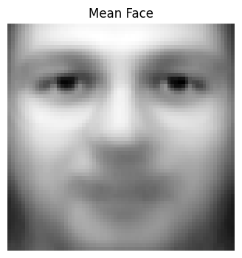
PHASE 1 · DATA PREPARATION
Dataset & Mean Face
Total images
400 grayscale, 64 × 64
Identities
40 people, 10 images each
Vector dimension
4096 pixels per image
Split per round
280 train / 40 validation / 80 test
Rounds
5 rotating folds, every image tested once
Mean face μ
computed from the 280 training rows only
Per-pixel variance: 0.01931817 before centring → 0.01931817 after
Mean face μ, reshaped to 64 × 64
Detail is blurred because expression, lighting and pose vary across the training set.
Symbols: μ = training mean face, a 4096-vector · X_c = X − μ, the mean-centred training matrix · N = 280 training images in this fold
EIGENFACES · TEAM 01
06 / 15
Notes:
The mean face is the pixel-wise average of the 280 training images of fold 1. Centering shifts each pixel column without changing its spread — the printed variances match to eight digits, which is a correctness check.

Slide 7
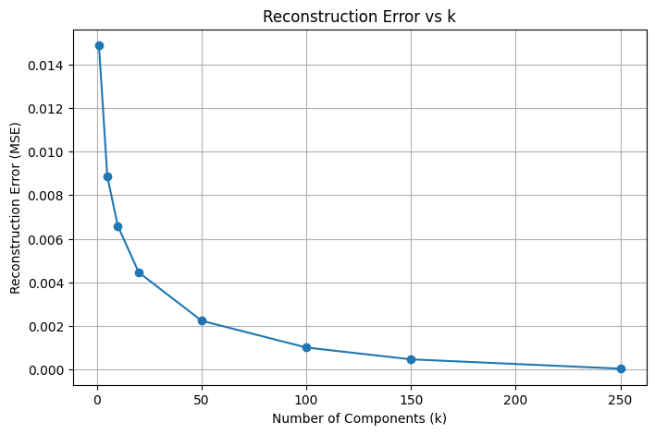
PHASE 3 · EVALUATION
Reconstruction Error — Mean Squared Error vs k
METRIC
MSE = (1 / n·d) Σᵢ Σⱼ (Xᵢⱼ − X̂ᵢⱼ)²
MSE measures the pixel-by-pixel distance between an image and its reconstruction, unlike explained variance, which only reports how much of the signal energy the retained directions carry.
Because the PCA basis is orthonormal, error can never increase as k grows — a useful correctness check on the implementation. These values are measured on the training images, so they describe how well the learned subspace represents the training set itself.
k = 1
k = 50
k = 250
0.014864
0.002239
0.0000402
Symbols: MSE = mean squared error · n = number of images scored · d = 4096 pixels per image · i = image index, j = pixel index · X = original pixel values, X̂ = reconstructed pixel values · k = components retained
EIGENFACES · TEAM 01
07 / 15
Notes:
Updated numbers from the current run. With 280 training images the rank limit is 279, so k = 250 is now inside the valid range and is no longer filtered out of the grid.

Slide 8
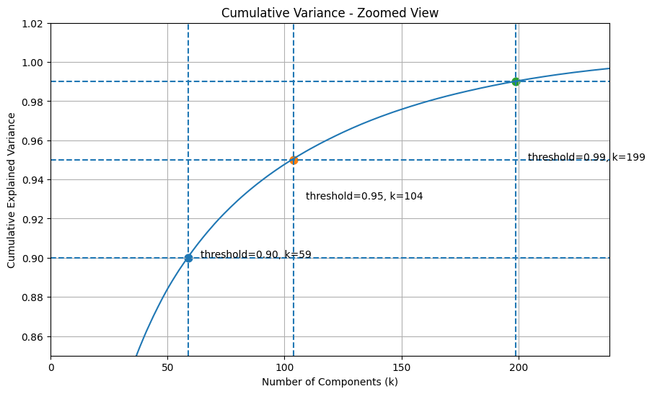
PHASE 3 · EVALUATION
Cumulative Explained Variance
DEFINITION
V(k) = (λ₁ + … + λₖ) / (λ₁ + … + λ_d)
Eigenvalues are sorted from largest to smallest, so V(k) rises steeply at first and then flattens. The ten leading eigenvalues run 18.31, 11.39, 6.25, 4.13, 2.93, 2.62, 1.96, 1.73, 1.59, 1.41.
90 %
95 %
99 %
k = 59
k = 104
k = 199
With 280 centred training images, at most 279 directions carry non-zero variance. Retained variance is not accuracy: 95 % explained variance does not imply 95 % recognition.
Symbols: λⱼ = j-th eigenvalue, the variance along eigenvector j · V(k) = share of total training variance carried by the first k components · k = components retained · d = 4096 pixels per image
EIGENFACES · TEAM 01
08 / 15
Notes:
New slide. The eigenvalue spectrum answers a different question from MSE: how much of the training variance the first k directions carry. Note that these thresholds land far above the k the elbow and silhouette methods pick.

Slide 9
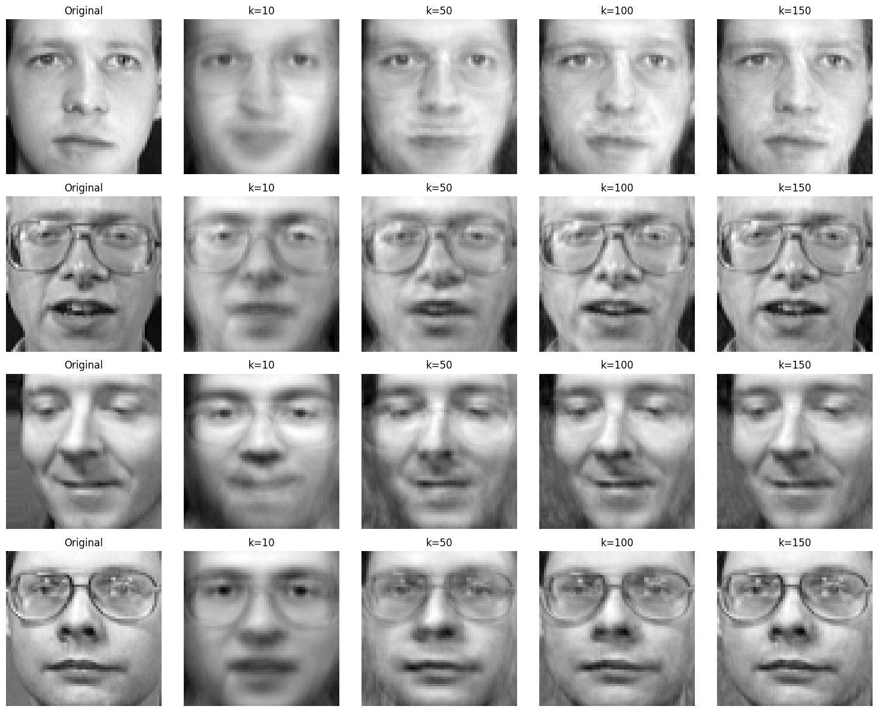
VISUAL VALIDATION
Original vs. Reconstructed Faces
WHAT TO LOOK FOR
k = 10 keeps the broad face shape and lighting but loses identity-specific detail.
k = 50 recovers glasses frames, eye shape and mouth line — this is where faces become individually recognisable.
k = 100 and k = 150 mainly sharpen texture; the perceptual gain over 50 is small.
This mirrors the MSE curve: the steep part of the drop is over well before k = 100.
Rows: 4 identities · Columns: original, then k = 10, 50, 100, 150. Training images.
Symbols: k = number of principal components used to encode and then reconstruct the image
EIGENFACES · TEAM 01
09 / 15
Notes:
Four identities, one training image each. Ten components already give a recognisable person; glasses frames and mouth detail only sharpen from about 50 onwards.

Slide 10
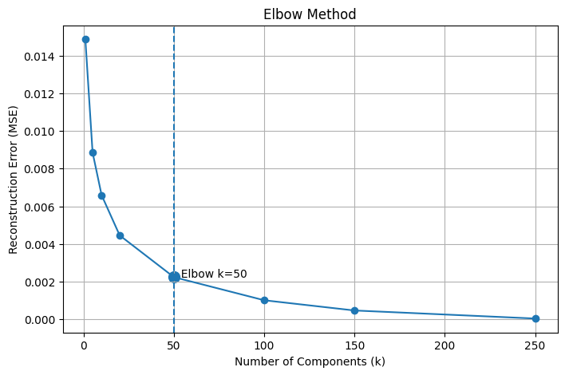
SELECTING K · METHOD 1
Elbow (Knee) Method — Reconstruction-Based
HOW IT WORKS
A straight line is drawn between the first and last point of the error curve. The perpendicular distance from every sampled point to that line is computed, and the k with the largest distance is the elbow — where the steep decline turns into a slow one.
The result is a candidate, not a proven optimum: it depends on which k values were sampled and on the scale of the axes. It should be read alongside the reconstructed images and the variance curve rather than on its own.
Elbow k
50
Symbols: k = number of principal components retained · MSE = mean squared reconstruction error on the training images
EIGENFACES · TEAM 01
10 / 15
Notes:
The elbow is a geometric heuristic on the sampled points, not an optimum. It still returns 50 under the new split.

Slide 11
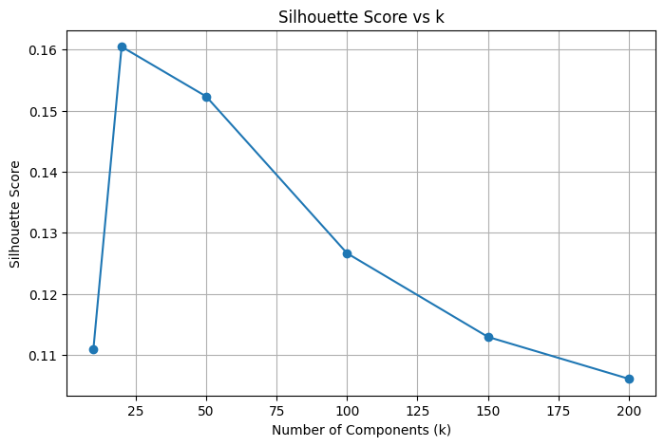
SELECTING K · METHOD 2
Silhouette Score — Identity-Separation Based
HOW IT WORKS
Unlike the elbow method this needs the true identity labels; it runs no clustering. For each projected training image i:
s(i) = ( b(i) − a(i) ) / max( a(i), b(i) )
A score near 1 means identities are well separated; near 0 means they overlap; a negative score means the face sits closer on average to another person's group. The mean score peaks at k = 20 (0.1605) and declines to 0.1061 at k = 200 — extra components add pixel detail, not separation.
Silhouette k
20
Symbols: i = index of one projected training image · a(i) = mean distance from image i to the other images of the same identity · b(i) = smallest mean distance from image i to any other identity's group · s(i) = silhouette score of image i · k = components retained
EIGENFACES · TEAM 01
11 / 15
Notes:
Silhouette uses the true identity labels and measures class geometry, not pixel error. It peaks at 20 and then falls steadily, which is the opposite trend to explained variance.

Slide 12
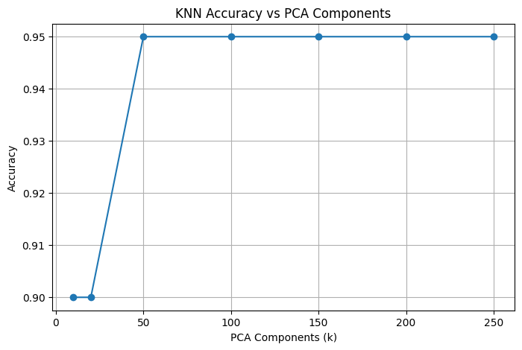
RECOGNITION
KNN Accuracy in PCA Space — Fold 1 Validation
METRICS USED
Accuracy
share of validation images given the correct identity
Precision (weighted)
of the predictions made for an identity, the share that were right
Recall (weighted)
of an identity's true images, the share that were found
F1-score (weighted)
harmonic mean of precision and recall
1-NN reaches 0.900 at k = 10 and k = 20 and saturates at 0.950 from k = 50 onward. The k = 50, n_neighbors = 3 baseline scores 0.800 — the neighbour count matters more than the component count here.
Because the task is single-label over 40 classes, weighted recall equals accuracy — matching columns are a correctness check, not a coincidence.
Symbols: k = number of PCA components used to represent each face · n_neighbors = number of training faces that vote on one query · accuracy, precision, recall and F1 are fractions between 0 and 1
EIGENFACES · TEAM 01
12 / 15
Notes:
All recognition numbers on this slide are validation numbers from fold 1, with 40 validation images. Test images are not used for any parameter comparison.

Slide 13
PHASE 3 · CROSS-VALIDATION
Five-Fold Results — Selection on Validation, Scoring on Test
Fold | Selected k | n_neighbors | Validation acc. | Test acc.
1 | 150 | 1 | 0.9625 | 0.9375
2 | 100 | 1 | 0.8625 | 0.9375
3 | 100 | 1 | 0.9000 | 0.8750
4 | 50 | 1 | 0.9250 | 0.8625
5 | 20 | 1 | 0.8750 | 0.9000
WHAT THE FOLDS SHOW
Every fold selects n_neighbors = 1. The voting size is the stable parameter.
The selected k swings from 20 to 150 across folds — k is not stable, and any single recommended value carries real uncertainty.
Validation accuracy is not a reliable predictor of test accuracy: fold 2 has the worst validation score and ties for the best test score.
The five folds share training images, so the standard deviation describes spread, not a confidence interval.
Test scores were never used to retune anything.
mean test accuracy
sample sd across folds
pooled out-of-fold F1
0.9025
± 0.0347
0.9006
Pooled over all 400 out-of-fold predictions: accuracy 0.9025, weighted precision 0.9098, weighted recall 0.9025.
Symbols: k = PCA components selected on validation inside the fold · n_neighbors = neighbours voting in KNN · sd = sample standard deviation over the five test scores. Note: this cell was last executed under the earlier 60/20/20 configuration (240/80/80 per fold); re-run the notebook end to end to refresh these figures for the current 280/40/80 split.
EIGENFACES · TEAM 01
13 / 15
Notes:
The headline result. Parameters are chosen on validation inside each fold, then frozen before the test images of that fold are scored. Read the standard deviation as a spread, not a confidence interval, because the folds share training data.

Slide 14
ENGINEERING TRADE-OFF
Computational Complexity in k
Stage | Time complexity | Effect of increasing k
Projection (train + query) | O(n · d · k) | Linear growth
Reconstruction | O(n · d · k) | Linear growth
KNN distance per query | O(n_train · k) | Slower search
Stored codes (memory) | O(n · k) | More memory
Eigendecomposition | O(d³), once per fold | Independent of k
The eigendecomposition of the 4096 × 4096 covariance matrix does not depend on k, but under five-fold cross-validation it is now performed five times instead of once. The cost of using the model — projecting a query and searching the training codes — grows linearly in k, with n_train = 280 per fold. Choosing k is therefore a trade-off between reconstruction quality and compute and memory cost.
Symbols: n = number of images processed at that stage · n_train = training images available in one fold (280) · d = 4096 pixels per image · k = number of principal components retained
EIGENFACES · TEAM 01
14 / 15
Notes:
Choosing k is not only a quality decision. Projection, reconstruction and every KNN query scale linearly in k, and the eigendecomposition now runs once per fold rather than once in total.

Slide 15
CONCLUSION
Choosing k — Three Criteria, One Recommendation
Elbow Method
Silhouette Score
Cross-Validation
Reconstruction-based (MSE)
Identity-separation based
Validation accuracy per fold
k = 50
k = 20
k = 20 – 150
Best balance between code size and pixel-level reconstruction quality.
The leading directions already separate identities; later ones add pixel detail, not separability.
Selected k is unstable across folds; every fold agrees only on n_neighbors = 1.
Recommended range: k ∈ [20, 50]. This is where the elbow, the silhouette peak and the saturation point of 1-NN validation accuracy meet. Going to k = 200 or 250 raises projection, search and memory cost without a measurable gain in recognition.
Honest limitation: with 7 training images per identity and folds that overlap in training data, the selected k varies from 20 to 150 across the five rounds. Cross-validated test accuracy is 0.9025 ± 0.0347, so the range above should be read as a defensible choice, not a proven optimum.
Symbols: k = number of principal components retained · n_neighbors = number of training faces voting in KNN · 1-NN = KNN with n_neighbors = 1 · MSE = mean squared reconstruction error
EIGENFACES · TEAM 01
15 / 15
Notes:
Close on the honest version: three criteria disagree, and the cross-validation says the neighbour count is what is really stable. Recommend a range rather than a single number.

