Slide 1

Movie Recommender System
Final Project for MATE-T580
Kiana Montazeri*, Zhou Yimai*
*Drexel University, Philadelphia, PA

Slide 2

Motivation
Recommending and personalization are important approaches to combating information over-load.
Machine Learning is an important part of systems for these tasks.
Recommenders have been shown to substantially increase sales at on-line stores.

Slide 3
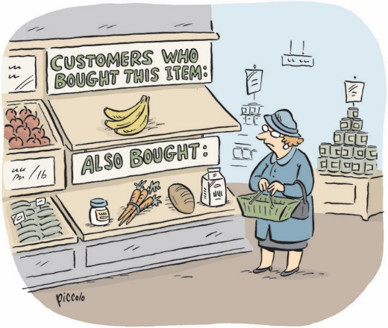
Methods : Collaborative Filtering
Aggregation of consumers’ preferences and recommendations to other users based on similarity in behavioral patterns
Maintain a database of many users’ ratings of a variety of items.
For a given user, find other similar users whose ratings strongly correlate with the current user.
Recommend items rated highly by these similar users, but not rated by the current user.
Almost all existing commercial recommenders use this approach (e.g. Amazon).

Slide 4

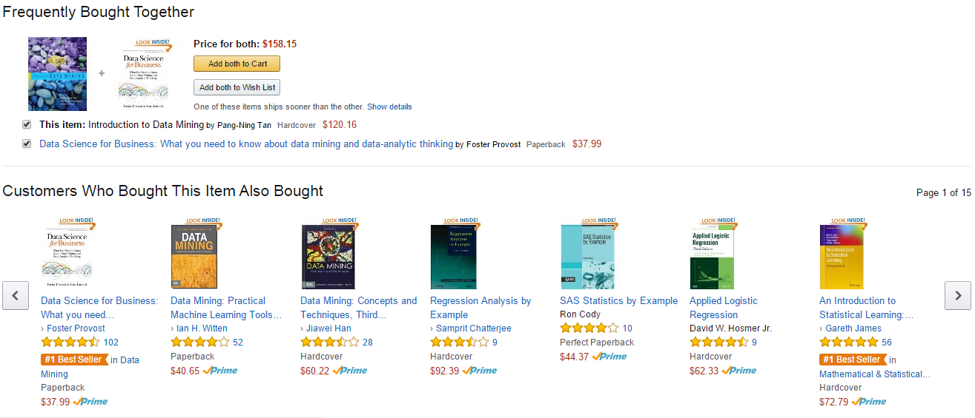

Slide 5
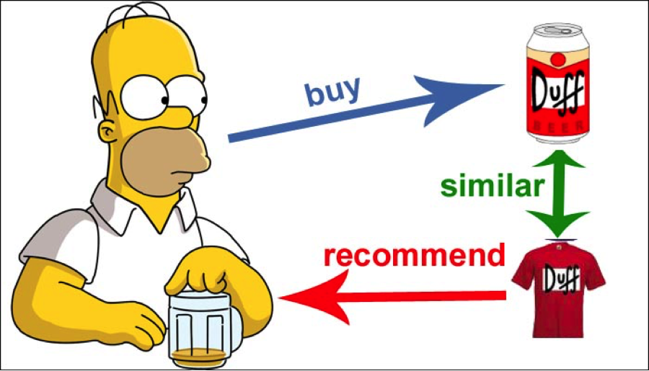
Methods : Content-Based
supervised machine learning used to induce a classifier to discriminate between interesting and uninteresting items for the user
Recommendations are based on information on the content of items rather than on other users’ opinions.
Uses a machine learning algorithm to induce a profile of the users preferences from examples based on a featural description of content.

Slide 6
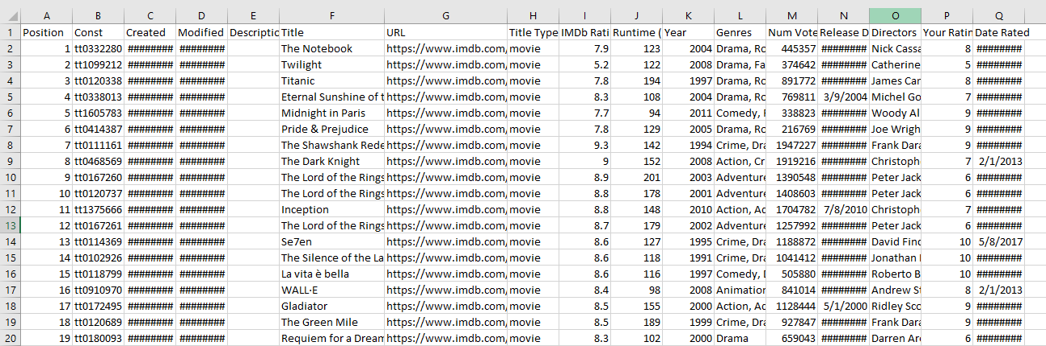
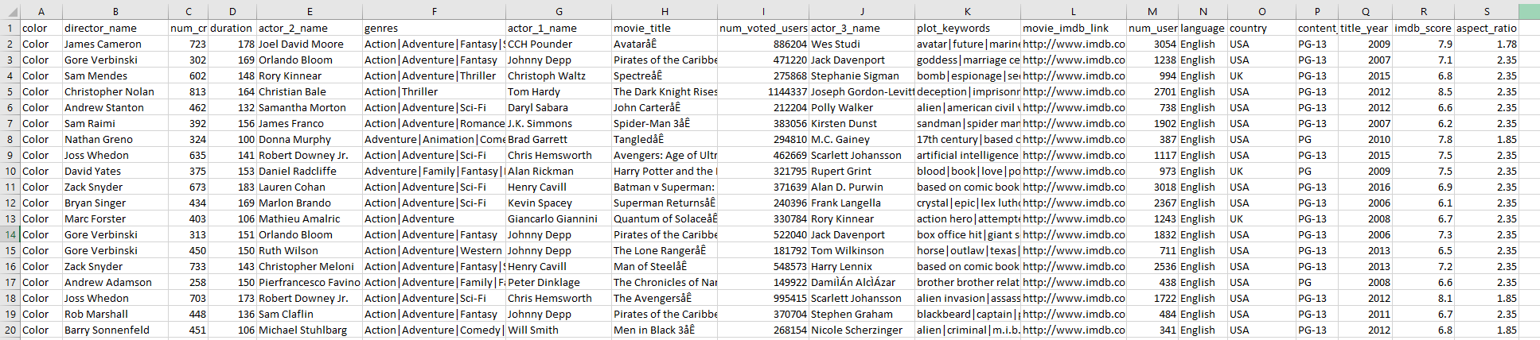
Recommender: Datasets
Watch-list:
Training + Validation
IMDB Movies

Slide 7
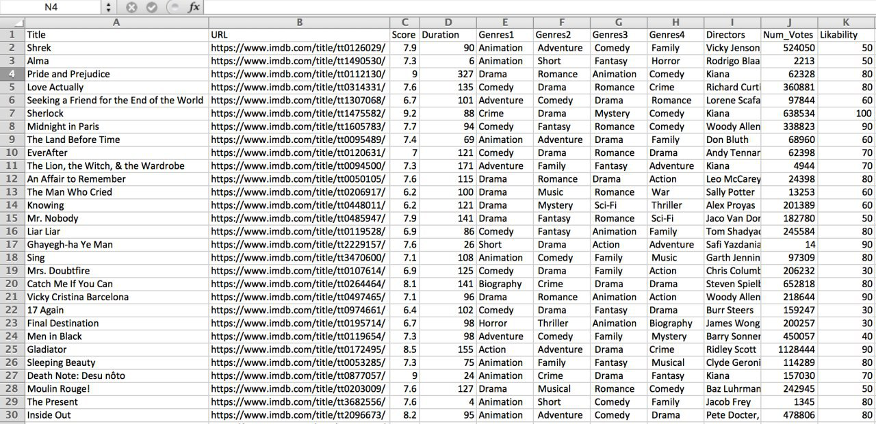
Cleaning the Data
IMDB Movies
Watch-List
Renaming the columns
Separating the Genres
Fixing the missing values
Fixing the Errors

Slide 8
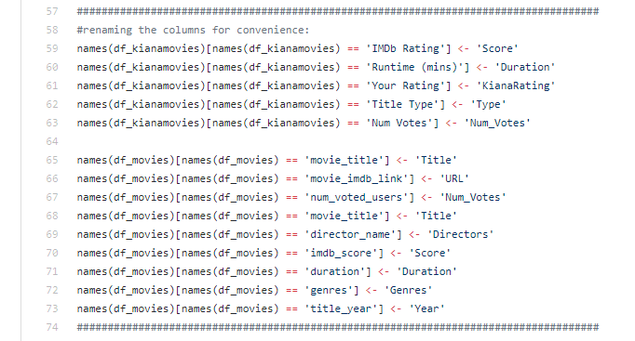



Cleaning the Data
Renaming the columns
Separating the Genres
Fixing the missing values
Fixing the Errors

Slide 9
Recommender: Strategy
a)
Model
Accuracy = 33 %
Training Set
Validation Set
Accuracy = 32 %
Watch-list
Validation Set
b)
Model
Accuracy = 32 %
IMDB Movies
Recommendations

Slide 10
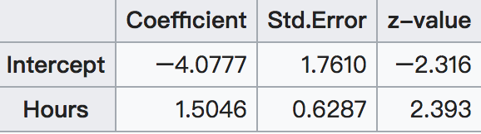
Regression Models
20 students spend (0 ~ 6H )studying for an exam. How does the number of hours spent studying affect the probability that the student will pass the exam?
Hour | 0.5 | 0.75 | 1.00 | 1.25 | 1.5 | 1.75 | 2.00
Pass | 0 | 0 | 0 | 0 | 0 | 0 | 1
Hour | 2.75 | 3.00 | 3.25 | 3.50 | 4.00 | 4.25 | 4.75
Pass | 1 | 0 | 1 | 0 | 1 | 1 | 1
A logistic model is one where the log-odds of the probability of an event is a linear combination of independent or predictor variables
Dependent value {y=1} as event y occurs, {y=0} as event y not occurs.
The model itself simply models probability of output in terms of input.
Eg.
Using simple regression analysis, we can get that follow and graph.
In R, the logistic regression is performed with the glm function, Dealing with multi-classes, using glmnet

Slide 11
Random Forest
Random forests or random decision forests are an ensemble learning method for classification, regression and other tasks, that operate by constructing a multitude of decision trees at training time and outputting the class that is the mode of the classes (classification) or mean prediction (regression) of the individual trees
Size of the sample (number of observations)
The random forest has additional hyperparameters related to the boosting method
The most significant advantage of using the random forest approach is that it can obtain more information to reduce the fitting value and estimate the deviation of the segmentation.
The R packages random Forest and ranger offer alternative implementations of the random forest algorithm
Number of variables included in the sample
Number of trees to build (default = 500)

Slide 12
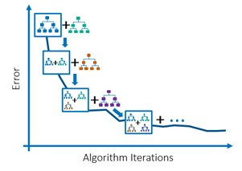
Extreme Gradient Boosting Trees
Prediction model in the form of an ensemble of weak prediction models
A certain level of error can serve as a base learner .
It can be improved by iteratively adding models that compensate for the error (Boosting).
Each added model is trained to minimize the error by searching in the negative gradient direction.
Gradient Boosting
Builds the model in a stage-wise fashion
Optimizes an arbitrary differentiable loss function

Slide 13
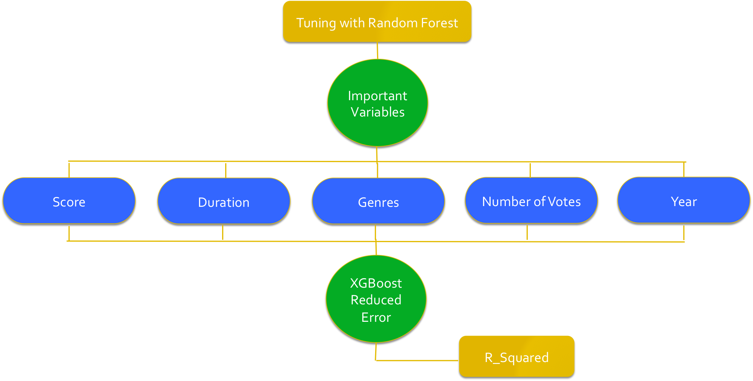

Approach
$$R^{2}=0.33$$

Slide 14
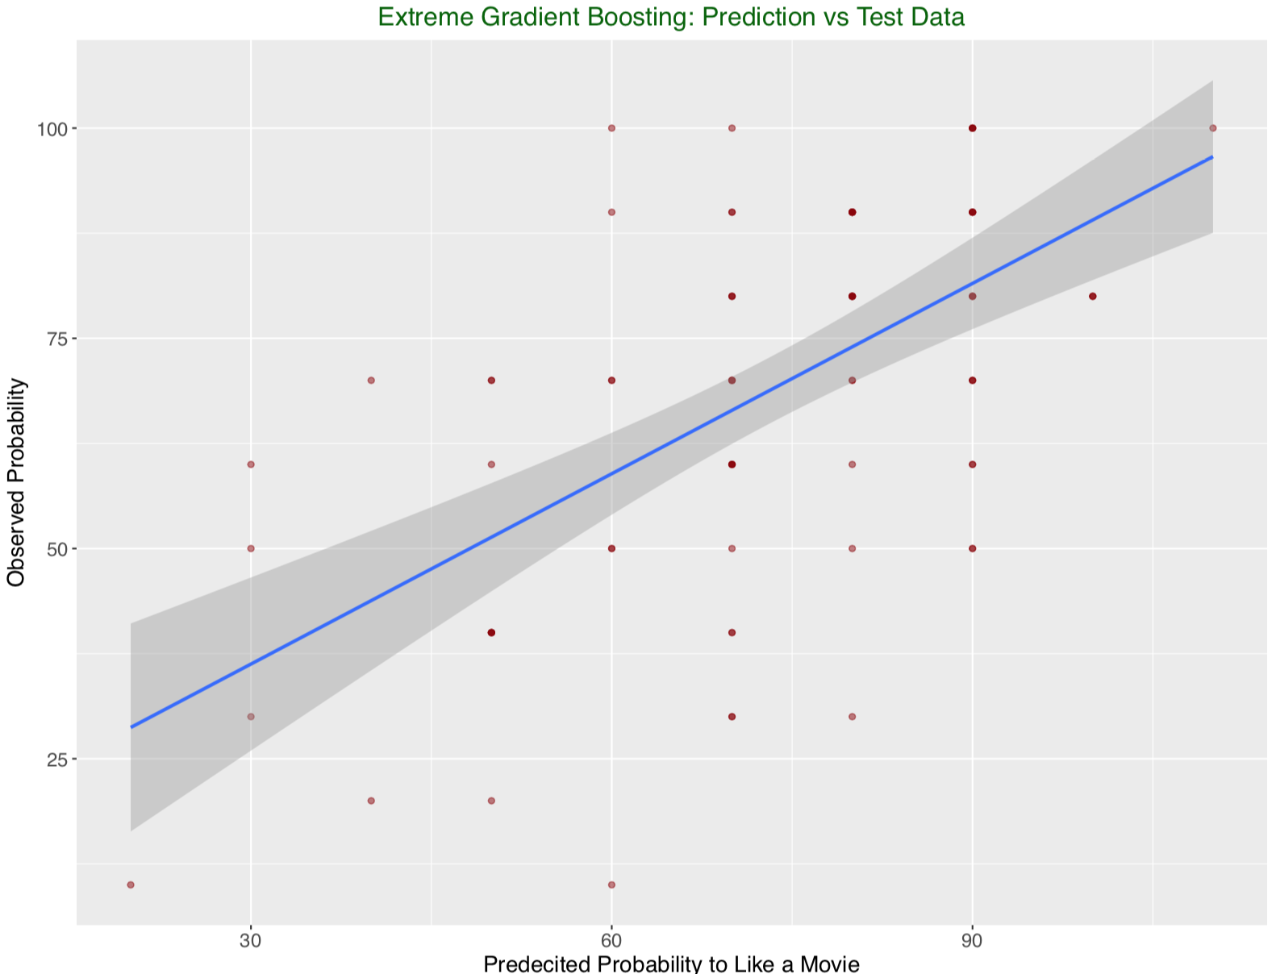

Slide 15
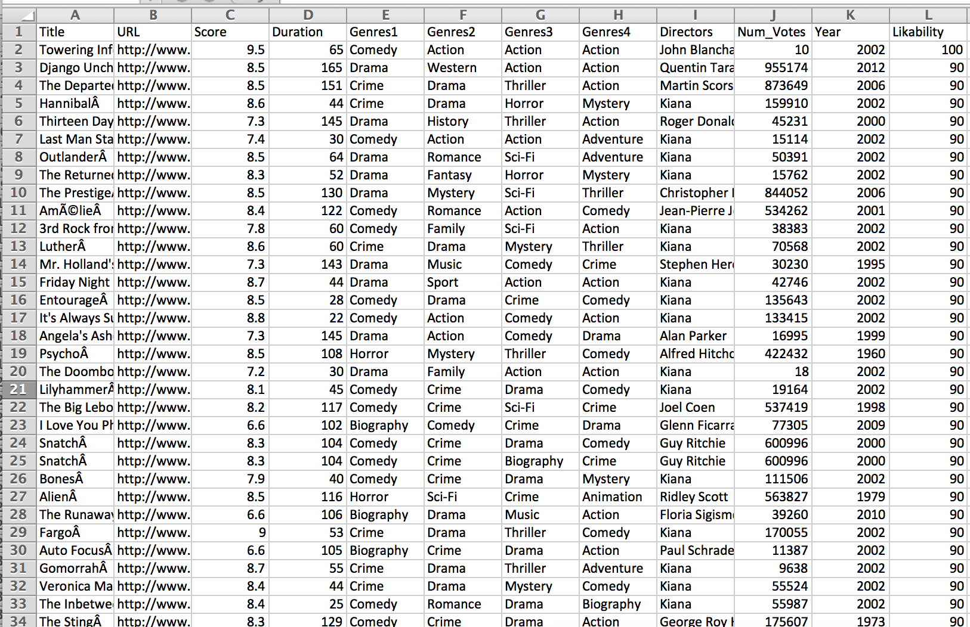
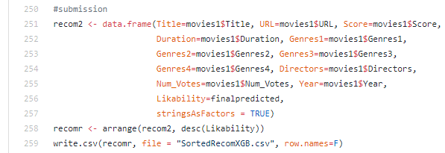
Generating the Output File

