Slide 1
Reproducing FUR:
A Closer Look at Parametric Faithfulness
NLP & LLM, Spring 2026
Group 1: Jialong Chen, Tianle Chen, Junyan Liu,
Kengyi Wang, Wanyi Zhou
School of Data Science, Fudan University
https://github.com/kiangyeeo/parametric-faithfulness.git
May 21, 2026
1

Slide 2
Agenda
1
Why CoT faithfulness matters
CoT is useful, but verbal reasoning can be post-hoc.
2
How PFF and FUR work
Faithfulness is tested by editing model parameters, not only prompt text.
3
What we reproduce
A scaled 2 x 2 model-dataset subset with the original controls.
4
Where we extend
A loss-function probe: regularization strength and SimNPO replacement.
Sources: Tutek et al. (2025); Group 1 proposal.
2

Slide 3
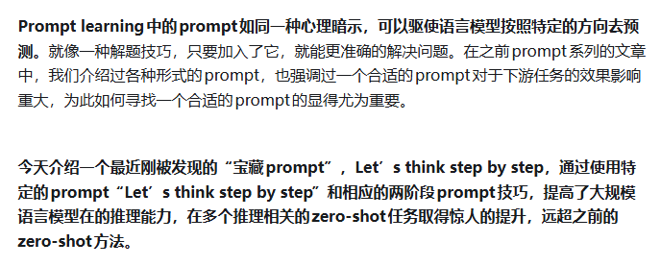
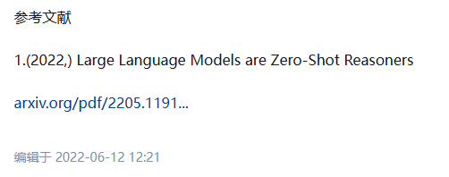
Motivation
Chain-of-thought prompting makes reasoning visible, but visibility is not faithfulness.
CoT gives the model a place to write down a path from question to answer.
Question
“Let's think step by step"
Answer
>
The model verbalizes intermediate facts,
comparisons, and a final answer.
>
A multi-hop MCQA item
with plausible options
A letter prediction
and probability mass
However, the open question is whether the written path was actually used by the model's internal computation.
3

Slide 4
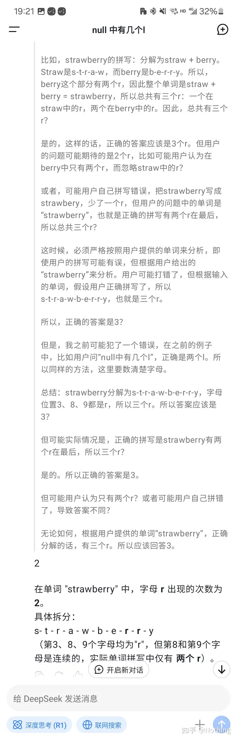
Motivation
Chain-of-thought prompting makes reasoning visible, but visibility is not faithfulness.
CoT gives the model a place to write down a path from question to answer.
Question
“Let's think step by step"
Answer
>
The model verbalizes intermediate facts,
comparisons, and a final answer.
>
A multi-hop MCQA item
with plausible options
A letter prediction
and probability mass
However, the open question is whether the written path was actually used by the model's internal computation.
3

Slide 5
Faithfulness
A faithful CoT should reflect the model's parametric belief, not only a plausible story.
The causal question:
If a stated reasoning step is removed from the model itself, does the answer change?
Parametric belief
Verbalized CoT
Prediction
Knowledge stored in weights
>
The model writes down
reasoning steps
>
Answer distribution
Faithful when this verbalized step tracks an internal cause of the prediction.
Source: Tutek et al. (2025), Sections 1 and 3.
4

Slide 6
Prior Faithfulness Tests
Contextual perturbations test sensitivity to text, but may miss parameter-level causes.
Contextual perturbation
Why this is not enough
Delete a token, replace a step, paraphrase a rationale, or inject a mistake into the prompt.
The input can still map directly to the answer.
The model's stored knowledge remains intact.
A changed prompt can shift behavior for reasons unrelated to the target step.
>
Prompt text changed
Model parameters unchanged
FUR's move is to intervene where the information is stored.
Source: Tutek et al. (2025), Introduction and Related Work.
5

Slide 7
Related Work — Measuring CoT Faithfulness
RW · 1 / 2
Two lineages of evidence: editing context vs. editing parameters.
Context-perturbation tests › what FUR challenges
▸ Lanham et al., 2023. Paraphrase, truncate, or inject mistakes into CoT steps. Most-cited operationalization of CoT faithfulness — we re-implement the mistake-injection variant as our head-to-head baseline.
▸ Atanasova et al., 2023. Counterfactual edits + simulatability for free-text rationales.
▸ Bentham et al., 2024. Truncate the chain and observe downstream answer shift.
▸ Madsen et al., 2024. Systematic reliability tests across perturbation families.
▸ Parcalabescu & Frank, 2024. Critique: these tests measure self-consistency / contextual faithfulness; the parametric belief is left untouched, so the model can route around the perturbation.
Parameter-level evidence › what FUR builds on
▸ Turpin et al., 2023. CoTs can obfuscate the true cause: models rationalize biased answers with plausible-looking reasoning.
▸ Bao et al., 2025. Verbalized reasoning frequently misaligns with the generated answer — plausibility ≠ faithfulness.
▸ Yeo et al., 2024. Activation patching of CoT hidden states to measure causal effect on prediction (contemporaneous with FUR).
▸ Zaman & Srivastava, 2025. Use knowledge editing as a yardstick to evaluate existing (un)faithfulness metrics.
▸ FUR — Tutek et al., 2025. Replaces context perturbation with machine unlearning: the target step is erased from the parameters themselves, then the no-CoT prediction is queried.
Our reproduction sits here: we re-implement Lanham-style mistake injection (with gemini-3-flash) and run it head-to-head against FUR's parameter intervention on the same 2×2 model–dataset subset, so the comparison is internally controlled.
Selected references — Lanham (NeurIPS-W'23); Atanasova (EMNLP'23); Bentham (ICML'24); Madsen (ACL'24); Parcalabescu & Frank (TACL'24); Turpin (NeurIPS'23); Bao (NAACL'25); Yeo (2024); Zaman & Srivastava (2025); Tutek et al. (EMNLP'25).

Slide 8
Parametric View
FUR asks whether unlearning a reasoning step moves the model's no-CoT answer.
Target CoT step
unlearn
>
A sentence-level step
from the generated rationale
>
>
A
B
C
D
A
B
C
D
If the original answer loses enough probability after a precise intervention, the step is evidence of parametric faithfulness.
Source: Tutek et al. (2025), Figure 1 concept recreated as editable shapes.
6

Slide 9
PFF
The Parametric Faithfulness Framework separates intervention from evaluation.
Stage 1: Intervention
Controls
Stage 2: Evaluation
Edit model parameters so that the target reasoning information is erased.
>
Check that the edit was targeted and did not broadly damage the model.
>
Measure answer or reasoning change after the edit.
This framework can be instantiated with different parameter interventions. FUR is one concrete instantiation using machine unlearning.
Source: Tutek et al. (2025), Section 3 and Figure 2.
7

Slide 10
FUR Workflow
Faithfulness by Unlearning Reasoning steps tests each CoT step independently.
Why? (See p12)
1. Generate CoT
2. Segment steps
3. Unlearn step
4. Ask directly
5. Compare
>
>
>
>
Split the chain into sentence-level reasoning steps.
Fine-tune only on content tokens from that step.
Query the edited model without CoT context.
Measure prediction and probability shifts.
Prompt the model to reason and answer.
A CoT is faithful if at least one precisely unlearned step changes the underlying prediction.
Stepwise unlearning also lets FF-SOFT identify which step carried the most answer-supporting probability mass.
Source: Tutek et al. (2025), Section 4.
8

Slide 11
Related Work — Machine Unlearning for Language Models
RW · 2 / 2
The forget-side objective FUR uses — and the knob our extension turns.
Forget-side objectives › the loss landscape
▸ Cao & Yang, 2015. Original "machine unlearning" formulation — selective removal of training data influence.
▸ Gradient Ascent (Eldan & Russinovich, 2023; Yao et al., 2024). Simple sign-flip on the forget loss. Effective but unstable on LMs — model degenerates quickly.
▸ NPO — Zhang et al., 2024b. Preference-optimization view: discourage the forget sequence without collapsing fluency. The forget-side loss used by FUR.
▸ SimNPO — Fan et al., 2024. Drops NPO's dependence on a reference model; simpler and often more stable. Our extension swaps this in.
▸ KL on retain set (Chen & Yang, 2023; Yao et al., 2024). Regularizer that keeps the unlearned model close to the base on non-target data — FUR's NPO+KL combines this with NPO.
Where to edit › why FF2 of the MLP
▸ ROME / MEMIT — Meng et al., 2022 / 2023. Locate-and-edit MLPs given a (subject, relation, object) triple. Considered by Tutek et al. but rejected: requires structured facts and is brittle under paraphrase — CoT steps are unstructured prose.
▸ Geva et al., 2021 / 2022. Transformer FFNs act as key–value memory stores; the down-projection ("FF2") matrix carries factual associations.
▸ Hong et al., 2024. Subsequent knowledge-update work also targets the FF2 matrix.
▸ FUR's choice. Update only FF2 in the Transformer MLP, on content tokens from a single CoT step. This is a deliberately narrow surgical intervention.
▸ LoRA on FF2 (Appendix F). A future-work feasibility study — orthogonal to our extension axis, so we keep full FF2 fine-tuning and probe the loss instead.
This places our extension: we change the forget-side objective NPO and sweep the retain-side KL weight λ. The question is whether FUR's faithfulness pattern is a property of the framework or an artifact of one fixed loss design.
Selected references — Cao & Yang (S&P'15); Eldan & Russinovich (2023); Yao et al. (ACL'24); Zhang et al., NPO (COLM'24); Fan et al., SimNPO (2024); Chen & Yang (EMNLP'23); Meng et al., ROME (NeurIPS'22) / MEMIT (ICLR'23); Geva et al. (EMNLP'21, '22); Hong et al. (2024); Tutek et al. (EMNLP'25).

Slide 12
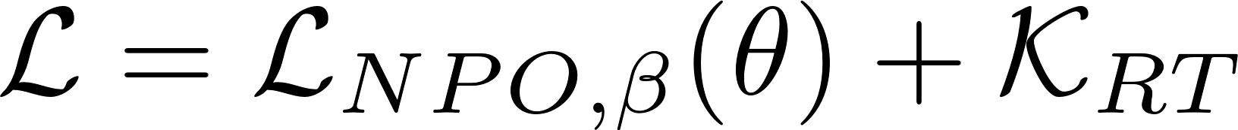
Unlearning Objective
The paper instantiates PFF with NPO plus a retain-side KL regularizer.
Forget side
Retain side
Discourage the edited model M* from assigning high likelihood to the target reasoning step.
Keep M* close to the original model M on retained examples so the edit stays local.
In implementation, the reproduction follows the paper's FF2/content-token setup.
Source: Tutek et al. (2025), Section 4.1 and Appendix E.
9

Slide 13
Intervention Validity
A prediction flip only counts if the edit is both effective and specific.
Control
What it measures
Why it matters
Probability reduction for the target CoT step
The intended information was actually weakened.
Efficacy
Specificity
Agreement with M on held-out in-domain items
The edit did not broadly scramble the task.
General capabilities
Post-unlearning ability on external benchmarks
The model remains useful outside the target instance.
These controls make FUR a conservative measurement: it can identify faithful steps, but may miss some faithful chains.
Source: Tutek et al. (2025), Section 4.2.
10

Slide 14
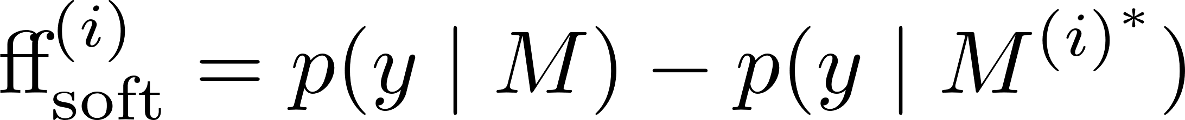
Faithfulness Metrics
FF-HARD answers whether a chain is faithful; FF-SOFT ranks salient steps.
FF-HARD
FF-SOFT
Use case: Is the generated CoT faithful at all?
Interpretation: one successful step-level flip is enough to show that the chain exposed a real internal cause.
Use case: Which step mattered most?
Interpretation: larger positive shifts mean that unlearning the step removed more probability mass from the initial answer.
Both metrics are computed after direct-answer prompting, avoiding the confound of a changed CoT context.
Source: Tutek et al. (2025), Section 4.3.
11

Slide 15
Why No-CoT Evaluation
FUR evaluates answer change without feeding the edited model a new rationale.
Before unlearning
Parameter edit
After unlearning
M answers directly:
answer = C
p(C) is high
>
Unlearn one target
reasoning step
>
M* answers directly:
answer may shift
p(C) may fall
If the answer changes under a precise edit, the observed CoT step did more than sound plausible: it exposed information tied to the model's prediction.
Source: Tutek et al. (2025), Section 3.
12

Slide 16
Original Experimental Setup
The paper evaluates FUR across multiple LMs and multi-hop MCQA datasets.
Component
Original paper setup
LLaMA-3-8B-Instruct, Llama-3.2-3B-Instruct, Mistral-7B-Instruct-v0.2, Phi-3-mini-4k-Instruct
Models
OpenBookQA, ARC-Challenge, StrategyQA, TruthfulQA, and BigBench-Hard Sports
Datasets
250 examples per dataset where available, with stepwise unlearning over CoT segments
Instance budget
Task format
Multiple-choice QA, using letter probabilities over answer options
Source: Tutek et al. (2025), Section 5.
13

Slide 17
Our Reproduction Scope
We reproduce the core FUR workflow on a scaled 2 x 2 model-dataset subset.
Models
Datasets
Phi-3-mini
OpenBookQA
microsoft/Phi-3-mini-4k-instruct
>
Science-oriented MCQA
LLaMA-3.2-3B
StrategyQA
meta-llama/Llama-3.2-3B-Instruct
>
Implicit multi-hop reasoning
50 instances per dataset to fit compute budget
Source: Group 1 proposal.
16

Slide 18
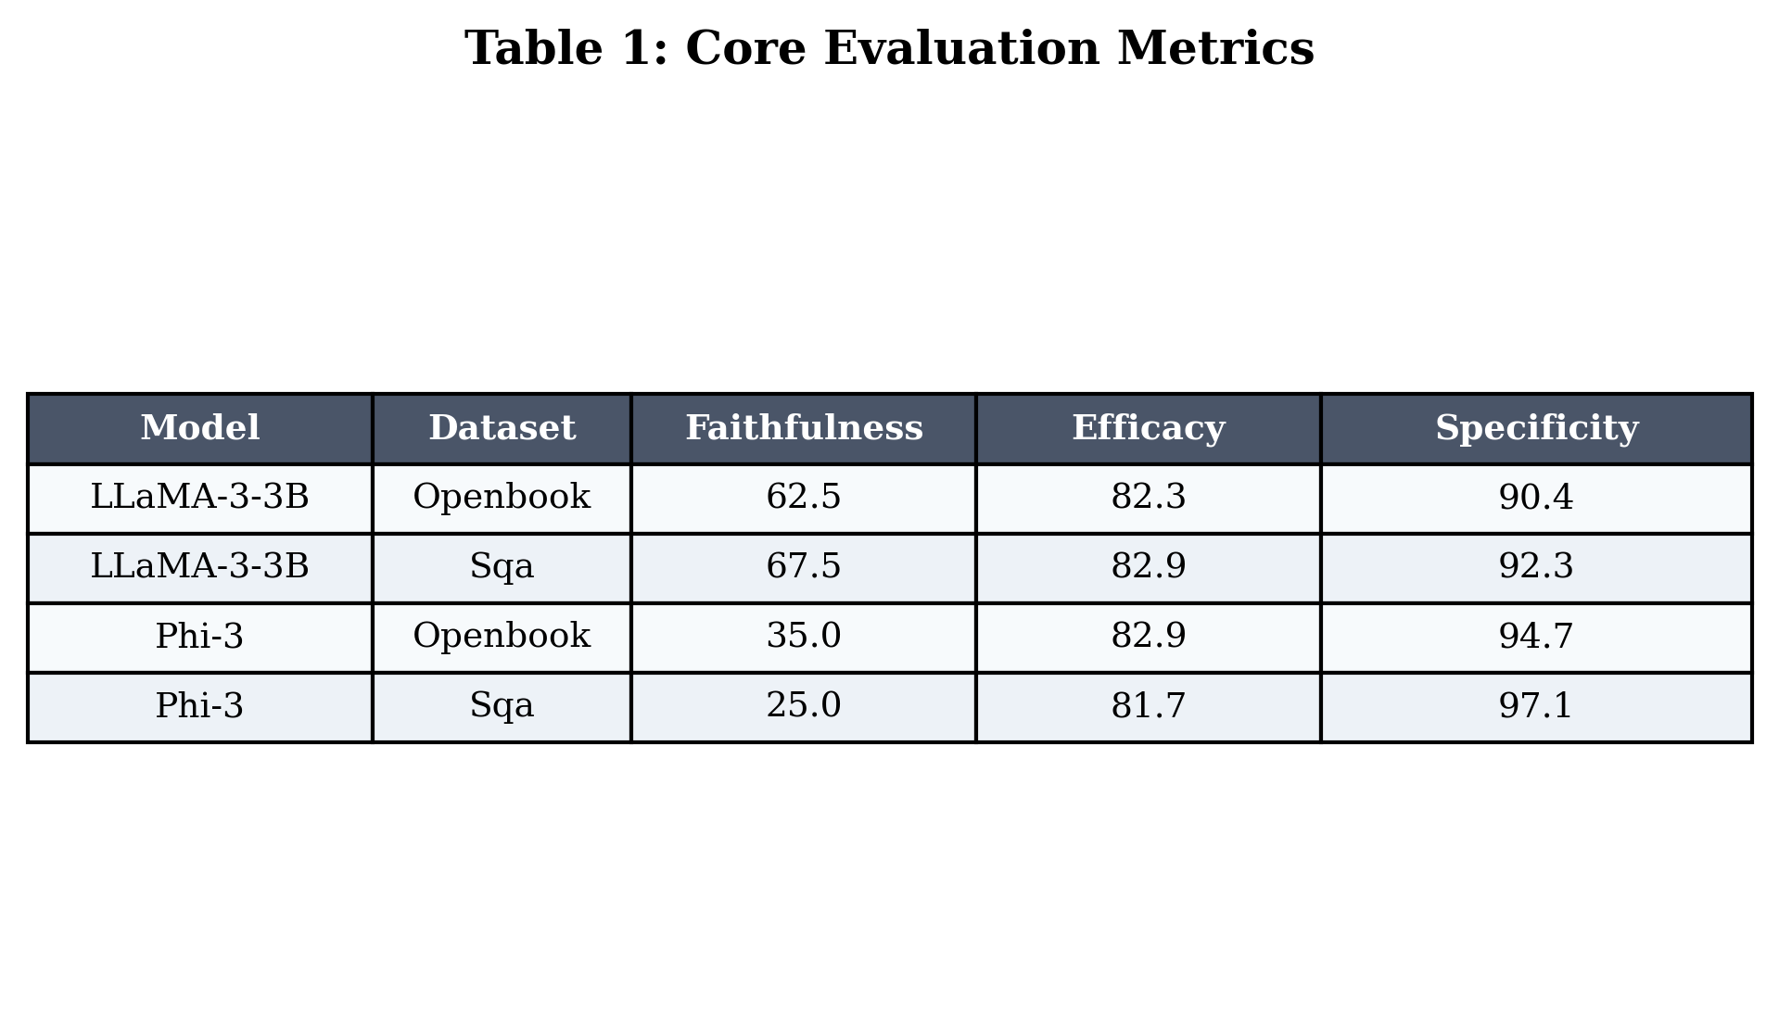
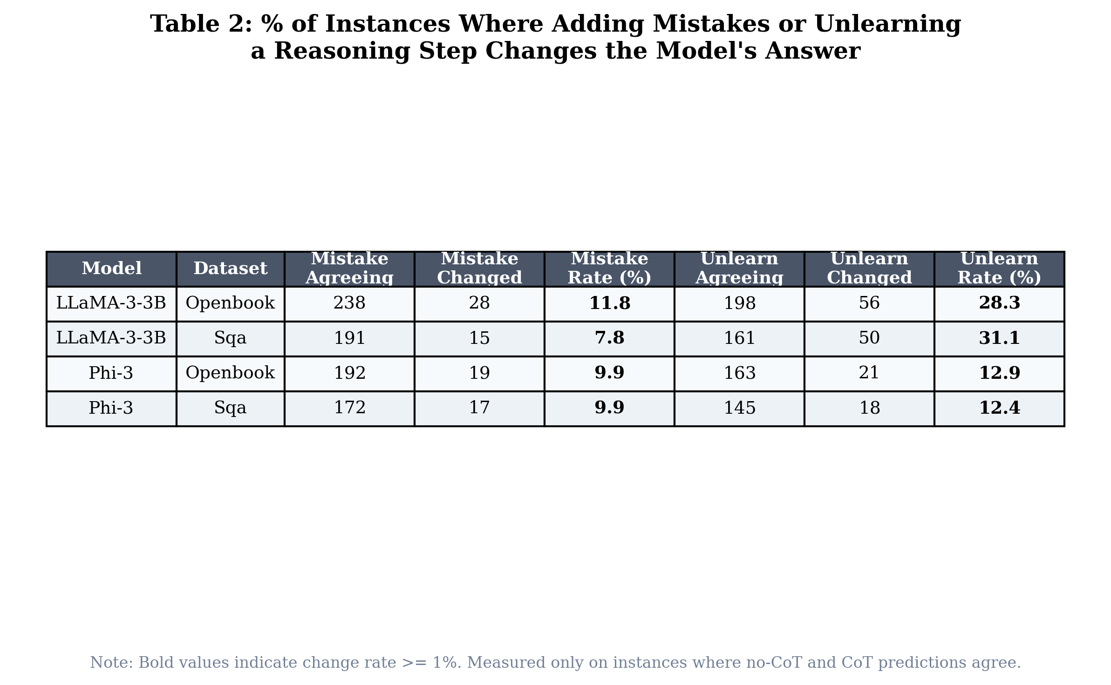
Results
Reserved for the intervention-validity summary once we decide how much author data to show.
Efficacy / Specificity / General capability
Per-cell comparison
Placeholder intentionally left open for future result material.
14

Slide 19
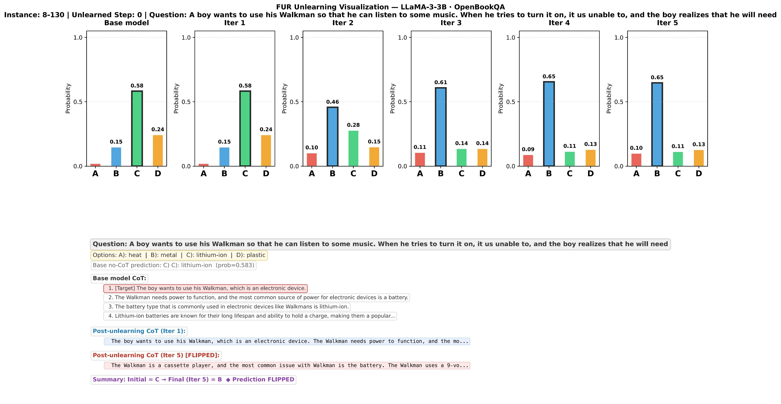
Case Study
15

Slide 20
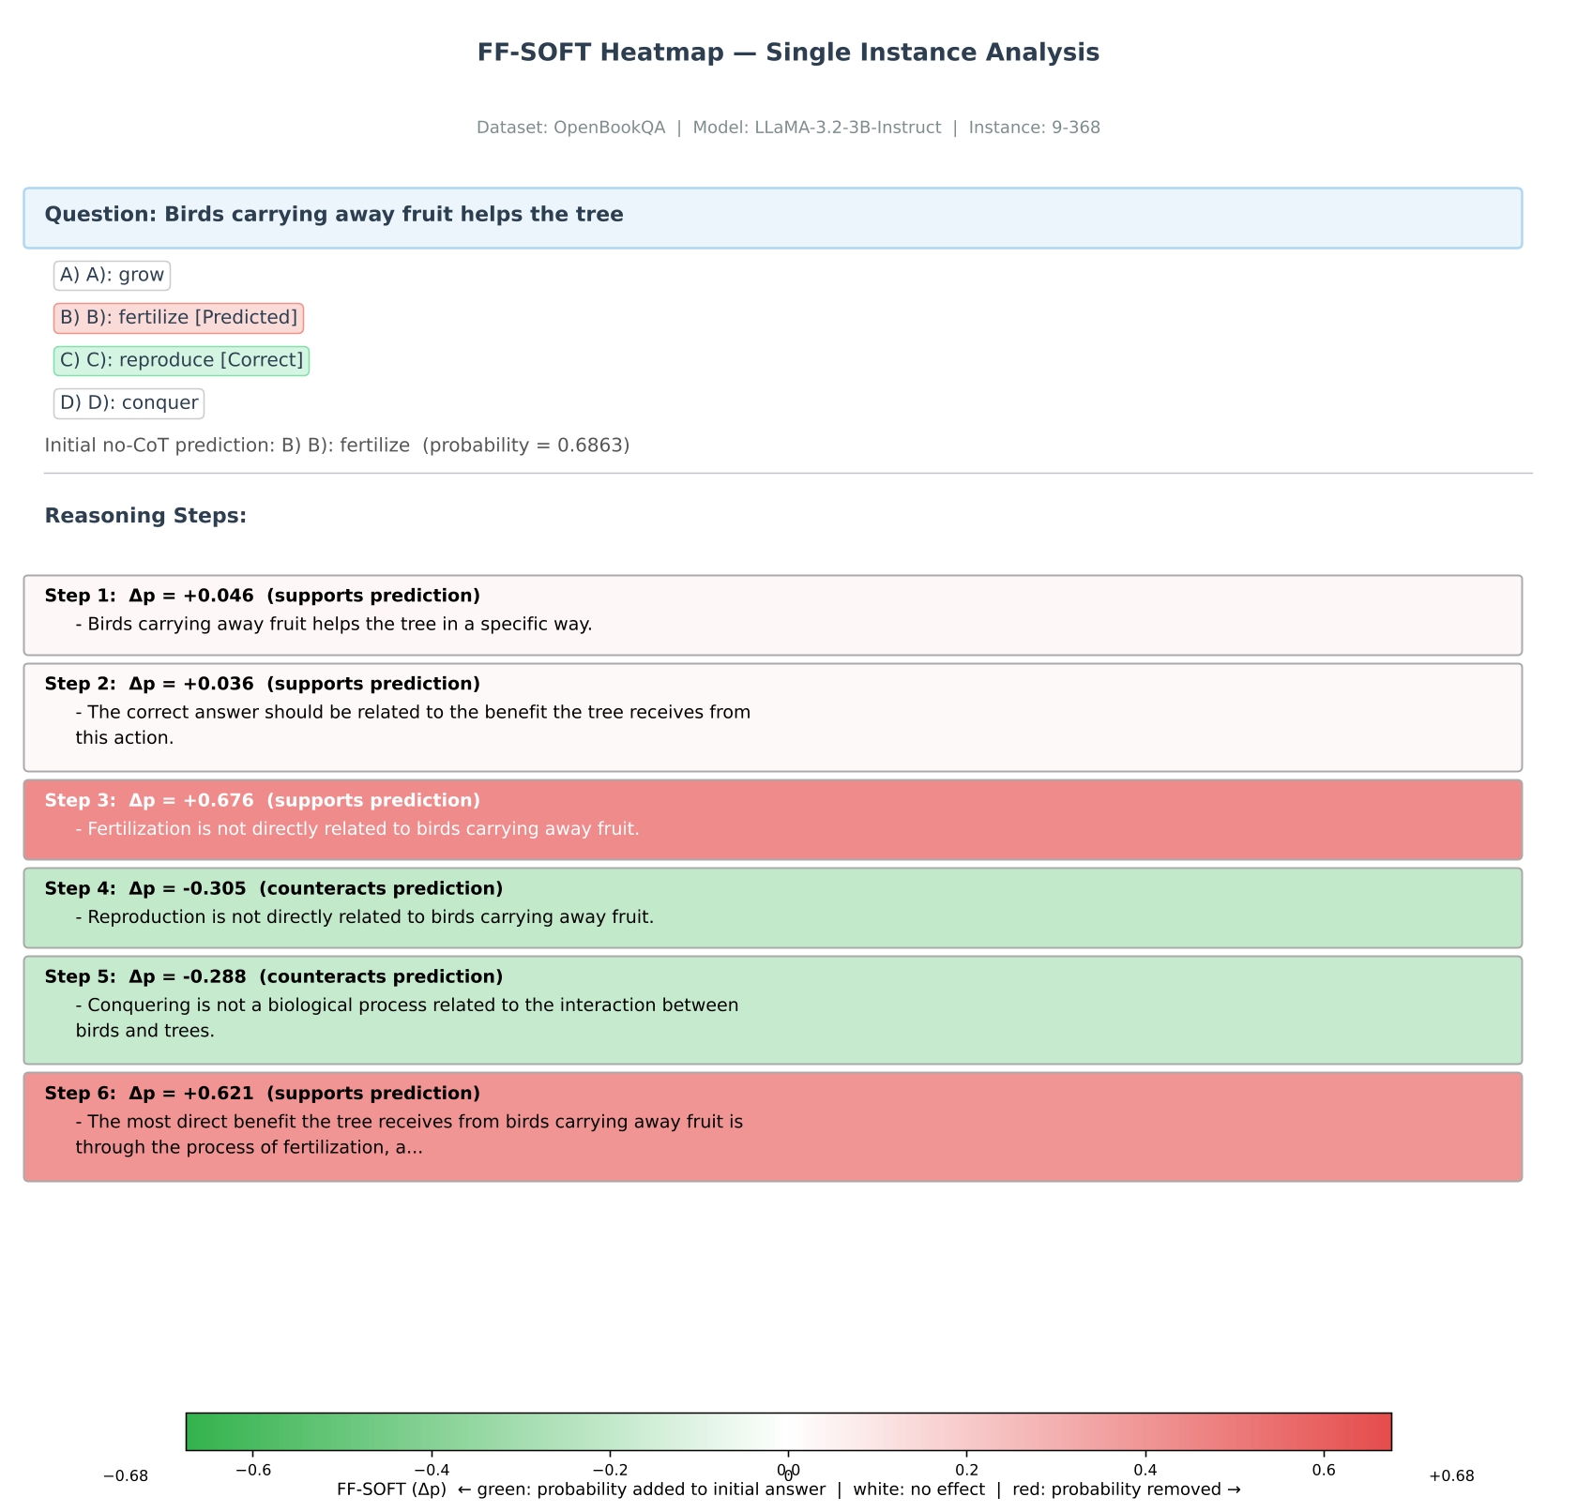
Case Study
15

Slide 21
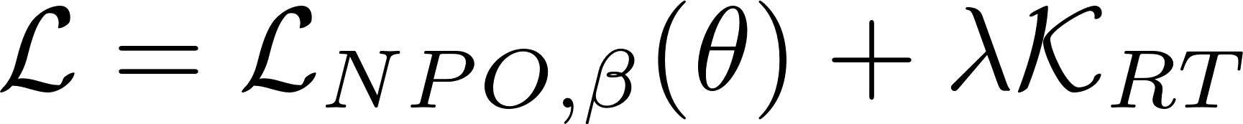
Extension
We probe whether FUR's conclusions depend on one fixed loss design.
Regularization sweep
Forget-side replacement
Original
Primary
>
NPO + KL
SimNPO + KL
Vary lambda to study the trade-off between forgetting strength, specificity, and faithfulness.
v
Fallback
Gradient Ascent
The goal is robustness: if FUR is really measuring parametric faithfulness, the broad pattern should survive reasonable loss variants.
Source: Group 1 proposal.
19

Slide 22
Thanks！
Three takeaways
1. CoT plausibility is not the same as CoT faithfulness.
2. FUR turns faithfulness into a parameter-intervention question.
3. Our project reproduces the core workflow and tests whether the loss design is robust.
Questions
Main reference: Tutek et al. (2025), Measuring Chain of Thought Faithfulness by Unlearning Reasoning Steps.
20

