Slide 1
Lecture 10 – Information Retrieval and Retrieval-Augmented Generation
Baojian Zhou
CS40008.01: NLP & LLMs School of Data Science Fudan University
05/14/2026
Notes:
Clustering and summarization

Slide 2
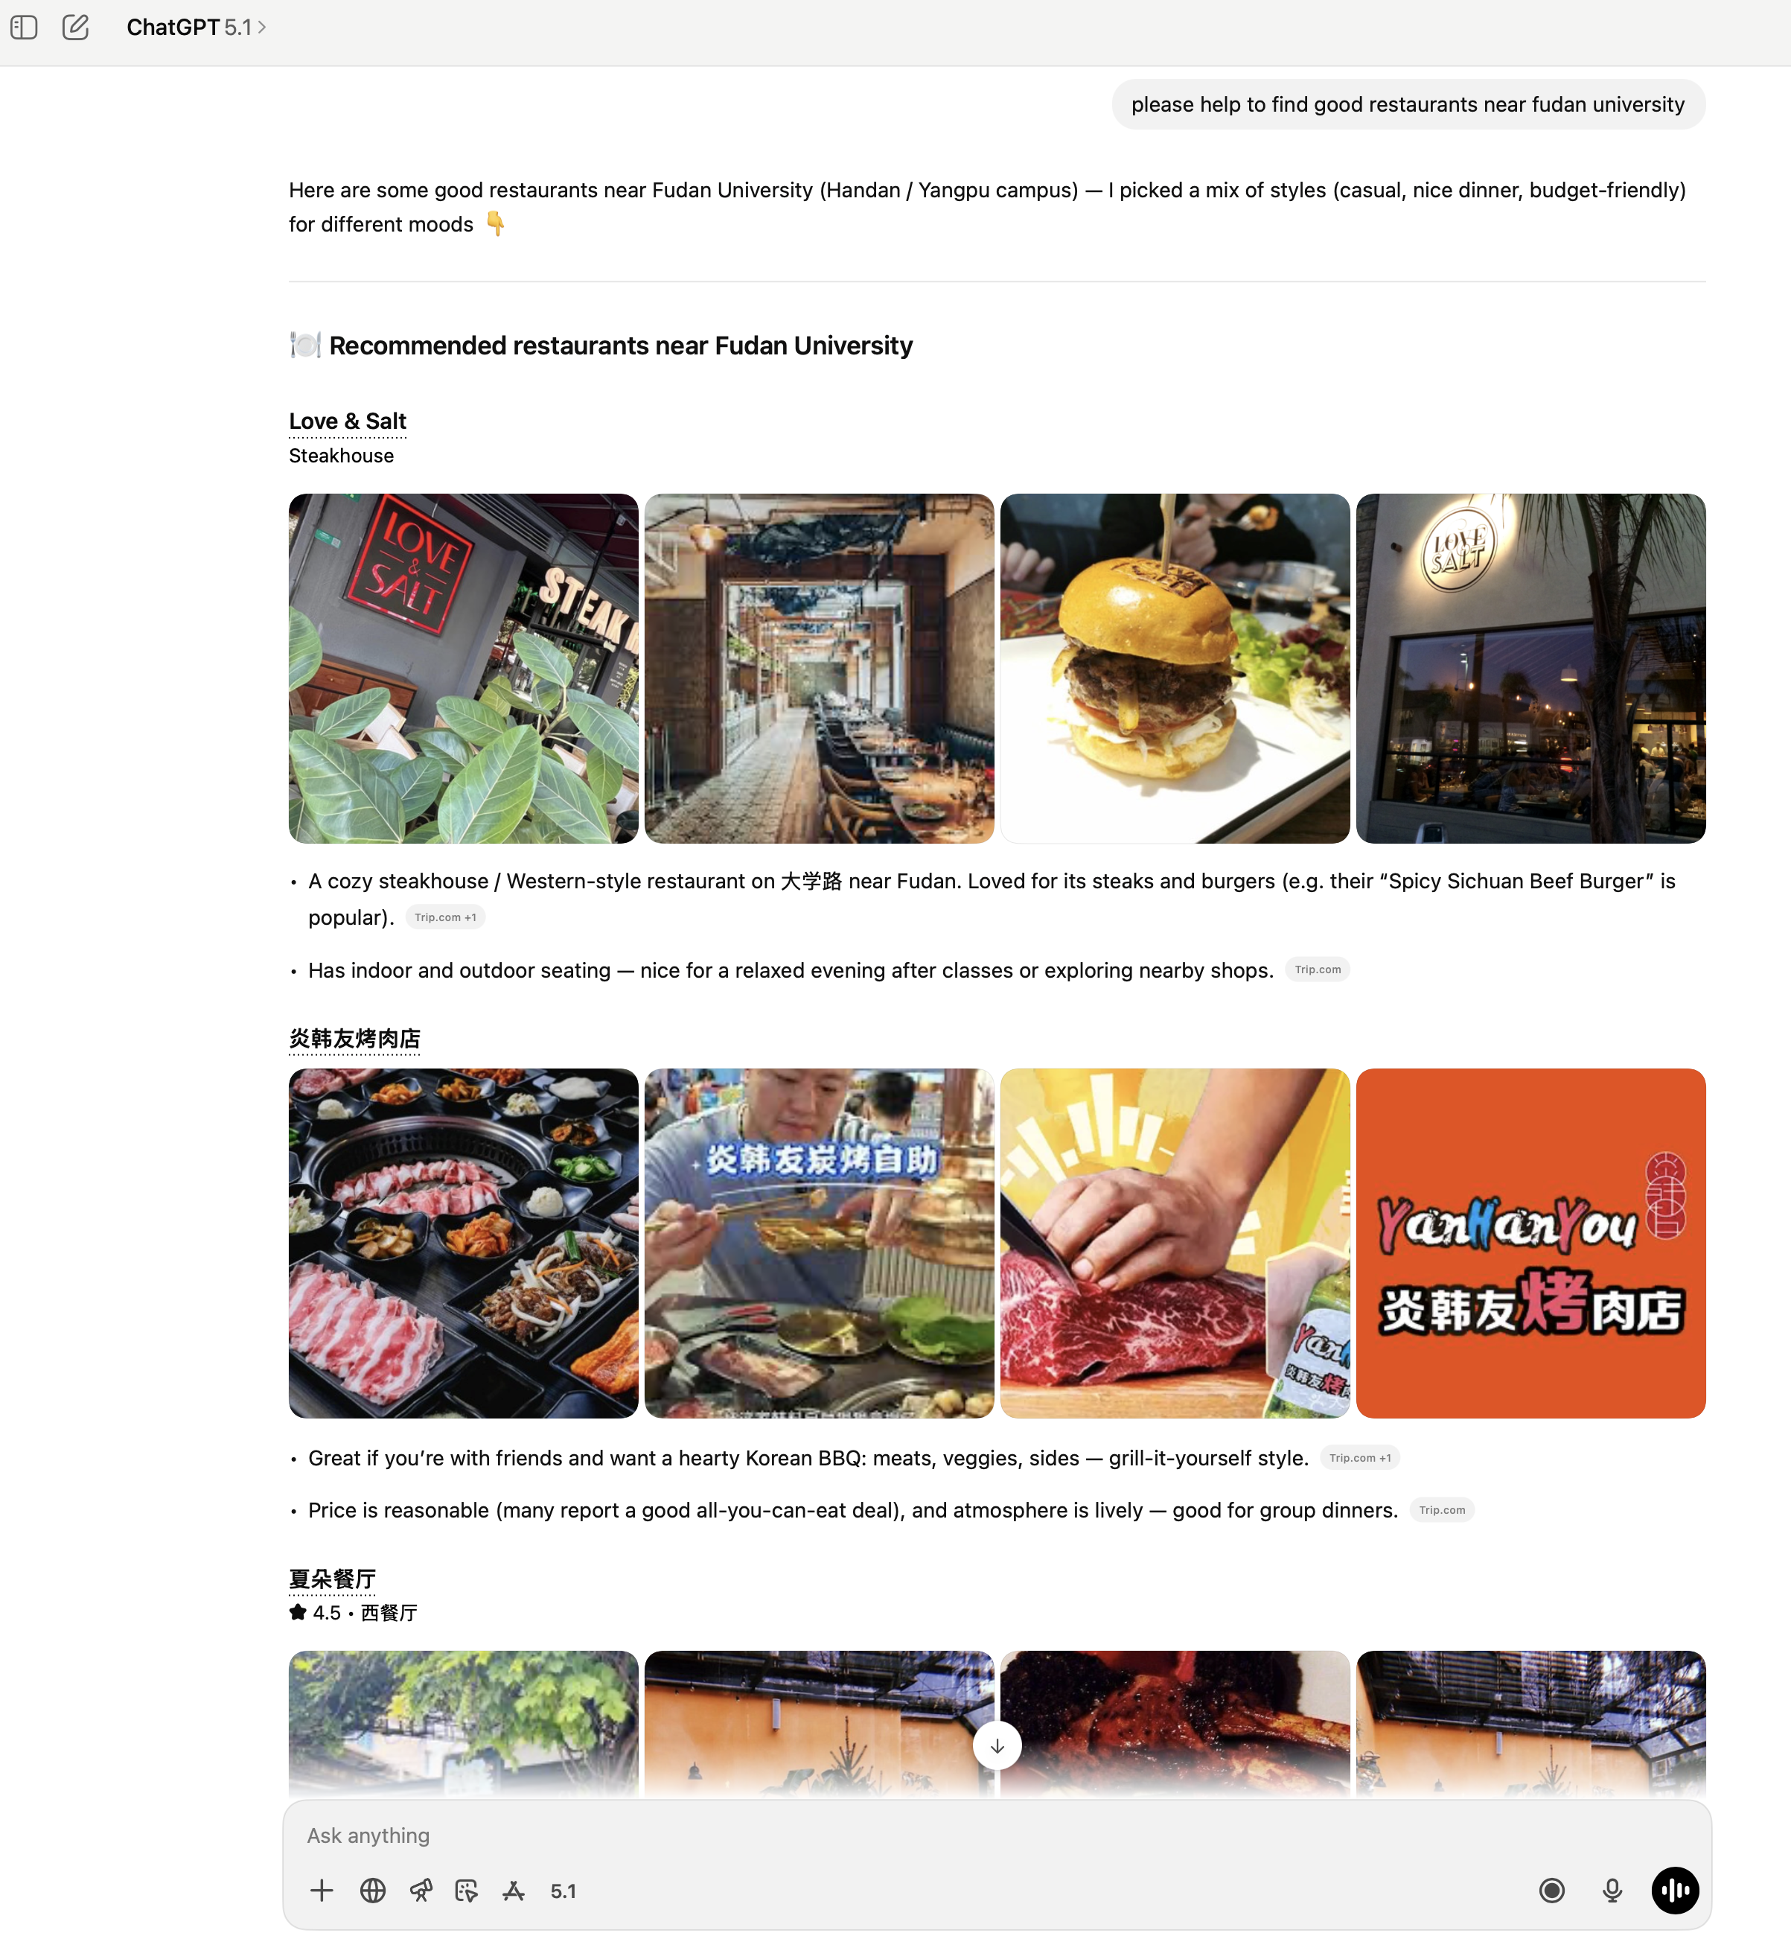

Motivation
Important function of LLMs is to fill human information needs by answering people’s questions
From searching engine to GPT5.1

Slide 3
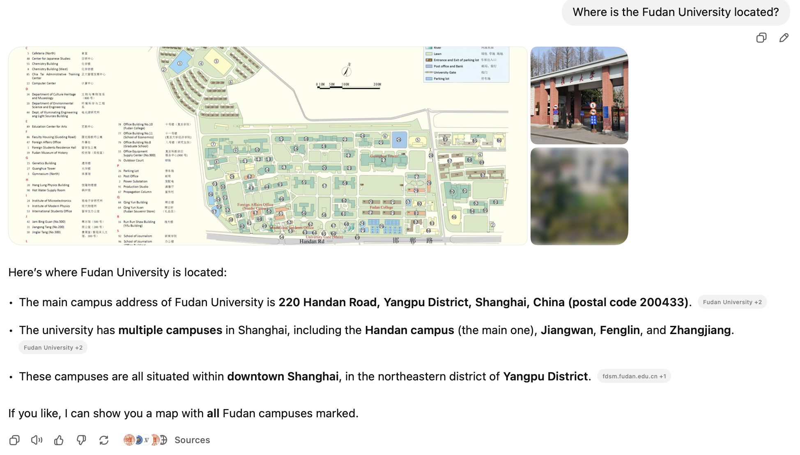
Motivation factoid questions
Where is the Fudan University located?
Where does the energy in a nuclear explosion come from?
How to get a script l in latex?
To get an LLM to answer these questions, we can just prompt it: by performing conditional generation given this prefix, and take the response as the answer as LLMs have processed a lot of facts in their pretraining data, including the location of the Fudan University and many others.
But LLMs often give the wrong answer to factual questions! (hallucination)

Slide 4
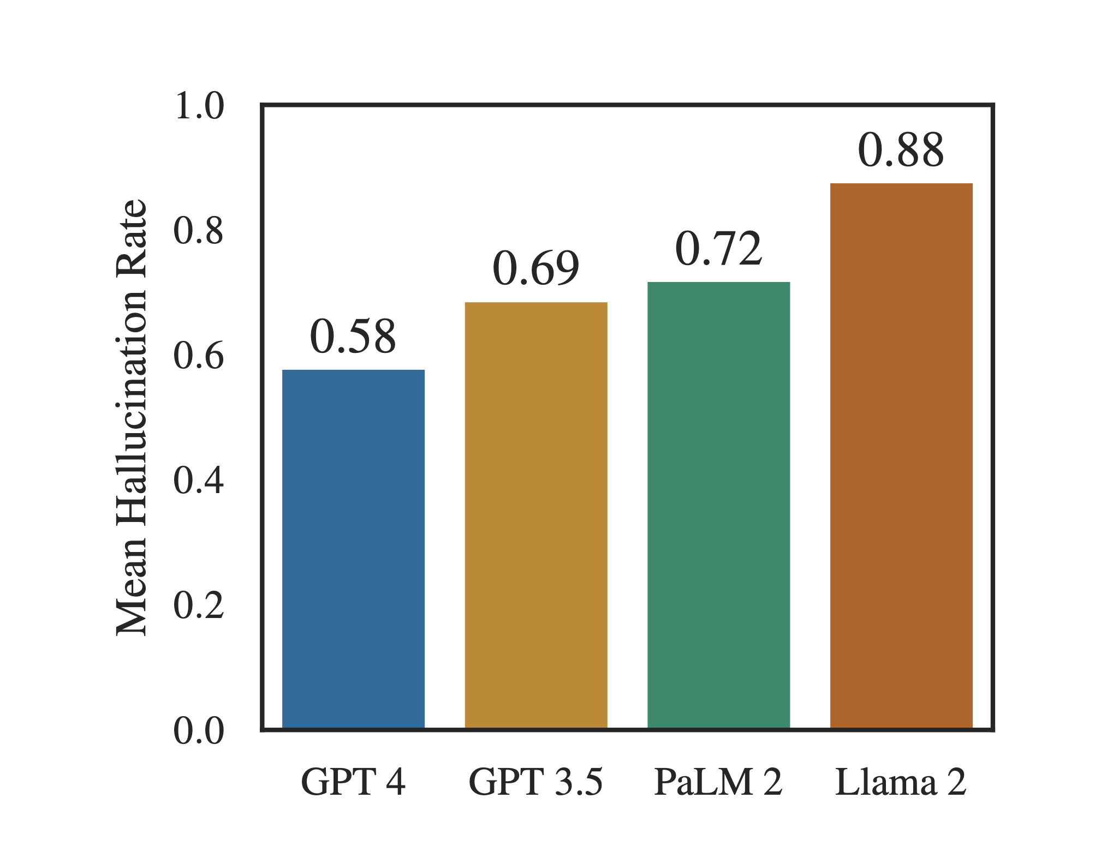
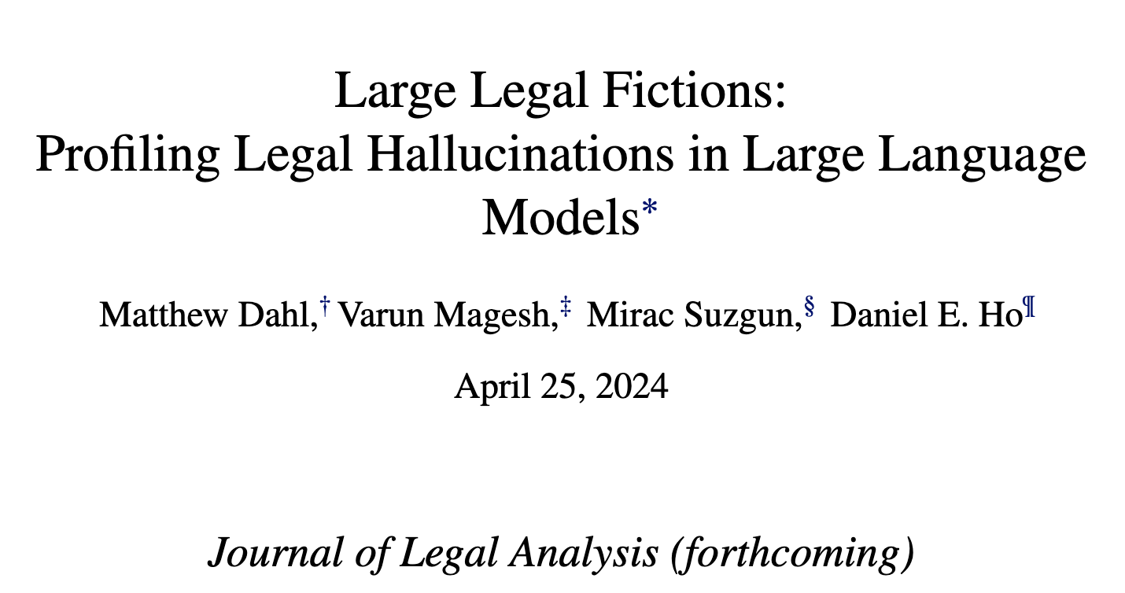
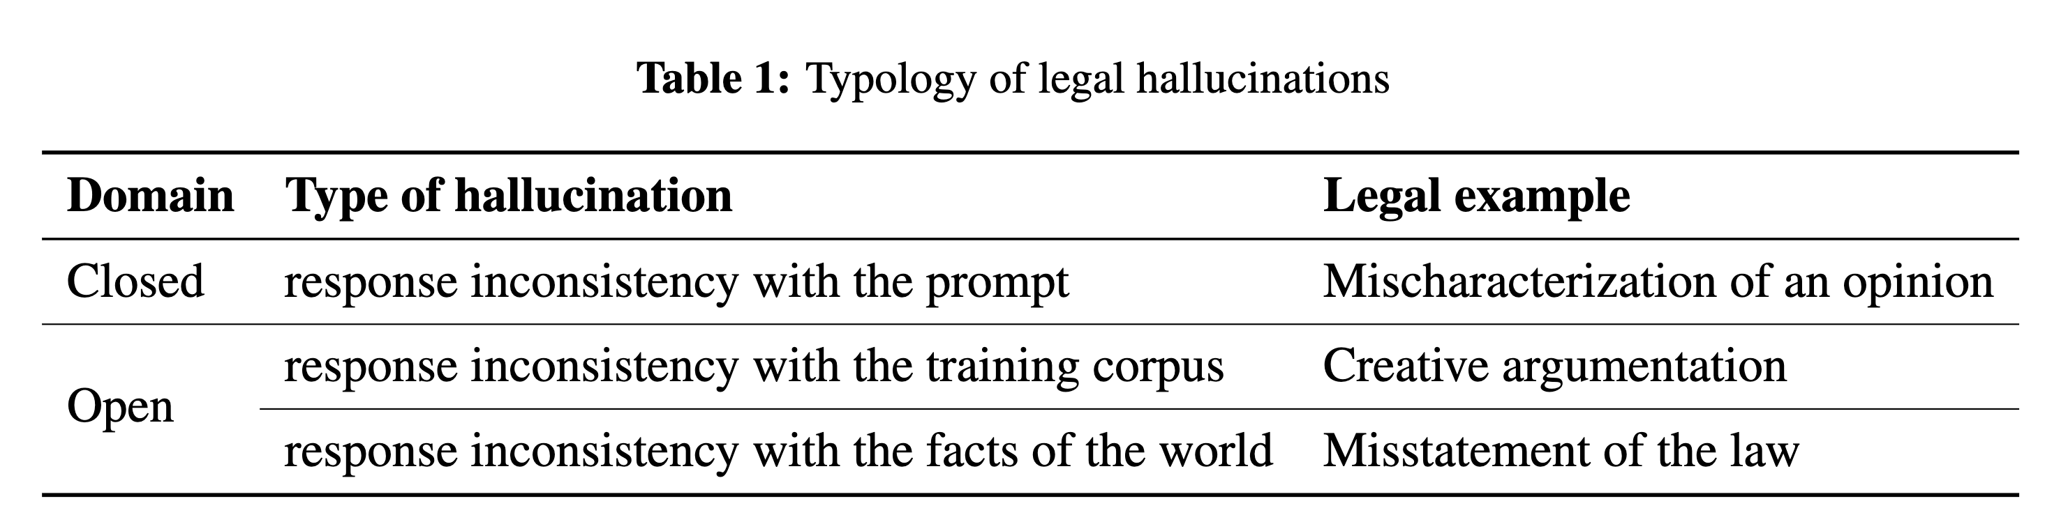
Motivation factoid questions
Hallucinations are common across all LLMs when they are asked a direct, verifiable question about a federal court case.

Slide 5
Motivation
Why LLM prompting fails for factual questions:
Hallucination Problem
No Access to Proprietary or Private Data: Pretrained LLMs cannot answer questions about Personal email, Medical records, Internal corporate documents, Legal discovery materials
Out-of-Date Knowledge: LLMs are static snapshots of knowledge at pretraining time. Cannot answer questions about recent or fast-changing events (e.g., “what happened last week?”)

Slide 6
RAG Retrieval-Augmented Generation
Use Information Retrieval to retrieve relevant documents (e.g., proprietary, curated, or up-to-date sources).
Let the LLM generate an answer using the retrieved documents.
Advantages:
Ensures answers are grounded in real, verifiable text
Provides citation or context, improving user trust
Overcomes hallucination, proprietary-data access issues, and factual staleness

Slide 7
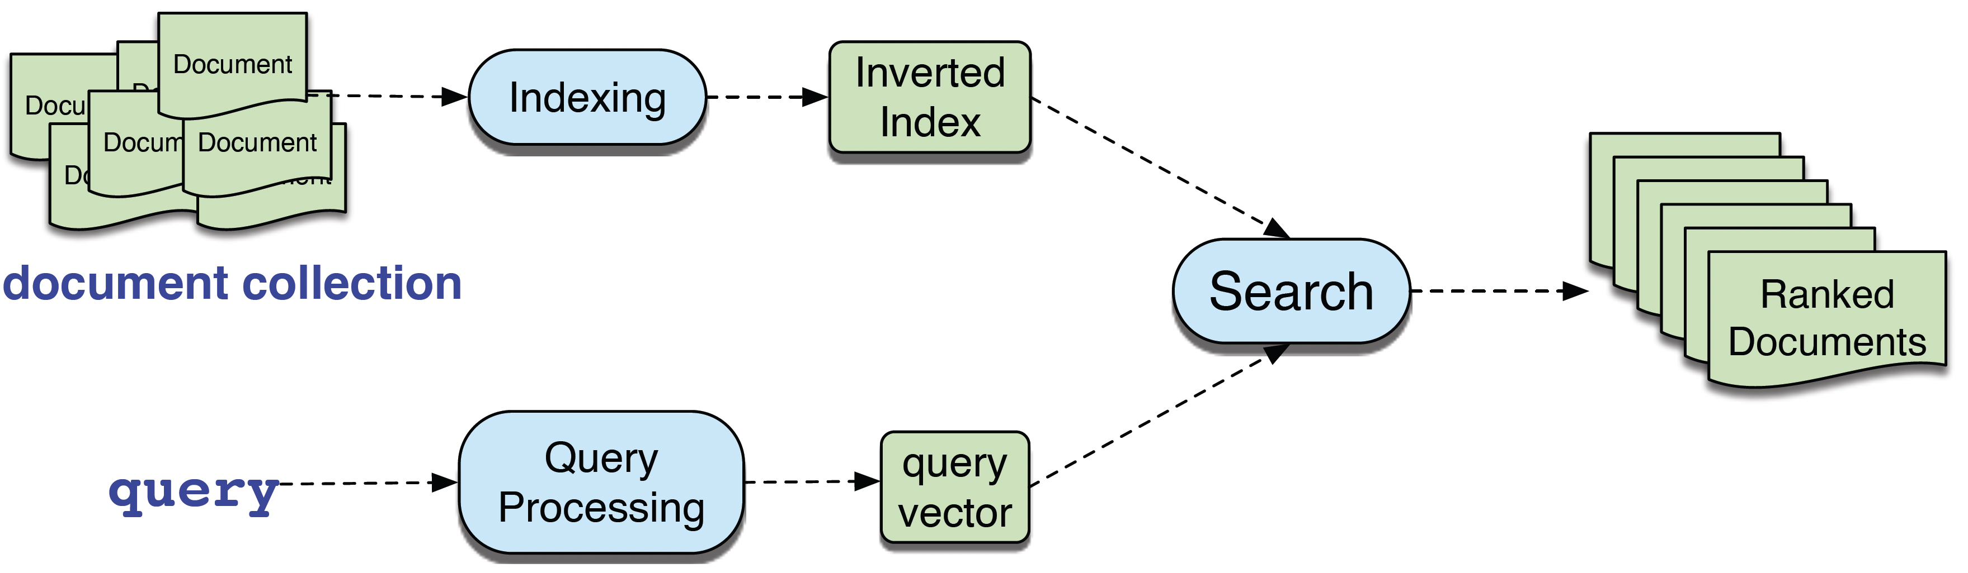
Information Retrieval (IR)
IR is the name of the field encompassing the retrieval of all retrieval IR manner of media based on user information needs
We map queries and document to vectors based on unigram word counts, and use the cosine similarity between the vectors to rank potential documents

Slide 8
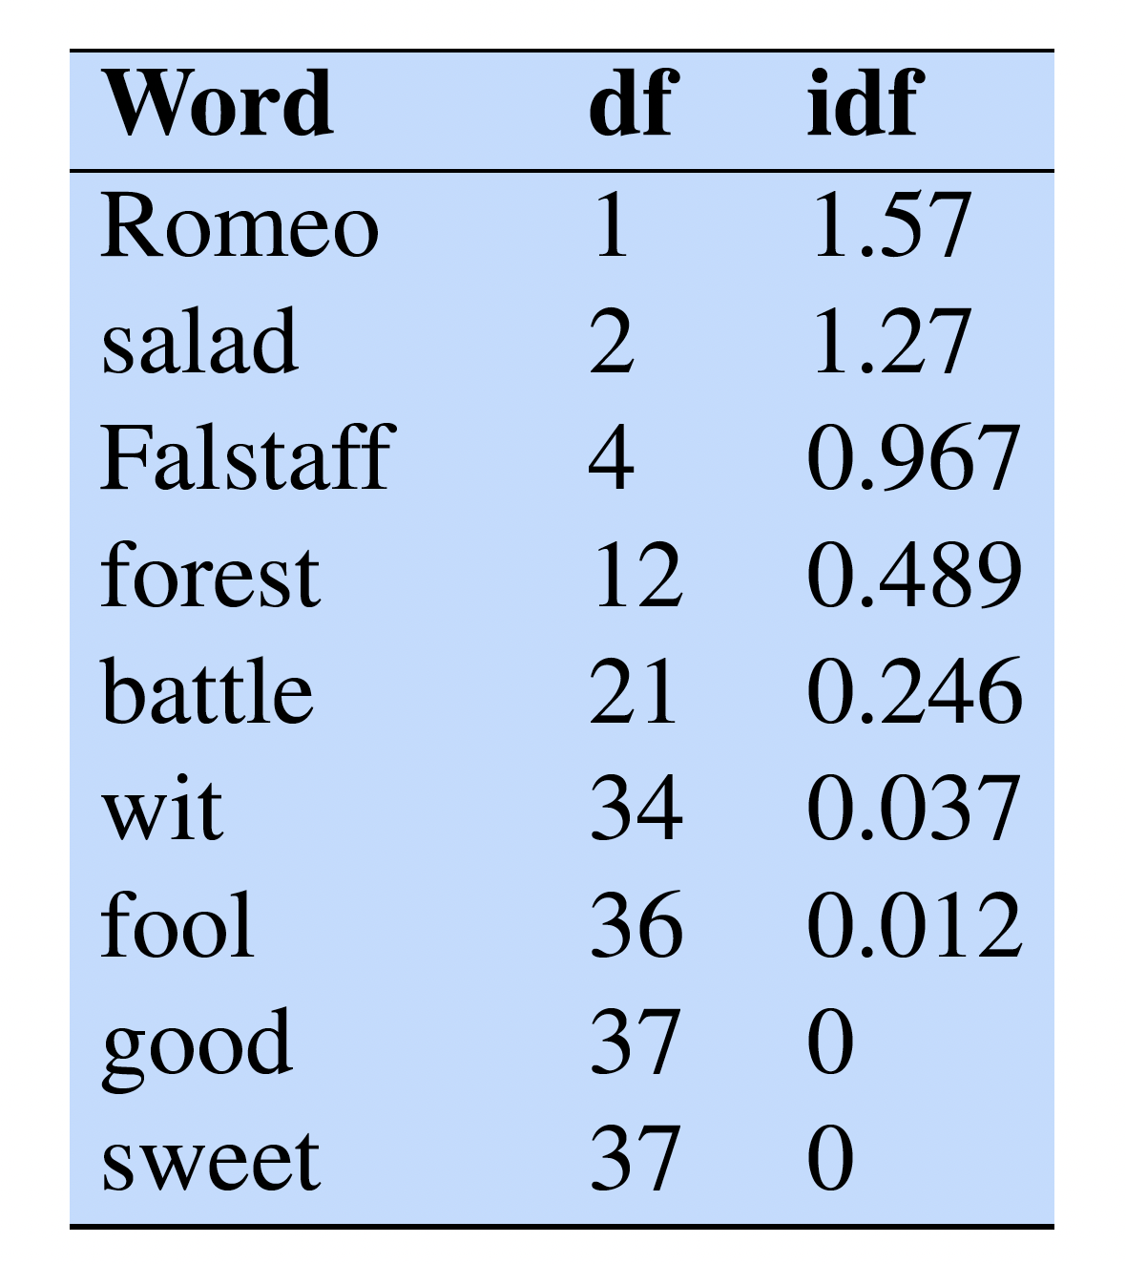
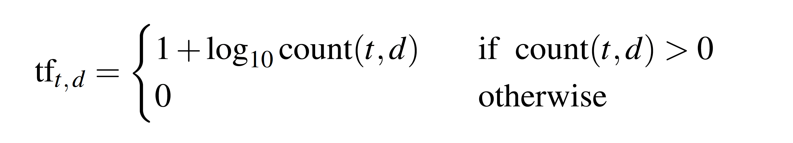
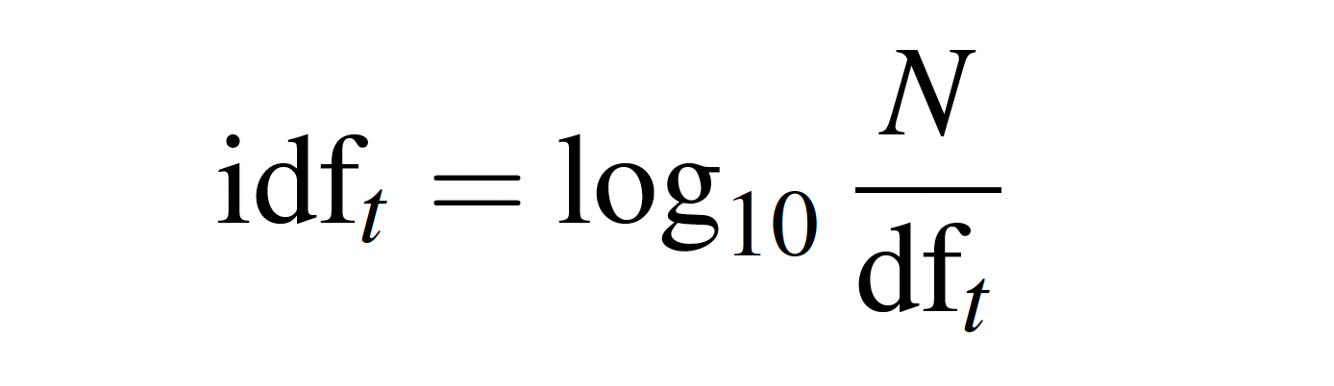
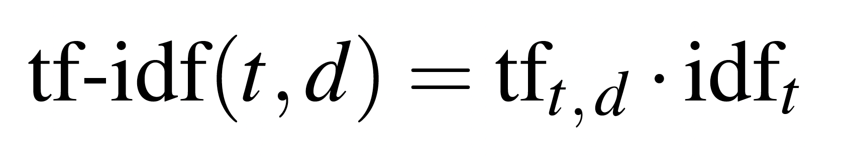
Information Retrieval (IR) TF-IDF
TF-IDF is the product of two terms
term frequency tells us how frequent the word is
document frequency (df) of a term t is the number of documents it occurs in; we use inverse document frequency
tf-idf value for word t in document d is then the product of these two
corpus of Shakespeare plays

Slide 9
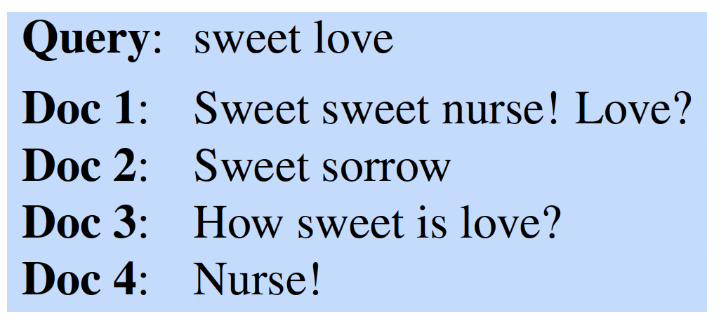
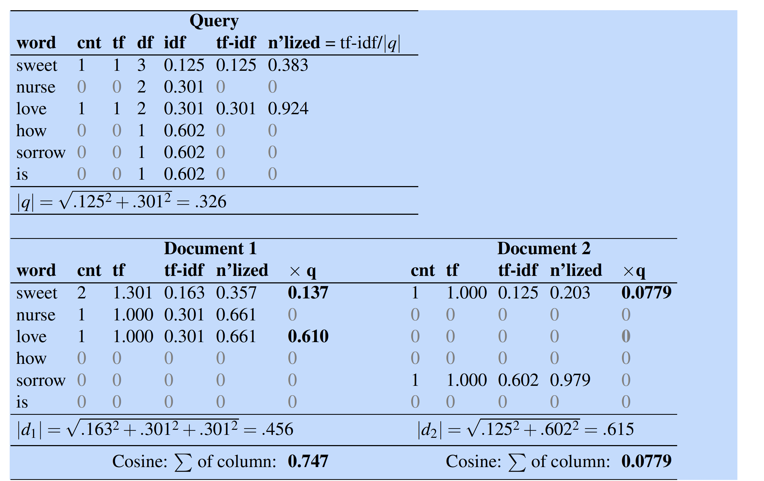
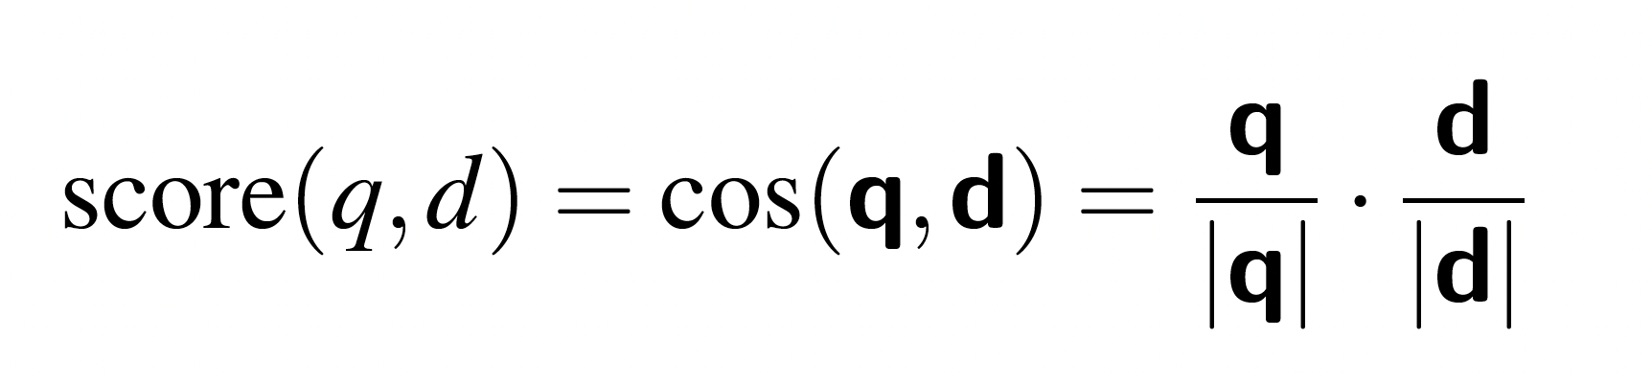
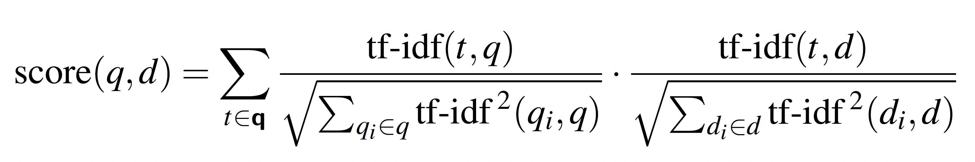
Information Retrieval (IR) Document Scoring
We score document d by the cosine of its vector d with the query vector q
using the tf-idf values and spelling out the dot product as a sum of products

Slide 10
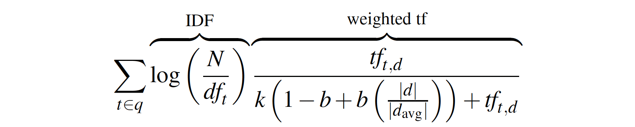
Information Retrieval (IR) BM25
It improves on TF-IDF by nonlinear term-frequency saturation and length normalization, and remains one of the strongest lexical baselines for retrieval and RAG systems
K - Term Frequency Saturation
Large k: term frequency matters more
Small k: strong saturation, TF grows slowly
b - Length Normalization
b=1: full normalization
b=0: no length normalization

Slide 11
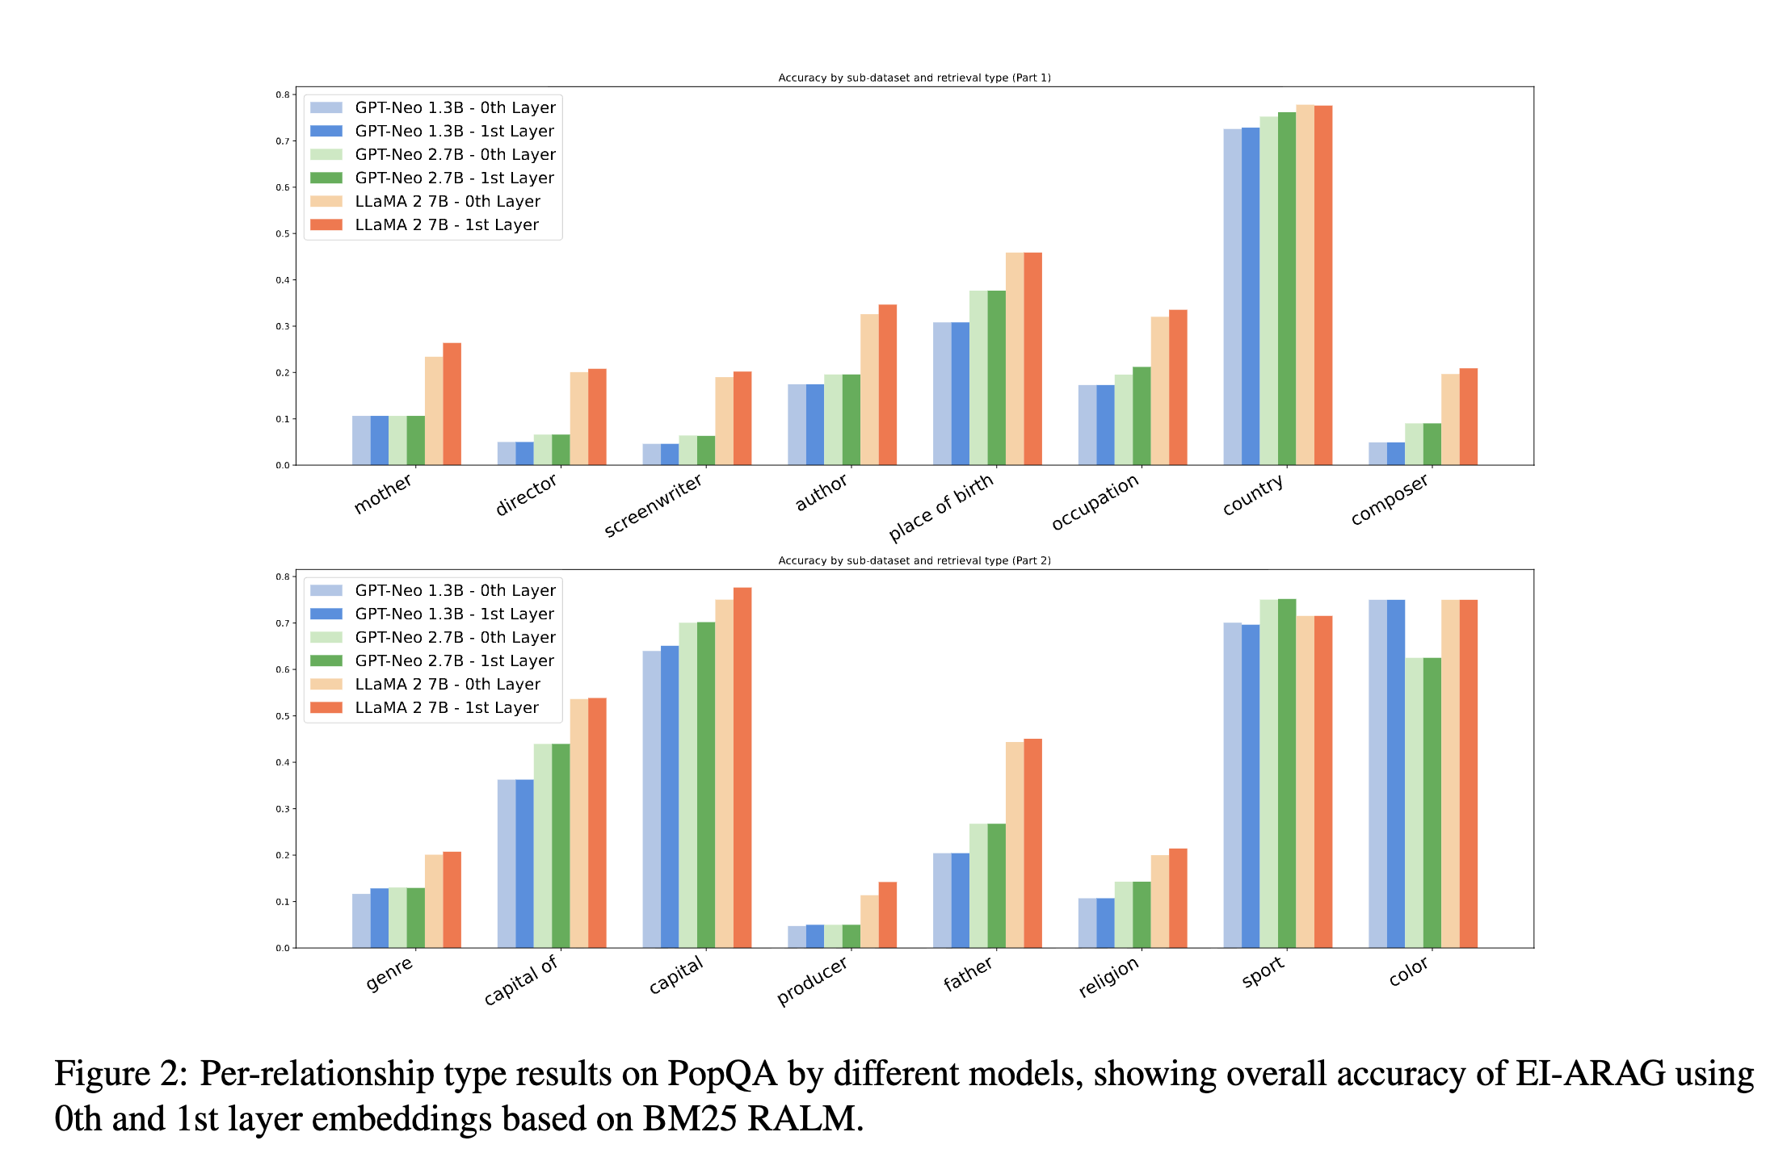
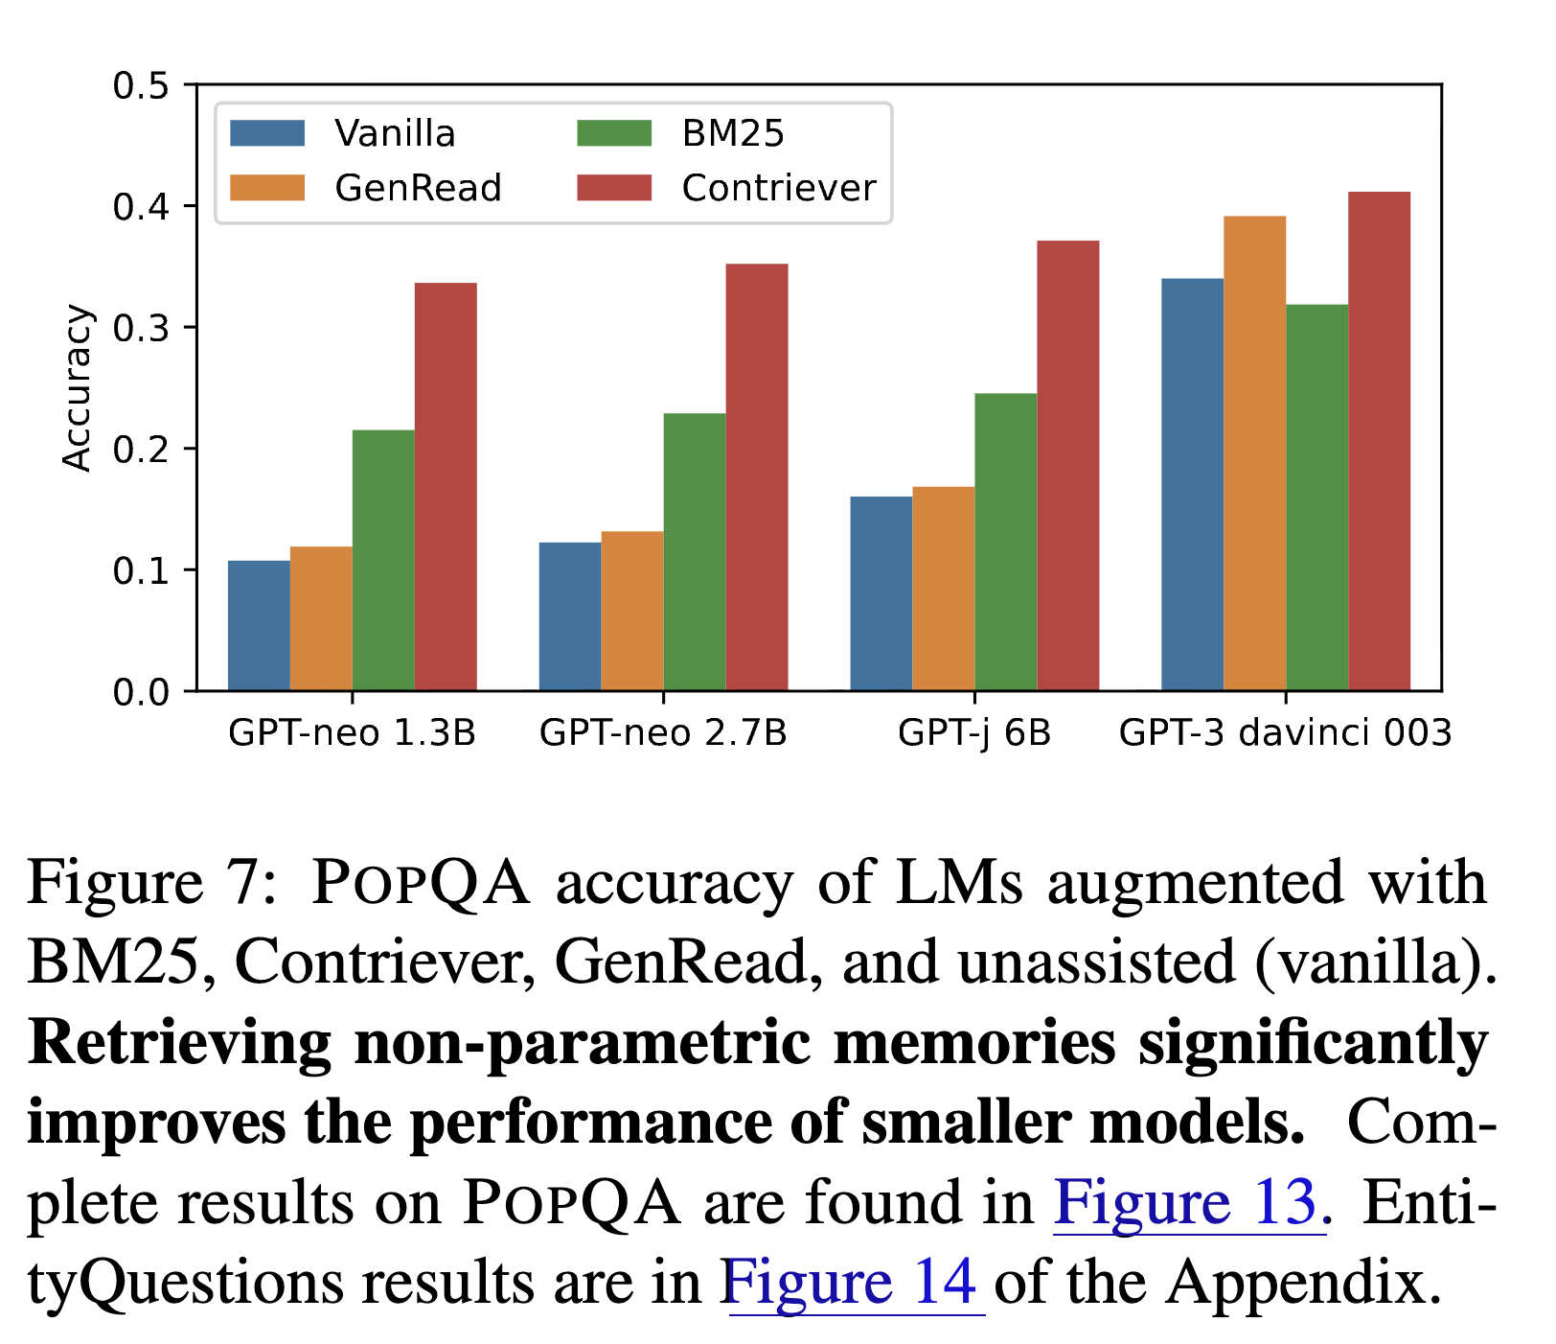
Applications of BM25
PopQA is a large-scale open-domain question answering (QA) dataset, consisting of 14k entity-centric QA pairs.
When Not to Trust Language Models: Investigating Effectiveness of Parametric and Non-Parametric Memories
Embedding-Informed Adaptive Retrieval-Augmented Generation of Large Language Models https://aclanthology.org/2025.coling-main.94.pdf

Slide 12

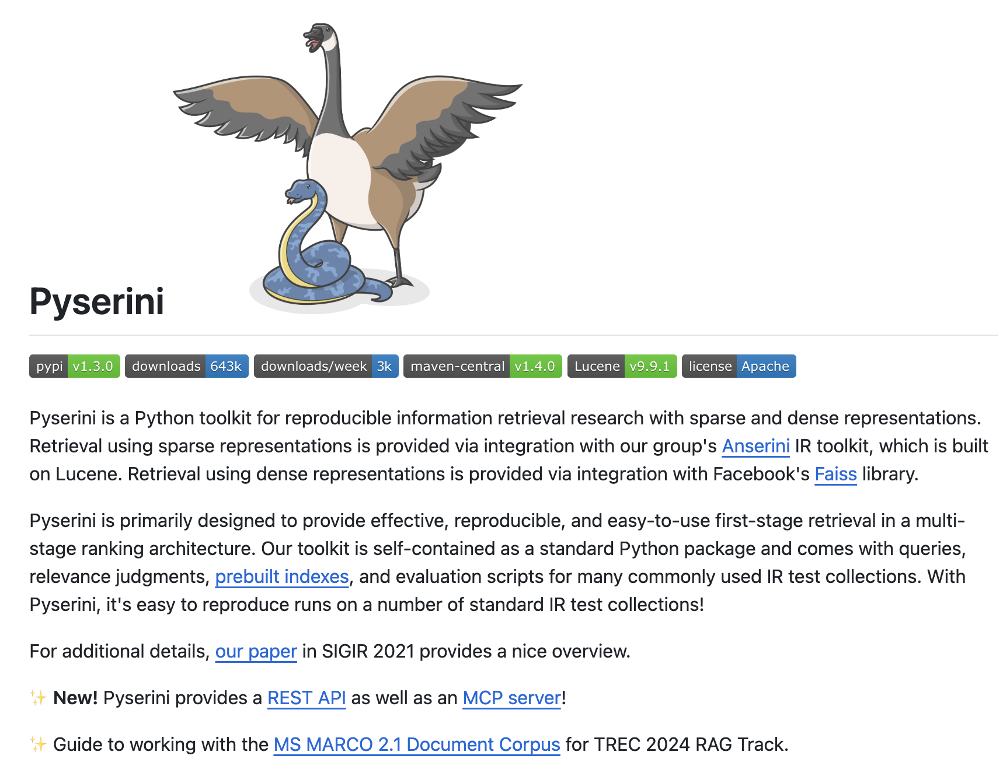
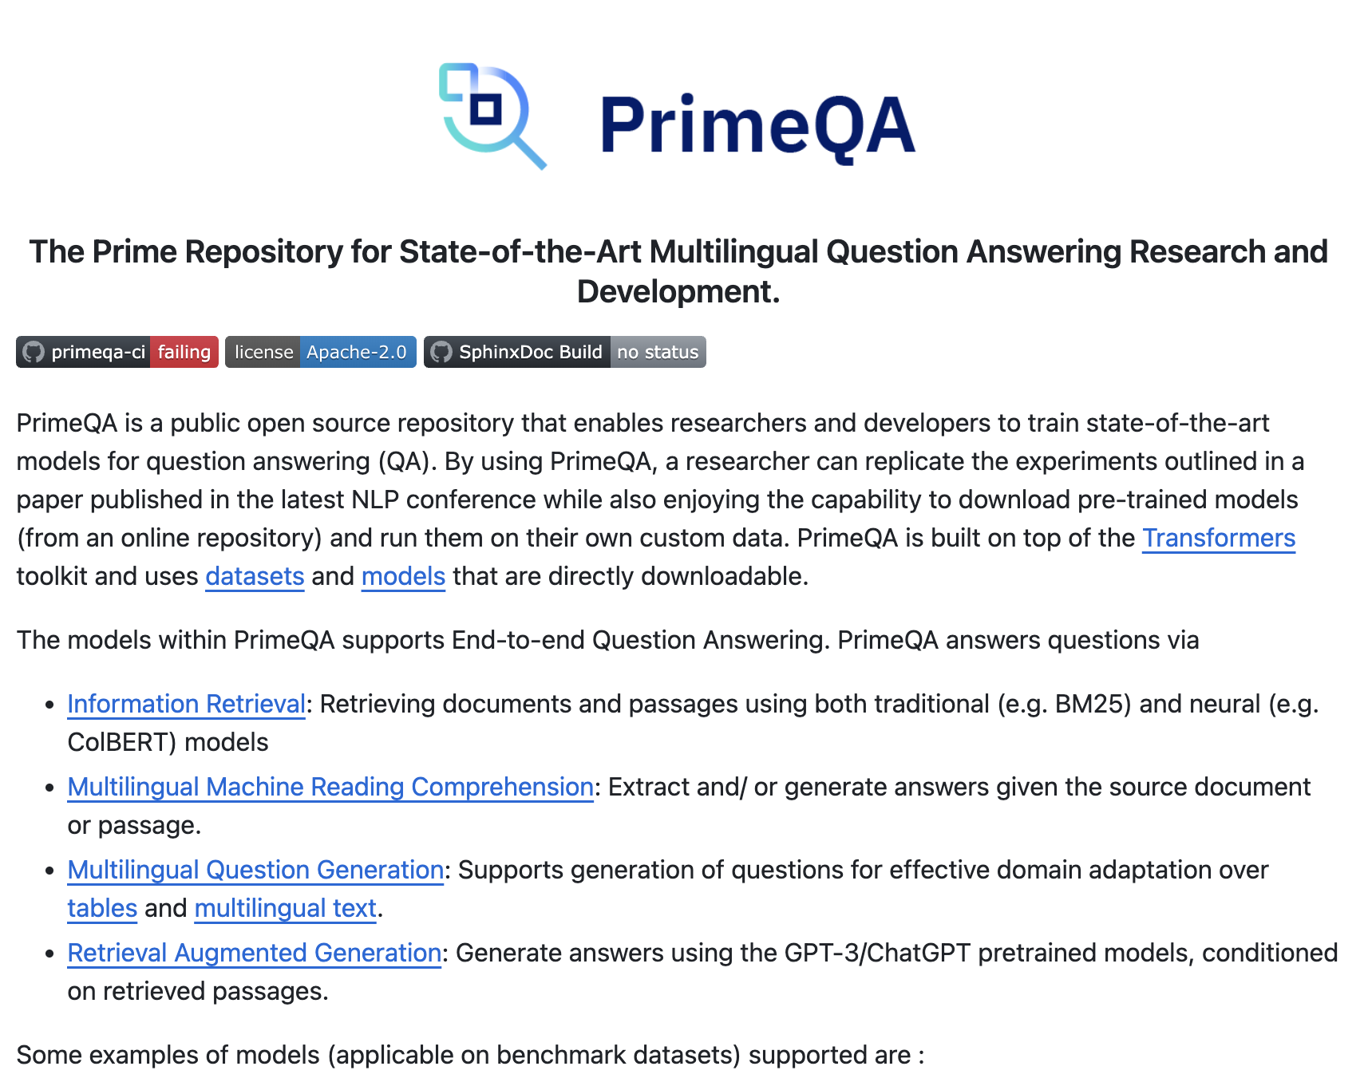
Tools for classic IR
Elasticsearch: https://www.elastic.co
Pyserini: https://github.com/castorini/pyserini
PrimeQA: https://github.com/primeqa/primeqa

Slide 13
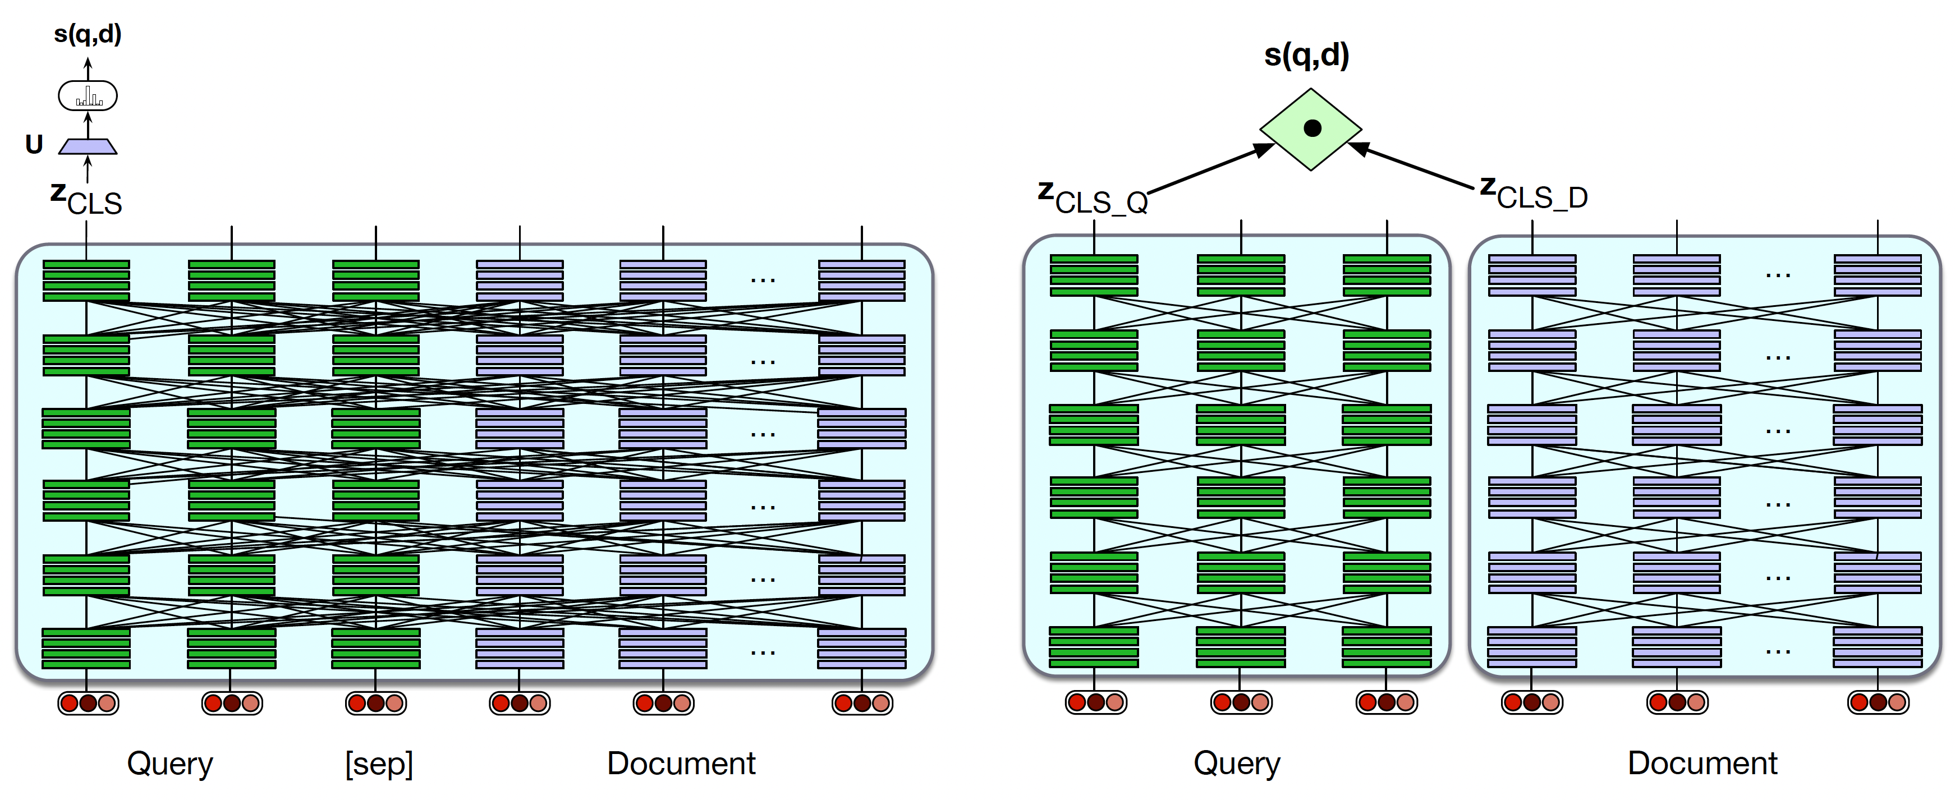
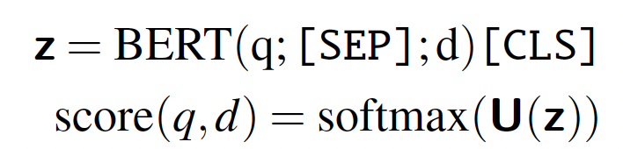
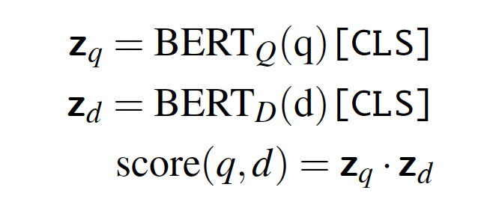
From Sparse BM25 to Dense Retrieval
Vocabulary Mismatch Problem: Methods like TF-IDF and BM25 rely on exact word overlap between query and document.
Sparse vectors only count words—no semantic understanding.

Slide 14
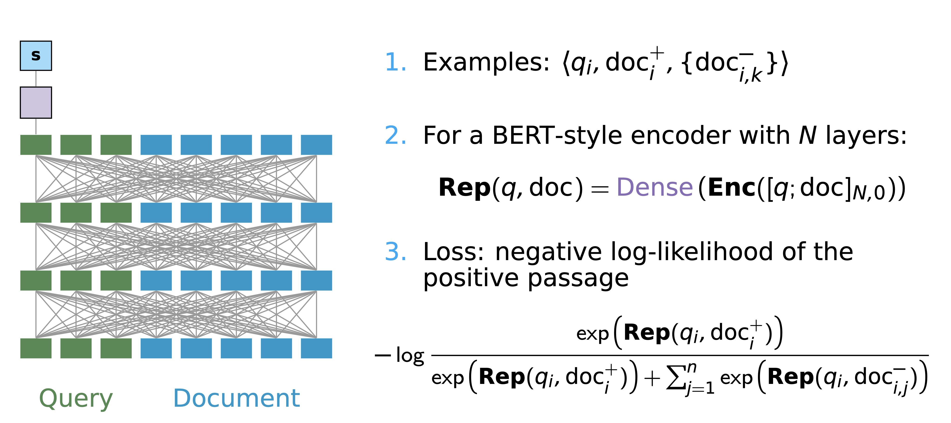
Neural IR Cross-encoders
Incredibly rich, but won’t scale!

Slide 15
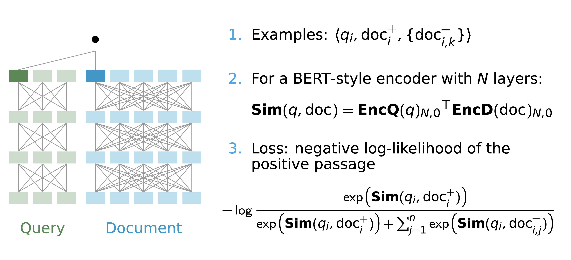
Neural IR Dense Passage Retrieval
Highly scalable, but limited query/doc interactions!

Slide 16
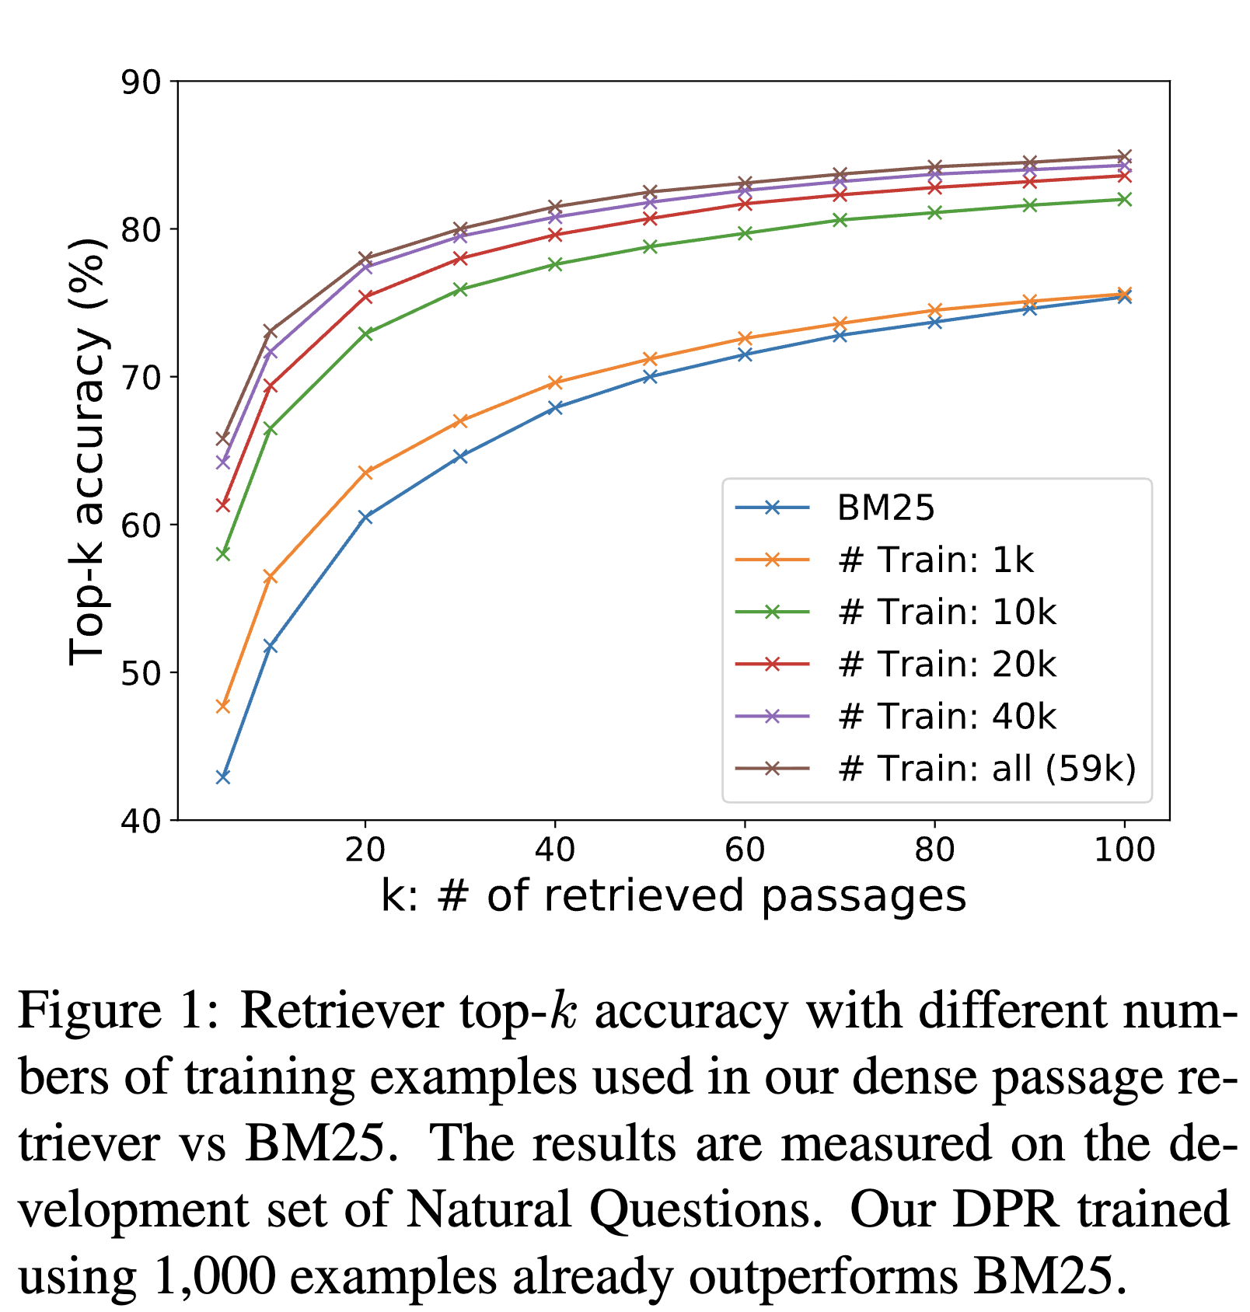
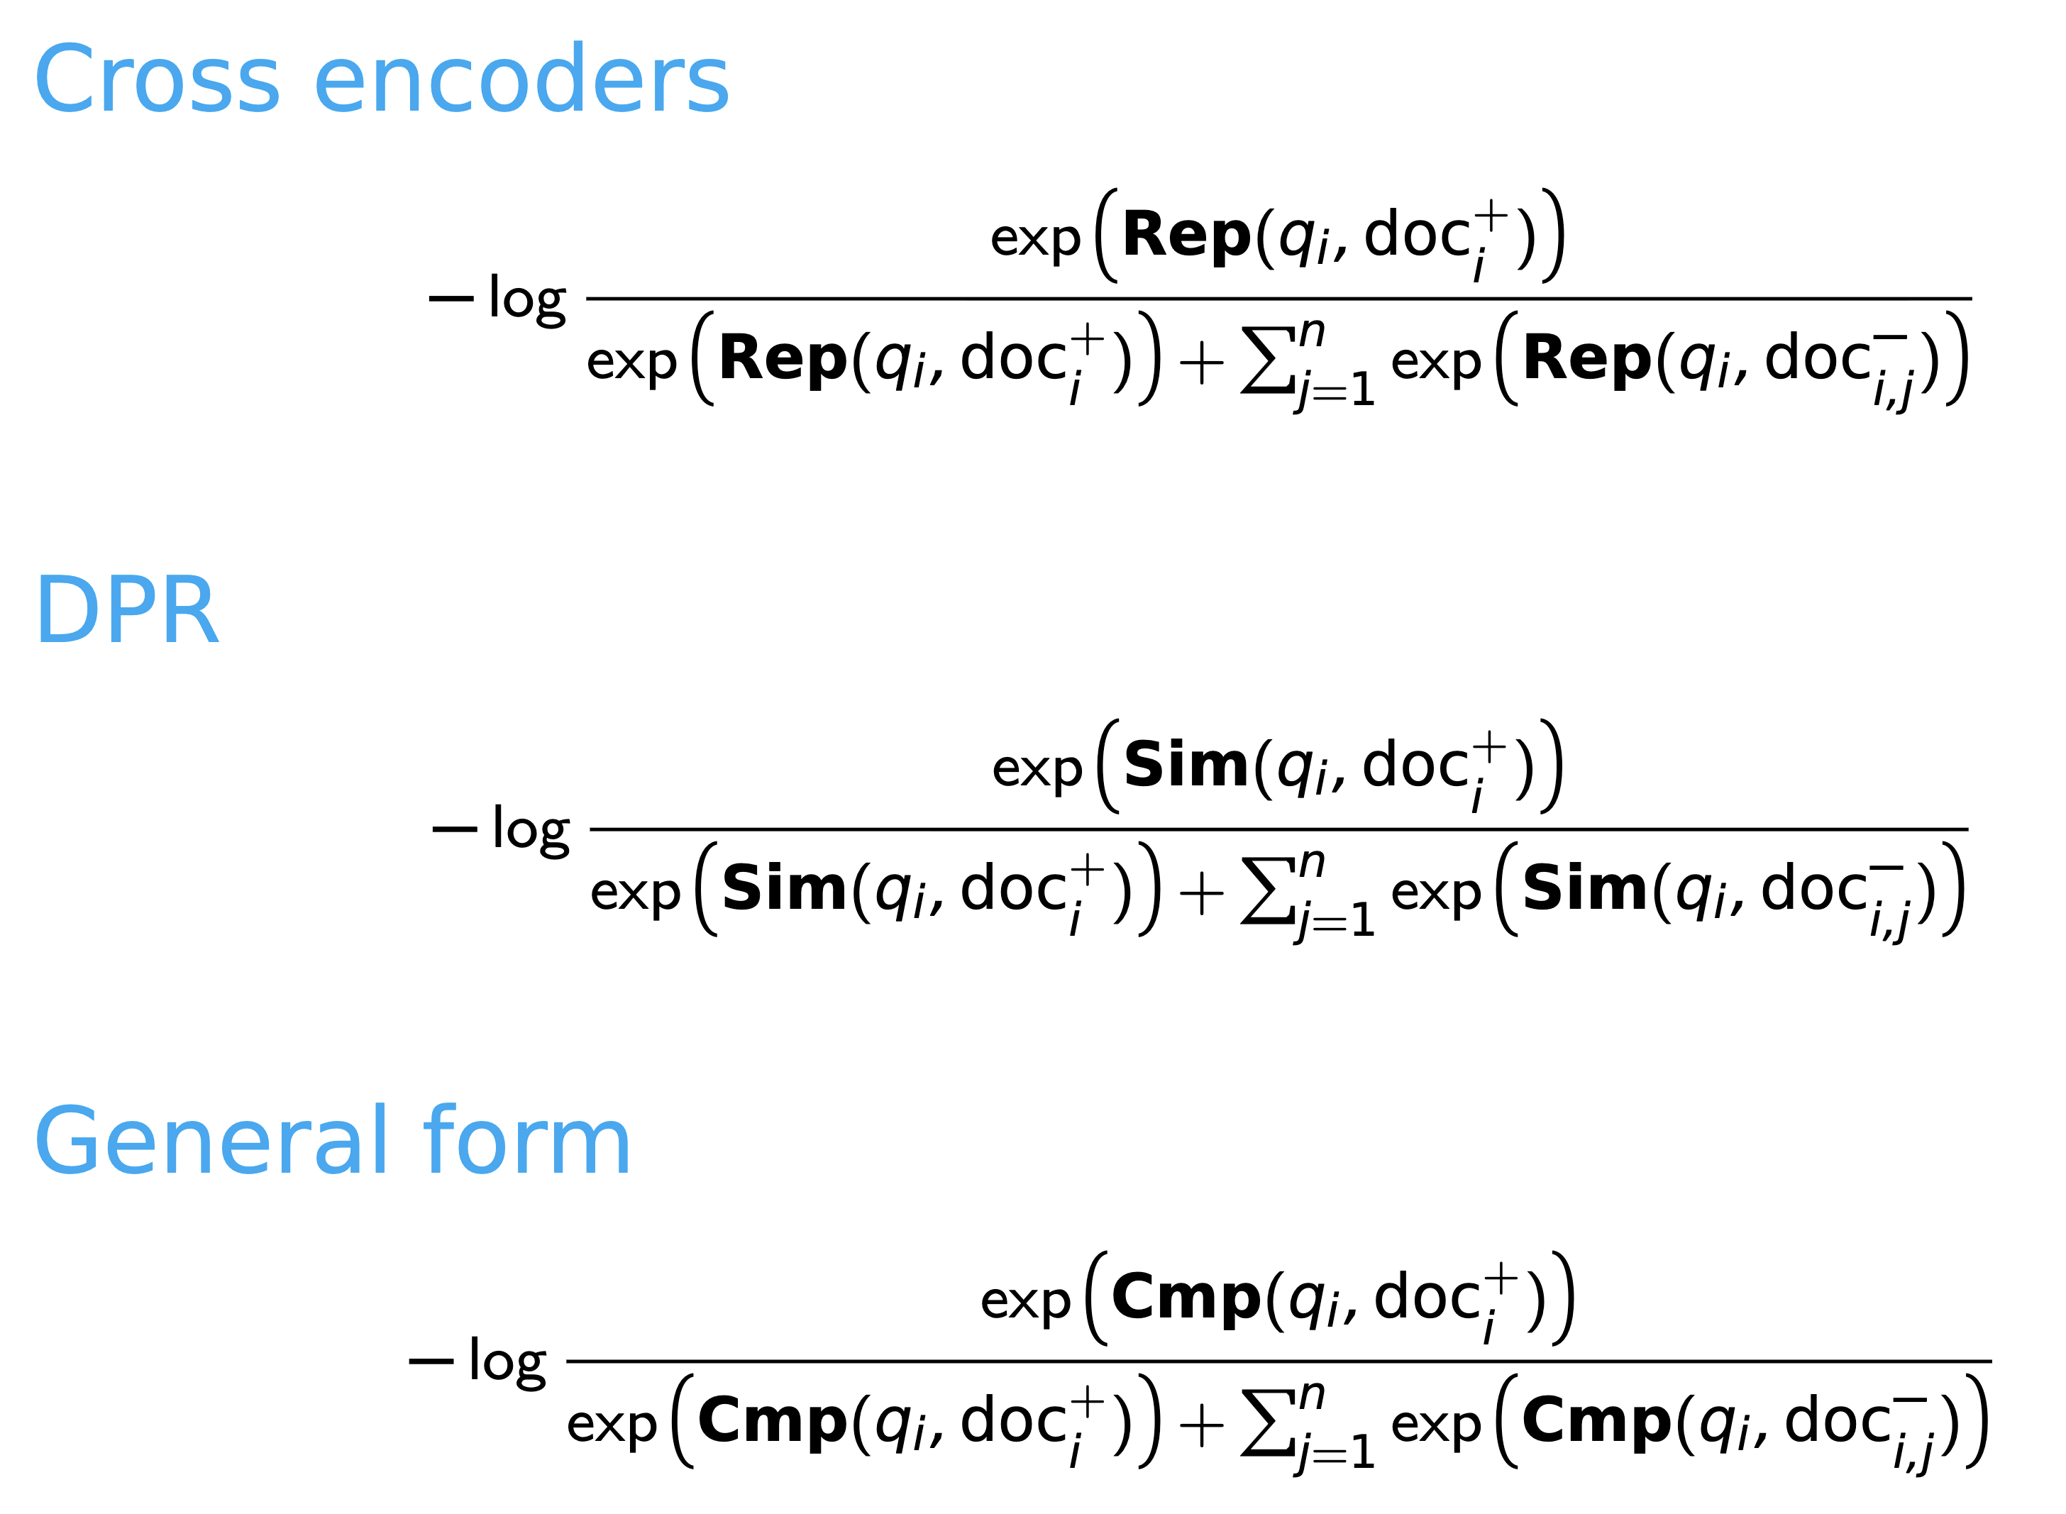
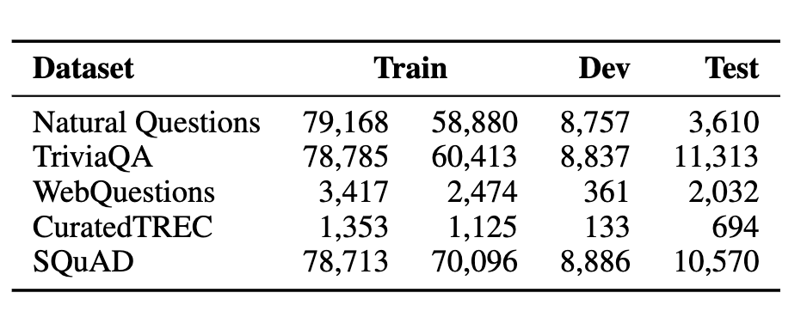
Neural IR Cross-Encoder vs DPR
Shared loss function: The negative log-likelihood of the positive passage

Slide 17
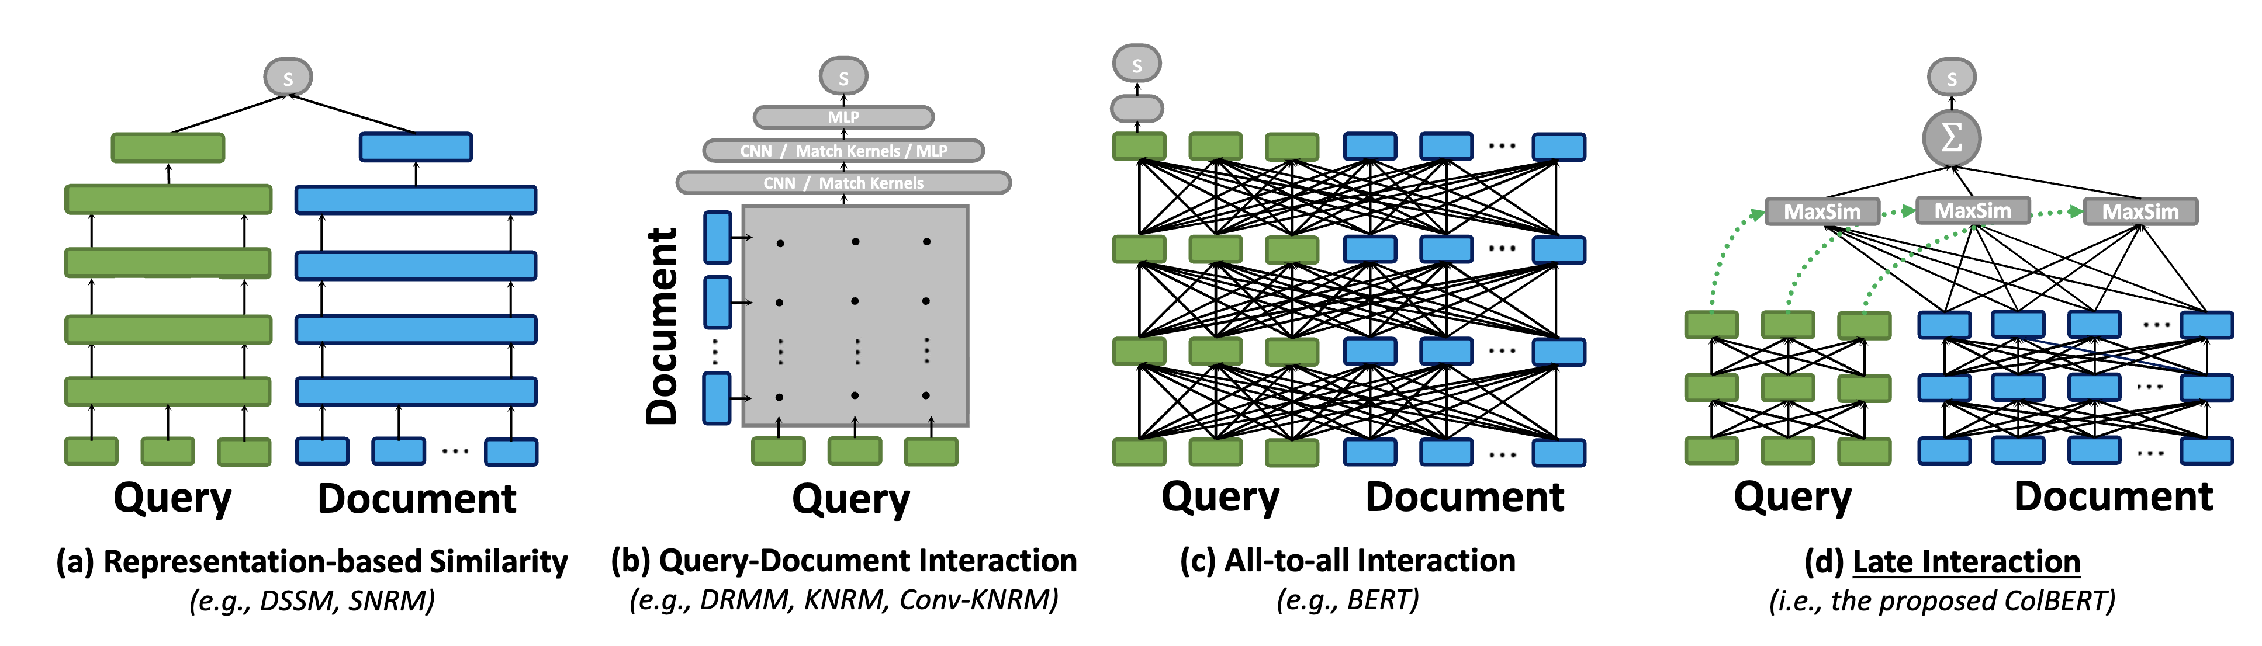
Neural IR ColBERT
ColBERT uses a late interaction architecture that separately encodes queries and documents with BERT, then performs a lightweight token-level similarity matching to retain fine-grained relevance signals.
This design allows document embeddings to be pre-computed and indexed, enabling retrieval that is both highly accurate and orders of magnitude faster than traditional cross-encoder BERT ranking.
ColBERT: Efficient and Effective Passage Search via Contextualized Late Interaction over BERT
Notes:
ColBERT 采用 后交互（late interaction） 架构：首先用 BERT 分别对查询和文档独立编码，然后通过轻量级的 词级相似度匹配 保留细粒度的相关性信息。
允许文档向量提前预计算并建立索引，使得检索过程在保持高精度的同时，比传统的跨编码器（cross-encoder）BERT 排序方法快上数个数量级。

Slide 18
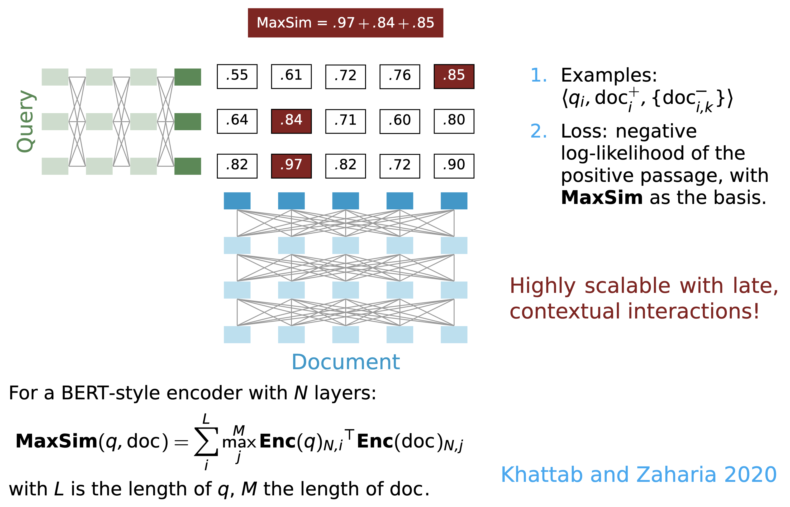
Neural IR ColBERT

Slide 19
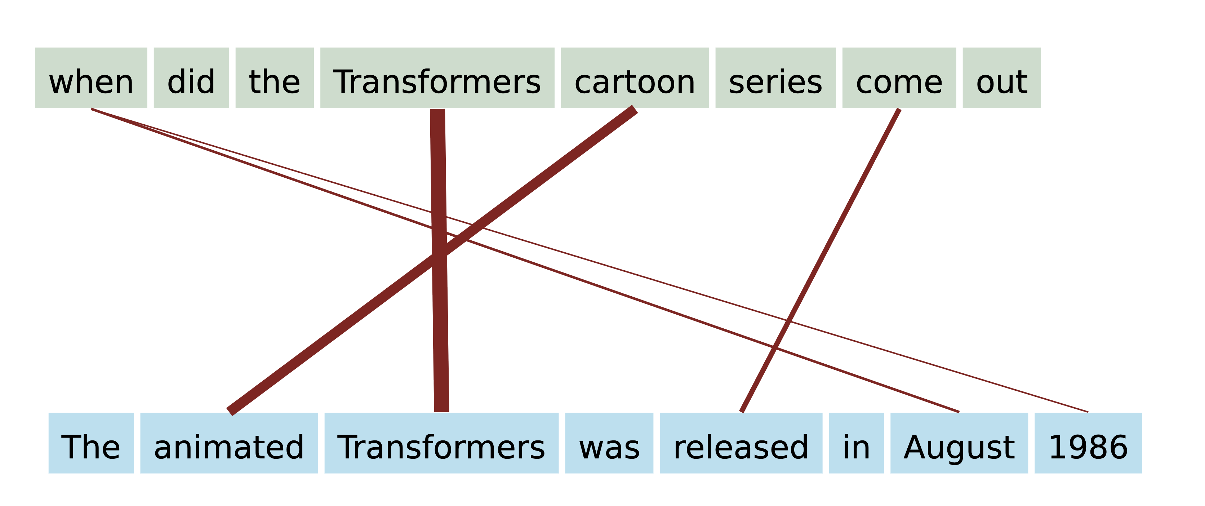
Neural IR ColBERT
Soft alignment with ColBERT
It matches each query token to its most similar document token using late-interaction max-sim scoring, enabling fine-grained semantic comparison without running BERT on every query–document pair.

Slide 20
References
[1] https://web.stanford.edu/class/cs224u/slides/cs224u-neuralir-2023-handout.pdf
[2] Jurafsky & Martin. Speech and Language Processing, Chapter 11: Information Retrieval and RAG. Draft, Jan 2026.
[3] Stanford CS224U Neural IR slides: cs224u-neuralir-2023-handout.pdf
Next lecture: Diffusion language models

