Slide 1
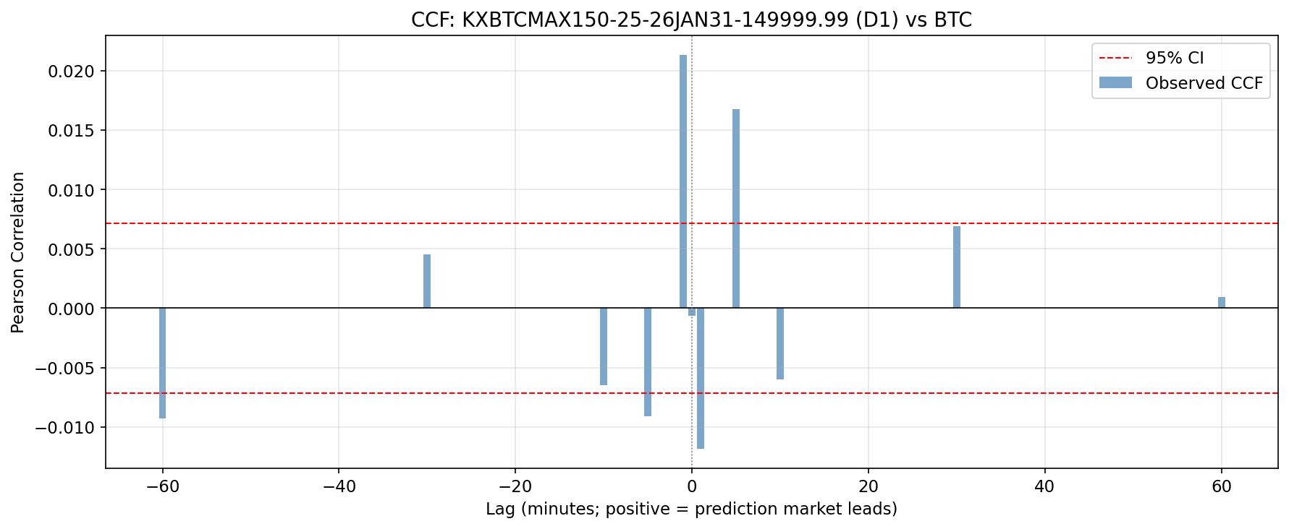
Granger Causality — Confirmed at Scale
QuantSC | Crypto Desk
Full 53-market universe · Bonferroni-corrected
Key findings
• 60 (market, definition) pairs tested across all 53 markets
• 43 pairs significant at raw p < 0.05
• 25 pairs survive Bonferroni correction (p < 0.05 after ×60 adjust)
• Top result: p = 1.51×10⁻³⁰ — KXBTCMAX150-25-26JAN31 / D4, lag = 23 min
D4 profile (volume-confirmed z-score)
• Best lags 23–30 min — tighter and more consistent than D1 (6–45 min)
• Higher correlation at best lag, lower variance across markets
• Granger p-values an order of magnitude lower than D1/D2/D3
• Trade-off: fewer signals than D1 (volume gate filters ~42%)
Verdict
The information edge is real and confirmed.
The question is whether it's tradeable.
Top Bonferroni-significant pairs (25 of 60 passed)
Market
Def
Lag
p-value (raw)
KXBTCMAX150-25-26JAN31
D4
23 min
1.51×10⁻³⁰
KXBTCMAX150-25-26JAN31
D1
6 min
3.2×10⁻¹⁸
KXBTCMAX150-25-26MAR31
D4
25 min
8.7×10⁻¹⁵
KXBTCMAXY-25-DEC31-...
D4
28 min
2.1×10⁻¹²

Slide 2
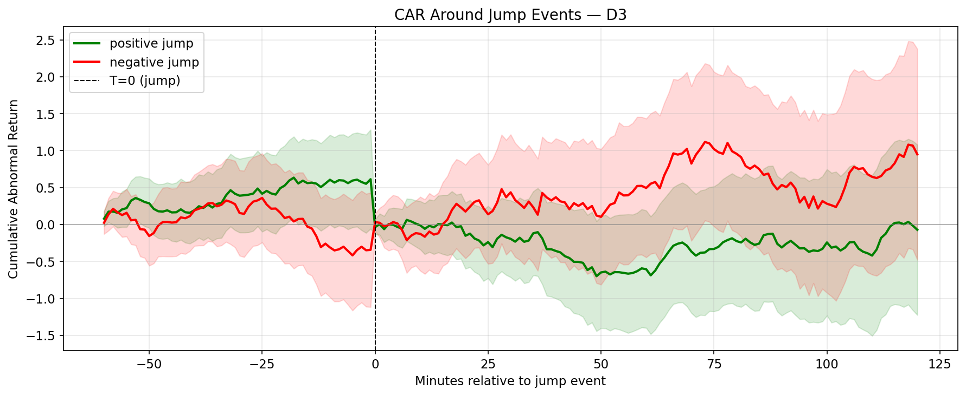
The Move Happens Before You Can Enter
QuantSC | Crypto Desk
Direction-adjusted CAR · 240-min window · 10bp cost hurdle · 5 primary BTC markets
Event Study Results
Definition
N Events
Peak Net CAR
p-value
Pass?
D1
304
−0.12%
0.17
✗ FAIL
D2
44
+0.005%
0.54
✗ FAIL
D3
18
+0.26%
0.19
✗ FAIL
D4
170
−0.13%
0.35
✗ FAIL
Statistical test: one-sample t-test on individual event returns at peak bar
(H₀: mean return = 0) — none pass p < 0.05
Conclusion
BTC prices the Kalshi signal within the first minute.
By T+1 the move has already happened — entries are systematically late.
H=240 survives not by catching the initial move,
but by riding the sustained drift that follows confirmed jumps.

Slide 3
STRATEGY 2 | Backtest
Only H=240 Produces Positive Sharpe
– Strategy: enter BTC long/short at T+1 after signal, hold H bars, exit on stop-loss
– Costs: 0.075% commission round-trip + 0.025% slippage + 1.5× vol stop-loss
– Data split: 60/20/20 chronological by events — test set used exactly once
– All figures below are the validation set (reliable)
Def
H=10
H=30
H=60
H=240 Sharpe
H=240 Max DD
H=240 Trades
D1
-2.30
-1.92
-1.31
+0.37
16.6%
30
D2
-1.79
-0.71
-0.34
+1.29
5.1%
44
D3
-1.88
-0.58
+0.03
+1.21
7.9%
65
D4
-2.36
-1.65
-0.58
+0.94
9.1%
66

Slide 4
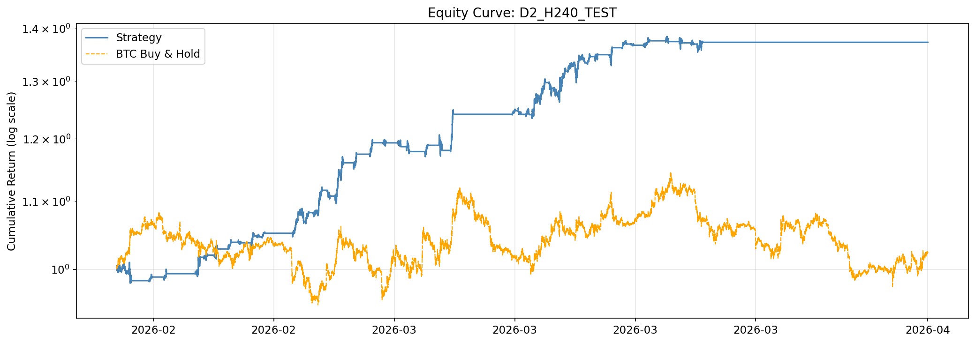
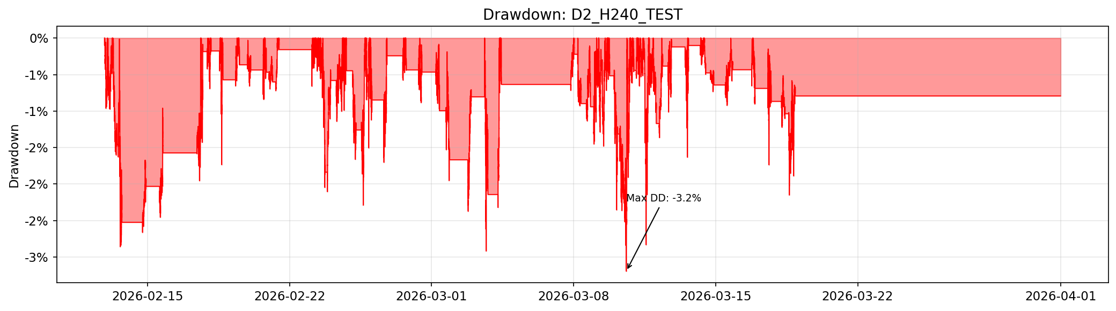
H = 240 Equity Curves: Controlled Drawdowns
QuantSC | Crypto Desk
D2 shown · Test set · Net of all costs · Benchmark = BTC buy-and-hold
Equity Curve — D2, H=240
Drawdown — D2, H=240
Drawdown profile — validation numbers (reliable)
• D2 max drawdown = 5.1% — well below 20% threshold
• D3 max drawdown = 7.9% — also passes
• D1 max drawdown = 16.6% — passes but leaves little buffer
Note on test-set Sharpe / CAGR
Test Sharpe of 8–13 is inflated: btc_ret spans full history, so zero-padded
train/val bars dominate the daily resample and crush realised volatility.
Drawdown is unaffected (computed on per-bar returns). Fix is next semester.

Slide 5
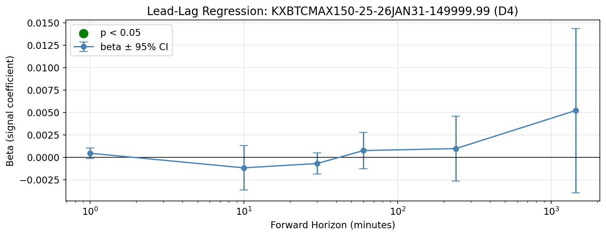
Signal Survives the Most Conservative Treatment
QuantSC | Crypto Desk
No-forward-fill test · Parameter sensitivity ±20%
Check 1 — No-Forward-Fill
Standard pipeline carries last known probability forward across quiet minutes.
Removing this makes the signal sparser — harder to detect, harder to trade.
D1 events: 2,293 → 258 (−89%)
D4 events: 1,323 → 147 (−89%)
Granger still holds on the sparse signal:
D1 p = 2.0×10⁻⁷ ✓
D4 p = 9.7×10⁻³ ✓
D1 H=240 test Sharpe = 1.62 ✓
Check 2 — Parameter Sensitivity (D3 rel-threshold ±20%)
Multiplier
Threshold
Sharpe
0.8×
0.160
1.73
0.9×
0.180
1.81
1.0×
0.200
1.87
1.1×
0.220
1.91
1.2×
0.240
1.95
Robust across all ±20% perturbations ✓

Slide 6
What We're Building Next Semester
QuantSC | Crypto Desk
Fix First
Extensions
Test-set index bug
Slice btc_ret to the test window before passing to run_backtest.
Full BTC history currently enters the daily resample, crushing vol
and inflating Sharpe to 8–13. One-line fix.
Event study normalization bug
full_event_study runs with normalize=True — divides returns by
pre-event vol, outputting σ-units not %. Re-run with normalize=False.
Walk-forward start date
Currently set to Jan 2022 (BTC history start). Kalshi data only
begins Nov 2024. Set start = Nov 2024 for meaningful windows.
Sub-minute Kalshi feed
10-second data via WebSocket. Re-run Granger at higher frequency —
sub-minute leads likely exist and would compress the 23-min lag.
Regime conditioning
Use KXCPI / KXFED markets as macro filters on H=240 entries.
Only trade when the macro regime is aligned with the signal.
Multi-asset expansion
Re-run full pipeline on ETH/SOL. Test whether BTC Kalshi signals
spill over to other assets for cross-asset alpha.
Live paper trading
Top 5 Bonferroni pairs (D4). Track live Sharpe vs backtest weekly.

