Slide 1
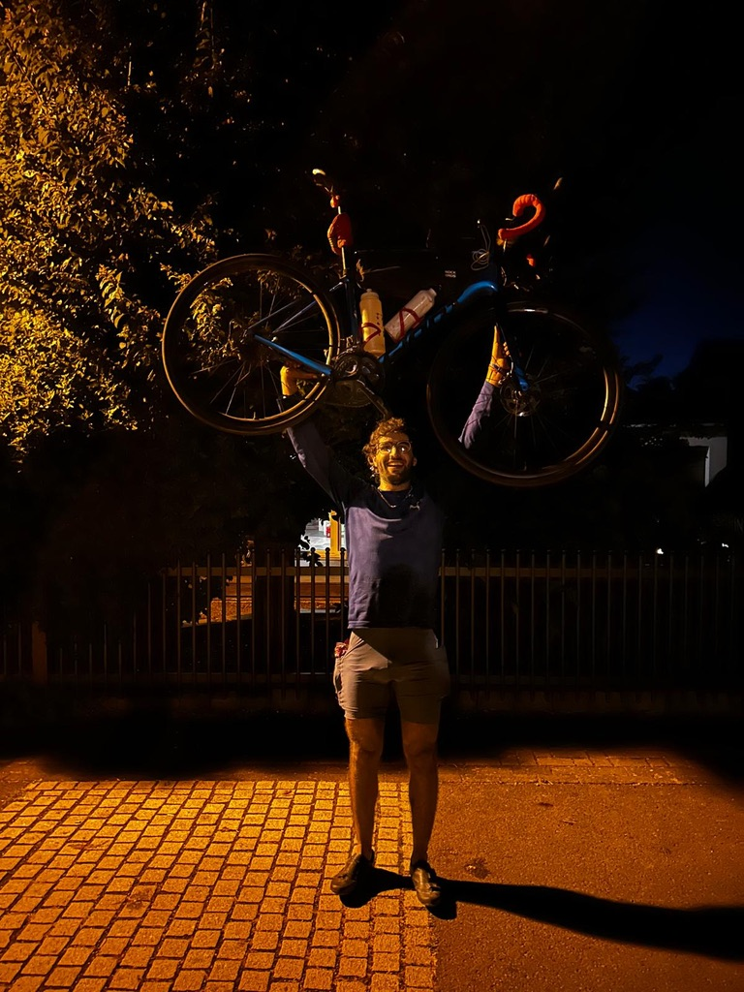
24 JUN → 10 JUL 2026
EUROPE
BY BICYCLE
14 riding days / 7 countries / 3,049.44 km
This is the trip I actually rode, not the route I drew before leaving.
Notes:
Open at the finish. The trip ran from June 24 to July 10, 2026: 17 elapsed days, 14 riding days, three rest or non-riding days, and seven countries. The audited riding distance is 3,049.438 km. The point of the talk is not that the original plan worked. It is that nearly every important part of the trip arrived after the plan broke.
[Sources]
- /Users/kian/Documents/Codex/2026-08-30/okay-that-post-was-the-most/sources/trip-chronology.txt
- /Users/kian/Documents/Codex/2026-08-30/okay-that-post-was-the-most/assets/manifest.txt
- https://www.youtube.com/watch?v=NWt_1sTojmA
[/Sources]

Slide 2
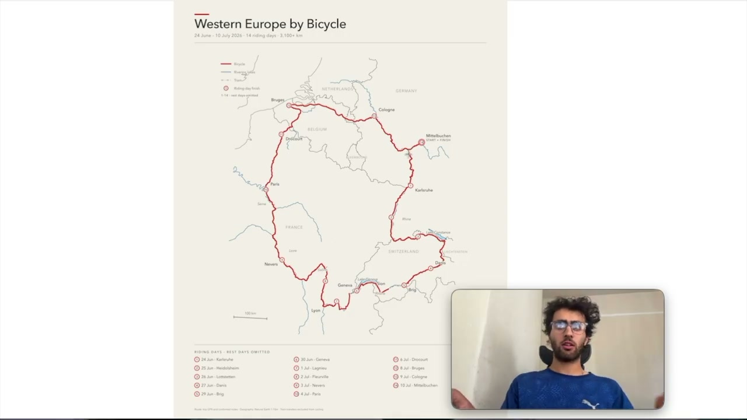
THE WHOLE LOOP
17 ELAPSED DAYS
THE PLAN
AND THE RIDE
4,173
3,049.44
KM IN THE ORIGINAL GPX
KM ACTUALLY RIDDEN
The vlog says 3,000. The map graphic says 3,100. The GPS, FIT and Strava audit resolves it to 3,049.438 km.
14 RIDING DAYS
3 REST DAYS
EXCLUDED: S-BAHN + BRIG→SION + GENEVA→VALSERHÔNE TRAINS
EUROPE BY BICYCLE
02
Notes:
Explain the numbers before anyone has to wonder which total is real. The original route file was 4,173 km. The public summary rounded the ride to about 3,100 km and the titles rounded it to 3,000 km. A later audit of Strava activities, FIT and GPX files, and Photos timestamps established 3,049.438 km as the preferred riding total, with a plausible range of 3,040 to 3,061 km. The S-Bahn on June 24 and train segments on June 29 and June 30 are excluded.
[Sources]
- /Users/kian/Developer/vélo/strava-europe-trip-audit-2026.md
- /Users/kian/Documents/Codex/2026-08-30/okay-that-post-was-the-most/assets/frames/route-map.jpg
- https://www.youtube.com/watch?v=NWt_1sTojmA&t=12s
[/Sources]

Slide 3
DAILY RIDING DISTANCE
KM / TRAINS REMOVED
THE SHAPE OF 3,049 KM
The last two bars are not a typo.
JUNE
JULY
FINAL 2 DAYS
608.26 KM
LONGEST DAY
337.84 KM
EUROPE BY BICYCLE
03
Notes:
Walk across the chart chronologically. There are three zero-distance days: June 28, July 5, and July 7. July 1 is reconstructed because the activity itself is missing. The final two riding days total 608.26 km. July 9 is the longest day at 337.84 km.
[Sources]
- /Users/kian/Developer/vélo/strava-europe-trip-audit-2026.md
- /Users/kian/Documents/Codex/2026-08-30/okay-that-post-was-the-most/sources/trip-chronology.txt
[/Sources]

Slide 4
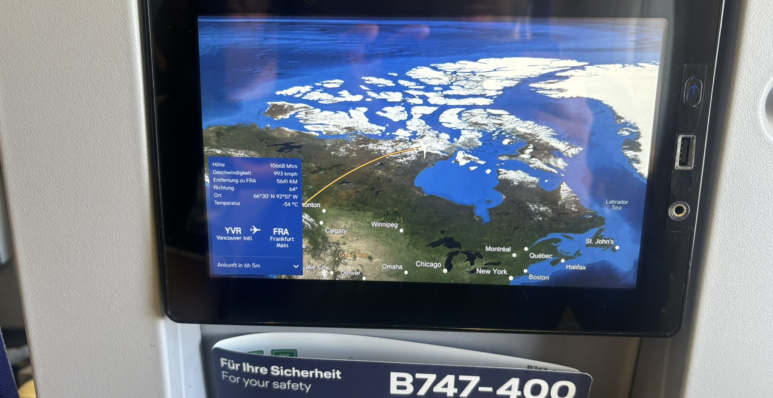
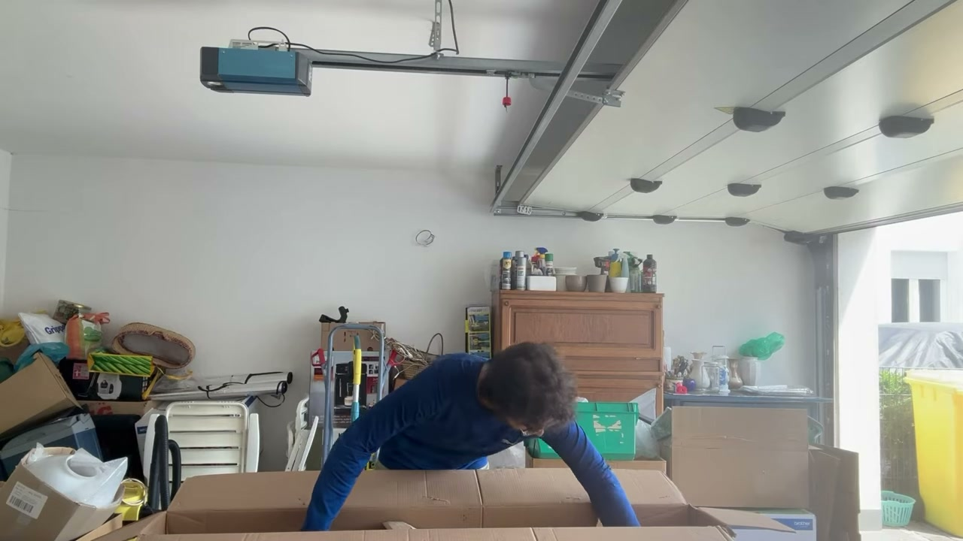
23 JUNE / FRANKFURT
THE DAY BEFORE RIDE 1
BEFORE KILOMETRE ONE,
THE BIKE WAS ALREADY LOOSE
I unpacked the bike in 33°C heat, rebuilt it, added the wrong tubeless sealant, and watched the headset rotate loose on the test ride.
THE FIRST PLAN CHANGE
Leave tomorrow morning instead.
EUROPE BY BICYCLE
04
Notes:
The trip effectively starts one day before the official riding log. I left Canada at 3 a.m., said an emotional goodbye, and flew with the bicycle in a cardboard box. In Frankfurt it was 33°C. The bicycle survived the flight, but after assembly the headset loosened and rotated during a nine-kilometre test ride. I tightened it without a torque wrench and delayed the departure to the next morning. The sealant added that day later made the puncture unrepairable.
[Sources]
- /Users/kian/Documents/Codex/2026-08-30/okay-that-post-was-the-most/transcripts/day-01.txt
- https://www.youtube.com/watch?v=nRVeTv7W0VE&t=44s
- /Users/kian/Library/Mobile Documents/com~apple~CloudDocs/obsidian/notes/2026-06-22.md
[/Sources]

Slide 5
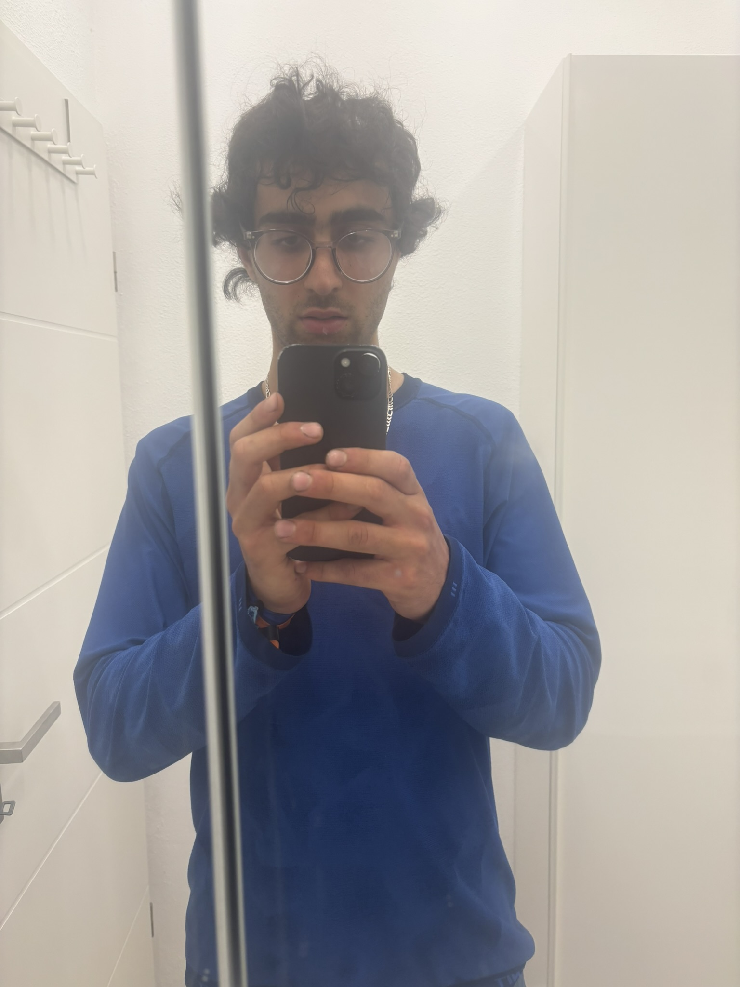
24 JUN / RIDE 1
ONE PEDAL.
FOUR BIKE SHOPS.
224.37 KM.
The pedal stripped the crank in Frankfurt. I rode one-footed to a station, took the train to Mainz, and found the part at shop number four.
08:00
THE CAMERA GOES SILENT FOR 12 HOURS
20:25
22:00 / Karlsruhe / chocolate milk described as heaven
Notes:
Day one nearly ended the trip. I left at 6:30 instead of 5:00 after losing the Polar charger. The headset was still loose. Then the pedal loosened until it destroyed the crank-arm threads. I pedalled with one foot to a station, took a train to Mainz, tried four bicycle shops, and considered returning to the house. The fourth shop had the rare part. The vlog has a twelve-hour hole because I recorded nothing between roughly 8 a.m. and 8:25 p.m. I still reached Karlsruhe and celebrated with bananas, milk, and chocolate milk.
[Sources]
- /Users/kian/Documents/Codex/2026-08-30/okay-that-post-was-the-most/transcripts/day-01.txt
- /Users/kian/Documents/Codex/2026-08-30/okay-that-post-was-the-most/sources/trip-chronology.txt
- https://www.youtube.com/watch?v=nRVeTv7W0VE&t=303s
[/Sources]

Slide 6
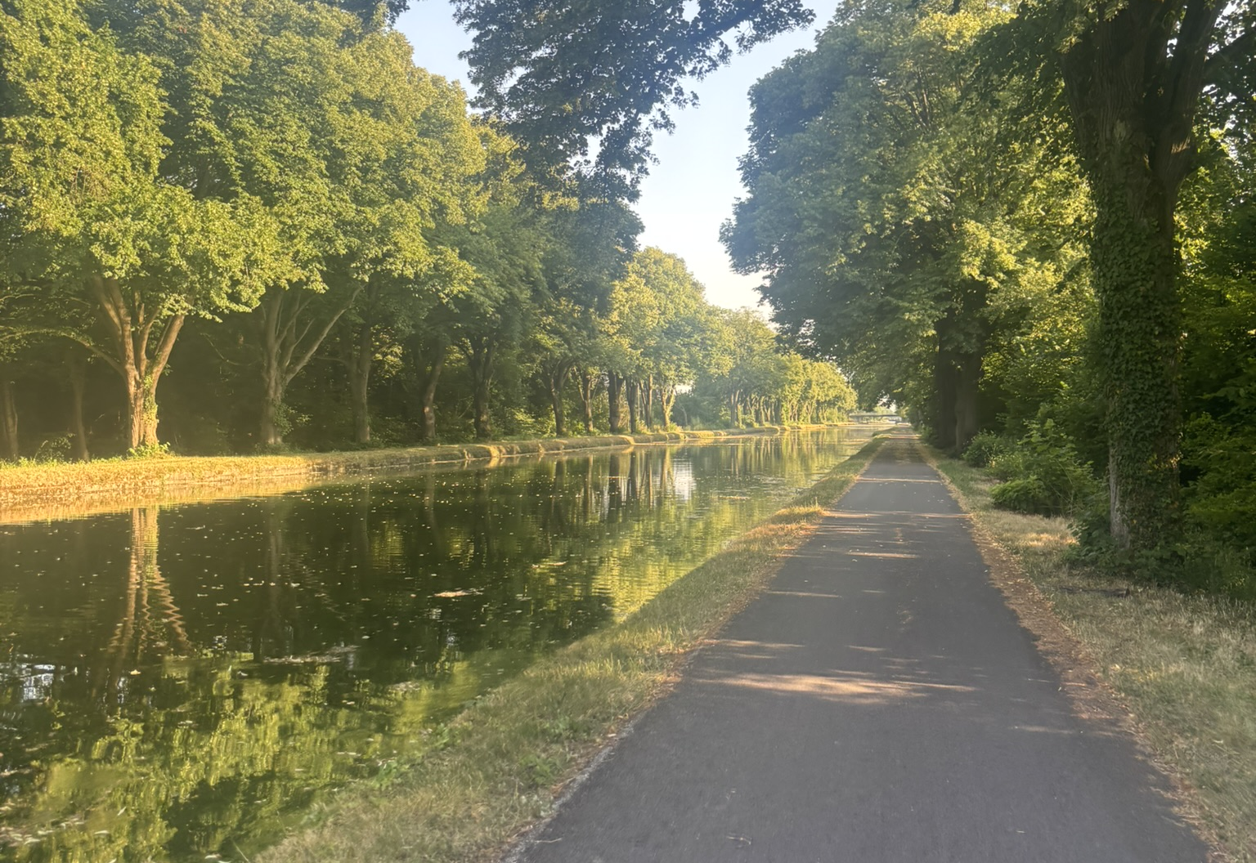
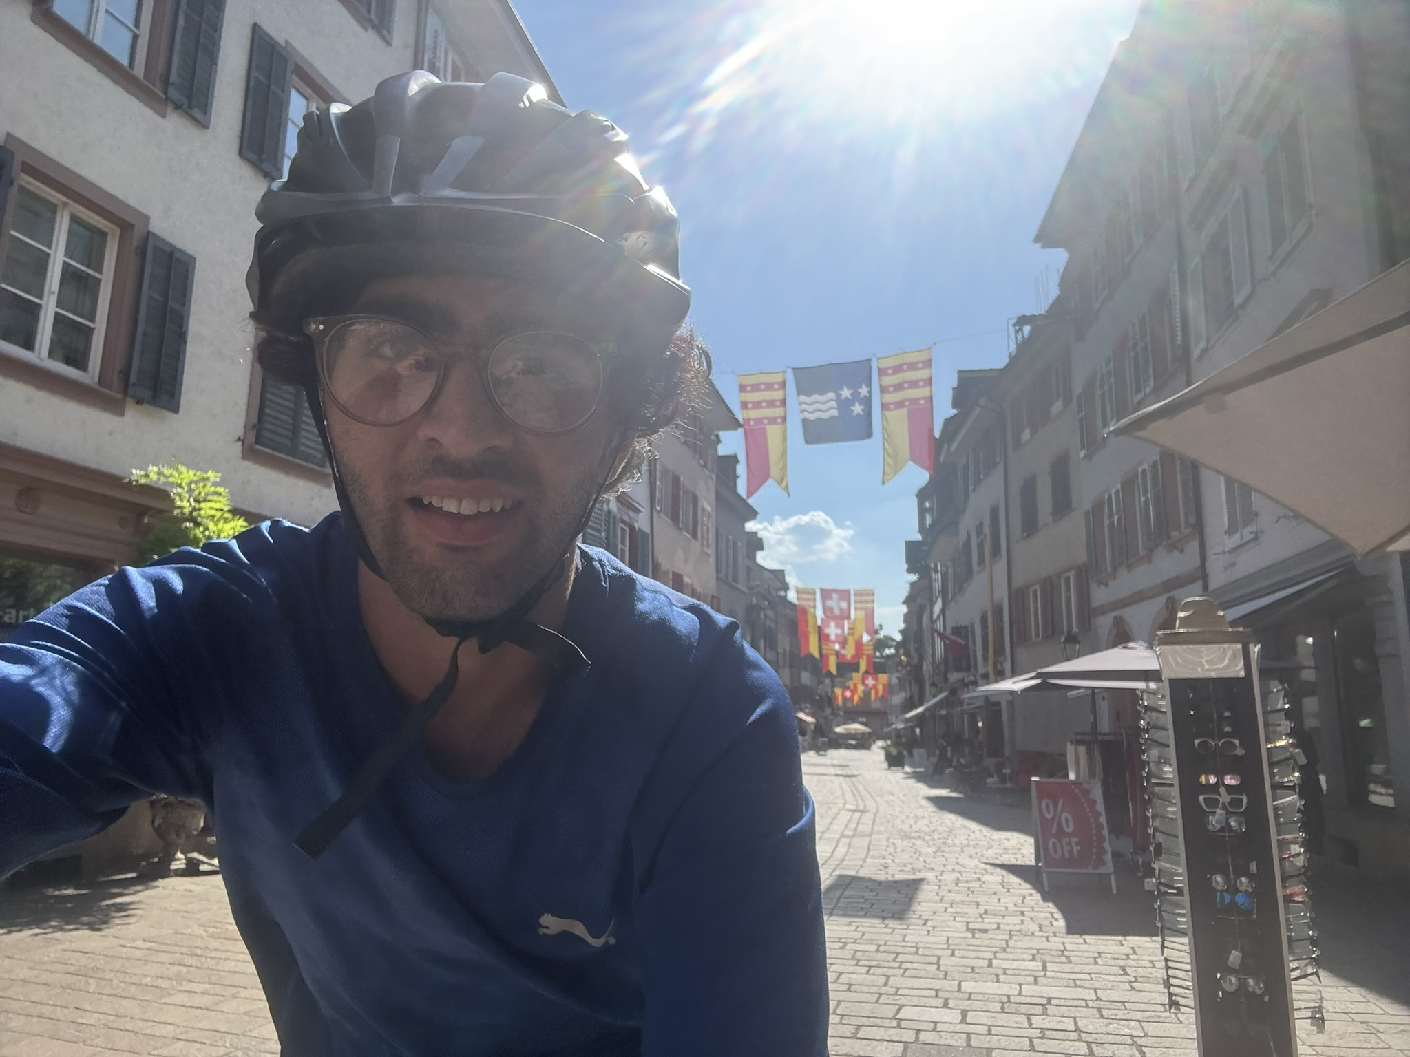
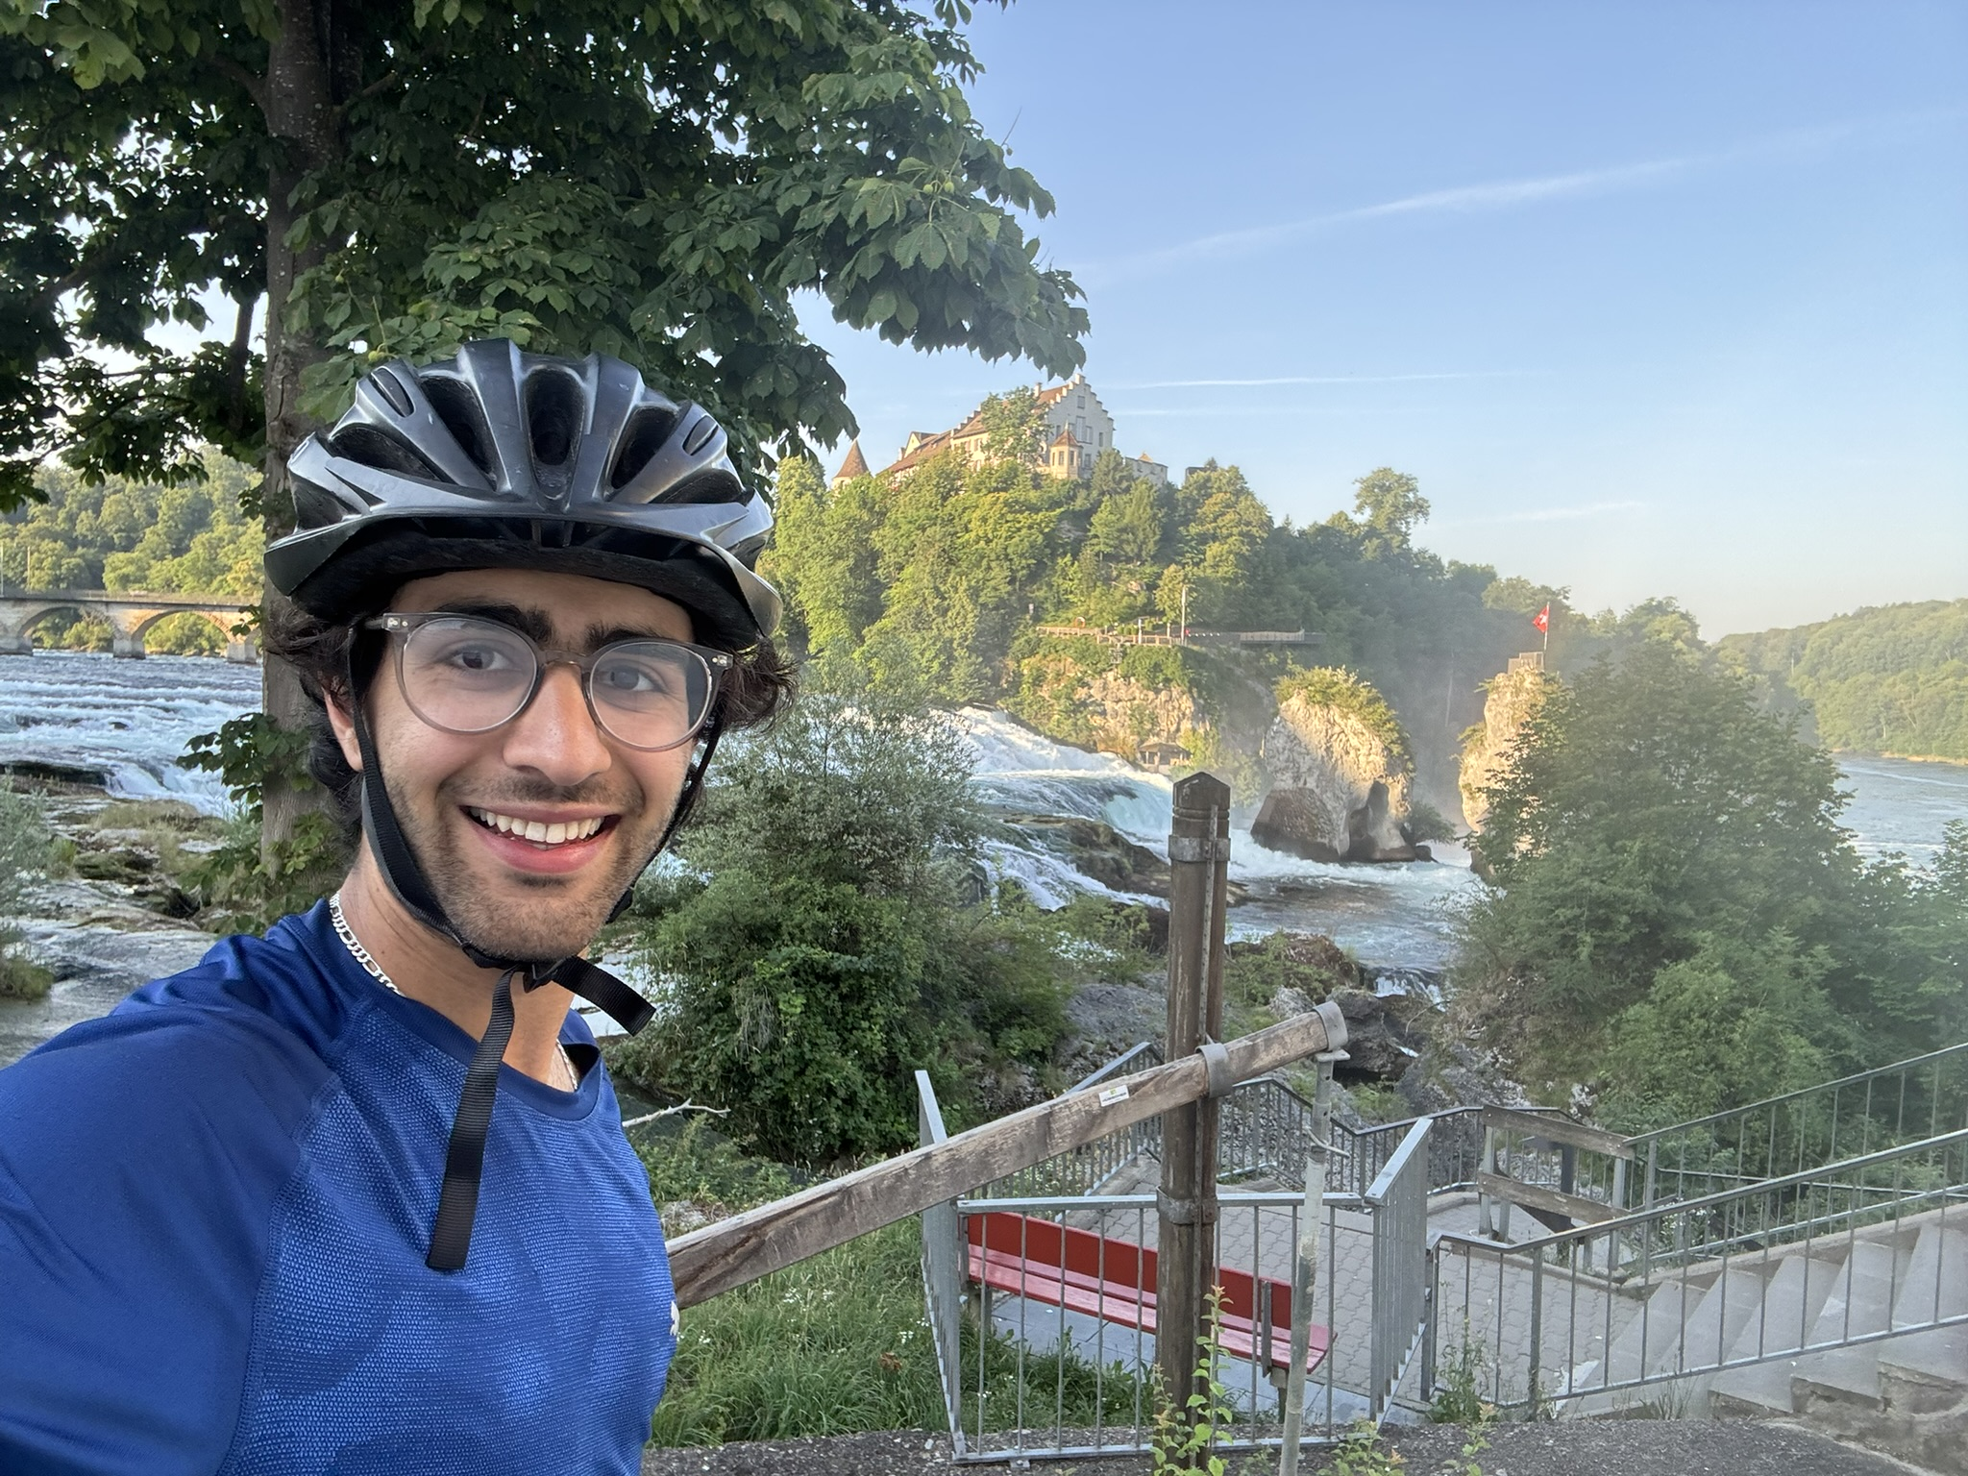
25–27 JUNE / RIDES 2–4
638.18 KM IN 3 DAYS
HEAT, BORDERS, AND A DEAD PHONE
25 JUN
157.57 KM
26 JUN
202.55 KM
27 JUN
278.06 KM
UP TO 42°C
RHINE → ALSACE
TRI-BORDER
PASSPORT ALMOST LOST
4 COUNTRIES
THUNDERSTORM
GERMANY → FRANCE → SWITZERLAND → AUSTRIA → LIECHTENSTEIN
EUROPE BY BICYCLE
06
Notes:
The next three days compress the trip into heat and border crossings. June 25 reached roughly 42°C and ended in Alsace after I realized the Polar charger was gone. June 26 crossed the France-Germany-Switzerland tri-border and included a near-loss of the passport. June 27 went past Rhine Falls and through Germany, Switzerland, Austria, and Liechtenstein in one day. Near Danis, a thunderstorm soaked and disabled the main phone.
[Sources]
- /Users/kian/Documents/Codex/2026-08-30/okay-that-post-was-the-most/transcripts/day-02.txt
- /Users/kian/Documents/Codex/2026-08-30/okay-that-post-was-the-most/transcripts/day-03.txt
- /Users/kian/Documents/Codex/2026-08-30/okay-that-post-was-the-most/transcripts/day-04.txt
- /Users/kian/Documents/Codex/2026-08-30/okay-that-post-was-the-most/sources/trip-chronology.txt
[/Sources]

Slide 7
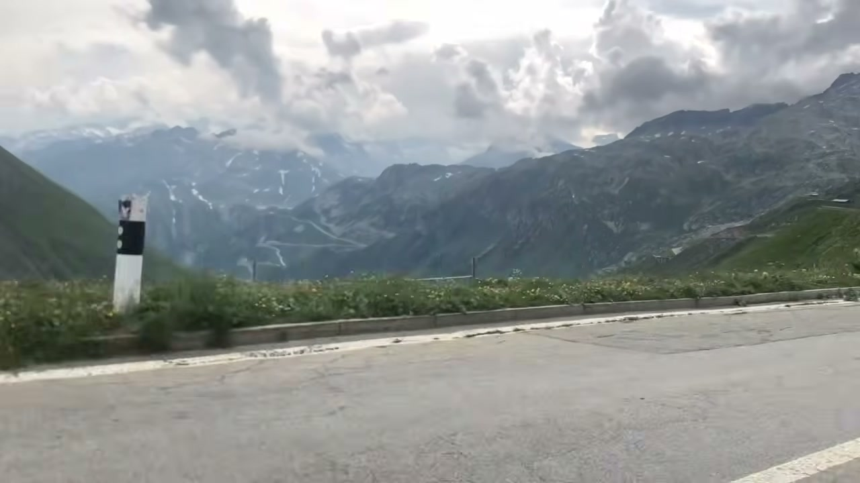
29 JUN / RIDE 5 / 135.60 KM
FURKA
2,436 M
The rest day before it was not recovery. It was Sunday, everything was closed, and I was stranded in Danis with a dead phone.
Oberalp first. Then 13 km and 890 m up Furka.
“Only looking forward.”
Notes:
June 28 was a forced rest day: it was Sunday, repair shops were closed, the phone was dead, and I remained in Danis. Jérôme and Marika helped make the day bearable. The next morning I crossed Oberalp Pass at roughly 2,000 metres and then climbed Furka Pass at 2,436 metres. The Furka climb was about 13 kilometres and 890 metres of elevation. In the vlog I made a deliberate emotional reset: only looking forward. A train from Brig to Sion is excluded from the riding total.
[Sources]
- /Users/kian/Documents/Codex/2026-08-30/okay-that-post-was-the-most/transcripts/day-05.txt
- /Users/kian/Documents/Codex/2026-08-30/okay-that-post-was-the-most/assets/frames/furka-pass.jpg
- https://www.youtube.com/watch?v=hHPp29eo9OI&t=387s
- /Users/kian/Developer/vélo/strava-europe-trip-audit-2026.md
[/Sources]

Slide 8
30 JUN / SION → GENEVA / 163.87 KM
GENEVA
For two hours I rode around the city trying to work out where to sleep. I panicked. I cried. The only open shops I found were inside the station.
Two Airbnb cancellations.
The backup phone died.
The main phone was still broken.
ZAHRAN
A stranger at the station heard what happened and offered me his balcony for the night.
The next morning: masala, eggs, and a way forward.
THE LOW POINT
08
Notes:
This is the emotional low point. After Lake Geneva and Evian, two Airbnb reservations cancelled. The backup iPhone ran out of charge, the main phone screen was broken, and stores had closed. I spent about two hours circling Geneva, panicking and crying, before going to the station. Zahran approached, heard that I had nowhere to sleep, and invited me to travel with him and stay on his balcony. The next morning his family provided masala and eggs.
[Sources]
- /Users/kian/Documents/Codex/2026-08-30/okay-that-post-was-the-most/transcripts/day-06.txt
- /Users/kian/Documents/Codex/2026-08-30/okay-that-post-was-the-most/transcripts/day-07.txt
- https://www.youtube.com/watch?v=8nglV62Vr2o&t=111s
- /Users/kian/Documents/Codex/2026-08-30/okay-that-post-was-the-most/sources/trip-chronology.txt
[/Sources]

Slide 9
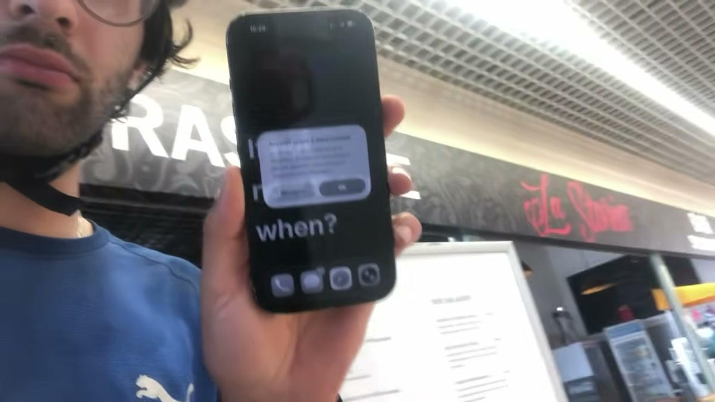
1 JULY / RIDE 7
140.66 KM RECONSTRUCTED
THE ORIGINAL ROUTE
WAS NOW IMPOSSIBLE
ROUTE
REWRITTEN
264 km/day remained, including the Italian Alps.
POINT NORTH
The replacement screen cost €180. My cousin transferred the payment. I pointed north: Lyon → Paris → Belgium → Rhine.
EUROPE BY BICYCLE
09
Notes:
On July 1 a random repair kiosk inside a Carrefour replaced the iPhone 15 screen for 180 euros. Payment itself took hours because the credentials were on the broken phone, so my cousin in Germany transferred the money. With planning restored, I calculated that the original route would require 264 kilometres every remaining day, including major days in the Italian Alps. I rejected it and rerouted north through Lyon, Paris, Belgium, the Netherlands, and back down the Rhine. The July 1 distance is reconstructed because the Strava activity is missing.
[Sources]
- /Users/kian/Documents/Codex/2026-08-30/okay-that-post-was-the-most/transcripts/day-07.txt
- /Users/kian/Documents/Codex/2026-08-30/okay-that-post-was-the-most/assets/frames/phone-fixed.jpg
- https://www.youtube.com/watch?v=8nglV62Vr2o&t=521s
- /Users/kian/Developer/vélo/strava-europe-trip-audit-2026.md
[/Sources]

Slide 10
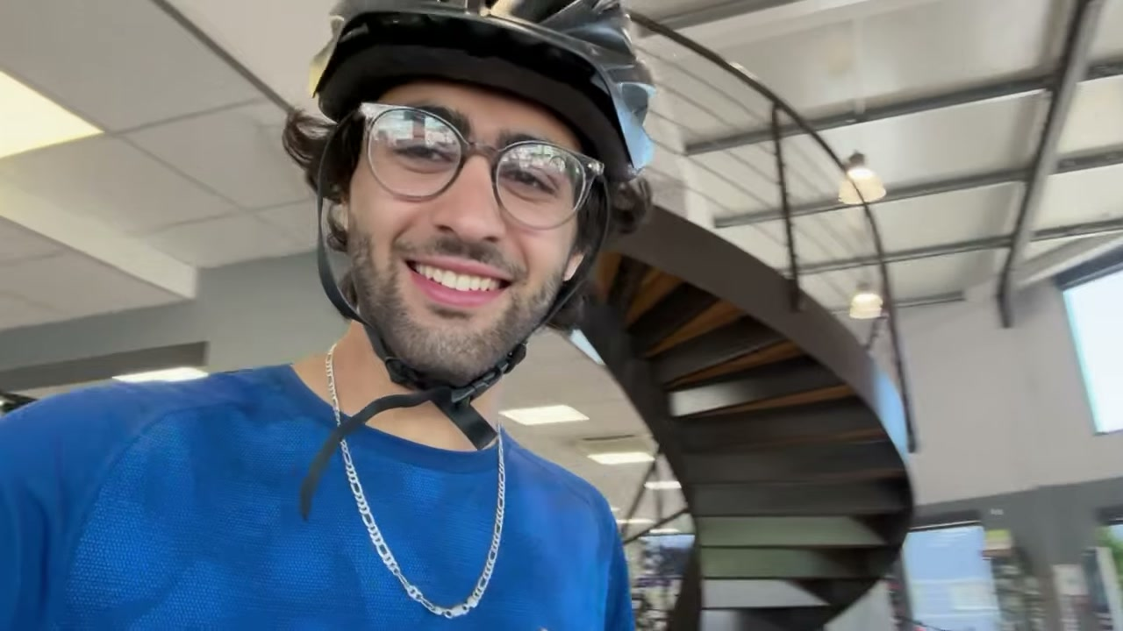
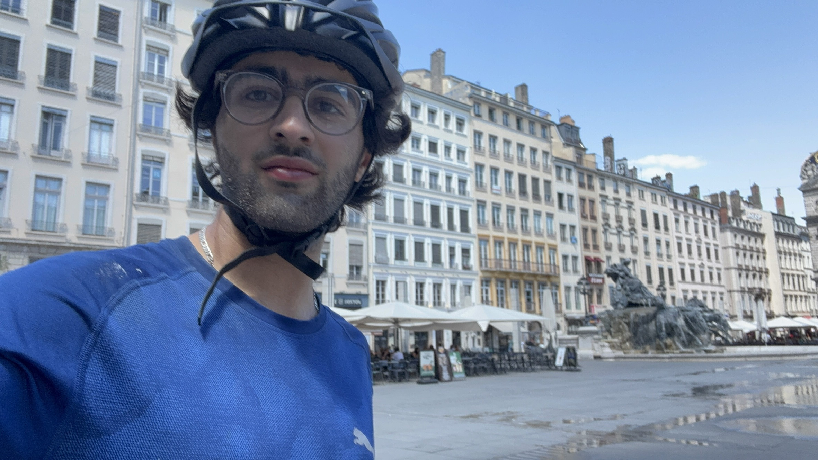
2 JULY / RIDE 8
172.48 KM
THE NEXT PROBLEM WAS A PUNCTURE
OLIVIER + ANTON
€50 tyre · labour + tools free
20 KM
2 L
2–4 KM
Then: Lyon, the Saône, and a bed beside the river.
RIDDEN WHILE IT LEAKED
WATER DUMPED TO SAVE WEIGHT
BETWEEN HAND-PUMP STOPS
EUROPE BY BICYCLE
10
Notes:
The puncture probably began the prior day. The sealant would not close it, and the front tyre fell toward roughly ten PSI. I was about twenty kilometres from a Giant shop. I dumped two litres of water, leaned back to take weight off the front wheel, avoided turns, and stopped every few kilometres to pump. Olivier and Anton replaced the tyre; the incorrect sealant prevented a patch. They charged only the 50-euro part and gave the labour and tools for free. I continued through Lyon and along the Saône.
[Sources]
- /Users/kian/Documents/Codex/2026-08-30/okay-that-post-was-the-most/transcripts/day-08.txt
- /Users/kian/Documents/Codex/2026-08-30/okay-that-post-was-the-most/assets/frames/giant-bike-shop.jpg
- https://www.youtube.com/watch?v=Jw-WU-_shfY&t=339s
- /Users/kian/Documents/Codex/2026-08-30/okay-that-post-was-the-most/assets/photos/day-08-lyon.jpg
[/Sources]

Slide 11
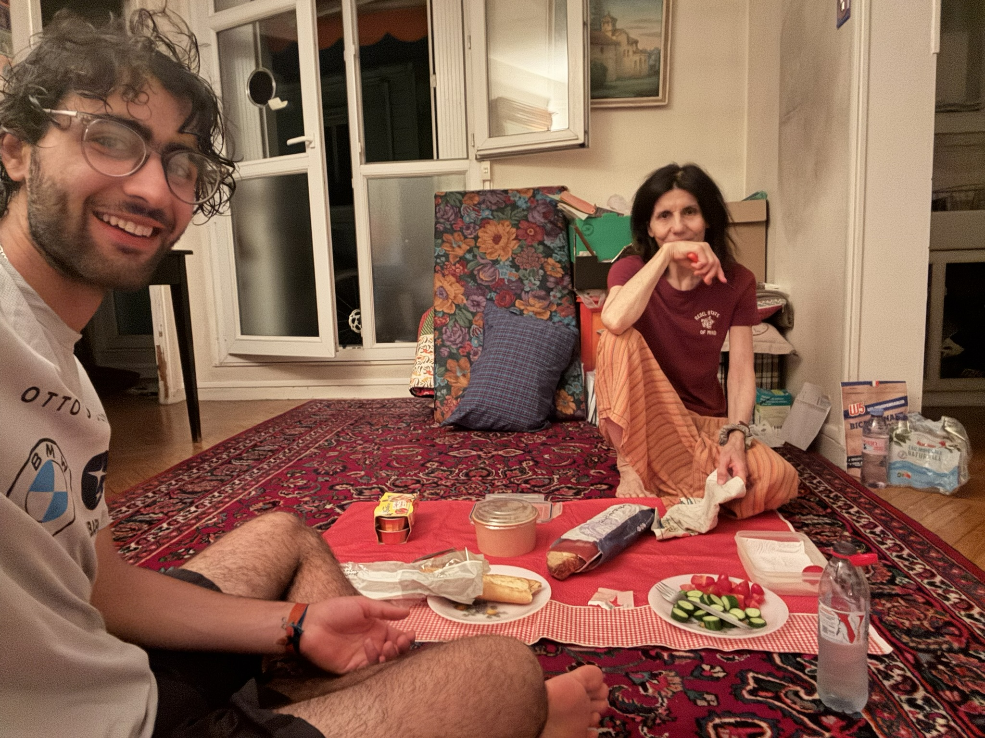
3–4 JUL / RIDES 9–10
562.45 KM
TO PARIS
03 JUL
274.98 KM · FLEURVILLE → NEVERS
Wasp sting. Nosebleed. Lost Croc elastic. Headwind. An 80 km/h road with no shoulder.
04 JUL
287.47 KM · NEVERS → PARIS
Started hungry. Fontainebleau. Paris traffic. Apple Maps sent me to the wrong address. Arrived about 23:30.
Dinner was still waiting.
Notes:
This is the first deliberate closing push. July 3 covered 274.98 km from Fleurville to Nevers through a wasp sting, nosebleed, lost Croc elastic, headwind, and a high-speed road without a shoulder. July 4 covered 287.47 km to Paris after starting hungry, passing a nuclear plant and Fontainebleau, and negotiating Paris traffic. Apple Maps supplied the wrong address near the end. I reached my aunt's home around 11:30 p.m. Two days total: 562.45 km.
[Sources]
- /Users/kian/Documents/Codex/2026-08-30/okay-that-post-was-the-most/transcripts/day-10.txt
- /Users/kian/Documents/Codex/2026-08-30/okay-that-post-was-the-most/transcripts/day-11.txt
- /Users/kian/Documents/Codex/2026-08-30/okay-that-post-was-the-most/sources/trip-chronology.txt
- /Users/kian/Documents/Codex/2026-08-30/okay-that-post-was-the-most/assets/photos/paris-aunt.jpg
[/Sources]

Slide 12
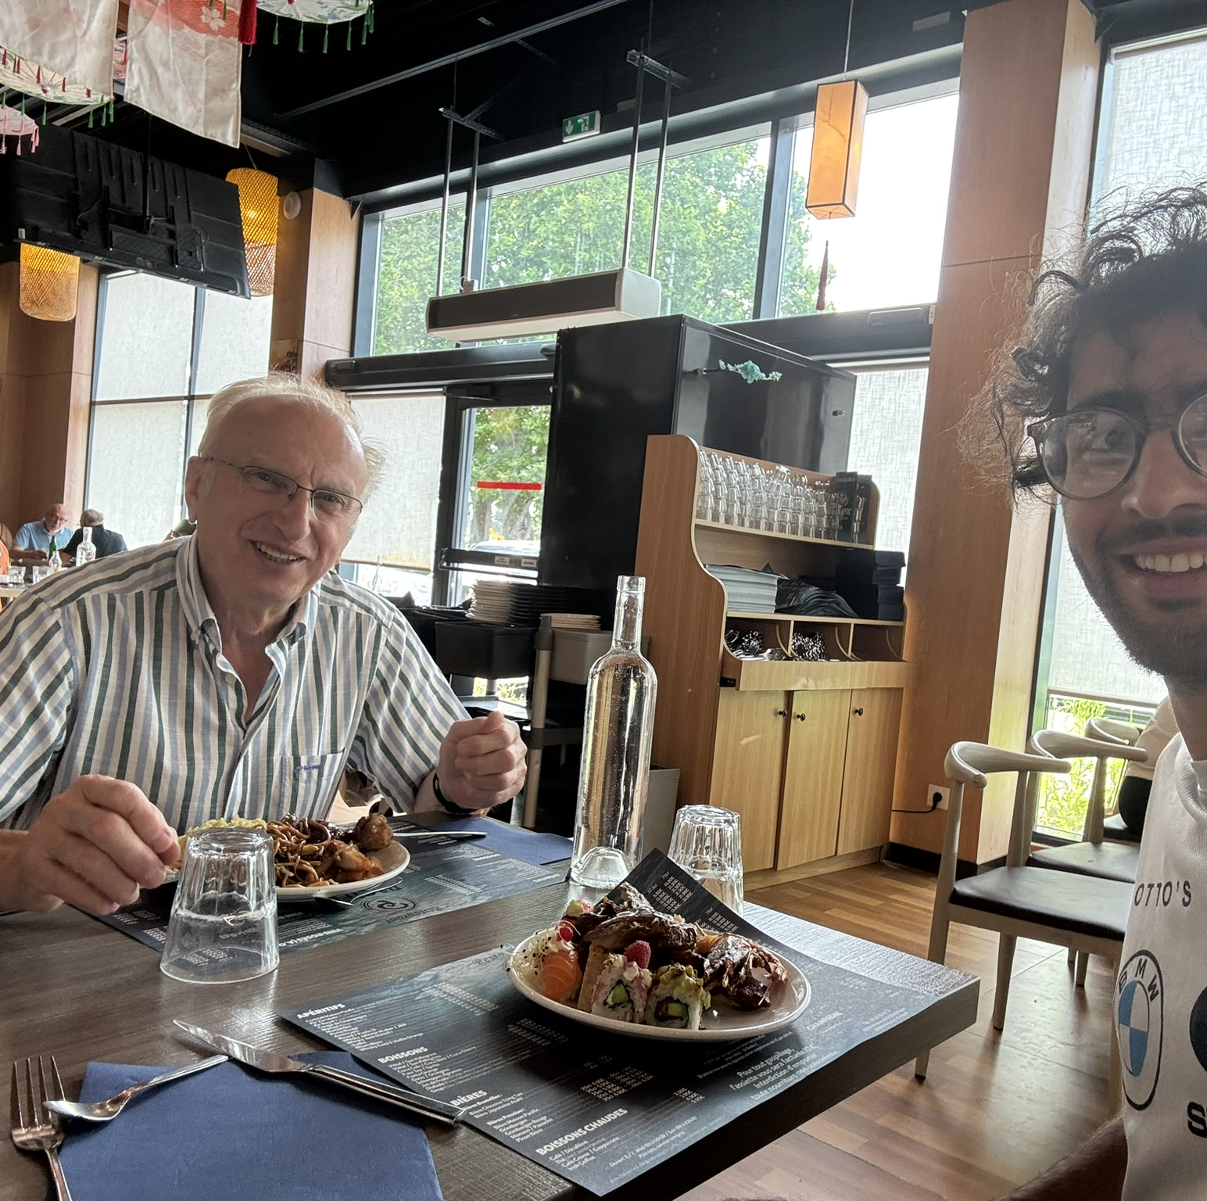
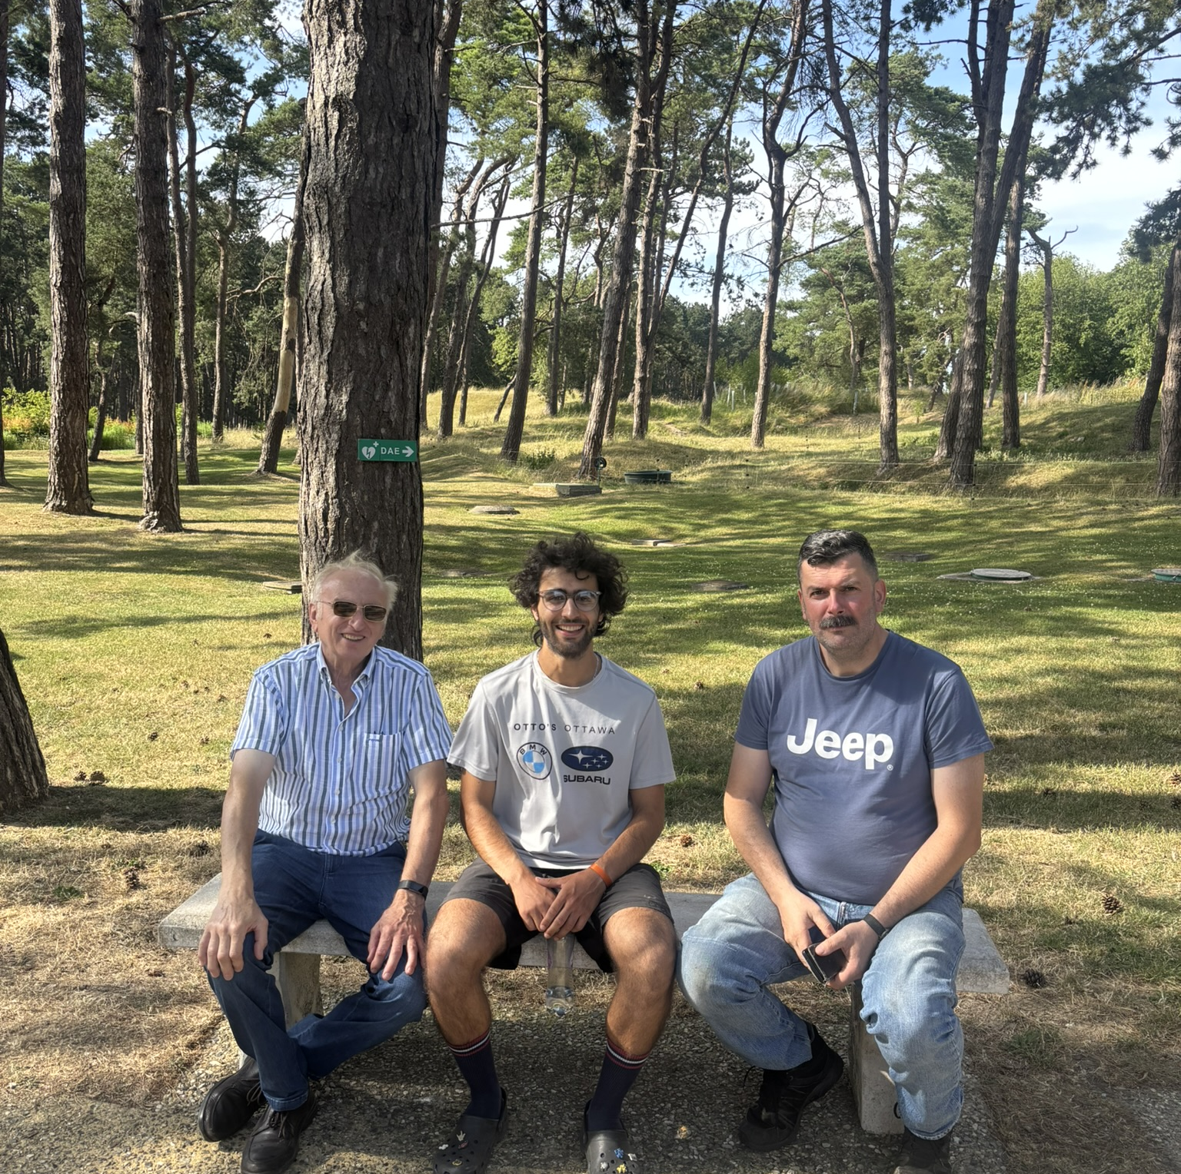
5–7 JULY
206.39 KM RIDDEN
PARIS → DROCOURT → VIMY
05 JUL / PARIS
06 JUL / DROCOURT
07 JUL / VIMY
Rest with my aunt
Dinner with Jean-Luc
A non-riding day
War cemeteries, poppies, coal slag heaps, and two days in which the kilometres were not the main event.
EUROPE BY BICYCLE
12
Notes:
July 5 was a rest day in Paris. On July 6 my aunt sent me out with eggs, and I rode 206.39 km north to Drocourt through war cemeteries, poppies, and the coal-mining landscape before staying with Jean-Luc. July 7 was another non-riding day, including a visit to Vimy by car. These pauses matter because the trip was no longer simply an attempt to complete a preloaded line. It now included specific people and places I wanted to reach.
[Sources]
- /Users/kian/Documents/Codex/2026-08-30/okay-that-post-was-the-most/transcripts/day-09.txt
- /Users/kian/Documents/Codex/2026-08-30/okay-that-post-was-the-most/sources/trip-chronology.txt
- /Users/kian/Documents/Codex/2026-08-30/okay-that-post-was-the-most/assets/photos/paris-aunt.jpg
- /Users/kian/Documents/Codex/2026-08-30/okay-that-post-was-the-most/assets/photos/drocourt-jean-luc.jpg
- /Users/kian/Documents/Codex/2026-08-30/okay-that-post-was-the-most/assets/photos/vimy-group.jpg
[/Sources]

Slide 13
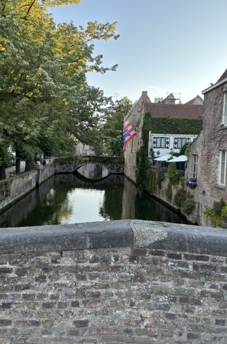
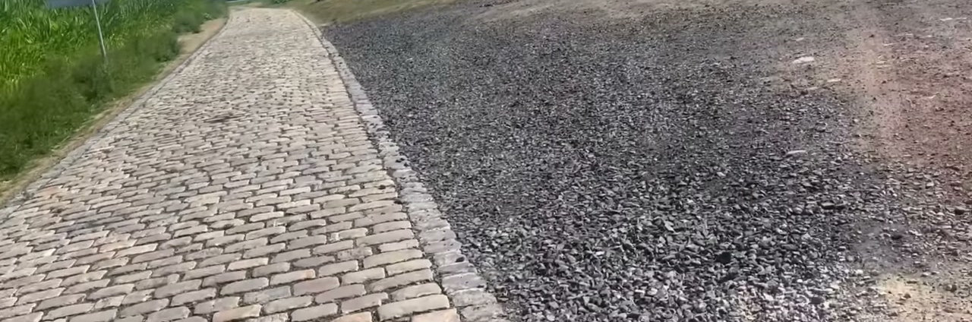
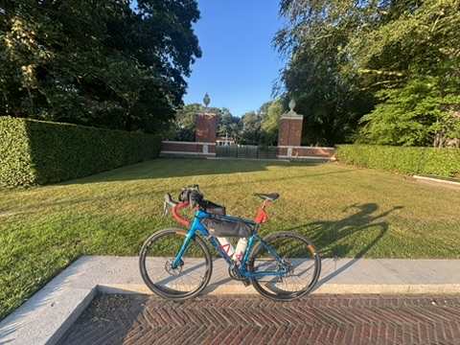
8 JULY / RIDE 12
197.17 KM
IN BRUGES, I CHOSE
TWO DAYS INSTEAD OF THREE
About 600 km remained. Finishing earlier meant seeing family sooner.
CHAIN: “PURE BUTTER”
EUROPE BY BICYCLE
13
Notes:
Ride 12 went from Drocourt to Bruges. The day included Paris-Roubaix cobbles, Tournai, a punishing headwind, and the contrast of Ghent's bicycle infrastructure. After maintenance, the chain felt like pure butter. The audited 197.17 km includes a 16.06 km loop around Bruges. That evening, with roughly 600 km remaining, I chose to cover it in two days rather than three so I could see family sooner.
[Sources]
- /Users/kian/Documents/Codex/2026-08-30/okay-that-post-was-the-most/transcripts/day-12.txt
- /Users/kian/Documents/Codex/2026-08-30/okay-that-post-was-the-most/assets/frames/paris-roubaix-cobbles.jpg
- https://www.youtube.com/watch?v=PTFawKQFJoo&t=85s
- /Users/kian/Documents/Codex/2026-08-30/okay-that-post-was-the-most/assets/photos/bruges-canal.jpg
- /Users/kian/Developer/vélo/strava-europe-trip-audit-2026.md
[/Sources]

Slide 14
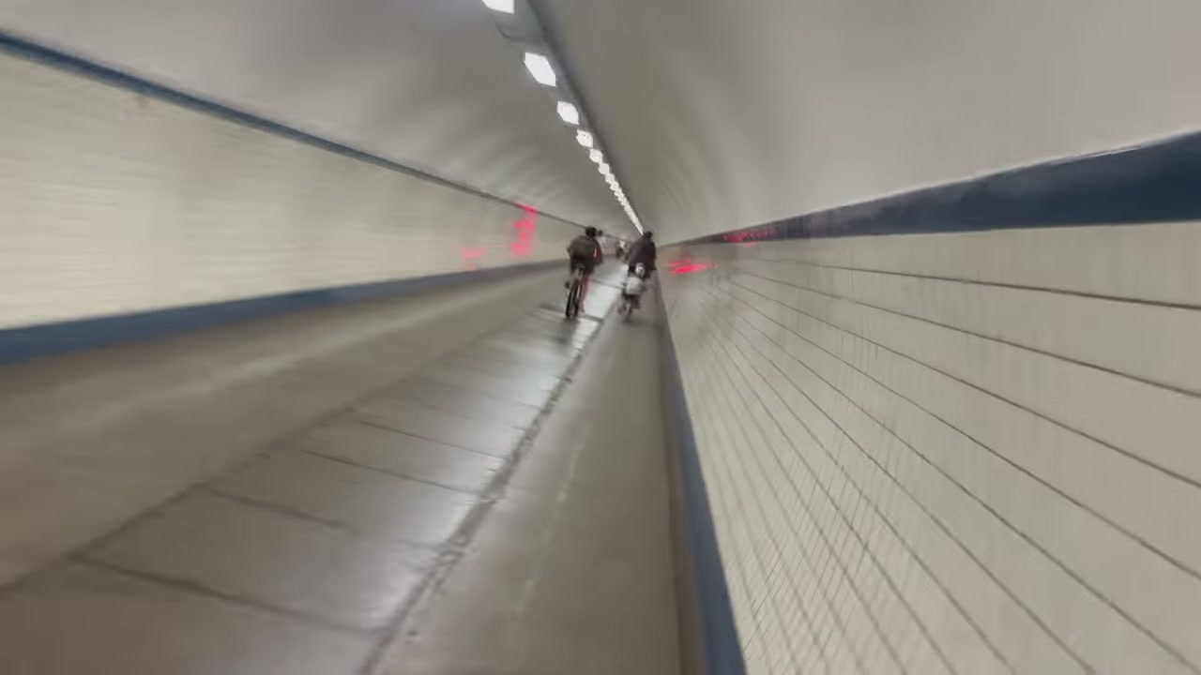
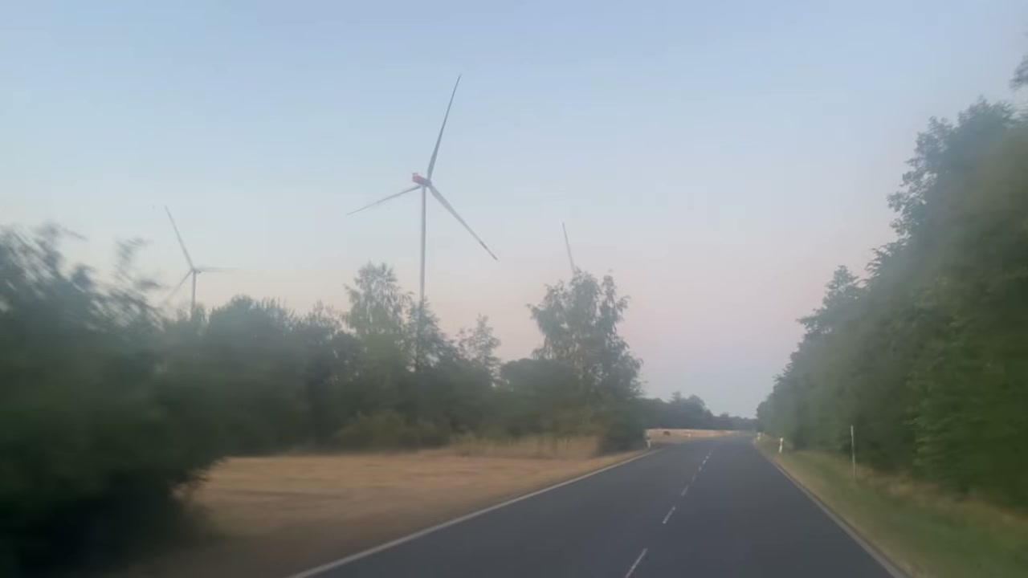
9 JUL / RIDE 13 / BRUGES → COLOGNE
337.84
KM
BEFORE 06:00 → 23:30
Canadian cemetery
Sint-Anna tunnel, 31 m underground
Belgium → Netherlands → Germany
Phone flashlight after dark
Longest day I had ever ridden.
Notes:
Ride 13 began before 6 a.m. in Bruges and ended around 11:30 p.m. in Cologne. I stopped at a Canadian war cemetery, entered Antwerp through the Sint-Anna pedestrian and bicycle tunnel 31 metres below the river, crossed briefly through the Netherlands, and returned to Germany. The final dark kilometres were on paths, but I had to hold the phone forward as a flashlight while riding. The audited distance is 337.84 km, the longest day of the trip.
[Sources]
- /Users/kian/Documents/Codex/2026-08-30/okay-that-post-was-the-most/transcripts/day-13.txt
- /Users/kian/Documents/Codex/2026-08-30/okay-that-post-was-the-most/assets/frames/antwerp-tunnel.jpg
- https://www.youtube.com/watch?v=jKRlZC1f514&t=145s
- /Users/kian/Documents/Codex/2026-08-30/okay-that-post-was-the-most/assets/frames/german-sunset.jpg
- /Users/kian/Developer/vélo/strava-europe-trip-audit-2026.md
[/Sources]

Slide 15
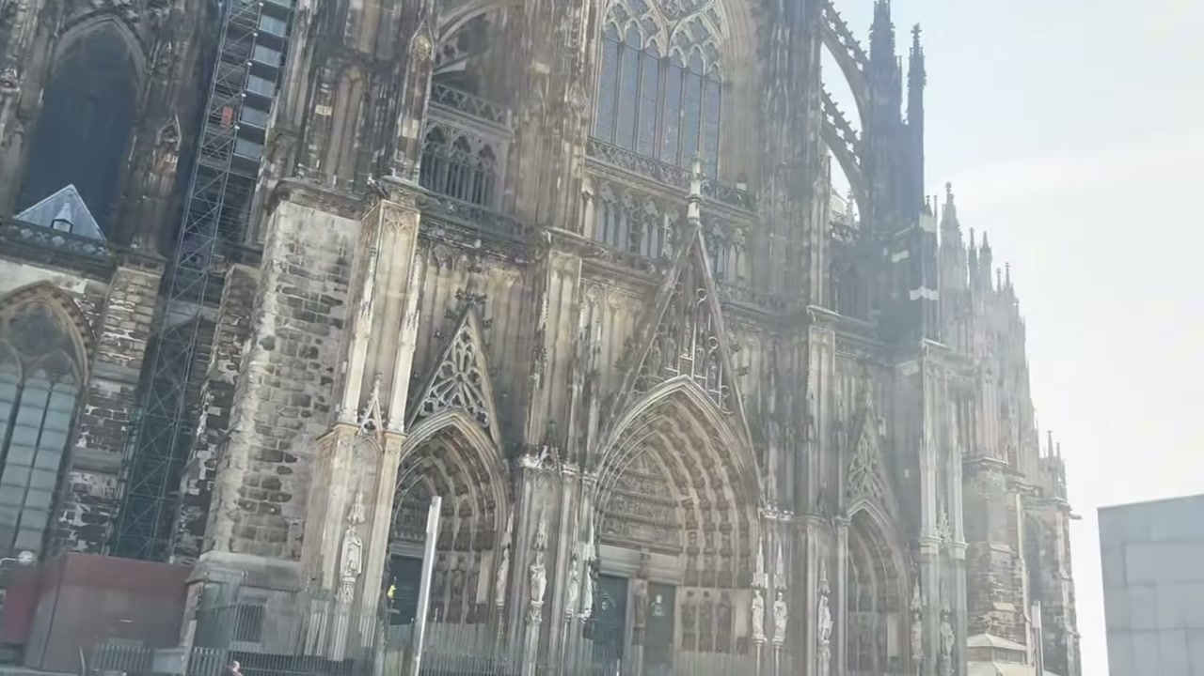
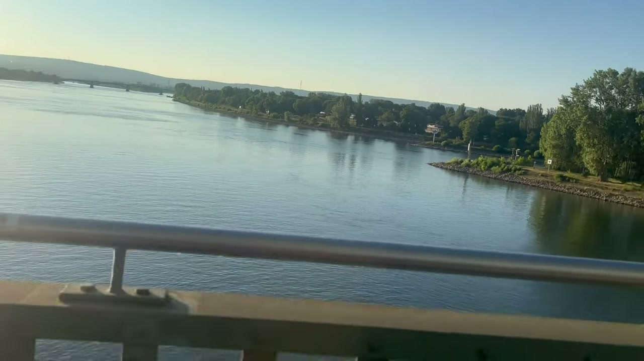
10 JULY / RIDE 14
THE FINAL DAY
270.42 KM HOME
COLOGNE
Cathedral before the city woke.
BONN + RHINE
Dead legs, familiar river, last crossing.
AFTER 23:00
My family tracked the phone and waited in the driveway.
608.26 KM / FINAL 2 DAYS
EUROPE BY BICYCLE
15
Notes:
The last day began in Cologne with the cathedral, continued through Bonn and along the Rhine, and ended after 11 p.m. in Mittelbuchen. The legs felt dead after the prior day's record, but the route was familiar again. My family tracked the phone and waited outside in the driveway. The final day was 270.42 km. Together, the last two days total 608.26 km.
[Sources]
- /Users/kian/Documents/Codex/2026-08-30/okay-that-post-was-the-most/transcripts/day-14.txt
- /Users/kian/Documents/Codex/2026-08-30/okay-that-post-was-the-most/assets/frames/cologne-cathedral.jpg
- /Users/kian/Documents/Codex/2026-08-30/okay-that-post-was-the-most/assets/frames/final-rhine.jpg
- /Users/kian/Documents/Codex/2026-08-30/okay-that-post-was-the-most/assets/photos/finish-night.jpg
- /Users/kian/Developer/vélo/strava-europe-trip-audit-2026.md
[/Sources]

Slide 16
10 JUL 2026 / DAILY NOTE
I LOVE LIFE
SO MUCH
Zahran
a balcony
My cousin
the €180 transfer
Olivier + Anton
the tyre, labour, and tools
My aunt + Jean-Luc
food, rooms, and time
Family
waiting in the driveway
17 DAYS LATER: BLISTERS, NUMB TOES, NECK PAIN. STILL WORTH IT.
Notes:
End on the exact line from the July 10 daily note: I LOVE LIFE SO MUCH. Do not turn it into a generic lesson. Name the people and the concrete acts that kept the trip moving: Zahran offered the balcony; my cousin transferred the phone payment; Olivier and Anton repaired the bicycle; my aunt and Jean-Luc supplied food and rooms; family waited in the driveway. Keep the physical cost in the ending too. Seventeen days later I still recorded hand blisters, numb toes, and neck pain.
[Sources]
- /Users/kian/Library/Mobile Documents/com~apple~CloudDocs/obsidian/notes/2026-07-10.md
- /Users/kian/Library/Mobile Documents/com~apple~CloudDocs/obsidian/notes/2026-07-11.md
- /Users/kian/Documents/Codex/2026-08-30/okay-that-post-was-the-most/research/story-notes.txt
- /Users/kian/Documents/Codex/2026-08-30/okay-that-post-was-the-most/assets/photos/finish-night.jpg
[/Sources]

