Slide 1
Specification-Based Testing
Team-1
Matt Taylor – Team Leader, Unit Tester
Kian Maroofi – System Tester, Timekeeper
Alexander Jimenez – Developer, Unit Tester
Kristian Perez – Subsystem Tester, Developer
Nicholas Delamo – Subsystem Tester, Minute Taker

Slide 2
Overview of System
Payroll Management System (POS) is a web-based system meant to provide employees and employers a mean to manage different aspects of payroll management, such as, time sheet management, salary calculations, etc.
We outline the features we test throughout the projects, the systems that these features involve, and the unit tests used to test the subsystems that compose said systems. We include specific test case input and logs of our activity, results, and problems we’ve encountered.

Slide 3
Use Case ID: PMS_13_AddEmployee
Actor: Employer
Pre-conditions: employee has a valid empID & employer is logged in
Post-conditions: PMS recognizes the new employee
Functional Requirements: | Non-functional Requirements:
1. Employer clicks on Add Employee Button | Frequency: every time a new employee is being added
2. Employer inputs employee details. | Criticality: High (important for PMS)
3. Employer clicks on Add button | Usability: No previous training needed. (~ 5min)
 | Reliability: 1 failure per 24 hr
 | Performance: 1 request per month
 | Supportability: Any browser which supports HTML.

Slide 4
Use Case ID: PMS_19_ForgotPwd
Actor: Employee
Pre-conditions: employee has a empID & answered security questions
Post-conditions: PMS sends an email with new password to employee
Functional Requirements: | Non-functional Requirements:
1. Employee clicks “Forgot Password?” | Frequency: when employee(s) forgot their password.
2. Employee selects security questions from list. | Criticality: Security use case.
3. Employee answers security questions. | Usability: No previous training needed. (~ 5min)
4. Employee clicks Get Password button. | Reliability: 1 failure per 24 hr
 | Performance: 1 request per month
 | Supportability: Any browser which supports HTML.

Slide 5
Overall Testing Approach
Overall Testing approach used is based on USDP (Clarke). For unit testing, we implemented a new façade “model.modelFacade.java”
Unit tests are done using JUnit in Eclipse IDE.
Subsystem Tests goes through all of the units to make sure they work properly together. JUnit and Mockito are used within the Eclipse IDE to perform all of the subsystem tests.
System Tests, were done by creating different test case scenarios. Selenium IDE and JUnit were used to perform all of the System Tests.

Slide 6
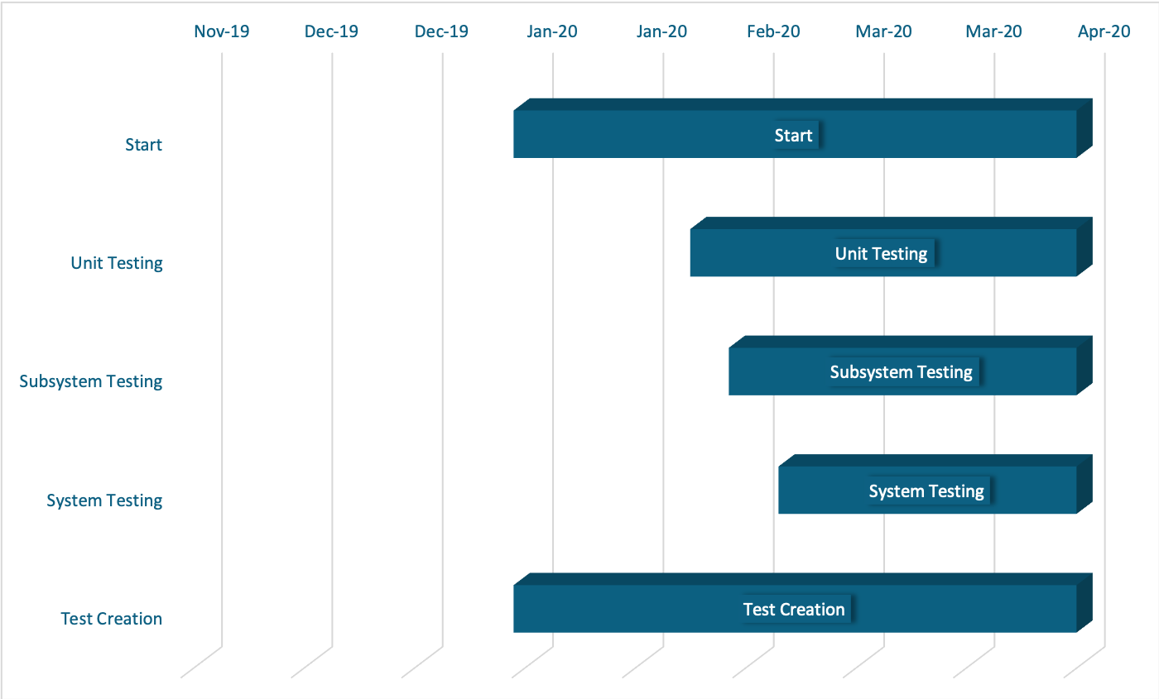
Test Schedule

Slide 7
H/W and S/W Requirements
Hardware Requirements: | Software Requirements:
CPU: Intel (R) Core (TM) i7 | MySQL 5.1.37
RAM: 16GB DDR4 SDRAM | Java JDK 1.8.0
Storage: 512GB | Eclipse EE IDE Version: 2019-12
Network Adapter: Inter (R) Ethernet Connection | Selenium IDE & Selenium Grid
 | JUnit 4.0
 | Mockito

Slide 8
Features Tested
Login
Logout
Add Employee
Submit Timesheet
Save Timesheet
Modify Timesheet
Approve Timesheet
Security Questions
Calculate Salary
View Profile
Reset Password (Security)

Slide 9
Features Not Tested
Search Employee Timesheet (Not implemented)
Pay Check
Work Profile
Duplicate Submission

Slide 10
Unit Tests
Test Case ID | UnitTest-PMS-ModelFacadeTests
Purpose | Ensure each method exposed through ModelFacade’s API functions as expected
Test Set Up | For each test, the PMS system must be set up and working. The database has been loaded with the data as specified in the test prerequisites.
Input |  | Output
EmployeeaddEmployee("5", "Hunter", "Biden", "M", "aaaaaaaaaaaaa", "Mailman", "3059032234", "test@email.com", "900 Walker Street", "1234567890", "Bank of America"); |  | Method should return a failure due to invalid date of birth
EmployeechangePassword("1", "adam", "Favorite Color?", "pink", "First PEt Name?", "adam", "Favorite movie?", "adam", "adam", "swordfish") |  | Method should update the employee’s password in the employee table and return success.

Slide 11
Subsystem Tests
Test Case ID | SubSystem-PMS-TimeSheetTest
Purpose | Test the interactions between multiple time sheet methods (add time sheet, update time sheet, get approved time sheets, etc)
Test Set Up | Data base found in section 3.1.2
Input |  | Output
TimeSheetaddTimeSheet("1", "1", "Monday", "2020-03-02", "09:00:00", "12:00:00", "13:00:00", "17:00:00") TimeSheetupdateTimeSheet("1","10:00:00","12:00:00","13:00:00","22:00:00", "11") TimeSheetsubmitTimeSheet(“1”) TimeSheetgetEmpTimeSheetNotApproved(“1”) TimeSheetaddTimeSheet("4", "4", "Monday", "2020-03-02", "09:00:00", "12:00:00", "13:00:00", "17:00:00") TimeSheetaddTimeSheet("5", "5", "Monday", "2020-03-02", "09:00:00", "12:00:00", "13:00:00", "17:00:00") TimeSheetsubmitTimeSheet(“4”) TimeSheetsubmitTimeSheet(“5”) TimeSheetgetTimeSheetNotApproved() TimeSheetgetTimeSheetApproved(“1”) TimeSheetGetTimeSheetApprovedEmpIds() |  | Add a time sheet to Emp “1”, update that time sheet then submit it. Return 3 Not Approved timesheets for Emp “1” (2 from DB and the 1 just added) Add two dummy timesheets for Emp “4” and “5”. Return 5 Not Approved timesheets for all Emps (3 from Emp 1 and 2 from Emp 4 and 5) Return 3 Approved time sheets from Emp 1 (found in setup DB) Return 2 (Emp 1 and Emp 2)

Slide 12
Subsystem Tests
Test Case ID | SubSystem-PMS-SalaryTest
Purpose | Test the interactions between multiple salary methods
Test Set Up | Data base found in section 3.1.2
Input |  | Output
SalarycalculateSalary(); SalarygetEmpPays(); SalarygetEmpPay("2"); |  | Return 4, 2 from Setup DB, 2 from method Return 4, 4 salaries in DB Return 2, 1 from setup DB, 1 from calculate salary method

Slide 13
System Tests
Test Case ID: SystemTest-PMS-AddEmployee-002-Sunny01
Purpose: Investigate the proper execution of the add employee case for Sara Smith for SFTalent Co. (the employer)
Test Setup: PMS is setup and running, with the database setup
employer
username | password
user1 | user1

Slide 14
SystemTest-PMS-AddEmployee-002-Sunny01
Test input:
SFTalent Co. Clicks Add employee button
They input the new employee information (see expected output)
They finally click on Add
Expected output:
New employee will be added to the PMS database (the following row will be added to employees table of the DB).
employees
emp_id | first_name | last_name | gender | dob | job | phone | email | address | accno | bankname | joindate
2 | Sara | Smith | on | 1990-01-01 | Sales Assistant | 3053458989 | ssmith@email.com | 21 SE 10th St | 123456789 | Bank of America | 2020-02-29

Slide 15
System Tests
Test Case ID: SystemTest-PMS-SecurityQuestion-003-Rainy02
Purpose: Investigate the proper execution of the security question security use case for Adam Sandler (an employee).
Test Setup: PMS is setup and running, with the database setup
users
emp_id | user_id | password | sec_que1 | ans1 | sec_que2 | ans2 | sec_que3 | ans3 | createDate
1 | adam | adam | Favorite Color? | pink | First pet name? | adam | Favorite movie? | adam | 2020-01-12

Slide 16
SystemTest-PMS-SecurityQuestion-003-Rainy02
Test input:
Adam Clicks on “Forgot Password?”
Then he inputs his employee ID & Username
He selects security questions & input answers for them
He finally clicks on Get Password button
Expected output:
“user details not found” alert will be shown since Adam did not enter correct answers for security questions. Hence there would be no changes to the database.

