Slide 1
1CWK50
Kian Naidoo
Student ID : 24793951
There are some comments in the Notes pane, below – make sure you read them

Slide 2
k-nearest neighbours classifier

Slide 3
1. fit()
=
=
Notes:
This slide is here as a reminder that you need to deal with both the fitting and prediction phases for each model – you can delete it at your own discretion.

Slide 4


Notes:
Add as many more slides as you need… Remember: no words(!) and all visuals must be created either with PowerPoint’s built-in tools (e.g., Shapes, Icons, and freehand drawing) or from images you personally authored (e.g., figures generated using Python code in labs).

Slide 5
2. predict()
Notes:
This slide is here as a reminder that you need to deal with both the fitting and prediction phases for each model – you can delete it at your own discretion.

Slide 6
=
=
Notes:
Add as many more slides as you need… Remember: no words(!) and all visuals must be created either with PowerPoint’s built-in tools (e.g., Shapes, Icons, and freehand drawing) or from images you personally authored (e.g., figures generated using Python code in labs).

Slide 7
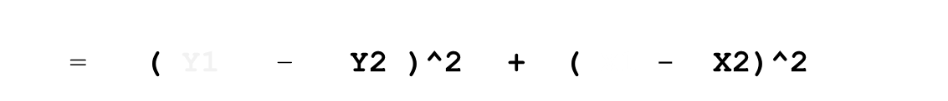
= ( Y1 – Y2 )^2 + ( X1 - X2)^2
Y1
Y2
X1 X2
Notes:
Add as many more slides as you need… Remember: no words(!) and all visuals must be created either with PowerPoint’s built-in tools (e.g., Shapes, Icons, and freehand drawing) or from images you personally authored (e.g., figures generated using Python code in labs).

Slide 8
K = 1
K = 5
=
=
Notes:
Add as many more slides as you need… Remember: no words(!) and all visuals must be created either with PowerPoint’s built-in tools (e.g., Shapes, Icons, and freehand drawing) or from images you personally authored (e.g., figures generated using Python code in labs).

Slide 9
K = 5
= 3
= 2
=
Y
=
=
X
Notes:
Add as many more slides as you need… Remember: no words(!) and all visuals must be created either with PowerPoint’s built-in tools (e.g., Shapes, Icons, and freehand drawing) or from images you personally authored (e.g., figures generated using Python code in labs).

Slide 10
naïve Bayes classifier

Slide 11
1. fit()
=
=
Notes:
This slide is here as a reminder that you need to deal with both the fitting and prediction phases for each model – you can delete it at your own discretion.

Slide 12
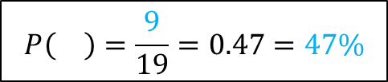
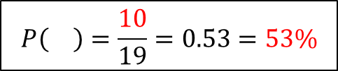
$$P\left(\right)=\frac{10}{19}=0.53=53\%$$
$$P\left(\right)=\frac{9}{19}=0.47=47\%$$
= 10
= 9
Notes:
This slide is here as a reminder that you need to deal with both the fitting and prediction phases for each model – you can delete it at your own discretion.

Slide 13
μ₁
μ₂
σ₁
σ₂
Notes:
Add as many more slides as you need… Remember: no words(!) and all visuals must be created either with PowerPoint’s built-in tools (e.g., Shapes, Icons, and freehand drawing) or from images you personally authored (e.g., figures generated using Python code in labs).

Slide 14
μ₂
μ₁
σ₂
σ₁
μ₁
μ₂
σ₁
σ₂
Notes:
Add as many more slides as you need… Remember: no words(!) and all visuals must be created either with PowerPoint’s built-in tools (e.g., Shapes, Icons, and freehand drawing) or from images you personally authored (e.g., figures generated using Python code in labs).

Slide 15
2. predict()
Notes:
This slide is here as a reminder that you need to deal with both the fitting and prediction phases for each model – you can delete it at your own discretion.

Slide 16
Notes:
Add as many more slides as you need… Remember: no words(!) and all visuals must be created either with PowerPoint’s built-in tools (e.g., Shapes, Icons, and freehand drawing) or from images you personally authored (e.g., figures generated using Python code in labs).

Slide 17
decision tree classifier

Slide 18
1. fit()
Notes:
This slide is here as a reminder that you need to deal with both the fitting and prediction phases for each model – you can delete it at your own discretion.

Slide 19
Notes:
Add as many more slides as you need… Remember: no words(!) and all visuals must be created either with PowerPoint’s built-in tools (e.g., Shapes, Icons, and freehand drawing) or from images you personally authored (e.g., figures generated using Python code in labs).

Slide 20
2. predict()
Notes:
This slide is here as a reminder that you need to deal with both the fitting and prediction phases for each model – you can delete it at your own discretion.

Slide 21
Notes:
Add as many more slides as you need… Remember: no words(!) and all visuals must be created either with PowerPoint’s built-in tools (e.g., Shapes, Icons, and freehand drawing) or from images you personally authored (e.g., figures generated using Python code in labs).

Slide 22
ensemble classifier
Notes:
Note: there are lots of different types of ensemble classifier – this section is a chance for you to go as far/deep as you like. (E.g., if you’re aiming for top marks.)

Slide 23
1. fit()
Notes:
This slide is here as a reminder that you need to deal with both the fitting and prediction phases for each model – you can delete it at your own discretion.

Slide 24
Notes:
Add as many more slides as you need… Remember: no words(!) and all visuals must be created either with PowerPoint’s built-in tools (e.g., Shapes, Icons, and freehand drawing) or from images you personally authored (e.g., figures generated using Python code in labs).

Slide 25
2. predict()
Notes:
This slide is here as a reminder that you need to deal with both the fitting and prediction phases for each model – you can delete it at your own discretion.

Slide 26
Notes:
Add as many more slides as you need… Remember: no words(!) and all visuals must be created either with PowerPoint’s built-in tools (e.g., Shapes, Icons, and freehand drawing) or from images you personally authored (e.g., figures generated using Python code in labs).

Slide 27
References
Notes:
You’re not expected to have lots of references. But if you do draw on particular sources for information or ideas, then you should cite/reference them. This includes the source files for any self-authored images. You need to use Cite Them Right Harvard – MMU library guidance here: https://www.mmu.ac.uk/library/referencing-and-study-support/citing-and-referencing/cite-them-right-Harvard
You can include the citations in the Notes panel underneath the relevant slide(s) with a brief note explaining the relevance of the reference.
If you have used other software to author an image in one of your slides, then you should cite/reference the original file you used to generate the image, and include a link. For example, if you generated the image by writing Python code, then you should cite/reference your original notebook and include a Colab link. If you generated the image using Excel, or using Paint3D, or using any other program, then you should cite/reference your original file, and link to a copy stored on your OneDrive. In all cases, the file sharing needs to be set to “anyone with the link” so that markers can access your work.

