Slide 1

Inflation Forecasting Analysis: Strategic Insights and Recommendations
Presented By: Kian Nazem

Slide 2
Objective and Importance
Objective: Forecast inflation trends for the next 3 years using data-driven methods.
Why It Matters: Inflation affects monetary policies, purchasing power, and economic stability.
Key Focus: Deliver actionable insights to guide strategic planning.

Slide 3

Dataset Overview
Inflation Data (CPI): Monthly CPI values from 2014 to 2024 reflect price changes in a standard basket of goods.
CPI Meaning: A value of 316 means prices are 216% higher than during the baseline period (1982-1984 = 100).
Relevance: Tracks inflation trends directly, providing a clear measure of purchasing power changes.
Fed Funds Rate: Monthly Federal Funds interest rate data from 2014 to 2024.
Relevance: The Fed Funds Rate is a key monetary policy tool used to influence inflation by controlling borrowing and spending.
Why These Datasets?
CPI shows how prices evolve, directly measuring inflation.
Fed Funds Rate explains the monetary policies driving inflationary trends.

Slide 4
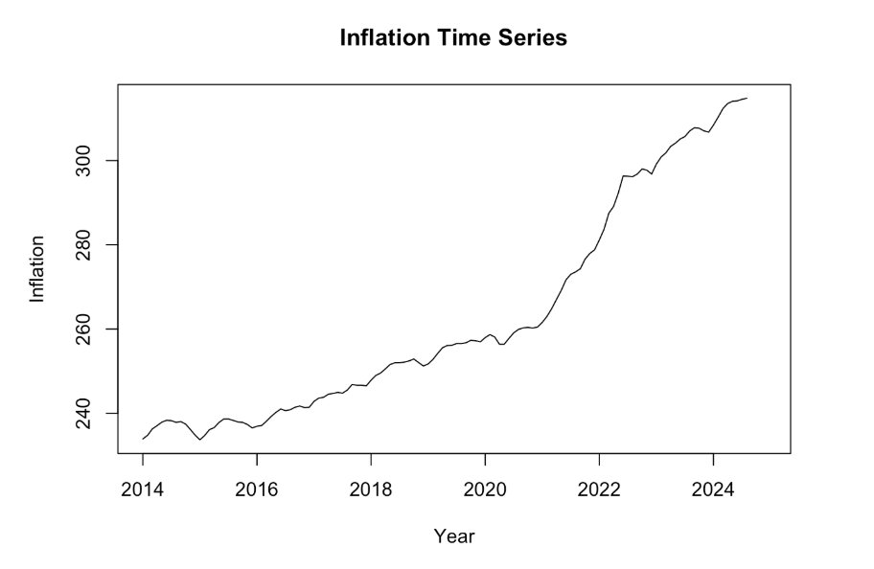
Inflation Time Series Plot
Key Observations:
A steady upward trend in inflation, with sharper increases post-2020.
Reflects macroeconomic pressures such as supply chain disruptions and increased demand.
Implications:
Rising prices indicate the need for continued vigilance in monetary policies.

Slide 5
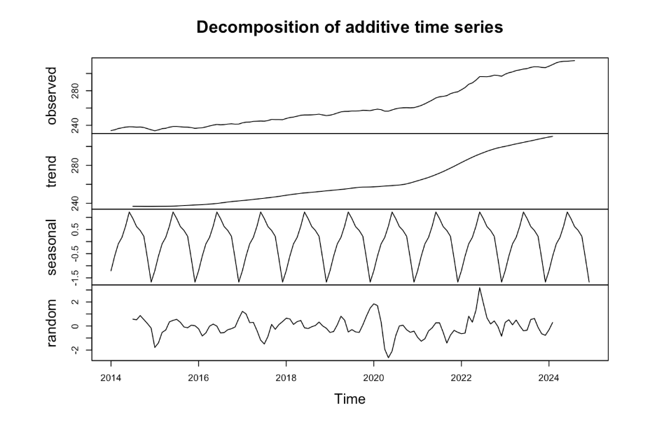
Decomposition of Inflation Time Series
Key Insights:
Trend: Clear upward trajectory, indicating steady inflation growth.
Seasonality: Minimal seasonal patterns, confirming inflation is driven by mostly long-term factors.
Random Noise: Moderate noise levels, reflecting relative stability with some unpredictability.
Forecasting Implications:
Our forecast must focus more on trends rather than seasonal adjustments.
Forecasting and decision-making should prioritize long-term strategies aligned with inflation trends.

Slide 6


ARIMA: Our Forecasting Model
How ARIMA Works:
Differencing to remove trends and achieve stationarity.
Incorporates past errors (moving average) to improve accuracy.
Provides predictions with confidence intervals, helping inform decisions.
ARIMA (2,2,2)(1,0,0)[12] for Inflation:
p = 2: Incorporates autoregression; past values significantly influence the current value.
d = 2: Differencing twice removes trends and ensures the data is stationary.
q = 2: Uses a moving average of errors to smooth random fluctuations.
P = 1: Seasonal autoregression accounts for periodic patterns in the data.
D = 0: No seasonal differencing is needed.
Q = 0: No seasonal moving average component.
[12]: Seasonal period is set to 12 months (yearly seasonality).

Slide 7
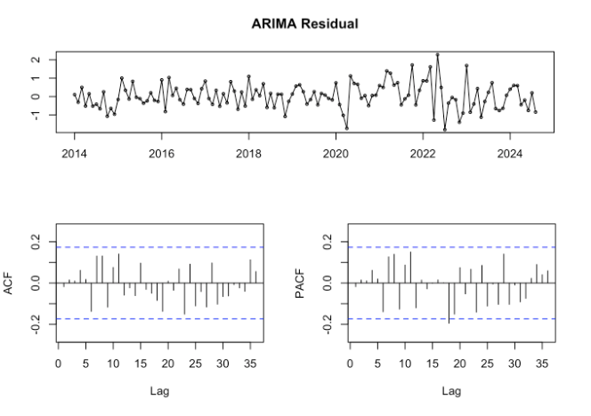
Why ARIMA
ARIMA (2,2,2)(1,0,0)[12] had the lowest RMSE, making it the most accurate model.
It shows predictions closely align with observed inflation trends.
Minimizes errors, enhancing reliability for strategic decision-making.
Effectively captured the strong inflation trend.
Focused on trends, perfect for non-seasonal data like inflation.
Clean residuals exhibit no discernible patterns or autocorrelation and
confirm that ARIMA (2,2,2)(1,0,0)[12] captures the inflation trend effectively.

Slide 8
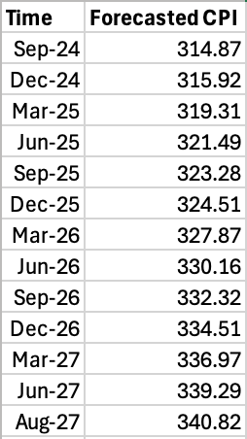
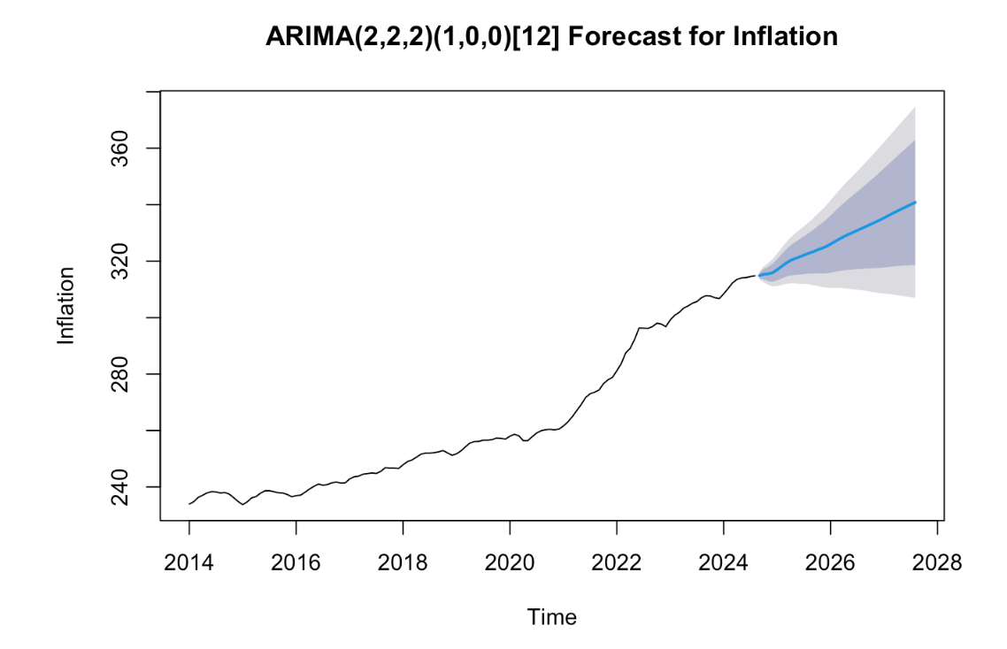
ARIMA Forecasting Results
Steady Increase in CPI: The forecast shows a consistent upward trend in inflation, with the Consumer Price Index (CPI) rising year-over-year.
Short-Term Projection: Inflation continues its steady growth, with CPI expected to remain above 315 by early 2025.
Medium-Term Projection: By late 2026, CPI surpasses 330, reflecting persistent inflationary pressures.
Long-Term Projection: By mid-2027, CPI is forecasted to reach 340, indicating sustained upward momentum in inflation.

Slide 9
Implications of Our Inflation Forecast
Continued Inflationary Pressure
The forecast indicates a steady rise in CPI, reflecting persistent inflationary trends.
By mid-2027, CPI is projected to reach approximately 340, signaling sustained economic pressure.
Economic Impact
Higher inflation erodes purchasing power, potentially increasing costs for households and businesses.
A steady rise in CPI may signal prolonged supply chain challenges or persistent demand-side pressures.
Policy Implications
Suggests the need for proactive monetary policy adjustments (e.g., gradual increases in the Federal Funds Rate) to mitigate inflation.
Policymakers may need to balance inflation control with economic growth to avoid stifling recovery efforts.
Strategic Recommendations
Businesses should prepare for cost increases in operations, inventory, and supply chain management.
Consumers may need to adjust spending habits to accommodate rising prices.

Slide 10
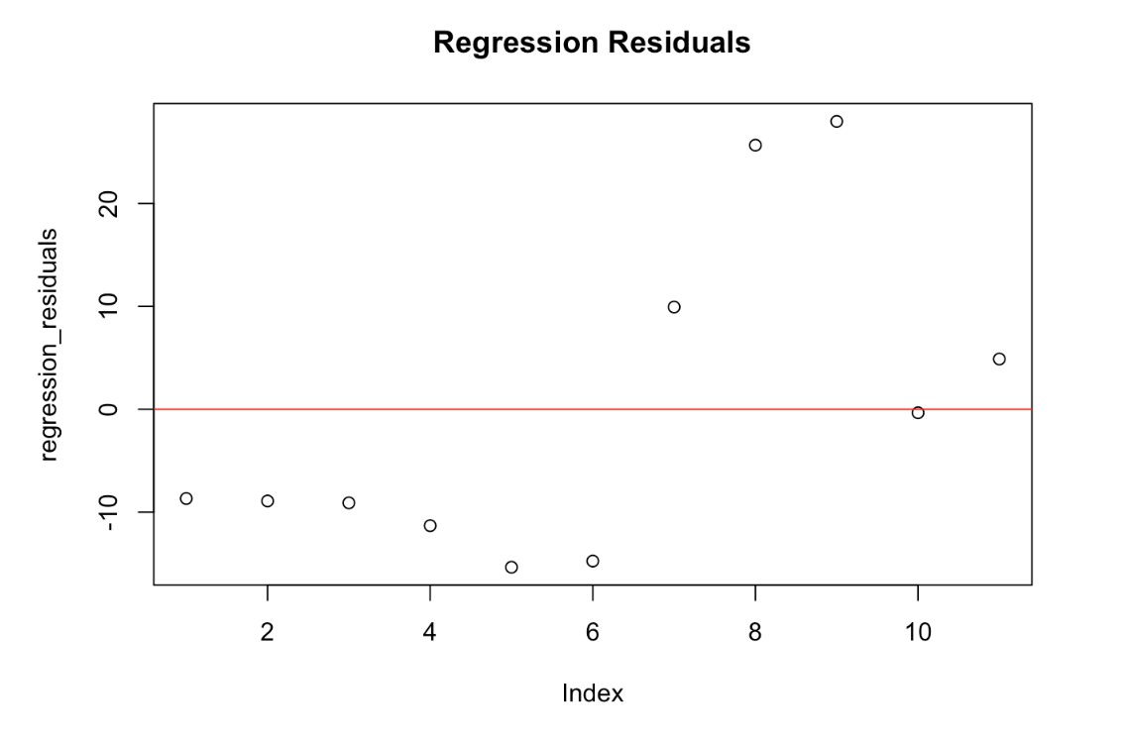
Relationship Between Federal Funds Rate and Inflation
Regression Analysis Findings
Our regression analysis indicates a significant relationship between the Federal Funds Rate and inflation, emphasizing monetary policy's influence.
The residual plot demonstrates variability, reinforcing the complexity of capturing all factors impacting inflation.
Implications for Policy
The Federal Funds Rate remains a critical tool for managing inflation.
Policymakers must evaluate the timing and magnitude of rate adjustments to balance growth and inflation control.
Key Detail
Rising Federal Funds Rates tend to slow inflation but require close monitoring to avoid unintended economic repercussions.

Slide 11
Recommendations

Slide 12
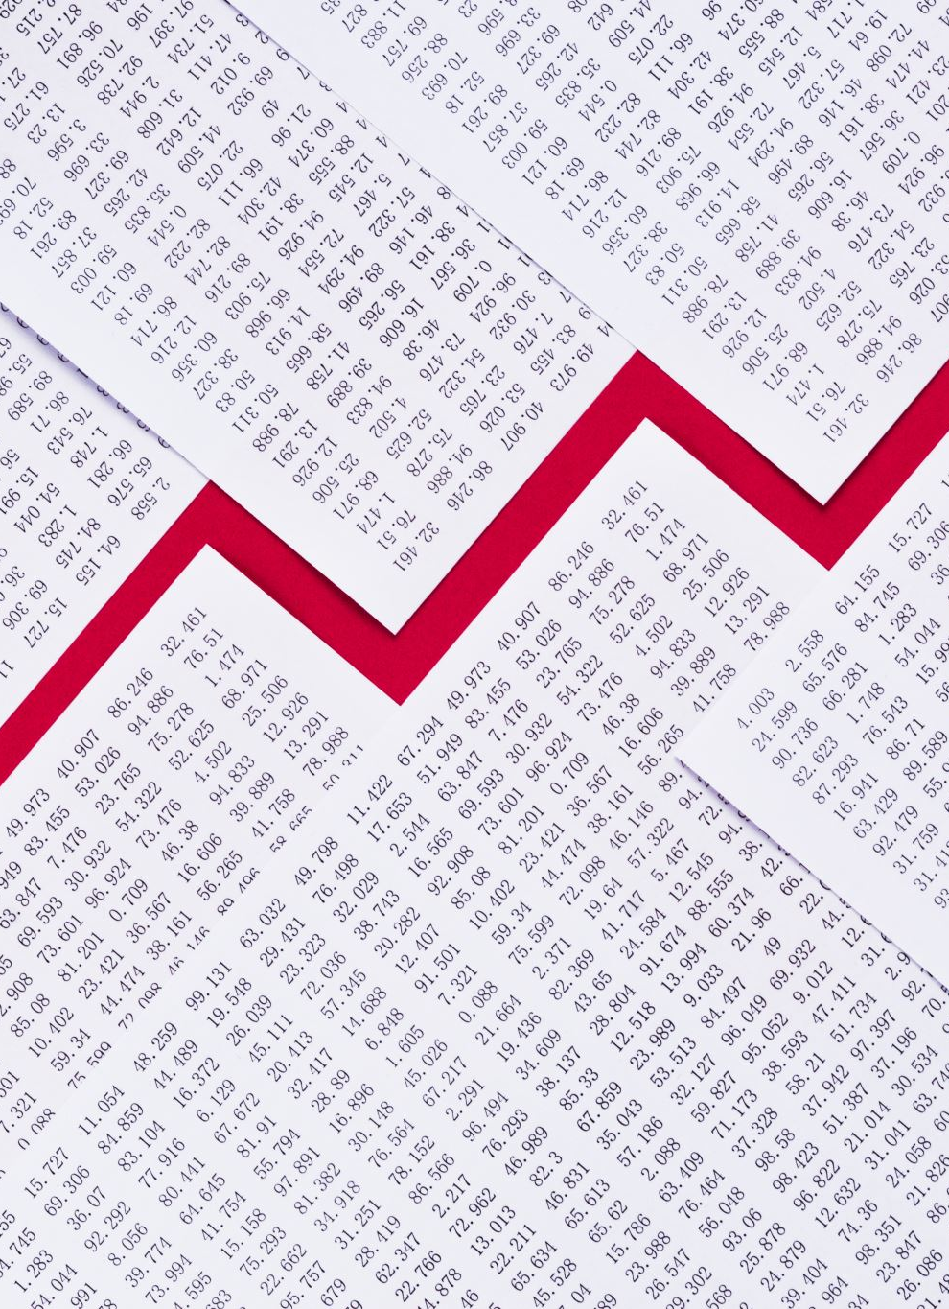
Gradual Federal Funds Rate Increases
Our analysis confirms the significant influence of the Federal Funds Rate on inflation.
Recommended Action: Gradually increase the Federal Funds Rate to combat inflationary pressures. A measured approach will help stabilize inflation without overly constraining economic growth.
Rationale: Historical trends demonstrate a slowing inflation rate as interest rates rise.
Gradual hikes allow businesses and households to adjust without abrupt financial strain.

Slide 13

Building Inflation-Ready Operations
Recommended Action:
Encourage businesses to adopt inflation-indexed pricing strategies to ensure affordability for consumers.
Advocate for inflation-adjusted wages in key sectors to preserve purchasing power.
Rationale:
Helps households manage higher costs without reducing spending power.
Prevents demand-side shocks from dampening economic activity.
Expected Impact:
Mitigates the social and economic impact of inflation on vulnerable groups.

Slide 14

Integrated Policy Approaches to Inflation Management
Recommended Action:
Align monetary policy (e.g., interest rates) with fiscal measures (e.g., tax incentives or subsidies).
Focus on sectors driving inflation, such as housing, energy, and food.
Rationale:
Prevents policy conflicts (e.g., expansive fiscal policies counteracting tight monetary measures).
Provides targeted relief to sectors under inflationary stress.
Expected Impact:
Greater policy coherence ensures inflation control without stifling economic growth.
Targeted fiscal measures reduce public dissatisfaction and economic inequity.

Slide 15
Conclusion
Key Forecast Findings:
Inflation is projected to rise steadily, with CPI reaching 340 by mid-2027.
Persistent inflationary pressures highlight challenges in monetary and economic management.
Strategic Implications:
Proactive Federal Funds Rate adjustments are essential to curb inflation without stifling growth.
Businesses must adapt to operational and pricing strategies to sustain through inflation.
Recommended Actions:
Implement gradual monetary policy changes.
Foster inflation-resilient business practices and targeted fiscal measures.
Next Steps:
Monitor inflation trends and update forecasts regularly.
Strengthen the alignment between monetary and fiscal strategies for sustainable growth.

Slide 16





Questions

