Slide 1
ENGI 301 Exercise Tracker Proposal
09/25/23
Kian Samra

Slide 2
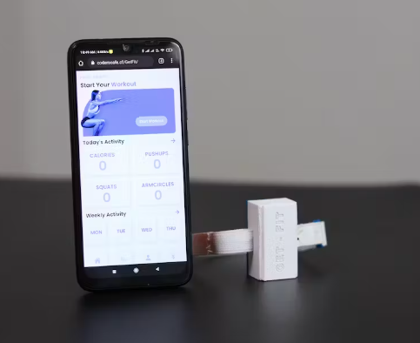
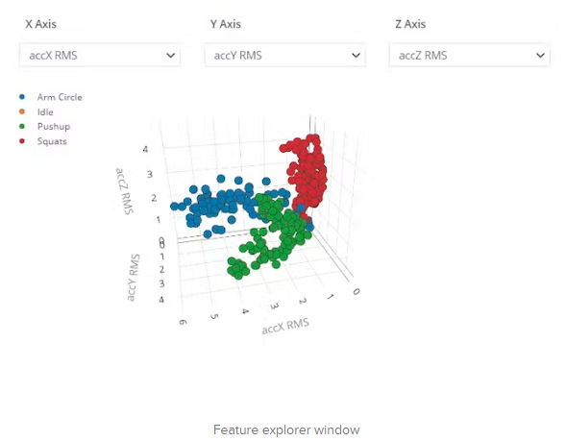
Background Information
Existing project: https://www.hackster.io/coderscafe/get-fit-4d29fb#:~:text=GetFit%20is%20an%20easy%2Dto,a%20completely%20open%2Dsource%20project.
Improvements/additions
Hardware: change attachment mechanism to suit rehabilitation system, change power source to comply with ENGI 301 parts list
Software: Deepen complexity of machine learning model and classification problem by adding different/additional exercises to track
Story: Creating a bed-rest rehabilitation system to allow patients to combat muscle atrophy and cardiovascular complications during post-operative recovery. This project will serve as a subset of this rehabilitation system to facilitate tracking of patient activity. This is an essential component of the rehabilitation system as it holds patients accountable and allows therapists to ensure patients are doing the appropriate activities for their recovery.

Slide 3
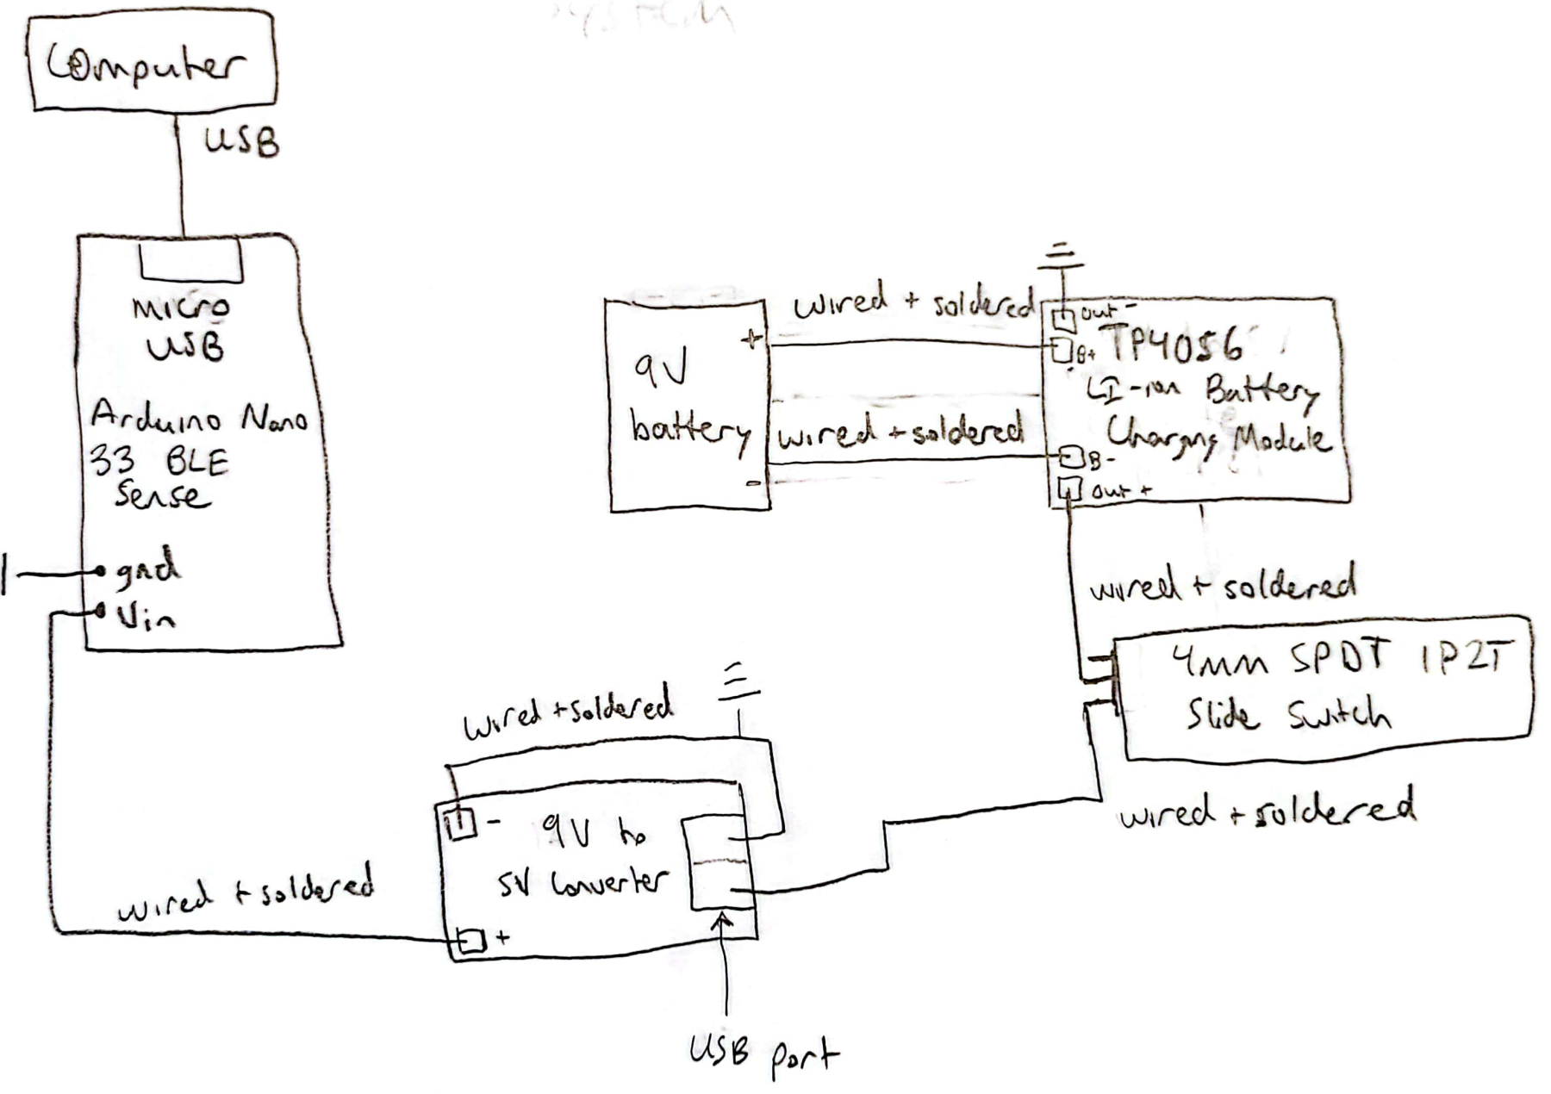
System Block Diagram

Slide 4
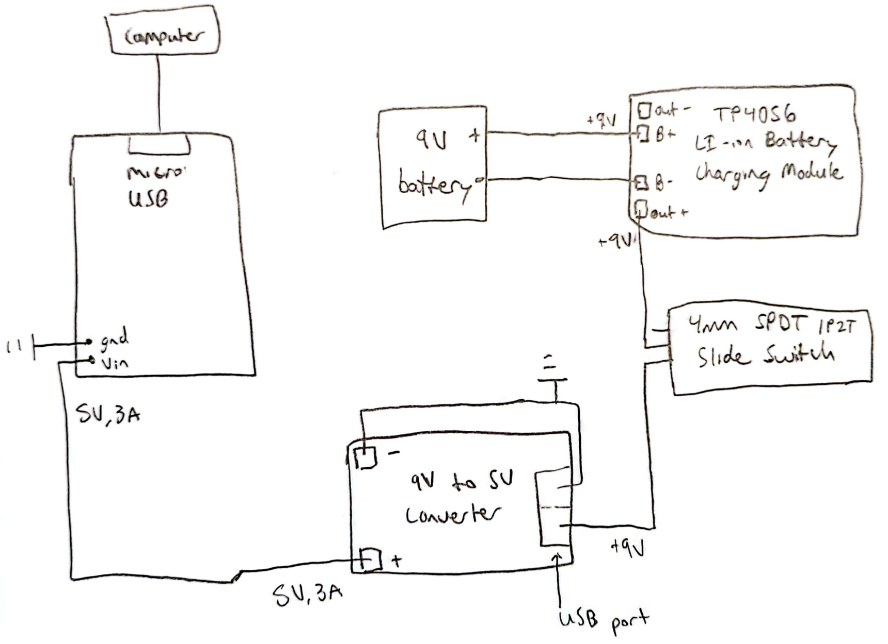
Power Block Diagram

Slide 5
Components / Budget
Component | Need to Buy | Cost
Arduino Nano 33 BLE Sense (https://shorturl.at/xSX04) | 1 | 44.50
9x15 cm Double Sided Universal PCB Prototype Board (https://shorturl.at/fijV1) | 1 | 2
9V battery | 1 | 0 (already have)
12V to 5V converter (https://shorturl.at/fDS26) | 1 | 8.89
TP4056 1A Li-Ion Lithium Battery charging Module with Current Protection - Micro USB (https://shorturl.at/akrJZ) | 1 | 8.99
4mm SPDT 1P2T Slide Switch (https://shorturl.at/guQUV) | 1 | 7.43
 | Total: | 71.81

