Slide 1
ENGI 301 Exercise Tracker Proposal
09/25/23
Kian Samra

Slide 2
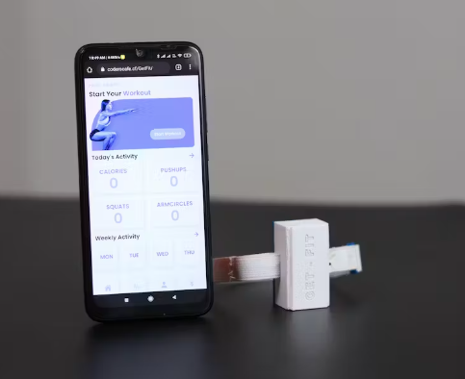
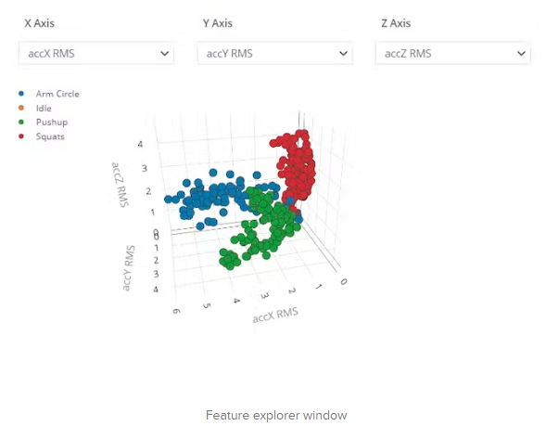
Background Information
Existing project: https://www.hackster.io/coderscafe/get-fit-4d29fb#:~:text=GetFit%20is%20an%20easy%2Dto,a%20completely%20open%2Dsource%20project.
Improvements/additions
Hardware: Use pocket beagle with external modules instead of Arduino, switch to turn exercise tracking on/off, add LED for feedback to indicate completed rep, add screen for users to see exercise counts
Software: Deepen complexity of machine learning model and classification problem by adding different/additional exercises to track, add switch, LED, and screen functionality
Story: Creating a bed-rest rehabilitation system to allow patients to combat muscle atrophy and cardiovascular complications during post-operative recovery. This project will serve as a subset of this rehabilitation system to facilitate tracking of patient activity. This is an essential component of the rehabilitation system as it holds patients accountable and allows therapists to ensure patients are doing the appropriate activities for their recovery.

Slide 3
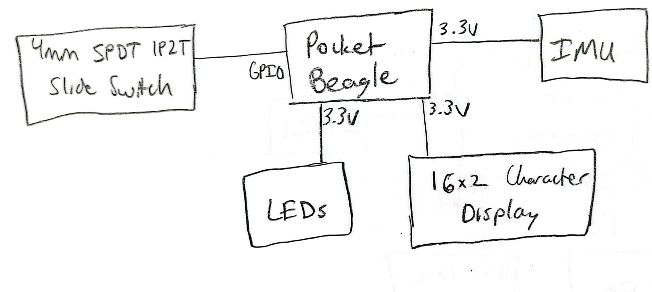
System Block Diagram

Slide 4
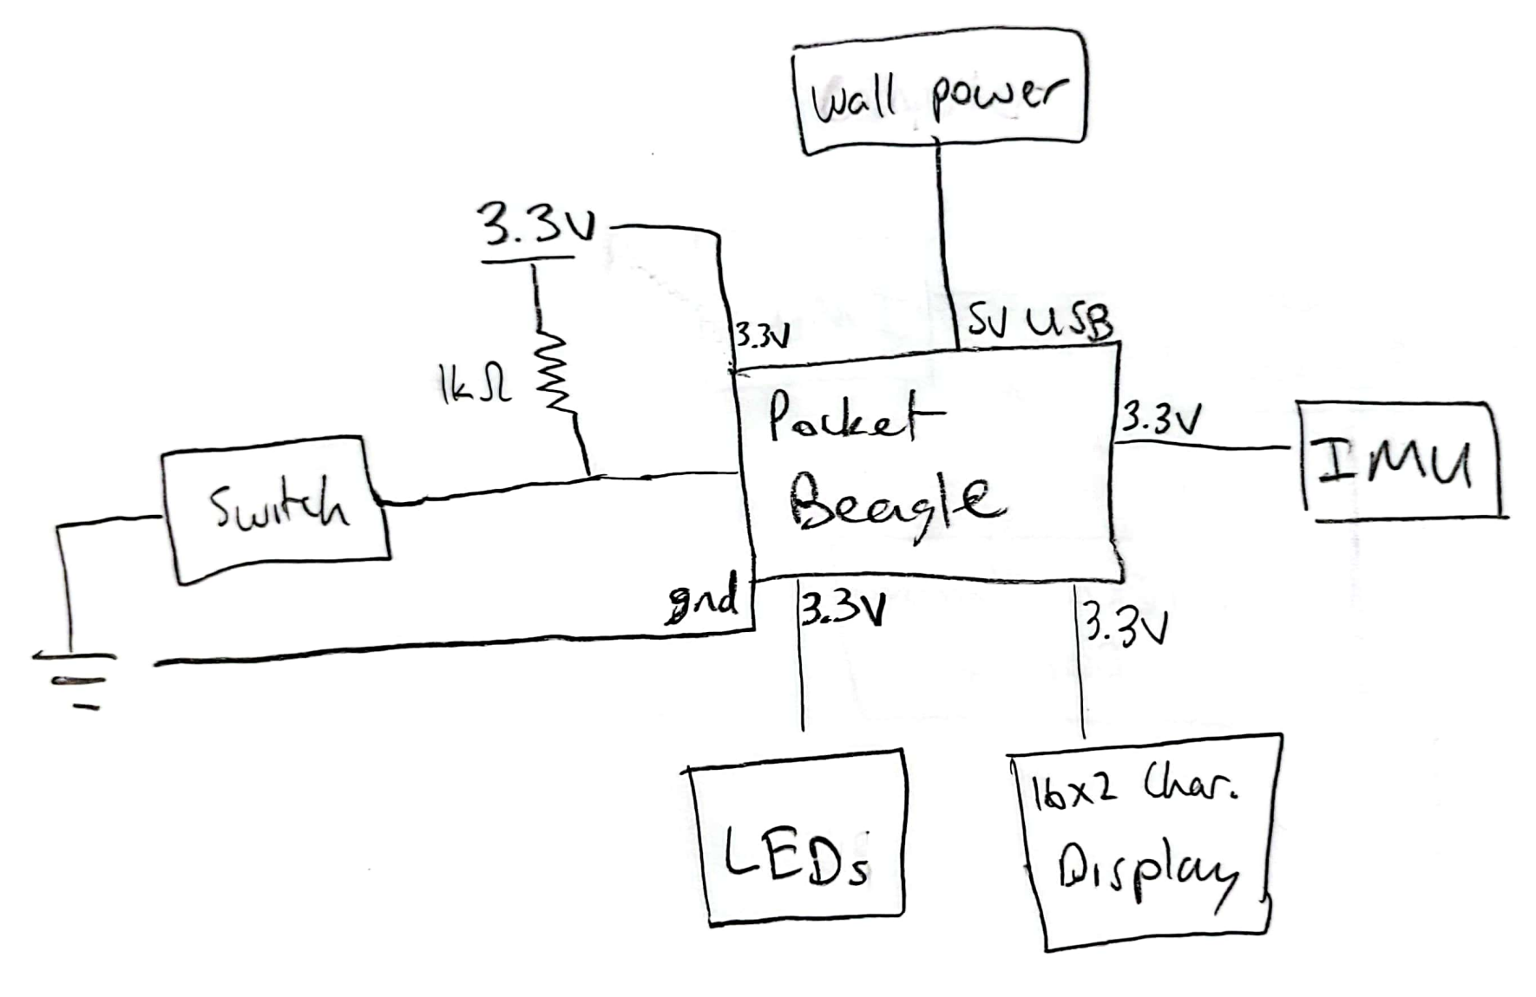
Power Block Diagram

Slide 5
Components / Budget
Component | Need to Buy | Cost
LED (one for each execise) | 0 | 0
IMU (https://shorturl.at/cgzEU) | 2 | 4.20
5V USB cable | 0 | 0
16x2 Character Display (https://www.adafruit.com/product/181) (https://shorturl.at/FHIY4, not sure if it interfaces with pocket beagle) | 1 | 9.95
4mm SPDT 1P2T Slide Switch (https://shorturl.at/guQUV) | 1 | 7.43
 | Total: | 21.58

