Slide 1
ENGI 301 PCB Project
Kian Samra
Due 12/12/2023 @ 11:59pm

Slide 2
Options
Can choose one of two options:
Create a PCB based on your Project #1
Create a PCB based on an example project
See Project #2 assignment for specific details
If choosing Option 1
Replace Background Information and System Block Diagram slides with your slides from the Project #1 proposal
Create a Mechanical Drawing
If choosing Option 2
Used provided Background Information and System Block Diagram slides
Create a Mechanical Drawing

Slide 3
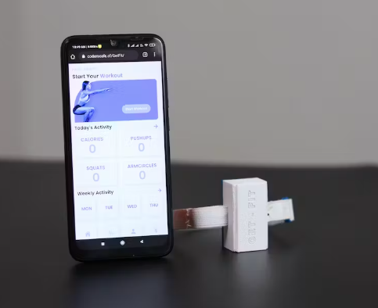
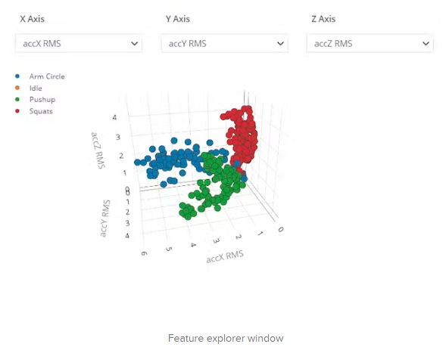
Background Information – Exercise Tracker
Existing project: https://www.hackster.io/coderscafe/get-fit-4d29fb#:~:text=GetFit%20is%20an%20easy%2Dto,a%20completely%20open%2Dsource%20project.
Improvements/additions
Hardware: Use pocket beagle with external modules instead of Arduino, switch to turn exercise tracking on/off, add LED for feedback to indicate completed rep, add screen for users to see exercise counts
Software: Instead of using a machine learning model, create an adaptive algorithm for rep detection. Have acquired data clouded in a designated google drive folder.
Story: Creating a bed-rest rehabilitation system to allow patients to combat muscle atrophy and cardiovascular complications during post-operative recovery. This project will serve as a subset of this rehabilitation system to facilitate tracking of patient activity. This is an essential component of the rehabilitation system as it holds patients accountable and allows therapists to ensure patients are doing the appropriate activities for their recovery.

Slide 4
System Block Diagram
VSS
VCC
VEE
RS
RW
E
D0
D1
D2
D3
D4
D5
D6
D7
LED+
LED-
16x2 LCD display
HD4478U
GPIO 60
GPIO 52
GPIO 57
GPIO 60
GPIO 89
GPIO 87
GPIO 58
LED
Pocket Beagle
SCL (I2C1)
SDA (I2C1)
SCL
SDA
Slide Switch
4mm SPDT 1P2T
GPIO 59
IMU
MPU-6050

Slide 5
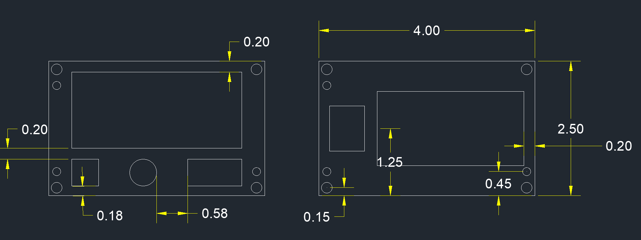
Mechanical Drawing (Dimensions in Inches)
Mounting Hole
Fiducial
Hex Display
IMU
PocketBeagle
Pot
LED
Switch
FRONT
BACK

