Slide 1
The Problem
How should a decision-maker allocate attention when selecting multiple items from a set of alternatives?
Prior work (k = 1): Callaway et al. (2021) showed optimal agents attend based on value estimates and uncertainty.
This work (k > 1): Extend the metalevel MDP framework to multi-response settings and validate with eye-tracking data.

Slide 2
Metalevel MDP Formulation
4-tuple (B, C, T, R) parameterized by n items, k selections, σ_obs, γ_sample, γ_switch
Belief State
Computations & Cost
b = (μ, λ, focused)
μ ∈ ℝⁿ — posterior means
λ ∈ ℝⁿ₊ — precisions
focused ∈ {0,1,…,n} — current item
Initial: μ₀ = 0, λ₀ = 1, focused₀ = 0
C = {1,…,n} ∪ {⊥}
Sample item c → signal:
xₜ ~ N(u⁽ᶜ⁾, σ²_obs)
Cost = γ_sample + γ_switch (if switching)
Cost = γ_sample (otherwise)

Slide 3
Transitions & Rewards
Bayesian Belief Update
Reward Function
After sampling item c:
focused_{t+1} = c
λ⁽ᶜ⁾_{t+1} = λ⁽ᶜ⁾_t + σ⁻²_obs
μ⁽ᶜ⁾_{t+1} = (σ⁻²_obs · xₜ + λ⁽ᶜ⁾_t · μ⁽ᶜ⁾_t) / λ⁽ᶜ⁾_{t+1}
All other items i ≠ c unchanged.
During sampling:
R(bₜ, c) = −cost(bₜ, c)
Upon termination:
R(bₜ, ⊥) = Σᵢ₌₁ᵏ μ₍ᵢ₎
μ₍ᵢ₎ = i-th largest posterior mean
Agent selects the top-k items.

Slide 4
Directed Cognition Approximation
The optimal policy is intractable. Following Gabaix & Laibson (2006), we use Directed Cognition.
VOC_DC(b, c) = max_{N≥1} [ VOI_N(b, c) − cost_N(b, c) ]
"What if we committed to N samples of item c, then terminated?"
Competing Value
Value of Information
cv(c) = μ₍ₙ₋ₖ₊₁₎ if c not in top-k
cv(c) = μ₍ₙ₋ₖ₎ if c in top-k
The threshold item c must beat.
VOI_N(b, c) = E[max(μ̃⁽ᶜ⁾, cv(c))] − baseline(c)
Closed-form via standard normal CDF Φ(z).

Slide 5
Action Selection & Termination
P(c | b) ∝ exp( β · VOC_DC(b, c) ) β = 1000
1. Evaluate VOC_DC(b, c) for each item c
2. Select action via softmax over VOC values
3. Terminate when max VOC ≤ 0
4. Choose top-k items by posterior mean

Slide 6
Empirical Study
N = 75 participants · 4 items per trial · k ∈ {1, 2, 3} · 100 trials per block
Phase 1 — Rating Task
Passively viewed 60 snack food images, then rated desirability (1–100).
Phase 2 — Multi-Response Choice
Selected k items from sets of 4, blocked by selection size. Webcam-based eye-tracking (WebGazer) recorded fixation patterns.
Analysis focused on correct trials (selections matching stated preferences).

Slide 7
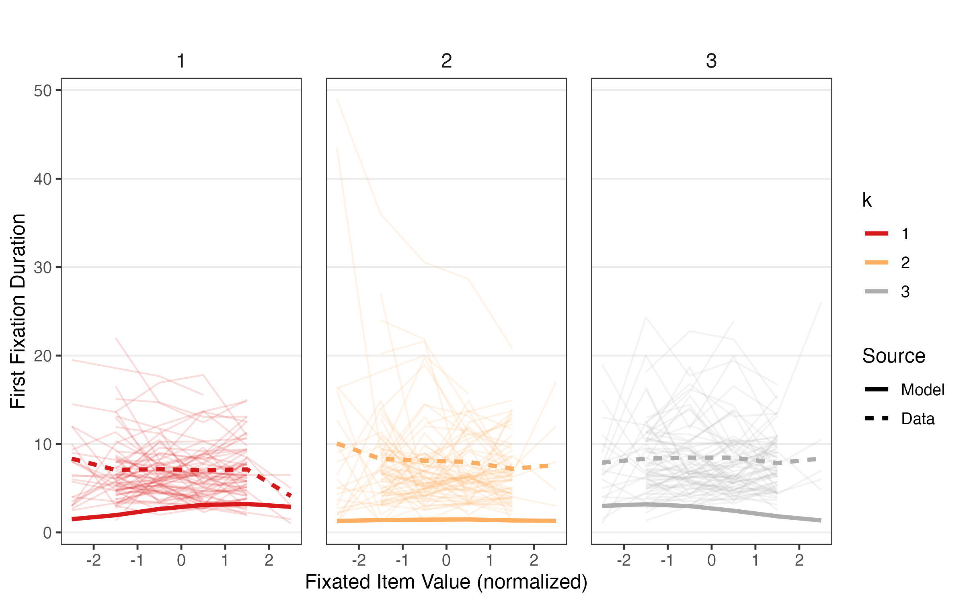
First Fixation Duration by Item Value
Solid = model · Dashed = data · Faint = individual subjects

Slide 8
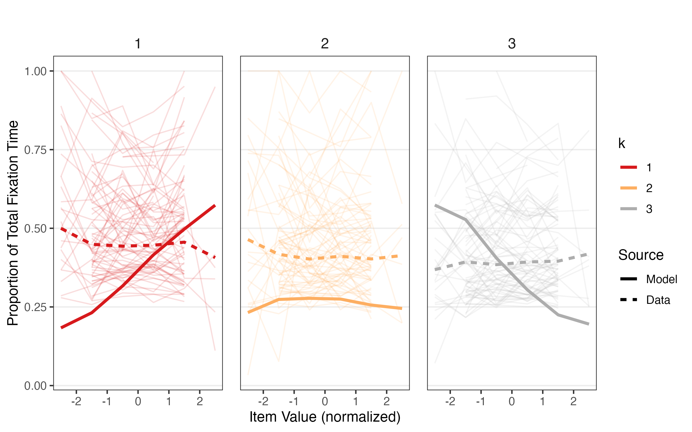
Proportion of Total Fixation Time
Attention concentrates on items near the decision boundary — broadening as k increases.

Slide 9
Key Findings
1. Selection size (k) determines which items are most informative — VOC depends on position relative to the selection boundary.
2. As k increases, attention distributes more broadly across items.
3. When choosing all but one item (k = n−1), identifying the worst item first is computationally efficient — yet participants rarely do so.
Human attention in multi-response decisions shows qualitative signatures of optimal information sampling.

