Slide 1
Spondyloarthritis

Slide 2
SpA refers to a family of immune-mediated inflammatory arthritis disorders that share many clinical, genetic, and pathologic characteristics.
Moll and Wright are credited in recognizing these diseases in 1974 as distinct from RA, a well-recognized inflammatory arthritis at that time.

Slide 3

While axial skeletal involvement is hinted at in the word “spondyloarthritis,” it is not mandatory.
The MSK manifestations of SpA include sacroiliitis, inflammatory spinal lesions, peripheral inflammatory arthritis, enthesitis (inflammation at the attachment of tendons and ligaments to the bones), tendonitis, tenosynovitis, and dactylitis (“sausage digits”).

Slide 4
Other clinical manifestations :
Uveitis
Skin psoriasis
IBD (Crohn’s, or UC)
Absence of RF and nodules (to differentiate from RA)
Familial correlation
Association with the gene HLA -B27

Slide 5

The 2009 Assessment of SPA International Society (ASAS) classification criteria divided SpA under “axial” (axSpA) and “peripheral” (pSpA).
“Peripheral” SpA may seem a misnomer, but it simply indicates that
peripheral MSK manifestations are predominant and more troublesome to the patient than the spinal involvement.

Slide 6
AxSpA is divided into radiographic (r-axSpA, also known as AS, and nonradiographic (nr-axSpA).
The conditions included under pSpA are PsA, ReA, arthritis associated with IBD, and undifferentiated SpA, where patients cannot be classified under any known categories.
Patients with axSpA can have peripheral MSK manifestations, and patients with pSpA may have additional axial skeletal involvement at presentation or may develop it later in the course of their disease.

Slide 7
Other conditions sometimes included under pSpA are SAPHO (synovitis, acne, pustulosis, hyperostosis, and osteitis) syndrome, acne-associated arthritis, and arthritis associated with hidradenitis suppurativa.

Slide 8
Typical patterns include asymmetric, mono- or oligoarticular ( 4 or less joints) inflammatory arthritis of large joints in the lower limb (usually knee), with enthesitis, tendonitis, and dactylitis.
This contrasts with RA, where polyarticular symmetric involvement of MCP / PIP joints predominates.
The cumulative prevalence of all conditions under SpA is 2–3% of the population, much more common than RA.

Slide 9
SpA is a prototypic chronic immune-mediated inflammatory disease that couples inflammation to structural damage.
A unique feature of SpA is that inflammation induced bone loss coexists with pathologic new bone formation, which occurs at specific sites in the skeleton.
These sites include not only the SIJ but also the anterior spinal ligaments or at entheses in the peripheral skeleton.
If uncontrolled, axSpA may ultimately lead to a complete ankylosis of the SIJs and the spine, termed bamboo spine.

Slide 10
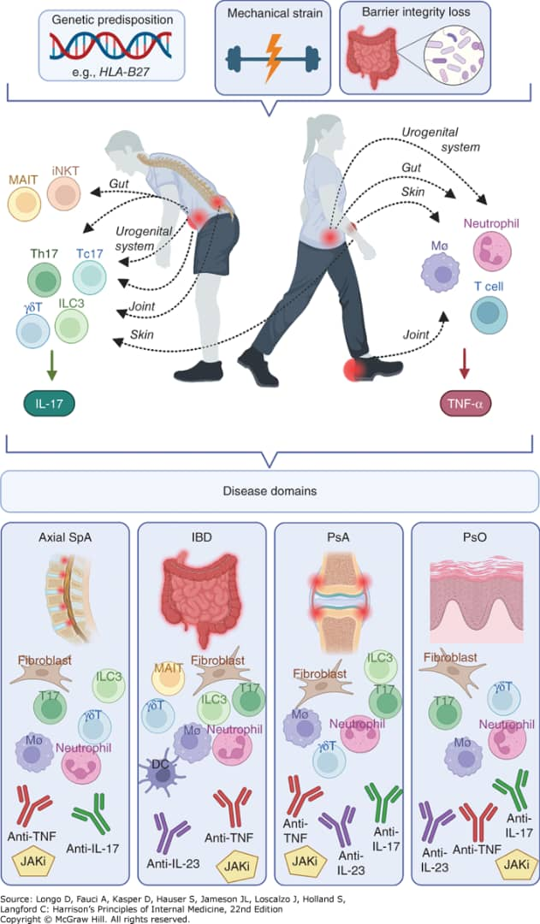
In genetically predisposed individuals, SpA may arise from mechanical stress, a well-known disease precipitator in PsA and axial SpA, or by altered host-microbial interplay at inner (gut, urogenital tract) or outer (skin) surfaces culminating in a cytokine crosstalk characterized by both TNF- and IL-17-driven immune responses. Drivers of disease include cells of both innate and adaptive immune system, along with tissue-resident stromal cells. Different disease domains (gut, spin, peripheral joints, and skin) harbor overlapping (e.g., TNF-α) but also distinct (e.g., IL-17, IL-23) signature cytokines, which has major therapeutic implications. JAK inhibitors, which interfere with signaling of several cytokines, are effective across all domains.

Slide 11
Regardless of the route of disease initiation, several common effector pathways have emerged, with TNF and IL-17 representing signature cytokines in the immunologic basis of axSpA.
The impact of TNF-α as a common effector pathway that acts downstream in the inflammatory process has been long recognized given its broad therapeutic efficacy across all disease domains (gut, enthesis, skin, eye, spine, and joints).
TNF-α is an important activator and product of macrophages that stimulates cytokine production in immune cells and activates fibroblasts.
TNF-α can also be made by neutrophils and activated T cells in the inflamed synovium, enthesis, and intestine.
By activating osteoclasts, it promotes inflammation-induced bone loss and bone erosions in SpA.

Slide 12
Even though axSpA and IBD share a similar genetic predisposition in IL-23R polymorphisms, the two disorders differ substantially in their cytokine dependency.
IL-17A blockade is effective in axSpA, whereas IL-23 inhibition does not provide benefit.
Conversely, IL-23 blockers are approved in IBD, but agents targeting IL-17A are contraindicated in active IBD, due to the barrier protective roles of IL-17.
In PsA, IL-23 and IL-17 inhibitors both appear to be effective.

Slide 13
GENETIC ASSOCIATIONS HLA-B27& BEYOND
HLA-B27 is a MHC class I allele that forms the strongest genetic risk factor for SpA and specifically axSpA.
MHC class I molecules are expressed on the surface of nucleate cells and can present peptides to CD8+ T cells.
HLA-B27 is present in 85–90% of the patients with r-axSpA and 50–90% in nr-axSpA, in contrast to about 5% of the healthy Caucasian population.

Slide 14
Despite the strong genetic association between HLA-B27 and AS, only a minority of HLA-B27 positive subjects develop disease.
In addition, the risk of developing AS in HLA-B27 positive first-degree relatives of AS patients is only 20%. This indicates that additional factors are needed to induce disease

Slide 15
Germ-free HLA-B27 transgenic rats fail to develop SpA, suggesting a crucial pathogenic role for intestinal microbiota.
In humans, microbiome profiling in stool and biopsy samples of HLA-B27+ individuals found that HLA-B27 affects the gut microbiome even in the absence of disease.
This supports the concept that in HLAB27+ individuals, intestinal dysbiosis occurs prior to the onset of clinical manifestations and may contribute to the risk of disease.
Earlier research suggested that HLA-B27 may promote intracellular survival and persistence of pathogens such as Chlamydia trachomatis in monocytes, which could travel to joints and promote synovial inflammation.

Slide 16
Because SpA affects seemingly distinct tissues (spine, peripheral joints, enthesis, anterior eye chamber, intestine, skin), it has been a challenge to seek a common denominator between these different organs.
Two main mechanisms are currently under consideration: the role of intestinal microbiota following a loss of barrier integrity and an aberrant response to mechanical stress.

Slide 17
Mechanical Stress as Gateway to Joint Disease in SpA
The entheses in SpA and PsA are key inflammatory target tissues, and patients can present with both axial and peripheral entheseal inflammation.
In both SpA patients and in individuals without inflammatory conditions, mechanical stress in entheses may lead to microdamage that leads to immune activation and tissue repair.
The importance of mechanical strain in the pathophysiology of enthesitis in SpA is supported by observations in patients and animal models.
Enthesitis occurs more often in the lower limbs, which are subject to higher mechanical strain. In patients with AS, exposure to physical labor was related to more structural damage.
In mouse models, mechanical strain was shown to be causally related to development of enthesitis and SpA-related new bone formation through mechanisms that support chronicity of inflammation.

Slide 18
Responses to mechanical stress are physiologic and self-limited, but they appear to be enhanced and prolonged in SpA. The reason for this is unclear, but this may be influenced by genetic factors and/or impaired intestinal barrier function.
Chronic entheseal inflammation in axSpA also leads to excessive local bone responses.
This is associated with osteoblast differentiation initiated by PG E , IL-17-A and -F, and IL-22 followed by activation of downstream bone morphogenic proteins and Wnt Prs, which are thought to play a role in pathological new bone formation.
This culminates in the generation of bony spurs at vertebral bodies and SIJ joints, eventually leading to ankylosis.

Slide 19
Barrier Integrity Loss and the Intestinal Microbiota in SpA
In view of the link between gut inflammation and SpA, much attention has been focused on barrier integrity loss in the intestine and the role of the intestinal microbiota.
Evidence supporting this mechanism has been the development of ReA following an infectious GE with Salmonella typhimurium, Shigella enteritidis, Yersinia enterocolitica, or Campylobacter enteritidis.
Studies have highlighted the loss of barrier integrity, which may facilitate translocation of bacteria and microbial peptides that can elicit an immune response.
The human microbiome is shaped by genetic and environmental factors. Changes in diversity and composition of the gut microbiome have been identified in SpA, pinpointing an intestinal dysbiosis that is similar to patients with IBD.

Slide 20
While most information on host-microbial interplay in SpA relates to the intestine, other mucosal surfaces and particularly the UGT(e.g., Chlamydia) may serve as an entry route for pathogens to instigate the onset of SpA.

Slide 21
The skin, as the outer barrier of the body, is also vulnerable to the development of immune-mediated inflammatory disease.
Like the inner barriers of the intestines and joints, the skin plays a key role in preserving tissue homeostasis at a site exposed to microbial, chemical, and mechanical challenges.
Alterations in the cutaneous microbiome of patients with psoriasis and PsA have been described with striking similarities between non-lesional and lesional skin. However, the functional impact of skin microbiota on the disease trajectory is still ill defined.

Slide 22
AxSpA is a chronic, immune-mediated inflammatory disorder predominantly involving the axial skeleton (SIJs and the spine) and also the peripheral skeleton.
The axial skeleton is always involved, and involvement of the peripheral joints occurs in ~30–40% of patients.
The hips, historically considered “root joints,” are the most common non spinal joints affected.
Enthesitis in the axial and peripheral skeleton is a common feature, but dactylitis is relatively rare.
Extraarticular manifestations include psoriasis, acute anterior uveitis, and IBD.
Some patients with axSpA experience gradual spinal bony fusion over several years, which leads to reduced spine and neck flexibility.
Despite these osteoproliferative changes in the skeleton, osteoporosis is a common morbidity.
AxSpA significantly affects patients’ well-being, function, productivity, and health-related quality of life.

Slide 23
AxSpA is divided into r-axSpA (also called AS) and nr-axSpA, the difference based on the presence or absence of definitive sacroiliitis on plain radiographs.
“Definitive sacroiliitis” is defined by the modified New York criteria as grade 2 bilateral or grade 3 or 4 unilateral or bilateral .
Patients with sacroiliitis of lower grade are classified as nr-axSpA.
Since the differentiation between r-axSpA and nr-axSpA is based on the degree of sacroiliitis, it is open to disagreements even between trained MSK radiologists.
The interreader reliability as measured by the kappa statistic is between 0.35 and 0.45.
nr-axSpA and r-axSpA have the same clinical features and share similar disease burden, though in late-stage r-axSpA, fusion of spine and hip involvement can add to functional loss.

Slide 25
The M/F ratio is 2:1 for r-axSpA and 1:1 for nr-axSpA.
The population prevalence of axSpA depends on the prevalence of HLA-B27 in that geographic region.
In Europe, HLA-B27 frequency in the population increases from south to north, and so does the prevalence of axSpA.
The prevalence of HLA-B27 in Spain and Norway is 7 and 9%, respectively, and the prevalence of AS and axSpA in these two countries is 0.1 and 0.56%

Slide 26
CLINICAL MANIFESTATIONS
The most common first manifestation of axSpA is low back, hip, or buttock pain, which starts before the age of 40–45 years, usually in the 20s to 30s.
The typical characteristics of this back pain include any combination of the following: insidious onset, chronicity (>3 m duration), age of onset < 45 , improvement with exercise or activity and no improvement with rest, worse back pain in the second half of the night with improvement after getting out of bed and walking around, and prolonged (MS >30 min) .
Back pain with these characteristics is termed IBP to differentiate it from the common “mechanical back pain”.

Slide 28
Peripheral arthritis is seen in 30–40% of patients with axSpA. Typically, this is an asymmetric, oligoarticular inflammatory arthritis involving the large joints of the lower extremities and rarely the small joints of hands and feet.
Hip involvement, presenting as pain in the groin with radiation to medial thigh or the knee, is common and is associated with significant functional impairment.
Enthesitis is a common manifestation of axSpA.
Dactylitis is an uncommon manifestation of axSpA.
Persistent axial inflammation may lead to bony fusion of SIJ, apophyseal joints, and development of syndesmophytes by osteoproliferation in the outer fibers of the annulus fibrosus of the intervertebral disks.
These bony changes lead to limitation of spinal, including neck, mobility in all directions and are a major cause of significant functional impairment in late stages of the disease.

Slide 29
Enthesitis may present as heel pain (plantar fasciitis, Achilles tendon insertion pain), chest wall pain, intercostal muscle insertions, medial or lateral epicondylitis, quadriceps or patellar tendon insertion pain around knees, or pelvic rim pain.

Slide 30
Extra MSK manifestations of axSpA, such as Pso, IBD& acute anterior uveitis, can also be the presenting symptom of axSpA in some patients, and such patients may first present to a dermatologist, gastroenterologist, or an ophthalmologist. Uveitis, the most common extra MSK manifestation, is seen in 40% of patients with axSpA and presents as eye discomfort followed by redness, pain, photophobia, and miosis.
The typical phenotype of uveitis associated with axSpA is acute, anterior, unilateral, and episodic.
While frank IBD is seen in 10%, histologic evidence of subclinical gut inflammation is seen in up to 50% of patients.
Pso is seen in 10%
Osteoporosis can be present in 40%.

Slide 31
AxSpA can affect multiple organ systems.
The two renal manifestations of axSpA are IgA nephropathy, which can present at any time in the disease course as microscopic hematuria
Nephrotic syndrome secondary to renal (AA) amyloidosis, which is a late complication only seen after prolonged uncontrolled inflammation.

Slide 32
Conduction abnormalities (heart blocks) can be seen at any stage of the disease, whereas aortic valve insufficiency and cauda equina syndrome presenting as urinary hesitancy and/or saddle anesthesia are late complications.
Pulmonary manifestations of axSpA include apical fibrosis, cavitary lung lesion, or fibrotic parenchymal lesions.
Sleep apnea syndrome and restrictive lung disease seen in late-stage axSpA are mostly related to osteoproliferative structural changes of the cervical spine and rib cage.

Slide 33
The course of axSpA can be variable, with close to 50% of patients progressing from nonradiographic to radiographic stage over 20 Y and <10% progressing to significant spinal involvement with bamboo spine.
Risk factors for osteoproliferation include male sex, persistent inflammation seen on MRI
of SIJs and spine, high CRP, syndesmophytes,
presence of HLA-B27, and smoking.

Slide 34
A diagnostic delay of 5–14 years from symptom onset of axSpA reported in various parts of the world is mostly related to the commonality of mechanical back pain in the general population.
Traditionally, AS is thought to be a disease of males, and back pain and enthesitis in women are commonly mistaken for fibromyalgia.
This delays the diagnosis in females even further.
Lower prevalence of HLA-B27 in nonwhite populations also adds to the delay in diagnosis.

Slide 35
The diagnosis of axSpA is based on pattern recognition, R/O common causes for the symptoms, and clinical reasoning.
While elevated inflammatory markers, ESR, and CRP help in making the diagnosis of axSpA, these tests are neither sensitive (seen in only 30–40% of patients with active axSpA) nor specific for axSpA.

Slide 36
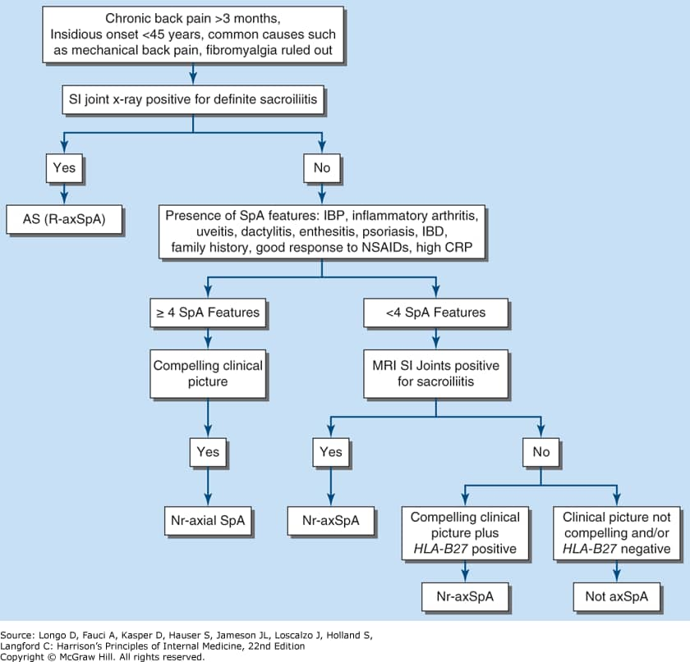

Slide 37
Imaging plays a very important role in the diagnosis of axSpA. A single AP or a Ferguson view x-ray of the pelvis is sufficient to image SIJs.
Multiple views (e.g., oblique) of the SIJs add little in making the diagnosis; in addition, they increase radiation risk to gonads.
Radiographic features of sacroiliitis include marginal sclerosis, erosions, narrowing and widening of the joints, and in late stages, fusion.

Slide 38
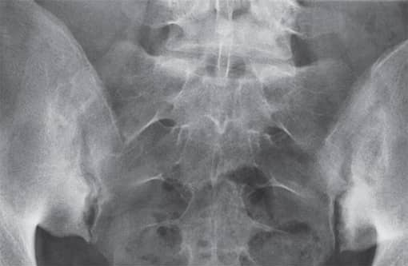

Slide 39
As a general rule, plain radiographs of the spine should be avoided in patients with chronic back pain.
However, there are some characteristic changes of axSpA seen in the lateral radiograph of the spine, and they include Romanus lesions or the shiny corner sign and squaring of the vertebral body seen as a result of erosions at the attachments of the spinal ligaments at the vertebral corners.
Andersson lesion is an uncommon finding and is characterized by vertebral body erosion and sclerosis at the intervertebral disk level.
In the late stages, ossification of the outer layer of annulus fibrosus leads to syndesmophyte formation.

Slide 40
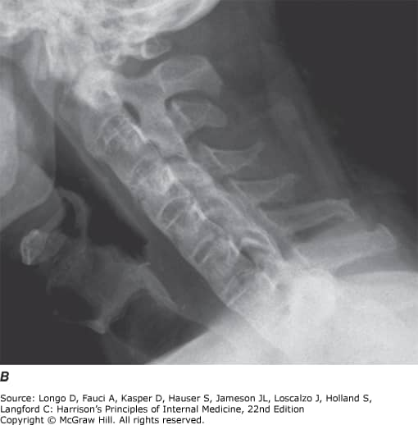

Slide 41
Typical syndesmophyte orientation is vertical, differentiating it from the horizontal orientation of osteophytes, which is commonly seen with OA of the spine.
Bamboo spine, or ankylosis of the entire spine, is seen in a very small percentage of late-stage AS patients.
Low dose CT of the SIJs and spine in the diagnosis of axSpA is emerging as an alternative to plain X-ray for diagnosis and assessing progression.

Slide 42
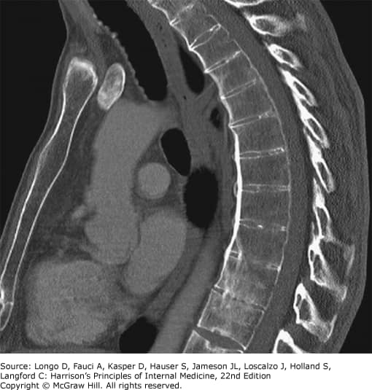

Slide 43
MRI of the SIJs and spine has evolved as an important tool in making the diagnosis of axSpA.
During the early stage of disease, MRI of the SIJs may show evidence of active inflammation, or “osteitis,” and that may be the only abnormality.
As time passes, the active inflammatory changes transition to fatty metaplasia, and this may further transform to new bone formation.
The structural changes of sclerosis, fat metaplasia, erosions, fat metaplasia in an erosion cavity (backfill), and new bone formation, in addition to the inflammatory changes seen on MRI, aid in making the diagnosis of axSpA .
Sole presence of inflammatory lesions in early stages or sole presence of ankylosis in very late stage may be enough for the diagnosis of axSpA, but as a general rule, multiple types of inflammatory and structural lesions increase the suspicion of axSpA.
In the spine, multiple corner inflammatory lesions and/or multiple corner fatty lesions increase the confidence of axSpA diagnosis.

Slide 44
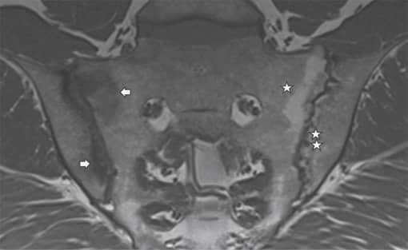
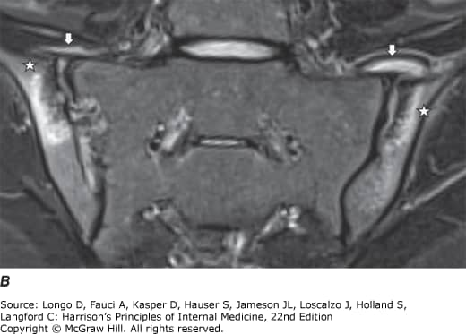

Slide 45
MRI is a very sensitive imaging technique, and mechanical stress on the SIJs in professional athletes, postpartum women, and even in normal individuals, especially above the age of 40, may show changes of osteitis.
Fat metaplasia-type changes in the SIJs are also seen in degenerative arthritis as well as in normal individuals.
Inappropriate utilization of MRI can lead to overdiagnosis.

Slide 46
DIFFERENTIAL DIAGNOSIS
Chronic nonspecific “mechanical” back pain is common in the general population, and axSpA is the etiology in only 4–5% of such patients.
Mechanical causes of back pain therefore should be considered first in a patient presenting with chronic back pain.
The so-called “red flag” signs of fever, weight loss, advanced age, and past history of malignancy should alert the examiner to look for osteomyelitis, osteoporotic fracture, or metastatic disease.
In young patients with generalized body pain, fibromyalgia, central sensitization, hypermobility, hypothyroidism, and hypovitaminosis D may be considered.

Slide 47
Abnormalities on incidental imaging in a patient with or even without chronic back pain lead to other DDx such as diffuse idiopathic skeletal hyperostosis (DISH) or osteitis condensans ilii (OCI).

Slide 48
DISH is a noninflammatory, degenerative condition affecting the spine, with exuberant new bone formation in the form of anterior and posterior longitudinal ligament ossification of at least 4 contiguous vertebral bodies and bulky “flowing” osteophytes typically on the right side of the thoracic spine, but normal SIJs.
It is generally seen in obese, diabetic males, often older than 50 Y of age.
DISH is sometimes mistaken for bamboo spine of AS.

Slide 49
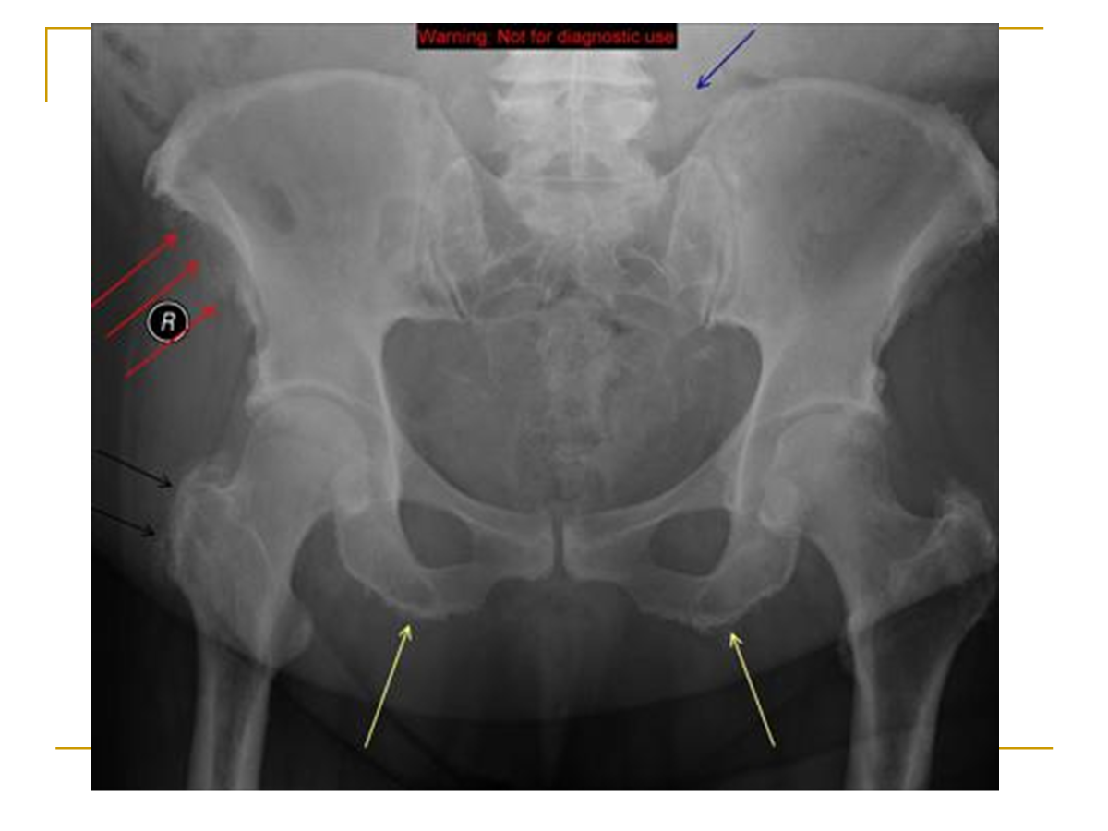

Slide 50
OCI is usually an asymptomatic condition of multiparous women characterized by radiographic findings of a triangular area of dense sclerosis on the lower and inferior part of the iliac side of the SIJs.
This can be mistaken for sacroiliitis, and in early stages, MRI of the SIJs may be indistinguishable from that of axSpA.
Lack of erosions should help distinguish OCI from axSpA.
OCI can be seen in nulliparous women and even men.
While DISH and OCI are generally asymptomatic, some patients with either condition may present with chronic back pain.

Slide 51
IBP with sclerotic changes on SIJs X-ray can also be seen in conditions such as postpartum insufficiency fx of the sacrum; septic sacroiliitis from TB, brucellosis, fungi, and other infectious agents; and rarely, malignancies such as ALL.

Slide 52
Treatment
NSAIDs should be used in highest tolerable doses continuously in active disease and on an as-needed basis if the disease is stable.
No particular NSAID is preferred over any other.
Side effects to monitor are GUD, HTN, renal insufficiency, and CVD.

Slide 53
CS DMARDs like SSZ, up to 3 g/d, and MTX, up to 25 mg/wk, are useful for the treatment of peripheral joint and entheses involvement, but not for axial disease in axSpA.

Slide 54
TNFi
If the disease remains active despite a 4-week trial of full-dose NSAIDs, treatment should be escalated to start a biologic from either the TNFi or IL-17i class.
Before initiating therapy with biologics or JAKi, screening for latent TB, hepatitis B, and hepatitis C should be performed.

Slide 55
PSORIATIC ARTHRITIS
PsA is a relatively common immune-mediated inflammatory condition that may lead to progressive joint damage. If left untreated, it is associated with poor quality of life, loss of function, and increased morbidity and mortality.
PsA, associated with cutaneous and nail psoriasis, involves peripheral joints, axial skeleton (SIJs and spine), entheses, and tendon sheaths.
In addition, uveitis and IBD may coexist with PsA. Common comorbidities of PsA include depression, metabolic syndrome, DM and CVD.
Sometimes the term “psoriatic disease” is used to emphasize these varied manifestations.

Slide 56
EPIDEMIOLOGY
With a prevalence of 2–3%, skin Pso is one of the most common immune-mediated diseases.
The prevalence of PsA in patients with Pso is 30% (range, 6–42%). The incidence of PsA in patients with psoriasis is 3 per 100 patient-years (range 2–10) and depends on the severity of skin Pso.
The likelihood of developing PsA in Pso patients does not change over time.

Slide 57
CLINICAL FEATURES
Clinical features of PsA include peripheral arthritis, axial arthritis (spondylitis), enthesitis, dactylitis, and tenosynovitis. Inflammatory arthritis presents with joint pain, swelling, prolonged stiffness, and reduced mobility.
Typically, early PsA is oligoarticular (and often asymmetric, and as the number of affected joints increases, the disease becomes polyarticular and the distribution becomes more symmetric.
DIP joint involvement is typical of PsA and is associated with psoriatic nail changes since the nail bed is closely linked to the DIP joints.

Slide 58
Dactylitis is due to inflammation of the joints, tendons, bones, and soft tissues within the digit.
Dactylitis is a marker of severity of PsA, and persistent dactylitis leads to structural damage to the joints within that digit.
Arthritis mutilans is an end manifestation of a severe arthritis process.

Slide 59
Pso may be hidden in areas such as the scalp, umbilicus, below breasts, or in the natal cleft, or it may be present in the nail only and should be looked for carefully.
Typical involvement of the joints of the fingers or toes is in a “ray” distribution (involvement of all joints in a finger or toe), with one finger showing dactylitis, another with bony ankylosis, and the neighboring finger showing arthritis mutilans.

Slide 60
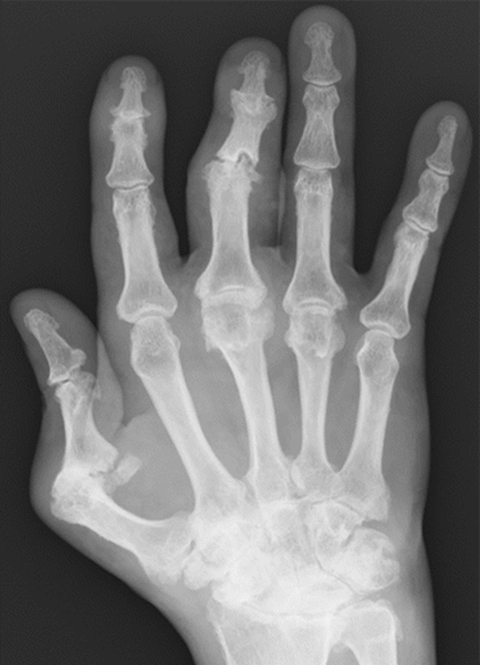

Slide 61
Lab tests only play a minor role in the diagnosis of PsA.
Tests for APR such as ESR or CRP are abnormal in ~50% of patients despite clinically active disease.
High levels of ESR or CRP are markers of severe disease and are predictors of radiographic damage and mortality.
RF is typically negative, but low titer RF or low titer anti- ccp may be positive in less than 10% of patients.
HLA-B27 is positive in 20% of all patients with PsA and 50% of patients with axial PsA

Slide 62
IMAGING FEATURES
In PsA, erosions are often accompanied by “fluffy” new bone formation.
The combination of erosions at joint margins with new bone formation is characteristic of PsA .
New bone formation may also cause ankylosis of the joints. There also may be joint space narrowing, “pencil-in-cup” deformity, and in late stages, such as arthritis mutilans, total joint destruction or joint lysis and acro-osteolysis (resorption of the terminal phalanx) are seen.

Slide 63
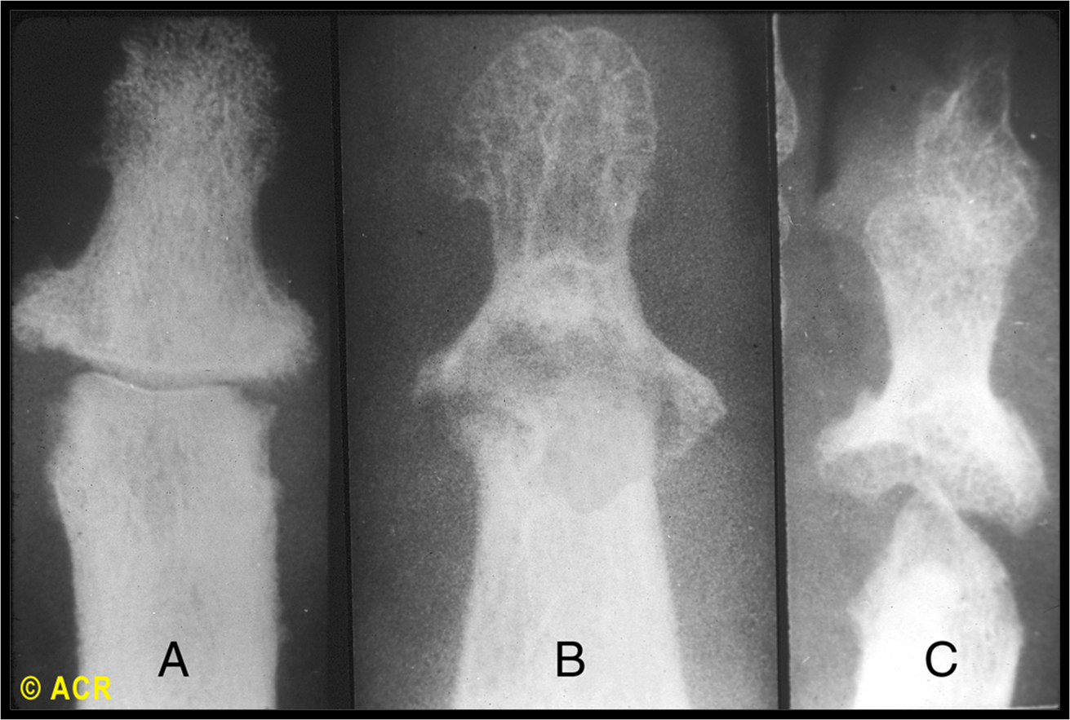

Slide 64
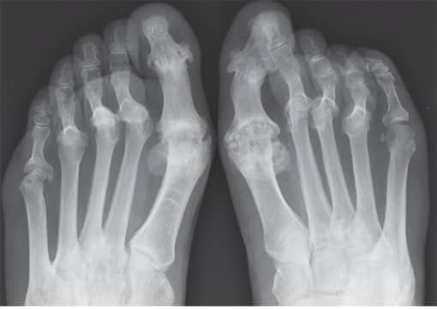

Slide 65
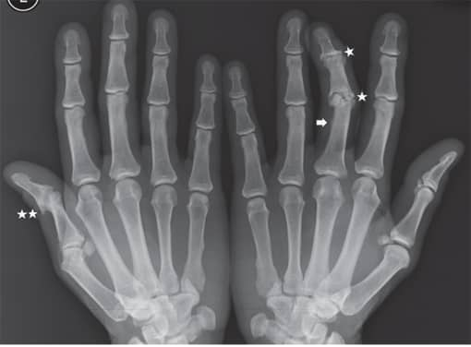

Slide 66
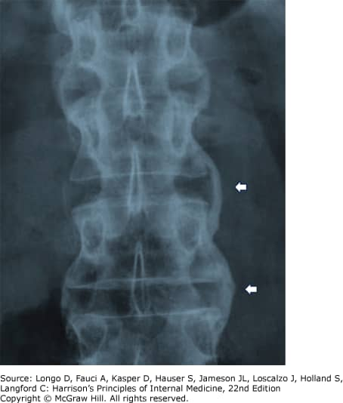

Slide 67
CLASSIFICATION CRITERIa
The Classification of Psoriatic Arthritis (CASPAR) criteria have a specificity of 98.7% and sensitivity of 91.4%.
To meet the CASPAR criteria for PsA, individuals must first have inflammatory articular disease (joint, spine, or entheseal) and must have at least 3 points from the five categories.

Slide 69
DIFFERENTIAL DIAGNOSIS
OA, the most common form of arthritis, occurs in ~5% of the population, and it may coexist with psoriasis especially in the DIP joints. Thus, the presence of Heberden nodules in the context of patients with hand OA with concomitant psoriasis is an important differential diagnosis to be made.
Psoriatic nail involvement would differentiate PsA from inflammatory OA of the DIP joints, along with imaging abnormalities such as on US. Patients with “seronegative RA” should be carefully examined for presence of Pso in hidden areas and questioned about FH of Pso.
Many patients with seronegative RA may have pSpA such as PsA, ReA, or IBD-associated arthritis.

Slide 70
TREATMENT OF PSORIATIC ARTHRITIS
The four main classes of pharmacotherapy used in the management of PsA include
NSAIDs
csDMARDs
biologic DMARDs: TNFi (etanercept, adalimumab, infliximab, certolizumab, or golimumab), antibodies against IL-12/23 (ustekinumab), IL-17A (secukinumab, ixekizumab), IL-17A and IL-17F (bimekizumab), IL-23 (guselkumab, risankizumab), and costimulatory blockade agent (abatacept).
tsDMARDs PDE4 inhibitor Apremilast, JAKi (Tofacitinib, Baricitinib)

Slide 71
REACTIVE ARTHRITIS
ReA refers to the development of arthritis following UG or GI infection involving well-defined triggering microorganisms that are normally not cultivable from the joints affected.
Prototypical inducers of ReA include Yersinia, Campylobacter, Salmonella, Shigella, and Chlamydia.

Slide 72
CLINICAL FEATURES
A crucial factor in the diagnosis relates to recognition of the clinical picture and the identification of causative organisms.
A hallmark feature is the time delay between initial infection and onset of arthritis: the interval ranges between 1 d and 4 W after infection.
Inflammatory MSK disease (joint, spine, or entheseal) is essential for the diagnosis of ReA. The clinical spectrum may include a typical asymmetrical oligoarticular arthritis preferentially involving lower limbs, enthesitis, tendonitis, bursitis, dactylitis, IBP, and sacroiliitis.
Mucocutaneous lesions may also occur in addition to the MSK manifestations and include uveitis/conjunctivitis, EN, oral ulcers, circinate balanitis, and keratoderma blenorrhagica.

Slide 73
ReA is strongly associated with the presence of HLA-B27, with up to 50–80% of all ReA patients carrying HLA-B27.
Prevalence of ReA matches the prevalence of HLA-B27, which has a clear North-South gradient.

Slide 74
While ReA is thought to be self-limiting and resolving in a large proportion of patients, ReA may also evolve into a chronic phase.
The presence of HLA-B27 has been linked to the evolution into chronicity in part because HLA-B27 has been suggested to promote intracellular survival of causative microorganisms in infected macrophages, providing a roadmap to chronicity.
In chronic forms of ReA (e.g., lasting longer than 6 m and with inadequate response to management outline in acute ReA), DMARDs such as SSZ and MTX and even TNFis can be considered.
Overall, the management of chronic forms of ReA follows treatment principles of peripheral SpA.

Slide 75
IBD Associated arthritis
An intriguing relationship between bowel and joint inflammation has emanated for >50 years that points to a prominent role of barrier integrity loss and dysbiosis in SpA, initially recognized by uncovering the occurrence of arthritis in IBD patients.
The link between gut and joint inflammation, however, is reciprocal. Hence, patients with a diagnosis of SpA but without associated GI symptoms were also found to display histologic signs of inflammation in ileocolonoscopic studies, primarily in the terminal ileum.
Here, two types of lesions were described: an acute type of inflammation resembling an infectious enterocolitis and a chronic type of inflammation with many features of Crohn’s disease.

Slide 76
infection-related arthritides
All forms of arthritis associated with infections except septic arthritis.
They include, among others, ARF, meningococcus, Mycoplasma genitalium, Ureaplasma urealyticum, Chlamydia pneumoniae, betahemolytic streptococci, and some live vaccines and COVID.
These should not be described as ReA since the clinical pattern does not fit the SpA spectrum and is unrelated to HLA-B27.

Slide 77
Both UC and CD are associated with SpA. AxSpA as well as pSpA commonly occur in both of them, with pSpA being the most prevalent form.
R-axSpA develops in up to 10% of IBD patients, whereas prevalence of pSpA varies largely according to various studies, ranging from 10 to 30%.

Slide 78
CLINICAL FEATURES
Axial skeletal involvement associated with IBD is clinically similar to idiopathic axSpA. There may be, however, a disconnect in time in the occurrence of both. Thus, axSpA may develop after diagnosis of IBD but, in other cases, precedes onset of IBD.
Peripheral involvement in IBD resembles the clinical picture of peripheral SpA, which may include more acute forms of oligoarthritis that co-occur with relapses of IBD.
More chronic forms of SpA may also occur that may cause substantial structural damage if not appropriately treated. A rare symmetric polyarticular arthritis that runs an independent course has also been described.
In addition to IBD patients with a firm diagnosis of SpA, a comparable fraction of IBD patients have arthralgias or fibromyalgia symptoms.

Slide 79
MANAGEMENT
Management of IBD-related arthritis follows the general principles of axSpA and pSpA treatment with some special considerations, given the observed disconnect that may occur between gut and joint symptoms with some targeted therapies. Within the targeted therapies, the monoclonal abs, but not the soluble receptor, blocking TNF-α are effective in IBD as well as in both axial and pSpA. Other biologics with efficacy in IBD that may have proven efficacy in peripheral SpA include ustekinumab (anti-IL12/23p40), guselkumab, and risankizumab (antiIL23p19), but anti-IL17 therapy is contraindicated.
The JAKi tofacitinib and upadacitinib are approved in ulcerative colitis and upadacitinib in CD and are also effective in axSpA and pSpA. Other treatments for IBD include SSZ and related drugs as well as systemic and local GCs. NSAIDs, especially COX2-selective formulations, are helpful for arthritis and generally well tolerated but may induce IBD flares, so they should be considered only for temporary use. Vedolizumab is a gut-selective integrin inhibitor approved for both Crohn’s disease and ulcerative colitis.

Slide 80

Thank you

