Slide 1
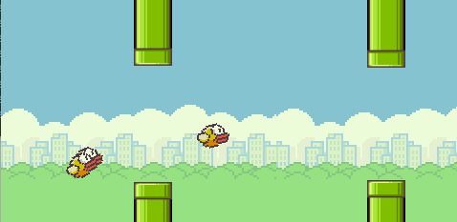
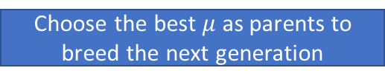
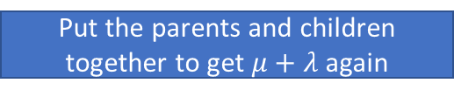


Initialize $μ+λ$ individuals randomly
Evaluate each individual
to assign fitness
Choose the best $μ$ as parents to breed the next generation
Generate $λ$ children
by random mutation
Put the parents and children together to get $μ+λ$ again

Slide 2


h
v
+
neg
-
/
$$⋯$$
*
+
+
-
$$y$$
g

