Slide 1
Wedding-Wise AI: Feature Roadmap for Bridal Teams
Digital Marketing
KIARA RAAB
M.S. ANALYTICS
JUNE 25, 2025

Slide 2
Context
The company needed one place to compare AI solutions across key controls.
Audience: internal teams evaluating AI tools.
Goal: Propose and prioritize features that deliver high value, low effort, and strong Responsible AI guard-rails.
KIARA RAAB
M.S. ANALYTICS
JUNE 25, 2025

Slide 3
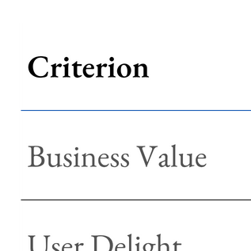
New Criteria
KIARA RAAB
M.S. ANALYTICS
JUNE 25, 2025

Slide 4
Research – AI in the Wedding Industry
(Summer 2025)
KEY TRENDS & STATISTICS
RESPONSIBLE AI CONSIDERATIONS
48 % of wedding photographers plan to use AI to automate routine editing tasks in the next 12 months wifitalents.com
65 % of wedding event planners use AI to analyze past event data for improved planning wifitalents.com
40 % of wedding planners use AI-based software to streamline vendor management zipdo.co
Advanced registries now use algorithms to suggest items based on recipients’ past behavior and preferences fastercapital.com
Wedding services market projected to grow at a 12.7 % CAGR from 2025 to 2030 grandviewresearch.com
Fairness: Ensure vendor-matching models don’t systematically favor large chains over local businesses.
Privacy: Protect guest lists and couple budgets with end-to-end encryption and SSO access.
Transparency: Surface “Why this vendor?” explanations so users trust AI suggestions.
Monitoring: Track chatbot accuracy, recommendation uptake, and drift quarterly.
KIARA RAAB
M.S. ANALYTICS
JUNE 25, 2025

Slide 5
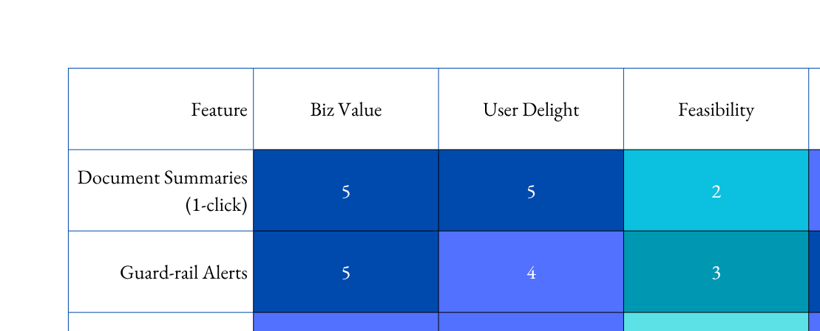
Feature Matrix
1 | 2 | 3 | 4 | 5
KIARA RAAB
(EFFORT BAKED INTO PRIORITY COLUMN)
M.S. ANALYTICS
JUNE 25, 2025

Slide 6
Decision Framework
BUILD NOW IF: PriORITY ≥ 2 AND RAI SCORE ≥ 4
SPRINT 1: SUMMARIES, GUARD-RAILS, GLOSSARY
SPRINT 2: VERSIONING
SPRINT 3: FLOW CHARTS
KIARA RAAB
M.S. ANALYTICS
JUNE 25, 2025

Slide 7
Next Steps & Career Tie-In
Next Steps:
Prototype Phase 1 features.
User test with two pilot teams.
Measure sprint velocity and fairness metrics.
Career Connection:
Shows I can define scope, prioritize by impact/effort, and bake in Responsible AI.
Ties to my resume story: moving from data science into product management.
KIARA RAAB
M.S. ANALYTICS
JUNE 25, 2025

Slide 8
Questions?
KIARA RAAB
M.S. ANALYTICS
JUNE 25, 2025

Slide 9
Thank you!
KIARA RAAB
M.S. ANALYTICS
JUNE 25, 2025

