Slide 1


ASME 2026 STUDENT HACKATHON · NEURALCAD-EDIT
UCONN CAD PACK
ASME 2026 STUDENT HACKATHON · AUTODESK NEURALCAD-EDIT
UCONN CAD PACK
A three agent loop that edits a solved B-rep from one line of customer intent, and measures its own work while it does it.
48 / 48 tasks scored
diff F1 0.390
best published model 0.184
$0.83 a task
UCONN CAD PACK · ASME 2026 Student Hackathon
1 / 13
Notes:
[25s] This is UCONN CAD PACK. A customer writes one line, a solved B-rep goes in, and the edited part comes out. We scored all forty eight benchmark tasks: mean diff F1 of 0.390, against the published GPT-5.2 baseline at 0.184, at eighty three cents a task.

Slide 2
ASME 2026 STUDENT HACKATHON · NEURALCAD-EDIT
UCONN CAD PACK
RESULTS
48 of 48 tasks, scored on diff F1
0.390
0.184
16
$0.83
our mean diff F1
best published model
solved outright
per task
all 48 tasks scored
GPT-5.2, the same 48 tasks
diff F1 at or above 0.60
$39.98 for the whole benchmark
Second only to the second human expert at 0.595, which is the agreement ceiling for this metric rather than a competitor. Chamfer similarity 0.98 and volume F1 0.91 are healthy and are not the point: both sit near 1.0 for every method, including the ones that never edited the part at all.
UCONN CAD PACK · ASME 2026 Student Hackathon
2 / 13
Notes:
[50s] The headline. All forty eight tasks scored: mean diff F1 of 0.390, where the best published model reaches 0.184 on the same forty eight. Sixteen of them are solved outright, meaning diff F1 at or above zero point six. Eighty three cents a task, thirty nine ninety eight for the whole benchmark. We sit second to the second human expert at 0.595, and that is the agreement ceiling for this metric, not a competitor.

Slide 3
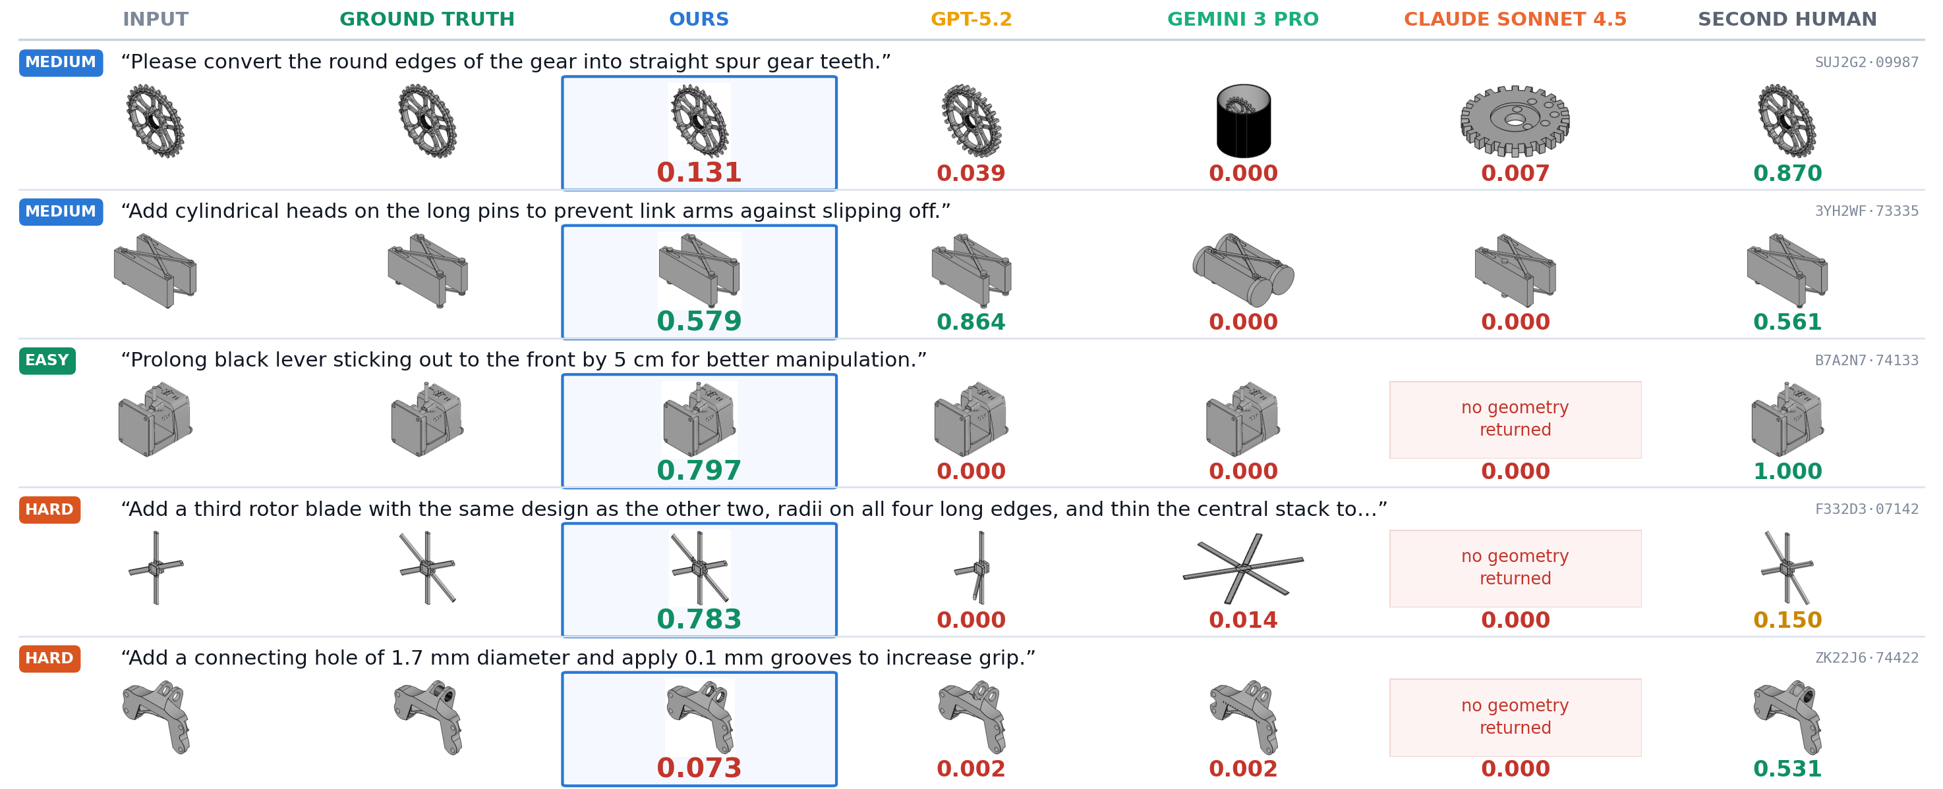
ASME 2026 STUDENT HACKATHON · NEURALCAD-EDIT
UCONN CAD PACK
THE FIVE TASKS THE ORGANISERS NAMED
All five, every method, with the score under each part
Our mean on these five is 0.473, the best benchmark model reaches 0.181, and the second human 0.622. Renders and scores are the benchmark's own, arranged by us.
UCONN CAD PACK · ASME 2026 Student Hackathon
3 / 13
Notes:
[70s] These are the five request ids the organisers named, all five on one slide. For each one: the input, the human expert's edit, ours, and then every published model with its diff F1 underneath. Our mean on these five is 0.473, the best benchmark model reaches 0.181, and the second human 0.622. On the lever task we score 0.797 while every published model scores zero, and Claude Sonnet returns no geometry at all. On the hard rotor task we score 0.783 where the best model manages 0.014 and even the second human only reaches 0.150. We are honest about where we are weak: on the link arm GPT-5.2 beats us 0.864 to 0.579, on the grooves task we only reach 0.073, and the second human is ahead of us on four of the five.

Slide 4
ASME 2026 STUDENT HACKATHON · NEURALCAD-EDIT
UCONN CAD PACK
WHAT WE ADDED
Six components we added to the framework
Part inspector
Strategist
Three agents, one job each
IT CAN POINT AT THINGS
A PLAN, NOT A WISH
FAILURES STAY SEPARABLE
Measures the solid into a text index of holes, faces and edges.
Turns one line into ordered CAD sub-goals, each with tags and an envelope.
One plans, one writes CadQuery for a single sub-goal, one judges.
Example: the plan can say chamfer edge 68, 119, 127 instead of “chamfer the holes”.
Example: “add a flange” becomes cut the pocket, then add the flange, then drill the four holes.
Example: the executor never sees the rest of the plan, so a bad plan cannot hide behind a good build.
Syntax and API check
QA inspector
A skill set, picked by sub-goal
BEFORE ANYTHING RUNS
IT SAYS WHAT IS WRONG
THE RIGHT RECIPES, NOT ALL OF THEM
Reads the CadQuery the model wrote and blocks the errors that never execute.
An independent call with no stake in the edit passing, judging pictures and numbers.
Every sub-goal the strategist writes carries tags. Those tags pull only the verified CadQuery recipes that fit it, inside a token budget.
Example: an unbalanced .faces() chain, or a method that does not exist in this CadQuery build, is caught without spending a run.
Example: “the chamfer landed on the outer rim, not the hole mouth” goes back as the next instruction.
Example: a sub-goal tagged cut-hole-slot is handed the hole cutting recipes only, and never the fillet cookbook.
UCONN CAD PACK · ASME 2026 Student Hackathon
4 / 13
Notes:
[95s] We started from what the benchmark already gives you, one model writing a CadQuery script, and added six components. A part inspector, so the system can point at things. A strategist, so one line becomes an ordered plan. Three agents with one job each, so failures stay separable. A syntax and API check that reads the CadQuery before anything runs. An independent QA inspector that says what is wrong, in words. And a skill set that is picked by sub-goal: every sub-goal the strategist writes carries tags, and those tags pull only the verified recipes that fit it, so a sub-goal tagged cut-hole-slot is handed the hole cutting recipes and never the fillet cookbook.

Slide 5
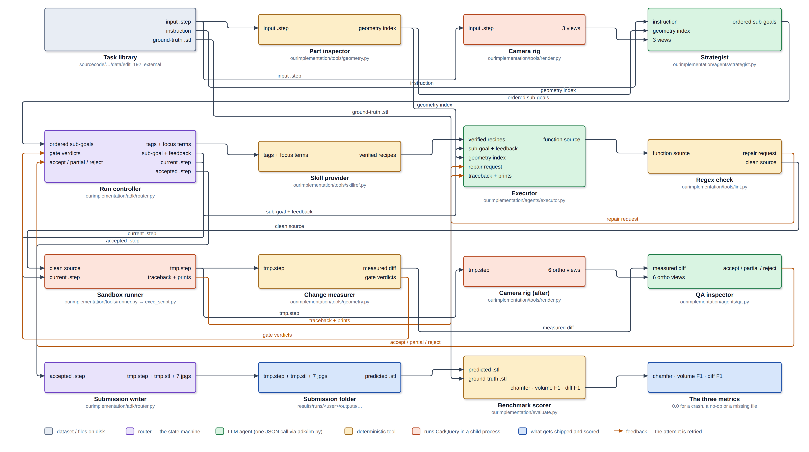
ASME 2026 STUDENT HACKATHON · NEURALCAD-EDIT
UCONN CAD PACK
THE FRAMEWORK, END TO END
Sixteen blocks, every wire labelled, and what holds it together
The models we run
Strategist gpt-5.6-sol. Executor gpt-5.2. QA gpt-5.2. The published baseline runs that same gpt-5.2.
Underneath, costing nothing
Six deterministic tools and six gates. A gate rejects an attempt without a model call.
What bounds the spend
5 sub-goals · 3 attempts each · 2 replans · 4,100 token recipe budget.
UCONN CAD PACK · ASME 2026 Student Hackathon
5 / 13
Notes:
[90s] This is the whole framework on one screen, and it is generated from the code, so it cannot drift from what actually runs. The task library hands over the part and the line. The part inspector measures the solid, the camera rig renders it, the strategist plans. Then the loop: the skill provider supplies verified recipes, the executor writes one function, the syntax check screens it, the sandbox runner executes it in a child process, the change measurer computes the delta, and QA judges. The amber wires are feedback. On the right, the three things a judge should know. The models: the executor and QA run gpt-5.2, the same model the published baseline runs, and the strategist ran gpt-5.6-sol on most scored runs. Underneath, a layer that costs nothing: six deterministic tools and six gates that can reject an attempt without spending a model call. And hard bounds on the loop, read live from the config, which are why a task costs eighty three cents and not eight dollars.

Slide 6
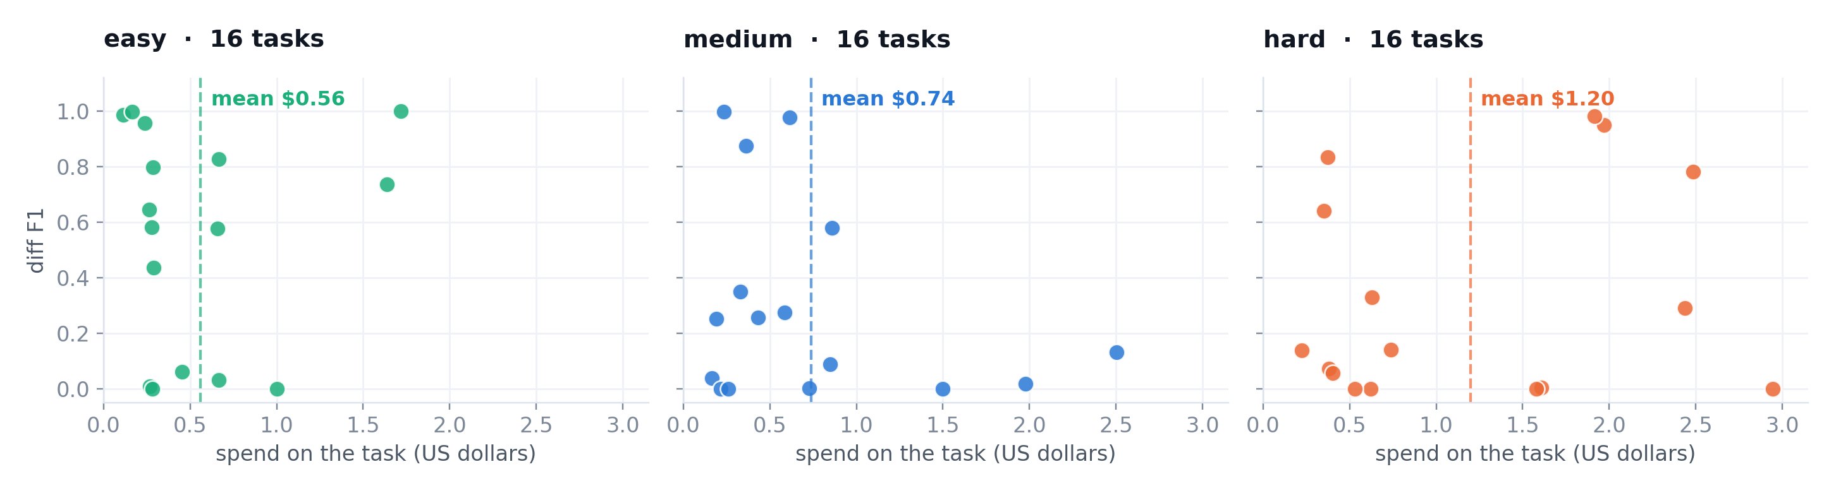
ASME 2026 STUDENT HACKATHON · NEURALCAD-EDIT
UCONN CAD PACK
WHAT IT COSTS, AND WHAT HOLDS IT THERE
Cost efficiency is a design constraint, not an outcome
$0.83
6
3
4,100
per task
gates that cost nothing
attempts per sub-goal
token recipe budget
$39.98 for the whole benchmark
a bad attempt is rejected without a model call
then the router rolls back to the best one
skills are selected, not pasted in whole
UCONN CAD PACK · ASME 2026 Student Hackathon
6 / 13
Notes:
[55s] Cost. Every task here is priced from its own real token counts, not an estimate. Eighty three cents a task and thirty nine ninety eight for the entire benchmark. What holds it there is structural. Six deterministic gates reject a bad attempt without spending a model call at all. Each sub-goal gets three attempts and then the router rolls back to the best one rather than grinding. Recipes are selected by tag inside a four thousand token budget rather than pasted in whole. The hard band costs more and earns it: that is where our margin is widest.

Slide 7
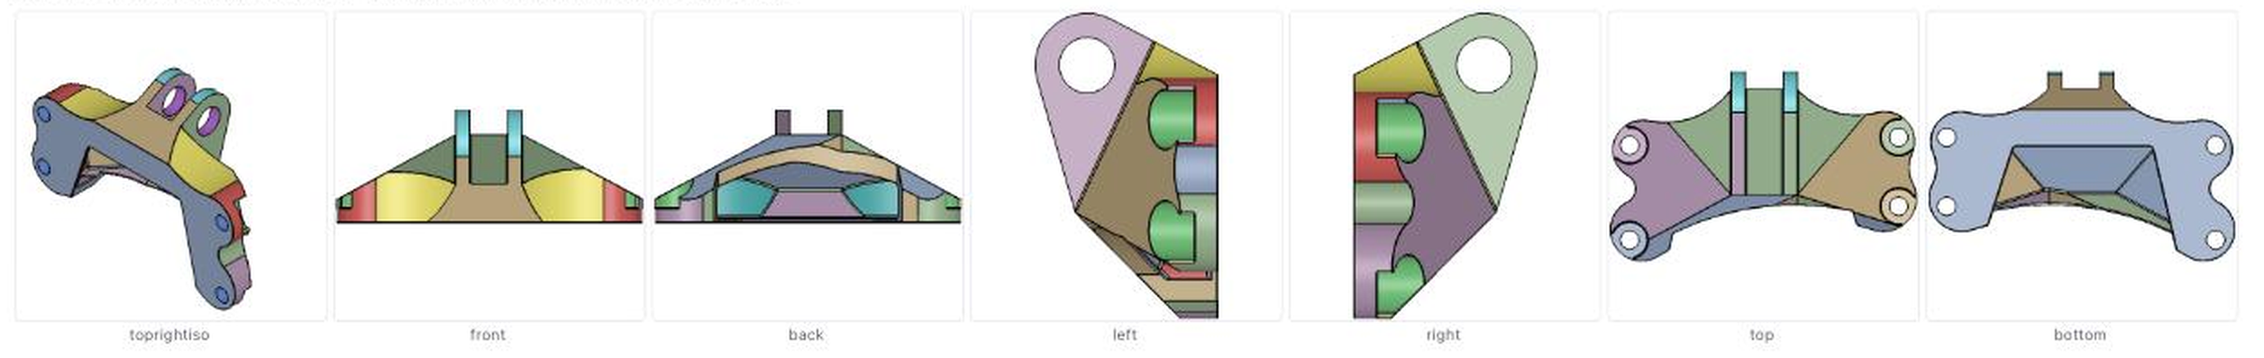
ASME 2026 STUDENT HACKATHON · NEURALCAD-EDIT
UCONN CAD PACK
ONE REQUEST
The part, the plan it became, and the score
What the strategist actually plans from: every feature family in its own colour, seven views, measured rather than guessed.
The whole input
0.646
0.989
0.998
“Add 0.2 mm chamfer to the hole edges to improve fitting.” One line of text and a solved B-rep. No feature tree, no sketches, nothing named.
diff F1
chamfer sim
volume F1
the metric that reads edits
near 1.0 for everyone
near 1.0 for everyone
The plan, split into sub-goals
1. Apply a 0.2 mm 45 degree chamfer to all listed hole-mouth circular edges: edge_idx [68, 119, 127, 149, 152, 254, 256, 300, 120, 129, 285, 287, ...], 36 in all. Keep the chamfer on the hole entry and exit rims, not on unrelated blend or fillet artefact edges. [tags: fillet-chamfer · done, 1 attempt]
What it cost
Three model calls, 44,953 tokens, $0.18 for this run, start to finish.
UCONN CAD PACK · ASME 2026 Student Hackathon
7 / 13
Notes:
[70s] Start with one request. The customer line is: add a 0.2 millimetre chamfer to the hole edges to improve fitting. That line and a solved B-rep are the entire input. Along the top is what our strategist actually plans from: the part measured and colour coded, every feature family in its own colour, from seven views. Underneath is the plan it wrote back. It does not say chamfer the holes. It names thirty six specific edge indices, tags the sub-goal fillet chamfer, and tells the executor to keep the chamfer on the hole entry rims and off unrelated blend artefacts. The result is diff F1 0.646, for three model calls and eighteen cents. Note chamfer similarity and volume F1 sit near one here as well, which is exactly why we lead on diff F1 and not on those two.

Slide 8
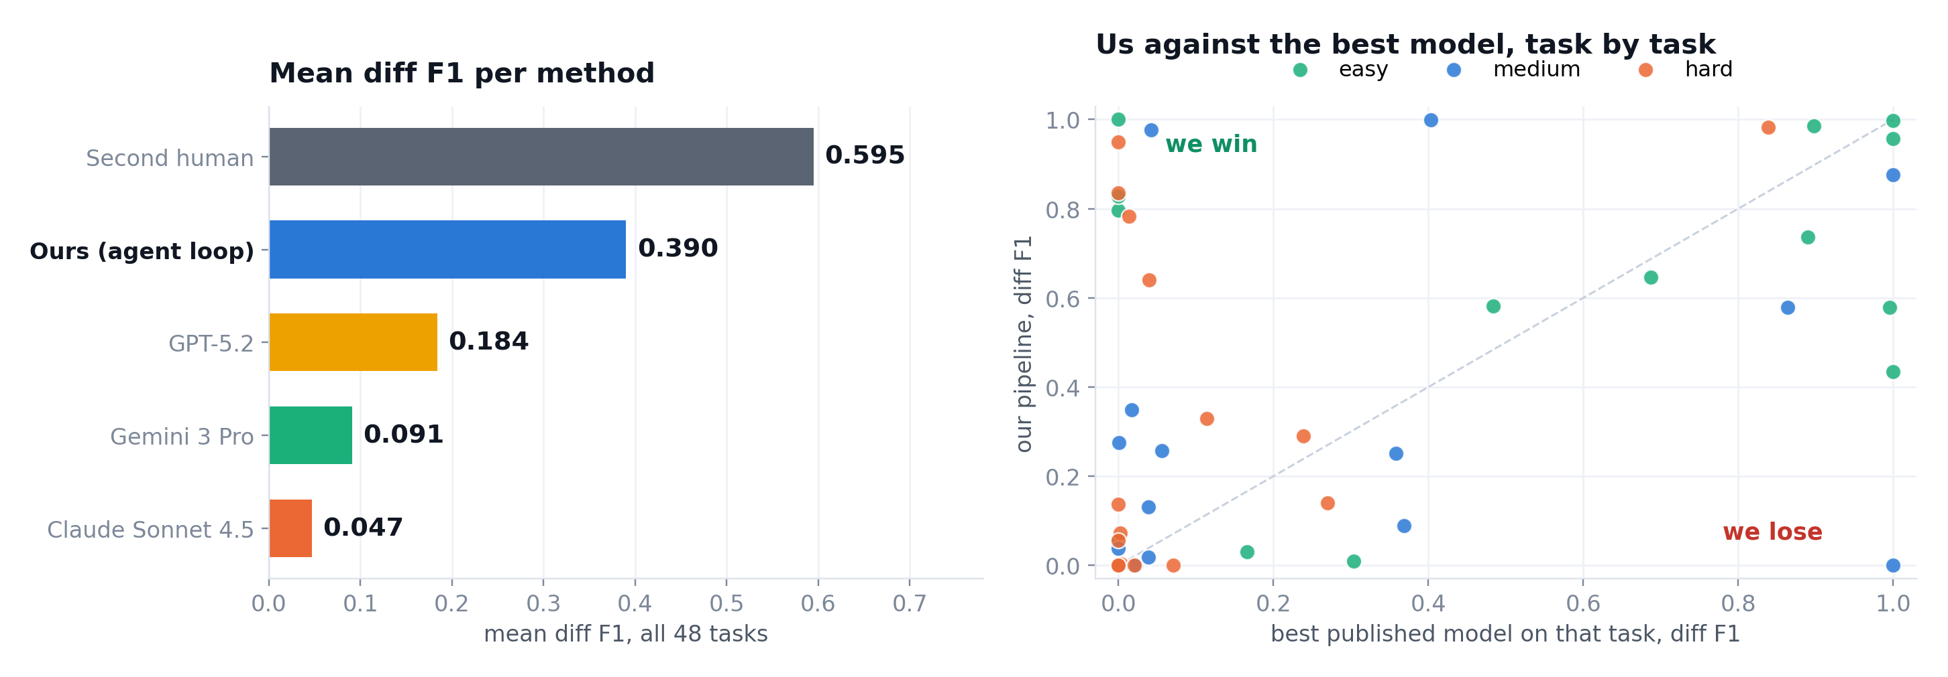
ASME 2026 STUDENT HACKATHON · NEURALCAD-EDIT
UCONN CAD PACK
THE WHOLE BENCHMARK
Ranked on diff F1, and task by task against the best model
Left, mean diff F1 per method. Right, every task against the best published model on that same task: above the diagonal is ours. Drawn from the same data the dashboard plots, at print resolution.
UCONN CAD PACK · ASME 2026 Student Hackathon
8 / 13
Notes:
[55s] Here is the whole benchmark. On the left, mean diff F1 per method: the second human at 0.595, us at 0.390, GPT-5.2 at 0.184, Gemini at 0.091 and Claude Sonnet at 0.047, and those last two count a failed run as zero across the same forty eight tasks, which is the benchmark's own convention. On the right, every task plotted against the best published model on that same task: twenty three above the diagonal, seven level, eighteen below, and the wins include the tasks where every published model scores zero.

Slide 9
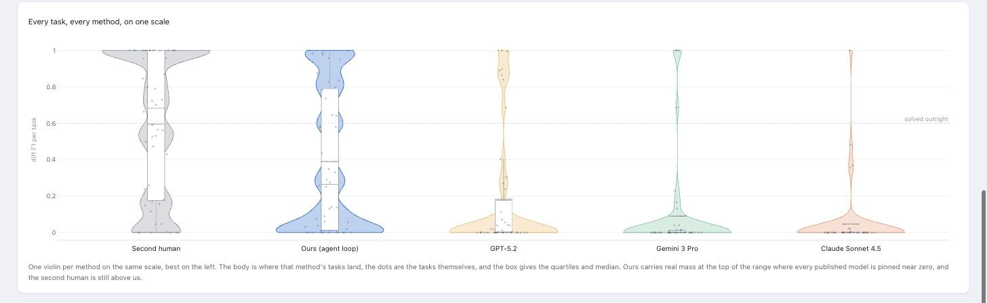
ASME 2026 STUDENT HACKATHON · NEURALCAD-EDIT
UCONN CAD PACK
DISTRIBUTION
A mean can hide everything, so here is every task
One violin per method on the same scale, the dots are the tasks themselves, the box gives the quartiles and median. Captured live from the UCONN CAD PACK dashboard, all 48 tasks scored.
UCONN CAD PACK · ASME 2026 Student Hackathon
9 / 13
Notes:
[50s] A mean can hide everything, so here is the dashboard's own plot, every task as a dot. Ours carries real mass at the top of the range, where every published model is pinned near zero, and the second human is still above us. Look at the shape rather than the average: the published models are a spike at zero with a thin tail, and ours is spread across the range.

Slide 10
ASME 2026 STUDENT HACKATHON · NEURALCAD-EDIT
UCONN CAD PACK
BY DIFFICULTY
The harder the edit, the wider the margin
difficulty | ours | GPT-5.2 | 2nd human
easy · 16 tasks | 0.540 | 0.299 | 0.867
medium · 16 tasks | 0.302 | 0.155 | 0.422
hard · 16 tasks | 0.326 | 0.097 | 0.497
Our hard band scores above our medium band, which is the loop doing the work rather than the model
On hard edits we hold 0.326 while the published baseline falls to 0.097
5 of the 48 are degenerate: a second human also scores 0.0 on them, so no pipeline change moves them
On a separate task the ground truth diff is zero voxels, so changing nothing scores 1.0
UCONN CAD PACK · ASME 2026 Student Hackathon
10 / 13
Notes:
[45s] Broken out by difficulty. Easy, 0.54 where the baseline gets 0.30. Medium, 0.30 against 0.15. Hard, 0.33 against 0.098. Notice that our hard band scores above our medium band. That is the loop doing the work rather than the model. Five of the forty eight are degenerate: a second human also scores zero on them, so no pipeline change can move them. On a separate task the ground truth diff is zero voxels, which means changing nothing scores one and any real edit scores zero.

Slide 11
ASME 2026 STUDENT HACKATHON · NEURALCAD-EDIT
UCONN CAD PACK
DEMO
45 seconds inside the dashboard
Every tab, one feature each. It runs the real pipeline, not a mock.
Animated capture of the live dashboard. In PowerPoint it plays in slideshow mode; press F5 or Play.
UCONN CAD PACK · ASME 2026 Student Hackathon
11 / 13
Notes:
[40s] Rather than describe the dashboard, here it is. Method overview, with the whole pipeline drawn from the code and every block clickable. The task and its input, the seven views and the measured index. Ground truth against every model on the same task. Our implementation, where you can press one button and run the real loop. The results page, with every method and every task. The animation flow, which replays a finished run across the same schematic. And the competition examples tab. All of it is live, and all of it is in the repo.

Slide 12
ASME 2026 STUDENT HACKATHON · NEURALCAD-EDIT
UCONN CAD PACK
GIVEN MORE TIME
What we would test next, in order
Fine tune the strategist
A mixture of experts in the executor
Finish the selector
PLANNING IS WHERE THE LOSS IS
MORE CANDIDATES TO CHOOSE FROM
ALREADY PROTOTYPED
QA checks the build against the sub-goal, so a faithful build of a wrong plan is invisible to it. We found Fusion derived CAD datasets that clean up into plan supervision.
A second vision capable model generating alongside gpt-5.2, then choosing between them. The only blocker is that every role shares one endpoint today, and a routing proxy fixes that.
Pick the candidate that agrees most with the others. The kernel is already verified against the benchmark's own metric, and it needs at least three distinct candidates, which is exactly what a second expert provides.
UCONN CAD PACK · ASME 2026 Student Hackathon
12 / 13
Notes:
[60s] Given more time, three things in this order. First, fine tune the strategist, because planning is where our loss lives, and we found Fusion derived CAD datasets that clean up into plan supervision. Second, a mixture of experts in the executor: a second vision capable model generating candidates alongside gpt-5.2 and then choosing between them. And third, finish the selector we already prototyped, which picks the candidate that agrees most with the others.

Slide 13
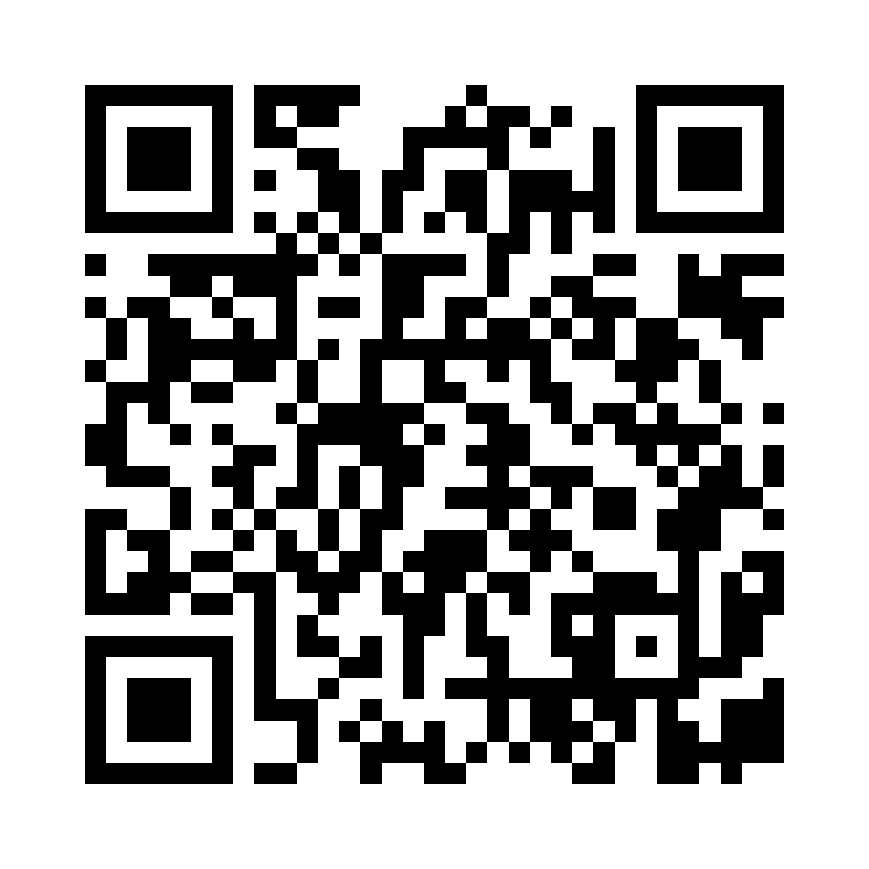
ASME 2026 STUDENT HACKATHON · NEURALCAD-EDIT
UCONN CAD PACK
Thank you
Everything on these slides is live and open: the dashboard, the handoff pack, the code and the scores.
PROJECT SITE
kiarash99naghavi.github.io/UCONN-CAD-PACK
Scan for the dashboard, the handoff pack and the code
UCONN CAD PACK · ASME 2026 Student Hackathon
13 / 13
Notes:
[20s] Thank you. Everything you have seen is live and open at this address, and the QR code goes straight there: the dashboard, the handoff pack, the code and every score behind these numbers.

