Slide 1
Writing Academic English
4th Edition

Slide 2
PART I
Writing a Paragraph

Slide 3
Chapter 1
Paragraph Structure

Slide 4
Introduction
A paragraph is a group of related sentences that discuss one (and usually only one) main idea. A paragraph can be as short as one sentence or as long as ten sentences. The number of sentences is unimportant; however, the paragraph should be long enough to develop the main idea clearly.
We mark a paragraph by indenting the first word about a half inch (five spaces on a typewriter or computer) from the left margin.

Slide 5
The Three Parts of a Paragraph
All paragraphs have a topic sentence and supporting sentences, and some paragraphs also have a concluding sentence.
The topic sentence states the main idea of the paragraph. It not only names the topic of the paragraph, but it also limits the topic to one specific area that can be discussed completely in the space of a single paragraph. The part of the topic sentence that announces the specific area to be discussed is called the controlling idea.
Example:
TOPIC
CONTROLLING IDEA
Gold, aprecious metal, is prized for two important characteristics.

Slide 6
The Three Parts of a Paragraph
Supporting sentences develop the topic sentence. That is, they explain or prove the topic sentence by giving more information about it. Example:
The concluding sentence signals the end of the paragraph and leaves the reader with important points to remember:
First of all, gold has a lustrous beauty that is resistant to corrosion.
In conclusion, gold is treasured not only for its beauty but also for its utility.

Slide 7
The Topic Sentence
A topic sentence is the most important sentence in a paragraph. It briefly indicates what the paragraph is going to discuss. For this reason, the topic sentence is a helpful guide to both the writer and the reader. The writer can see what information to include (and what information to exclude). The reader can see what the paragraph is going to be about and is therefore better prepared to understand it.
Here are three important points to remember about a topic sentence.
A topic sentence is a complete sentence; that is, it contains at least one subject and one verb. The following are not complete sentences because they do not have verbs:
Driving on freeways.
How to register for college classes.
The rise of indie films.

Slide 8
The Topic Sentence
A topic sentence contains both a topic and a controlling idea. It names the topic and then limits the topic to a specific area to be discussed in the space of a single paragraph.
A topic sentence is the most general statement in the paragraph because it gives only the main idea. It does not give any specific details. A topic sentence is like the name of a particular course on a restaurant menu.
TOPIC
CONTROLLING IDEA
Driving on freeways requires skill and alertness.
TOPIC
CONTROLLING IDEA
Registering for classes an be a frustrating experience for new students.

Slide 9
The Topic Sentence
Position of Topic Sentences
The topic sentence is usually (but not always) the first sentence in a paragraph. Experienced writers sometimes put topic sentences in other locations, but the best spot is usually right at the beginning. Readers who are used to the English way of writing want to know what they will read about as soon as they begin reading.
Sometimes a topic sentence comes at the end. In this case, the paragraph often begins with a series of examples.

Slide 10
The Topic Sentence
The Two Parts of a Topic Sentence
The topic names the subject of the paragraph. The controlling idea limits or controls the topic to a specific area that you can discuss in the space of a single paragraph.
A topic sentence should not have controlling ideas that are unrelated. The three parts of the following controlling idea are too unrelated for a single paragraph. They require three separate paragraphs (and perhaps more) to explain fully.
TOPIC
CONTROLLING IDEA
Convenience foods are easy to prepare

Slide 11
Supporting Sentences
Supporting sentences explain or prove the topic sentence.
There are several kinds of specific supporting details: examples, statistics, and quotations.
Example
Examples are perhaps the easiest kind of supporting detail to use because you can often take examples from your own knowledge and experience. You don't have to search the library or the Internet for supporting material. Furthermore, examples make your writing lively and interesting, and your reader is more likely to remember your point if you support it with a memorable example.
Words and phrases that introduce examples include for example, for instance, and such as.

Slide 12
The Concluding Sentence
A concluding sentence serves two purposes:
It signals the end of the paragraph.
It leaves the reader with the most important ideas to remember. It can do this in two ways: By summarizing the main points of the paragraph or By repeating the topic sentence in different words A
A paragraph does not always need a concluding sentence.
End-of-Paragraph Signals Followed by a Comma:
End-of-Paragraph Signals Not Followed by a Comma:
Finally, In brief, In conclusion, Indeed, In short, Lastly, Therefore, Thus, To sum up,
The evidence suggests that…
These examples show that…
We can see that...

Slide 13
The Concluding Sentence
Notes
Many writing teachers think In conclusion and In summary are overused and so will not want you to use them
Do not use the phrase At last as an end-of-paragraph signal. At last means "at the end of a long period of time," as in this sentence: At last, you've come home.
Never introduce a new idea in the concluding sentence.
INCORRECT
In conclusion, there are many other legends like this one in Hawaii. (This is a new idea.)

Slide 14
Review
These are the important points covered in this chapter:
A good topic sentence
is a complete sentence with a subject, a verb, and a controlling idea.
is neither too general nor too specific. It clearly states the main idea of the paragraph but does not include specific details.
is usually the first sentence in the paragraph.
Good supporting sentences
explain or prove the topic sentence.
are specific and factual.
can be examples, statistics, or quotations.
A good concluding sentence
signals the end of the paragraph.
summarizes the important points briefly or restates the topic sentence
in different words.

Slide 15
Chapter 2
Unity and Coherence

Slide 16
Introduction
An important element of a good paragraph is unity. Unity means that a paragraph discusses one and only one main idea from beginning to end.
Sometimes it is possible to discuss more than one aspect of the same idea in one paragraph if they are closely related to each other.
The second part of unity is that every supporting sentence must directly explain or prove the main idea.

Slide 17
Coherence
The Latin verb cohere means "hold together." For coherence in writing, the sentences must hold together; that is, the movement from one sentence to the next must be logical and smooth. There must be no sudden jumps. Each sentence should flow smoothly into the next one.
There are four ways to achieve coherence:
1. Repeat key nouns.
2. Use consistent pronouns.
3. Use transition signals to link ideas.
4. Arrange your ideas in logical order.
There is no fixed rule about how often to repeat key nouns or when to substitute pronouns. You should repeat a key noun instead of using a pronoun when the meaning is not clear.

Slide 18
Coherence
Key Noun Substitutes
If you do not wish to repeat a key noun again and again, you can use synonyms or expressions with the same meaning.
Consistent Pronouns
When you use pronouns, make sure that you use the same person and number throughout your paragraph.
Transition Signals
Transition signals are like traffic signs; they tell your reader when to go forward, tum around, slow down, and stop. In other words, they tell your reader when you are giving a similar idea (similarly, and, in addition), an opposite idea (on the other hand, but, in contrast), an example (for example), a result (therefore, as a result), or a conclusion (in conclusion).

Slide 19
Transition Words and Phrases and Conjunctive Adverbs
Most words and phrases in the first two columns of the chart can appear at the beginning, in the middle, or at the end of one independent clause and are usually separated by commas.
EXCEPTIONS
The words and phrases in the last four groups in the chart (for listing ideas and time sequences, for emphasizing, for giving reasons, and for conclusions) usually appear only at the beginning of a sentence, not in the middle or at the end
Too usually appears only at the end of a sentence, sometimes preceded by a comma.
The short time words then, now, and soon usually do not need commas.

Slide 20
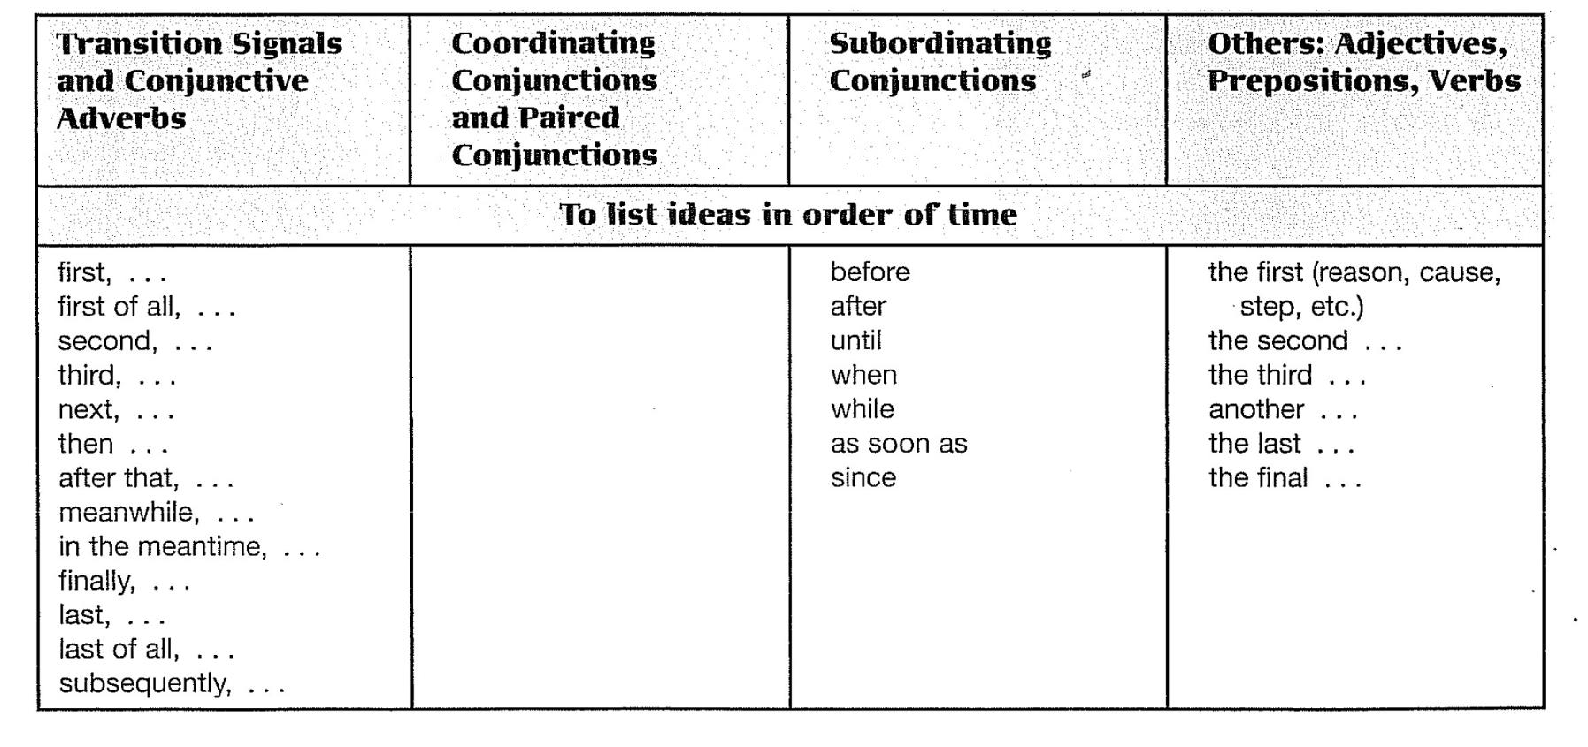
Transition Signals

Slide 21
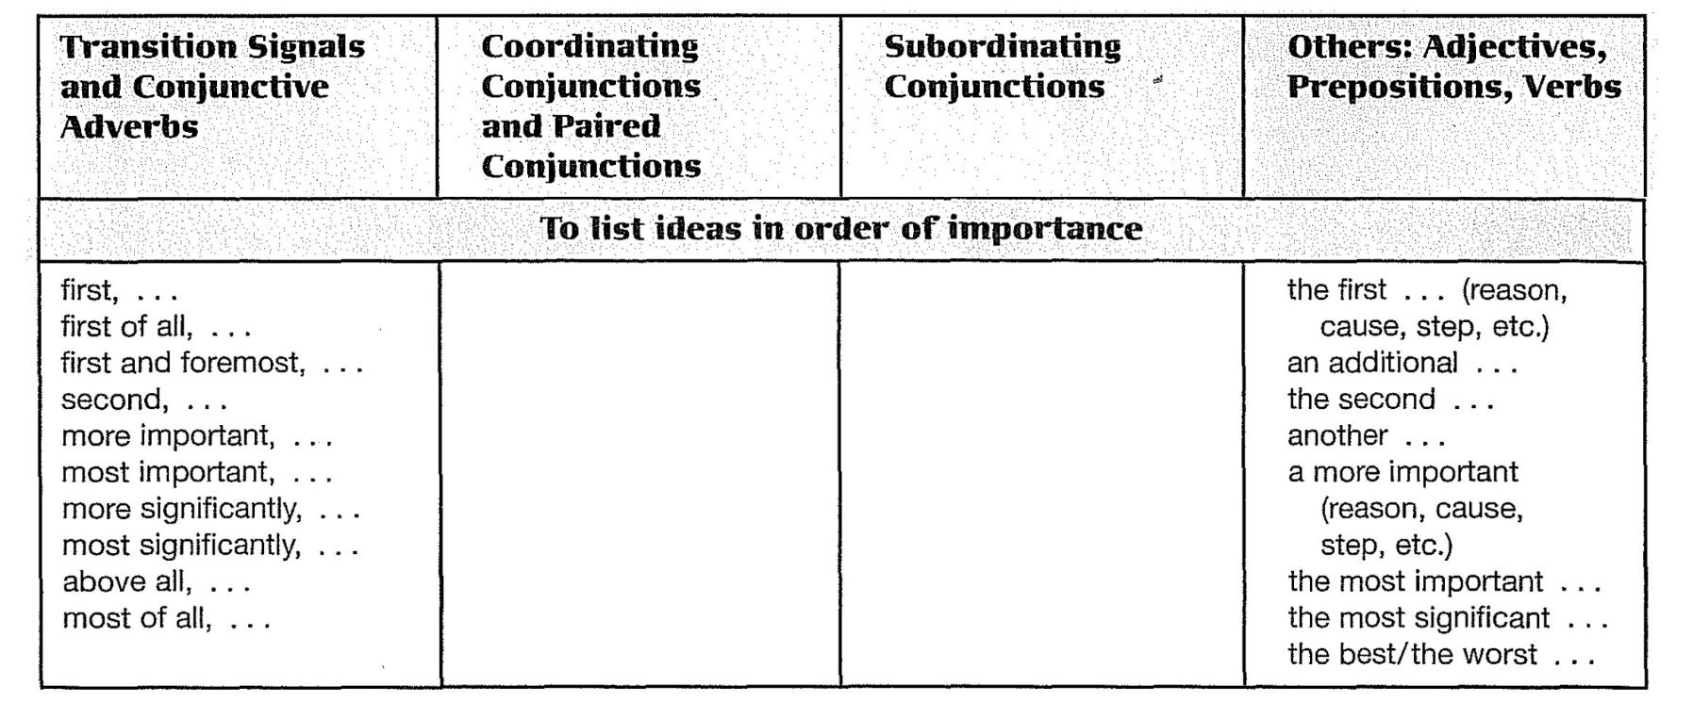
Transition Signals

Slide 22
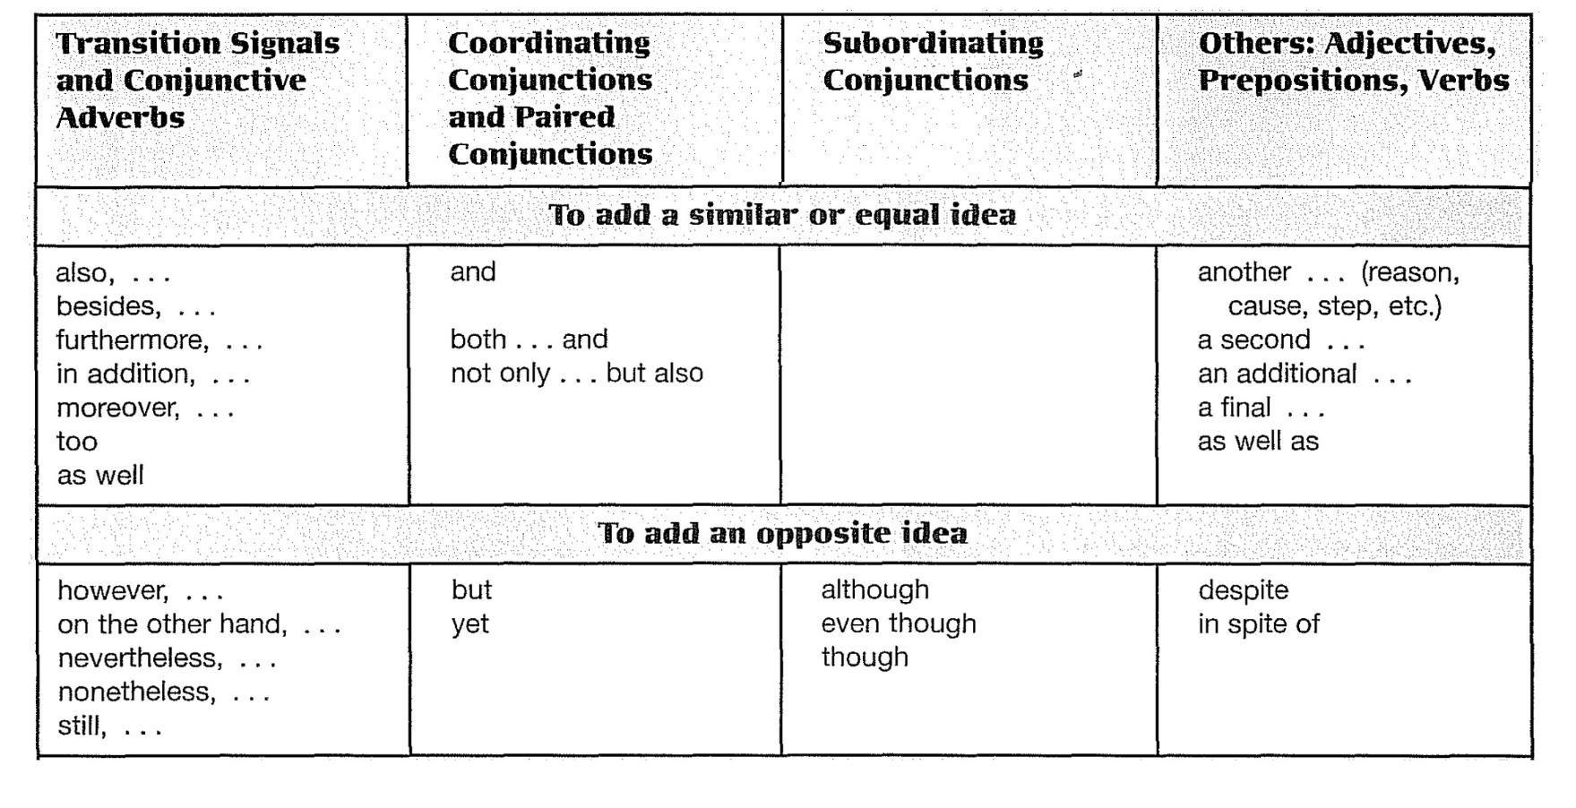
Transition Signals

Slide 23
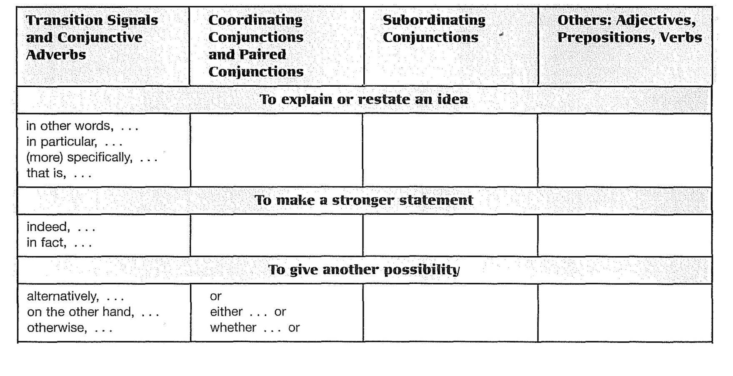
Transition Signals

Slide 24
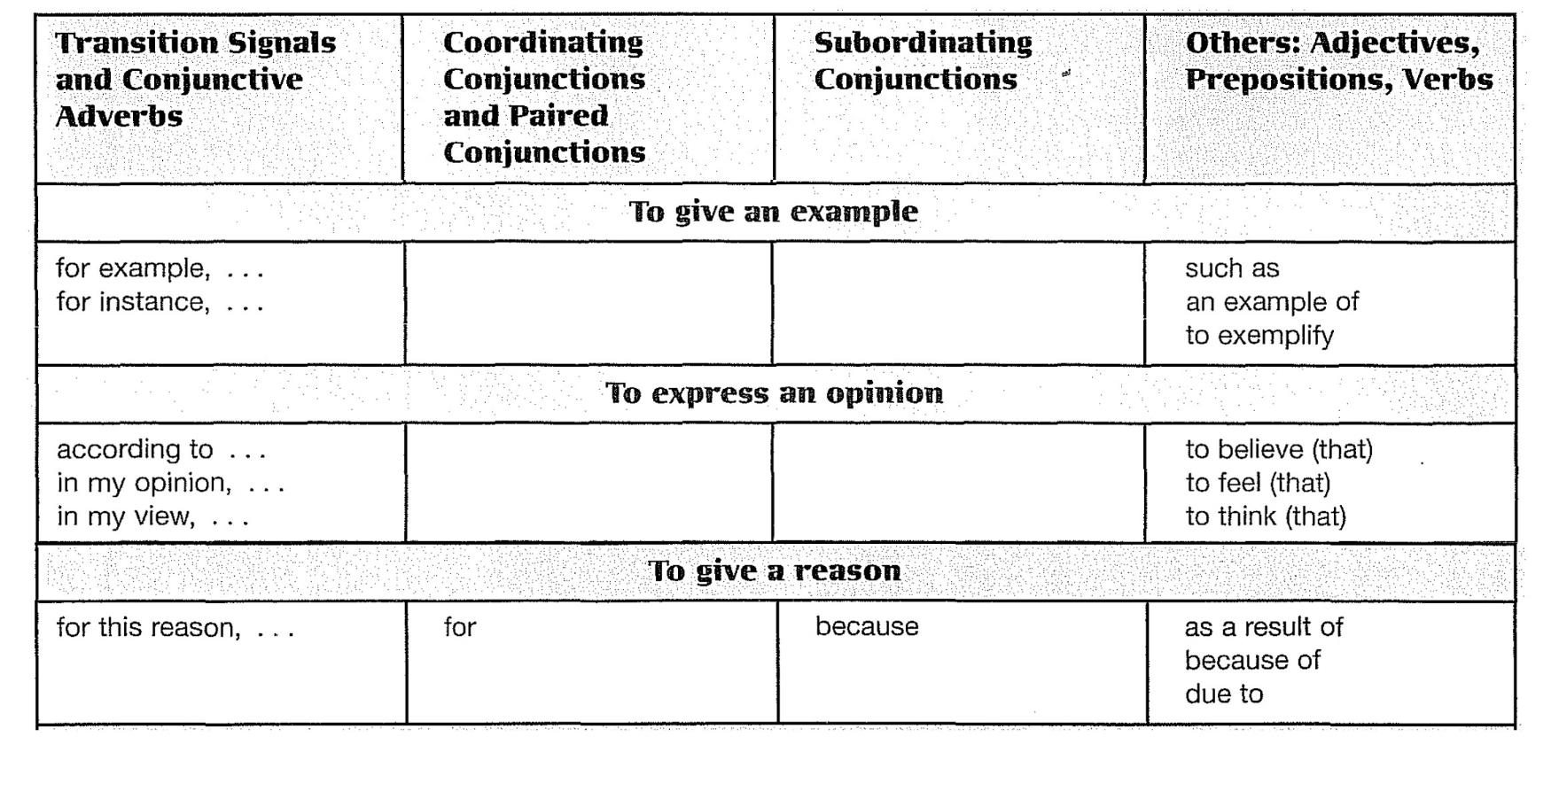
Transition Signals

Slide 25
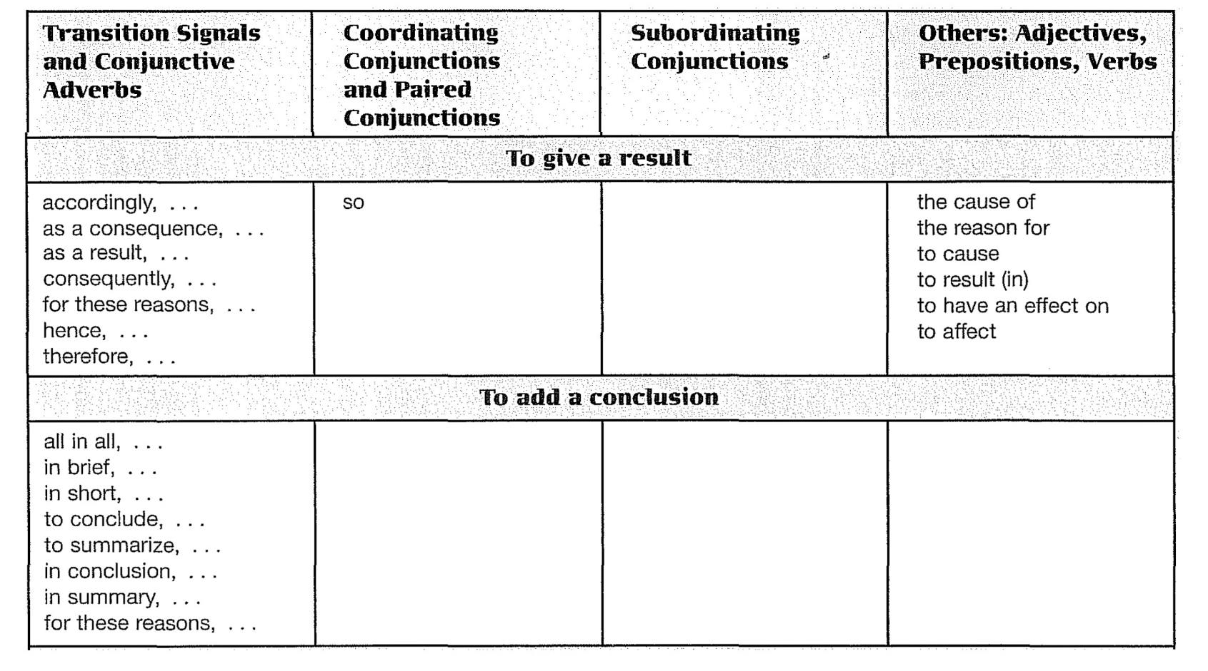
Transition Signals

Slide 26
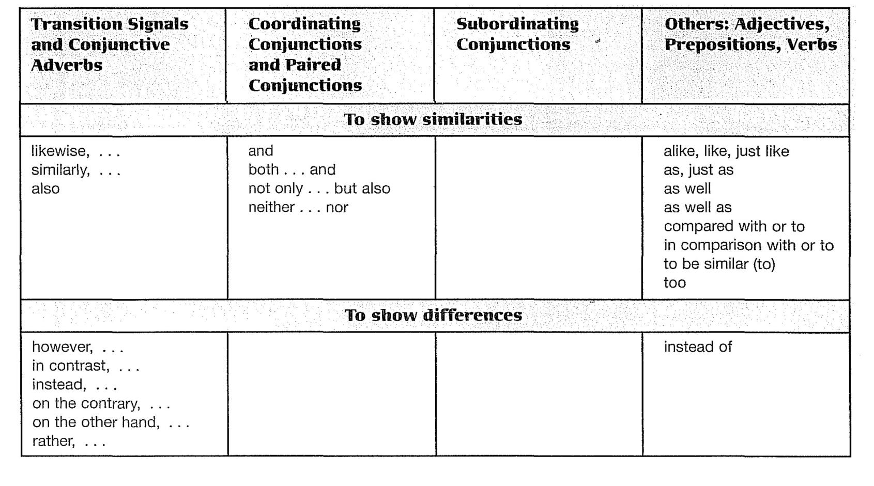
Transition Signals

Slide 27
Transition Words and Phrases and Conjunctive Adverbs
Subordinators
A subordinator (subordinating conjunction) is the first word in a dependent clause. 2 A dependent clause is always connected to an independent clause to make a sentence. The sentence mayor may not have a comma. The general rule is this: Put a comma after a dependent clause but not in front of one.
Don't Overuse Transition Signals: Too many can be distracting rather than helpful. Use them only when they will help your reader follow your ideas.
DEPENDENT CLAUSE
INDEPENDENT CLAUSE
Although the company's sales increased last year, its net profit declined.
INDEPENDENT CLAUSE
DEPENDENT CLAUSE
The company's net profit declined last year although its sales increased.

Slide 28
Transition Words and Phrases and Conjunctive Adverbs
Logical Order
fourth way to achieve coherence is to arrange your sentences in some kind of logical order.
You may even combine two or more different logical orders in the same paragraph. The important point to remember is to arrange your ideas in some kind of order that is logical to a reader accustomed to the English way of writing.
Some common kinds of logical order in English are chronological order, logical division of ideas, and comparison/contrast.
Chronological order is order by time
In logical division of ideas, a topic is divided into parts
In a comparison/contrast paragraph

Slide 29
Review
These are the important points covered in this chapter:
Every good paragraph has both unity and coherence.
You achieve unity by
discussing only one idea in a paragraph.
always staying on the topic in your supporting sentences.
You achieve coherence by
repeating key nouns.
using consistent pronouns.
using transition signals.
arranging your ideas in some kind of logical order.
There are different types of transition signals. Each type is punctuated differently.

Slide 30
Chapter 3
Supporting Details:
Facts, Quotations, and Statistics

Slide 31
Introduction
Academic writing normally requires that you support your ideas and opinions with facts, statistics, quotations, and similar kinds of information. You get these kinds of supporting details from outside sources such as books, magazines, newspapers, Web sites, personal interviews, and so on.

Slide 32
Facts versus Opinions
First, it is important to distinguish between facts and opinions. Opinions are subjective statements based on a person's beliefs or attitudes.
Opinions are not acceptable as support. It is certainly acceptable to express opinions in academic writing. In fact, most professors want you to express your own ideas. However, you may not use an opinion as support, and if you express an opinion, you must support it with facts. Facts are objective statements of truths.
Sometimes even facts need proof.

Slide 33
Using Outside Sources
There are three ways to insert outside information into your own writing: (1) You can quote it, (2) you can summarize it, or (3) you can paraphrase it.
Plagiarism
Plagiarism is using someone else's words or ideas as if they were your own, and it is a serious offense.
When you use information from an outside source without acknowledging that source, you are guilty of plagiarism.
One way to avoid plagiarism is to always put quotation marks around words that you copy exactly. (You do not need to use quotation marks if you change the words.) You are also guilty of plagiarism if you fail to cite the source of outside intonation-words

Slide 34
Using Outside Sources
Citing Sources
Citing a source is a two-step process.
Insert a short reference in parentheses at the end of each piece of borrowed information. This short reference is called an in-text citation.
Prepare a list describing all your sources completely. This list is titled "Works Cited" and appears as the last page of your paper.

Slide 35
Quotations
There are two kinds of quotations: direct and indirect.
In a direct quotation, you copy another person's exact words (spoken or written) and enclose them in quotation marks. In an indirect quotation, you report the person's words without quotation marks, but with a reporting expression such as according to XYZ… or XYZ believes that…
Reporting Verbs and Phrases
To introduce borrowed information-direct quotations, indirect quotations, or statistics-use the phrase according to or a reporting verb such as the following:
assert, insist, report, suggest, claim, write, say, declare, mention and state

Slide 36
Quotations
Here are some rules for their use:
Reporting verbs can appear before, in the middle of, or after borrowed information. The reporting phrase according to usually appears before or after but not in the middle.
Reporting verbs can be used either with or without the subordinator as. (As one writer says…)
Reporting verbs can be in any tense. However, be aware that a past tense reporting verb may cause changes in verbs, pronouns, and time expressions in an indirect quotation.
Including the source of the borrowed information with the reporting expression gives authority to your writing because it lets your reader know immediately that your information is from a credible source.

Slide 37
Quotations
Punctuating Direct Quotations
Follow these general rules for punctuating direct quotations.
Put quotation marks around information that you copy word for word from a source. Do not use quotation marks with paraphrases, summaries, or indirect quotations.
Normally, place commas (and periods) before the first mark and also before the second mark in a pair of quotation marks.
There are two important exceptions:
If you insert only a few quoted words into your own sentence, don't use commas.
When you add an in-text citation after a quotation, put the period after the closing parenthesis mark.
According to Sports Illustrated, "Eliminating drug use from Olympic sports would be no small challenge."

Slide 38
Quotations
Capitalize the first word of the quotation as well as the first word of the sentence. Reporting verbs can be used either with or without the subordinator as. (As one writer says…)
If you break a quoted sentence into two parts, enclose both parts in quotation marks and separate the pal1S with commas. Capitalize only the first word of the sentence.
Dr. Donald Catlin, director of a drug-testing lab eat UCLA, stated, "The sophisticated athlete who wants to take drugs has switched to things we can't test for" (qtd. in Bamberger and Yaeger 62).
"The sophisticated athlete who wants to take drugs," stated Dr. Donald Catlin, director of a drug-testing lab at UCLA, "has switched to things we can't test for" (qtd. in Bamberger and Yaeger 62).

Slide 39
Quotations
If you omit words, use an ellipsis (three spaced periods).
If you add words, put square brackets around the words you have added.
Use single quotation marks to enclose a quotation within a quotation.
If your quotation is four lines or longer, do not use quotation marks. Introduce this type of quotation with a colon and indent it one inch from the left-hand margin.
One athlete declared, "The testers know that the [drug] gurus are smarter than they are" (qtd. in Bamberger and Yaeger 62).
A young athlete openly admitted, "My ethical inner voice tells me, 'Don't use drugs,' but my competitive inner voice says, 'You can't win if you don't'" (Jones).

Slide 40
Quotations
Indirect Quotations
In indirect quotations, the speaker's or writer's words are reported indirectly, without quotation marks. The word that is often added for clarity. The tense of verbs in indirect quotations is affected by the tense of the reporting verb.
Changing Direct Quotations to lndirect Quotations
To change a direct quotation to an indirect quotation:
Omit the quotation marks.
Add the subordinator that.
Change the verb tense if necessary.
Change pronouns (and time expressions if necessary) to keep the sense of the original.

Slide 41
Quotations
There are three exceptions:
When the reporting verb is simple present, present perfect, or future, the verb tense in the quotation does not change.
When the reporting phrase is according to, the verb tense does not change.
When the quoted information is a fact or a general truth, the verb tense in the quotation does not change.
He says, "I can finish it today."
He says that he can finish it today.
The lawyer said, "My client is innocent."
According to the lawyer, his client is innocent.
He said, "Water boils at a lower temperature in the mountains."
He said that water boils at a lower temperature in the mountains.

Slide 42
Review
These are the important points covered in this chapter:
In academic writing, you are expected to use information from outside sources to support your ideas. Keep in mind that the U.S. system of education values students' original thinking and writing. Use outside sources to support your own ideas. Don't write a paper that contains only the ideas of others.
Search for specific supporting details in the library or on the Internet.
Direct quotations: Repeat the writer's or speaker's exact words, and place them inside quotation marks.
Indirect quotations: Report the author's words, making changes in pronouns and verb tenses as necessary. Do not use quotation marks.
Use appropriate statistics to support your points.
Don't just drop a quotation or a statistic into your paper. Make the connection between the borrowed information and your idea clear.
Cite your sources to avoid plagiarizing.

Slide 43
PART II
Writing an Essay

Slide 44
Chapter 4
From Paragraph to Essay

Slide 45
Introduction
An essay is a piece of writing several paragraphs long. It is about one topic, just as a paragraph is. However, because the topic of an essay is too complex to discuss in one paragraph, you need to divide it into several paragraphs, one for each major point. Then you need to tie the paragraphs together by adding an introduction and a conclusion.

Slide 46
The Three Parts of an Essay
An essay has three main parts: an introduction (introductory paragraph), a body (at least one, but usually two or more paragraphs), and a conclusion (concluding paragraph).
An essay introduction consists of two parts: a few general statements to attract your reader's attention and a thesis statement to state the main idea of the essay.
The body consists of one or more paragraphs. Each paragraph develops a subdivision of the topic, so the number of paragraphs in the body will vary with the number of subdivisions or subtopics.
The conclusion, like the concluding sentence in a paragraph, is a summary or review of the main points discussed in the body.

Slide 47
The lntroductory Paragraph
An introductory paragraph has two parts, general statements and the thesis statement
General statements:
introduce the general topic of the essay.
capture the reader's interest.
The thesis statement:
states the specific topic.
may list subtopics or subdivisions of the main topic or subtopics.
may indicate the pattern of organization of the essay.
is normally the last sentence in the introductory paragraph.
Notice how the general statements in the introductory paragraph of the model essay introduce the topic.

Slide 48
The lntroductory Paragraph
Funnel Introduction
The introductory paragraph of the model essay is a funnel introduction. This introduction is so called because it is shaped like a funnel-wide at the top and narrow at the bottom.
It begins with one or two very general sentences about the topic. Each subsequent sentence becomes increasingly focused on the topic until the last sentence, which states very specifically what the essay will be about.

Slide 49
The lntroductory Paragraph
Attention Getting introduction
Other kinds of introductions are good for capturing your reader's attention:
Dramatic, Interesting, or Funny Story
Surprising Statistics or Facts
Historical Background
Thesis statement
The thesis statement is the most important sentence in the introduction. It states the specific topic of the essay.
Sometimes a thesis statement lists the Subtopics that will be discussed in the body.
Sometimes a thesis statement also indicates the pattern of organization that the essay will follow. Which of the following thesis statements indicates chronological order? Logical division of ideas? Comparison/contrast?

Slide 50
Body Paragraphs
The body paragraphs in an essay are like the supporting sentences in a paragraph. They are the place to develop your topic and prove your points. You should organize body paragraphs according to some Sort of pattern, such as chronological order or comparison/contrast. Sometimes, depending on your topic, you will need to use a combination of patterns.
Logical Division of ldeas
A basic pattern for essays is logical division of ideas. In this pattern, you divide your topic into subtopics and then discuss each subtopic in a separate paragraph. Logical division is an appropriate pattern for explaining causes, reasons, types, lands, qualities, methods, advantages, and disadvantages, as these typical college exam questions ask you to do.

Slide 51
Body Paragraphs
Thesis Statements for Logical Division of Ideas
The thesis statement of a logical division essay often indicates the number of subtopics:
The thesis statement may even name the specific subtopics:
Native Americans have made valuable contributions to modern U.S. culture in four main areas.
Inflation has three causes.
Native Americans have made many valuable contributions to modern U.S. culture, particularly in the areas of language, art, food, and government.
b. Inflation has three causes: excessive government spending, unrestrained consumer borrowing, and an increase in the supply of paper money.

Slide 52
Body Paragraphs
Paired conjunctions (both . .. and, not only . .. but also) are an especially effective way to list two subtopics:
A colon (:) is often useful before lists of two, three, or more subtopics in a thesis statement:
Notice that subtopics are in parallel form, which means that they have the same grammatical form.
Young people in my culture have less freedom than young people in the United States not only in their choice of lifestyle but also in their choice of careers.
Puppies, like children, need both love and discipline to become responsible members of society.
Young people in my culture have less freedom than young people in the United States in three areas: where they live, whom they marry, and what their job is.
The Father of Psychoanalysis, Sigmund Freud, believed that the human mind had three separate parts: the id, the ego, and the superego.

Slide 53
Body Paragraphs
Thesis Statements Pitfalls
A thesis is the most important sentence in your essay, so write it with special thought and care. Avoid these common problems:
The thesis is too general.
The thesis makes a simple announcement.
The thesis states an obvious fact.
Too GENERAL
A college education is a good investment.
IMPROVED
A college education is a good investment for four reasons.
ANNOUNCEMENT
I am going to write about sports injuries.
IMPROVED
Avoid sports injuries by taking a few simple precautions.

Slide 54
The Concluding Paragraph
The conclusion is the final paragraph in an essay. It has three purposes:
It signals the end of the essay.
It reminds your reader of your main points
summarize your subtopics.
paraphrase your thesis.
It leaves your reader with your final thoughts on the topic.
Here are techniques that you can use to write a memorable conclusion:
Make a prediction.
Suggest results or consequences.
Suggest a solution, make a recommendation, or call for action.
Quote an authority on the topic.

Slide 55
Essay Outlining
Because an essay is long, it is important to organize and plan before you begin to write. The best way to do this is to make an outline. An outline not only organizes your thoughts, but it also keeps you on track once you begin to write.
A formal outline has a system of numbers and letters such as the following. In other fields of study, different systems are used:
- Roman numerals I, II, and III number the major sections of an essay
- Capital letters A, B, C, D, and so on label the body paragraphs.
- Arabic numerals 1,2,3,4, and so on number the subpoints in each paragraph.
- Small letters a, b, c, d, and so on label the specific supporting details.

Slide 56
Review
Main Parts of an Essay
An essay has three main parts: an introduction, a body, and a conclusion.
The introductory paragraph consists of two parts: a few general statements to attract your reader's attention and a thesis statement to state your main idea. A thesis statement may also name the major subdivisions of the topic, and it may indicate how you will organize the essay.
The body of an essay discusses the subtopics, one by one. It contains as many paragraphs as necessary to explain all subtopics.
The concluding paragraph reminds your reader of what you have said. In it, you summarize your main ideas or paraphrase your thesis. You may also mal<:e a final comment on the topic for your reader to remember.
Use the logical division of ideas pattern to divide a topic into separate paragraphs.
Link paragraphs with transitions; that is, show how one paragraph is related to the next by using appropriate transition words, phrases, or clauses.
Prepare an outline to organize your ideas before you begin to write.

Slide 57
Chapter 5
Chronological Order:
Process Essays

Slide 58
Introduction
Chronos is a Greek word meaning time. Chronological order is a way of organizing ideas in the order of their occurrence in time. Chronological order has all sorts of uses. We use it to tell stories, to relate historical events, and to write biographies and autobiographies. We also use it to explain processes and procedures. Such essays are called "how to“ essays, or process essays.

Slide 59
Thesis Statements for a Process Essay
A thesis statement for a process essay in some way indicates the time order. Expressions such as the process of, the procedure for, plan, develop, evolve, five stages, and several phases indicate that time order will be used.
Sometimes the thesis statement tells the number of steps in the process.
The thesis statement may even name the steps.
Heating water by solar radiation is a simple process.
The process of heating water by solar radiation involves three main steps.
The main steps in the process of heating water by solar radiation are (1) trapping the sun's energy, (2) heating and storing the hot water, and (3) distributing the hot water to its points of use.

Slide 60
Review
These are the important points covered in this chapter:
Using chronological order to organize an essay means putting the ideas in order or sequence by occurrence in time.
2. Use chronological order for narrative essays (stories, history, biography, and autobiography) and for process essays (how to do or make something).
3. Following are the three keys to success in writing a chronological order essay:
Group the steps or events into paragraphs where natural breaks occur.
Write a thesis statement that indicates chronological order.
Use chronological order signal words and phrases to show the sequence of steps (in a process) or events (in a narration).

Slide 61
Chapter 6
Cause/Effect Essays

Slide 62
Introduction
Another common pattern of essay organization is called cause and effect. In a cause/ effect essay, you discuss the causes (reasons) for something, the effects (results), or both causes and effects.

Slide 63
Organization for Cause/Effect Order
You can organize a cause/effect essay in two main ways: "block" organization and "chain" organization.
Block Organization
In block organization, you first discuss all the causes as a block (in one, two, three, or more paragraphs, depending on the number of causes). Then you discuss all the effects together as a block. You can discuss either causes or effects first. Of course, you can also discuss only causes or only effects.
In block organization, a short paragraph often separates one major section from another major section.
Essays that discuss mainly (or only) causes or mainly (or only) effects might have a transition paragraph between blocks of different kinds of causes or between blocks of different kinds of effects.

Slide 64
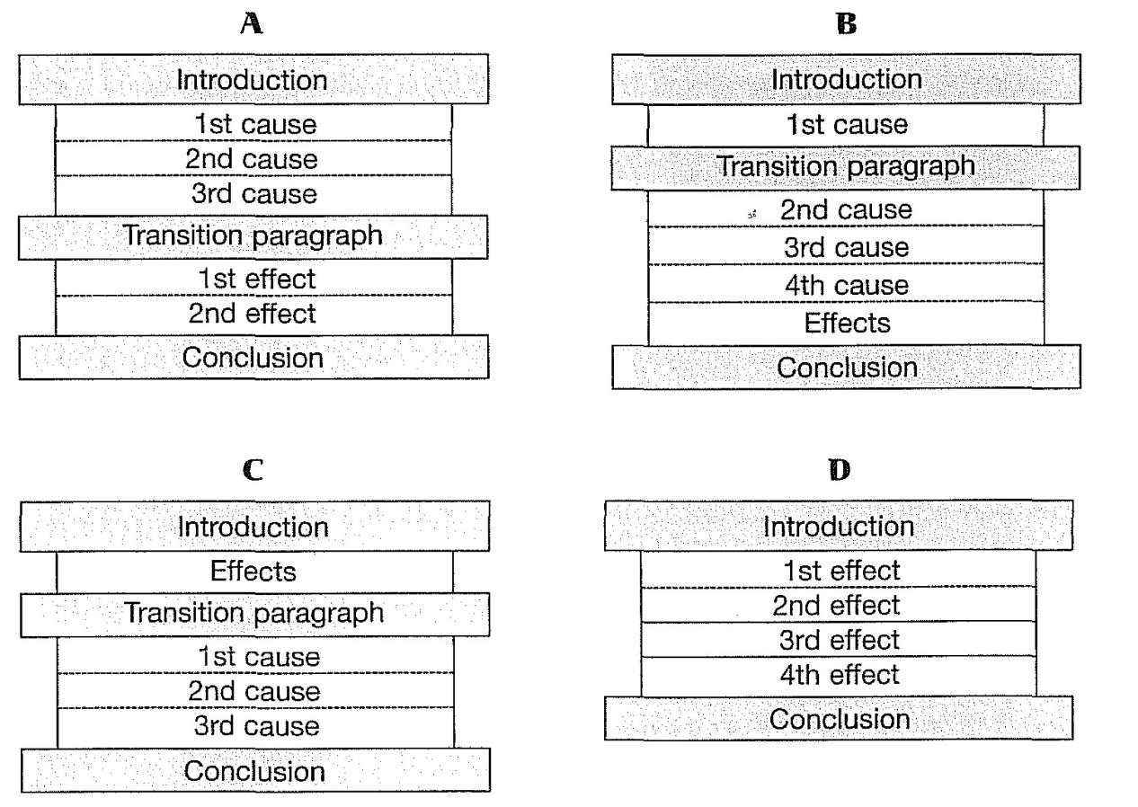
Block Organization

Slide 65
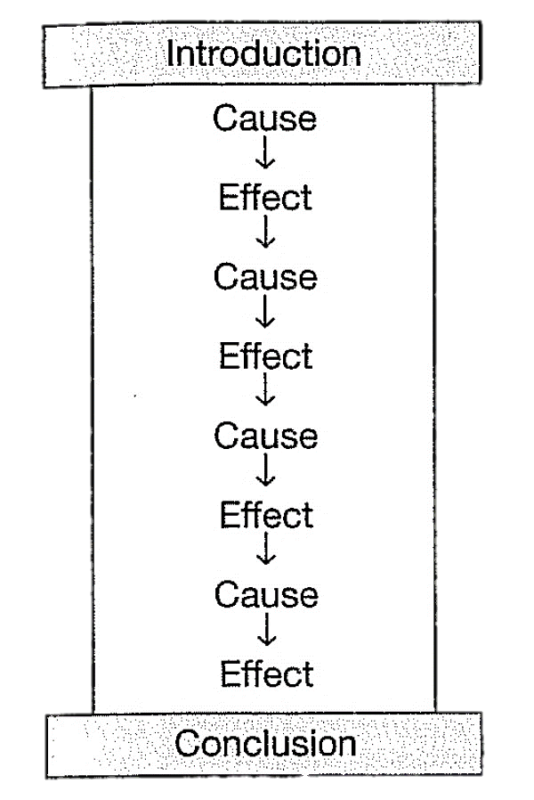
Organization for Cause/Effect Order
Chain Organization
In this pattern, causes and effects are linked to each other in a chain.
Each new cause and its effect are links in a chain. Depending on the complexity of the ideas in each link, you can devote an entire paragraph to one topic, or you may include several links in one paragraph, or you may describe the entire chain in one paragraph.
Chain organization usually works better than block organization when the causes and effects are too closely linked to be separated.

Slide 66
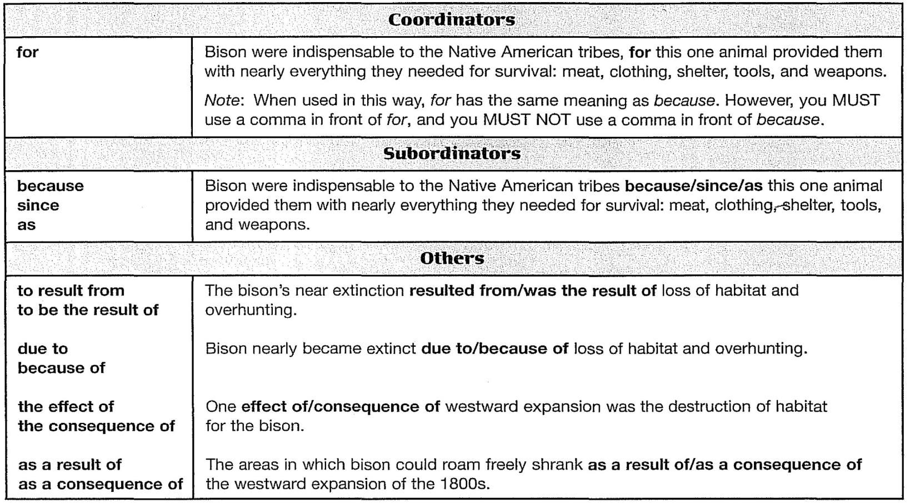
Cause Signal Words

Slide 67
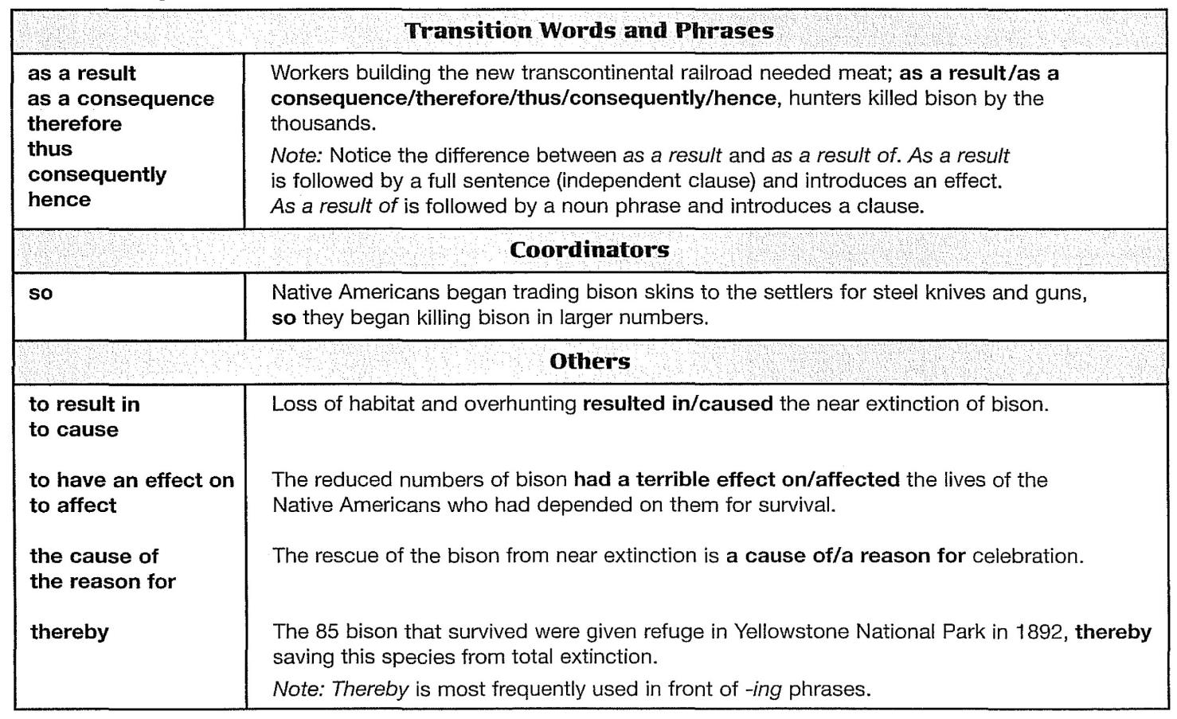
Effect Signal Words

Slide 68
Review
These are the important points covered in this chapter:
Cause/effect organization is a common pattern in academic writing to write about causes (or reasons) and effects (or results).
There are two common cause/effect patterns of organization.
In block organization, the causes (or reasons) are grouped together in one block, and the effects (or results) are grouped together in another block. There may be a transition paragraph between blocks.
In chain organization, the causes and effects are too closely linked to be separated. One cause leads to an effect, which is the cause of the next effect.
Use a variety of cause/effect signal words to help your reader follow your ideas.

Slide 69
Chapter 7
Comparison/Contrast Essays

Slide 70
Introduction
In a comparison/contrast essay, you explain the similarities and the differences between two items. Comparison and contrast is a very common pattern in most academic fields. It is also a common type of essay test question.

Slide 71
Organization of Comparison/Contrast Essays
The first key to writing a successful comparison/contrast essay is to organize it carefully.
Point by Point Organization
First, make a list of factors that are important to you.
Each factor, or point of comparison, is like a subtopic in a logical division essay.
Block Organization
The other way to organize a comparison/contrast essay is to arrange all the similarities together in a block and all the differences together in a block. You often insert a transition paragraph or transition sentence between the two blocks.
The number of paragraphs in each block depends on the topic
Some topics may have one paragraph of similarities and several paragraphs of differences, or vice versa.

Slide 72
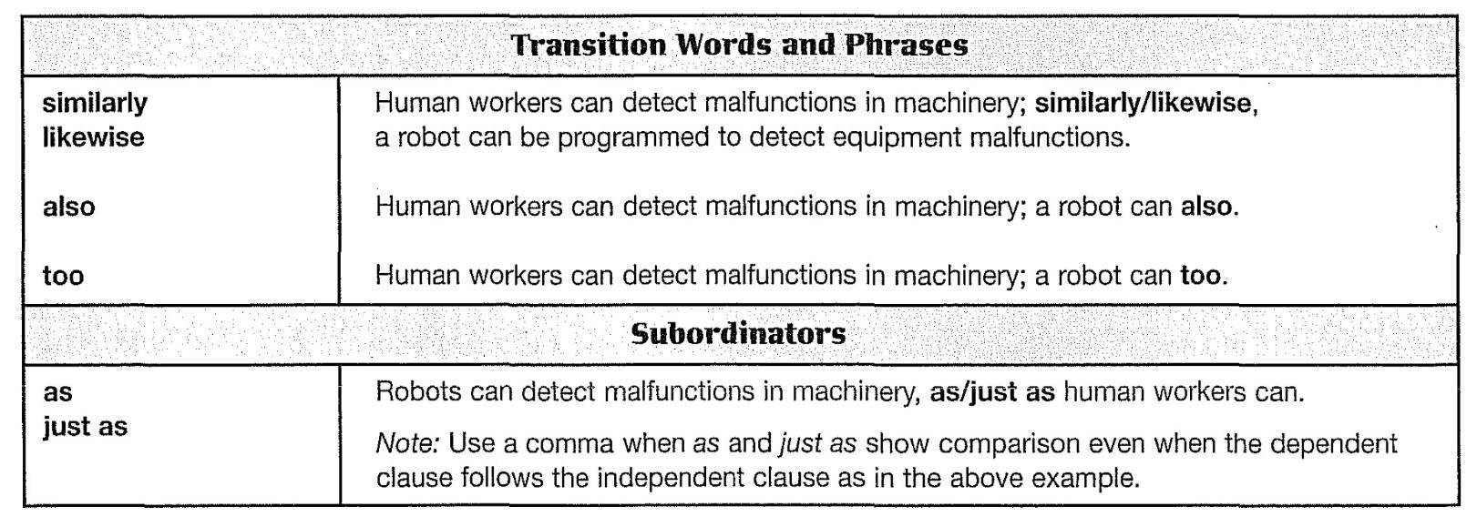
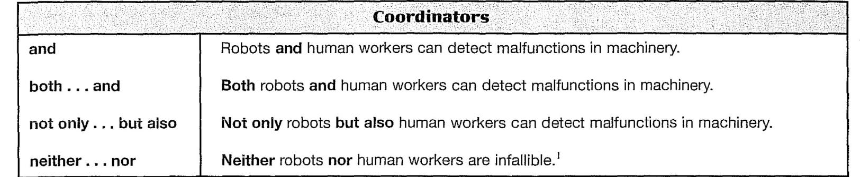
Comparison Signal Words

Slide 73
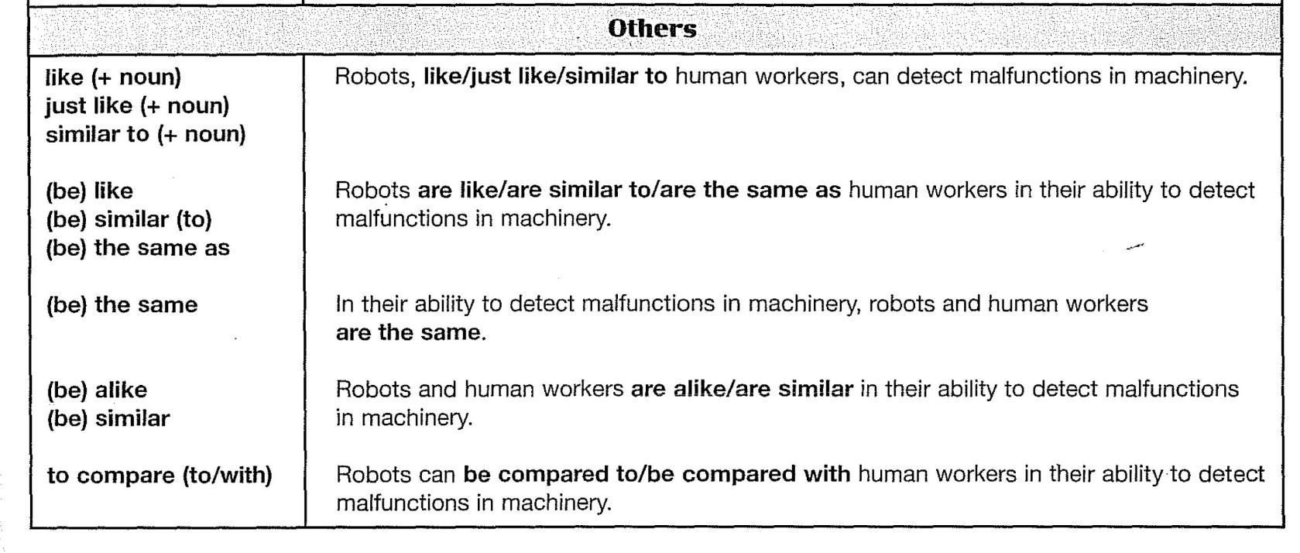
Comparison Signal Words

Slide 74
Comparison Signal Words
Contrast signal words fall into two main groups according to their meaning. The words in the first group show a relationship that is called concession. The words in the second group show an opposition relationship.
Contrast Signal Words: Concession (Unexpected Result)
Concession signal words indicate that the information in one clause is not the result you expect from the information given in the other clause.
Contrast Signal Words: Direct Opposition
The second group of contrast signal words shows that two things are direct opposites. With direct opposites, the signal word can introduce either piece of information.

Slide 75
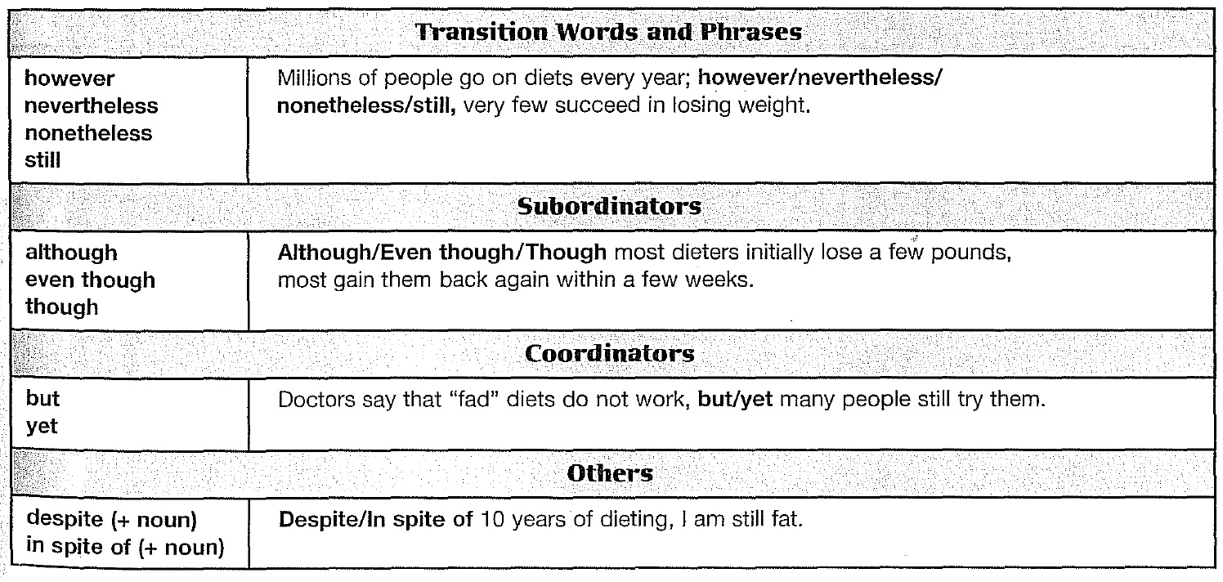
Contrast Signal Words

Slide 76
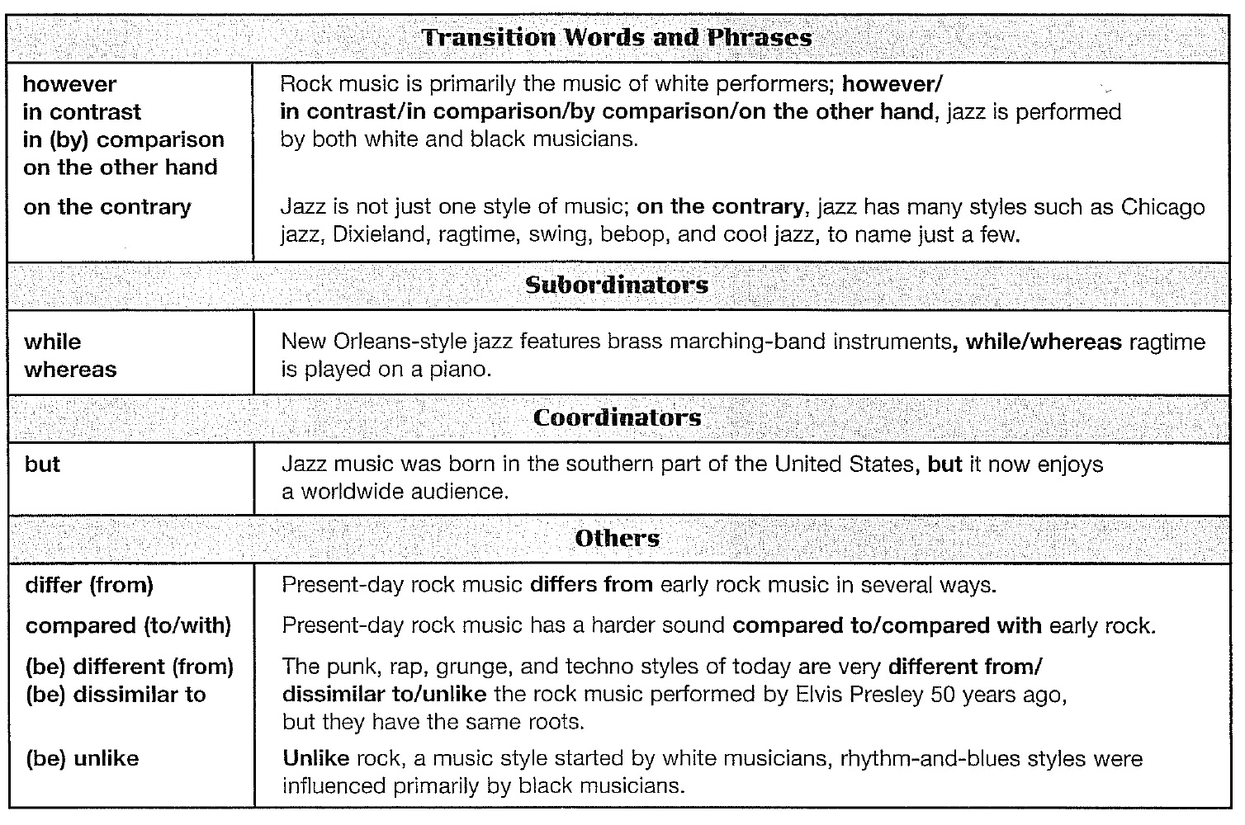
Contrast Signal Words

Slide 77
Review
These are the important points covered in this chapter:
Comparison/contrast is a common pattern for writing about similarities and differences. It is used in all academic fields.
There are two common ways to organize a comparison/contrast essay.
In point-by-point organization, you discuss each similarity and each difference in some other order-usually order of their importance without grouping them into blocks. In this type of organization, you may discuss a similarity and then a difference, and then a similarity and then a difference.
In block organization, you first discuss all the similarities in a block and then all the differences in another block. (You may, of course, begin with the block of differences.)
Use comparison and contrast signal words to help your reader understand your points of comparison and contrast.

Slide 78
Chapter 8
Paraphrase and Summary

Slide 79
Introduction
Academic writing normally requires that you support your ideas and opinions with facts, statistics, quotations, and similar kinds of information. There are four ways to use information from outside sources. You can quote it directly or indirectly. You can also paraphrase or summarize it, skills that you will practice in this chapter. Writing paraphrases and summaries are important tools in academic writing.

Slide 80
Paraphrasing
When you paraphrase, you rewrite information from an outside source in your own words without changing the meaning. Because you include in your rewriting all or nearly all of the content of the original passage, a paraphrase is almost as long as the Original. (A summary, by contrast, is much shorter than the original.)
Plagiarism
Plagiarism is wrongly using someone else's words or ideas, and it is a serious offense. There are two kinds of plagiarism:
When you use information from an outside source without citing the source (telling where you got the information), you are guilty of plagiarism.
Even when you cite your source, if your paraphrase is too similar to the original, you are guilty of plagiarism.

Slide 81
Paraphrasing
How to Write a Good Paraphrase
There are three keys to writing a good paraphrase:
Use your own words and your own sentence structure.
Make your paraphrase approximately the same length as the original.
Do not change the meaning of the original.
You can write a good paraphrase if you follow these steps:
Read the original passage several times until you understand it fully.
It helps to take notes. Write down only a few words for each idea.
Write your paraphrase from your notes.
Check your paraphrase against the original to make sure you have not copied vocabulary or the sentence structure too closely.
Add an in-text citation at the end.

Slide 82
Summarizing
Another way to use borrowed information from an outside source is to summarize it. When you retell a story that someone has told you, you repeat the story in your own words. If your retelling is about the same length as the original, it is a paraphrase. If you shorten the story-retelling only the most important points and leaving out the details-it is a summary.
How to Write a Good Summary
There are three keys to writing a good Summary:
Use your own words and your own sentence structure.
Remember that a summery is much shorter than a paraphrase.
Do not change the meaning of the original.

Slide 83
Review
These are the important points you should have learned from this chapter:
In academic wilting, you are expected to use information from outside sources to support your ideas. In addition to using quotations, you may also use paraphrases and summaries.
Paraphrase: Rewrite the author's meaning in your own words. Include all or almost all of the ideas that are in the original. Change the sentence structure and substitute synonyms where possible to avoid plagiarizing.
Summary: Condense a writer's words and summarize the main ideas in as few of your own words as possible.
Keep in mind that the U.S. system of education values students' original thinking and writing. Use outside sources to support your own ideas. Don't write a paper that contains only the ideas of others.
Don't just drop a paraphrase or summary into your paper. Make the connection between the borrowed information and your idea clear.
Document your sources to avoid plagiarizing and to help the reader find the sources of your information.

Slide 84
Chapter 9
Argumentative Essays

Slide 85
Introduction
An argumentative essay is an essay in which you agree or disagree with an issue, using reasons to support your opinion. Your goal is to convince your reader that your opinion is right. Argumentation is a popular kind of essay question because it forces students to think on their own: They have to take a stand on an issue, support their stand with solid reasons, and support their reasons with solid evidence.

Slide 86
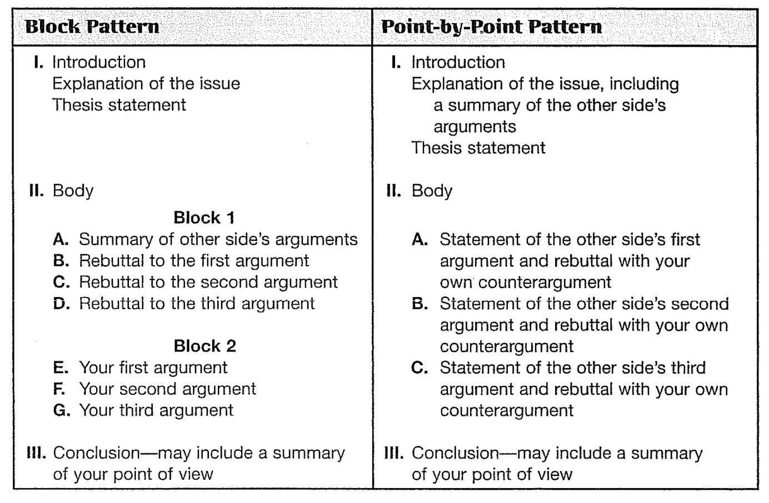
Organization of Argumentative Essays

Slide 87
The lntroductory Paragraph
The introductory paragraph of the model contains an explanation of the issue, which is a necessary part of an argumentative essay. However, you may also begin an argumentative essay with a more engaging introduction-with surprising statistics, for example, or with a dramatic story.
If you write an attention-getting introduction, you may need to explain the issue in a second introductory paragraph and write your thesis statement at the end of this (the second) paragraph.
Thesis Statement
The thesis statement in an argumentative essay states clearly which side you are for.

Slide 88
The lntroductory Paragraph
A thesis statement often mentions the opposing point of view. Notice that the writer's opinion is expressed in the main (independent) clause, and the opposing point of view is normally put into a subordinate structure.
SUBORDINATE STRUCTURE
Despite the claims that curfew laws are necessary to control juvenile gangs,.
MAIN (INDEPENDENT) CLAUSE
Despite the claims that curfew laws are necessary to control juvenile gangs,.

Slide 89
The lntroductory Paragraph
Use expressions such as the following to introduce opposing points of view.
Some people feel that the United States should have a national health care plan like Canada's.
Many think that genetically engineered crops are a grave danger to the environment.
Smokers say that they have a right to smoke.
Then connect the opposing point of view to your own with transition signals of contrast.
Some people feel that the United States should have a national health care plan like Canada's; however, others feel that government should stay out of the health care business.
Although/Even though many think that genetically engineered crops are a grave
danger to the environment, such crops can alleviate world hunger and malnutrition.

Slide 90
Review
These are the important points covered in this chapter:
An argumentative essay is a kind of essay in which you try to persuade your reader to agree with your opinion about a controversial topic.
An argumentative essay contains these five elements:
An explanation of the issue
A clear thesis statement
A summery of the opposing arguments
Rebuttals to the opposing arguments
Your own arguments
Use either a block pattern or a point-by-point pattern. Be sure to include the opposite point of view as well as your own.
Use contrast transition signals to connect opposing arguments and your counter-arguments.

Slide 91
PART III
Sentence Structure

Slide 92
Chapter 10
Types of Sentences

Slide 93
Clauses
Clauses are the building blocks of sentences. A clause is a group of words that contains (at least) a subject and a verb.
Clauses
Not Clauses
SUBJECT
VERB
ecology is a science
to protect the environment
SUBJECT
VERB
because pollution causes cancer
after working all day

Slide 94
Clauses
Independent Clauses
An independent clause contains a subject and a verb and expresses a complete thought. It can stand alone as a sentence by itself. An independent clause is formed with a subject and a verb and often a complement.
Dependent Clauses
A dependent clause begins with a subordinator such as when, while, if, that, or who. A dependent clause does not express a complete thought, so it is not a sentence by itself. A dependent clause is also called a sentence fragment. By itself, it is an incomplete sentence, and it is an error. A dependent clause is formed with a subordinator, a subject, and a verb.
The sun (Subject) rose (Verb).
… When (Subordinator) The sun (Subject) rose (Verb)...

Slide 95
Kinds of Sentences
A sentence is a group of words that you use to communicate your ideas. Every sentence is formed from one or more clauses and expresses a complete thought. The four basic kinds of sentences in English are simple, compound, complex, and compound-complex.
Simple Sentence
Notice that the second sentence has two verbs, boils and freezes. This is called a compound verb. The second sentence has both a compound subject and a compound verb.
S
V
Freshwater boils at 100 degrees Celsius at sea level.
S
S
V
V
Freshwater and salt water do not boil and do not freeze at the same

Slide 96
Kinds of Sentences
Compound Sentences
A compound sentence is two or more independent clauses joined together. There are three ways to join the clauses:
With a coordinator
With a conjunctive adverb
With a semicolon
Salt water boils at a higher temperature than freshwater, so food cooks faster in salt water.
Salt water boils at a higher temperature than freshwater; therefore, food cooks faster in salt water.
Salt water boils at a higher temperature than freshwater; food cooks faster in
salt water.

Slide 97
Kinds of Sentences
1. Compound Sentence with Coordinators
A compound sentence can be formed as follows:
There are seven coordinators, which are also called coordinating conjunctions. You can remember them by the phrase FAN BOYS (For, And, Nor, But, Or, Yet, So). The following sentences illustrate the meanings of the seven FAN BOYS coordinators. (Punctuation note: There is a comma after the first independent clause.)
Independent clause, + coordinator + independent clause
Salt water boils at a lower temperature than freshwater, so food cooks faster in salt water.

Slide 98
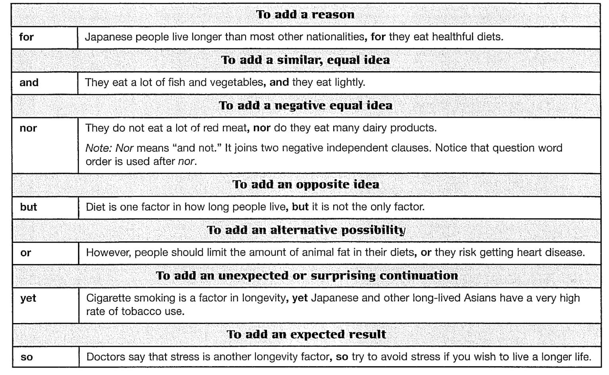
Coordinators (Coordinating Conjunctions)

Slide 99
Kinds of Sentences
But and yet have similar meanings: They both signal that an opposite idea is coming. But is preferred when the two clauses are direct opposites. When the second clause is an unexpected or surprising continuation because of information given in the first clause, yet is preferred. (But is acceptable for both meanings; yet for only one meaning.) Compare:
I want to study art, but my parents want me to study engineering.
(direct opposite)
I am very bad at math, yet my parents want me to study engineering.
(surprising continuation after "I am very bad at math")

Slide 100
Kinds of Sentences
2. Compound Sentence with Conjunctive Adverbs
A second way to form a compound sentence is as follows:
Punctuation note: Put a semicolon before and a comma after the conjunctive adverb.
Several transition signals, such as on the other hand, as a result, and for example, act like conjunctive adverbs; they can also connect independent clauses with a semicolon and a comma. The following chart lists common conjunctive adverbs and a few transition signals that can be used in this way.
Independent clause; + conjunctive adverb, + independent clause
Salt water boils at a higher temperature than freshwater; therefore, food cooks faster in salt water.

Slide 101
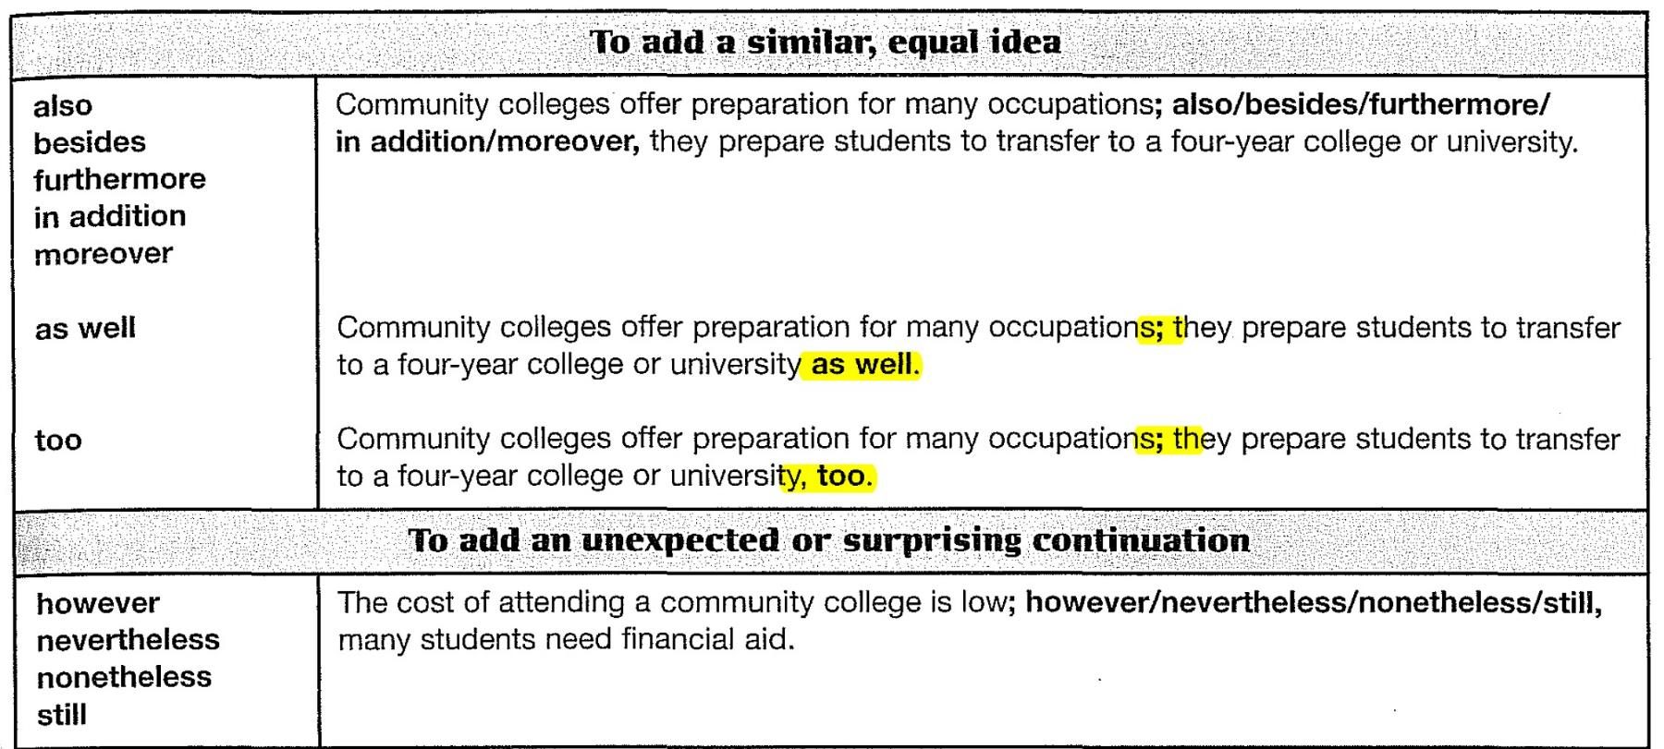
Conjunctive Adverbs

Slide 102
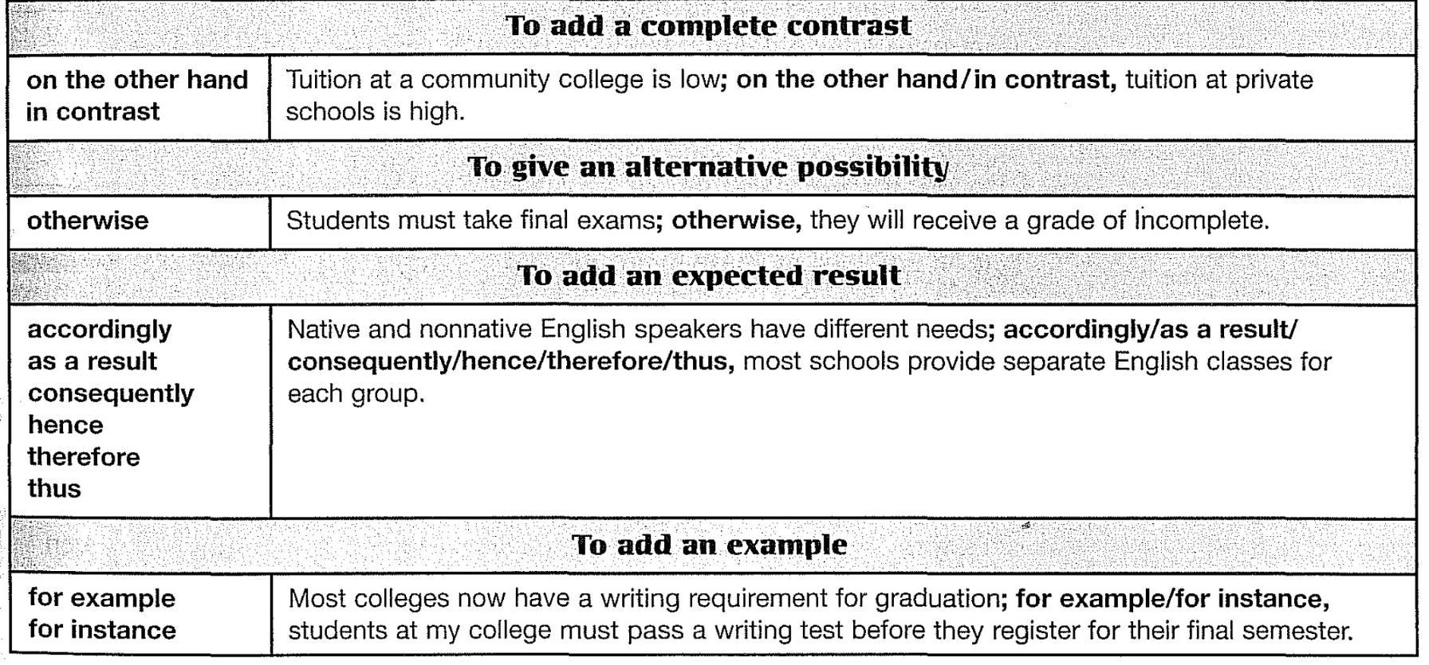
Conjunctive Adverbs

Slide 103
Kinds of Sentences
3. Compound Sentence with Semicolons
A third way to form a compound sentence is to connect the two independent clauses with a semicolon alone:
This kind of compound sentence is possible only when the two independent clauses are closely related in meaning. If they are not closely related, they should be written as two simple sentences, each ending with a period.
INDEPENDENT CLAUSE
Poland was the first Eastern European country to turn away from communism;
INDEPENDENT CLAUSE
others soon followed.

Slide 104
Kinds of Sentences
Complex Sentences
A complex sentence contains one independent clause and one (or more) dependent clause(s). In a complex sentence, one idea is generally more important than the other. We place the more important idea in the independent clause and the less important idea in the dependent clause.
There are three kinds of dependent clauses:
With Adverb Clauses
With Adjective Clauses
With Noun Clauses

Slide 105
Kinds of Sentences
1. Complex Sentence with Adverb Clauses
An adverb clause acts like an adverb; that is, it tells where, when, why, and how. An adverb clause begins with a subordinator, such as when, while, because, although, if, so, or that. It can come before or after an independent clause.
DEPENDENT ADVERB CLAUSE
INDEPENDENT CLAUSE
Although women in the United States could own property, they could not vote until 1920.
INDEPENDENT CLAUSE
DEPENDENT ADVERB CLAUSE
A citizen can vote in the United States, when he or she is 18 years old.

Slide 106
Kinds of Sentences
2. Complex Sentence with Adjective Clauses
An adjective clause acts like an adjective; that is, it describes a noun or pronoun. An adjective clause begins with a relative pronoun, such as who, whom, which, whose, or that, or with a relative adverb, such as where or when. It follows the noun or pronoun it describes.
DEPENDENT ADJECTIVE CLAUSE
Men who are not married are called bachelors.
DEPENDENT ADJECTIVE CLAUSE
Last year we vacationed in Cozumel, which features excellent scuba diving.

Slide 107
Kinds of Sentences
3. Complex Sentence with Noun Clauses
A noun clause begins with a wh-question word, that, whether, and sometimes if. A noun clause acts like a noun; it can be either the subject or an object of the independent clause.
DEPENDENT NOUN CLAUSE
That there is a hole in the ozone layer of Earth's atmosphere is well known.
DEPENDENT NOUN CLAUSE
Scientists know what caused it.

Slide 108
Kinds of Sentences
Compound-Complex Sentences
A Compound-complex sentence has at least three clauses, at least two of which are independent.
Punctuate the compound part of a compound-complex sentence like a compound sentence; that is, use a semicolon/comma combination, or put a comma before a coordinator joining two independent clauses.
Punctuate the complex part like a complex sentence.
I wanted to travel after I graduated from college; however, I had to go to work immediately.
After I graduated from college, I wanted to travel, but I had to go to work immediately.
I could not decide where I should work or what I should do, so at first I did nothing.

Slide 109
Review
These are the important points covered in this chapter:
Clauses are the main building blocks of sentences. There are two kinds of clauses: independent and dependent.
An independent clause
A dependent clause
We build different kinds of sentences in English by combining clauses in different patterns:
A simple sentence is one independent clause.
A compound sentence is two independent clauses joined by a coordinator, a conjunctive adverb, or a semicolon.
A complex sentence is one independent and one (or more) dependent clauses.
A compound-complex sentence has two independent clauses and one (or more) dependent clauses.
The type of sentence you write depends on your message. When you want to show that ideas are equal, use more coordinated structures, such as compound sentences. When ideas are not equal, use more subordinated structures, such as complex sentences. Develop a good writing style by mixing sentence types.

Slide 110
Chapter 11
Using Parallel Structures
and Fixing Sentence Problems

Slide 111
Introduction
In this chapter, you will learn to use parallel structure to add symmetry and style to your sentences. You will also learn to recognize and repair common sentence problems: fragments, run-ons, comma splices, choppy, and stringy sentences.

Slide 112
Parallelism
Parallelism is an important element in English writing, especially when you are listing and comparing and contrasting items or ideas. Parallelism means that each item in a list or comparison follows the same grammatical pattern. If you are writing a list and the first item in your list is a noun, write all the following items as nouns also. If the first item is an -ing word, make all the others -ing words; if it is an adverb clause, make all the others adverb clauses.

Slide 113
Parallelism
Parallelism with Coordinators: And, Or, But
Words, phrases, and clauses that are joined by and, or, and but are written in parallel form.
The Federal Air Pollution Control Administration regulates automobile exhausts,
and the Federal Aviation Administration makes similar regulations for aircraft.
Pesticides cannot be sold if they have a harmful effect on humans, on animal life, or on the environment.
The states regulate the noise created by motor vehicles but not by commercial aircraft.

Slide 114
Parallelism
Parallelism with Correlative (Paired) Conjunctions
Use parallel forms with the paired conjunctions both . .. and, either . .. or, neither . .. nor, and not only . .. but also.
A new law provides the means for both regulating pesticides and ordering their removal if they are dangerous.
Air pollutants may come either from the ocean as natural contaminants given off by sea life or from the internal combustion engines of automobiles.
At the present time, air pollution is controlled through laws passed not only to reduce the pollutants at their sources but also to set up acceptable standards of air quality.

Slide 115
Sentence Problems
Sentence Fragments
Sentence fragments are incomplete sentences or parts of sentences. Remember that a complete sentence must contain at least one main or independent clause.
This is a dependent clause. It begins with a subordinator (because). It does not express a complete thought because there is no independent clause.
Add an independent clause.
Delete the subordinator (because).
Because some students work part-time while taking a full load of classes.
Because some students work part-time while taking a full load of courses, they have very little free time.
Some students work part-time while taking a full load of classes.

Slide 116
Sentence Problems
Choppy Sentences
Choppy sentences are sentences that are too short. Short sentences can be effective in certain situations. For instance, when you want to make an impact, use a short sentence. However, overuse of short sentences is considered poor style in academic writing.
Choppy sentences are easy to correct. Just combine two or three short sentences to make one compound or complex sentence. Your decision to make a compound or a complex sentence should be based on whether the ideas in the short sentences are equal or whether one idea is dependent on the other.
If the sentences express equal ideas, use coordination to combine them.
If the sentences express unequal ideas, that is, if one sentence expresses a less important idea than the other, use subordination to combine them.

Slide 117
Sentence Problems
Run-On Sentences and Comma Splices
A run-on sentence is a sentence in which two or more independent clauses are written one after another with no punctuation. A similar error happens when two independent clauses are incorrectly joined by a comma without a coordinating conjunction. This kind of error is called a comma splice.
The ways to correct these two sentence errors are the same.
Add a period:
Add a semicolon:
Add a coordinator:
Add a subordinator:
[RUN-ON] My family went to Australia then they emigrated to Canada.
[COMMA SPLICE] My family went to Australia, then they emigrated to Canada.
My family went to Australia. Then they emigrated to Canada.
My family went to Australia; then they emigrated to Canada.
My family went to Australia, and then they emigrated to Canada.
My family went to Australia before they emigrated to Canada.

Slide 118
Sentence Problems
Stringy Sentences
A stringy sentence is a sentence with too many clauses, usually connected with and, but, so, and sometimes because. It often results from writing the way you speak, going on and on like a string without an end.
To connect a stringy sentence, divide it and/or recombine the clauses, remembering to subordinate when appropriate.
[STRINGY SENTENCE] Many students attend classes all morning, and then they work all afternoon, and they also have to study at night, so they are usually exhausted by the weekend.
[CORRECTED] Many students attend classes all morning and work all afternoon. Since they also have to study at night, they are usually exhausted by the weekend.

Slide 119
Review
These are the important points covered in this chapter:
Parallelism: Two or more items joined by coordinating conjunctions and paired conjunctions must be parallel in structure. The same is true of contrasts and comparisons of items. If the first item is a noun, make all others nouns; if it is a phrase, make all the others phrases; if it is a clause, make all the others clauses.
Sentence Problems: The main kinds of problem sentences that students may write are fragments, run-ons, comma splices, choppy, and stringy sentences:
Fragments are incomplete sentences.
Run-ons and comma splices are incorrectly joined independent clauses.
Choppy sentences are sentences that are too short.
Stringy sentences are sentences with too many independent clauses.

Slide 120
Chapter 12
Noun Clauses

Slide 121
Introduction
A noun clause is a dependent clause that functions as a noun. A noun clause is often part of an independent clause, where it can be a subject or an object.
A noun clause can also follow certain adjectives and nouns.
SUBJECT
VERB
What the newspaper reported was incorrect.
VERB
OBJECT
People once believed that the world was flat.
ADJECTIVE
We were happy that the semester was over.
NOUN
Who first challenged the belief that the world was flat?

Slide 122
That Clauses
A that clause is a dependent noun clause that begins with the word that.
You can sometimes omit that if the meaning is clear without it. However, you can never omit that when it is the first word in a sentence.
[CORRECT] The young filmmaker hopes that his film will be a financial success.
[CORRECT] The young filmmaker hopes his film will be a financial success.
[CORRECT] That his film is a critical success is beyond doubt.
[INCORRECT] His film is a critical success is beyond doubt.
A that clause can appear in different locations.

Slide 123
That Clauses
After the independent clause verb: The most common position of a noun clause is after the verb of the independent clause, where it functions as the object of that verb.
After certain adjectives: that clause can also follow certain adjectives such as happy, glad, proud, pleased, sad, upset, worried, sorry, certain, surprised, and sure. These adjectives describe emotions.
After certain nouns: A that clause can follow certain nouns such as idea, theory, thought, claim, assertion, statement, belief, notion, and opinion.
At the beginning of a sentence
The catalog states that science courses require a laboratory period.
The class was surprised that the instructor canceled the final exam.
No one believed Galileo's theory that Earth revolves around the sun.
That Earth is getting warmer is certain.

Slide 124
That Clauses
Sentences Beginning with It
Starting a sentence with a noun clause seems awkward to many English speakers, so they often rewrite such sentences by putting it at the beginning and moving the noun clause to the end.
In addition, the verb following it (except be or any intransitive verb like seem or appear) is often written in the passive voice, especially in academic writing.
You can also write these sentences in the active voice:
[AWKWARD] That Earth is getting warmer is certain.
[BETTER] It is certain that Earth is getting warmer.
It is believed that carbon dioxide is responsible for global warming.
Measurements have proven that the world's deserts are expanding.

Slide 125
That Clauses
In general, English writers prefer the active voice because it is more direct. However, they prefer the passive voice in five specific situations:
You want to emphasize what happened, not who did it.
The performer of the action is unknown.
The performer of the action is unimportant.
You want to be objective, such as in a scientific or technical report.
You want to be diplomatic; that is, you don't want to say who did something wrong or made an error.
Jack was promoted last month.
The wheel was invented during the Bronze Age.
Smoking is prohibited on airplanes.
With a dropper, 3 ml of HCI were added to the test tube and heated to 37°^{C}.
I believe a mistake has been made on our bill.

Slide 126
That Clauses
Special Verb Tenses in That Clauses
One of the most common uses of noun clauses in academic writing is to report what someone else has said or written. This kind of noun clause is called reported speech, indirect speech, or indirect quotation. Verb tenses in reported speech follow special rules.
If the main clause verb is simple present, present perfect, or future, the verb in the noun clause is in the tense that expresses the meaning that the main clause intends.
If the main clause verb is in past tense, the verb in the noun clause is usually in a past form.
Exception: The verb in the noun clause stays in the present tense when it reports a fact or a general truth:
The prime ministers agree that global warming is a serious world problem.
They hoped that all nations would be responsible for finding a solution.
Researchers in the field verified that icebergs and glaciers are melting.

Slide 127
That Clauses
Subjunctive Noun Clauses
After certain independent clause verbs and adjectives, you must use the subjunctive form of the verb in the following noun clause. The subjunctive form of a verb is the same as the base form-be, go, come, do, and so on.
The verbs and adjectives that require the subjunctive form in the noun clauses that follow indicate urgency, advisability, necessity, and desirability.
advise
ask
command
demand
insist
order
prefer
propose
request
require
suggest
urge
advisable mandatory
desirable necessary
essential urgent
important vital
[Verbs]
[Adjectives]

Slide 128
If/Whether Clauses
An if/whether clause is a dependent noun clause that begins with the subordinator whether or if. Whether is more formal than if. The optional phrase or not may be added in two places with whether and in one place with if. Therefore, there are five possible patterns:
The patient wanted to know whether Dr. Chen practices acupuncture.
The patient wanted to know whether or not Dr. Chen practices acupuncture.
The patent wanted to know whether Dr. Chen practices acupuncture or not.
The patient wants to know if Dr. Chen practices acupuncture.
The patient wants to know if Dr. Chen practices acupuncture or not.

Slide 129
If/Whether Clauses
Notice that if/whether clauses are statements, not questions, even though they are made from yes/no questions (questions that can be answered yes or no). If/whether clauses use statement word order (subject-verb) and do not contain do, does, or did.
To change a question into an if/whether clause, add a subordinator (if or whether), change the word order to statement word order, and delete do, does, and did if necessary.
[Question]
[Sentence with if/whether clause]
Is the test easy?
Does he know the answer?
The students want to know if the test is easy.
I want to know whether he knows the answer

Slide 130
Question Clauses
A question clause is a dependent noun clause that begins with a subordinator such as who, what, when, where, why, how, how much, how long, and so on. There are two possible patterns. In the first pattern, the subordinator is the subject of the clause.
In the second pattern, the subordinator is not the subject of the clause.
Notice that the word order in question clauses is statement order (subject + verb), not question order (verb + subject). Also, question clauses do not contain do, does, or did because they are not questions even though they begin with a question word.
Follow the sequence of tenses rules if necessary. (If the independent clause verb is in a past tense, the verb in the noun clause should also be in a past tense.)
The police do not know who committed the robbery.
The police do not know when the robbery happened.

Slide 131
Review
These are the important points covered in this chapter:
A noun clause is a dependent clause that acts like a noun.
A noun clause can act as a subject, an object, or a subject complement. That clauses can also follow certain adjectives and nouns. The most common position of a noun clause is after the verb of the main (independent) clause
Starting a sentence with a noun clause is awkward. English speakers usually rewrite these sentences so that they begin with it and end with the noun clause.
Passive voice is often used in these kinds of sentences, especially in academic writing.
When a noun clause reports what someone asked or said, you must follow the sequence of tenses rules for reported speech.
Following verbs and adjectives indicating urgency, advisability, necessity, and desirability, use the base form of the verb in the noun clause. This kind of noun clause is called a subjunctive noun clause.
Noun clauses use statement word order even when they begin with a question word. They also do not contain do, does, or did because they are not questions.
Commas are not used with noun clauses.

Slide 132
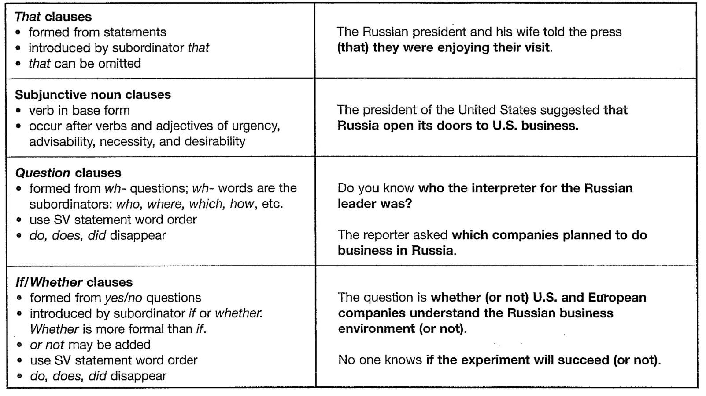
Review

Slide 133
Chapter 13
Adverb Clauses

Slide 134
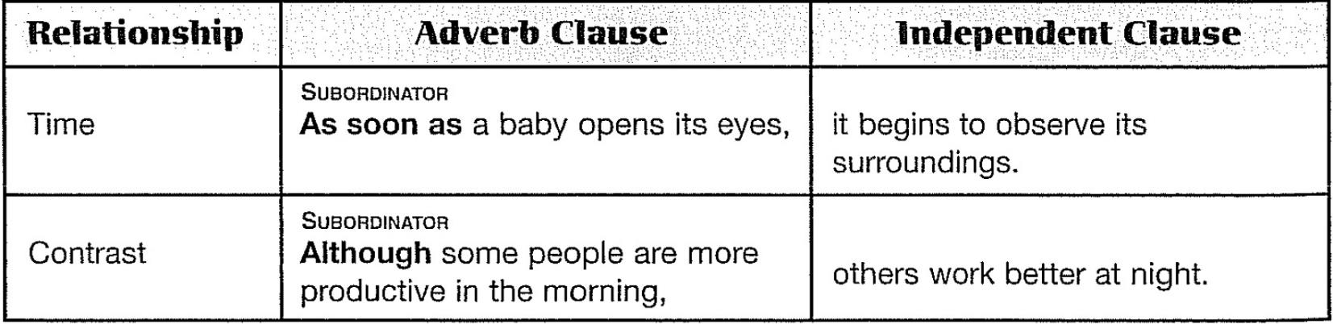
Introduction
An adverb clause is a dependent clause that functions as an adverb. It can tell when, where, why, how, how long, how far, how often, and for what purpose something happened. An adverb clause can also express a contrast. An adverb clause always begins with a subordinating conjunction that expresses the relationship between the adverb clause and the independent clause..

Slide 135
Punctuation of Adverb Clauses
The punctuation of an adverb clause depends on the order of the clauses. When an adverb clause comes first in a sentence, put a comma after it. When an adverb clause follows an independent clause, do not separate the clauses with a comma.
ADVERB CLAUSE
INDEPENDENT CLAUSE
Because humans are curious animals,
they constantly explore their world.
INDEPENDENT CLAUSE
ADVERB CLAUSE
Humans constantly explore their world
because they are curious animals.

Slide 136
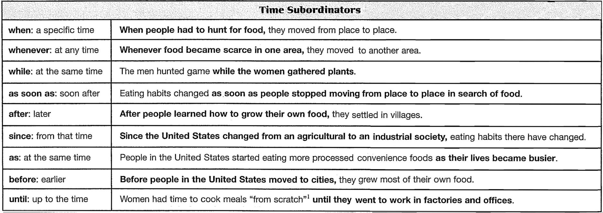
Time Clauses
An adverb time clause tells when the action described in the independent clause took place. The action in a time clause can occur at the same time or at a different time. A time clause can come before or after an independent clause.

Slide 137
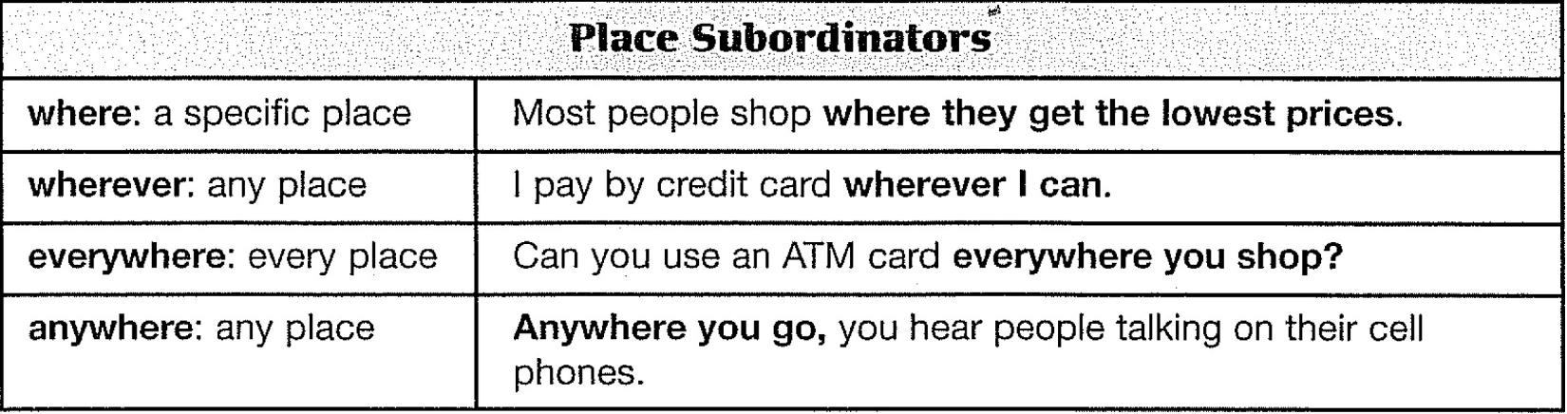
Place Clauses
An adverb place clause tells where the action described by the main verb took place. The subordinators wherever; everywhere, and anywhere are similar in meaning and are interchangeable. You can begin a sentence with wherever, everywhere, and anywhere clauses, but usually not with a where clause

Slide 138
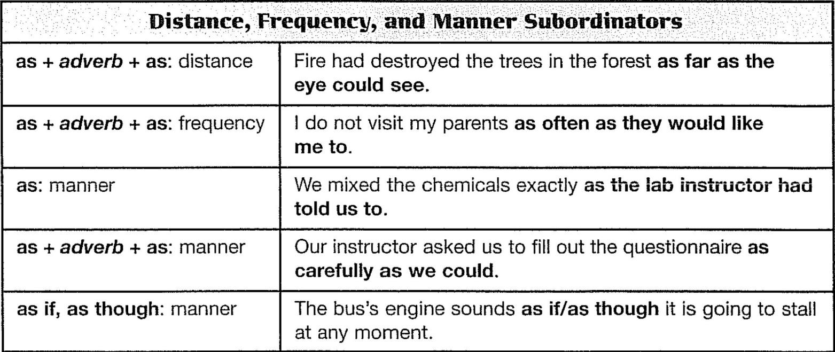
Distance, Frequency, and Manner Clauses
Adverb clauses of distance answer the question "How far?" Adverb clauses of frequency answer the question "How often?" Adverb clauses of manner answer the question "How?" Distance, frequency, and most (but not all) manner clauses follow the independent clause

Slide 139
Distance, Frequency, and Manner Clauses
Notes
In informal spoken English, people often use like in place of as if and as though. Like is not correct in formal written English, so use only as if and as though in your writing.
In very formal written English, the verb takes the same form as it does in conditional clauses when the information in the as if/as though clause is untrue (or probably untrue). However, many English speakers use normal verb forms in this situation.
[FORMAL] It looks as if it is going to rain.
[INFORMAL] It looks like it is going to rain.
[FORMAL] John acts as if he were the Prince of Wales.
[INFORMAL] John acts as if he is the Prince of Wales.

Slide 140
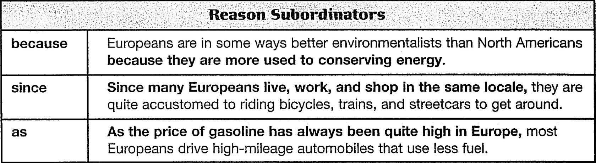
Reason Clauses
An adverb reason clause answers the question "Why?" A reason clause can come before or after the independent clause in a sentence.

Slide 141
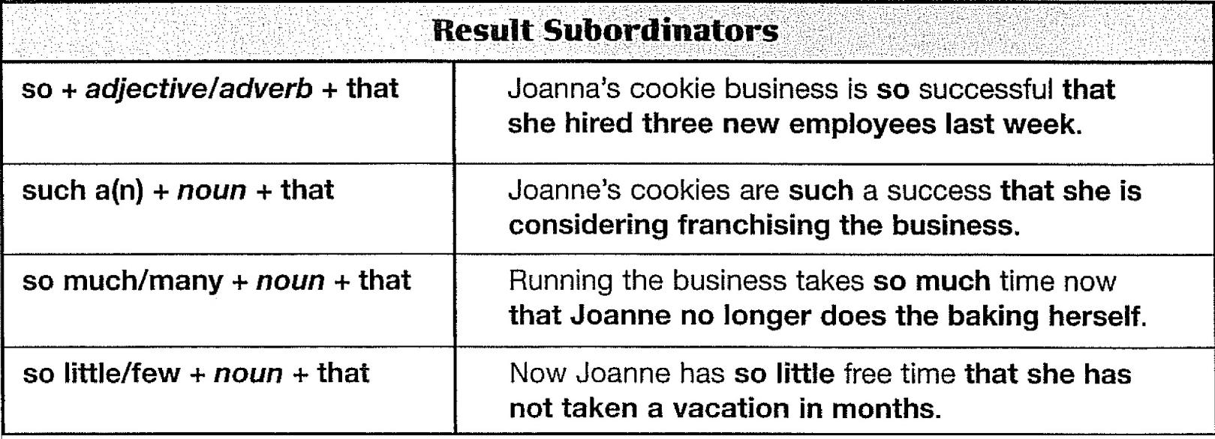
Result Clauses
An adverb result clause expresses the effect or consequence of the information in the independent clause. A result clause follows the independent clause in a sentence.

Slide 142
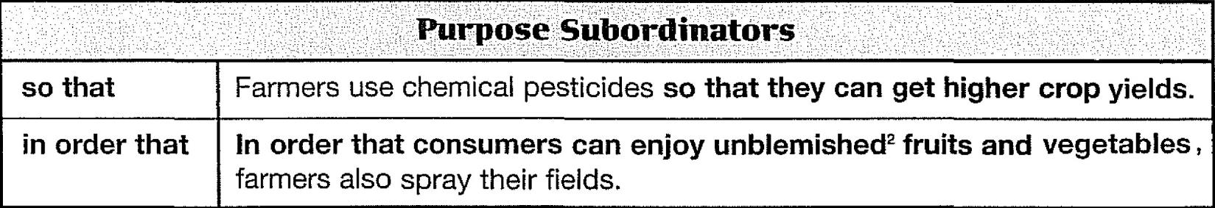
Purpose Clauses
An adverb purpose clause states the purpose of the action in the independent clause. A purpose normally follows the independent clause, but you may put it at the beginning of a sentence if you want to especially emphasize it.
Notes
In order that is formal.
The modals may/might, can/could, will/would, or have to usually occur in a purpose clause.
We often use the phrase in order to + a base verb or simply to + a base verb when the subjects of both the independent clause and the purpose clause are the same person or thing.

Slide 143
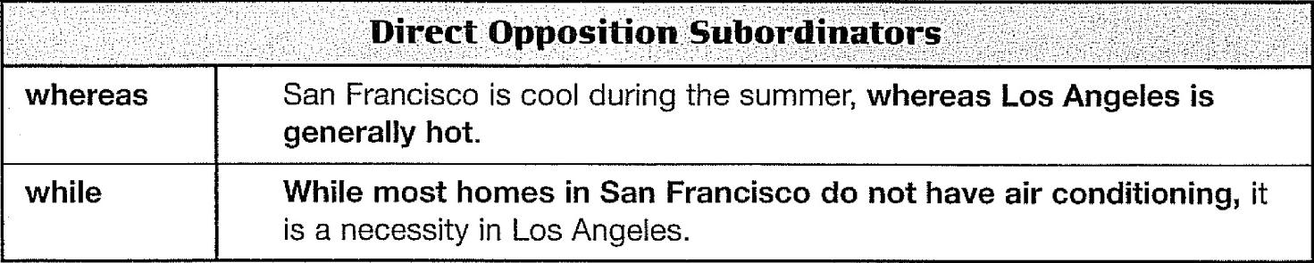
Contrast Clauses
1.Direct Opposition Clauses
In this type, the information in the adverb clause and the information in the independent clause are in direct contrast.
Notes
While and whereas have the same meaning and are interchangeable.
Use a comma between the two clauses no matter which order they are in.
Since the two ideas are exact opposites, you can put the subordinator with either clause, and the clauses can be in either order.

Slide 144
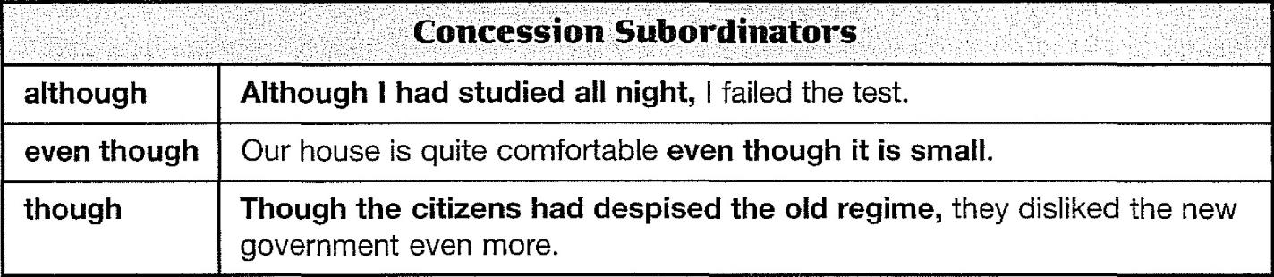
Contrast Clauses
2. Concession (Unexpected Result) Clauses
A concession clause means "This idea is true, but the idea in the independent clause is more important."
Notes
Although, even though, and though have almost the same meaning. Though is less formal. Even though is a little stronger than although.
Use a comma only when the concession clause comes before the independent clause.
Be careful about which clause you use the subordinator with. Sometimes you can use it with either clause, but not always.

Slide 145
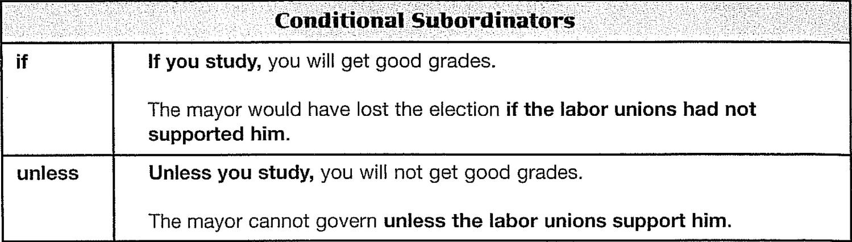
Conditional Clauses
A conditional clause states a condition for a result to happen or not happen.
Notes
There are four basic patterns of conditional sentences. Each patterns has a different combination of verb forms depending on whether the time is present, future, or past, and on whether the condition is hue or not true. The Next slide chart summarizes the four patterns.
Unless means "if not.".

Slide 146
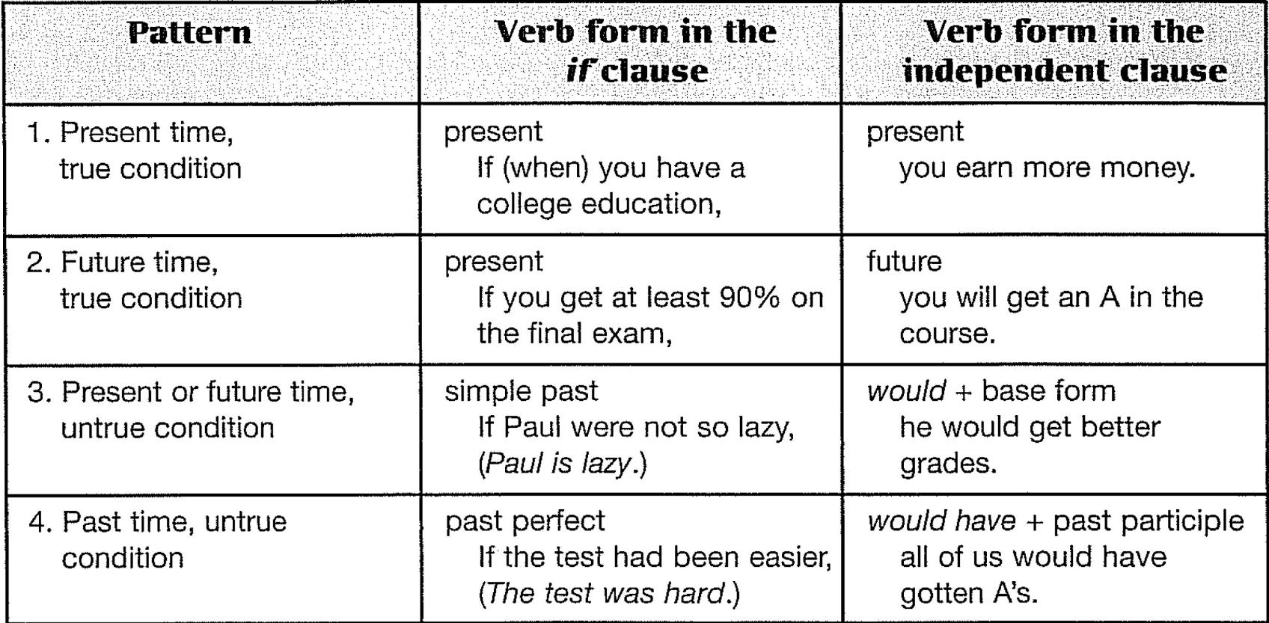
Conditional Clauses

Slide 147
Review
These are the important points covered in this chapter:
An adverb clause is a dependent clause that answers questions such as Where? When? Why? How? For what purpose? and Under what conditions? Adverb clauses can also express two kinds of contrast
Place an adverb clause either before or after an independent clause. If an adverb clause comes before an independent clause, put a comma after it. If it comes after an independent clause, do not use a comma. (Exception: Always use a comma with while and whereas. Also, many writers always use a comma with although, though, and even though.)

Slide 148
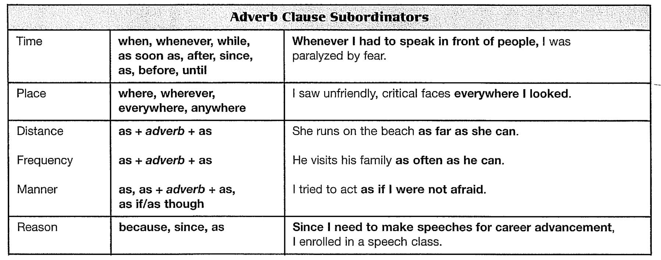
Review

Slide 149
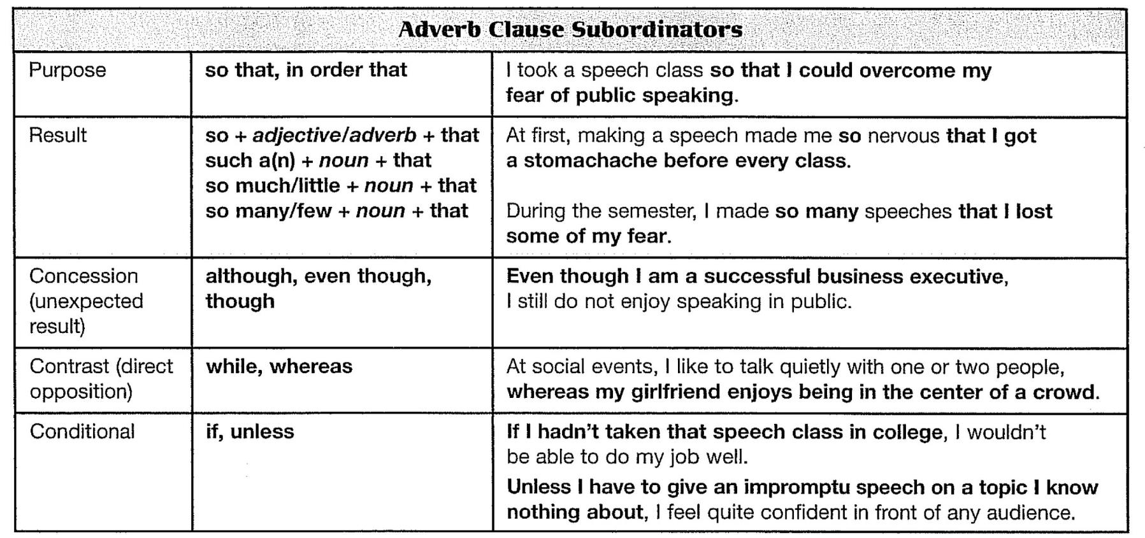
Review

Slide 150
Chapter 14
Adjective Clauses

Slide 151
Introduction
An adjective clause is a dependent clause that functions as an adjective. That is, it modifies (gives more information about) a noun or pronoun. Adjective clauses are one way to improve your writing style because they use subordination to connect ideas. Subordination, rather than coordination (using lots of ands and buts to connect ideas) is the mark of a mature writing style. However, take care not to use too many adjective clauses. A paragraph or essay that is filled with too many who's and which's is not good either.

Slide 152
Relative Pronouns and Adverbs
An adjective clause begins with a relative pronoun or relative adverb.
Position of Adjective Clauses
To avoid confusion, an adjective clause should come right after its antecedent.
Occasionally, other words may come between the antecedent and the adjective clause.
Sometimes an adjective clause modifies an entire sentence. In this case, it comes at the end of the sentence. The relative pronoun is always which, and the clause is always nonrestrictive.
Scientists who study fossils are called paleontologists.
Recently, a friend of mine at the University of Toronto who is majoring in electrical engineering, received a government grant to study airport runway lighting.
The team won the championship, which shocked the opponents.

Slide 153
Relative Pronouns and Adverbs
Verb Agreement in Adjective Clauses
The verb in an adjective clause agrees in number with its antecedent. Compare these two sentences:
Punctuation of Adjective Clauses
Adjective clauses are either restrictive (necessary) or nonrestrictive (unnecessary).
A restrictive clause is necessary because it identifies its antecedent for the reader. Do not use commas with restrictive clauses.
A nonestrictive clause is not necessary to identify its antecedent; it merely gives the reader some extra information about it. Because you can omit a nonestrictive clause without loss of meaning, separate it from the rest of the sentence with commas.
The relative pronoun that is used in restrictive clauses only. (Which is used in nonestrictive clauses only.)
An employee who works part-time usually receives no benefits.
Employees who work part-time usually receive no benefits.

Slide 154
Relative Pronouns and Adverbs
Restrictive (necessary): no commas
Nonrestrictive (unnecessary): commas
The professor who teaches my biology class won a Nobel Prize two years ago.
(Which professor won a Nobel Prize two years ago?
The clause who teaches my biology class is necessary to identify the professor.)
Professor Jones, who teaches my biology class, won a Nobel Prize two years ago.
(The person who won a Nobel Prize is identified by his name, so the clause who teaches my biology class is extra, unnecessary information about Professor Jones. If it were omitted, we would still know which person won the Nobel Prize.)

Slide 155
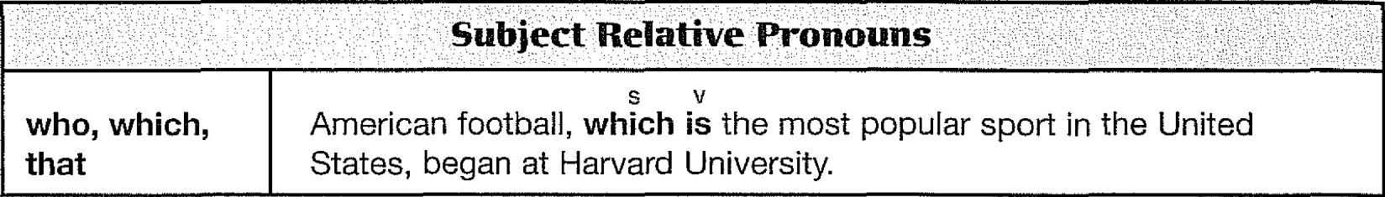
Kinds of Adjective Clauses
There are different types of adjective clauses. In each different type, the relative pronoun has a different function. It may be a subject or an object in its own clause, it may replace a possessive word.
1. Relative Pronouns as Subjects
A relative pronoun can be the subject of its own clause.
In this pattern, who, which, and that can be either singular or plural. Make the verb agree with the antecedent.

Slide 156
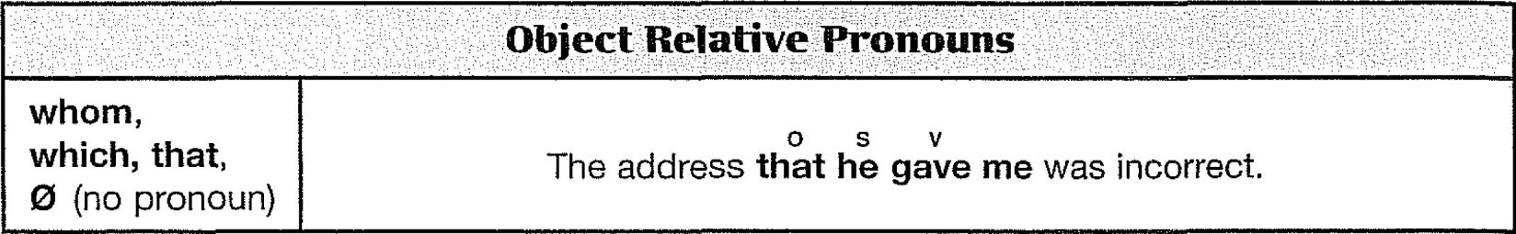
Kinds of Adjective Clauses
2. Relative Pronouns as Objects
A relative pronoun can be an object in its own clause.
Note: You can omit that in object pattern clauses only.
The address he gave me was incorrect.

Slide 157
Kinds of Adjective Clauses
3. Possessive Adjective Clauses
In possessive adjective clauses, the relative pronoun whose replaces a possessive word such as Mary's, his, our, their, the company's, or its. Possessive adjective clauses can follow the subject or the object pattern.
In the subject pattern, the whose + noun phrase is the subject of the adjective clause. In the object pattern, the whose + noun phrase is the object in the adjective clause.
Notes
Some writers feel that whose should be used to refer only to people. For animals and things, they recommend using of which.
You have learned that the verb in an adjective clause agrees with the antecedent.
Now learn the exception: When whose + noun is the subject of an adjective clause, the verb agrees with that noun.

Slide 158
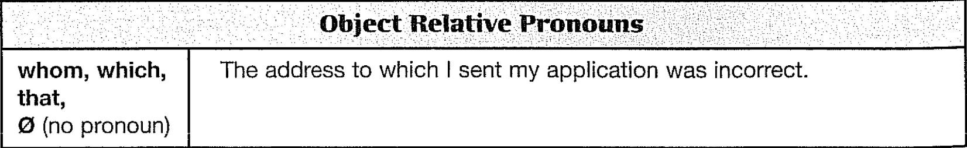
Kinds of Adjective Clauses
4. Relative Pronouns as Objects of Prepositions
A relative pronoun can be the object of a preposition in its own clause.
These adjective clauses are formed in two ways: the formal way and the informal way.
In the formal way, the preposition and relative pronoun are together at the beginning of the clause:
In the informal way, the pronoun comes at the beginning and the preposition at the end of the clause:
for whom I did a favor | with whom I shared a secret | to which I sent my application
whom I did a favor for | whom I shared a secret with | which I sent my application to

Slide 159
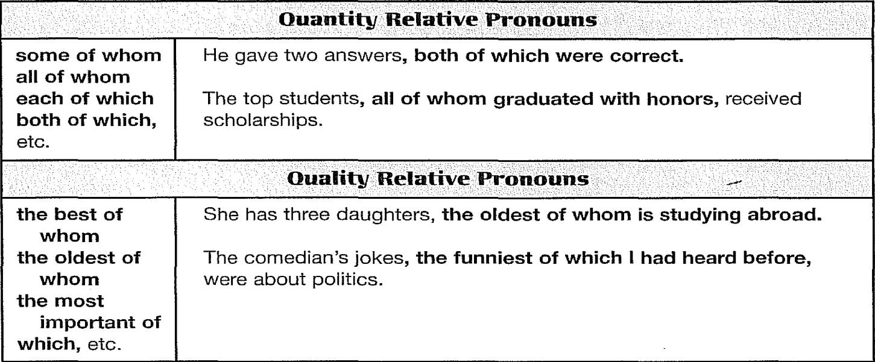
Kinds of Adjective Clauses
5. Relative Pronouns in Phrases of Quantity and Quality
A relative pronoun can occur in phrases of quantity and quality.
These adjective clauses can follow either the subject or the object pattern, and they are always nonrestrictive; that is, they are always used with commas.

Slide 160
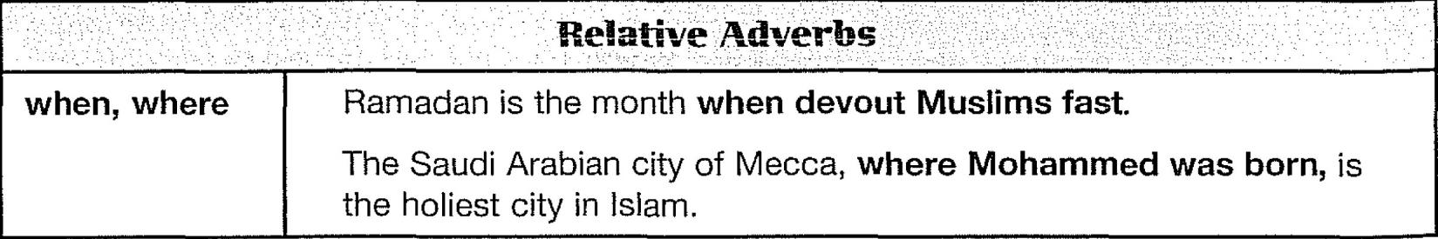
Kinds of Adjective Clauses
6. Adjective Clauses of Time and Place
Adjective clauses can also be introduced by the relative adverbs when and where.
These clauses refer to a time or a place, and they can be restrictive or nonrestrictive. In the following examples, notice how when and where replace entire prepositional.

Slide 161
Kinds of Adjective Clauses
6. Adjective Clauses of Time and Place
It is also possible to write time and place clauses with the relative pronoun which, that, or 0 and a preposition. The following patterns are possible.
when I was born.
on which I was Darn.
March 31, 1980, was the day
which I was born on.
that I was born on.
I was born.

Slide 162
Review
These are the important points covered in this chapter:
An adjective clause is a dependent clause that functions as an adjective; that is, it gives more information about a noun or pronoun in the independent clause. The modified noun or pronoun is called the antecedent.
An adjective clause begins with a relative pronoun or a relative adverb.
Place an adjective clause after its antecedent and as close to it as possible to avoid confusion of meaning.
The verb in an adjective clause should agree in number with its antecedent.
Adjective clauses are either restrictive (necessary) or nonestrictive (unnecessary). Add commas before and after nonestrictive clauses.

Slide 163
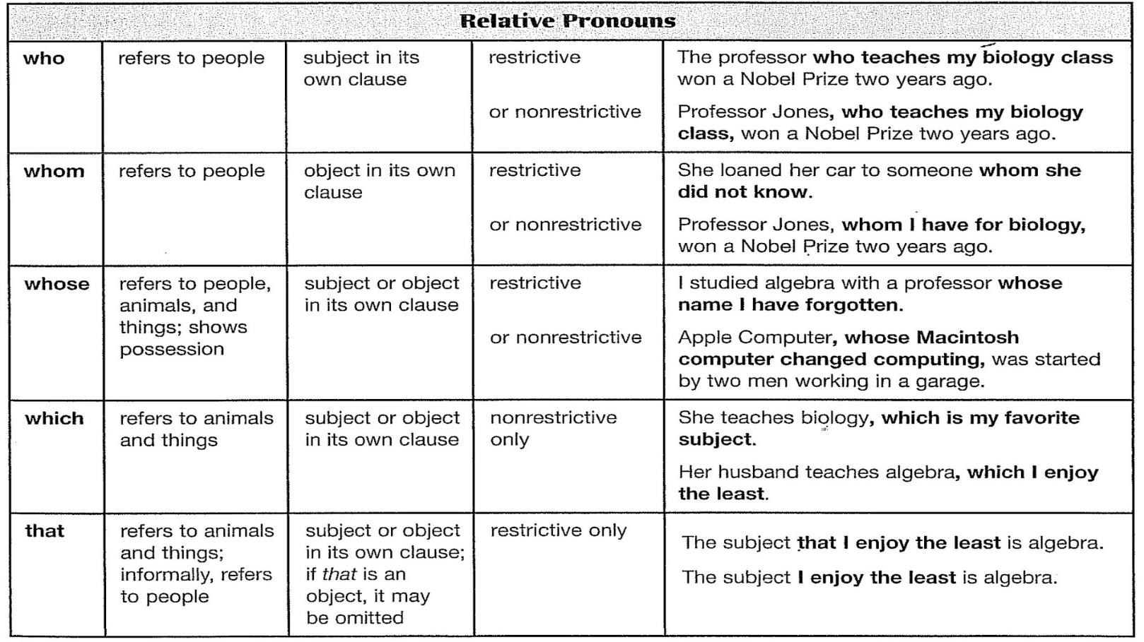
Review

Slide 164
Chapter 15
Participial Phrases

Slide 165
Participles
A participle is an adjective fanned from a verb. There are two kinds of participles: -ing participles (called present participles) and -ed participles (called past participles).
The two kinds of participles come from either active or passive voice verbs.
An active voice verb becomes an -ing participle.
A passive voice verb becomes an -ed participle.
There are also perfect forms.
a sleeping baby | a frightening experience | a frightened child | a used car
The essay won an award. → Jacob wrote the winning essay.
My leg was broken in three places. → My broken leg is healing slowly.
The students had solved most of the problems → Having solved most of the problems

Slide 166
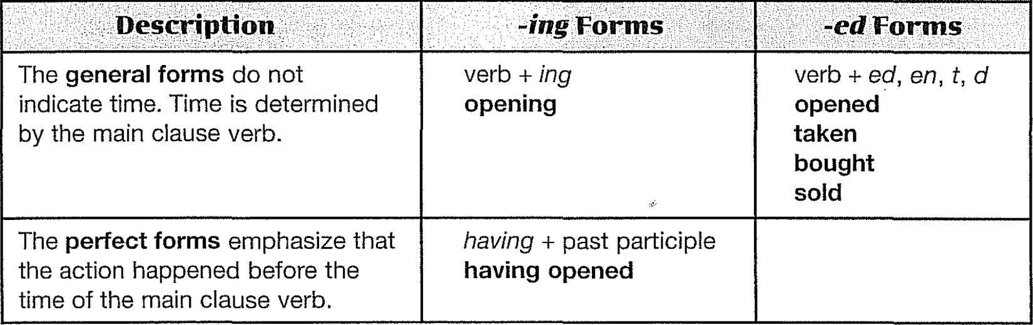
Participles
The most commonly used participle forms are shown in the following chart.
Participle Forms

Slide 167
Participial Phrases
A participial phrase contains a participle + other words. Use participial phrases to modify nouns and pronouns.
Participial phrases can be formed by reducing adjective clauses and adverb clauses. For this reason, they are sometimes called reduced clauses.
Reduced Adjective Clauses
You can reduce a subject pattern adjective clause as follows.
Delete the relative pronoun (who, which, or that).
Change the verb to a participle.
Keep the same punctuation (commas or no commas).
Put the word not at the beginning of a participial phrase to make it negative.
Students planning to graduate in June must make an appointment with the registrar.

Slide 168
Participial Phrases
Position and Punctuation of Participial Phrases
Participial phrases, like adjective clauses, can be restrictive (necessary) or nonrestrictive (unnecessary). If the original clause is nonrestrictive, the phrase is nonrestrictive also. A nonrestrictive phrase is separated from the rest of the sentence by commas. Restrictive phrases use no commas.
A restrictive participial phrase can only follow the noun it modifies and does not have commas.
A nonrestrictive participial phrase can precede or follow the noun it modifies and is separated by a comma or commas from the rest of the sentence.
CAUTION! When you begin a sentence with a participial phrase, make certain that the phrase modifies the subject of the sentence. If it does not, your sentence is incorrect.
Sometimes a participial phrase modifies an entire independent clause. In this case, it follows the clause and requires a comma.
A woman hurrying to catch a bus tripped and fell.
Teresa, hurrying to catch a bus stumbled and fell.
The team won the championship, shocking their opponents.

Slide 169
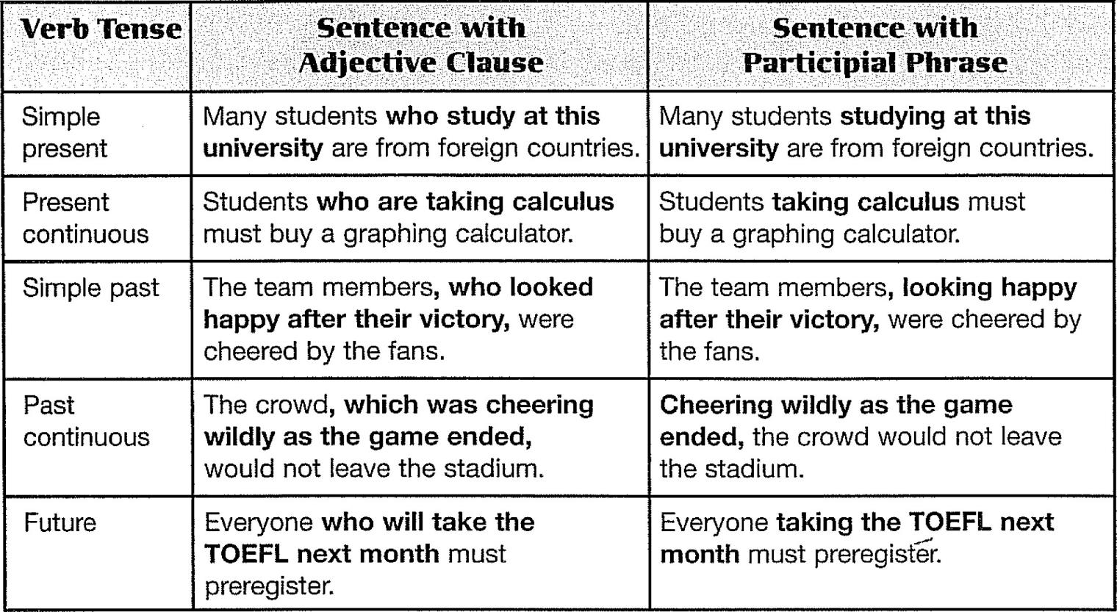
Participial Phrases
General Form -ing Participial Phrases

Slide 170
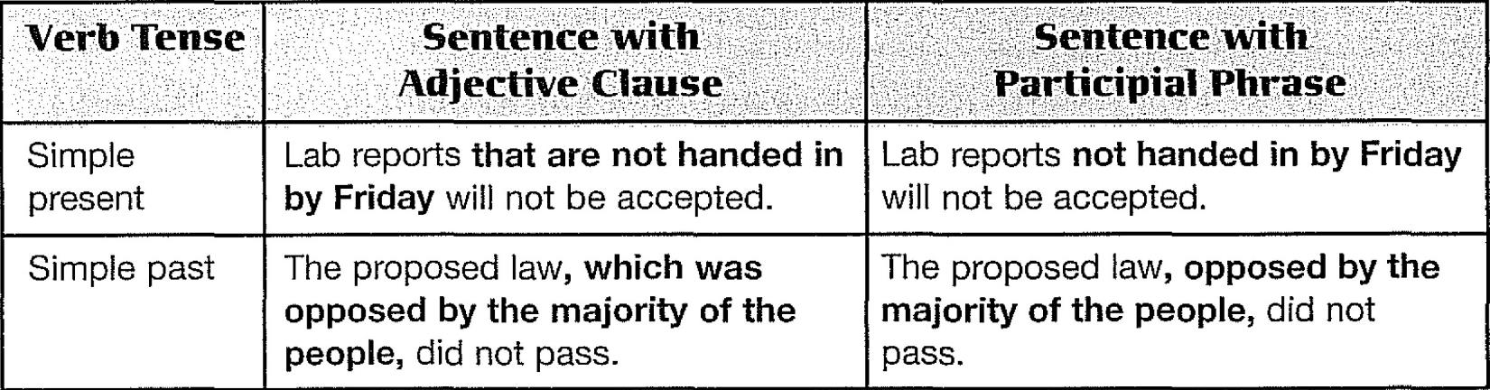
Participial Phrases
General Form -ed Participial Phrases
A general form -ed participle comes from both present and past tense passive voice verbs.

Slide 171
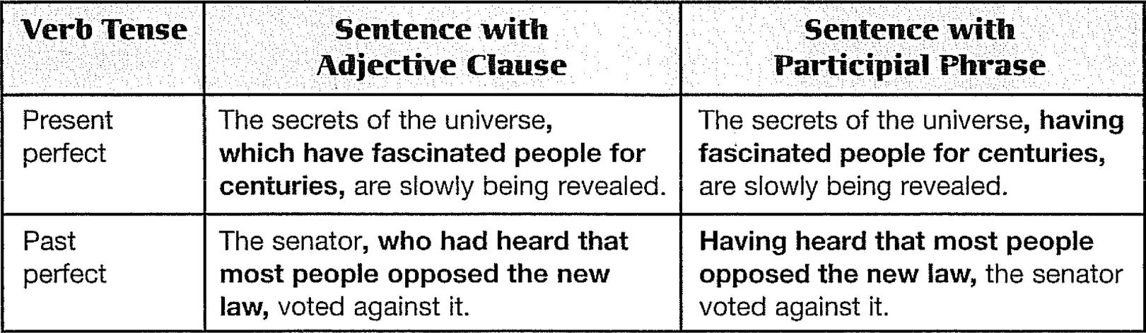
Participial Phrases
Perfect Form Participial Phrases
Perfect forms emphasize the completion of an action that takes place before the action of the main verb. You can change both present perfect and past perfect verbs into perfect participles.

Slide 172
Participial Phrases
Participial Phrases and Writing Style
Use participial phrases to improve your writing style.
If you write sentences with a lot of which's, who's, and that's, consider reducing some adjectives clauses to participial phrases.
If you write short, choppy sentences, consider combining them by using participial phrases.
Vary your sentence openings by occasionally starting a sentence with a participial phrase.
[CHOPPY SENTENCES] First-born children are often superachievers. They feel pressure to behave well and to excel in school.
[IMPROVED] First-born children, who feel pressure to behave well and to excel in school, are often superachievers.

Slide 173
Participial Phrases
Reduced Adverb Clauses
You can reduce some adverb clauses to -ing and -ed phrases.
Sentence with Adverb Clause
Sentence with -ing or -ed Phrase
When you enter a theater, you
should turn off your cell phone.
Because he had read that the
company needed workers,
John applied for a job.
When entering a theater, you should turn off your cell phone.
Having read that the company
needed workers, John applied
for a job.

Slide 174
Participial Phrases
Reduced Adverb Clauses
To reduce an adverb clause, follow these steps:
Make sure that the subject of the adverb clause and the subject of the independent clause are the same.
Delete the subject of the adverb clause. If necessary, move it to the subject position in the independent clause.
Change the adverb clause verb to the appropriate participle.
Delete or retain the subordinator according to the following rules:
Retain before, and retain since when it is a time subordinator.
Delete as when it is a time subordinator.
Delete all three reason subordinators because, since, and as.
Retain after, while, and when if the participial phrase follows the independent clause. When the phrase is in another position, you may either retain or delete these subordinators.

Slide 175
Participial Phrases
Delete or retain the subordinator
Retain
Before
Since
Before a student chooses a college, he or she should consider several factors.
Before choosing a college, a student should consider several factors.
A student should consider several factors before choosing a college.
Carlos has not been back home since he came to the United States three years ago.
Since coming to the United States three years ago, Carlos has not been back home.
Carlos has not been back home since coming to the United States three years ago.

Slide 176
Participial Phrases
Delete or retain the subordinator
Delete because since
as (reason)
as (time)
Because (Since/As) Carlos came from a very conservative family, he was shocked at the U.S. system of coed dormitories.
Coming from a very conservative family, Carlos was shocked at the U.S. system of coed dormitories.
Carlos was shocked at the American system of coed dormitories coming from a very conservative family.
As he gradually got used to the way of life in the United States, he became less homesick.
Gradually getting used to the way of life in the United States, he became less homesick.

Slide 177
Participial Phrases
Delete or retain the subordinator
Retain or Delete
After
While
After he had passed the TOEFL exam, he became a freshman in college.
After passing the TOEFL exam, he became a freshman in college.
Having passed the TOEFL exam, he became a freshman in college.
He became a freshman in college after passing the TOEFL exam.
While he was preparing for the TOEFL, he lived with a family.
While preparing for the TOEFL, he lived with a family.
Preparing for the TOEFL, he lived with a family.
He lived with a family while preparing for the TOEFL.

Slide 178
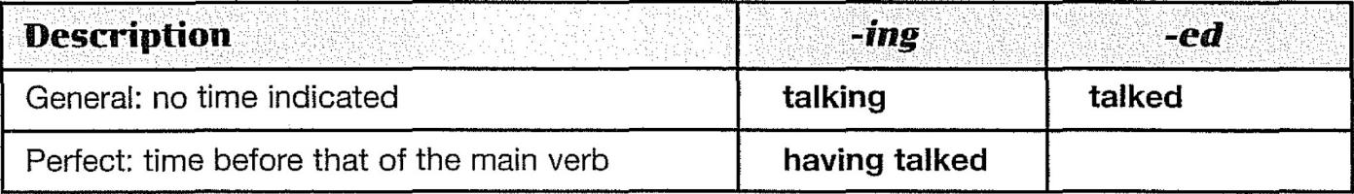
Review
These are the important points covered in this chapter:
Participles are adjectives formed from verbs. Some participles are from active voice verbs.
You can form a participial phrase by reducing an adjective clause:
Participial phrases may also be reduced from time and reason adverb clauses:
Participial phrases reduced from time clauses may occupy various positions in a sentence, and the time subordinators are sometimes deleted and sometimes retained.
Participial phrases reduced from reason clauses may come before or after the independent clause in a sentence. Reason subordinators are always deleted.

Slide 179
Appendix
APPENDIX A:
The Process of Academic Writing

Slide 180
Introduction
Academic writing, as the name implies, is the kind of writing that you are required to do in college or university. It differs from other kinds of writing, such as personal, literary, journalistic, or business writing. Its differences can be explained in part by its particular audience, tone, and purpose.
It is revealed by your choice of words and grammatical structures and even the length of your sentences. The tone of a piece of writing can be, for example, serious, amusing, personal, or impersonal. Academic writing is formal and serious in tone. Finally, the purpose of a piece of writing determines its organizational pattern.
Writing is a process of creating, organizing, writing, and polishing.

Slide 181
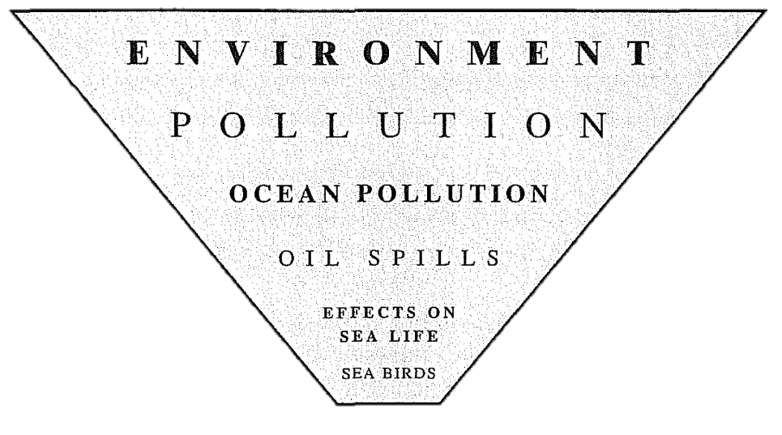
The Writing Process, Step 1: Creating (Prewriting)
The first step in the writing process is to choose a topic and collect information about it.
Step 1A: Choosing and Narrowing a Topic
The diagram illustrates the process of narrowing a topic.
GENERAL TOPIC
VERY SPECIFIC TOPIC

Slide 182
The Writing Process, Step 1: Creating (Prewriting)
Step 1B: Generating ldeas
After you have chosen a topic and narrowed it, the next prewriting step is to collect information and develop ideas.
Four useful techniques for exploring within yourself are journal writing, listing, freewriting, and clustering.
Journal Writing
In journal writing, you can record your daily experiences, or you can write down quotations that are meaningful to you.
Three other brainstorming techniques are listing, freewriting, and clustering.
Listing
Listing is a brainstorming technique in which you think about your topic and quickly make a list of whatever words or phrases come into your mind. Your purpose is to produce as many ideas as possible in a short time, and your goal is to find a specific focus for your topic.

Slide 183
The Writing Process, Step 1: Creating (Prewriting)
Step 1B: Generating ldeas
For Listing, Follow this procedure:
Write down the general topic at the top of your paper.
2Make a list of every idea that comes into your mind about the topic. Don't stop writing until you have filled a page. Keep the ideas flowing. Try to stay on the general topic; however, if you write down information that is completely off the topic, don't worry about it because you can cross it out later.
Use words, phrases, or sentences, and don't won)' about spelling or grammar.
Now rewrite your list and group similar ideas together. Cross out items that don't belong or that are duplications.
The writer can choose one list to be the basis for a single paragraph or all three for an essay.

Slide 184
The Writing Process, Step 1: Creating (Prewriting)
Step 1B: Generating ldeas
Freewriting
Freewriting is a brainstorming activity in which you write freely about a topic because you are looking for a specific focus. While you are writing, one idea will spark another idea. As with listing, the purpose of freewriting is to generate as many ideas as possible and to write them down without worrying about appropriateness, grammar, spelling, logic, or organization.
Follow this procedure:
Write the topic at the top of your paper.
Write as much as you can about the topic until you run out of ideas. Include such supporting items as facts, details, and examples that come into your mind about the subject.
After you have run out of ideas, reread your paper and circle the main idea(s) that you would like to develop.
Take each main idea and freewrite again.

Slide 185
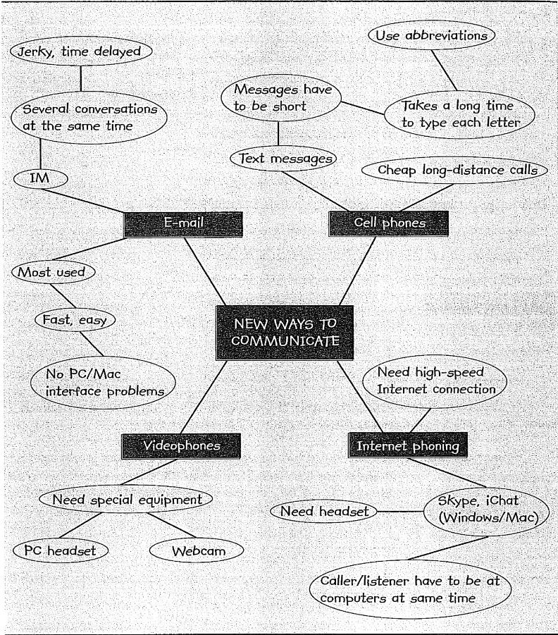
The Writing Process, Step 1: Creating (Prewriting)
Step 1B: Generating ldeas
Clustering
Clustering is another brainstorming activity you can use to generate ideas. To use this technique, first, write your topic in the center of your paper and draw a "balloon" around it.
This is your center, or core, balloon. Then write whatever ideas come to you in balloons around the core. Think about each of these ideas and make more balloons around them.

Slide 186
The Writing Process, Step 2: Planning (Outlining)
In Step l, you chose topics and narrowed them, and you generated ideas by brainstorming. In Step 2 of the writing process, the planning stage, you organize the ideas into an outline.
Step 2A: Making Sublists
The two sublists are (1) items that describe international students (poor verbal skills) and (2) items that describe Americans (Americans difficult to understand).
Step 2B: Writing the Topic Sentence
Finally, write a topic sentence. The topic is clearly communication problems.
Step 2C: Outlining
An outline is a formal plan for a paragraph. You may never need to prepare a formal outline, but if you do, this is what one looks like.
With this outline in front of you, it should be relatively easy to write a paragraph. There is a topic sentence, two main supporting points, supporting details, and since this is a stand-alone paragraph, a concluding sentence.

Slide 187
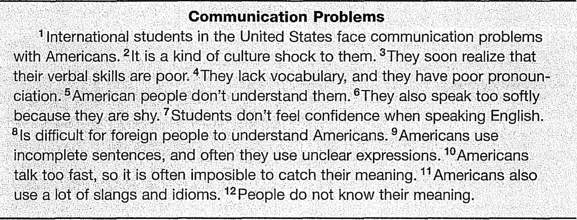
The Writing Process, Step 3: Writing
Step 3 in the writing process is writing the rough draft. Follow your outline as closely as possible, and don't worry about grammar, punctuation, or spelling. A rough draft is not supposed to be perfect.
Above all, remember that writing is a continuous process of discovery. As you are writing, you will think of new ideas that may not be in your brainstorming list or outline. You can add or delete ideas at any time in the writing process. Just be sure that any new ideas are relevant.

Slide 188
The Writing Process, Step 4: Polishing
The fourth and final step in the writing process is polishing what you have written. This step is also called revising and editing. Polishing is most successful if you do it in two stages. First, attack the big issues of content and organization (revising). Then work on the smaller issues of grammar and punctuation (editing).
Step 4A: Revising
After you write the rough draft, the next step is to revise it. When you revise, you change what you have written to improve it. You check it for content and organization, including unity, coherence, and logic. You can change, rearrange, add, or delete, all for the goal of communicating your thoughts in a clearer, more effective, and more interesting way.

Slide 189
The Writing Process, Step 4: Polishing
During the first revision, do not try to correct grammar, sentence structure, spelling, or punctuation; this is proofreading, which you will do later. During the first revision, be concerned mainly with content and organization.
Read over your paragraph carefully for a general overview. Focus on the general aspects of the paper and make notes in the margins about rewriting the parts that need to be improved.
Check to see that you have achieved your stated purpose,
Check for general logic and coherence. Your audience should be able to follow your ideas easily and understand what you have written.
Check to make sure that your paragraph has a topic sentence and that the topic sentence has a central (main) focus.
Check for unity. Cross out sentences that are off the topic.
Check to make sure that the topic sentence is developed with sufficient supporting details. Does each paragraph give the reader enough information to understand the main idea? If the main point lacks sufficient information, make notes in the margin such as "add more details" or "add an example.“
Check your use of transition signals.
Finally, does your paragraph have or need a concluding sentence? If you wrote a final comment, is it on the topic?

Slide 190
The Writing Process, Step 4: Polishing
Step 4B: Editing (Proofreading)
The second step in polishing your writing is proofreading your paper for possible errors in grammar, sentence structure, spelling, and punctuation.
Check each sentence for correctness and completeness. You should have no fragments and no choppy or run-on sentences.
Check each sentence for a subject and a verb, subject-verb agreement, correct verb tenses, noun plurals, articles, and so on.
Check the mechanics: punctuation, spelling, and capitalization.
Check for incorrectly used or repeated words.
Check for contractions (can't, isn't, I'll, and so on). (Some writing instructors permit them, but others do not. Find out your instructor's preference.)

