Slide 1
Megatest/Logpro Training
Using Megatest and Logpro for creating flows and automation for software, EDA, or Unix infrastructure at the unit, functional, and regression levels.
Matt Welland, 2016

Slide 2
Training Overview
Background
Getting started
  Dashboard/command line
    Running tests and managing runs
  Creating a flow
    configs: megatest, runconfig
    tests/tasks: testconfig, logpro
  Getting information about runs and tests
Preview of advanced Megatest topics
Future Megatest development

Slide 3
What does Megatest do?
Run tests or tasks with
  one or many steps
  dynamic test dependency calculation
  on multiple hosts
  multi-level iteration
Report, record and roll up state, status and data
  state: RUNNING, COMPLETED
  status: PASS, FAIL, WARN, CHECK
  data: slew rate, count of failed assertions etc.
Organize “runs” by project specific variables

Slide 4
Megatest Design Philosophy
Factors for Sustainable Automation
Self-checking | write directed or self-checking tests (avoid delta based tests)
Traceable | environment variables, host OS, etc. captured and recorded.
Immutable | once run do not modify, reuse or overwrite tests.
Repeatable | this test result can be recreated in the future
Relocatable | the test area can be checked out and the tests run anywhere
Encapsulated | test run area is self-contained with all inputs and outputs kept
Deployable | anyone on the team, at any site, at any time can run the tests
Wisdom is knowing when it is ok to bend or break the rules!
Megatest strives to make it straightforward to do things right but still possible to get the job done when the rules must be bent or broken.

Slide 5
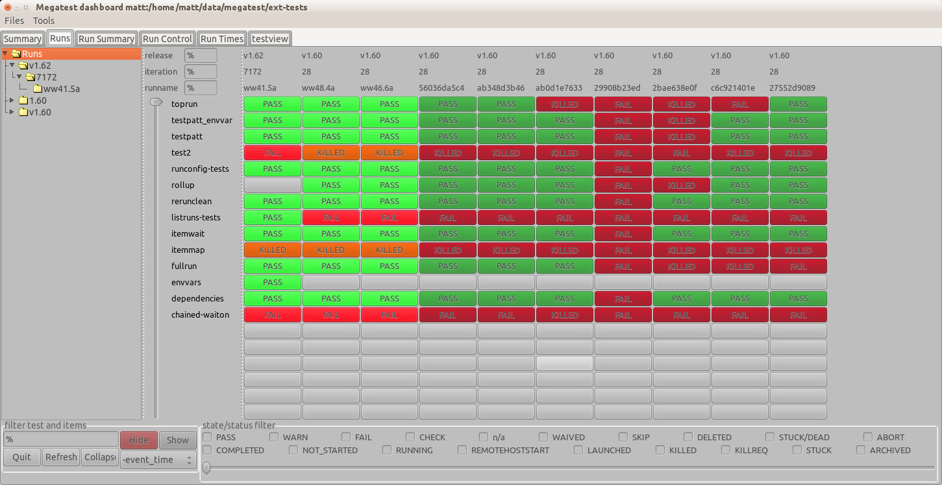
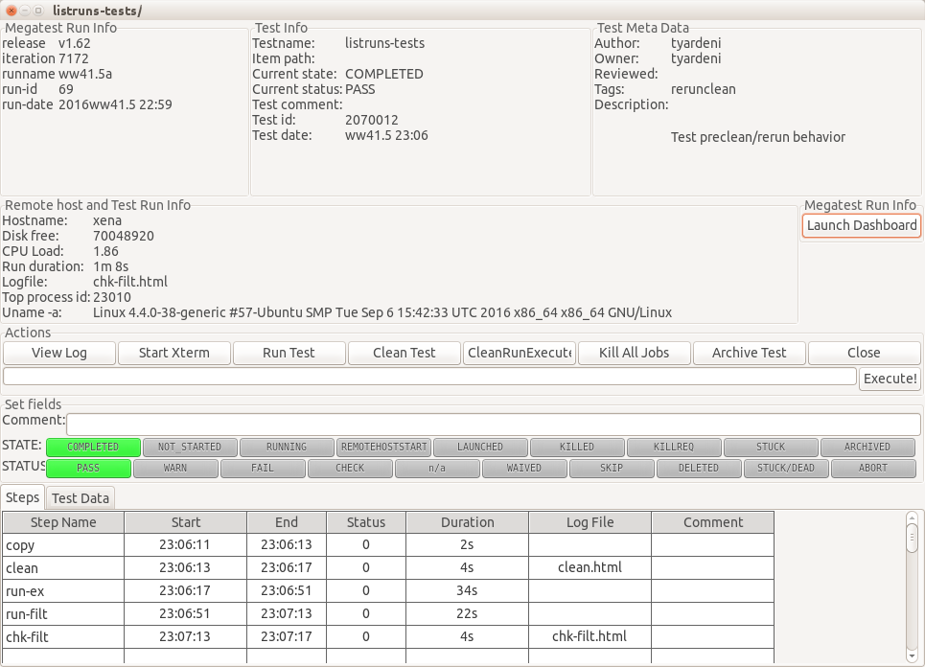
Dashboard/Test Control Panel
dashboard
  browse runs
  filtering
    target
    runname
    test pattern
    state/status
  launch runs
test control panel
  xterm
  view log
  cleanrunexecute

Slide 6
Backup

Slide 7
Megatest Information
Main development site
http://www.kiatoa.com/fossils/megatest
http://www.kiatoa.com/fossils/logpro
Mirror
http://chiselapp.com/user/kiatoa/repository/megatest
http://chiselapp.com/user/kiatoa/repository/logpro
SourceForge Page
http://sourceforge.com/projects/megatest

Slide 8
Architecture
config files, static state, human input
  megatest.config
  runconfigs.config
  tests/<testname>/testconfig
SQL database, dynamic state
  megatest.db
Tools
  megatest (command line), dashboard (gui), and logpro (log file analysis via rules)

Slide 9
Terminology
target | one or more “keys” separated by “/”, used to organize runs hierarchically; examples include platform, architecture, stage (e.g. development, final QA, alpha, beta) and so forth. E.g target = x86/centos/dev where the keys are ARCHITECTURE, OS, and RELEASE
run name | a unique name (within a single target grouping) for a run, a common idiom is to use week and day numbers: date +%V.%u
run | a group of tests run under a single target and run name
test or task | a self-contained area with scripts and data to achieve some testing or automation goal
iterated test | a single test run multiple times with variables iterated over a range of values
state | the state of a test; NOT_STARTED, RUNNING, COMPLETED etc.
status | the current status of this test given its state; PASS, FAIL, n/a

Slide 10
How it Works
remote host
remote host
remote host
remote host
megatest -execute
ssh/netbatch
(system)
test process
megatest -step ...
megatest -run
dashboard
megatest.db
(sqlite3)

Slide 11
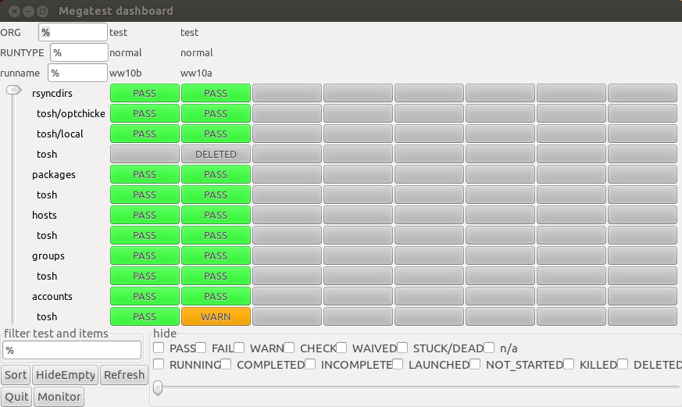
dashboard
runs filter
a “run”
a “test”
a “test item”
tests filter

Slide 12
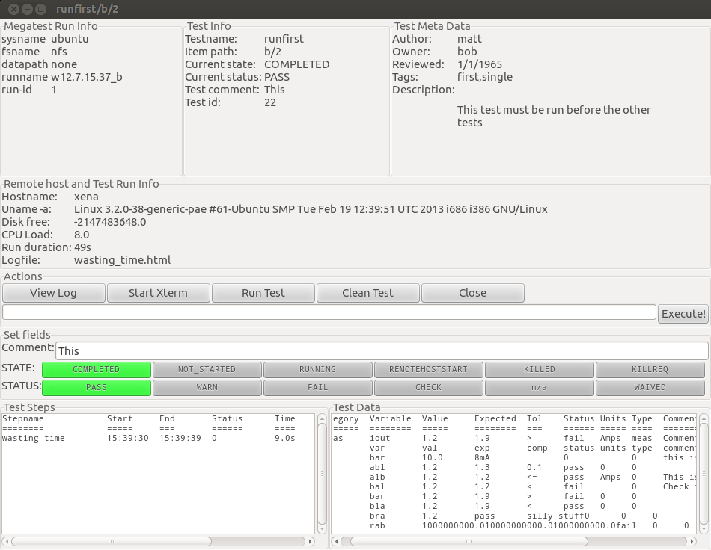
test control panel
meta data
Controls
(debug,
run &
state/status
run info
test info
remote host info
step records
Test data

Slide 13
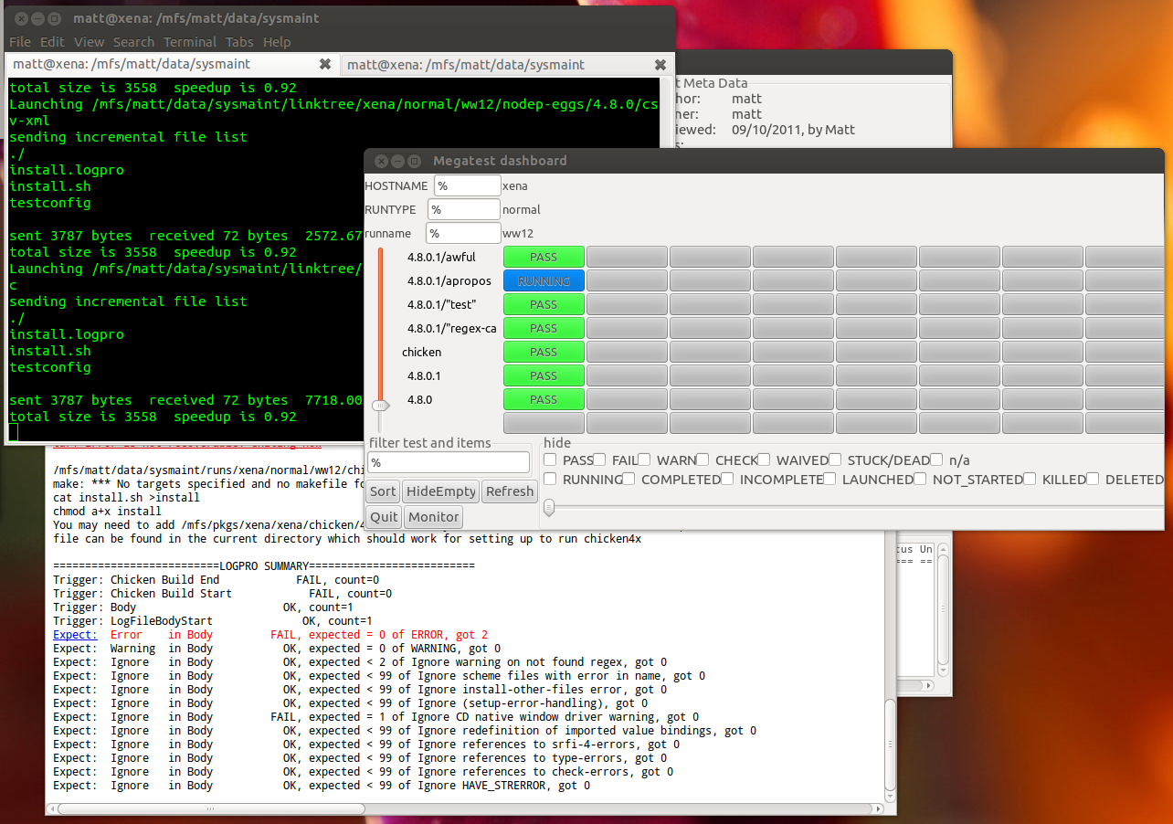
A Day in The Life ...
test control panel
(in background)
run progress seen in xterm
dashboard
logpro output

Slide 14
Run Management
Launching runs
  command line: “megatest -run ...”
  test control panel: push “run” then “execute”
Removing runs
  command line: “megatest -remove-runs ...”
Archiving runs
  command line: “megatest -archive ...”
note: all these commands require the use of additional selector parameters such as -target and -runname

Slide 15
Task/Test Management
Killing jobs
  In the gui set status to “KILLREQ” and the job will be killed.
  Command line example:
Changing state and status of tests
  Use -set-state-status, see example above.
Add “-rerun FAIL” to your launch command line to force the re-run of failed jobs
megatest -set-state-status KILLREQ,FAIL -target ubuntu/nfs/none \
:runname w10.2a -testpatt %/% :state RUNNING

Slide 16
Test Selectors
-testpatt testpatt/itempatt
  “%” is wild card
  “%” is synonymous with “%/%”
  comma separate multiple patterns (OR)
  “%/” is tests with no items

Slide 17
Getting information
-list-runs pattern
  lists runs with runname matching pattern.
-extract-ods
  creates an open-document spreadsheet
Miscellaneous queries
  -list-disks
  -list-targets
  -list-db-targets
  -find-files, -find-paths

Slide 18
Config File Syntax
The config file syntax was designed to be:
  simple and forgiving to syntax mistakes
  easy to understand and trace where values originated
  expressive enough for complex needs.
 | Example | description of the example
Sections | [setup] | Variables defined on subsequent lines will be in the “setup” section
Variables | ABC 1 | Variable “ABC” will have the value “1”
[ ] directives | [include a.txt] | include file “a.txt”, see manual for all directives
#{ } text substitutions | #{shell ls $PWD} | replace the #{ … } with the output of the ls $PWD command. Note that newlines are replaced with spaces.

Slide 19
Config File Text Substitutions
NOTE: [ ] substitutions can be deferred by megatest and executed just before launching a test but #{ } substitutions are done as each line is read.
[include filename] | Includes filename. Ignores if filename does not exist
[system command] | replaced with output from command
#{shell command} | replaced with output from command
#{system command} | replaced with the exit code of command
#{scheme schemecode} | replaced with the result of evaluating schemecode
#{getenv VAR} | replaced with the value of environment variable VAR
#{get section var} | replaced with the value of var from section

Slide 20
Creating a Megatest Area
Required Config files
  megatest.config
  runconfigs.config
Tests
  testconfig
  How to write a test

Slide 21
Setup Megatest Area (configs)
Config files
  megatest.config
    Target A/B/C ...
      One or more “keys” (the “A”, “B” and “C”)
      Choose carefully! They cannot be changed after your megatest.db is created
    links area (the link tree to all your tests)
    runs disk (can add more over time)
      Lowest space used first
      Link tree symlinks point into run areas
  runconfigs.config
    can be empty initially

Slide 22
Required Config Files
megatest.config | runconfigs.config
[fields] PLATFORM TEXT OS TEXT [setup] # Adjust max_concurrent_jobs to limit parallel jobs max_concurrent_jobs 50 # This is your link path, best to set it and then not change it linktree #{getenv PWD}/linktree # Job tools control how your jobs are launched [jobtools] useshell yes launcher nbfind # You can override environment variables for all your tests here [env-override] EXAMPLE_VAR example value # As you run more tests you may need to add additional disks # the names are arbitrary but must be unique [disks] Disk0 #{getenv PWD}/runs | [default] ALLTESTS see this variable # Your variables here are grouped by targets [SYSTEM/RELEASE] [SYSTEM_val/RELEASE_val] ANOTHERVAR only defined if target is SYSTEM_val/RELEASE_val

Slide 23
Setup Megatest Area (tests)
Tests
  tests/<yourfirsttest>/testconfig
Can use the helper “wizards”
  megatest -gen-megatest-area
  megatest -gen-megatest-test

Slide 24
Example testconfig
testconfig
# Add additional steps here. Format is "stepname script" [ezsteps] step1 step1.sh step2 step2.sh # Test requirements are specified here [requirements] waiton setup priority 0 # Iteration for your tests are controlled by the items section [items] COMPONENT parser datastore transport analyzer # test_meta is a section for storing additional data # on your test [test_meta] author matt owner matt description An example test tags tagone,tagtwo reviewed never

Slide 25
Writing a Test “checkspace”
Write a test that checks for available space
  tests can “waiton” this test before running.
Our test will use this simple script, checkspace.sh:
  Note: Files for this example can be found in “example” dir in Megatest distribution
#!/bin/bash -e freespace=`df -k $DIRECTORY | grep $DIRECTORY | awk '{print $4}'` if [[ $freespace -lt $REQUIRED ]];then echo "ERROR: insufficient space on $DIRECTORY" exit 1 else echo "There is adequate space on $DIRECTORY" fi

Slide 26
Writing a Test “checkspace”
Commands to create test “checkspace”
  mkdir -p linktree runs tests/checkspace
  cd tests/checkspace
  vi checkspace.sh
  chmod a+x checkspace.sh
  vi testconfig
# Add steps here. Format is "stepname script" [ezsteps] checkspace checkspace.sh # Iteration for your tests are controlled by the items section [itemstable] DIRECTORY /tmp /opt REQUIRED 1000000 100000

Slide 27
Writing a test “checkspace”
Write a logpro file to analyze your results
(expect:error in "LogFileBody" = 0 "Any error" #/err/i) (expect:required in "LogFileBody" = 1 "Sucess signature" #/adequate space/)
.
|-- megatest.config
|-- megatest.db
|-- monitor.db
|-- runconfigs.config
`-- tests
`-- checkspace
|-- checkspace.logpro
|-- checkspace.sh
`-- testconfig

Slide 28
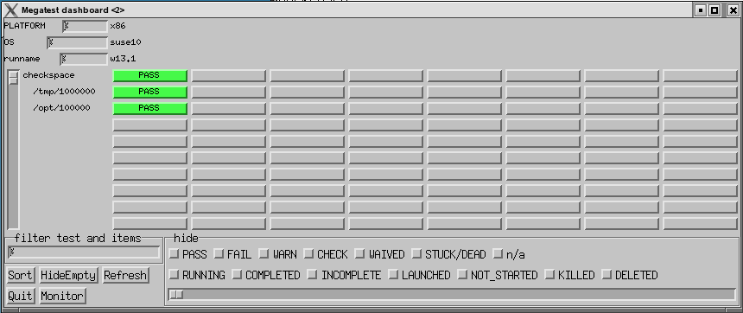
Runing the “checkspace” Test
Run your test
  From the directory where “megatest.config” exists run these commands:
dashboard &
megatest -runtests % -target x86/suse10 :runname w`date +%V.%u`

Slide 29
The “checkspace” Test Directories
|-- linktree
| `-- x86
| `-- suse10
| `-- w13.1
| `-- checkspace
| |-- opt
| | `-- 100000 -> /nfs/ch/disks/ch_unienv_disk005/qa_mrwellan/interim/src/megatest/example/runs/x86/suse10/w13.1/checkspace//opt/100000
| |-- testdat.db
| `-- tmp
| `-- 1000000 -> /nfs/ch/disks/ch_unienv_disk005/qa_mrwellan/interim/src/megatest/example/runs/x86/suse10/w13.1/checkspace//tmp/1000000
|-- runs
| `-- x86
| `-- suse10
| `-- w13.1
| `-- checkspace
| |-- opt
| | `-- 100000
| | |-- NBFAKE-2013WW13.1_09:57:48
| | |-- checkspace.html
| | |-- checkspace.log
| | |-- checkspace.logpro
| | |-- checkspace.sh
| | |-- megatest.csh
| | |-- megatest.sh
| | |-- mt_launch.log
| | |-- testconfig
| | `-- testdat.db
| `-- tmp
| `-- 1000000
| |-- NBFAKE-2013WW13.1_09:57:49
| |-- checkspace.html
| |-- checkspace.log
| |-- checkspace.logpro
| |-- checkspace.sh
| |-- megatest.csh
| |-- megatest.sh
| |-- mt_launch.log
| |-- testconfig
| `-- testdat.db

Slide 30
Setup for Run “Flavors”
runconfigs.config
  [default]
  VARS here are inherited by all runs
  [some/target]
  VARS here inherited in some/target runs
NB// the last specified definition overrides prior definitions.

Slide 31
Setup Tests/Tasks
A test or task is a set of scripts and data designed to do something or test something.
Create in tests directory
Test name limitations
  No spaces or special characters
  [a-zA-Z0-9_] and “-” are ok.

Slide 32
The testconfig file [setup]
[setup]
runscript scriptname.sh
  The script must exist in the testconfig directory and be executable
  Output from the script is NOT captured by Megatest directly
  The script can be an executable or written in any scripting language

Slide 33
The testconfig file [ezsteps]
[ezsteps]
step1 script1.sh
  The script “script1.sh” will be executed and its output redirected to the file step1.log.
  If a logpro file step1.logpro exists it will be used to process the logfile step1name.log and generate the PASS/FAIL/WARN status.

Slide 34
The testconfig file [items]
[items]
VAR1 value11 value12 value13 …
VAR2 value21 value22 value23 ...
  This will iterate this test with all possible combinations of VAR1 and VAR2 values.
Results:
  value11/value21, value11/value22, value11/value23, value12/value21, value12/value22, value12/value23 ...

Slide 35
The testconfig file [itemstable]
[itemstable]
VAR1 value11 value12 …
VAR2 value21 value22 …
  This will iterate over the test with only aligned value combinations.
Result:
  value11/value21, value12/value22 …
NOTE: You can combine items and itemstable but they work independently and the result may not be what you expect.

Slide 36
The testconfig file [requirements]
  [requirements]
  waiton <testname … >
    this test will not be launched until the listed tests are COMPLETED and PASS, WAIVE or SKIP.
  jobgroup <groupname>
    this test will be added to the named job group and the relevant max concurrent jobs will apply
  mode toplevel
    this test will proceed once all it waiton tests are completed with any status.

Slide 37
The testconfig file[test_meta]
author matt
owner bob
description The description can run to multiple lines but subsequent lines must be indented with spaces.
tags first,single
reviewed 09/10/2011, by Matt

Slide 38
Megatest Calls in Tests
-step stepname
  mark the start or end of a step
-test-status
  set the state and status of a test
-setlog logfname
  set the path/filename to the final log relative to the test directory.
-set-toplog logfname
  set the log for a series of iterated tests

Slide 39
Other Megatest calls
-summarize-items
  for an itemized test create a summary html (usually called automatically)
-m comment
  insert a comment for this test, can be used with any of the above calls
-test-files or -test-paths
  Use the database to search for files or paths in the test run area

Slide 40
Example Megatest in-test calls
-step
  $MT_MEGATEST -step step1 :state start :status running -setlog step1.html
-test-status
  (Mark a test as completed and trigger a rollup to the parent test of overall status)
  $MT_MEGATEST -test-status :state COMPLETED :status AUTO
-test-path
export EZFAILPATH2=`$MT_MEGATEST -test-paths -target $MT_TARGET :runname $MT_RUNNAME -testpatt runfirst/a%`

Slide 41
Environment Variables
MT_TARGET | Contains the target for this run
MT_RUNNAME | The run name
MT_MEGATEST | Full path to megatest executable
MT_TEST_RUN_DIR | The area where the test itself runs
MT_TEST_NAME | The name of the current test
MT_ITEM_INFO | Data on the iteration
MT_RUN_AREA_HOME | The base area for this regression
MT_CMDINFO | Used internally by megatest
MT_DEBUG_MODE | Used to propogate debug mode to underlying megatest calls.
MT_LINKTREE | Full path to the link tree, use to find tests

Slide 42
Additional Features
Run locking
  Prevents removing or adding tests to a run
  -lock
  -unlock

Slide 43
Logpro
Logpro syntax
  Logpro uses scheme calls directly and the full power of scheme is available. However 99% of logpro rule files will not need anything other than the base logpro rules.
Documentation at: http://www.kiatoa.com/fossils/logpro
Rule | Example | Purpose
expect:error | (expect:error in “Logf” = 0 “Err desc” #/err1/i) | Flags errors matching the pattern err1
expect:ignore | (expect:ignore in “Logf” < 10 “Err desc” #/err2/i) | Ignore errors matching the pattern err2
expect:warning | (expect:warning in “Logf” = 0 “Desc” #/warn1/i) | Lines matching pattern warn1 flagged as warning
expect:required | (expect:required in “Logf” = 1 “Desc” #/reqrd/i) | Line matching pattern reqrd must exit in log file
expect:waive | (expect:waive in “Logf” = 0 “Err desc” #/err3/i) | Waive error matching pattern err3
expect:value | (expect:value in “Logf” 10 1 “Err desc” #/(\d+)/i) | The number matched must be 10 +/- 1
trigger | (trigger “start” #/Start logfile/) | Set trigger “start” on line with “Start logfile” string.
section | (section “Logf” “start” “end”) | Section Logf starts at trigger start, ends at end
hook:add | (hook:add “err1” “err1.pl #{msg}” ) | On err1 call the err1.pl script with msg as param

Slide 44
Advance Logpro Usage
Data collection
  Capturing with logpro
  Rolling up with Megatest

Slide 45
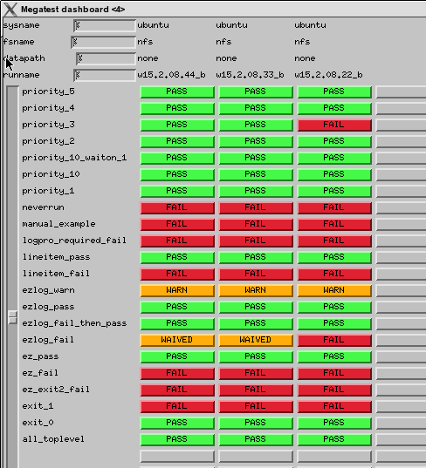
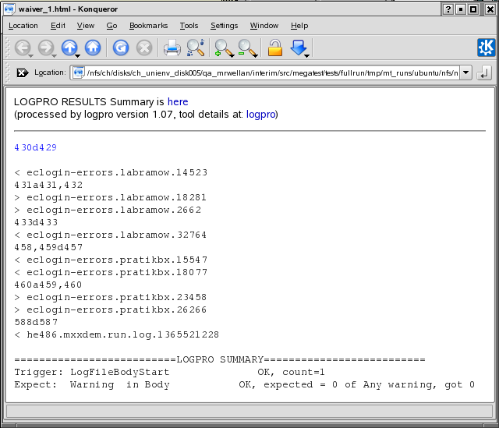
Waiver Propagation
This test failed and was manually
set to WAIVED in the next run
This test uses diff and logpro to
determine if ok to propagate WAIVED
The WAIVED status was propagated
because the criteria set in testconfig
were all met

Slide 46
Waiver Propagation
waiver name
waiver rule type
# logpro_file input_glob
# matching file(s) will be diff'd with previous run and logpro applied
# if PASS or WARN result from logpro then WAIVER state is set
#
[waivers]
waiver_1 logpro lookittmp.log
[waiver_rules]
# This builtin rule is the default if there is no <waivername>.logpro file
# diff diff %file1% %file2%
# This builtin rule is applied if a <waivername>.logpro file exists
# logpro diff %file1% %file2% | logpro %waivername%.logpro %waivername%.html
file to apply rule
example rules

Slide 47
Direct Access to Megatest Functions
-repl
  This will start a read-eval-print loop allowing you to directly call Megatest calls.
-load test.scm
  This will load the scheme source code and exectute it in the Megatest context.

Slide 48
New Features in v1.55
Task/Test search path
  organize your tests in different directories
  reuse tests from other flows
Automatic SKIP handling
  Crontab friendly runs (can overlap)
“itemmatch” mode
  iterated tests block only on previous same-named iteration

