Slide 1

SYSTEM USER MANUAL
Comprehensive Guide to System Modules, Functions, and Procedures
LGMED-iMMS
Local Government Monitoring and Evaluation Division - Information Management and Monitoring System
Department of the Interior and Local Government - Regional Office XIII - Caraga | Version 1.0 | 08 October 2026 | Build 3129cb5

Slide 2
Contents
1. Introduction and Purpose
2. Scope of the Manual
3. System Overview
4. System Requirements and Supported Browsers
5. Accessing the System
6. Logging In and Logging Out
7. User Interface Overview
8. Dashboard Guide
9. User Roles and Access Permissions
10. Module-by-Module Instructions
11. Common Tasks and Procedures
12. Notifications and Alerts
13. Data Validation and Error Handling
14. Frequently Asked Questions
15. Troubleshooting Guide
16. Security, Privacy, and Good Practices
17. Glossary of Terms
18. Appendices and Reference Materials
LGMED-iMMS System User Manual | DILG Regional Office XIII - Caraga | LGMED
2

Slide 3
1. Introduction and Purpose
LGMED-iMMS System User Manual | DILG Regional Office XIII - Caraga | LGMED
3

Slide 4
2. Scope of the Manual
LGMED-iMMS System User Manual | DILG Regional Office XIII - Caraga | LGMED
4

Slide 5
3. System Overview
LGMED-iMMS System User Manual | DILG Regional Office XIII - Caraga | LGMED
5

Slide 6
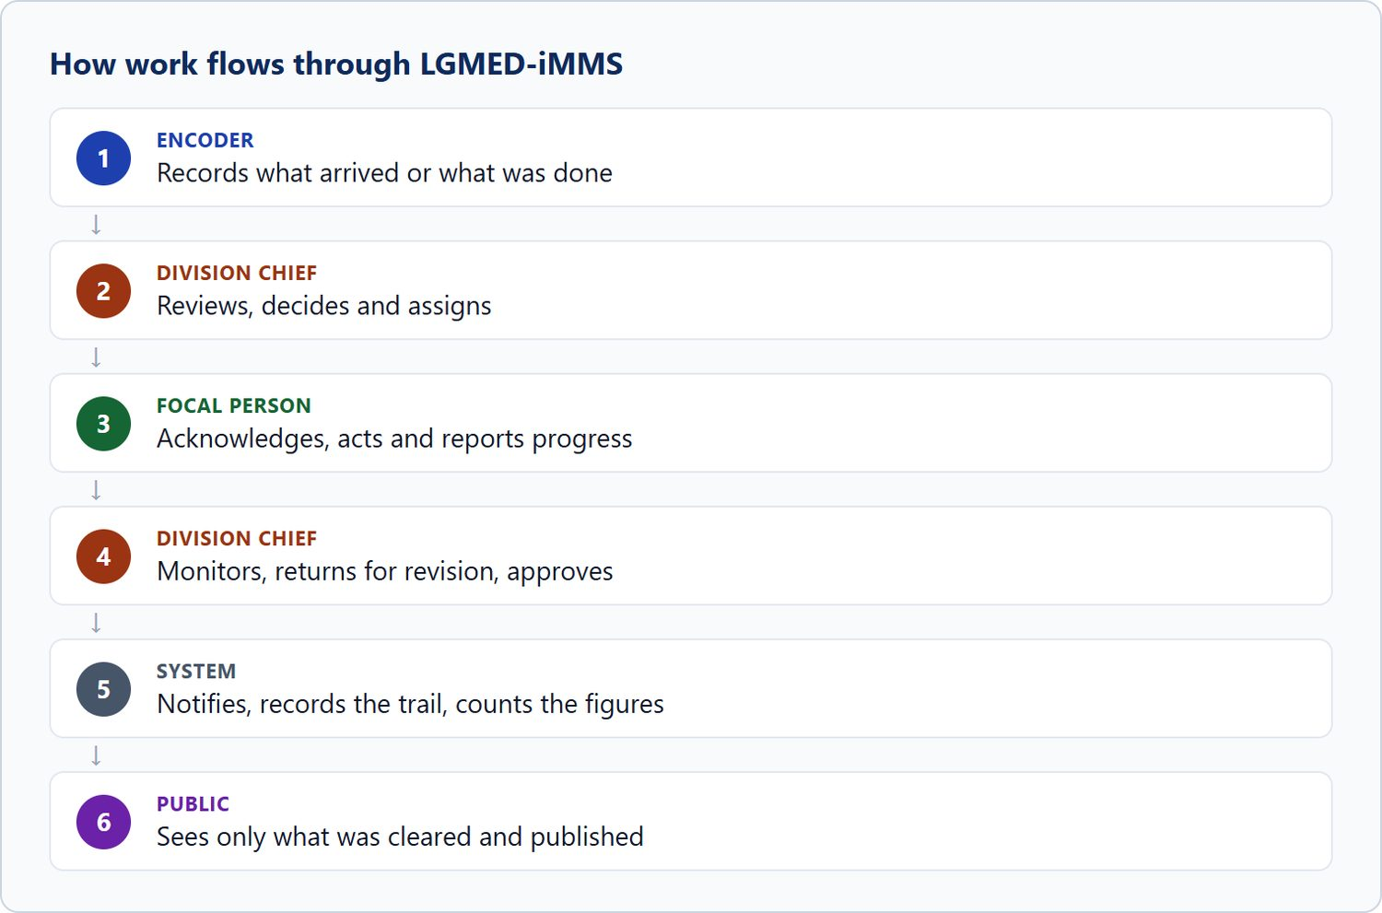
Figure 1. How work flows through LGMED-iMMS
LGMED-iMMS System User Manual | DILG Regional Office XIII - Caraga | LGMED
6

Slide 7
4. System Requirements and Supported Browsers
LGMED-iMMS System User Manual | DILG Regional Office XIII - Caraga | LGMED
7

Slide 8
5. Accessing the System
LGMED-iMMS System User Manual | DILG Regional Office XIII - Caraga | LGMED
8

Slide 9
6. Logging In and Logging Out
LGMED-iMMS System User Manual | DILG Regional Office XIII - Caraga | LGMED
9

Slide 10
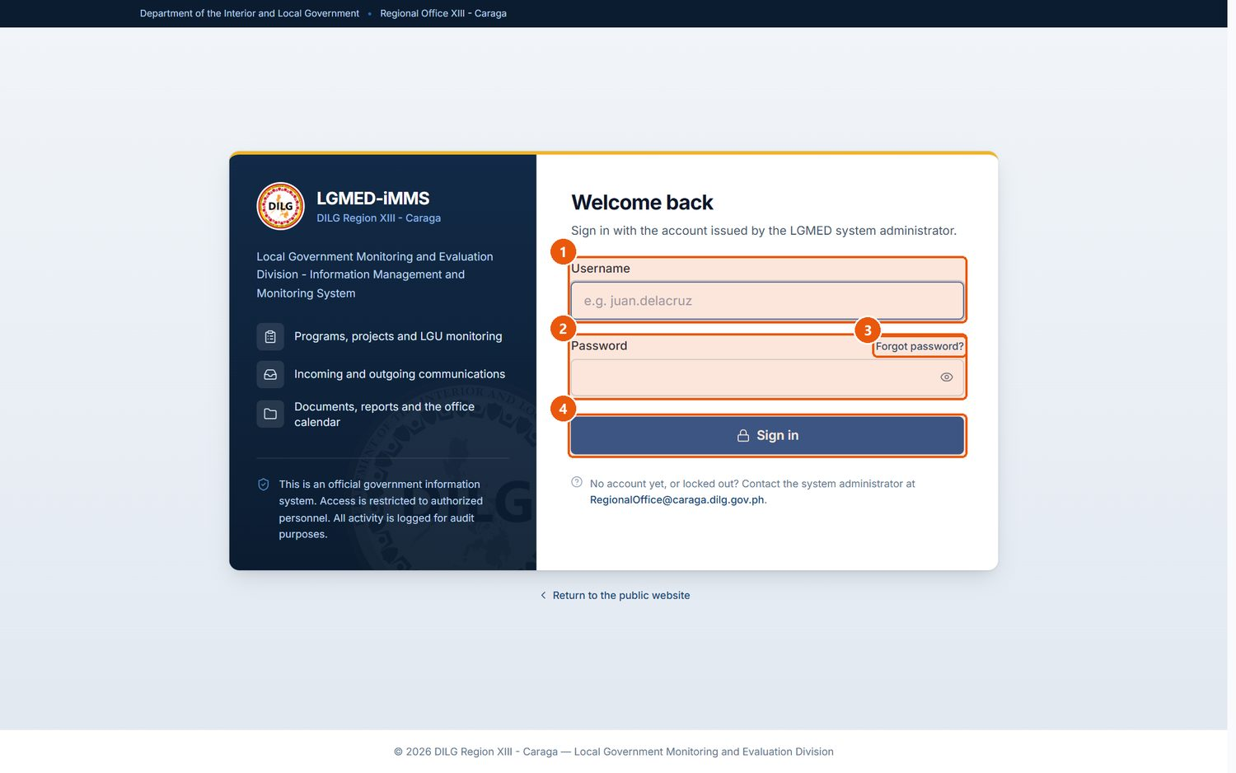
Figure 2. The staff sign-in page (/staff or /accounts/login/)
1
Username
The username issued by the system administrator.
2
Password
Your password. The eye button shows or hides what you typed; a warning appears if Caps Lock is on.
3
Forgot password?
Opens an e-mail to the office asking for a password reset. Passwords are reset by an administrator.
4
Sign in
Submits your username and password.
Signed in as: Public visitor
LGMED-iMMS System User Manual | DILG Regional Office XIII - Caraga | LGMED
10

Slide 11
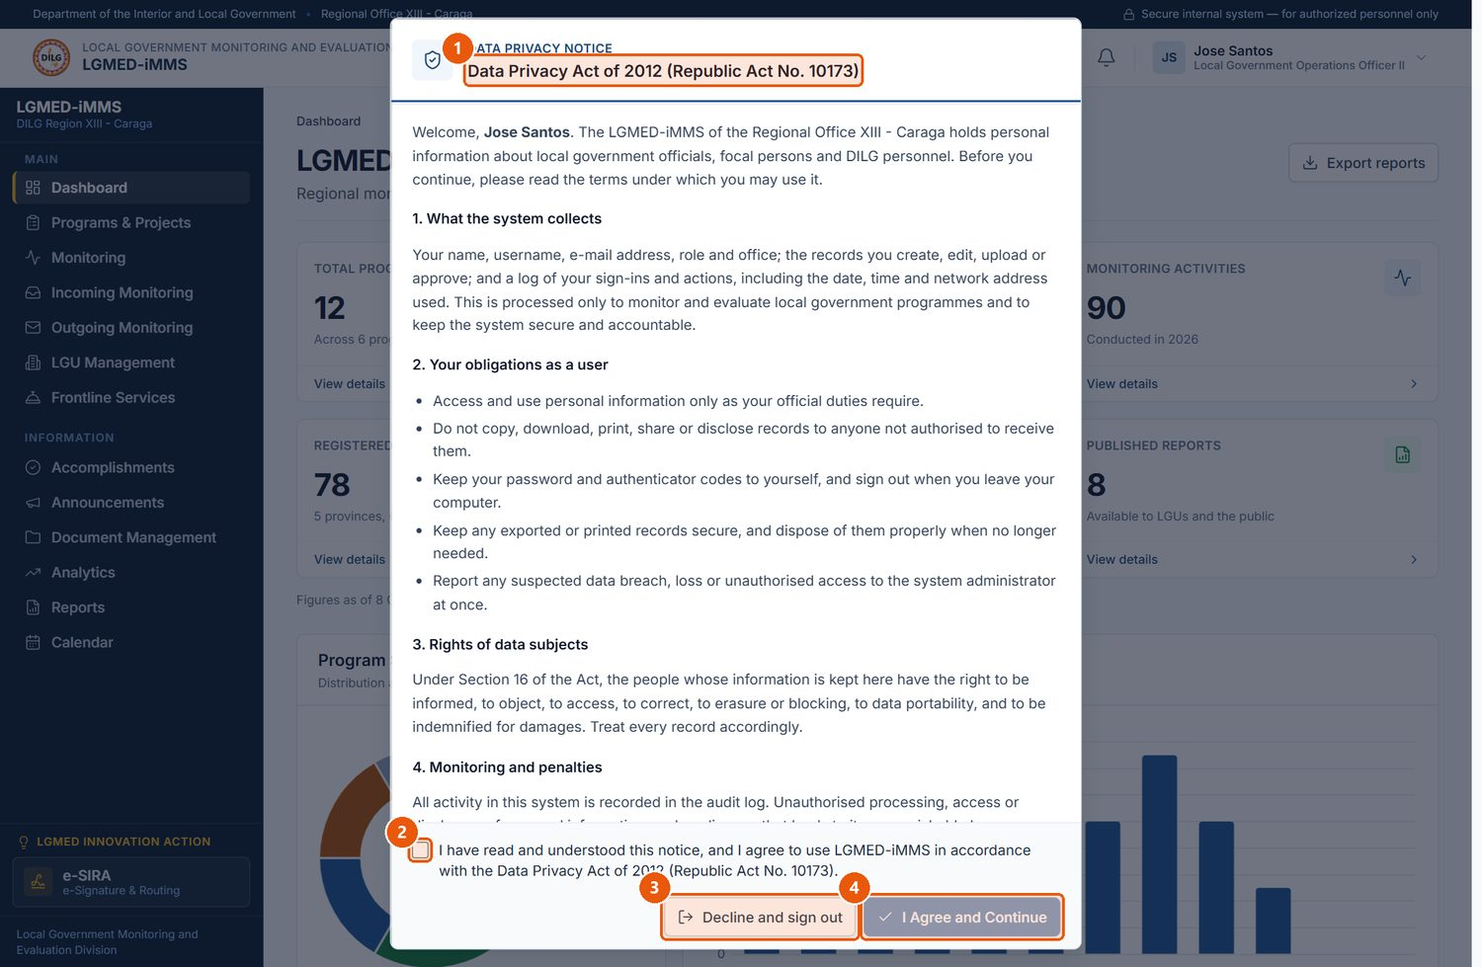
Figure 3. The Data Privacy Notice shown at first sign-in
1
Notice title
Data Privacy Act of 2012 (Republic Act No. 10173). Scroll to read all sections.
2
Agreement box
Tick to confirm you have read and agree to the notice.
3
Decline and sign out
Leaves the system without accepting. You cannot use LGMED-iMMS until you accept.
4
I Agree and Continue
Becomes available once the box is ticked; records your acceptance and opens the system.
Signed in as: Viewer
LGMED-iMMS System User Manual | DILG Regional Office XIII - Caraga | LGMED
11

Slide 12
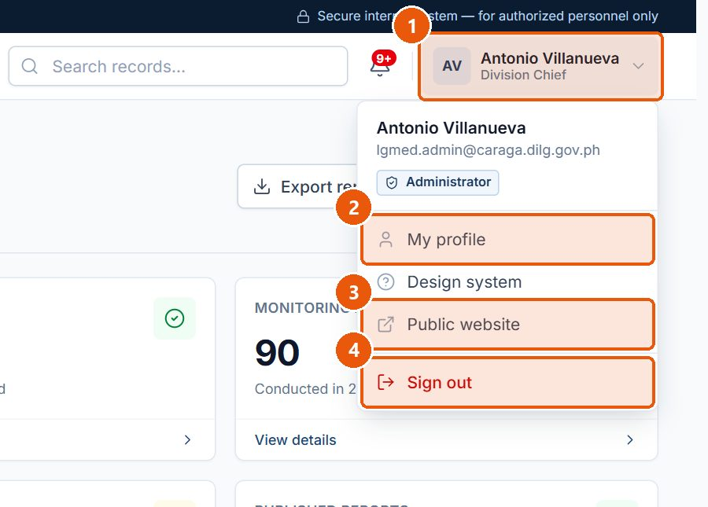
Figure 4. The account menu in the top bar
1
Account menu
Your name and position. Click to open or close the menu.
2
My profile
Your account details, profile photo, permissions and two-step verification.
3
Public website
Opens the public LGMED website.
4
Sign out
Ends your session. Always sign out on a shared computer.
Signed in as: Administrator (Division Chief)
LGMED-iMMS System User Manual | DILG Regional Office XIII - Caraga | LGMED
12

Slide 13
7. User Interface Overview
LGMED-iMMS System User Manual | DILG Regional Office XIII - Caraga | LGMED
13

Slide 14
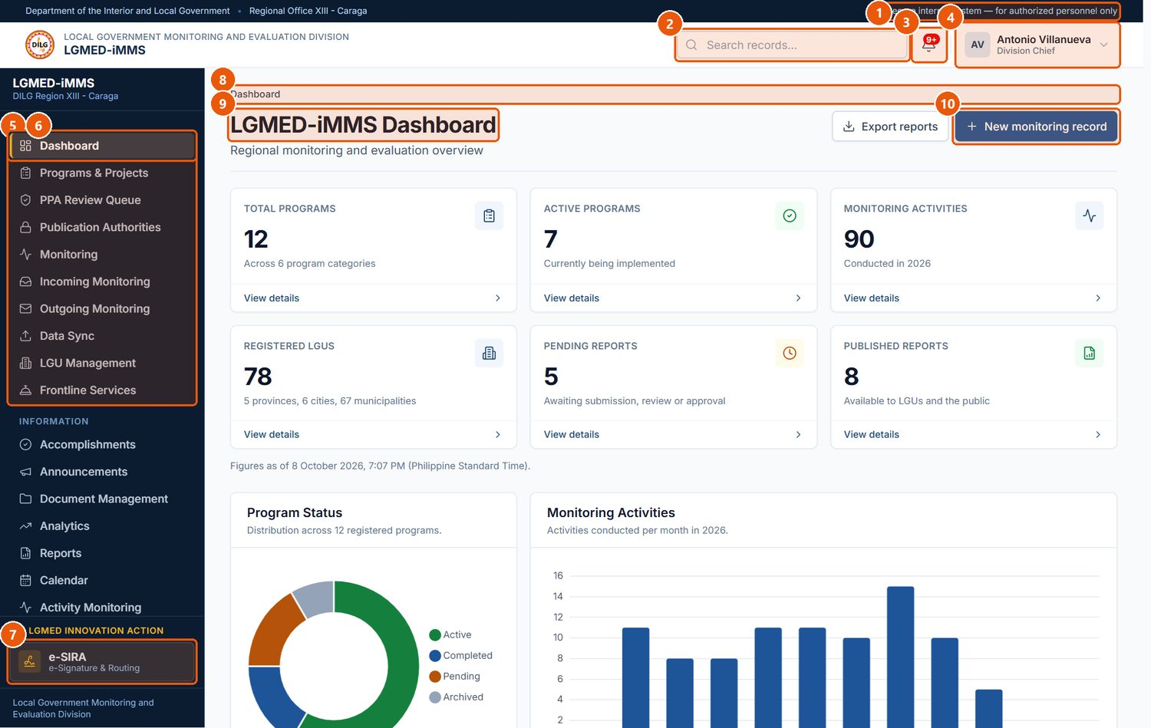
Figure 5. Parts of the LGMED-iMMS screen (Dashboard, signed in as the Division Chief)
1
System banner
Confirms you are in the secure internal system, for authorised personnel only.
2
Search records
Quick search box in the top bar.
3
Notifications bell
The red badge counts your unread notifications. Click to see the latest.
4
Account menu
Profile, public website and Sign out.
5
Sidebar - Main
Operational modules. You only see the modules your role and menu permissions allow.
6
Current page
The highlighted item shows where you are.
7
LGMED Innovation Action
e-SIRA, pinned at the foot of the sidebar.
8
Breadcrumb
The path to the current page. Click an earlier part to go back.
9
Page title
The name of the page, with a short description beneath it.
10
Page actions
The main actions for the page, at the top right.
Signed in as: Administrator (Division Chief)
LGMED-iMMS System User Manual | DILG Regional Office XIII - Caraga | LGMED
14

Slide 15
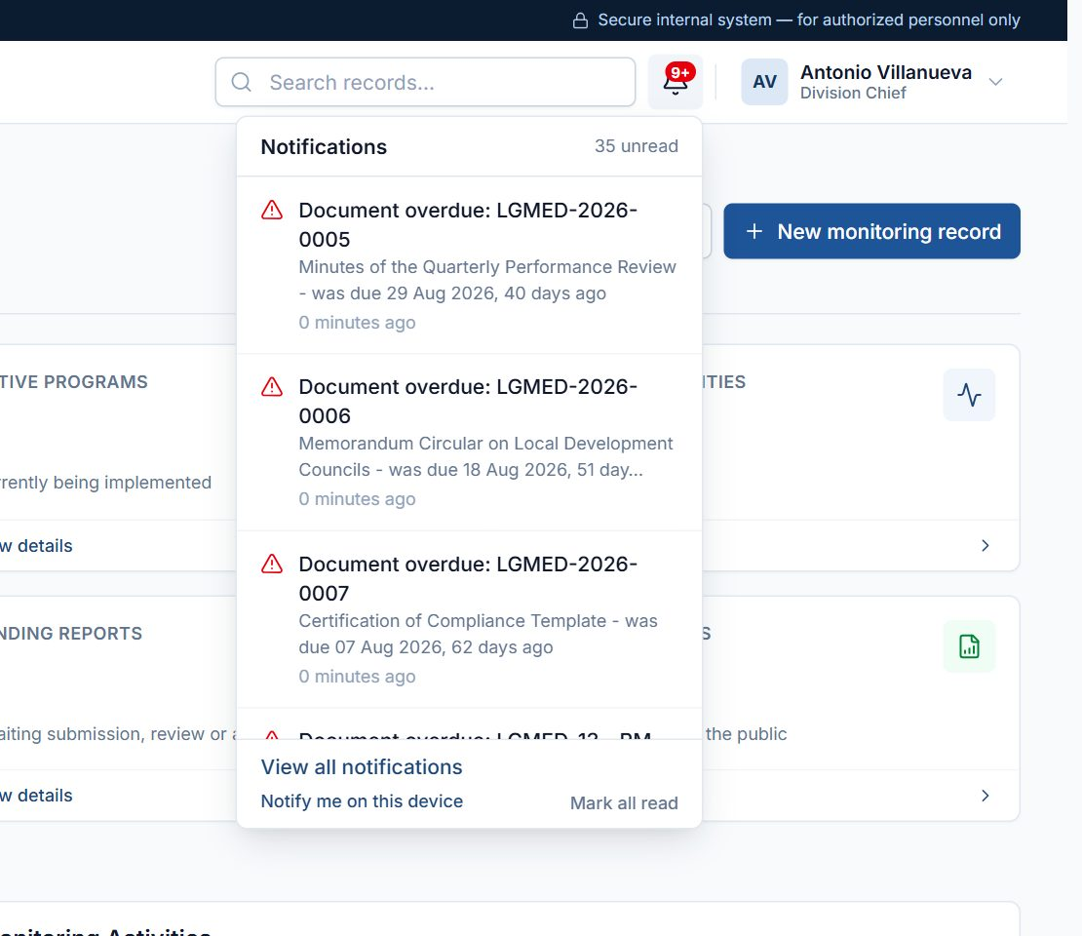
Figure 6. The notifications drop-down
Signed in as: Administrator (Division Chief)
LGMED-iMMS System User Manual | DILG Regional Office XIII - Caraga | LGMED
15

Slide 16
8. Dashboard Guide
LGMED-iMMS System User Manual | DILG Regional Office XIII - Caraga | LGMED
16

Slide 17
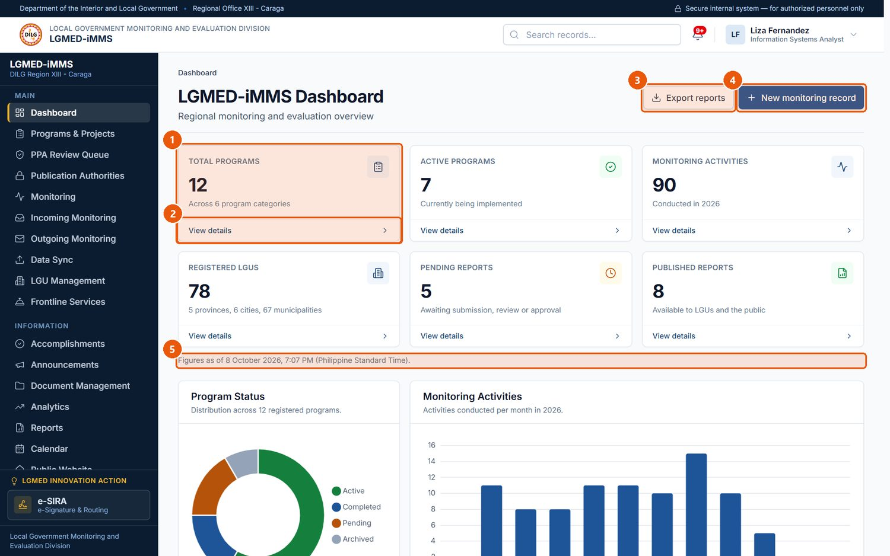
Figure 7. The Dashboard - summary figures
1
Summary figure
A headline count taken directly from the records.
2
View details
Opens the records behind the figure.
3
Export reports
Downloads the Reports register as a CSV file.
4
New monitoring record
Shortcut to record a monitoring activity (roles that may encode).
5
Time stamp
When the figures were calculated (Philippine Standard Time).
Signed in as: LGMED Staff
LGMED-iMMS System User Manual | DILG Regional Office XIII - Caraga | LGMED
17

Slide 18
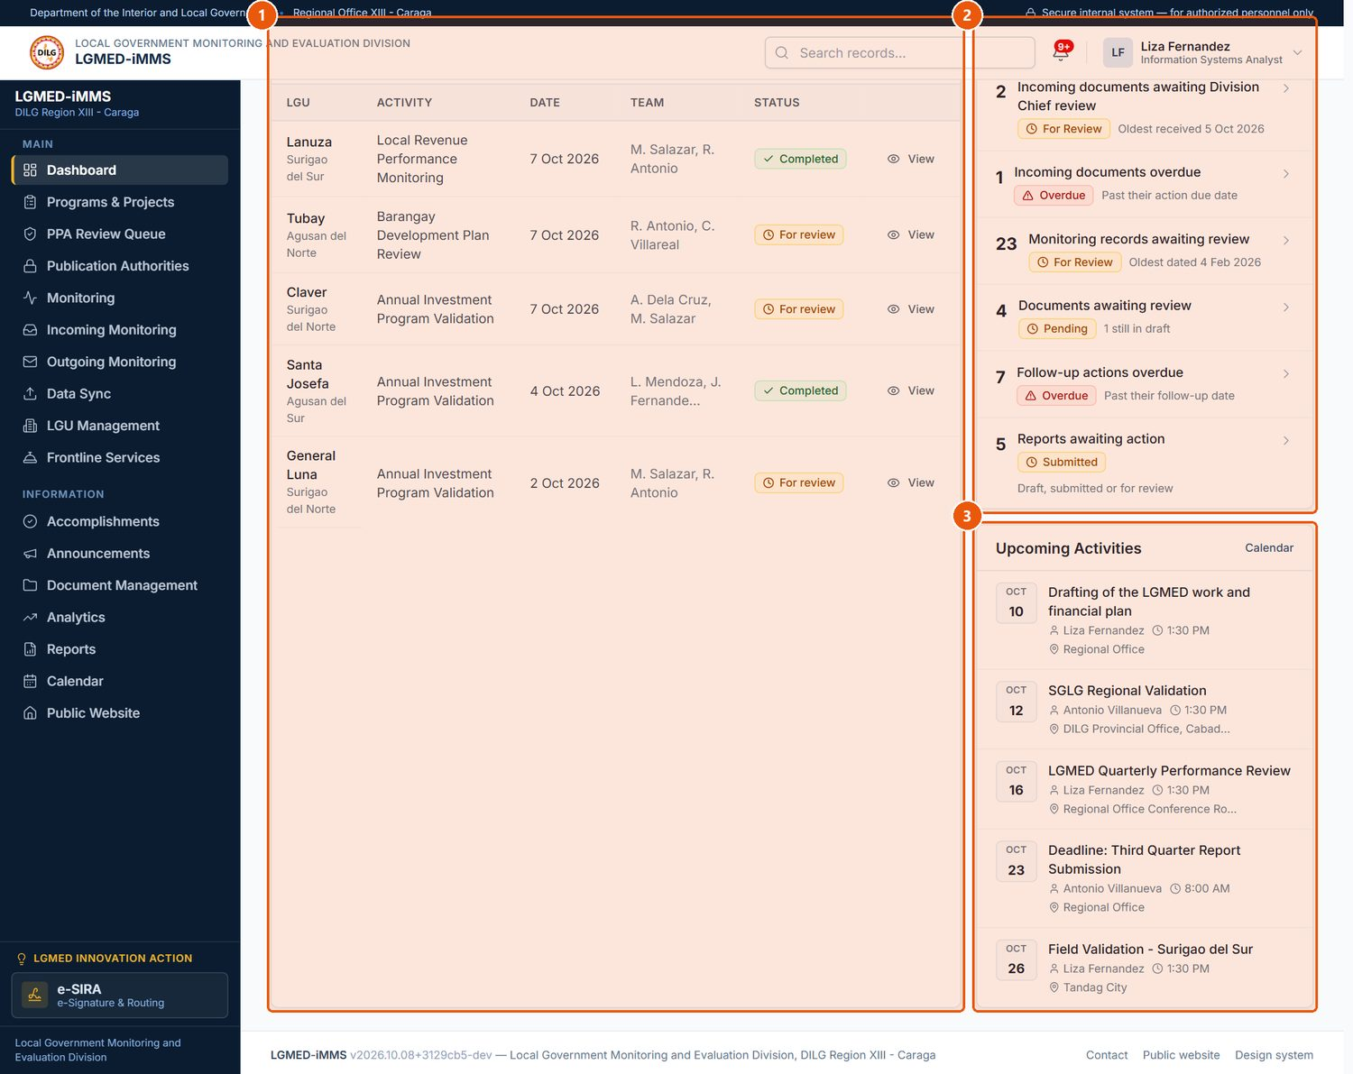
Figure 8. The Dashboard - recent activity and items requiring attention
1
Recent Monitoring Activities
The latest monitoring records; click an LGU or the eye icon to open one.
2
Requires Attention
Work waiting on the Division, such as documents awaiting review or overdue follow-ups. Each line opens the matching records.
3
Upcoming Activities
Calendar activities coming up that you are allowed to see.
Signed in as: LGMED Staff
LGMED-iMMS System User Manual | DILG Regional Office XIII - Caraga | LGMED
18

Slide 19
9. User Roles and Access Permissions
LGMED-iMMS System User Manual | DILG Regional Office XIII - Caraga | LGMED
19

Slide 20
10. Module-by-Module Instructions
LGMED-iMMS System User Manual | DILG Regional Office XIII - Caraga | LGMED
20

Slide 21
10.1 My Profile and Two-Step Verification
LGMED-iMMS System User Manual | DILG Regional Office XIII - Caraga | LGMED
21

Slide 22
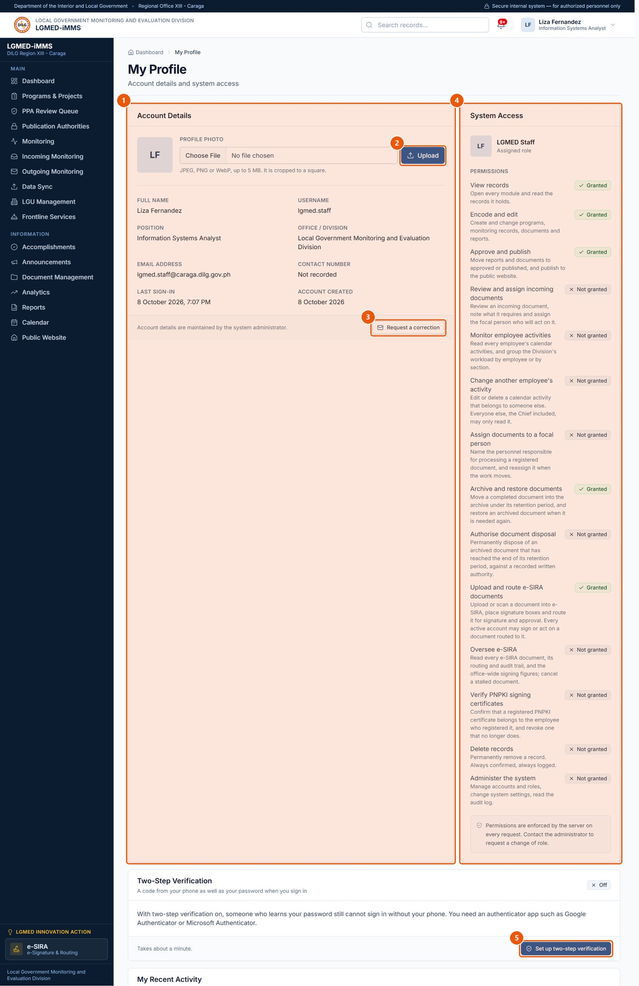
Figure 9. My Profile
1
Account Details
Your name, username, e-mail, position and office as recorded by the administrator.
2
Profile photo
Choose a JPEG, PNG or WebP picture (up to 5 MB) and click Upload.
3
Request a correction
Opens an e-mail to the office to correct your account details.
4
System Access
Your role and the permissions it carries.
5
Two-step verification
Protect your account with an authenticator app (required for administrators).
Signed in as: LGMED Staff
LGMED-iMMS System User Manual | DILG Regional Office XIII - Caraga | LGMED
22

Slide 23
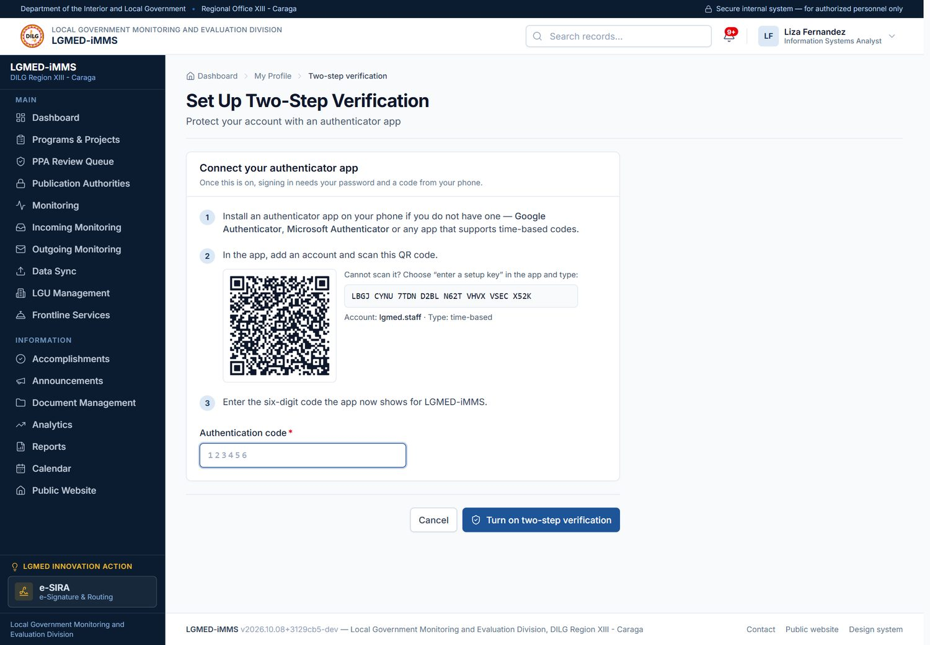
Figure 10. Setting up two-step verification
Signed in as: LGMED Staff
LGMED-iMMS System User Manual | DILG Regional Office XIII - Caraga | LGMED
23

Slide 24
10.2 Notifications
LGMED-iMMS System User Manual | DILG Regional Office XIII - Caraga | LGMED
24

Slide 25
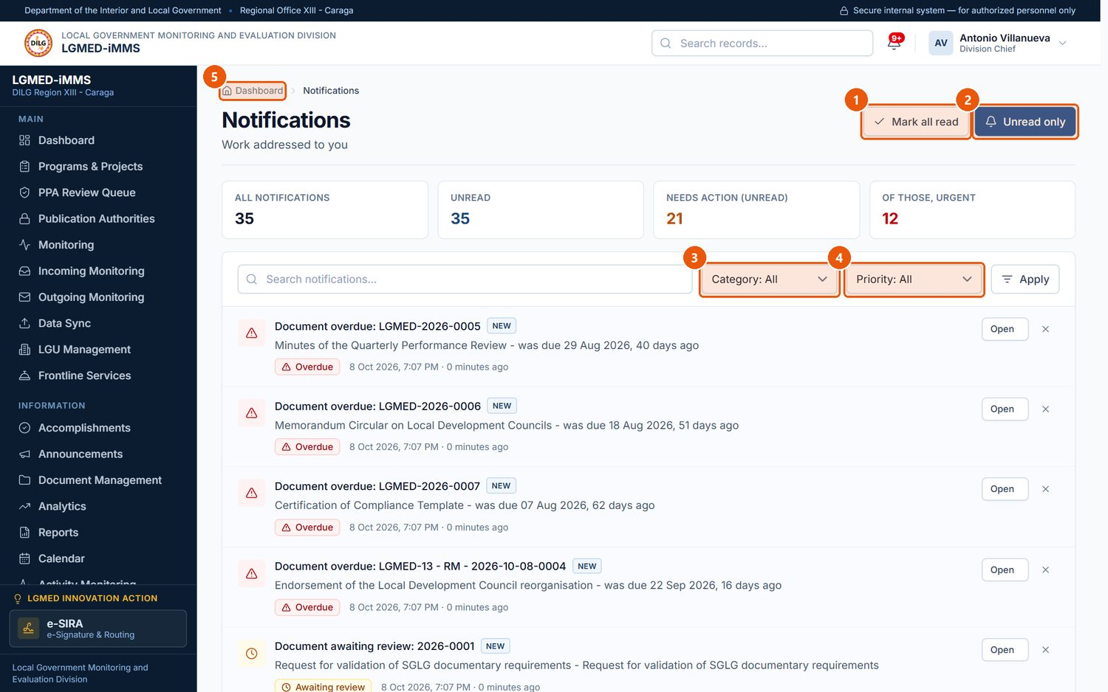
Figure 11. The Notifications page
1
Mark all read
Marks every notification as read.
2
Unread only
Shows only notifications you have not opened.
3
Category filter
Awaiting review, Overdue, Awaiting publication, Assigned to you, Account or System.
4
Priority filter
Information, Needs action or Urgent.
5
Notification
Click the title or Open to go to the record it concerns. Dismiss removes it from your list.
Signed in as: Administrator (Division Chief)
LGMED-iMMS System User Manual | DILG Regional Office XIII - Caraga | LGMED
25

Slide 26
10.3 Programs, Projects and Activities (PPAs)
LGMED-iMMS System User Manual | DILG Regional Office XIII - Caraga | LGMED
26

Slide 27
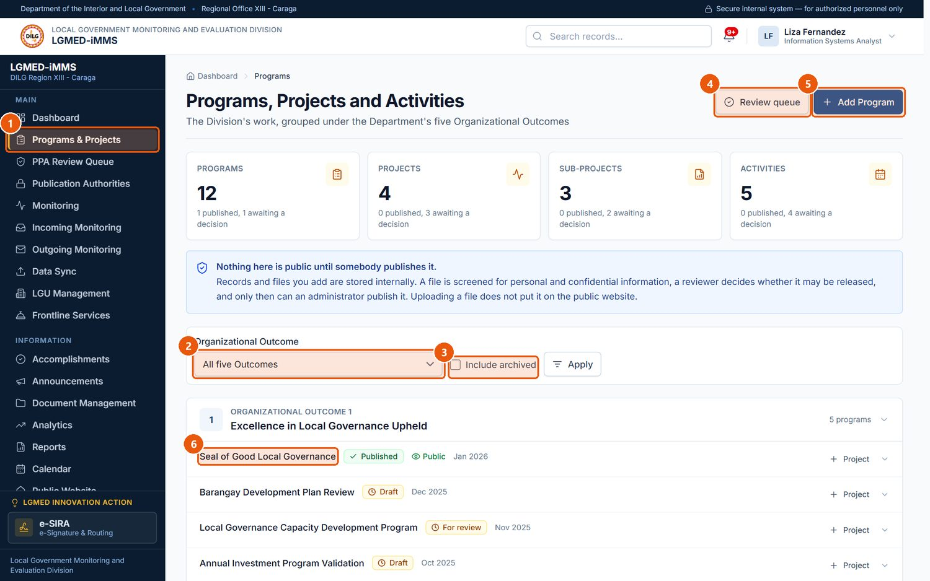
Figure 12. Programs, Projects and Activities - the workbench
1
Programs & Projects
Sidebar entry for the module.
2
Organizational Outcome
Shows the programmes under one of the Department's five outcomes, or all of them.
3
Include archived
Also lists archived records.
4
Review queue
Items waiting for review (reviewers only).
5
Add Program
Starts a new programme.
6
Programme
Click a title to open the record.
Signed in as: LGMED Staff
LGMED-iMMS System User Manual | DILG Regional Office XIII - Caraga | LGMED
27

Slide 28
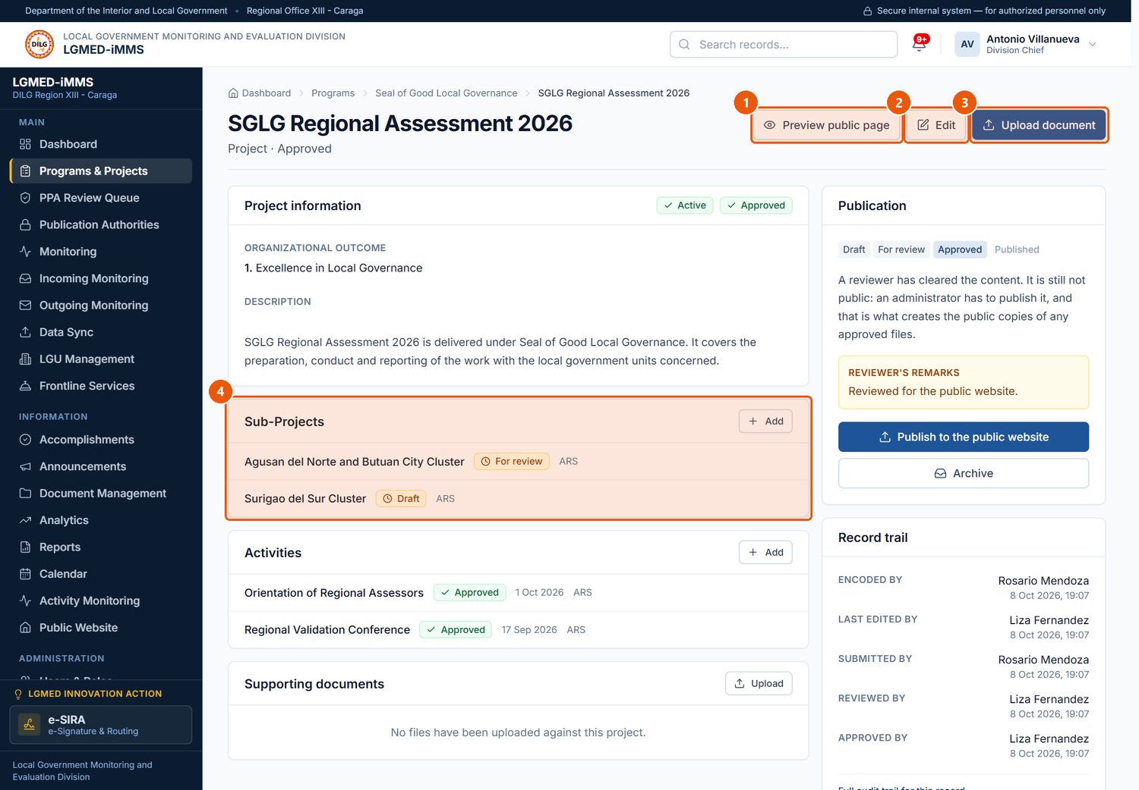
Figure 13. A project record (Administrator view)
1
Preview public page
Shows how the page will look on the public website.
2
Edit
Changes the record's details.
3
Upload document
Adds supporting files or photographs.
4
Sub-Projects / Activities
Records under this one. Add creates a new one.
Signed in as: Administrator (Division Chief)
LGMED-iMMS System User Manual | DILG Regional Office XIII - Caraga | LGMED
28

Slide 29
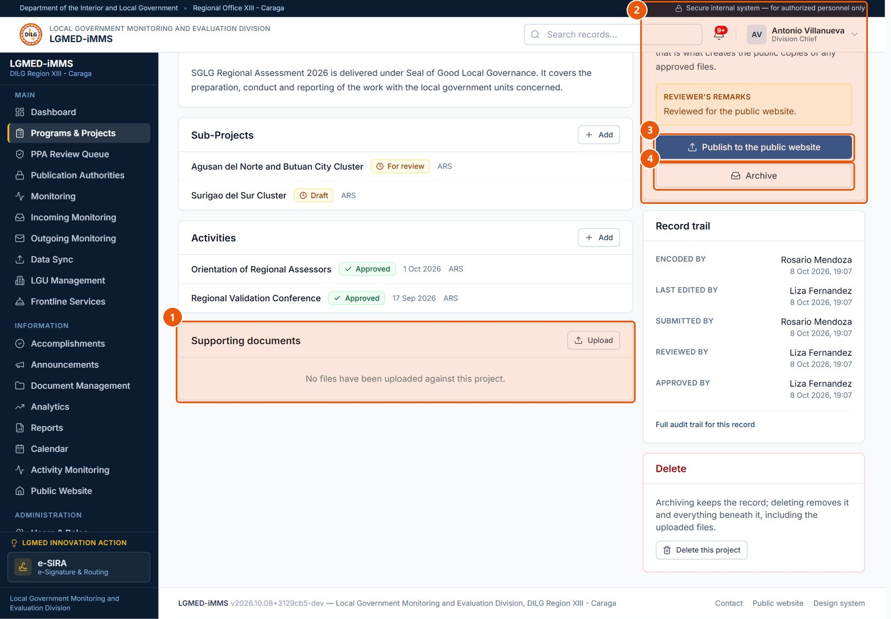
Figure 14. Supporting documents and the Publication panel
1
Supporting documents
Uploaded files with their screening result and review status.
2
Publication
Where the record stands: Draft, For review, Screening, Review required, Approved, Published, Unpublished, Archived.
3
Publish to the public website
Administrators only, once the content is approved.
4
Archive
Closes the record out; kept, not public.
Signed in as: Administrator (Division Chief)
LGMED-iMMS System User Manual | DILG Regional Office XIII - Caraga | LGMED
29

Slide 30
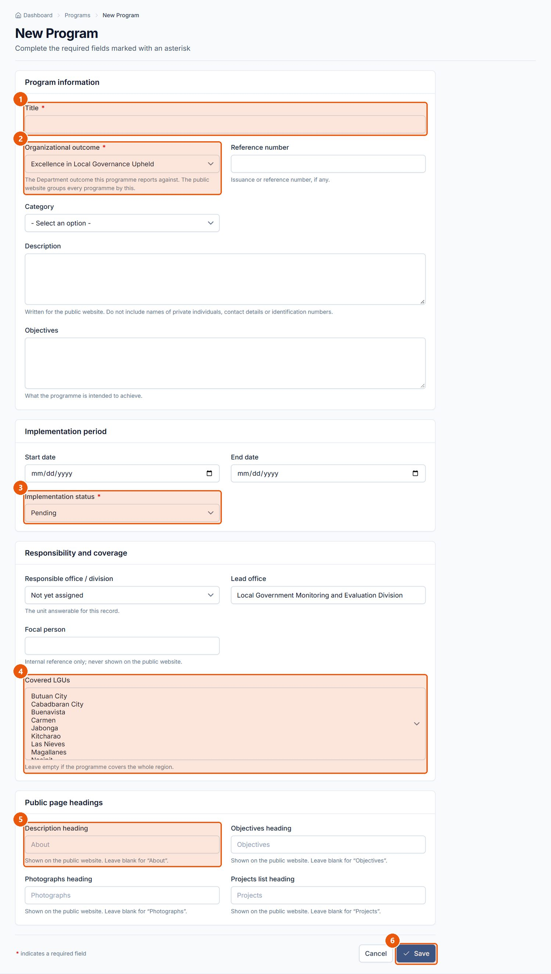
Figure 15. New Program form
1
Title
Required. The programme's name.
2
Organizational outcome
Required. Which of the five Department outcomes it serves.
3
Implementation status
Required. Pending, Active, Completed, Suspended or Archived.
4
Covered LGUs
Select the LGUs the programme covers.
5
Public page headings
Optional headings used on the public page.
6
Save
Saves the record as a Draft. Cancel returns without saving.
Signed in as: LGMED Staff
LGMED-iMMS System User Manual | DILG Regional Office XIII - Caraga | LGMED
30

Slide 31
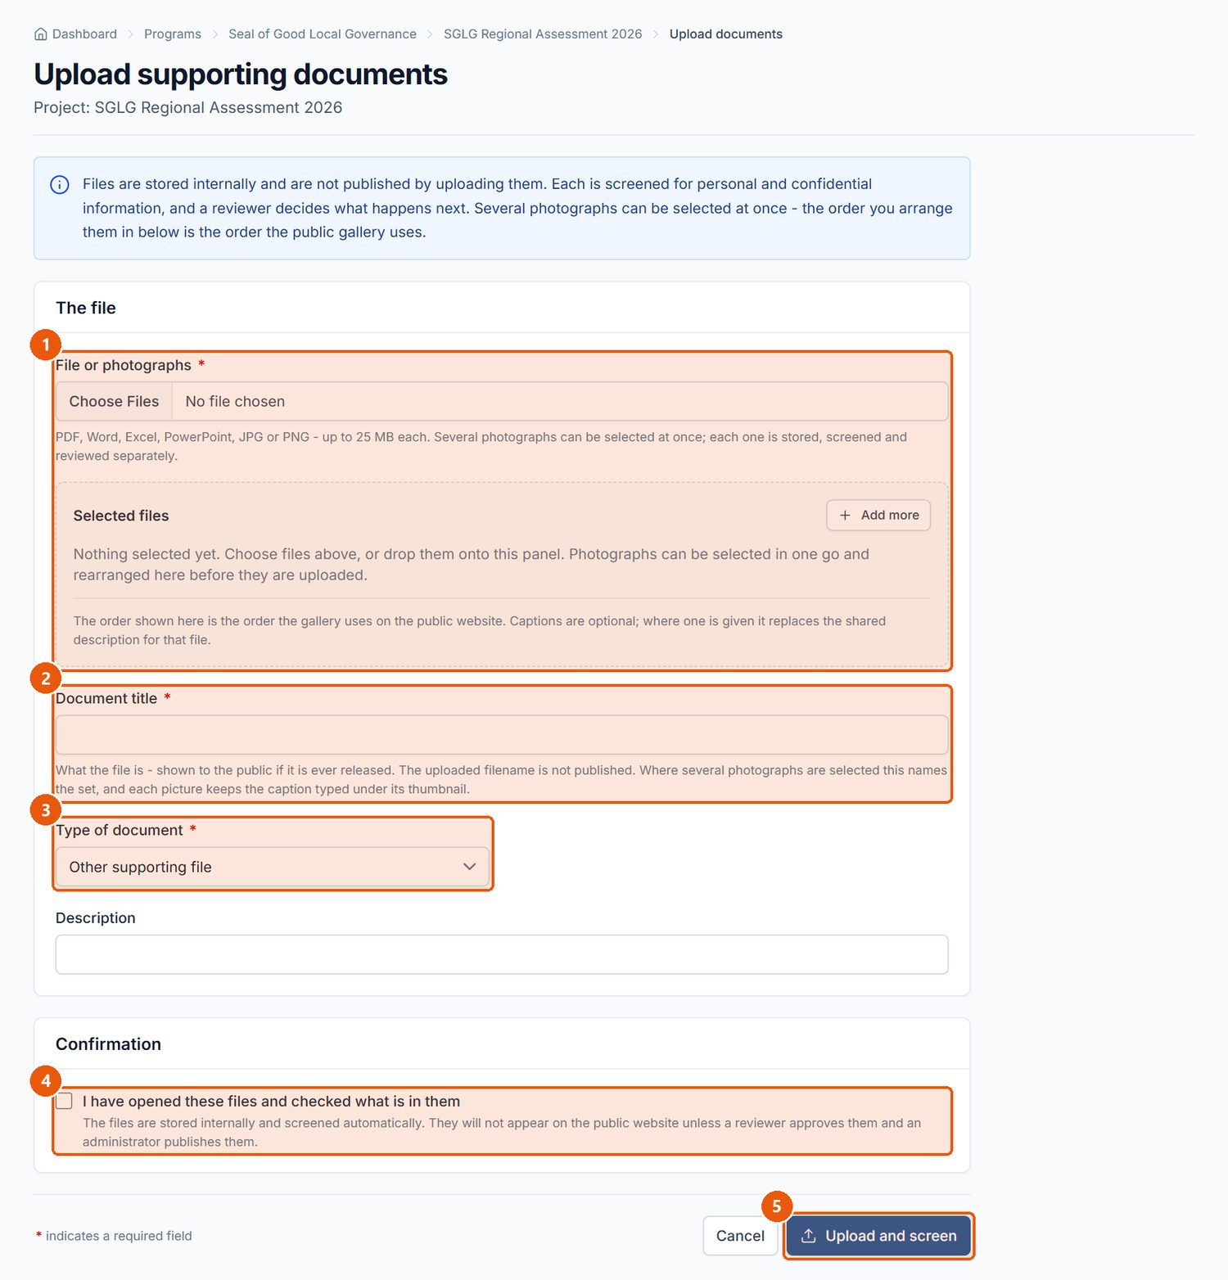
Figure 16. Upload supporting documents
1
File or photographs
Required. One file, or several photographs at once.
2
Document title
Required.
3
Type of document
Issuance, report, guidelines, presentation, photograph, certificate or other.
4
Confirmation
Required. Confirms you checked the file's contents before uploading.
5
Upload and screen
Uploads the file and runs the automated screening for personal or confidential information.
Signed in as: LGMED Staff
LGMED-iMMS System User Manual | DILG Regional Office XIII - Caraga | LGMED
31

Slide 32
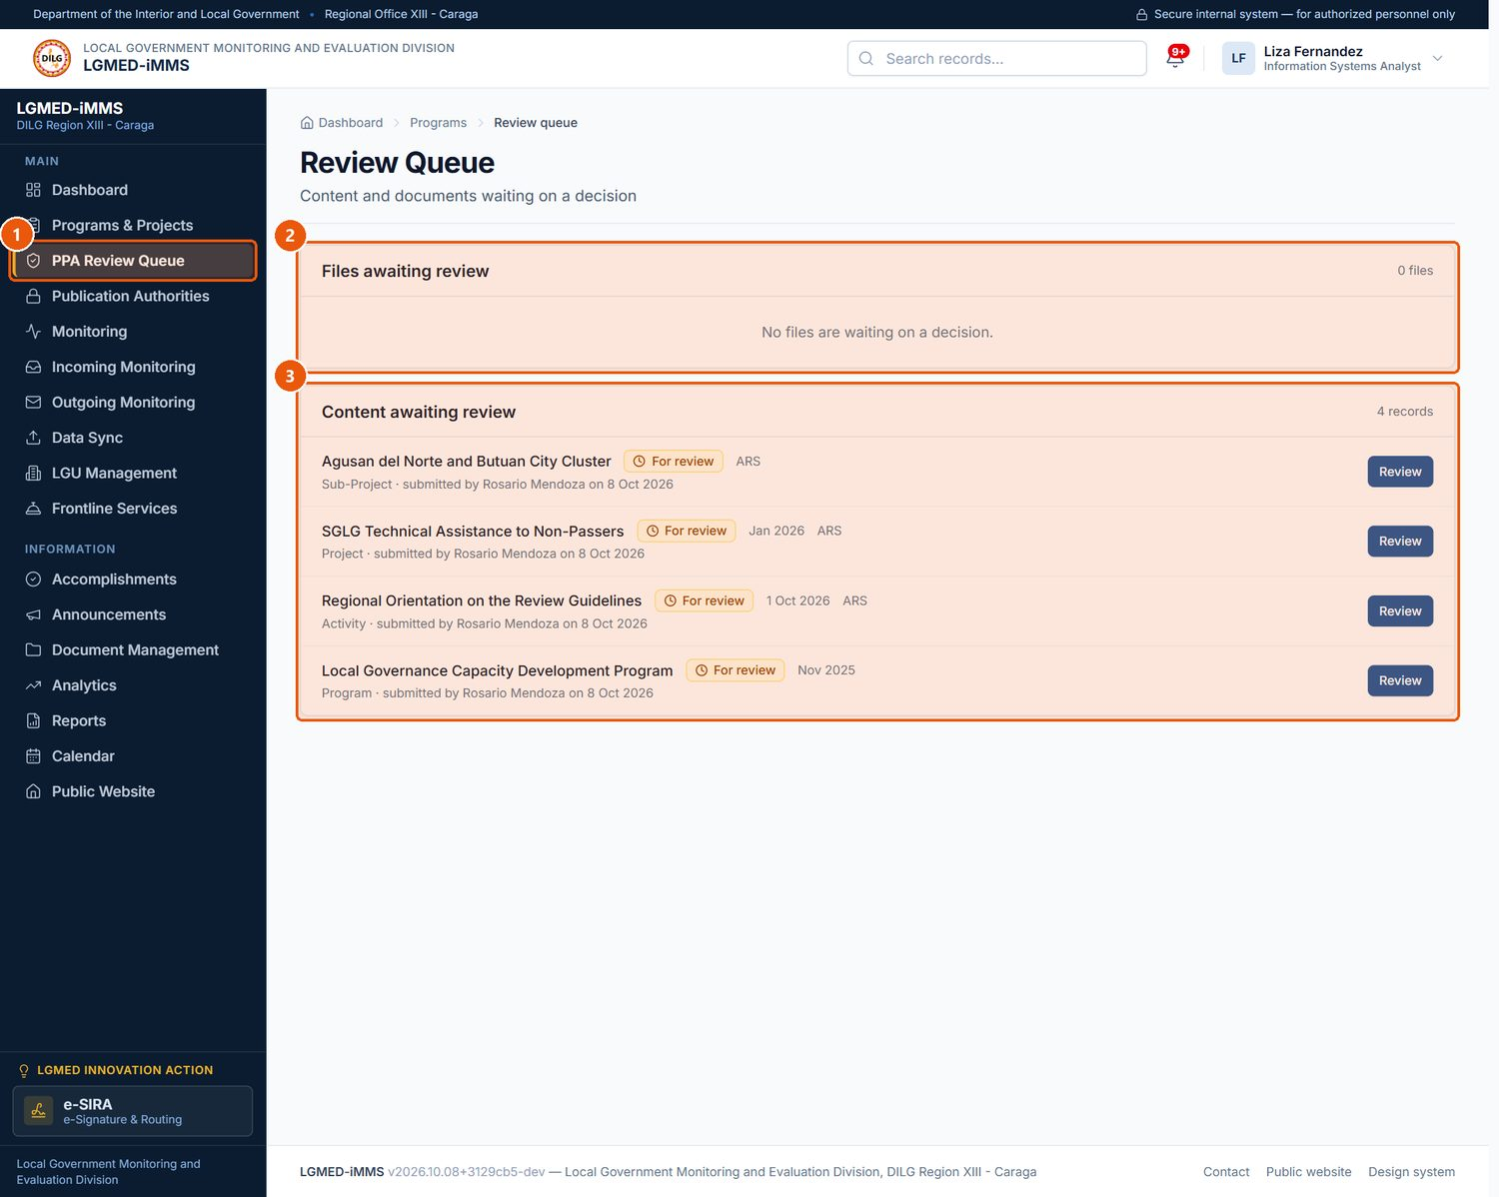
Figure 17. The PPA Review Queue
1
PPA Review Queue
Visible to LGMED Staff, the Division Chief and administrators.
2
Files awaiting review
Uploaded files whose screening needs a reviewer's decision.
3
Content awaiting review
Records submitted for review. Click Review to open one.
Signed in as: LGMED Staff
LGMED-iMMS System User Manual | DILG Regional Office XIII - Caraga | LGMED
32

Slide 33
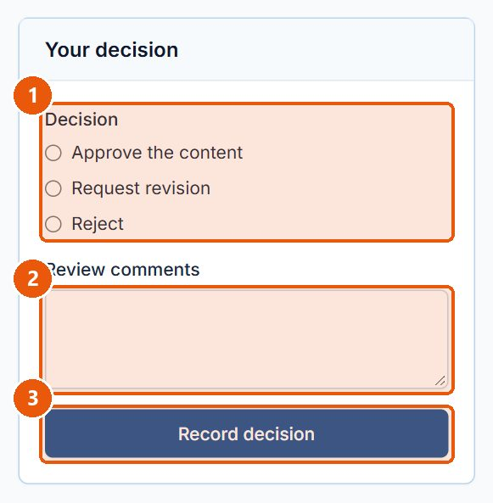
Figure 18. Recording a review decision on a submitted record
1
Decision
Approve the content, Request revision, or Reject.
2
Review comments
Required when requesting revision or rejecting, so the encoder knows what to change.
3
Record decision
Saves the decision; the record moves to Approved, back to Draft, or is rejected.
Signed in as: LGMED Staff
LGMED-iMMS System User Manual | DILG Regional Office XIII - Caraga | LGMED
33

Slide 34
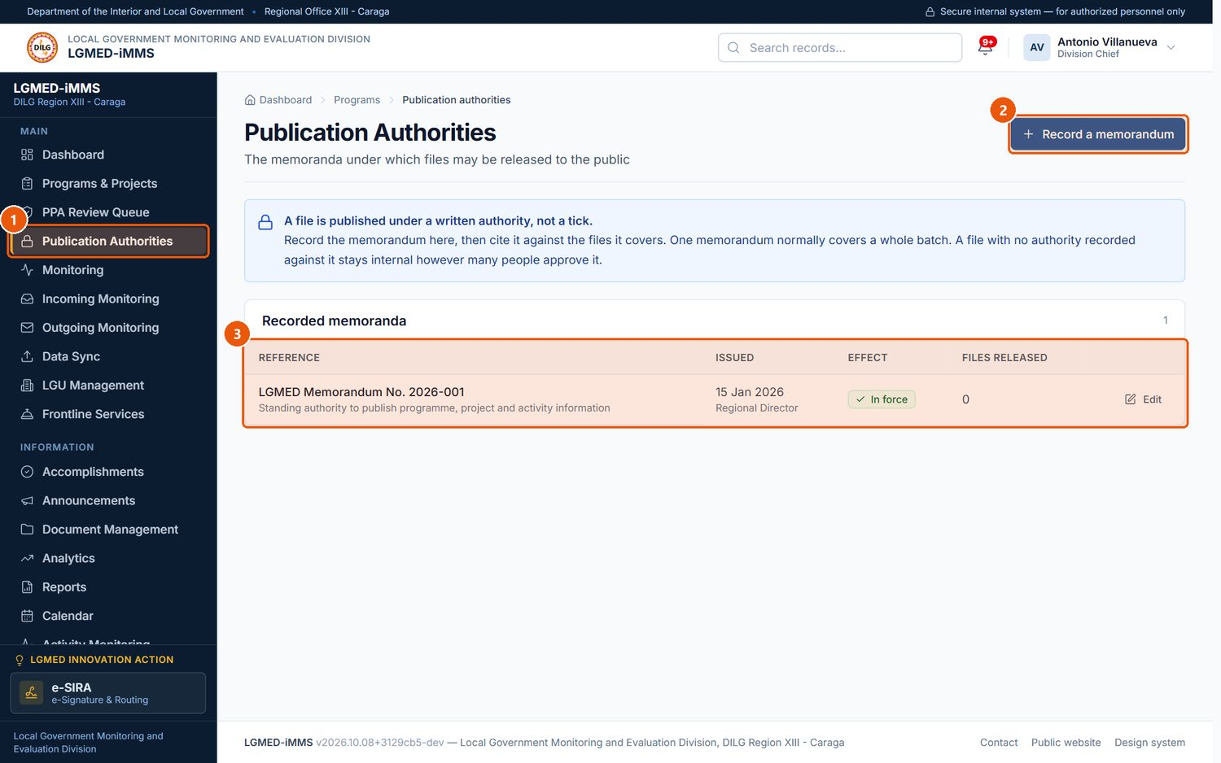
Figure 19. Publication Authorities
1
Publication Authorities
Memoranda that authorise releasing files to the public.
2
Record a memorandum
Records a new memorandum before any file is cited against it.
3
Recorded memoranda
Reference, date issued, whether it is in effect, and how many files it released.
Signed in as: Administrator (Division Chief)
LGMED-iMMS System User Manual | DILG Regional Office XIII - Caraga | LGMED
34

Slide 35
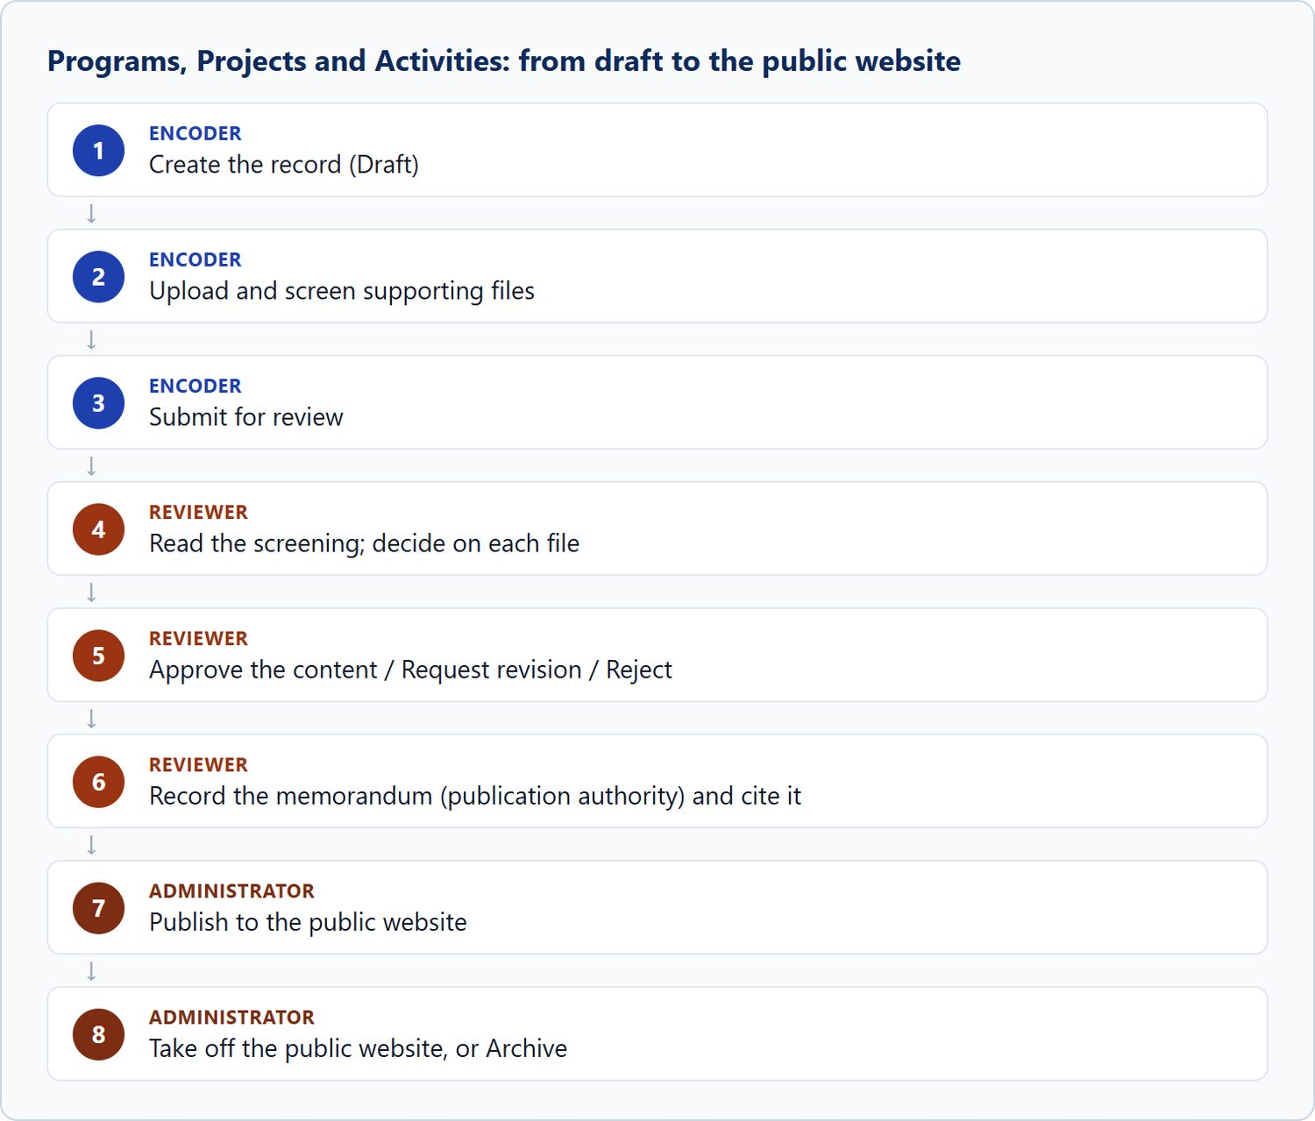
Figure 20. Programs, Projects and Activities: from draft to the public website
LGMED-iMMS System User Manual | DILG Regional Office XIII - Caraga | LGMED
35

Slide 36
10.4 Monitoring
LGMED-iMMS System User Manual | DILG Regional Office XIII - Caraga | LGMED
36

Slide 37
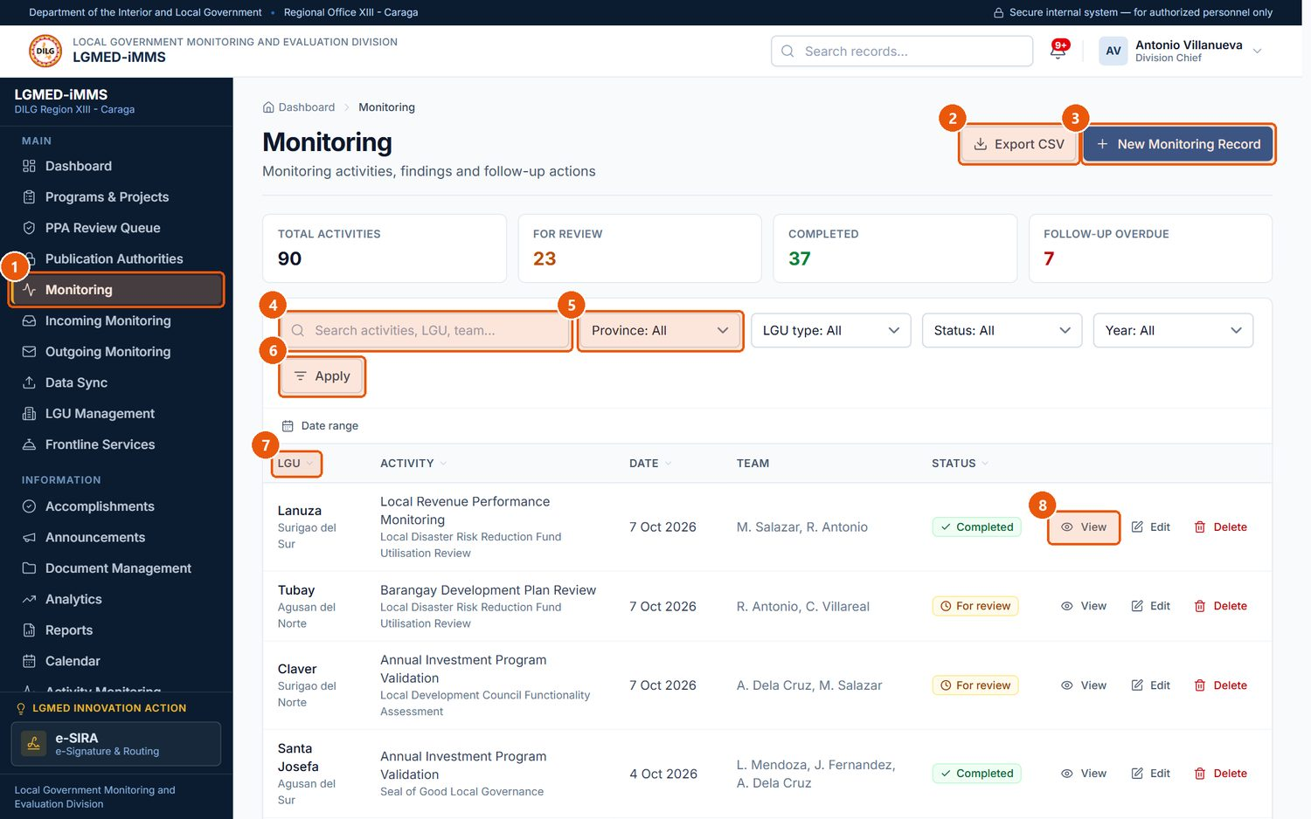
Figure 21. The Monitoring register
1
Monitoring
Sidebar entry.
2
Export CSV
Downloads the rows currently listed - with the search and filters applied - as a spreadsheet file. Every export is recorded in the audit trail.
3
New Monitoring Record
Records a monitoring activity.
4
Search box
Type part of a name, title, code or other text, then press Enter or click Apply.
5
Filters
Province, LGU type, Status and Year narrow the list.
6
Apply
Runs the search and filters.
7
Sortable heading
Click to sort by this column.
8
Row actions
View (eye), Edit (pencil) and Delete (bin) for that record. Only the actions your role permits are shown.
Signed in as: Administrator (Division Chief)
LGMED-iMMS System User Manual | DILG Regional Office XIII - Caraga | LGMED
37

Slide 38
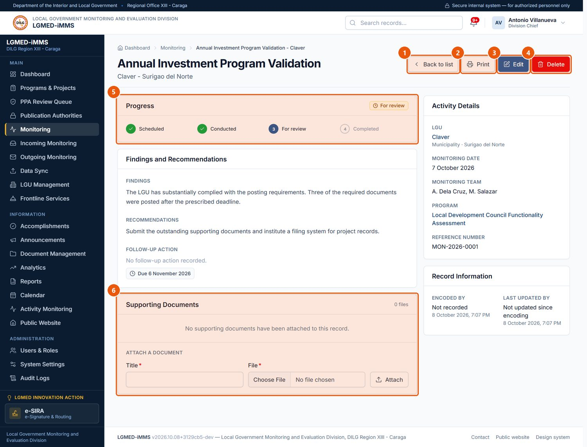
Figure 22. A monitoring record
1
Back to list
Returns to the register.
2
Print
Prints the record.
3
Edit
Changes the record.
4
Delete
Administrators only; asks for confirmation.
5
Progress
Where the record stands.
6
Supporting Documents
Attach files with a title and click Attach.
Signed in as: Administrator (Division Chief)
LGMED-iMMS System User Manual | DILG Regional Office XIII - Caraga | LGMED
38

Slide 39
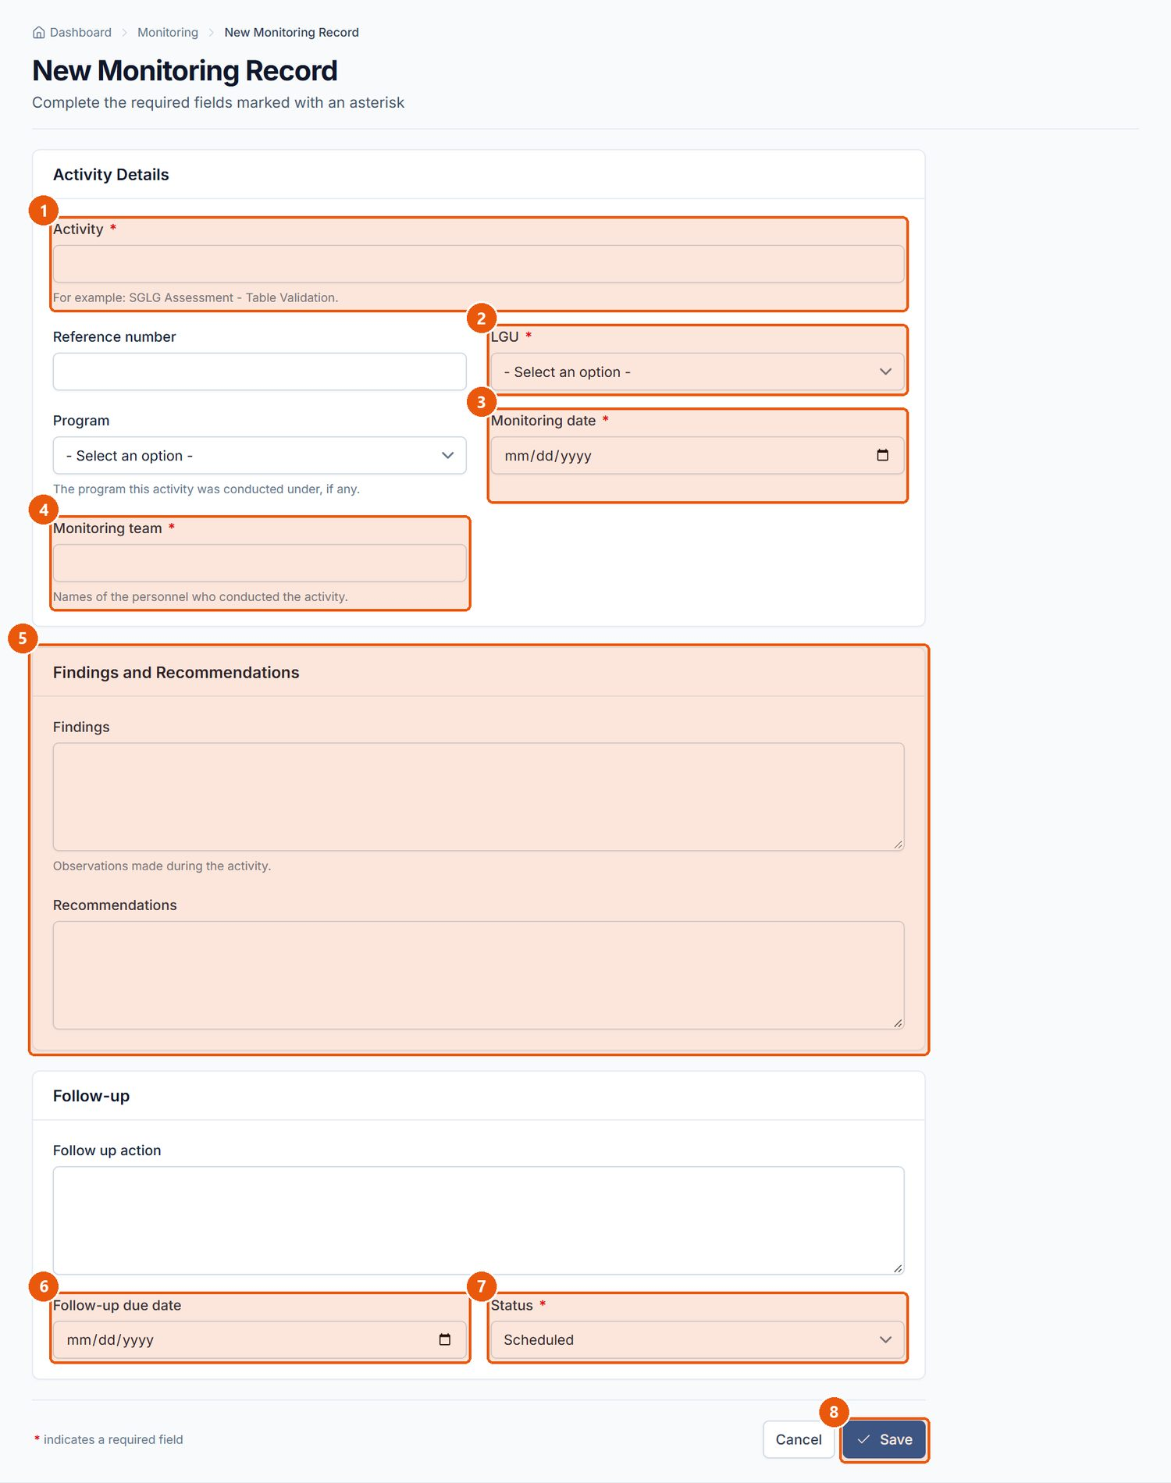
Figure 23. New Monitoring Record form
1
Activity
Required. What was monitored.
2
LGU
Required. The LGU monitored.
3
Monitoring date
Required.
4
Monitoring team
Required. Who conducted it.
5
Findings and Recommendations
What was found and what is recommended.
6
Follow-up due date
When the follow-up action falls due; overdue follow-ups raise notifications.
7
Status
Required. Scheduled, In progress, For review, Completed or Cancelled.
8
Save
Saves the record.
Signed in as: Encoder
LGMED-iMMS System User Manual | DILG Regional Office XIII - Caraga | LGMED
39

Slide 40
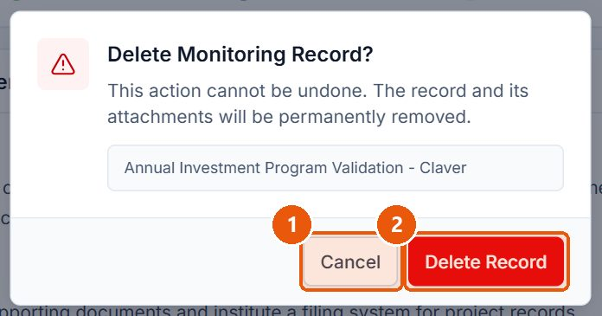
Figure 24. Every deletion asks for confirmation
1
Cancel
Closes the dialog; nothing is deleted.
2
Delete Record
Permanently deletes the record. This cannot be undone.
Signed in as: Administrator (Division Chief)
LGMED-iMMS System User Manual | DILG Regional Office XIII - Caraga | LGMED
40

Slide 41
10.5 Incoming Monitoring
LGMED-iMMS System User Manual | DILG Regional Office XIII - Caraga | LGMED
41

Slide 42
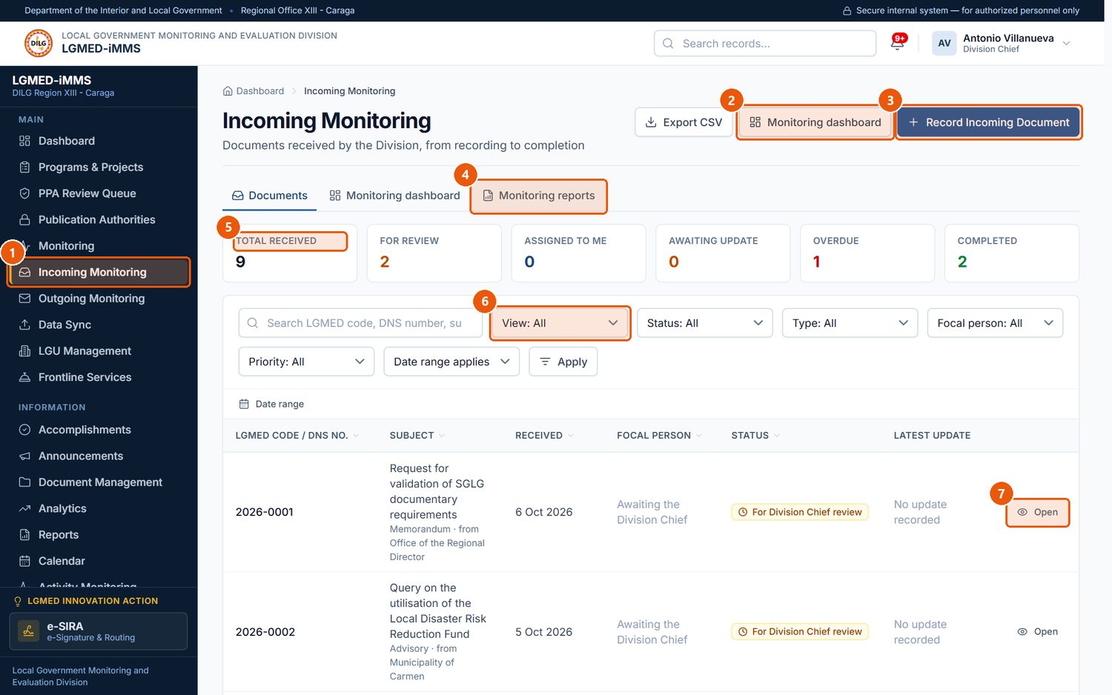
Figure 25. Incoming Monitoring - the documents register
1
Incoming Monitoring
Sidebar entry.
2
Monitoring dashboard
The Division Chief's overview (Administrators).
3
Record Incoming Document
Records a newly received document.
4
Tabs
Documents, Monitoring dashboard and Monitoring reports.
5
Status figures
Totals by status; overdue items are shown in red.
6
View
Quick lists such as Assigned to me, For Division Chief review, Awaiting acknowledgement, Overdue.
7
Open
Opens the document's record.
Signed in as: Administrator (Division Chief)
LGMED-iMMS System User Manual | DILG Regional Office XIII - Caraga | LGMED
42

Slide 43
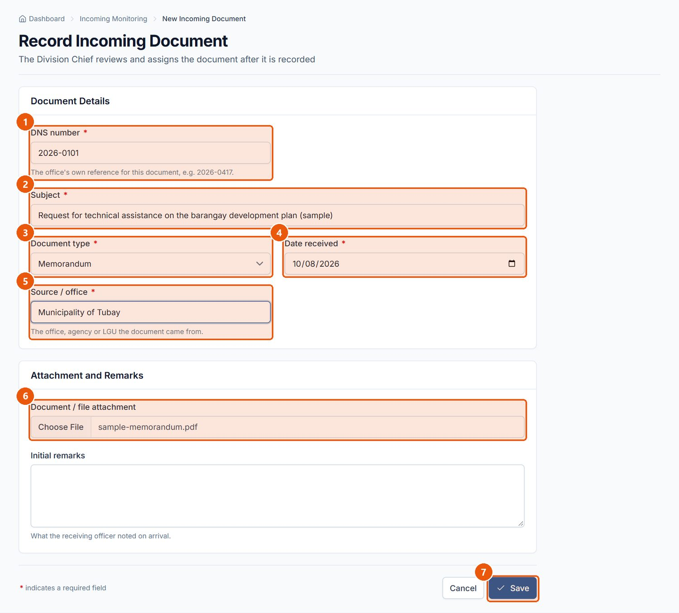
Figure 26. Recording an incoming document (Encoder)
1
DNS number
Required. The document's number in the Document Numbering System.
2
Subject
Required.
3
Document type
Required.
4
Date received
Required. Defaults to today.
5
Source / office
Required. Who sent it.
6
Attachment
The scanned document (optional).
7
Save
Records the document. It starts at For Division Chief review with no focal person.
Signed in as: Encoder
LGMED-iMMS System User Manual | DILG Regional Office XIII - Caraga | LGMED
43

Slide 44
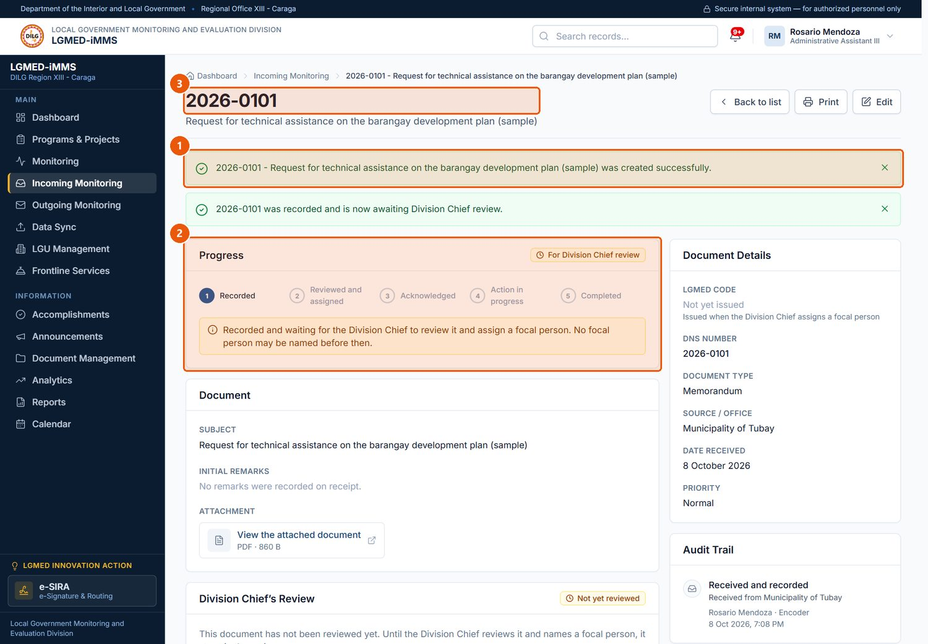
Figure 27. The new record, awaiting the Division Chief's review
1
Confirmation
Confirms the document was recorded.
2
Progress
Shows each stage; the current one is highlighted.
3
LGMED code
The record's identifier.
Signed in as: Encoder
LGMED-iMMS System User Manual | DILG Regional Office XIII - Caraga | LGMED
44

Slide 45
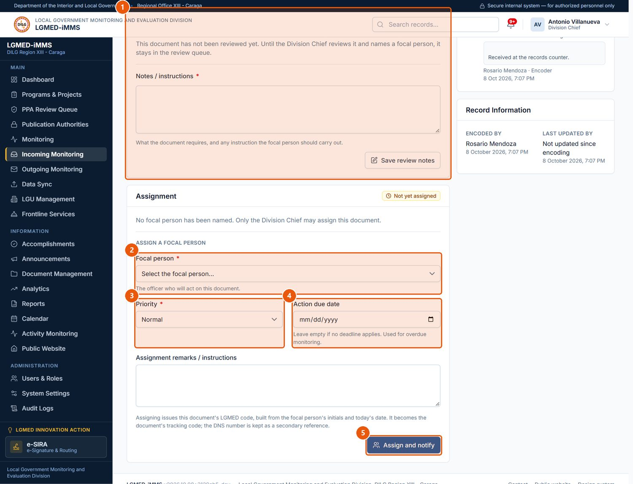
Figure 28. The Division Chief's review and assignment (Administrator)
1
Division Chief's Review
Notes or instructions on what the document requires. Save review notes records them.
2
Focal person
Required. The officer who will act on the document.
3
Priority
Low, Normal, High or Urgent.
4
Action due date
When action is due; the document becomes overdue after this date.
5
Assign and notify
Assigns the document and notifies the focal person.
Signed in as: Administrator (Division Chief)
LGMED-iMMS System User Manual | DILG Regional Office XIII - Caraga | LGMED
45

Slide 46
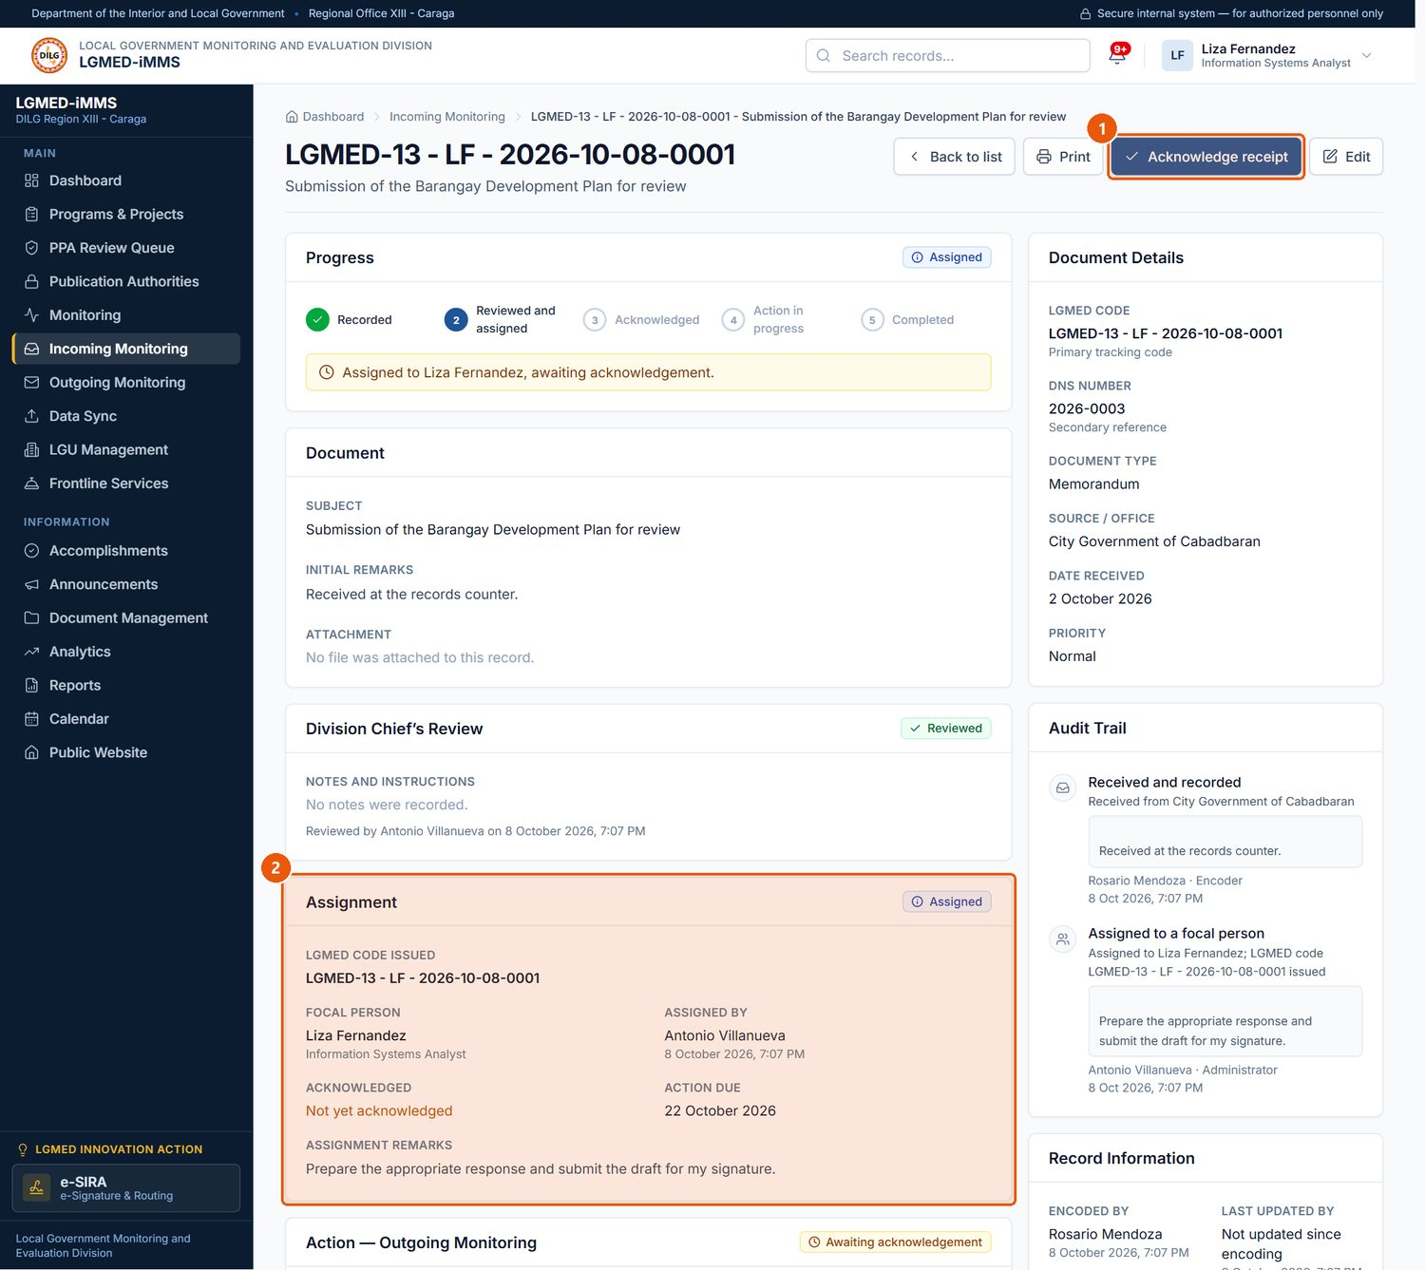
Figure 29. The focal person acknowledges the assignment (LGMED Staff)
1
Acknowledge receipt
Confirms you received the assignment. The document then continues in Outgoing Monitoring under its LGMED code.
2
Assignment
Who assigned it, when, the priority, due date and the Chief's instructions.
Signed in as: LGMED Staff
LGMED-iMMS System User Manual | DILG Regional Office XIII - Caraga | LGMED
46

Slide 47
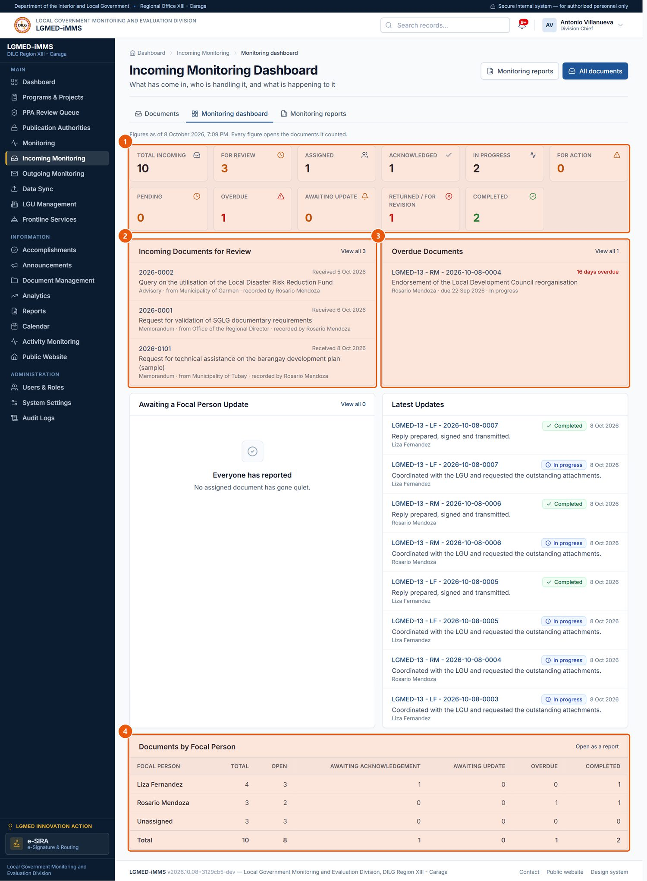
Figure 30. Incoming Monitoring Dashboard (Administrators)
1
Figures
Every figure is a link to the documents it counts.
2
For Review
Documents still waiting for the Chief.
3
Overdue Documents
Past their action due date and not completed.
4
Documents by Focal Person
Workload per officer.
Signed in as: Administrator (Division Chief)
LGMED-iMMS System User Manual | DILG Regional Office XIII - Caraga | LGMED
47

Slide 48
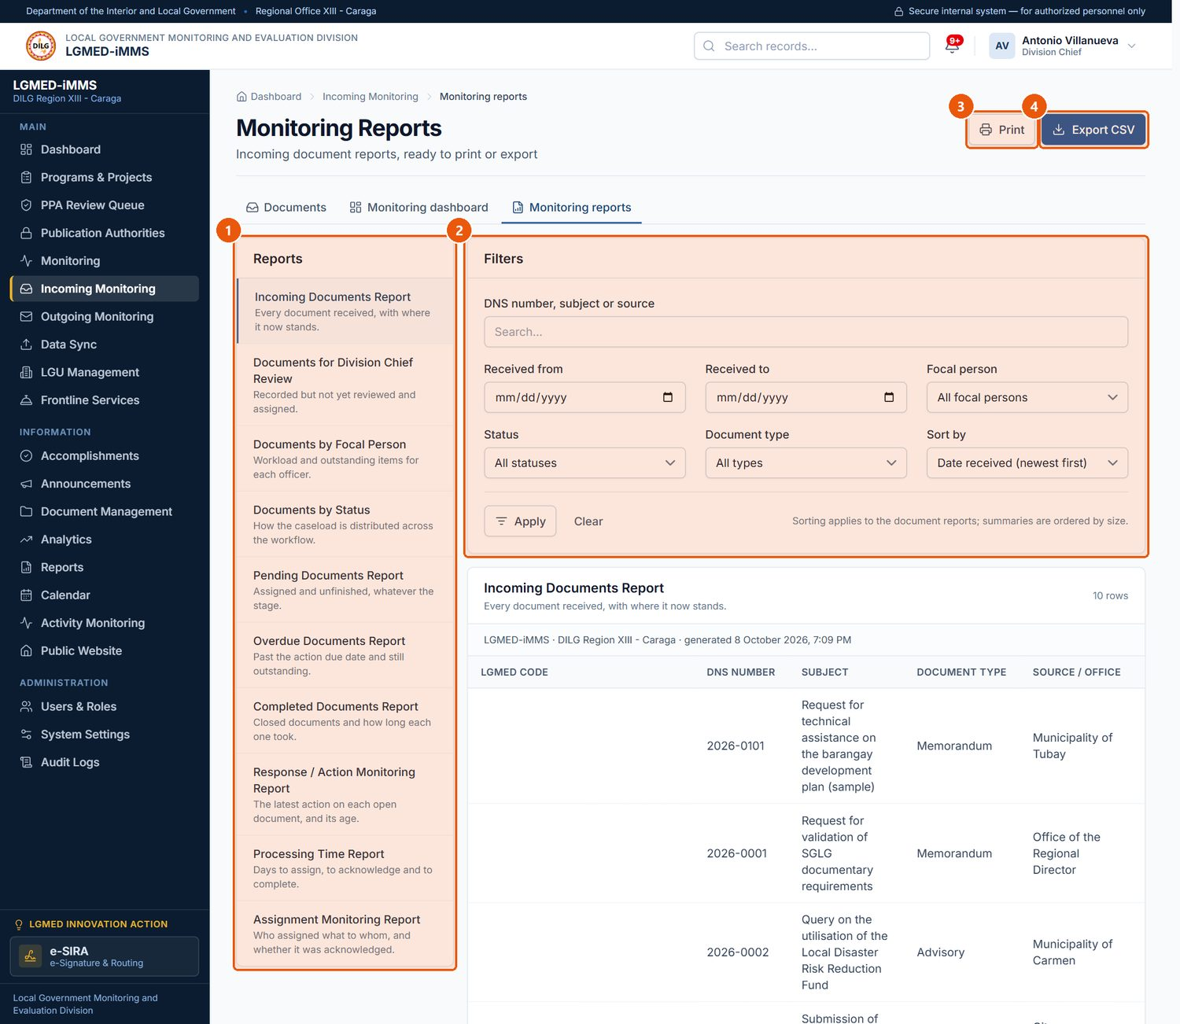
Figure 31. Monitoring Reports
1
Reports
Ten ready-made reports. Click one to open it.
2
Filters
Narrow the report by text, dates, focal person, status, type; choose the sort order.
3
Print
Prints the report.
4
Export CSV
Downloads the same rows as a spreadsheet file.
Signed in as: Administrator (Division Chief)
LGMED-iMMS System User Manual | DILG Regional Office XIII - Caraga | LGMED
48

Slide 49
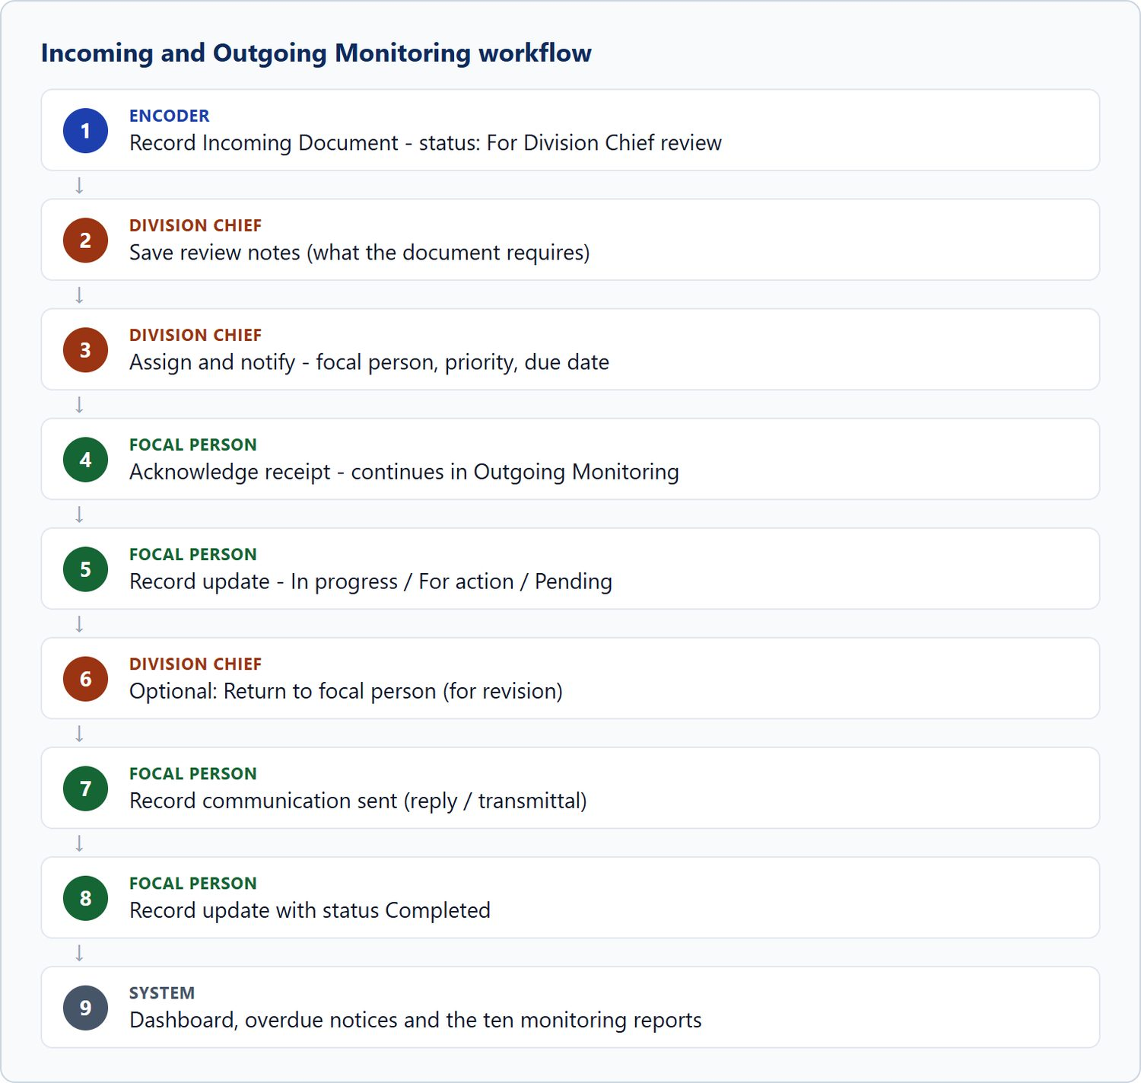
Figure 32. Incoming and Outgoing Monitoring workflow
LGMED-iMMS System User Manual | DILG Regional Office XIII - Caraga | LGMED
49

Slide 50
10.6 Outgoing Monitoring
LGMED-iMMS System User Manual | DILG Regional Office XIII - Caraga | LGMED
50

Slide 51
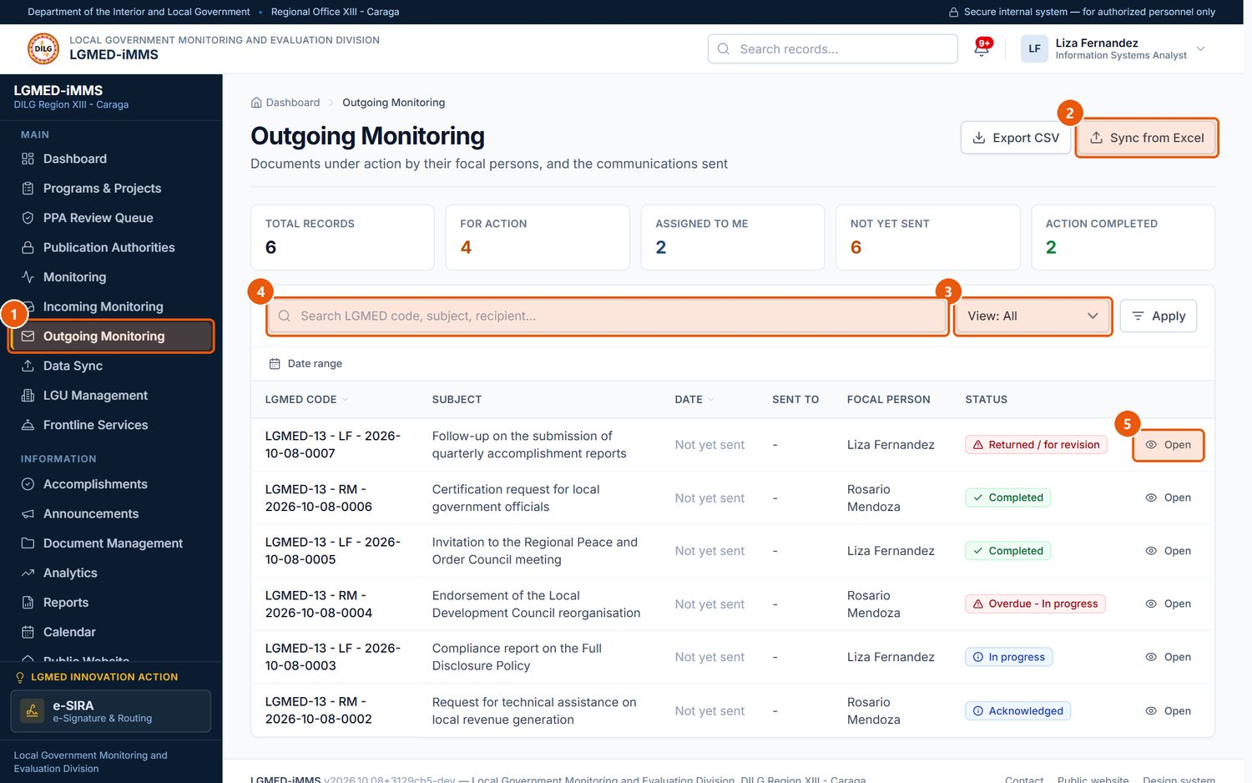
Figure 33. Outgoing Monitoring
1
Outgoing Monitoring
Sidebar entry.
2
Sync from Excel
Imports historical records from the Outgoing spreadsheet (Data Sync).
3
View
Assigned to me, For action (open), Action completed, Communication not yet sent, From the spreadsheet register.
4
Search box
Type part of a name, title, code or other text, then press Enter or click Apply.
5
Open
Opens the outgoing record.
Signed in as: LGMED Staff
LGMED-iMMS System User Manual | DILG Regional Office XIII - Caraga | LGMED
51

Slide 52
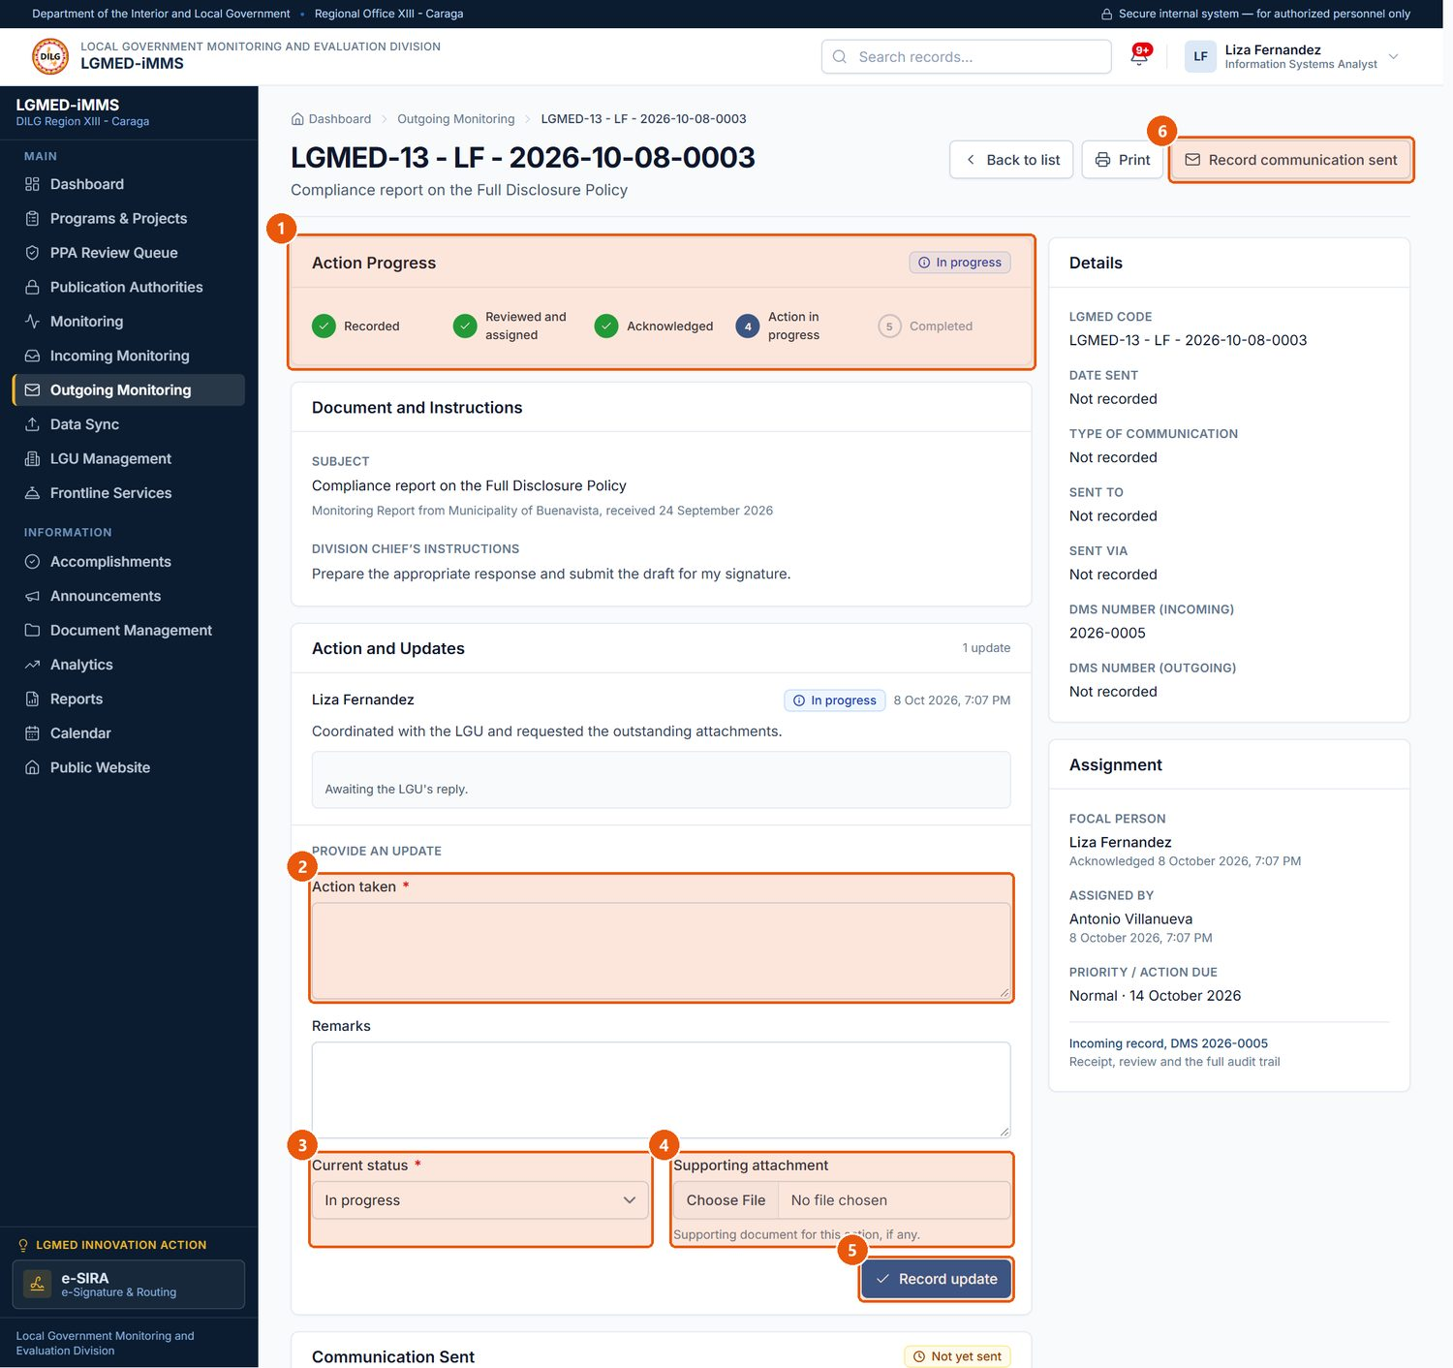
Figure 34. Reporting action on an assigned document (focal person)
1
Action Progress
Where the document stands.
2
Action taken
Required. What you did.
3
Current status
Required. In progress, For action, Pending or Completed - the update and the status change are one act.
4
Supporting attachment
Optional file, e.g. the reply sent.
5
Record update
Saves the update.
6
Record communication sent
Records the reply or transmittal that was sent.
Signed in as: LGMED Staff
LGMED-iMMS System User Manual | DILG Regional Office XIII - Caraga | LGMED
52

Slide 53
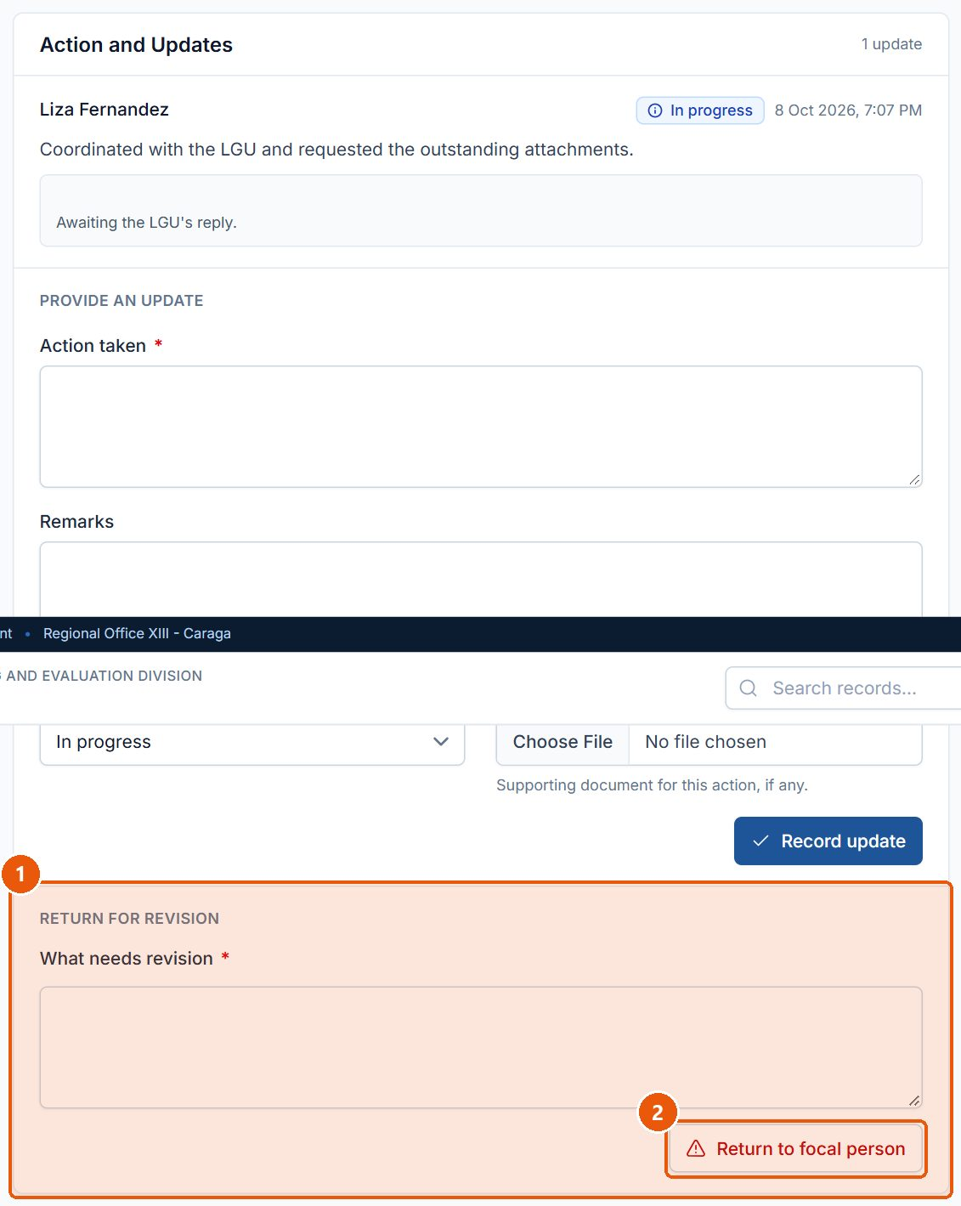
Figure 35. Returning a document to the focal person (Division Chief)
1
What needs revision
Required. Explain what must be revised.
2
Return to focal person
Sends the document back; its status becomes Returned / for revision.
Signed in as: Administrator (Division Chief)
LGMED-iMMS System User Manual | DILG Regional Office XIII - Caraga | LGMED
53

Slide 54
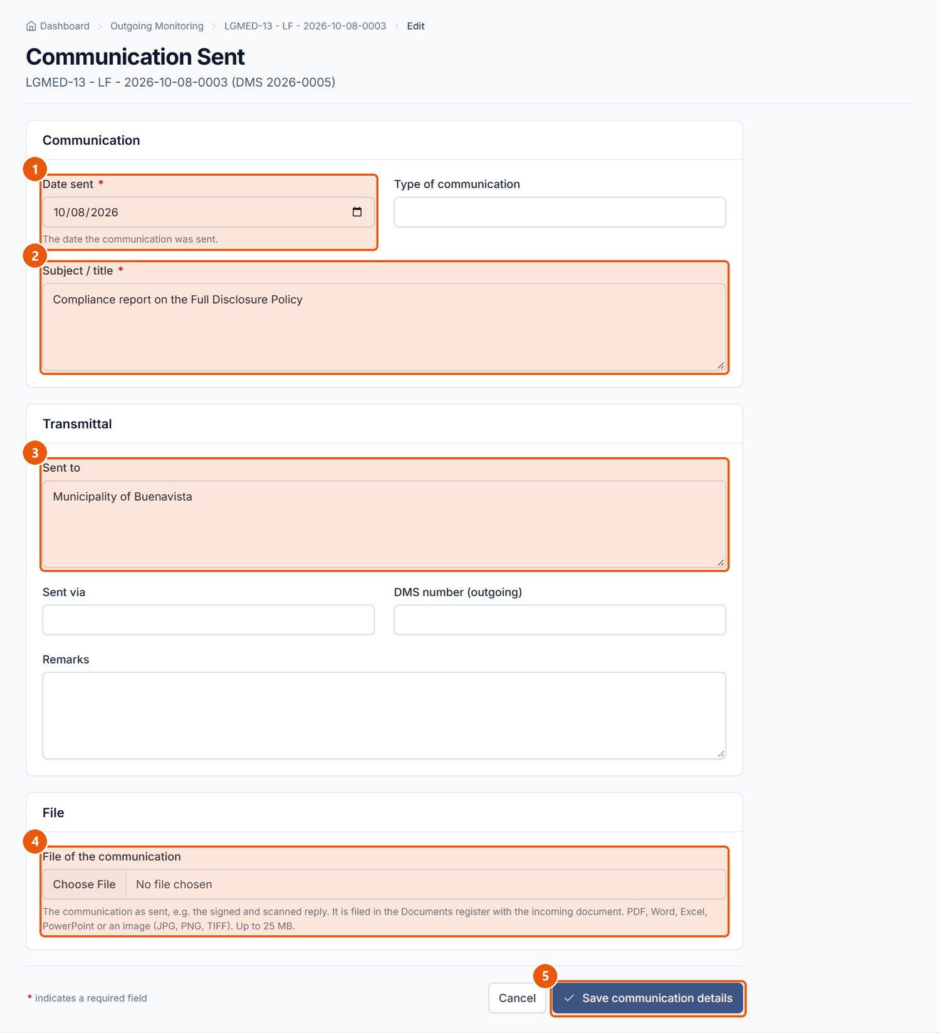
Figure 36. Recording the communication sent
1
Date sent
Required. The date the reply or transmittal was sent.
2
Subject / title
Required. Filled in from the incoming document; change it if needed.
3
Sent to
The addressee.
4
File of the communication
The communication as sent; it is filed in the Documents register with the incoming document.
5
Save communication details
Records the communication; Cancel returns without saving.
Signed in as: LGMED Staff
LGMED-iMMS System User Manual | DILG Regional Office XIII - Caraga | LGMED
54

Slide 55
10.7 Data Sync (spreadsheet import)
LGMED-iMMS System User Manual | DILG Regional Office XIII - Caraga | LGMED
55

Slide 56
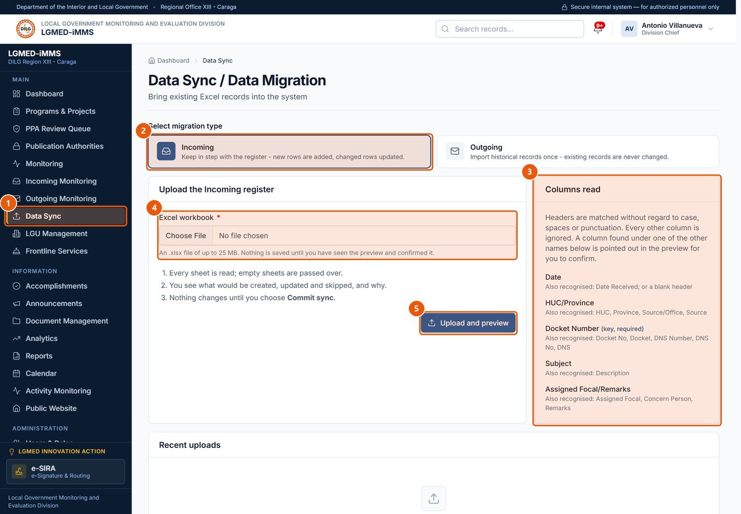
Figure 37. Data Sync - choosing the register and uploading the workbook
1
Data Sync
Sidebar entry (roles that may encode).
2
Migration type
Incoming keeps the register in step (new rows added, changed rows updated). Outgoing imports historical records once.
3
Columns read
The column headings the sync recognises in the workbook.
4
Excel workbook
Required. Choose the .xlsx file.
5
Upload and preview
Reads every sheet and shows a preview. Nothing is saved yet.
Signed in as: Administrator (Division Chief)
LGMED-iMMS System User Manual | DILG Regional Office XIII - Caraga | LGMED
56

Slide 57
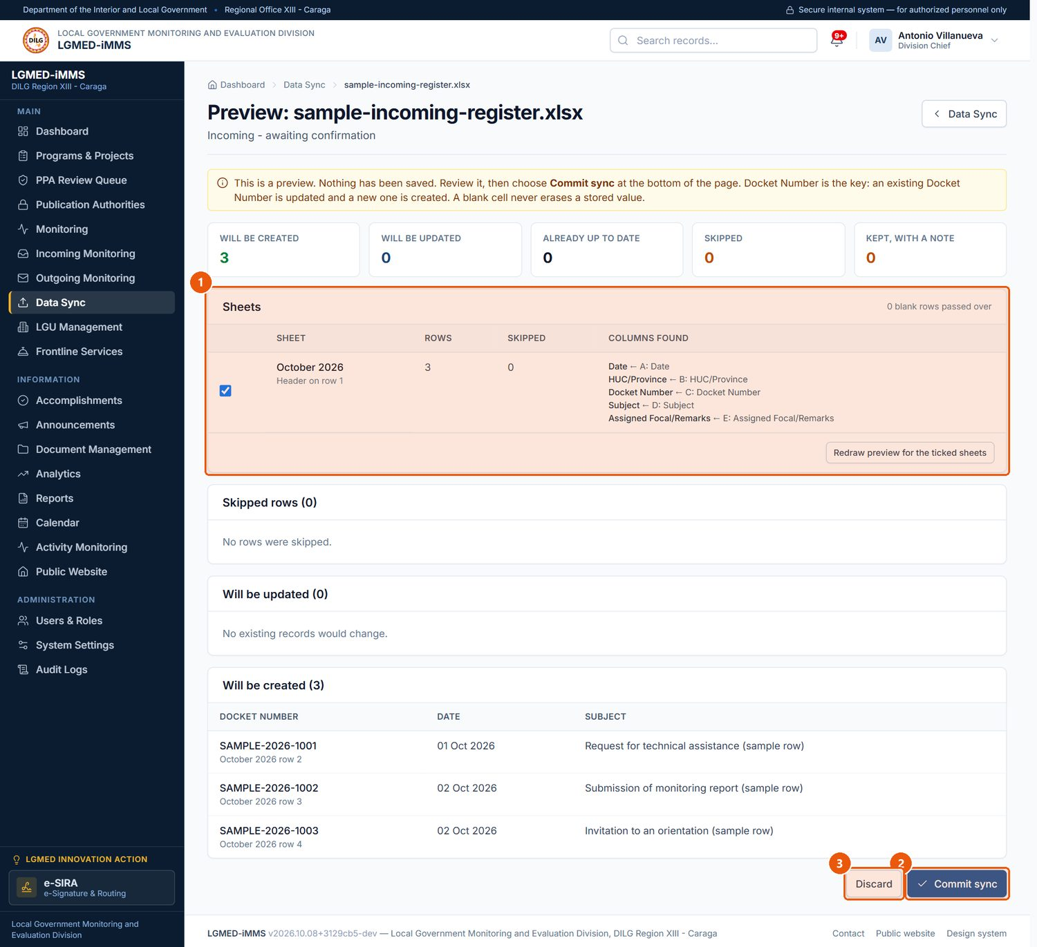
Figure 38. The preview of an uploaded workbook (illustrative sample file)
1
Sheets
Tick the sheets to include, then redraw the preview.
2
Commit sync
Saves the previewed rows to the register.
3
Discard
Throws the upload away; nothing is saved.
Signed in as: Administrator (Division Chief)
LGMED-iMMS System User Manual | DILG Regional Office XIII - Caraga | LGMED
57

Slide 58
10.8 LGU Management
LGMED-iMMS System User Manual | DILG Regional Office XIII - Caraga | LGMED
58

Slide 59
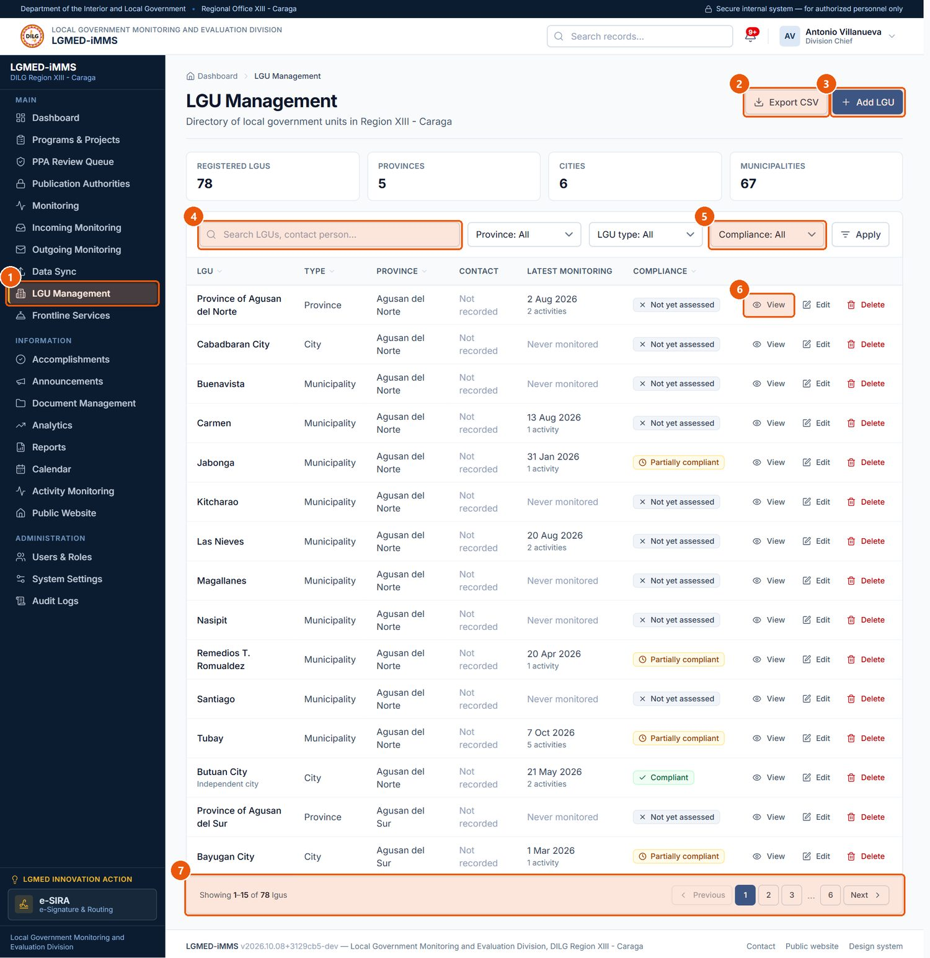
Figure 39. LGU Management - the directory of the 78 LGUs of Region XIII
1
LGU Management
Sidebar entry.
2
Export CSV
Downloads the rows currently listed - with the search and filters applied - as a spreadsheet file. Every export is recorded in the audit trail.
3
Add LGU
Adds an LGU to the directory.
4
Search box
Type part of a name, title, code or other text, then press Enter or click Apply.
5
Compliance filter
Compliant, Partially compliant, Non-compliant, Not yet assessed.
6
Row actions
View (eye), Edit (pencil) and Delete (bin) for that record. Only the actions your role permits are shown.
7
Pagination
Moves between pages of results. The number of rows per page is a system setting.
Signed in as: Administrator (Division Chief)
LGMED-iMMS System User Manual | DILG Regional Office XIII - Caraga | LGMED
59

Slide 60
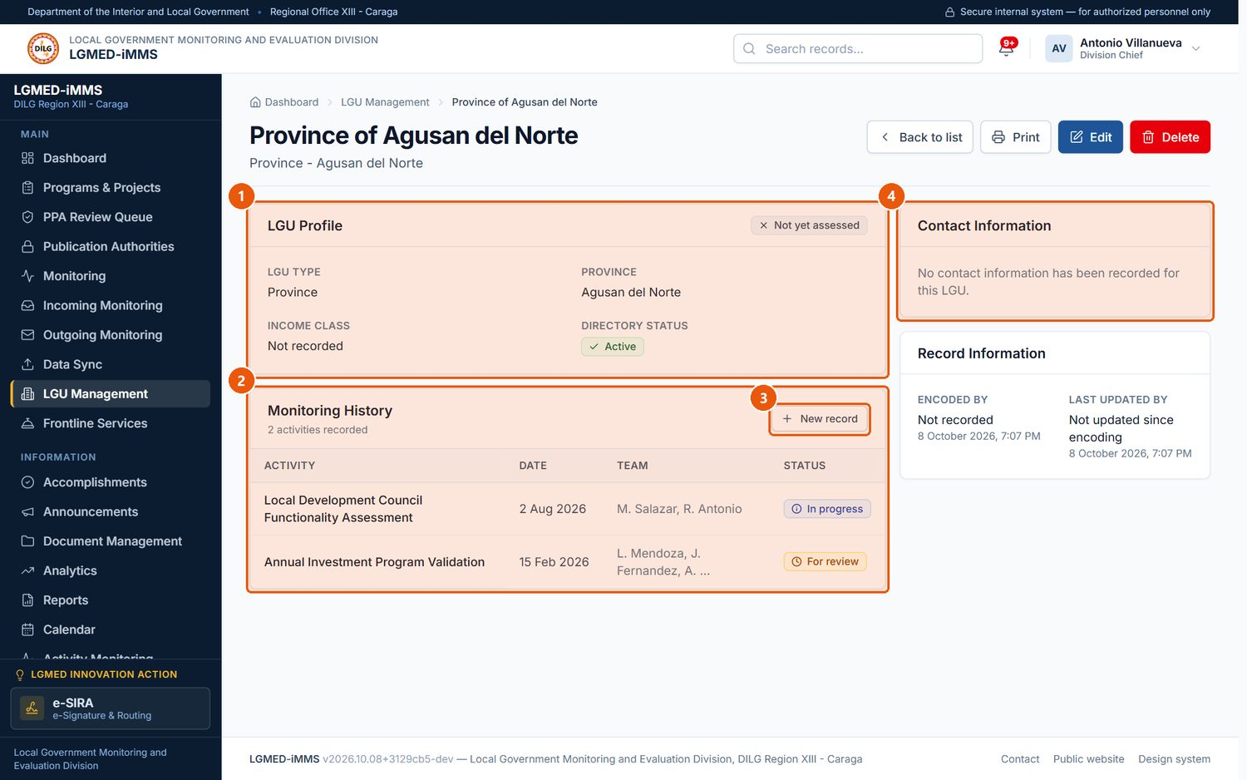
Figure 40. An LGU profile
1
LGU Profile
Type, province, income class and compliance status.
2
Monitoring History
Monitoring activities recorded for the LGU.
3
New record
Records a monitoring activity.
4
Contact Information
The LGU's contact person and details.
Signed in as: Administrator (Division Chief)
LGMED-iMMS System User Manual | DILG Regional Office XIII - Caraga | LGMED
60

Slide 61
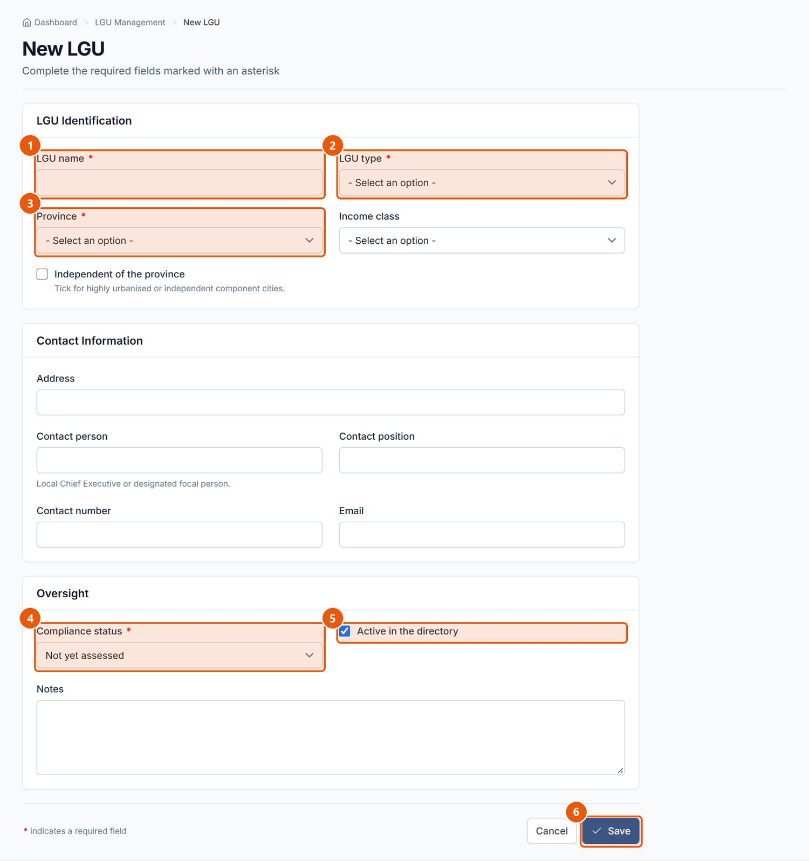
Figure 41. New LGU form
1
LGU name
Required.
2
LGU type
Required. Province, City or Municipality.
3
Province
Required.
4
Compliance status
Required.
5
Active in the directory
Untick to hide an LGU without deleting it.
6
Save
Saves the LGU.
Signed in as: Administrator (Division Chief)
LGMED-iMMS System User Manual | DILG Regional Office XIII - Caraga | LGMED
61

Slide 62
10.9 Frontline Services
LGMED-iMMS System User Manual | DILG Regional Office XIII - Caraga | LGMED
62

Slide 63
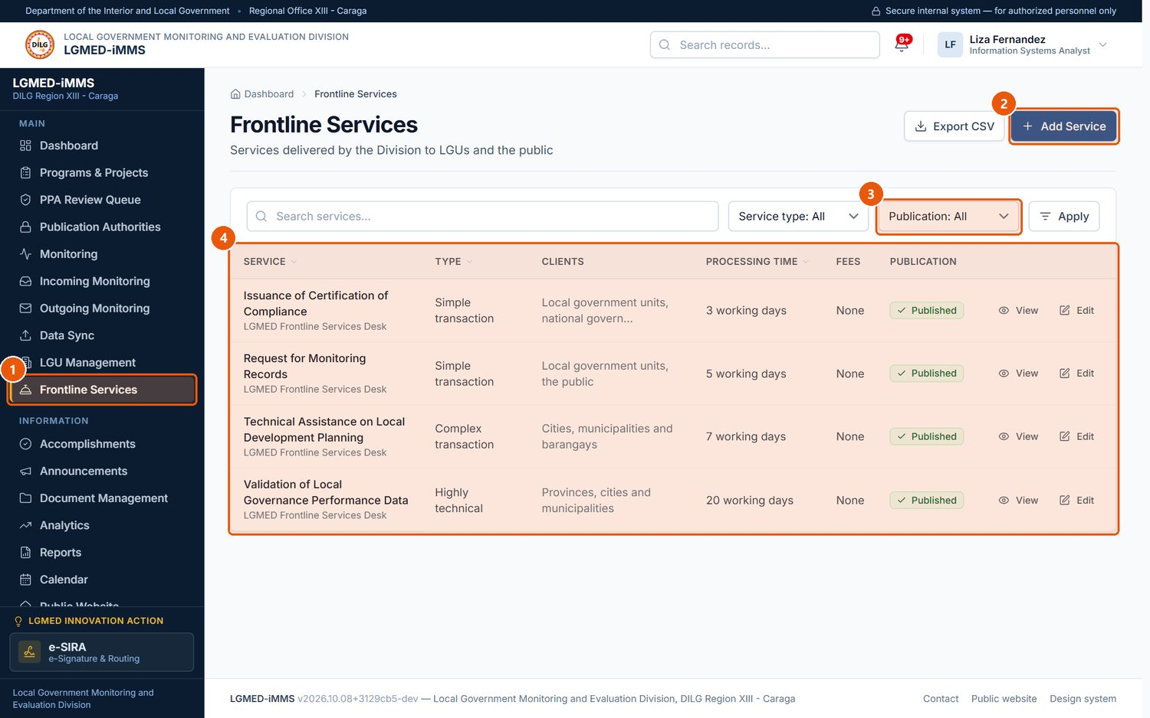
Figure 42. Frontline Services
1
Frontline Services
Sidebar entry.
2
Add Service
Adds a service.
3
Publication filter
Published or Not published on the public website.
4
Records table
One row per record. Underlined column headings sort the list; click again to reverse the order.
Signed in as: LGMED Staff
LGMED-iMMS System User Manual | DILG Regional Office XIII - Caraga | LGMED
63

Slide 64
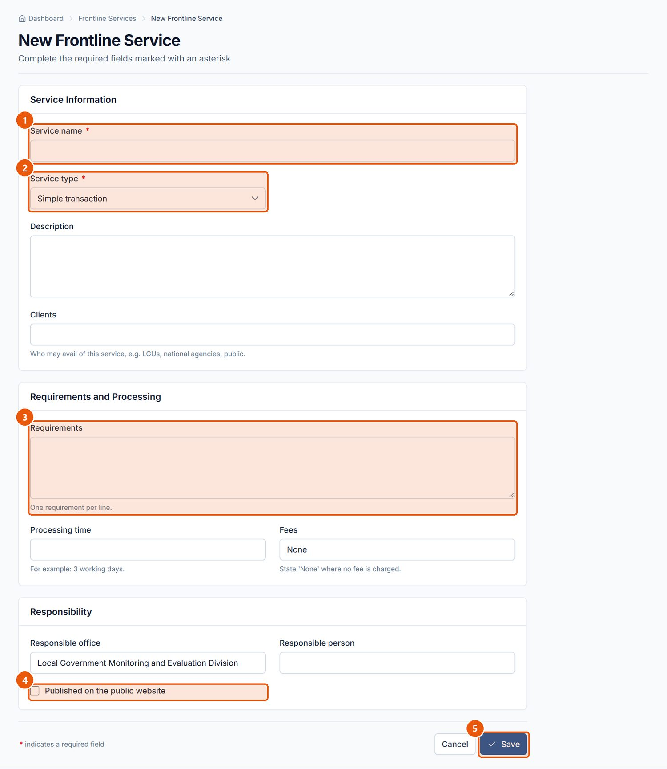
Figure 43. New Frontline Service form
1
Service name
Required.
2
Service type
Required. Simple, Complex or Highly technical transaction.
3
Requirements
What the client must bring.
4
Published on the public website
Tick to list the service on the public website.
5
Save
Saves the service.
Signed in as: LGMED Staff
LGMED-iMMS System User Manual | DILG Regional Office XIII - Caraga | LGMED
64

Slide 65
10.10 Updates & Accomplishments
LGMED-iMMS System User Manual | DILG Regional Office XIII - Caraga | LGMED
65

Slide 66
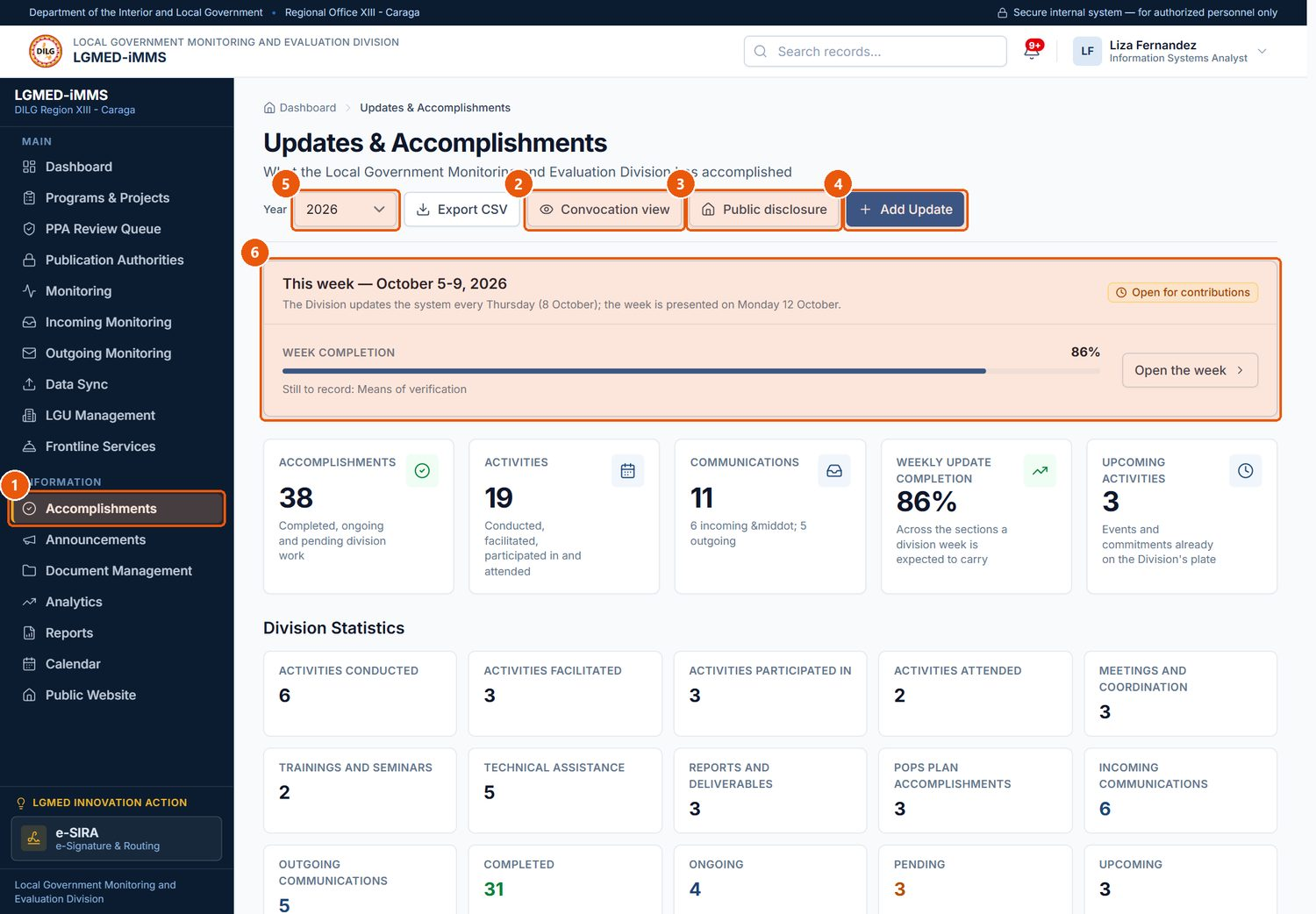
Figure 44. Updates & Accomplishments - the division dashboard
1
Accomplishments
Sidebar entry.
2
Convocation view
The presentation for the Monday convocation.
3
Public disclosure
How much of the published record the public website shows (Chief / LGMED Staff).
4
Add Update
Contributes an entry to the Division's week.
5
Year
Changes the year the statistics cover.
6
This week
The current reporting week and what it still lacks.
Signed in as: LGMED Staff
LGMED-iMMS System User Manual | DILG Regional Office XIII - Caraga | LGMED
66

Slide 67
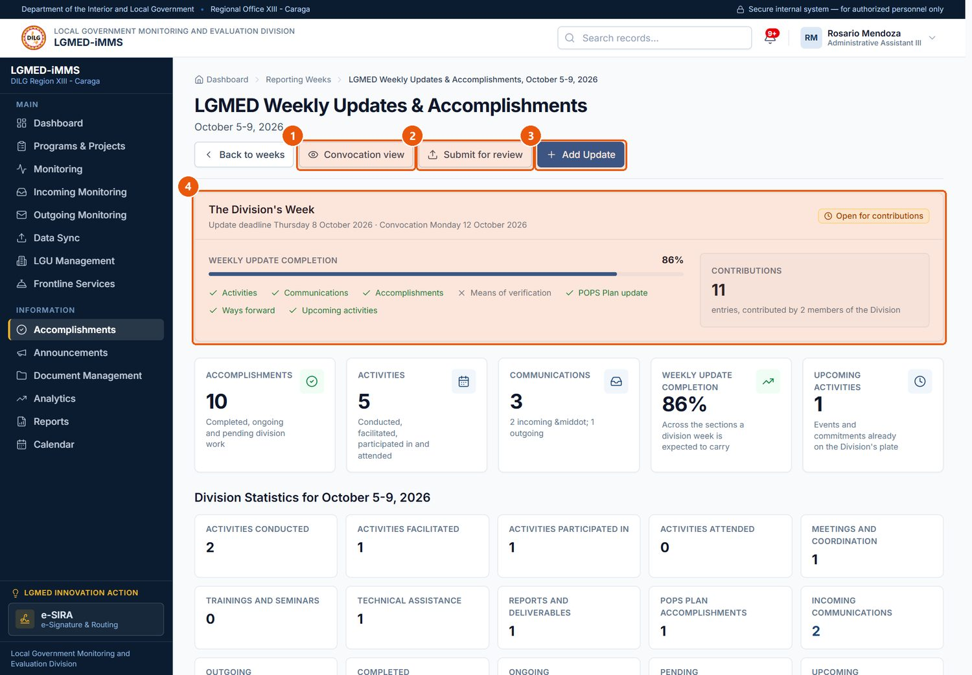
Figure 45. A reporting week (open for contributions)
1
Convocation view
Presentation view of the week.
2
Submit for review
Hands the week to the Division Chief.
3
Add Update
Adds an entry.
4
The Division's Week
Which of the seven parts of the week are recorded and which are still missing.
Signed in as: Encoder
LGMED-iMMS System User Manual | DILG Regional Office XIII - Caraga | LGMED
67

Slide 68
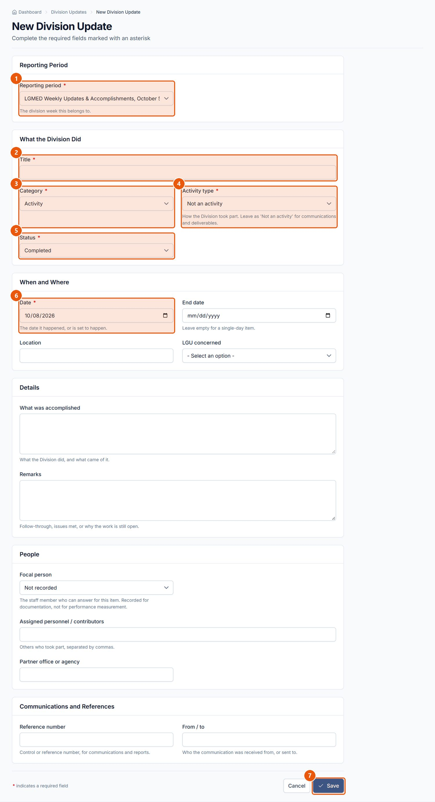
Figure 46. New Division Update form
1
Reporting period
Required. The week the entry belongs to.
2
Title
Required.
3
Category
Required. Activity, communication, technical assistance, report, POPS Plan accomplishment or other.
4
Activity type
Required. Conducted, Facilitated, Participated in, Attended, Meeting, Training - or Not an activity.
5
Status
Required. Completed, Ongoing, Pending or Upcoming.
6
Date
Required. Must fall inside the reporting week, except for Upcoming items.
7
Save
Saves the entry to the week.
Signed in as: Encoder
LGMED-iMMS System User Manual | DILG Regional Office XIII - Caraga | LGMED
68

Slide 69
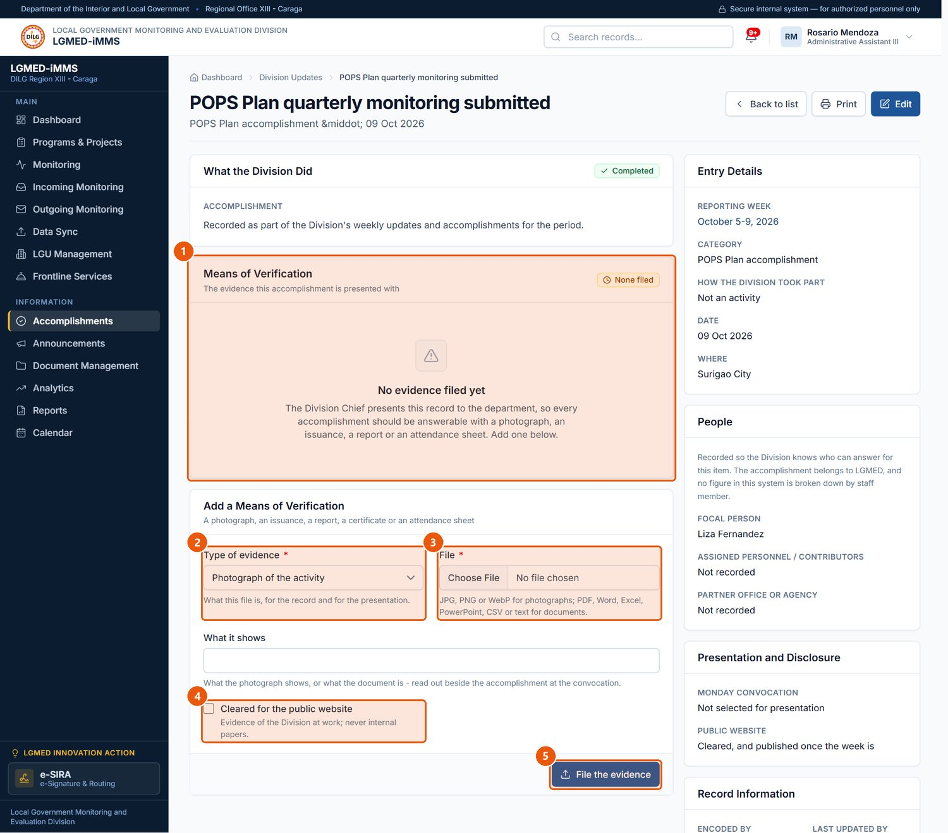
Figure 47. An entry and its means of verification
1
Means of Verification
Evidence filed for the entry.
2
Type of evidence
Required. Photograph, official document, report, certificate, attendance sheet, letter or other.
3
File
Required. The evidence file.
4
Cleared for the public website
Only cleared evidence on a published week reaches the public website.
5
File the evidence
Attaches the file to the entry.
Signed in as: Encoder
LGMED-iMMS System User Manual | DILG Regional Office XIII - Caraga | LGMED
69

Slide 70
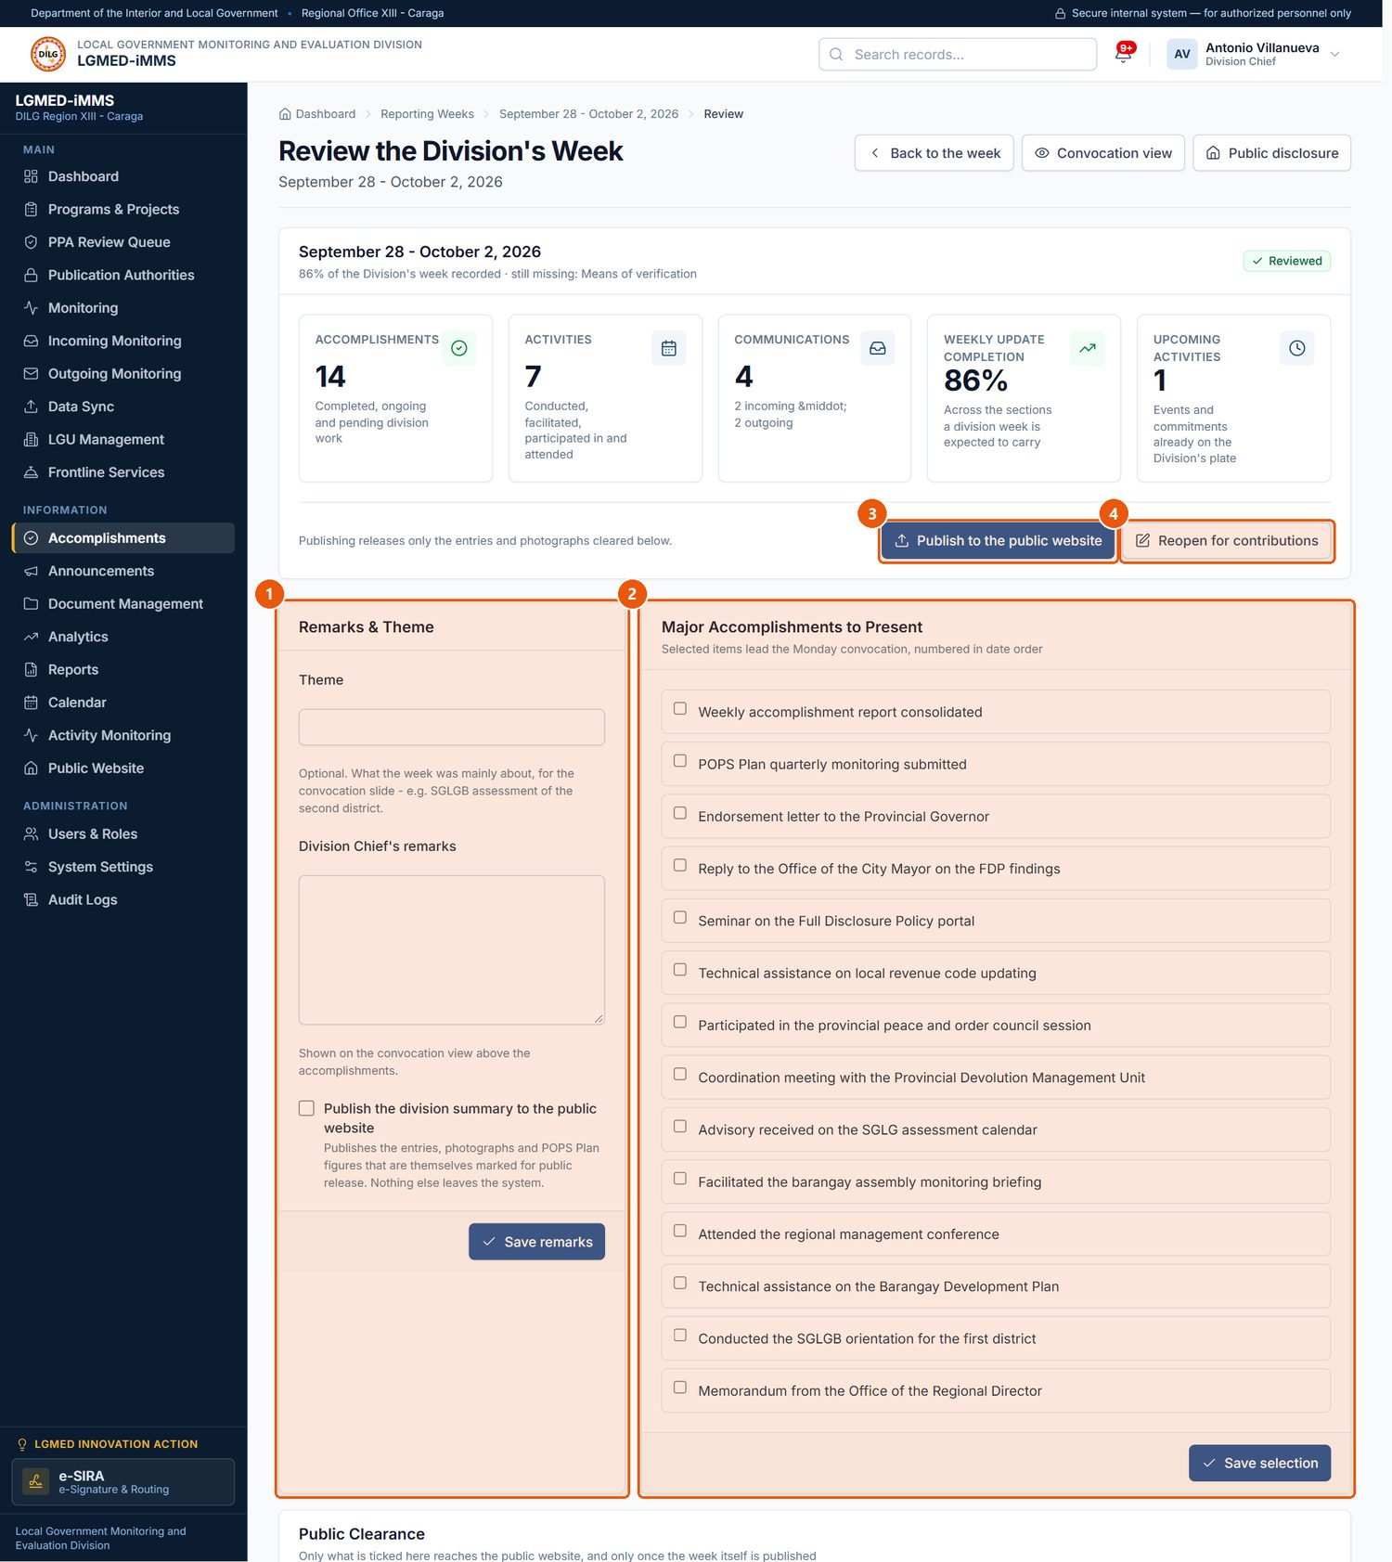
Figure 48. The Division Chief's review of a week
1
Remarks & Theme
The week's theme and the Chief's remarks (Save remarks).
2
Major Accomplishments to Present
Tick what leads the Monday convocation (Save selection).
3
Publish to the public website
Publishes the cleared items of the week.
4
Reopen for contributions
Returns the week to staff; withdraws it from the public website if it was published.
Signed in as: Administrator (Division Chief)
LGMED-iMMS System User Manual | DILG Regional Office XIII - Caraga | LGMED
70

Slide 71
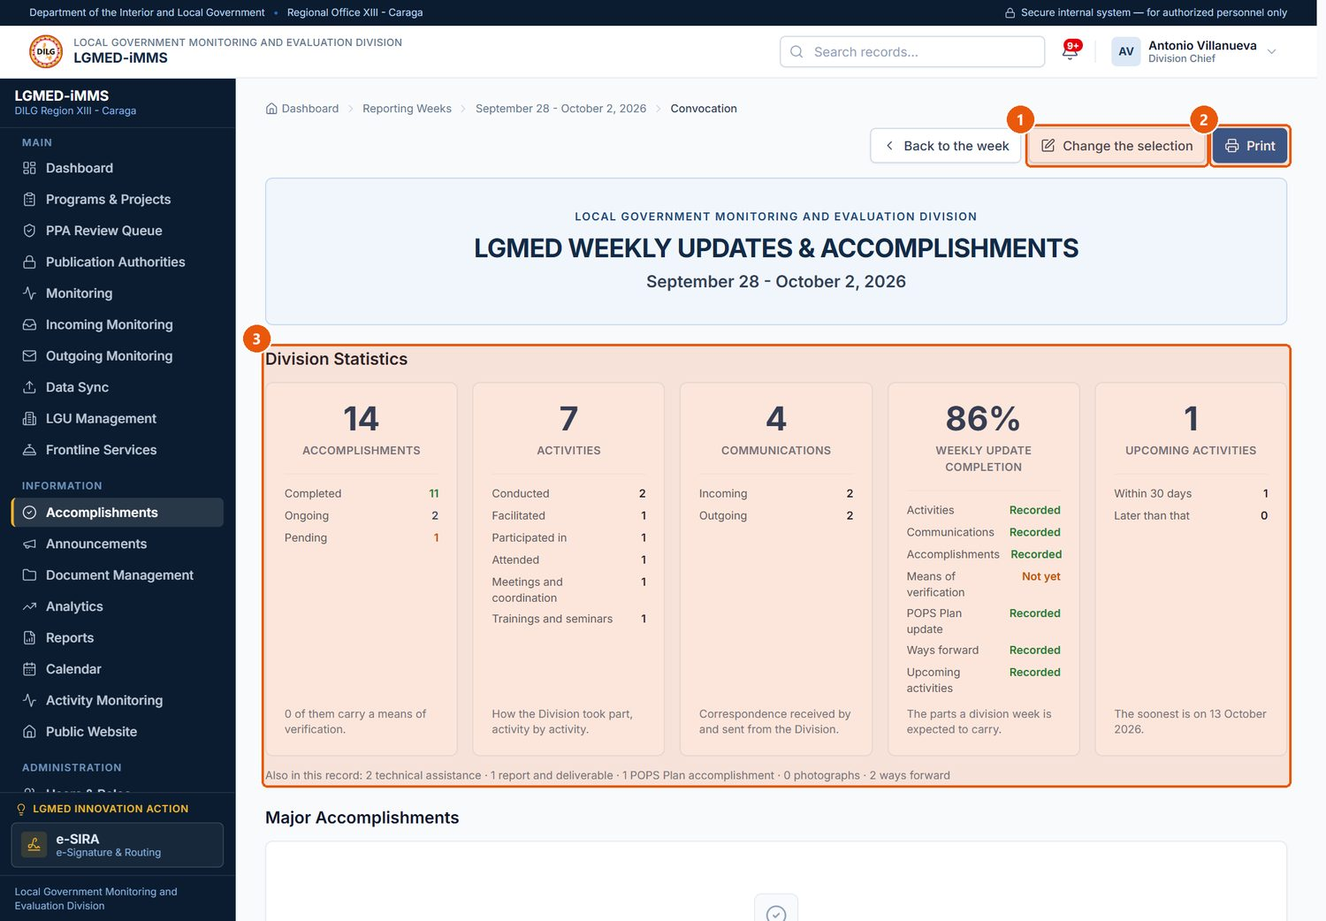
Figure 49. The Monday Convocation view
1
Change the selection
Returns to the review page to choose what is presented.
2
Print
Prints the presentation.
3
Division Statistics
The week's figures, typed large to be read from the back of a room.
Signed in as: Administrator (Division Chief)
LGMED-iMMS System User Manual | DILG Regional Office XIII - Caraga | LGMED
71

Slide 72
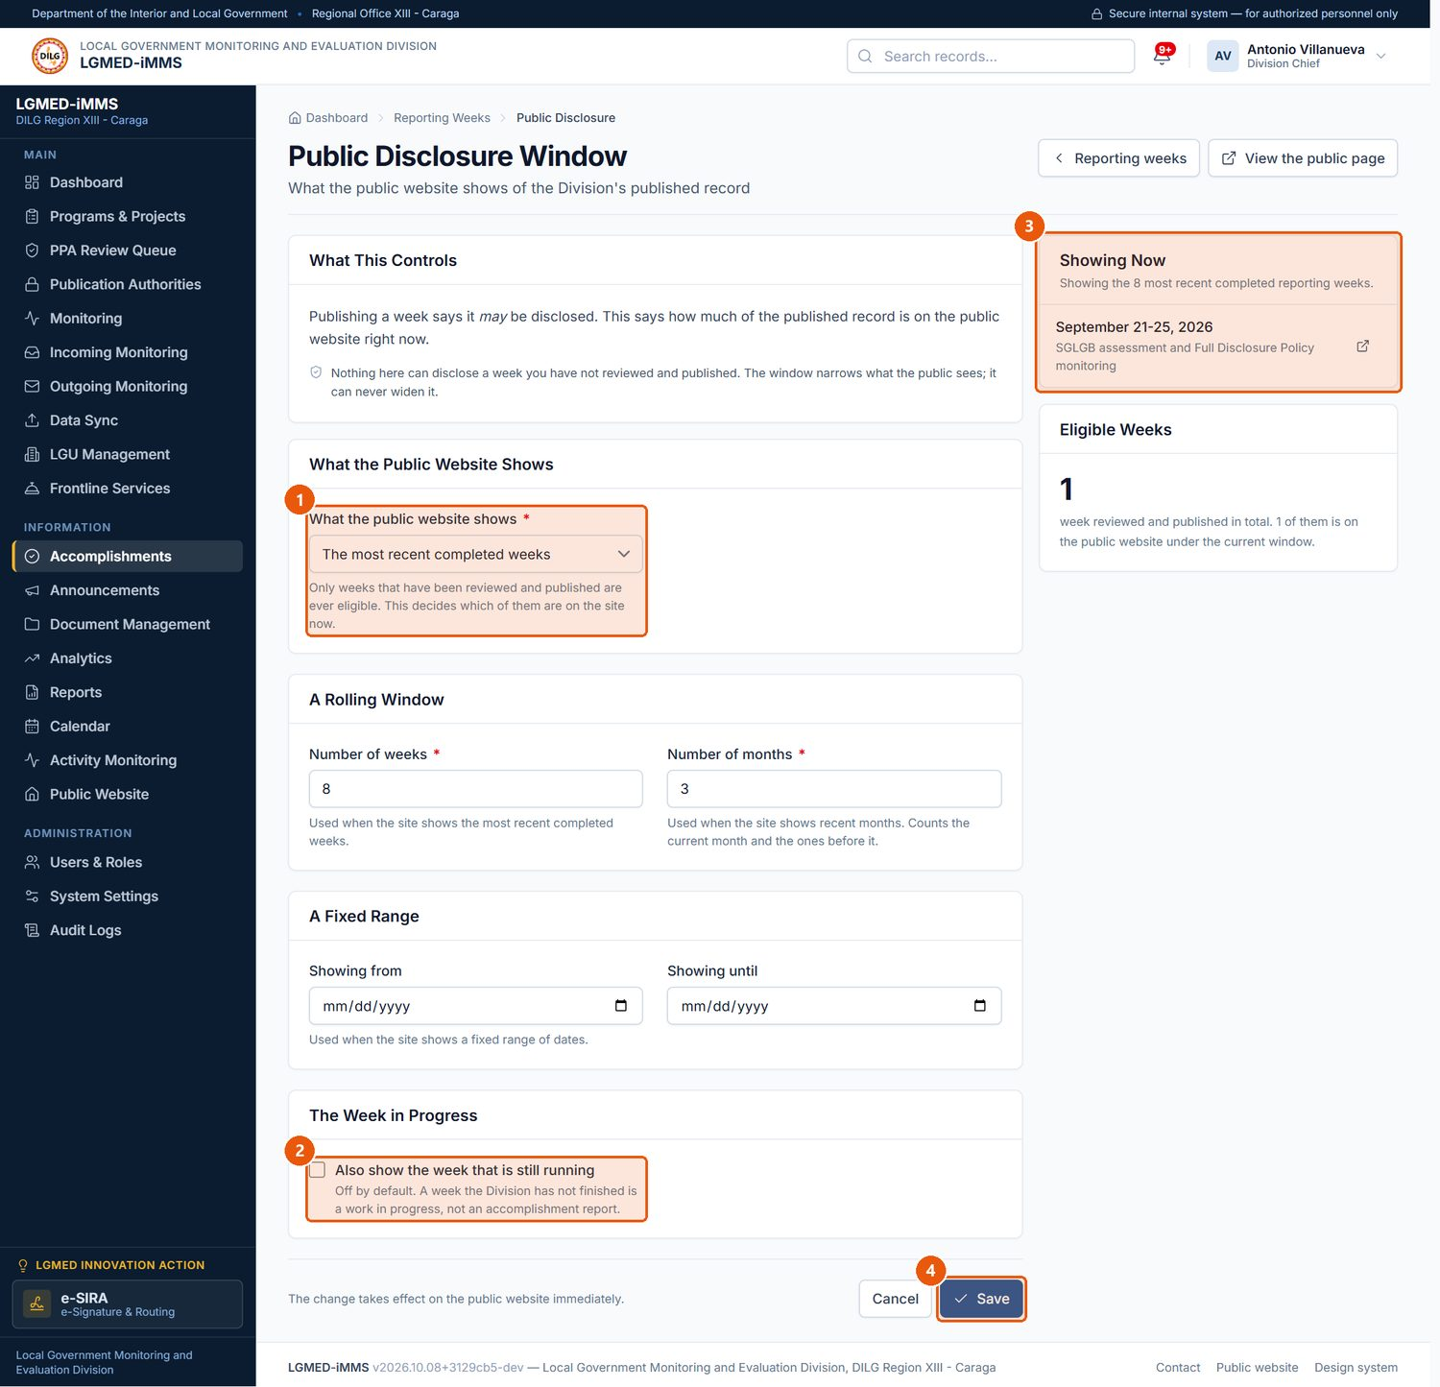
Figure 50. Public Disclosure Window
1
What the public website shows
Most recent completed weeks, most recent months, a fixed date range, or every published week.
2
Week in progress
Off by default: the running week is not shown publicly.
3
Showing Now
The weeks the current setting puts on the public website.
4
Save
Saves the setting.
Signed in as: Administrator (Division Chief)
LGMED-iMMS System User Manual | DILG Regional Office XIII - Caraga | LGMED
72

Slide 73

Figure 51. The weekly Updates & Accomplishments cycle
LGMED-iMMS System User Manual | DILG Regional Office XIII - Caraga | LGMED
73

Slide 74
10.11 Announcements
LGMED-iMMS System User Manual | DILG Regional Office XIII - Caraga | LGMED
74

Slide 75

Figure 52. Announcements
1
Announcements
Sidebar entry.
2
Add Announcement
Writes a news item, advisory, issuance, activity or commendation.
3
Publication filter
Published or Draft.
4
Records table
One row per record. Underlined column headings sort the list; click again to reverse the order.
Signed in as: LGMED Staff
LGMED-iMMS System User Manual | DILG Regional Office XIII - Caraga | LGMED
75

Slide 76

Figure 53. New Announcement form
1
Headline
Required.
2
Category
Required.
3
Date published
Required. A future date keeps the item off the public site until that day.
4
Lead paragraph
Required. The summary shown on the news feed.
5
Photograph
Optional image for the item.
6
Published on the public website
Untick to keep the item as a draft.
7
Feature on the homepage
Puts the item in the homepage's featured position.
8
Save
Saves the item.
Signed in as: LGMED Staff
LGMED-iMMS System User Manual | DILG Regional Office XIII - Caraga | LGMED
76

Slide 77
10.12 Document Management
LGMED-iMMS System User Manual | DILG Regional Office XIII - Caraga | LGMED
77

Slide 78

Figure 54. Document Management - the register
1
Document Management
Sidebar entry.
2
Register Document
Registers a document.
3
Tabs
Register, Monitoring, Files, and Retention & Archive.
4
View
Owned by me, Assigned to me, Not yet assigned, Overdue, Retention review due, Archived and more.
5
Status
Draft, Received, For review, For assignment, Assigned, In progress, For approval, Completed, Archived, Cancelled.
6
Records table
One row per record. Underlined column headings sort the list; click again to reverse the order.
Signed in as: LGMED Staff
LGMED-iMMS System User Manual | DILG Regional Office XIII - Caraga | LGMED
78

Slide 79

Figure 55. A document record
1
Document Lifecycle
Each stage from registration to completion; the current stage is highlighted.
2
Document File
View or download the file, its version history, and upload a new version.
3
Review and Assignment
Review notes, the focal person and the Chief's instructions.
4
Actions
The next step for the document's current status (see Table).
Signed in as: LGMED Staff
LGMED-iMMS System User Manual | DILG Regional Office XIII - Caraga | LGMED
79

Slide 80

Figure 56. Register Document form
1
Document title
Required.
2
Document type
Required. The type decides the retention period.
3
Action due date
Optional; overdue documents are flagged.
4
Owner
Required. The person answerable for the document.
5
Office / division
Required.
6
Document file
The file (version 1).
7
Save
Registers the document and issues its control number.
Signed in as: Encoder
LGMED-iMMS System User Manual | DILG Regional Office XIII - Caraga | LGMED
80

Slide 81

Figure 57. Review and assignment of a document (Division Chief)
1
Review and Assignment
The Chief names the focal person and gives instructions.
2
Retention
Record a retention decision: within period, for review, for disposal, or permanent preservation.
Signed in as: Administrator (Division Chief)
LGMED-iMMS System User Manual | DILG Regional Office XIII - Caraga | LGMED
81

Slide 82

Figure 58. Document Files - every stored file in one list
1
Source
Incoming document, Focal person's update, Outgoing communication, or Registered here.
2
Search
Runs the search.
3
Download
Downloads the file. Every download is recorded on the document's trail.
Signed in as: LGMED Staff
LGMED-iMMS System User Manual | DILG Regional Office XIII - Caraga | LGMED
82

Slide 83

Figure 59. Document Monitoring
1
Document counts
Each figure is a link to the documents it counts.
2
Awaiting action
Documents waiting at each stage.
3
Overdue documents
Past their action due date.
Signed in as: LGMED Staff
LGMED-iMMS System User Manual | DILG Regional Office XIII - Caraga | LGMED
83

Slide 84

Figure 60. Archiving a completed document
1
Reason for archiving
Why the document is being archived.
2
Archive document
Archives it. Nothing is deleted; access is restricted and it leaves the public website.
Signed in as: LGMED Staff
LGMED-iMMS System User Manual | DILG Regional Office XIII - Caraga | LGMED
84

Slide 85

Figure 61. Retention and Archive
1
Browse the archive
Lists archived documents.
2
Retention review due
Documents whose retention period has run out.
3
Retention schedule
The retention period of each document type.
Signed in as: LGMED Staff
LGMED-iMMS System User Manual | DILG Regional Office XIII - Caraga | LGMED
85

Slide 86

Figure 62. Document Management lifecycle
LGMED-iMMS System User Manual | DILG Regional Office XIII - Caraga | LGMED
86

Slide 87
10.13 Analytics
LGMED-iMMS System User Manual | DILG Regional Office XIII - Caraga | LGMED
87

Slide 88

Figure 63. Analytics
1
Analytics
Sidebar entry.
2
Year
The year analysed.
3
Export CSV
Downloads the figures.
4
Print
Prints the page.
5
Headline figures
Coverage, trend and turnaround for the year.
Signed in as: LGMED Staff
LGMED-iMMS System User Manual | DILG Regional Office XIII - Caraga | LGMED
88

Slide 89

Figure 64. Least-Monitored LGUs
1
Least-Monitored LGUs
LGUs the Division has reached least, in the order to reach them.
2
Schedule monitoring
Opens a new monitoring record.
Signed in as: LGMED Staff
LGMED-iMMS System User Manual | DILG Regional Office XIII - Caraga | LGMED
89

Slide 90
10.14 Reports
LGMED-iMMS System User Manual | DILG Regional Office XIII - Caraga | LGMED
90

Slide 91

Figure 65. Reports
1
Reports
Sidebar entry.
2
Add Report
Adds a report.
3
Status
Draft, Submitted, For review, Approved, Published, Returned.
4
Records table
One row per record. Underlined column headings sort the list; click again to reverse the order.
Signed in as: LGMED Staff
LGMED-iMMS System User Manual | DILG Regional Office XIII - Caraga | LGMED
91

Slide 92

Figure 66. New Report form
1
Report title
Required.
2
Reporting period
Required. Monthly, Quarterly, Semestral, Annual or Special report.
3
Year
Required.
4
File
The report file.
5
Status
Required. Where the report stands in review.
6
Save
Saves the report.
Signed in as: LGMED Staff
LGMED-iMMS System User Manual | DILG Regional Office XIII - Caraga | LGMED
92

Slide 93

Figure 67. A report and its review workflow
1
Review Workflow
Draft, Submitted, For review, Approved, Published.
2
Report Summary
Summary, file and any review remarks.
3
Edit
Changes the report, including its status.
Signed in as: LGMED Staff
LGMED-iMMS System User Manual | DILG Regional Office XIII - Caraga | LGMED
93

Slide 94
10.15 Calendar and Activity Monitoring
LGMED-iMMS System User Manual | DILG Regional Office XIII - Caraga | LGMED
94

Slide 95

Figure 68. The Calendar (All employees, month view)
1
Calendar
Sidebar entry.
2
Add Activity
Opens the full activity form.
3
Scope
My calendar, Assigned to me, Shared with me, All employees (supervisors).
4
Period
Month, Week, Upcoming, Overdue.
5
Month navigation
Previous and next month.
6
Month grid
Click anywhere in a day to see everything on it and add an activity for that day.
Signed in as: Administrator (Division Chief)
LGMED-iMMS System User Manual | DILG Regional Office XIII - Caraga | LGMED
95

Slide 96

Figure 69. The day dialog - quick add for the selected day
1
Title
Required.
2
Activity type
Required.
3
Visibility
Required. Private (only you and your supervisors), Assigned users, Team or Organization-wide.
4
Save activity
Saves the activity on that day.
Signed in as: LGMED Staff
LGMED-iMMS System User Manual | DILG Regional Office XIII - Caraga | LGMED
96

Slide 97

Figure 70. New Activity form
1
Title
Required.
2
Assigned to
The person doing it when that is not the owner.
3
Start date
Required.
4
Visibility
Required. Defaults to Private.
5
Show on the public calendar
Allowed only for Organization-wide activities.
6
Save
Saves the activity.
Signed in as: LGMED Staff
LGMED-iMMS System User Manual | DILG Regional Office XIII - Caraga | LGMED
97

Slide 98

Figure 71. An activity record
1
Ownership
Owner, assignee and section.
2
Report progress
The owner or assignee updates the status and remarks, then clicks Save update.
3
Visibility
Who may see the activity.
Signed in as: Administrator (Division Chief)
LGMED-iMMS System User Manual | DILG Regional Office XIII - Caraga | LGMED
98

Slide 99

Figure 72. Activity Monitoring (Division Chief)
1
Activity Monitoring
Sidebar entry for supervisors.
2
Workload by employee
Open, upcoming, overdue, assigned and completed counts per employee.
3
All employees' calendar
Opens everyone's activities.
Signed in as: Administrator (Division Chief)
LGMED-iMMS System User Manual | DILG Regional Office XIII - Caraga | LGMED
99

Slide 100
10.16 Public Website
LGMED-iMMS System User Manual | DILG Regional Office XIII - Caraga | LGMED
100

Slide 101

Figure 73. Public Website management
1
Public Website
Sidebar entry (Administrators and LGMED Staff).
2
What the public can see
What is published right now, counted from the records. Manage opens the module.
3
Website text
The homepage heading, mandate, office details and standing notices.
Signed in as: LGMED Staff
LGMED-iMMS System User Manual | DILG Regional Office XIII - Caraga | LGMED
101

Slide 102

Figure 74. The public website homepage
1
Public navigation
Home, News, Accomplishments, Programs, Frontline Services, Statistics, Reports, Document Library, Calendar, About, Contact.
Signed in as: Public visitor
LGMED-iMMS System User Manual | DILG Regional Office XIII - Caraga | LGMED
102

Slide 103
10.17 Administration
LGMED-iMMS System User Manual | DILG Regional Office XIII - Caraga | LGMED
103

Slide 104

Figure 75. Users & Roles
1
Users & Roles
Sidebar entry (Administrators).
2
Roles & permissions
The permission matrix.
3
Add Account
Creates a user account.
4
Role filter
Narrows the list by role.
5
Records table
One row per record. Underlined column headings sort the list; click again to reverse the order.
Signed in as: Administrator (Division Chief)
LGMED-iMMS System User Manual | DILG Regional Office XIII - Caraga | LGMED
104

Slide 105

Figure 76. A user account
1
Reset password
Sets a new password for the user.
2
Edit
Changes the account details and role.
3
Deactivate
Blocks sign-in. Accounts are never deleted, so their history stays attributable.
4
Full audit trail
Everything this person did, in the audit log.
Signed in as: Administrator (Division Chief)
LGMED-iMMS System User Manual | DILG Regional Office XIII - Caraga | LGMED
105

Slide 106

Figure 77. New User Account form
1
Username
Required.
2
Email address
Required.
3
Initials for LGMED codes
Used in LGMED control codes (e.g. middle initial included).
4
Role
Required. System Administrator, Administrator, LGMED Staff, Encoder or Viewer.
5
Active
Untick to create the account deactivated.
6
Save
Creates the account.
Signed in as: Administrator (Division Chief)
LGMED-iMMS System User Manual | DILG Regional Office XIII - Caraga | LGMED
106

Slide 107

Figure 78. Roles & Permissions - the permission matrix
1
Permission Matrix
Which role holds which permission, generated from the rules the system enforces.
Signed in as: Administrator (Division Chief)
LGMED-iMMS System User Manual | DILG Regional Office XIII - Caraga | LGMED
107

Slide 108

Figure 79. Menu Permissions (System Administrator only)
1
Menu Permissions
Sidebar entry for the System Administrator.
2
Modules by Role
Tick or untick which modules each role is offered; Save role permissions.
3
Save role permissions
Saves the matrix.
Signed in as: System Administrator
LGMED-iMMS System User Manual | DILG Regional Office XIII - Caraga | LGMED
108

Slide 109

Figure 80. System Settings
1
Preferences
Records per page, session warning, system notice and the public website switch.
2
Save settings
Saves the preferences.
3
Reference lists
Program categories, document types, sections, disposal authorities, provinces. Add / Edit / Remove.
Signed in as: Administrator (Division Chief)
LGMED-iMMS System User Manual | DILG Regional Office XIII - Caraga | LGMED
109

Slide 110

Figure 81. Audit Logs
1
Audit Logs
Sidebar entry (Administrators).
2
Date range
From date and To date; click Apply dates.
3
Needing attention
Failed sign-ins, refused access and similar.
4
Filters
Action, Record type and Actor.
5
Records table
One row per record. Underlined column headings sort the list; click again to reverse the order.
Signed in as: Administrator (Division Chief)
LGMED-iMMS System User Manual | DILG Regional Office XIII - Caraga | LGMED
110

Slide 111
10.18 e-SIRA — Electronic Signature, Identification, Routing and Approval
LGMED-iMMS System User Manual | DILG Regional Office XIII - Caraga | LGMED
111

Slide 112

Figure 82. e-SIRA dashboard
1
e-SIRA
LGMED Innovation Action, pinned at the foot of the sidebar.
2
e-SIRA menu
Dashboard, Documents, My Digital Certificate, My Signature Style (and, for administrators, Certificate Verification and Audit Trail).
3
Upload / Scan Document
Starts a new document.
4
My certificates
Your PNPKI certificate and signature image.
5
Waiting on Me
Documents whose next step is yours.
Signed in as: Encoder
LGMED-iMMS System User Manual | DILG Regional Office XIII - Caraga | LGMED
112

Slide 113

Figure 83. My Digital Certificate
1
Digital certificate
Upload your DICT PNPKI .p12 file and its password.
2
Require password when signing
Recommended. Asks for the password each time you sign.
3
Save certificate
Registers the certificate. An administrator must verify it before you can sign.
4
My Registered Certificates
Your certificates and their verification status.
Signed in as: LGMED Staff
LGMED-iMMS System User Manual | DILG Regional Office XIII - Caraga | LGMED
113

Slide 114

Figure 84. My Signature Style
1
Add custom style
Adds a graphic style (up to 10).
Signed in as: LGMED Staff
LGMED-iMMS System User Manual | DILG Regional Office XIII - Caraga | LGMED
114

Slide 115

Figure 85. Upload or Scan a Document
1
Title
Required.
2
How is the document coming in?
Upload a PDF, or Scan pages (images from a scanner or phone camera).
3
PDF file
The PDF to be signed or routed.
4
Upload and prepare
Uploads the file and opens the signing workspace.
Signed in as: Encoder
LGMED-iMMS System User Manual | DILG Regional Office XIII - Caraga | LGMED
115

Slide 116

Figure 86. The signing workspace - preview and signature boxes
1
Zoom and pages
Zoom, fit width and move between pages.
2
Signature Boxes
Choose the signer for new boxes, then Add Signature Box and drag it into place.
3
Add Signature Box
Places a box on the current page.
4
Route for signature
Chooses who signs or approves, and in what order.
Signed in as: Encoder
LGMED-iMMS System User Manual | DILG Regional Office XIII - Caraga | LGMED
116

Slide 117

Figure 87. Routing the document
1
Recipient
The person for this step.
2
Action required
Signature, Approval, Review / initials, or For information / acknowledgement.
3
Add a step
Adds another recipient; steps run in order.
4
Send on route
Sends the document to the first recipient.
Signed in as: Encoder
LGMED-iMMS System User Manual | DILG Regional Office XIII - Caraga | LGMED
117

Slide 118

Figure 88. A one-step route: the Division Chief is asked to approve
1
Recipient
Antonio Villanueva (Division Chief) is chosen.
2
Action required
Approval.
3
Purpose / instructions
What the recipient is asked to do.
4
Send on route
Sends the document.
Signed in as: Encoder
LGMED-iMMS System User Manual | DILG Regional Office XIII - Caraga | LGMED
118

Slide 119

Figure 89. The recipient acts on a routed document (Division Chief)
1
Status
Where the document stands and what is asked of you.
2
Approve
Completes your step (Mark reviewed or Acknowledge for those step types).
3
Reject and return
Stops the route and returns the document to its owner.
4
Routing History
Every step: when it was routed, received and acted on.
Signed in as: Administrator (Division Chief)
LGMED-iMMS System User Manual | DILG Regional Office XIII - Caraga | LGMED
119

Slide 120

Figure 90. PNPKI Certificate Verification (Administrators)
1
Awaiting Verification
Certificates registered by employees. Compare name, e-mail and serial number with the PNPKI issuance record, then Verify.
2
Reviewed Certificates
Verified or rejected certificates; a verified one can be revoked.
Signed in as: Administrator (Division Chief)
LGMED-iMMS System User Manual | DILG Regional Office XIII - Caraga | LGMED
120

Slide 121

Figure 91. e-SIRA Documents
1
Views
Awaiting my signature, Waiting on me, Owned by me, Out for signature and more.
2
Status
Draft through Completed, Rejected or Cancelled.
3
Records table
One row per record. Underlined column headings sort the list; click again to reverse the order.
Signed in as: Encoder
LGMED-iMMS System User Manual | DILG Regional Office XIII - Caraga | LGMED
121

Slide 122

Figure 92. e-SIRA: electronic signature and routing
LGMED-iMMS System User Manual | DILG Regional Office XIII - Caraga | LGMED
122

Slide 123
11. Common Tasks and Procedures
LGMED-iMMS System User Manual | DILG Regional Office XIII - Caraga | LGMED
123

Slide 124
12. Notifications and Alerts
LGMED-iMMS System User Manual | DILG Regional Office XIII - Caraga | LGMED
124

Slide 125
13. Data Validation and Error Handling
LGMED-iMMS System User Manual | DILG Regional Office XIII - Caraga | LGMED
125

Slide 126

Figure 93. The page shown when your role does not permit an action
1
Access denied
The action is not available to your role. Use the sidebar to return.
Signed in as: Viewer
LGMED-iMMS System User Manual | DILG Regional Office XIII - Caraga | LGMED
126

Slide 127
14. Frequently Asked Questions
LGMED-iMMS System User Manual | DILG Regional Office XIII - Caraga | LGMED
127

Slide 128
15. Troubleshooting Guide
LGMED-iMMS System User Manual | DILG Regional Office XIII - Caraga | LGMED
128

Slide 129
16. Security, Privacy, and Good Practices
LGMED-iMMS System User Manual | DILG Regional Office XIII - Caraga | LGMED
129

Slide 130
17. Glossary of Terms
LGMED-iMMS System User Manual | DILG Regional Office XIII - Caraga | LGMED
130

Slide 131
18. Appendices and Reference Materials
LGMED-iMMS System User Manual | DILG Regional Office XIII - Caraga | LGMED
131

