Slide 1
Software for solving (stochastic) linear programs
MPS/SMPS format
GAMS/DECIS
Pyomo/PySP

Slide 2
Another farmer example
Suppose a farmer has 75 acres on which to plant two crops: wheat and barley.
To produce these crops, it costs the farmer (for seed, fertilizer, etc.) $120 per acre for the wheat and $210 per acre for the barley. The farmer has $15000 available for expenses.
But after the harvest, the farmer must store the crops while awaiting favorable market conditions. The farmer has storage space for 4000 bushels.
Each acre yields an average of 110 bushels of wheat or 30 bushels of barley.
If the net profit per bushel of wheat (after all expenses have been subtracted) is $1.30 and for barley is $2.00, how should the farmer plant the 75 acres to maximize profit?
Algebraic formulation suitable for humans:
Max 143x + 60y
s.t. 120x + 210y <= 15000
110x + 30y <= 4000
x + y <= 75
x >= 0 y >= 0

Slide 3
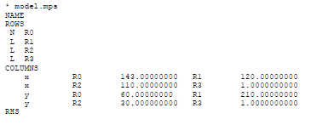

Algebraic vs. MPS formats
Max 143x + 60y
s.t. 120x + 210y <= 15000
110x + 30y <= 4000
x + y <= 75
x >= 0 y >= 0
Any commercial solver can read MPS format
Column-oriented
Set up for punch cards (!) so fields start in specific columns 2, 5, 15, 25, 40, 50
Allows for meaningful names (like Acreswht instead of x, Acresbar instead of y)
Sense of objective may be specified within the MPS file, like
OBJSENSE
MAX

Slide 4
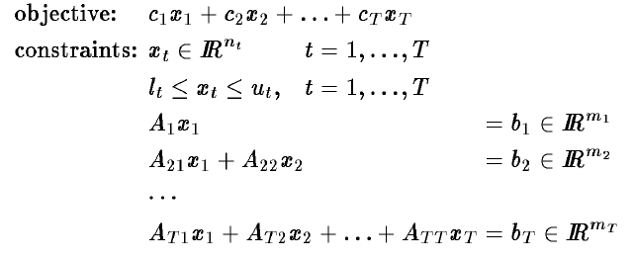
SMPS extensions
Time file
Identifies stage structure: which rows and columns are identified with each stage
Assumes block diagonal structure

Slide 5
SMPS extensions
Stoch file
Specifies distributions of random variables
Independent – distributions of random variables
Arbitrary discrete, or name and parameters
Blocks – joint distributions of dependent random variables
Discrete, subroutine, or linear transformation of independent random variables
Scenarios – paths in the scenario tree with conditional probabilities for arcs
Main idea
Deterministic model in MPS format
Additional stage and probability information for stochastic version

Slide 6
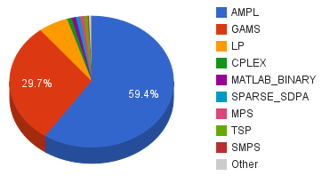
Modeling languages
Focus on formulation
Allow easy modifications
Human-readable
Algebraic-like structure
Separate data from model
Easy to update
Specify multiple instances of different sizes
NEOS input statistics for January 2011
(Argonne National Laboratory)

Slide 7
General Algebraic Modeling System (GAMS)
Modeling language with integrated solvers
linear, nonlinear and mixed integer
Large model library
“Concise and exact specification of entities and relationships”
“Whole sets of closely related constraints are entered in one statement”
“Models can be developed and documented simultaneously because GAMS allows the user to include explanatory text as part of the definition of any symbol or equation.”

Slide 8

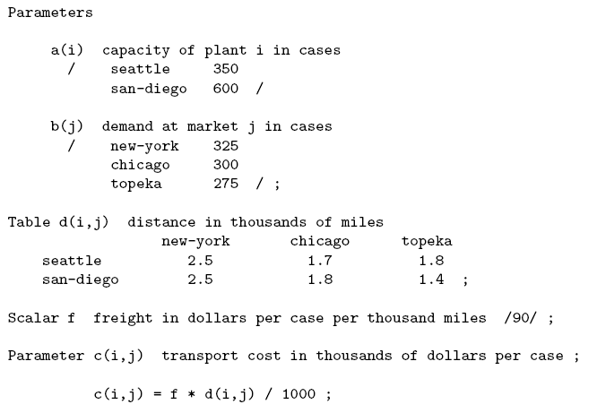
General GAMS model structure
Sets
Parameters
Variables
Equations
Model
Solver instructions
Display commands

Slide 9
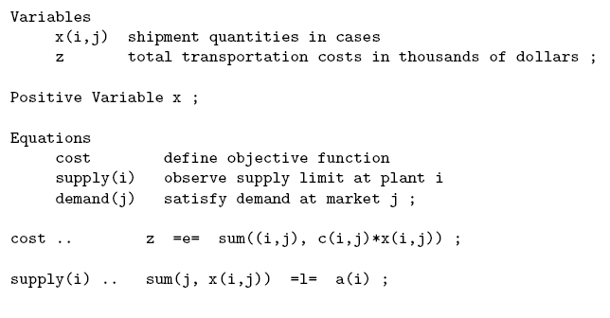
General GAMS model structure
Sets
Parameters
Variables
Equations
Model
Solver instructions
Display commands

Slide 10

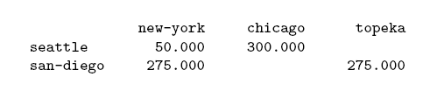

General GAMS model structure
Sets
Parameters
Variables
Equations
Model
Solver instructions
Display commands
Optimal solution (level)
Dual values (marginal)

Slide 11
DECIS
Two-stage stochastic programs with recourse
Based on Benders decomposition
Monte Carlo sampling of scenarios
Importance sampling
Control variates to reduce width of confidence interval around optimal objective value
Employ as
Stand-alone (SMPS input format)
GAMS solver
API – call from C or Fortran

Slide 12
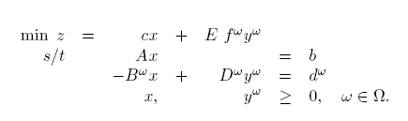
GAMS/DECIS
Strategies:
Solve the Expected Value problem
Solve the universe problem – all scenarios
Scenario sampling schemes (see BL chapter 9)
Specification
Deterministic (core) model
Decision stages
Random parameters

Slide 13
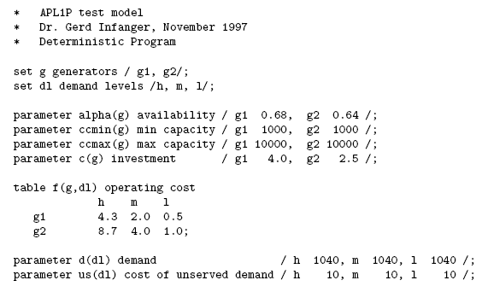
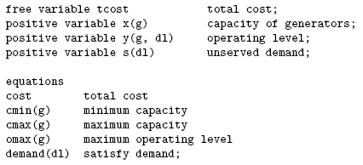
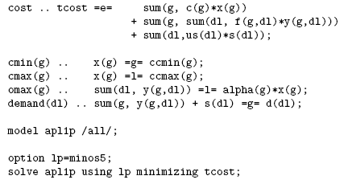
Power capacity expansion example

Slide 14
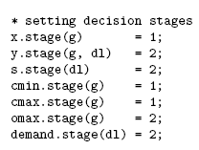
Decision stages
Capacity
Operating level
Unserved demand
Min and max capacity constraints
Maximum operating cost constraint
Demand constraint

Slide 15
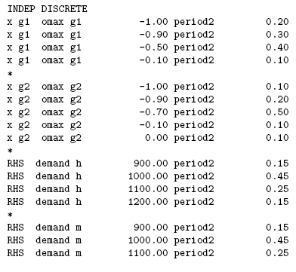
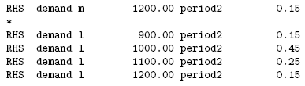
Stochastic model
Independent
Dependent

Slide 16
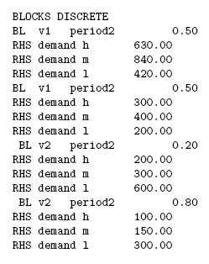
Stochastic model
Independent
Dependent

Slide 17
COOPR – Pyomo and PySP
Dinakar Gade
Sarah M. Ryan
IE 633x – Spring 2013
Iowa State University

Slide 18
COOPR
“Coopr is a collection of Python software packages that supports a diverse set of optimization capabilities for formulating and analyzing optimization models”
https://software.sandia.gov/trac/coopr
Moderately large user community: https://groups.google.com/forum/?fromgroups=#!forum/coopr-forum
Pyomo book: available online thru library! http://www.springer.com/mathematics/book/978-1-4614-3225-8

Slide 19
Pyomo – Getting Started
Disclaimer: I am not a Python expert.
To develop optimization models in Pyomo/PySP you need:
Coopr installation: https://software.sandia.gov/trac/coopr/downloader/ or CoE remote linux servers http://it.engineering.iastate.edu/remote/
A solver: CPLEX, Gurobi, GLPK (must be in your path)
Elementary programming knowledge
Pyomo is an Algebraic modeling language
On Windows – Paths are setup automatically upon installation
On Linux/Mac – You need to update your path. Example:
export PATH=/Users/you/Documents/coopr/bin/:$PATH
To check whether coopr is running, from your command line/terminal, type: pyomo -–help. You should see a list of options

Slide 20
Pyomo – Basics
Pyomo is an algebraic modeling language (like GAMS, AMPL)
Create a model and declare components
Instantiate the model (by specifying data)
Apply a solver (e.g. CPLEX, Gurobi, GLPK)
Query the results

Slide 21
Basic Modeling Components
Set() - set data that is used to define a model instance
Param() - parameter data that is used to define a model instance
Var() - decision variables in a model
Objective() – Expressions that are minimized or maximized in a model
Constraint() – Constraint expressions in a model

Slide 22
BL Facility Location Example - Recap

Slide 23
Input Data for Deterministic Model
Sets:
Plants
Clients
Parameters:
FixedCost c_{i}
Capacity investment cost g_{j}
Unit price r_{i}
Variable cost v_{j}
Transportation cost t_{ij}
Client demand d_{i}
Revenue: q_{ij} = (r_{i} – v_{j} - t_{ij})d_{ij}

Slide 24
Variables, Constraints, Objective
Variables:
Facility location x_{j}
Installed capacity w_{j}
Fraction of client i’s demand met from plant j
Objective
Maximize profit
Constraints
Demand constraint
Capacity Constraint
Shipping Constraint

Slide 25
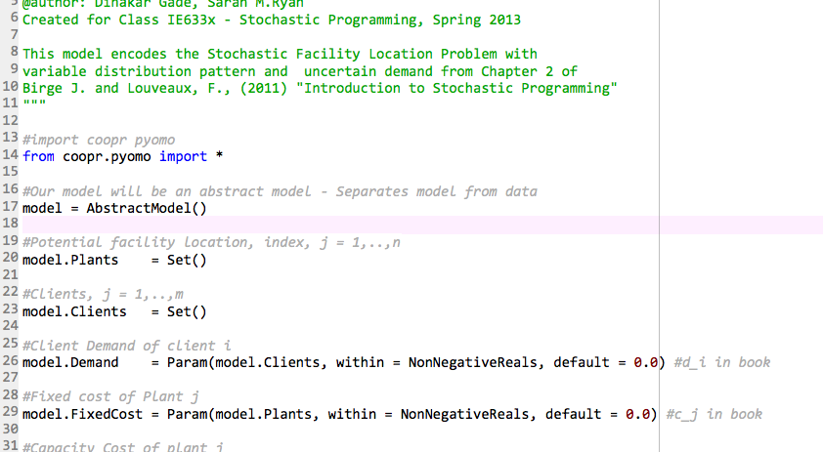
Specifying the Model

Slide 26
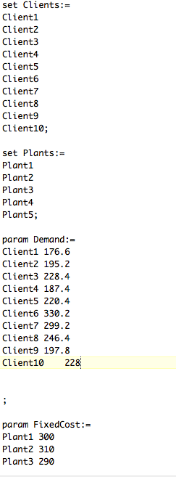
Specifying the data

Slide 27
Solving the deterministic optimization model
Directly from the command line:
pyomo models/ReferenceModel.py scenariodata/AverageScenario.dat --solver=cplex
Options to get the solution:
Results are saved in a file results.json
--show-results prints the contents of results.json in the command window
--summary prints the solution in tabular form in the command window
Pyomo book includes a post-processing plugin to write solution to CSV file
Using a python script from command line
Writing to a (human-readable) LP format file and solving it outside Pyomo
pyomo2lp models/ReferenceModel.py scenariodata/AverageScenario.dat --symbolic-solver-labels

Slide 28
PySP for Stochastic Programming
Specify scenario data files
Specify the scenario tree using the ScenarioStructure.dat file
Solve the stochastic program:
Using the extensive form:
runef -m models -i scenariodata --solve
Using the progressive hedging algorithm:
runph –m models –i scenariodata

Slide 29
Solution Analysis
For our facility location instance with 5 scenarios:
Expected value problem:
Profit = 2377.75
Plants opened = Plant1, Plant4
Total installed capacity = 1823 units
Stochastic program:
Expected Profit = 2295.524
Plants opened = Plant1, Plant2
Total installed capacity = 1985 units
The plant location and installed capacity solution (first-stage variables) of the stochastic program hedges against the future uncertain demands

