Slide 1
SIPLIB 2.0
Progress report

Slide 2
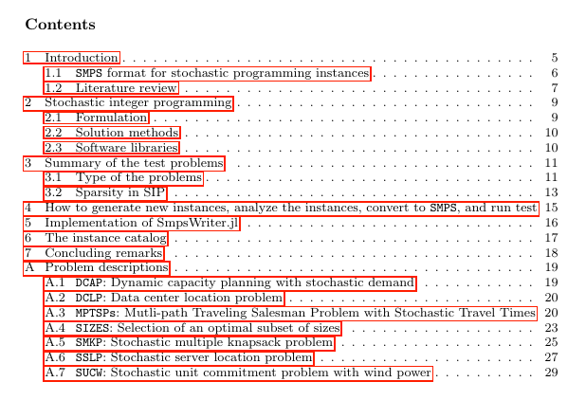
Preparation status
Writing status
70%?
95%?
20%
20%
80%
80%
90%
0% (2 days)
90%
0% (1 day)
50%
10%
90%
90%

Slide 3
1. Introduction – literature review
MIPLIB 2010
5th version
Holmes and Birge’s POSTS
Stochastic linear programming
1994 - present
Ariyawansa and Felt’s test problem collection
Stochastic linear (integer) programming
INFORMS JoC, 2004
2001 - present
Ahmed et al.’s SIPLIB 1.0
Stochastic Integer (linear/nonlinear) Programming
2002 - present

Slide 4
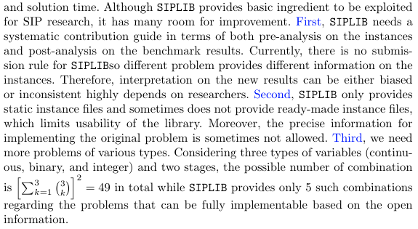
1. Introduction – literature review
SIPLIB 1.0 limitations

Slide 5
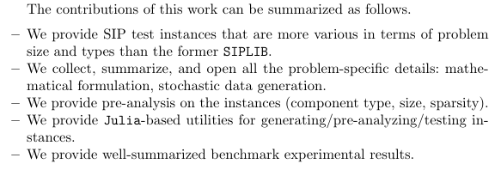
1. Introduction - contributions
SIPLIB 2.0 contributions (in my mind)

Slide 6
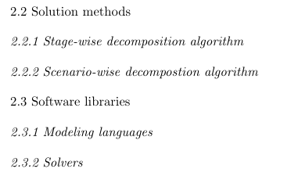
2. SIP (brief review)
Contents Candidates
DD, BD, PH
StructJuMP, PySP
DSP, SMI, FortSP

Slide 7
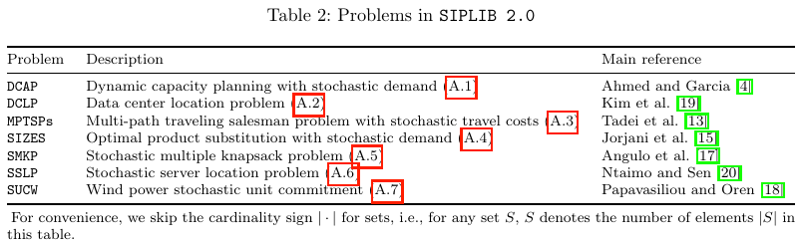
3. Summary of the test problems
3.1. Type of problems: description, source

Slide 8
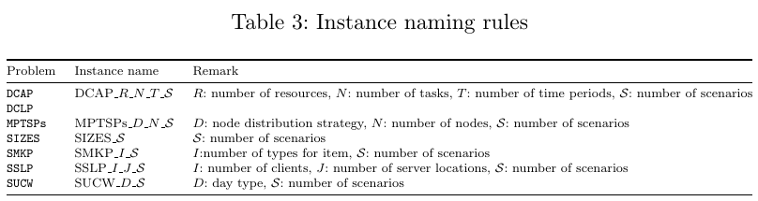
3. Summary of the test problems
3.1. Type of problems: naming rule (for consistency)

Slide 9
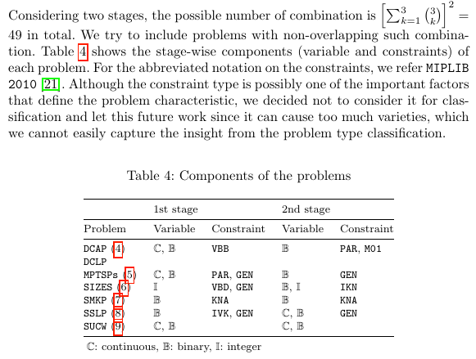
3. Summary of the test problems
3.1. Type of problems: component-based categorization
Currently we have 6 combinations

Slide 10
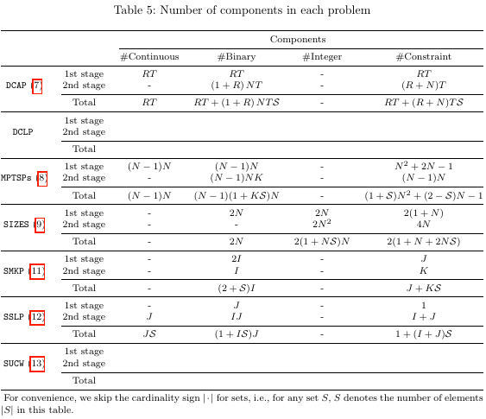
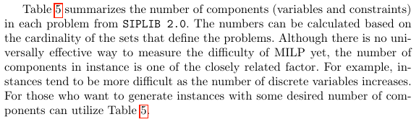
3. Summary of the test problems
3.1. Type of problems: number of components based on set cardinality

Slide 11
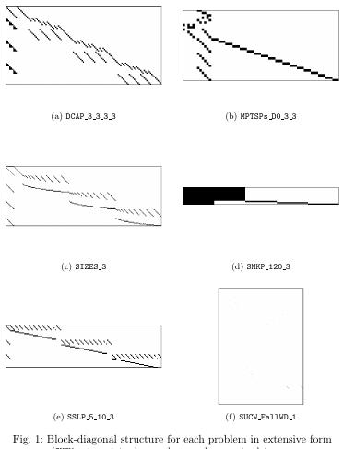
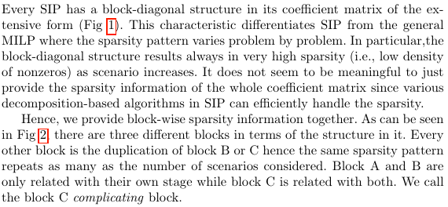
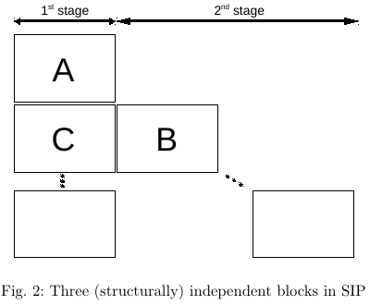
3. Summary of the test problems
3.2. Sparsity in SIP

Slide 12
3. Summary of the test problems
3.2. Sparsity in SIP: sparsity analysis table (to be implemented)
 |  | 1st stage only (block A) |  |  | 2nd stage only (block B) |  |  | Complicating (block C) |  |  | Total
Problem | Instance | #row | #col | %density | #row | #col | %density | #row | #col | %density | #row | #col | %density
DCAP | DCAP_2_3_3_S
 | DCAP_2_4_3_S
 | DCAP_3_3_2_S
 | DCAP_3_4_2_S
MPTSPs | MPTSPs_D_50_S
 | MPTSPs_D_100_S
SIZES | SIZES_S
SMKP | SMKP_120_S
SSLP | SSLP_5_25
 | SSLP_5_50
 | SSLP_10_50
 | SSLP_15_45
SUCW | SUCW_DayType_S

Slide 13
4. ﻿How to generate new instances, analyze the instances, convert to SMPS, and run test
Generation
main.jl
models.jl
functions.jl
types.jl
Analysis
SparsityAnalyzer.jl
Conversion
SmpsWriter.jl
Testing
CPLEX: DSP --algo de
DSP: DSP --algo dd

Slide 14
5. Implementation of SmpsWriter.jl
Converts JuMP.Model to SMPS files
Implemented by exploiting members in JuMP & StructJuMP

Slide 15
6. Instance catalog
Design of experiment
Computation environment

Slide 16
6. Instance catalog
Basic size information table
 |  | 1st stage variables |  |  | 2nd stage variables |  |  | Total |  |  |  |  |  |  | File size
Problem | Instance | #cont1 | #bin1 | #int1 | #cont2 | #bin2 | #int2 | #cont | #bin | #int | #rows | #cols | #nonzeros | %density | .cor | .tim | .sto
DCAP | DCAP_2_3_3_500 | 6 | 6 | 0 | 9 | 18 | 0 | 4506 | 9006 | 0 | 7506 | 13512 | 28512 | 0.0281
 | DCAP_2_3_3_1000 | 6 | 6 | 0 | 9 | 18 | 0 | 9006 | 18006 | 0 | 15006 | 27012 | 57012 | 0.0141
 | DCAP_2_3_3_5000 | 6 | 6 | 0 | 9 | 18 | 0 | 45006 | 90006 | 0 | 75006 | 135012 | 285012 | 0.0028
 | DCAP_2_3_3_10000 | 6 | 6 | 0 | 9 | 18 | 0 | 90006 | 180006 | 0 | 150006 | 270012 | 570012 | 0.0014
 | DCAP_2_4_3_500 | 6 | 6 | 0 | 12 | 24 | 0 | 6006 | 12006 | 0 | 9006 | 18012 | 36012 | 0.0222
 | DCAP_2_4_3_1000 | 6 | 6 | 0 | 12 | 24 | 0 | 12006 | 24006 | 0 | 18006 | 36012 | 72012 | 0.0111
 | DCAP_2_4_3_5000 | 6 | 6 | 0 | 12 | 24 | 0 | 60006 | 120006 | 0 | 90006 | 180012 | 360012 | 0.0022
 | DCAP_2_4_3_10000 | 6 | 6 | 0 | 12 | 24 | 0 | 120006 | 240006 | 0 | 180006 | 360012 | 720012 | 0.0011
 | DCAP_3_3_2_500 | 6 | 6 | 0 | 6 | 18 | 0 | 3006 | 9006 | 0 | 6006 | 12012 | 25512 | 0.0354
 | DCAP_3_3_2_1000 | 6 | 6 | 0 | 6 | 18 | 0 | 6006 | 18006 | 0 | 12006 | 24012 | 51012 | 0.0177
 | DCAP_3_3_2_5000 | 6 | 6 | 0 | 6 | 18 | 0 | 30006 | 90006 | 0 | 60006 | 120012 | 255012 | 0.0035
 | DCAP_3_3_2_10000 | 6 | 6 | 0 | 6 | 18 | 0 | 60006 | 180006 | 0 | 120006 | 240012 | 510012 | 0.0018
 | DCAP_3_4_2_500 | 6 | 6 | 0 | 8 | 24 | 0 | 4006 | 12006 | 0 | 7006 | 16012 | 32512 | 0.029
 | DCAP_3_4_2_1000 | 6 | 6 | 0 | 8 | 24 | 0 | 8006 | 24006 | 0 | 14006 | 32012 | 65012 | 0.0145
 | DCAP_3_4_2_5000 | 6 | 6 | 0 | 8 | 24 | 0 | 40006 | 120006 | 0 | 70006 | 160012 | 325012 | 0.0029
 | DCAP_3_4_2_10000 | 6 | 6 | 0 | 8 | 24 | 0 | 80006 | 240006 | 0 | 140006 | 320012 | 650012 | 0.0015

Slide 17
6. Instance catalog
Solution report
 |  | CPLEX |  |  |  | DSP-DD
Problem | Instance | Best Integer Objective | Best Bound | Relative gap | Time | Master obj. | Primal bound | Dual bound | Apprx. Gap | Duality gap | Time
DCAP | DCAP_2_3_3_500
 | DCAP_2_3_3_1000
 | DCAP_2_3_3_5000
 | DCAP_2_3_3_10000
 | DCAP_2_4_3_500
 | DCAP_2_4_3_1000
 | DCAP_2_4_3_5000
 | DCAP_2_4_3_10000
 | DCAP_3_3_2_500
 | DCAP_3_3_2_1000
 | DCAP_3_3_2_5000
 | DCAP_3_3_2_10000
 | DCAP_3_4_2_500
 | DCAP_3_4_2_1000
 | DCAP_3_4_2_5000
 | DCAP_3_4_2_10000

Slide 18
6. Instance catalog
Need some more good ideas...
Pre- or post- analysis?
Classification?
Categorization?
Status?
 | name | description | example | Usage | How to classify?
1 | LDG (large duality gap) | instances with huge duality gap when solving by DD | MPTSPs | for Lagrangian-type decomposition algorithm | Post-analysis
2 | DS (difficult subproblem) | instances with difficult subproblems when solving by DD | SMKP, SUCW | for Lagrangian-type decomposition algorithm | Post-analysis
3 | PC2 (pure cont. 2nd stage) | instances with pure continuous 2nd stage | DCLP | for Benders-type decomposition algorithm | Pre-analysis
4 | HD2 (high density 2nd stage) | high density 2nd stage | SMKP |  | Pre-analysis
5 | HDC (high density complicating block) | high density complicating block | SMKP, DCAP | for any type of decomposition algorithm | Pre-analysis

