Slide 1
Investigating the feasibility of the Bluetooth Low Energy Man-in-the-middle frameworks GATTacker and BtleJuice
Arne Zismer
Rahaf Mousa
Leandro Velasco

Slide 2
Introduction
Research Question:
  In how far can the Man-in-the-middle frameworks GATTacker and BtleJuice be used to investigate the security of Bluetooth Low Energy devices?

Slide 3
Related Research
Secure Simple Pairing
Bluetooth - No Input, No Output - Man-In-The-Middle attack
Ubertooth - Bluetooth: With Low Energy Comes Low Security

Slide 4
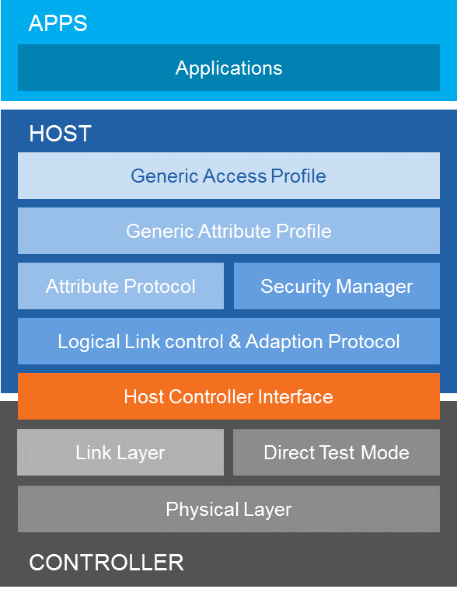
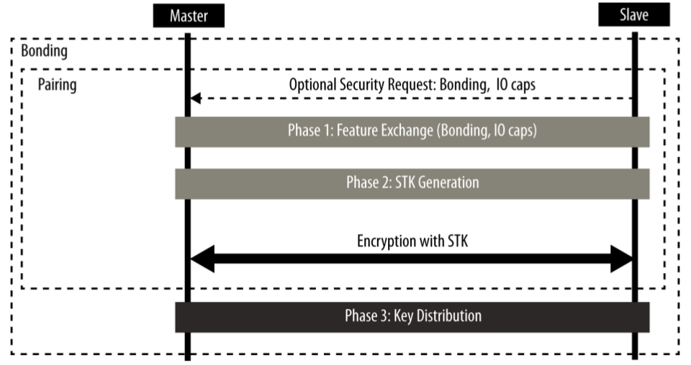
Theoretical Background
Bluetooth with Low Energy

Slide 5
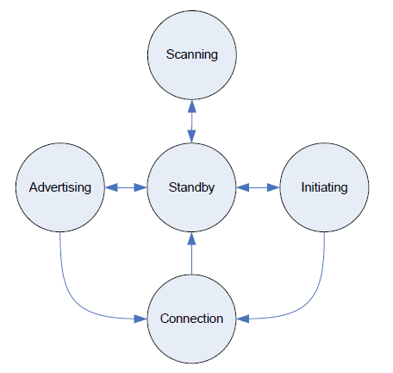
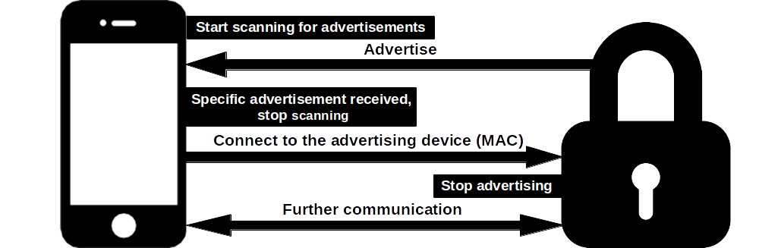
Theoretical Background
Bluetooth with Low Energy

Slide 6
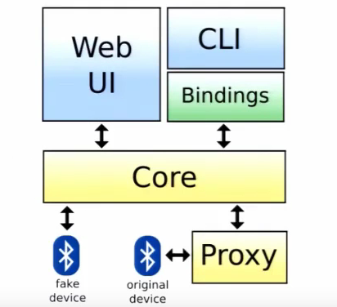
Theoretical Background
BtleJuice Smart MITM Framework

Slide 7

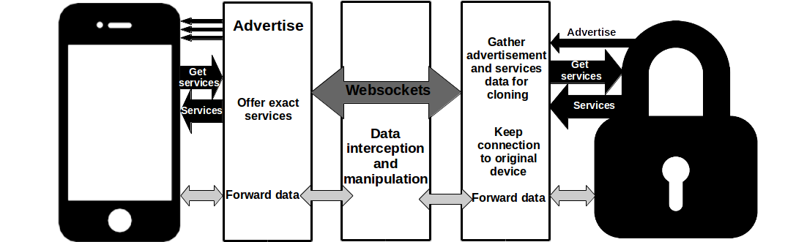
Theoretical Background
GATTaker Smart MITM Framework

Slide 8

Methodology
Experiments Design
  Keyboard
  iTAG
  ViVoFit
Approach
  No MITM
  GATTacker
  BtleJuice

Slide 9
Results
Keyboard
Implements security at the link layer
  Security Manager Pairing with Bonding.
BtleJuice & GATTacker
  Both frameworks try to gather as much data as possible without pairing.
  Both frameworks performed “BT Niño Attack”.

Slide 10
Results
ITAG - cTracing
Does not implement security at the link layer
  No Security Manager Pairing.
BtleJuice & GATTacker
  Both frameworks succeeded to perform the MITM attacks.
  Due to a bug in the BtleJuice framework, connection with iTAG not stable.

Slide 11
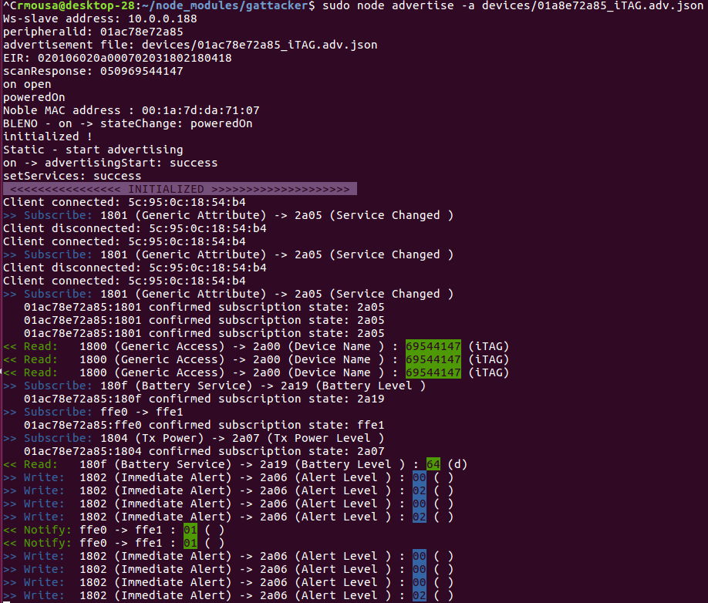
Results
GATTacker output of the MITM attack to ITAG :

Slide 12
Results
Garmin ViVoFit - Connect
Does not implement security at the link layer
  No Security Manager Pairing.
BtleJuice & GATTacker
  BtleJuice framework succeeded to perform the MITM attack.
  GATTacker stalls during the GATT service exploring.

Slide 13
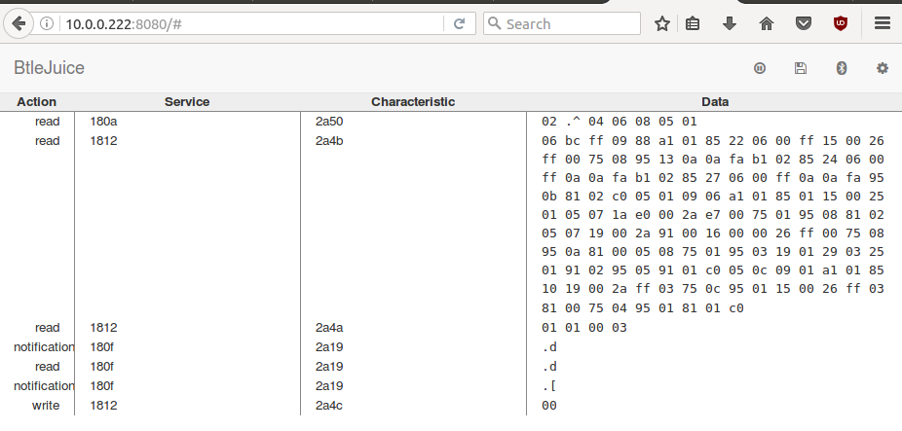
Results
BtleJuice output of the MITM attack to ViVOFit :

Slide 14
Discussion
Limitations
  Frameworks stability
  Usability
  Learning curve
Future Work
  Analyze and temper information exchanged between ViVoFit and mobile app.
  Use framework python bindings for automated attacks.
  Re-study field once the frameworks are improved.

Slide 15
Conclusion
  In how far can the Man-in-the-middle frameworks GATTacker and BtleJuice be used to investigate the security of Bluetooth Low Energy devices?
  Even though some attacks succeeded, the frameworks are still unstable making the security analysis cumbersome.

Slide 16

Questions

