Slide 1
Attention Model
성균관대학교 소프트웨어학과
이 지 형

Slide 2
Sequence Generation
실제로 기계번역을 해보면 잘 안된다.
RNN의 문제 (Vanishing)
Error가 크게 누적된다.
Encoder-Decoder Scheme
Encoder: compress input sequence into one vector
h₃ is the vector representation of the given sequence
Decoder: uses this vector to generate output
It extracts necessary information only from the vector
사람은 번역 시..
나는 번역 -> I
가다 번역 -> go
반면에 RNN은..
x
y
z
h₁
h₂
h₃
h₃
h₄
h₅
h₆
A
B
C
eos
x
y

Slide 3
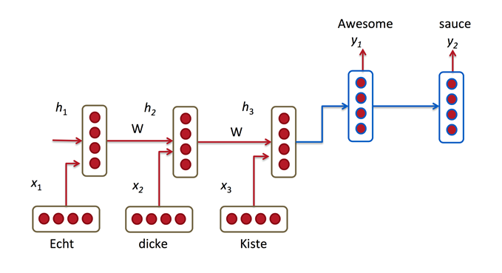
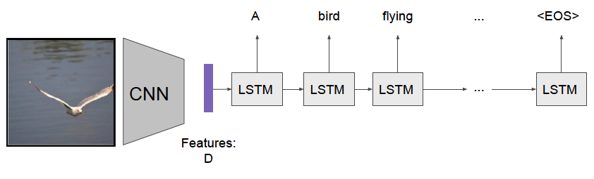
Sequence Generation
Encoder-Decoder Scheme
RNNs or CNNs can be used as Encoders
RNNs are usually used as Decoders
http://www.wildml.com/2016/01/attention-and-memory-in-deep-learning-and-nlp/
Attention Models, Amaia Salvador, 2017

Slide 4
Sequence Generation
Challenges
Hard for encoder to compress the whole source sentence into a single vector
Performance is degraded as the length of sentence increases
A single vector may not enough for decoder to generate correct words
o₁
o₂
o₃
h₁
h₂
h₃
h₃
h₄
h₅
h₆
x₁
x₂
x₃
eos
o₁
o₂

Slide 5

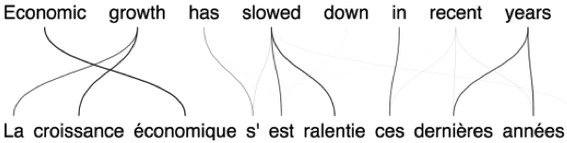

Attention Model
Observation
At every step, all the inputs are not equally useful
Inputs relevant to the context may be more useful
Kyunghyun Cho, “Introduction to Neural Machine Translation with GPUs” (2015)

Slide 6
Attention Model
Overview
학교에
o_{t}
나는
h_{t-1}
h_{t}
Weighted summation
of each input considering context
z
context
Attention Module
지금 이순간..
어떤 입력에 더 신경을 써야하지?? 를 고르기 위한 판단 기준
input
x₁
x₂
…
x_{n}
To school

Slide 7
Attention Model
o_{t}
Overview
h_{t-1}
h_{t}
Weighted summation
of each input considering context
z
context
구조의 변경은 언제나 가능
Attention Module
input
x₁
x₂
…
x_{n}

Slide 8
Attention Model
o_{t}
Overview
h_{t-1}
h_{t}
z
context
구조의 변경은 언제나 가능
Attention Module
input
x₁
x₂
…
x_{n}

Slide 9
Attention Model
Attention Module
All inputs share the same NN for matching degree
z
각 Input(xi)의 유용도
출력노드 1, sigmoid
Z = 0.1x1 + 0.1x2+ 0.8x3
X1은 임베딩값
+
X
X
X
s₁
s₂
s_{n}
Softmax
m₁
m₂
m_{n}
NN
(Matching degree)
NN
(Matching degree)
NN
(Matching degree)
c
I (x1)가 얼마나 유용할까?
input
x₁
x₂
…
x_{n}

Slide 10
Attention Model
Step 1: Evaluating Matching Degree
Evaluating matching degree of each input to the context
Produce scalar matching degree (Higher value is higher attention)
All inputs share the same NN
z
+
End-to-End로 학습된다. Error 로..
X
X
X
s₁
s₂
s_{n}
Softmax
m₁
m₂
m_{n}
NN
(Matching degree)
NN
(Matching degree)
NN
(Matching degree)
c
input
x₁
x₂
…
x_{n}

Slide 11
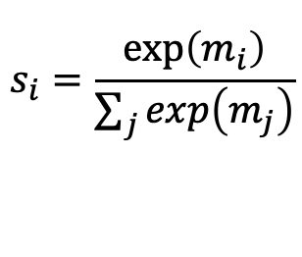
Attention Model
Step 2: Normalizing Matching Degree
z
+
X
X
X
s₁
s₂
s_{n}
Softmax
m₁
m₂
m_{n}
NN
(Matching degree)
NN
(Matching degree)
NN
(Matching degree)
c
input
x₁
x₂
…
x_{n}

Slide 12
Attention Model
Step 3: Aggregating Inputs
Each input is scaled by s_{i} and summed up into z
z is the input focused on the current context
z
+
X
X
X
s₁
s₂
s_{n}
Softmax
m₁
m₂
m_{n}
NN
(Matching degree)
NN
(Matching degree)
NN
(Matching degree)
c
input
x₁
x₂
…
x_{n}

Slide 13
Attention Model
Overview
o_{t}
Weighted summation
of each input considering context
h_{t-1}
h_{t}
z
+
X
X
X
context
s₁
s₂
s_{n}
Softmax
m₁
m₂
m_{n}
NN
(Matching degree)
NN
(Matching degree)
NN
(Matching degree)
input
x₁
x₂
…
x_{n}

Slide 14
Attention Model
Variation
Matching NN can be replaced with the inner products of inputs and context
뉴럴 네트워크는 내적으로 대체 가능하다.
내적은 전산 분야에서 문서의 유사도를 구하는 개념으로 많이 사용된다.
https://ihwoo.tistory.com/49
+
X
X
X
s₁
s₂
s_{n}
Softmax
m₁
m₂
m_{n}
<,> (inner product)
<,> (inner product)
<,> (inner product)
input
x₁
x₂
…
x_{n}

Slide 15
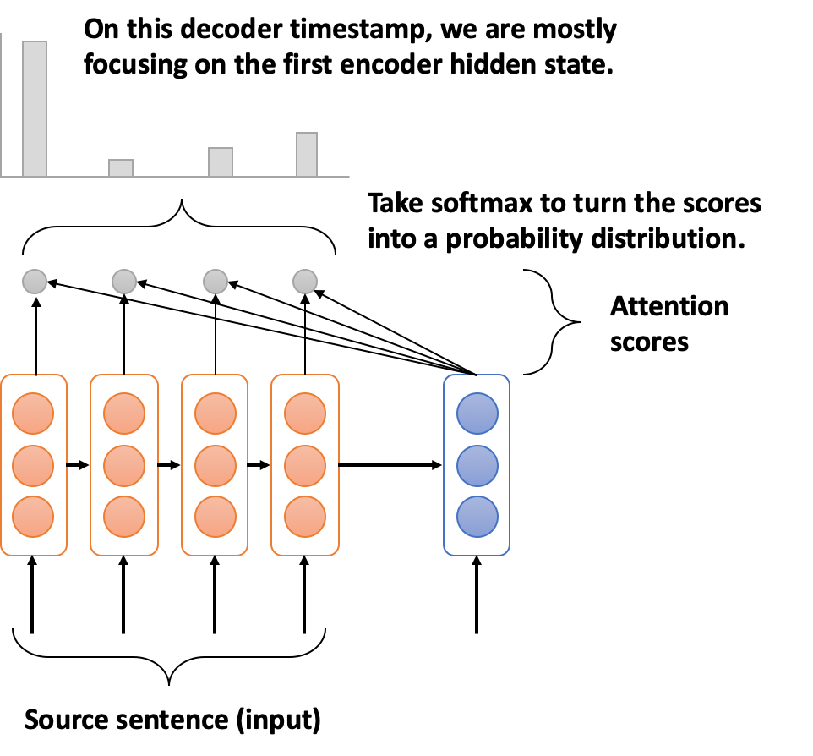
Seq2Seq with Attention

Slide 16
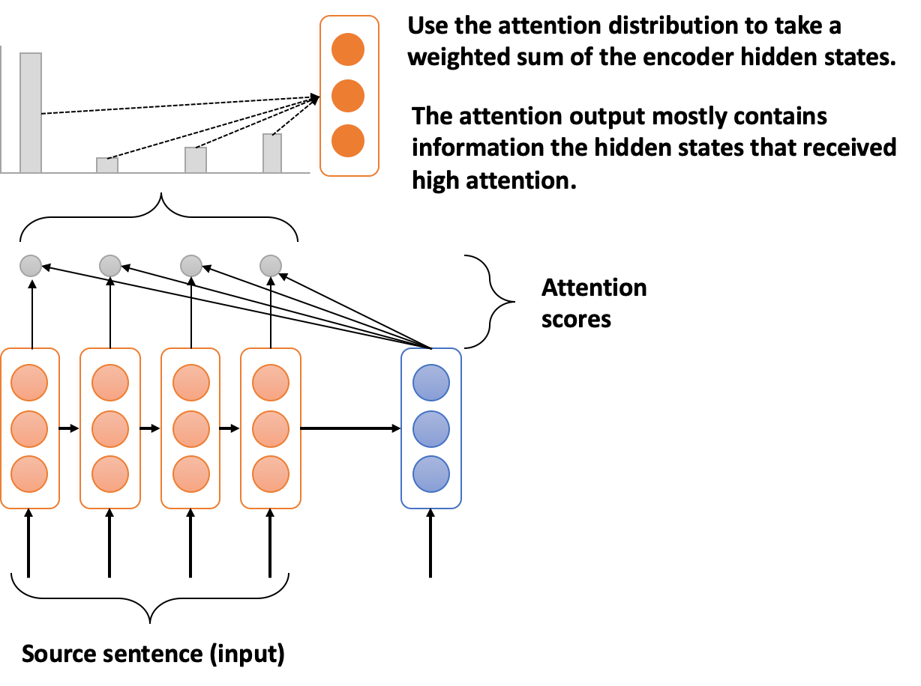
Seq2Seq with Attention

Slide 17
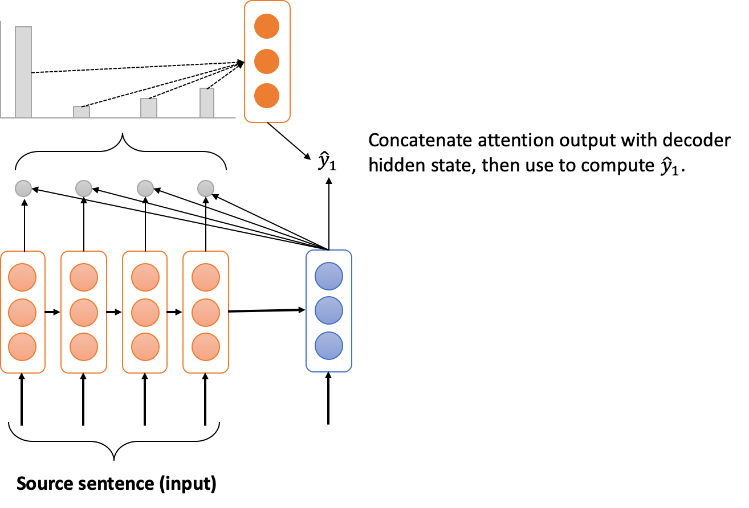
Seq2Seq with Attention

Slide 18
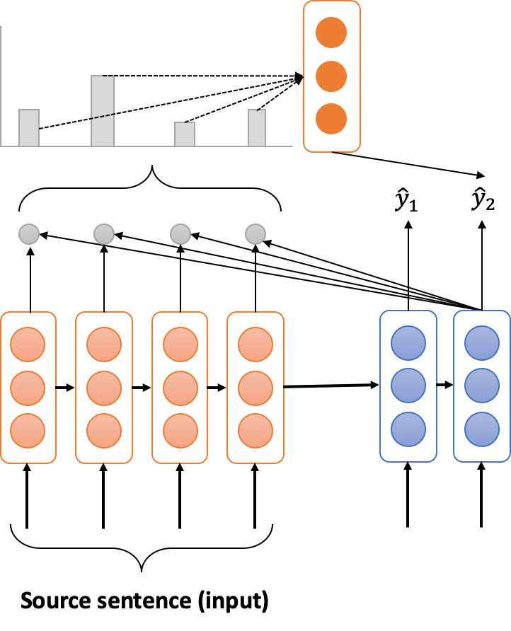
Seq2Seq with Attention

Slide 19
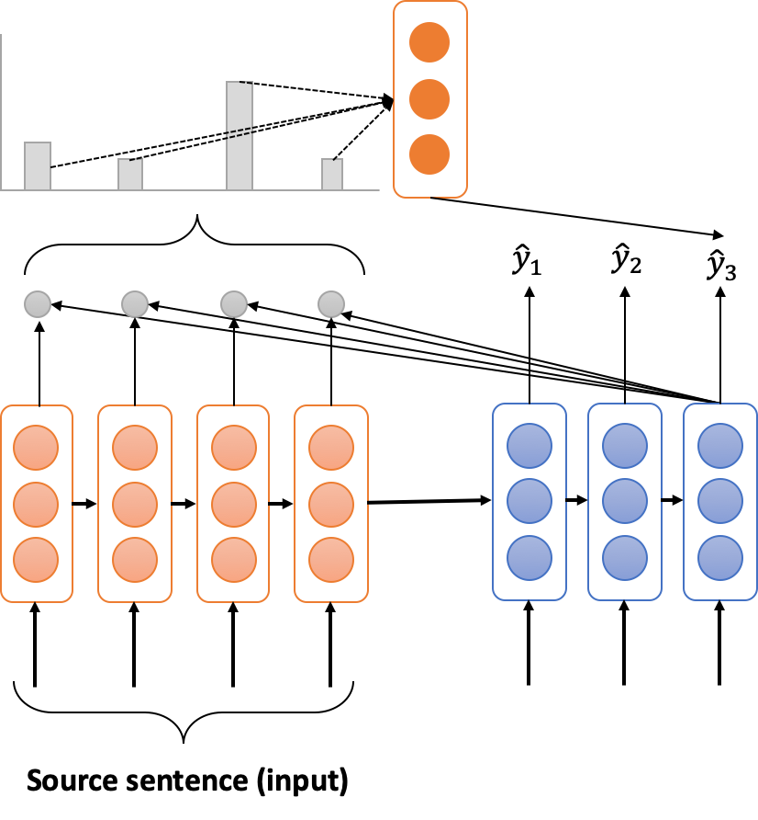
Seq2Seq with Attention

Slide 20
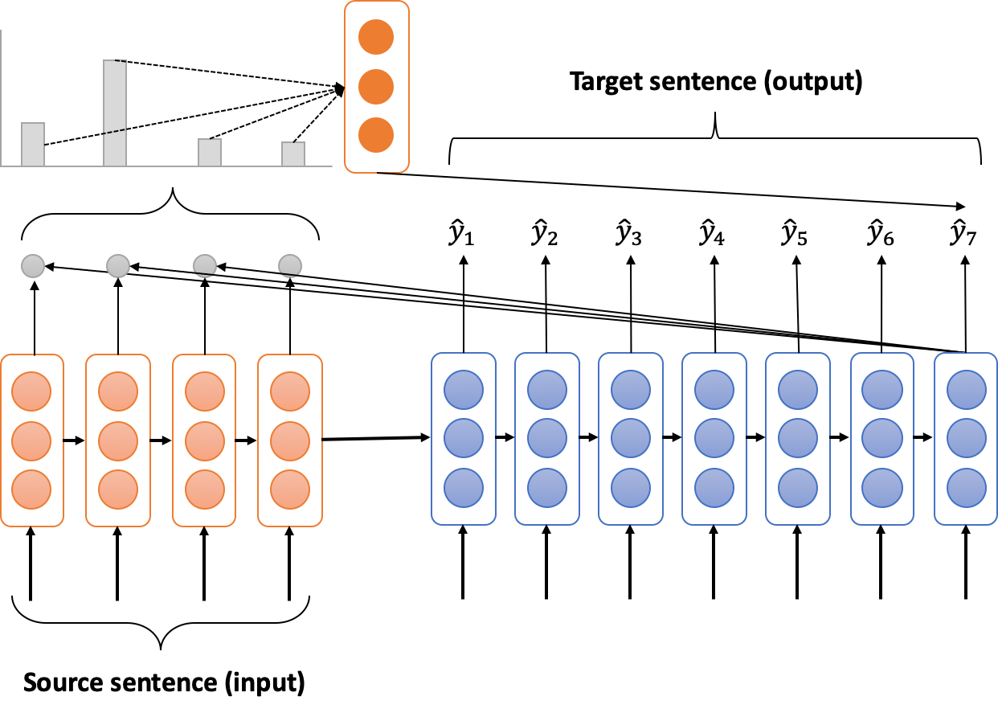
Seq2Seq with Attention

Slide 21
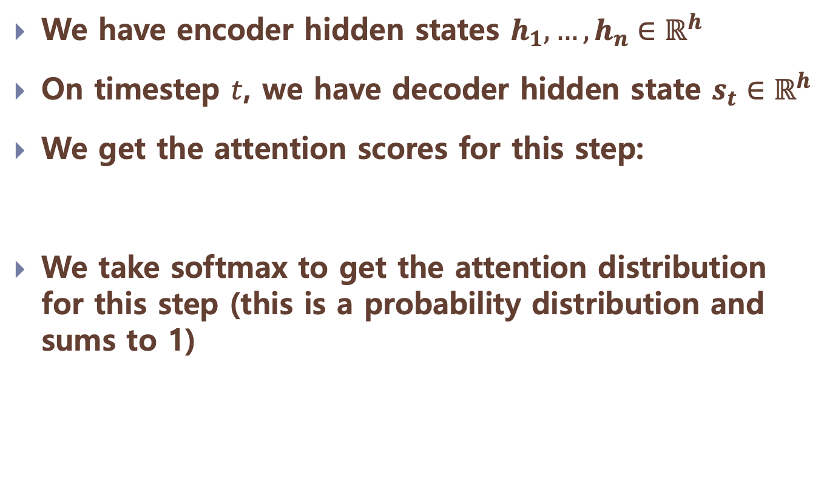
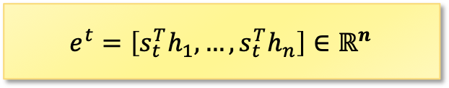
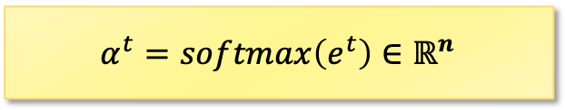
Attention in Equations

Slide 22
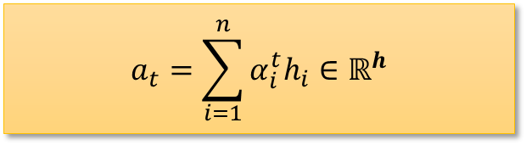

Attention in Equations
We use to take a weighted sum of the encoder hidden states to get the attention output
Finally, we concatenate the attention output with the decoder hidden state and proceed as in the non-attention seq2seq model.

Slide 23
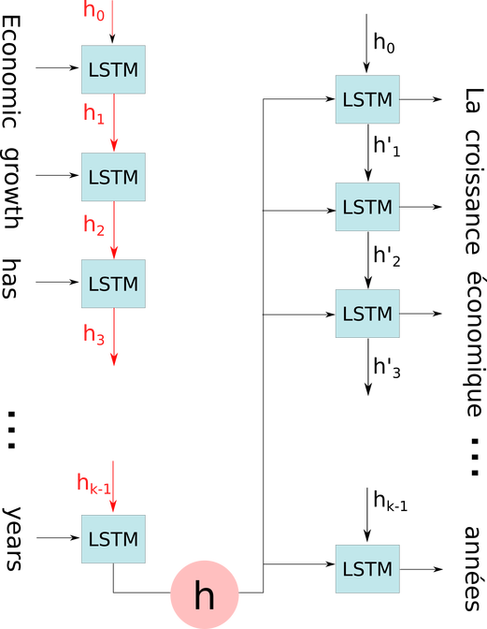
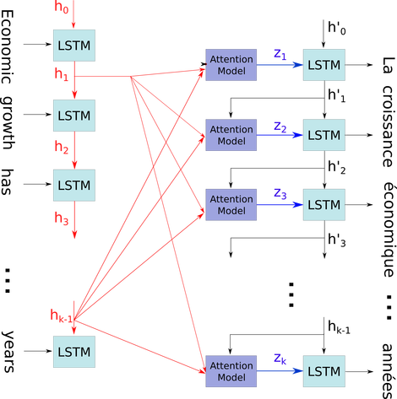
Attention Model
Example
Encoder-decoder model
Attention based model
https://blog.heuritech.com/2016/01/20/attention-mechanism/

Slide 24
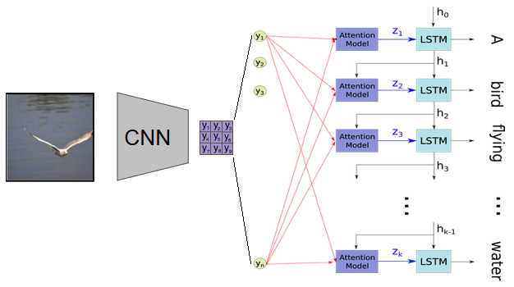
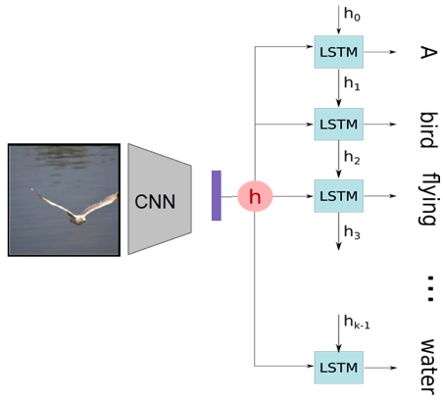
Attention Model
Example
Encoder-decoder model
Attention based model
Attention Models, Amaia Salvador, 2017
https://blog.heuritech.com/2016/01/20/attention-mechanism/

Slide 25
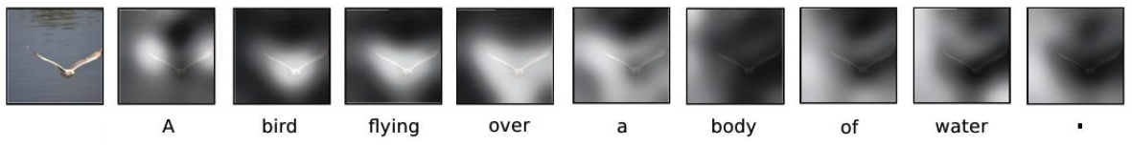
Attention Model
One more advantage
We can interpret and visualize what the model is doing
Kyunghyun Cho, “Introduction to Neural Machine Translation with GPUs” (2015)
Xu et al. Show, Attend and Tell: Neural Image Caption Generation with Visual Attention. ICML 2015

Slide 26
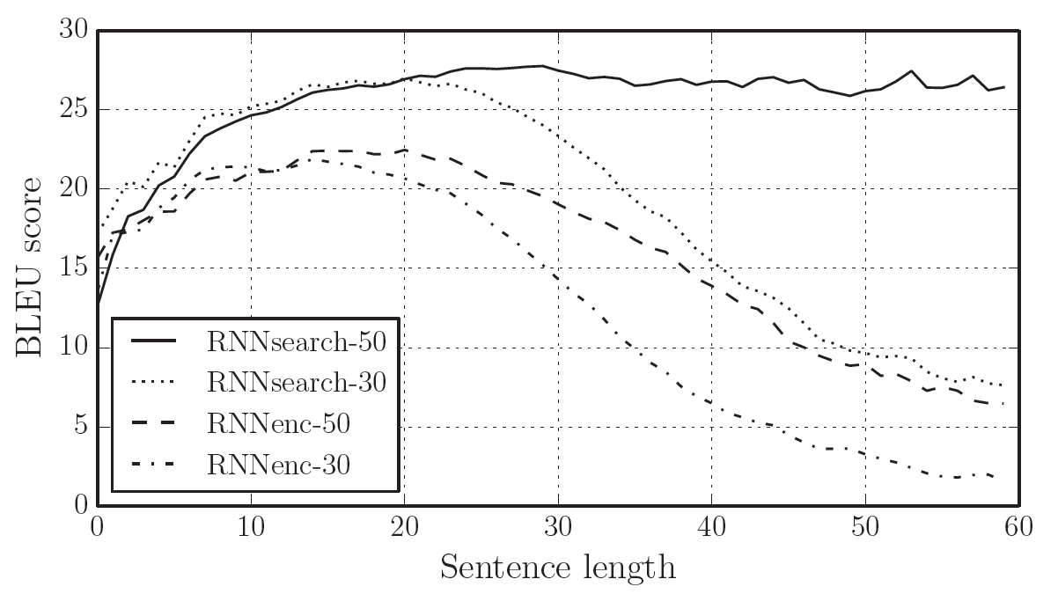
Attention is Great!
RNNsearch-50 is a neural machine translation model with the attention mechanism trained on all the sentence pairs of length at most 50.
Dzmitry Bahdanau, KyungHyun Cho, Yoshua Bengio, “Neural Machine Translation by Jointly Learning to Align and Translate,” ICLR 2015

Slide 27
Attention is Great!
Attention significantly improves NMT performance.
It’s very useful to allow decoder to focus on certain parts of the source.
Attention solves the bottleneck problem.
Attention allows decoder to look directly at source; bypass bottleneck.
Attention helps with vanishing gradient problem.
Provides shortcut to faraway states.
Attention provides some interpretability.
By inspecting attention distribution, we can see what the decoder was focusing on.
We get alignment for free!
This is cool because we never explicitly trained an alignment system
The network just learned alignment by itself.

Slide 28
Question and Answer

