Slide 1
Phylogenetic and Phylogeographic meta-analysis of Cytochrome c Oxidase I barcode sequences of East African arthropods submitted into the Barcode of Life Database
Supervisors:
Dr Scott Miller
Dr Jandouwe Villinger
Dr Steven Ger
Presented by:
Kibet Rono Gilbert
DRIP fellow
Collaborators:
Dr Caleb Kipkurui
Dr Jean-Baka Domelevo
Dr Daniel Masiga

Slide 2
Background
Identification and classification of organisms:
Morphology-based identification systems – extensive information (ecology, anatomy, physiology); expensive, slow and needs expertise
Molecular-based system – efficient (fast and effective); dependent on reference libraries of DNA barcode -short and standardized genes or regions thereof used in identification and discovery of species
The Consortium for the Barcode of Life (CBOL), May 2004: To aid rapid and inexpensive identification of millions of species using DNA barcodes
  International Nucleotide Sequence Database Collaborative (INSDC): GenBank, the European Molecular Biology Lab in Europe, and the DNA Data Bank of Japan
  Barcode of Life Database (BOLD): University of Guelph in Ontario

Slide 3
Background
A 658 base-pair 5’ region of mitochondrial cytochrome c oxidase subunit I (COI/COXI) gene is the standard the barcode for most animal groups
Problem statement:
Thousands of East African COI sequences from voucher arthropods submitted into the BOLD database and are yet to be analysed comprehensively: *phylogenetic* diversity and phylogeographic distribution
Objectives:
Improve phylogeographic and *phylogenetic* diversity descriptions of arthropod in East Africa.
Identify the cryptic species that may not yet be recognized and may be potential crop pests or vectors of human and animal diseases.

Slide 4
Workflow
Data Access
BOLD-Systems via API
Over 36,000 sequences
+
10,000 records
(5000 sequences)
Expected to grow
+
Seqs from select
African countries
Data Clean-up
and sorting
R (tidyverse package)
Awk and bash
Bioinformatics
Pipeline Tests:
Alignment
(PASTA, T_coffee, MUSCLE,
MAFFT, SATe)
Phylogenetics
(RaxML, FastTree)
Phylogeography
(BASTA/BEAST)
Tools
Git & GitHub
Linux System
R & Python
Progress Reports
Manuscript
Thesis
Publications
Run Pipelines
High Performance
Computing (HPC)
Data analysis

Slide 5
Data Mining and Clean up
Sequence retrival:
BOLD-Systems via API; using specific syntax:
“arthropoda Kenya Uganda Tanzania Rwanda Burundi”
Data clean up:
R (tidyverse package), Awk and Bash
Metadata (80 columns)
'COI-5P' = 35990 out of 37257 (1 sample)
#nucleotides / unaligned seqs / #ns
Over 700 (592) | Under 500 (705) | 500 -700 (34693) | 650 -660 (21886) | Over 500 (35285)
1 sample | 1 sample | 3 samples | 2 samples
Build.fasta: ProcessID | order | seq_len | seq

Slide 6
Multiple Sequence Alignment
Large dataset:
Accuracy
Speed
Algorithms:
Progressive (mafft/muscle)
Progressive & transivity (pasta)
Regressive (T_coffee)
MUSCLE: default | MAFFT: --large G-INS-1 | T_coffee: -reg | PASTA: default | SATe
Fast speed | Fast speed | Fast speed | Fast speed | NA
Low accuracy | High accuracy | High accuracy | High accuracy | NA
Refine Align Merge | Align Add sequence Add_fragments Merge | Align Evaluate: (CORE index TCS) | Align Add fragments | NA

Slide 7
Multiple Sequence Alignment evaluation
Evaluation for Accuracy:
T_coffee: consistency based scoring
CORE index (html)
Transitive Consistency Scores (TSC) (html/ascii)
Purpose:
Used to select the most suitable alignments.
TCS ascii to used in applying different weights to columns in phylogenetic analysis

Slide 8
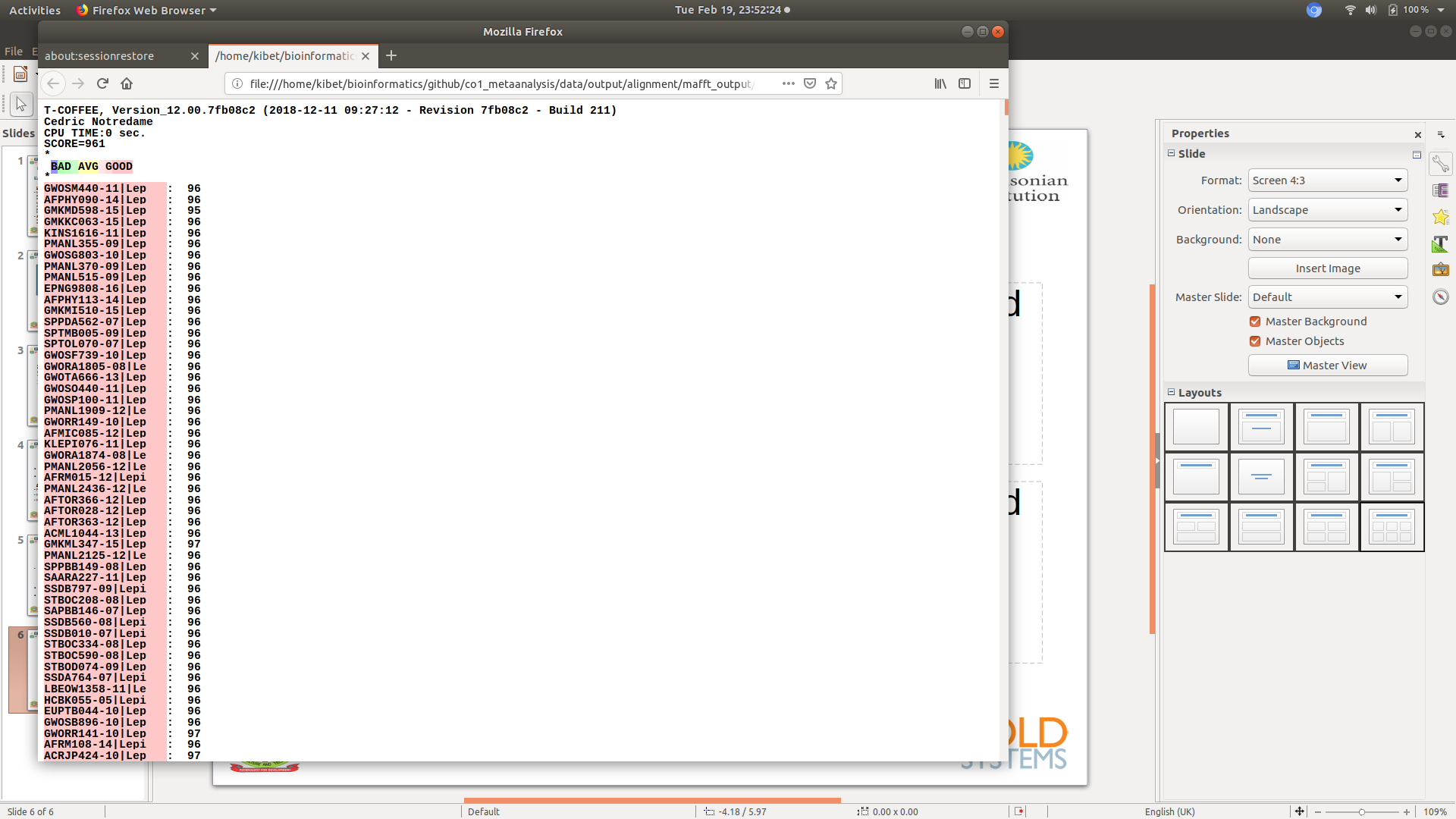
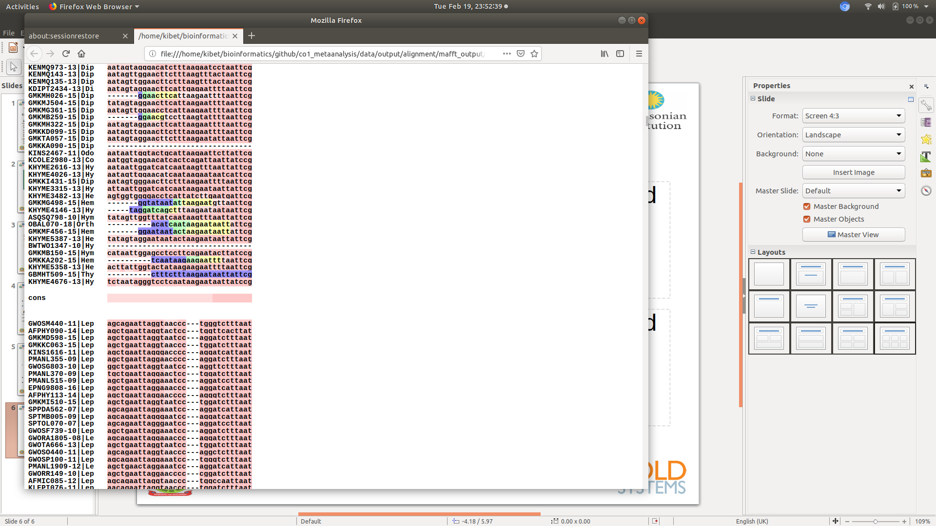
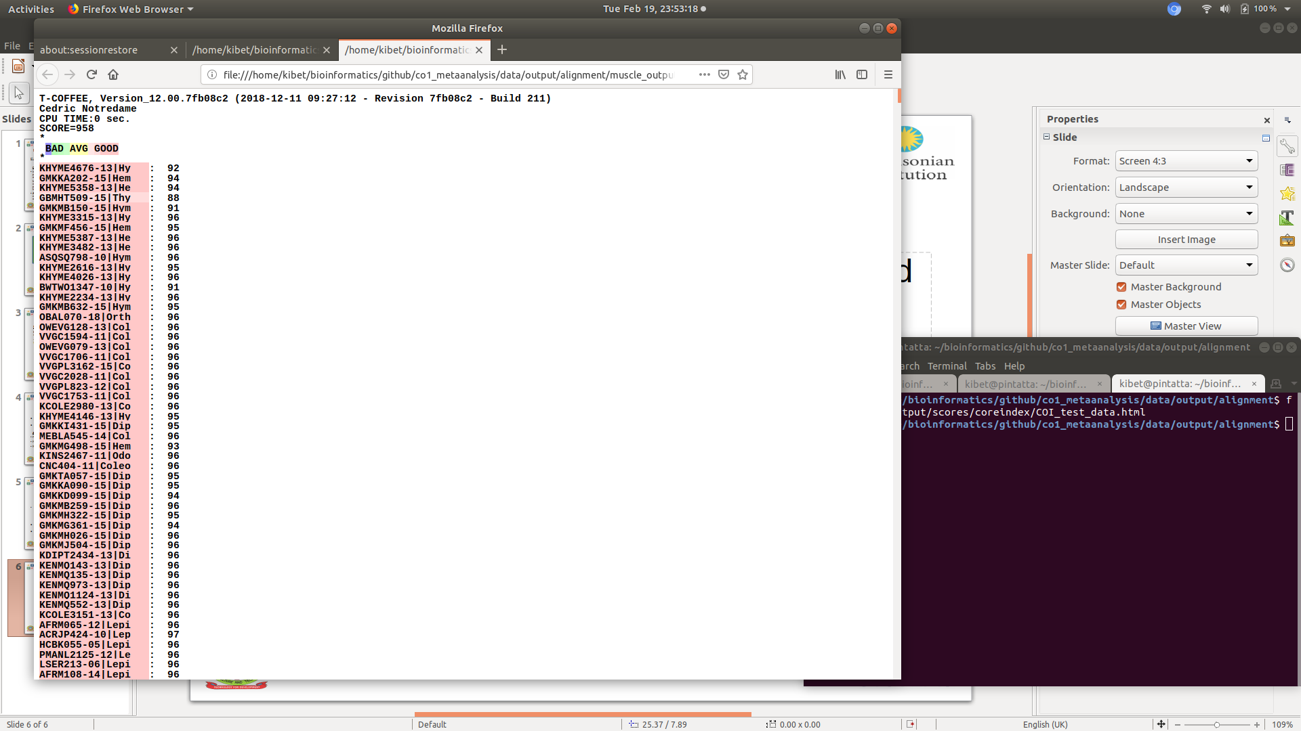
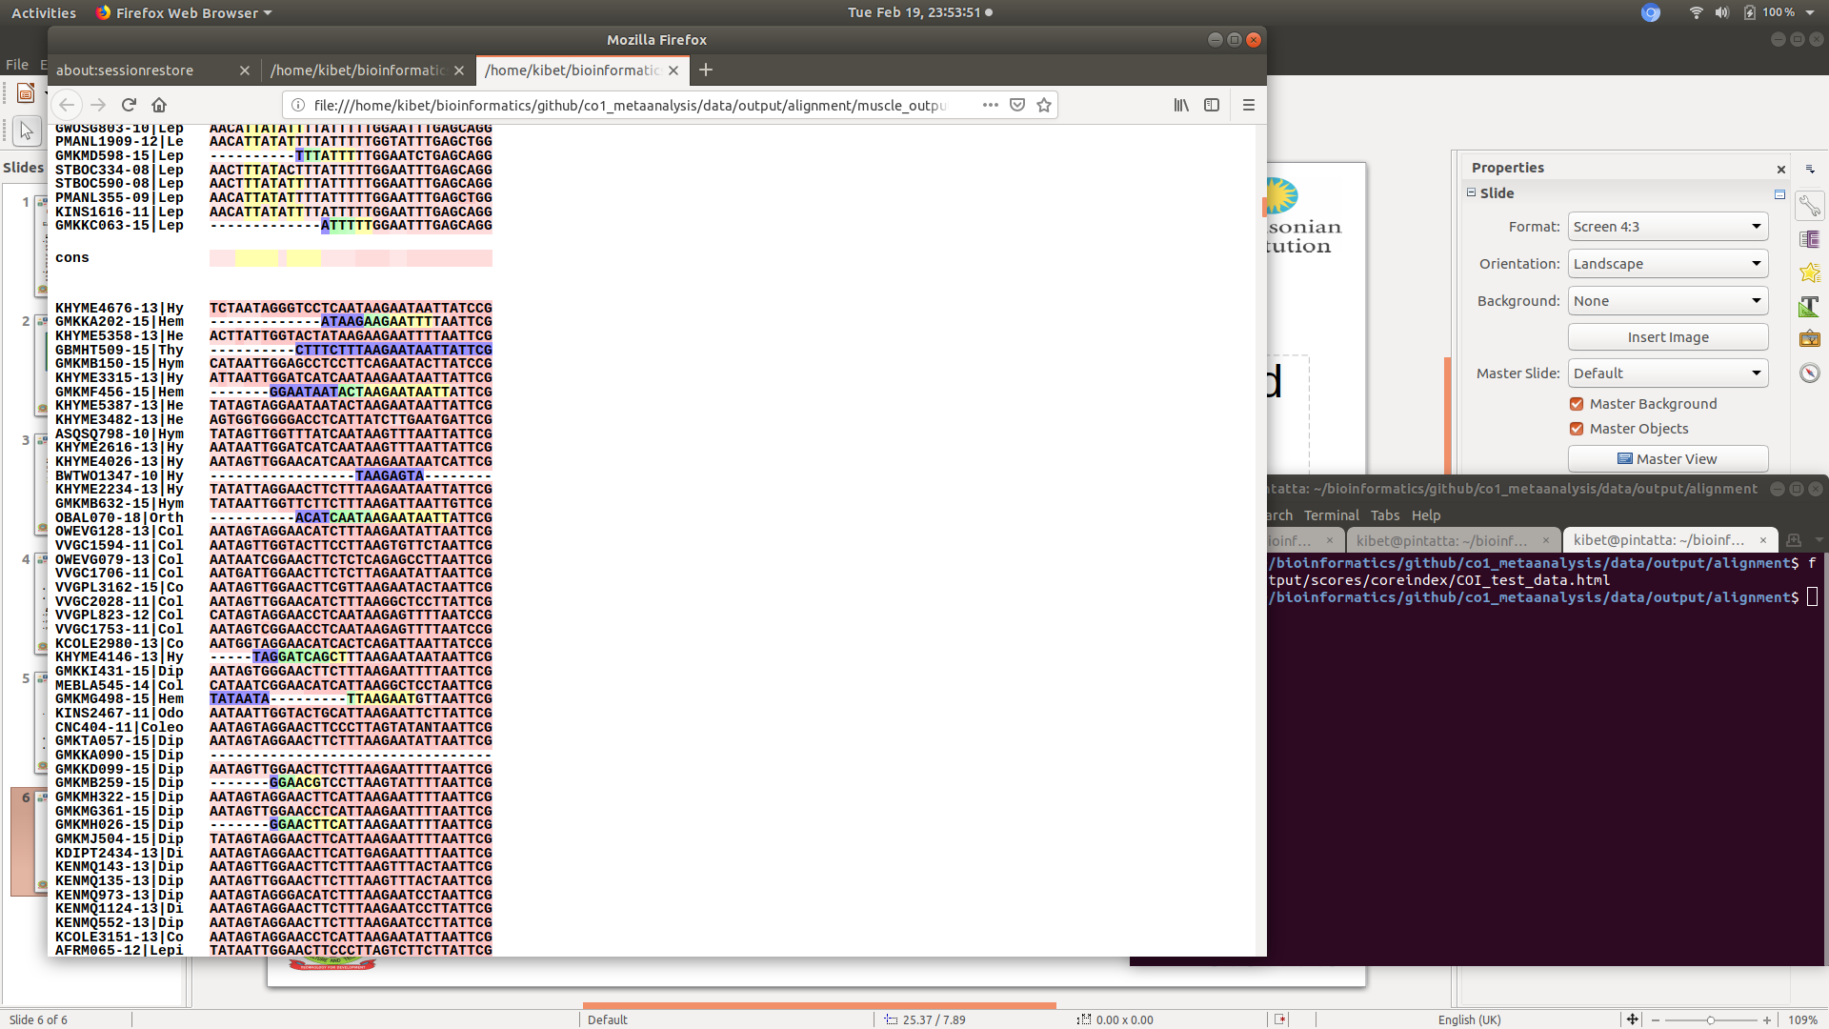
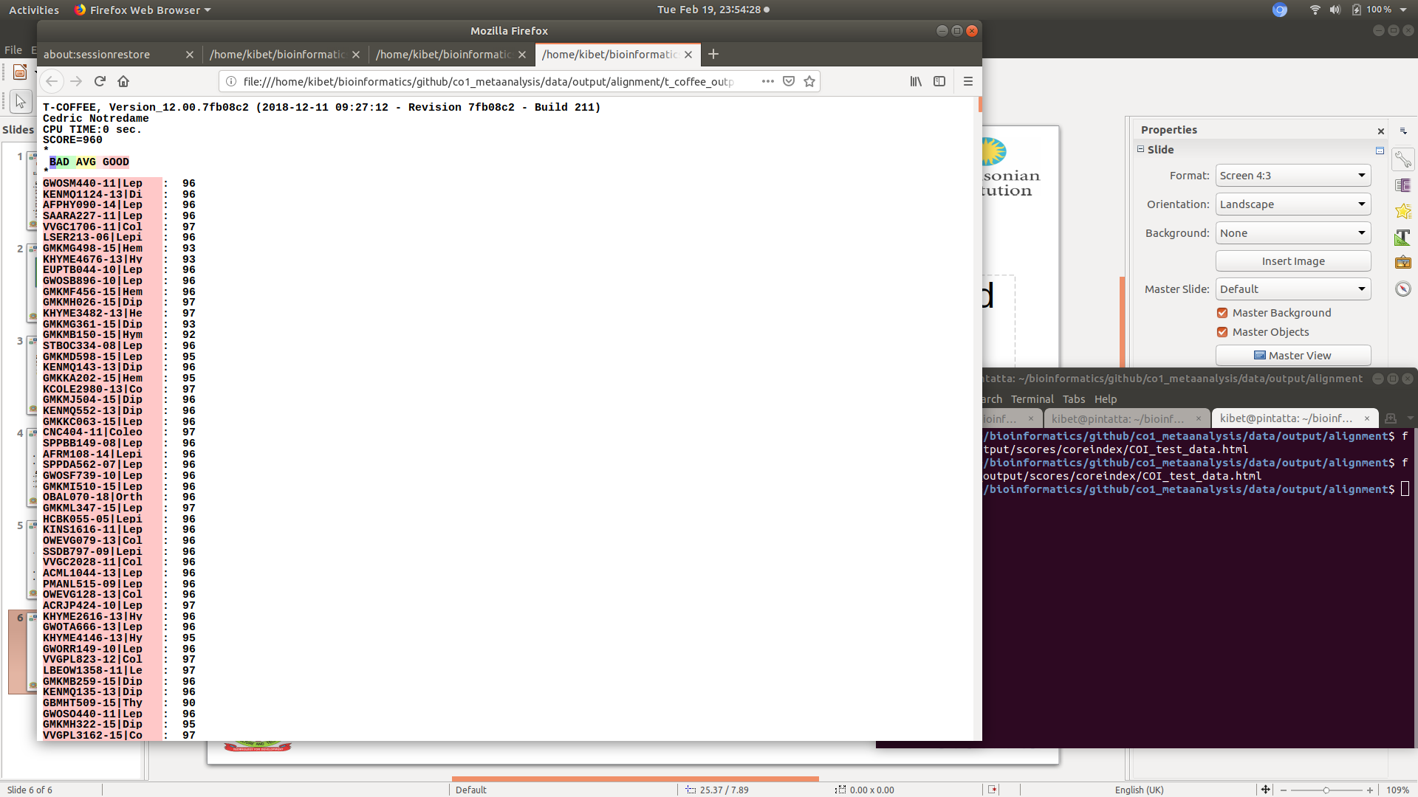
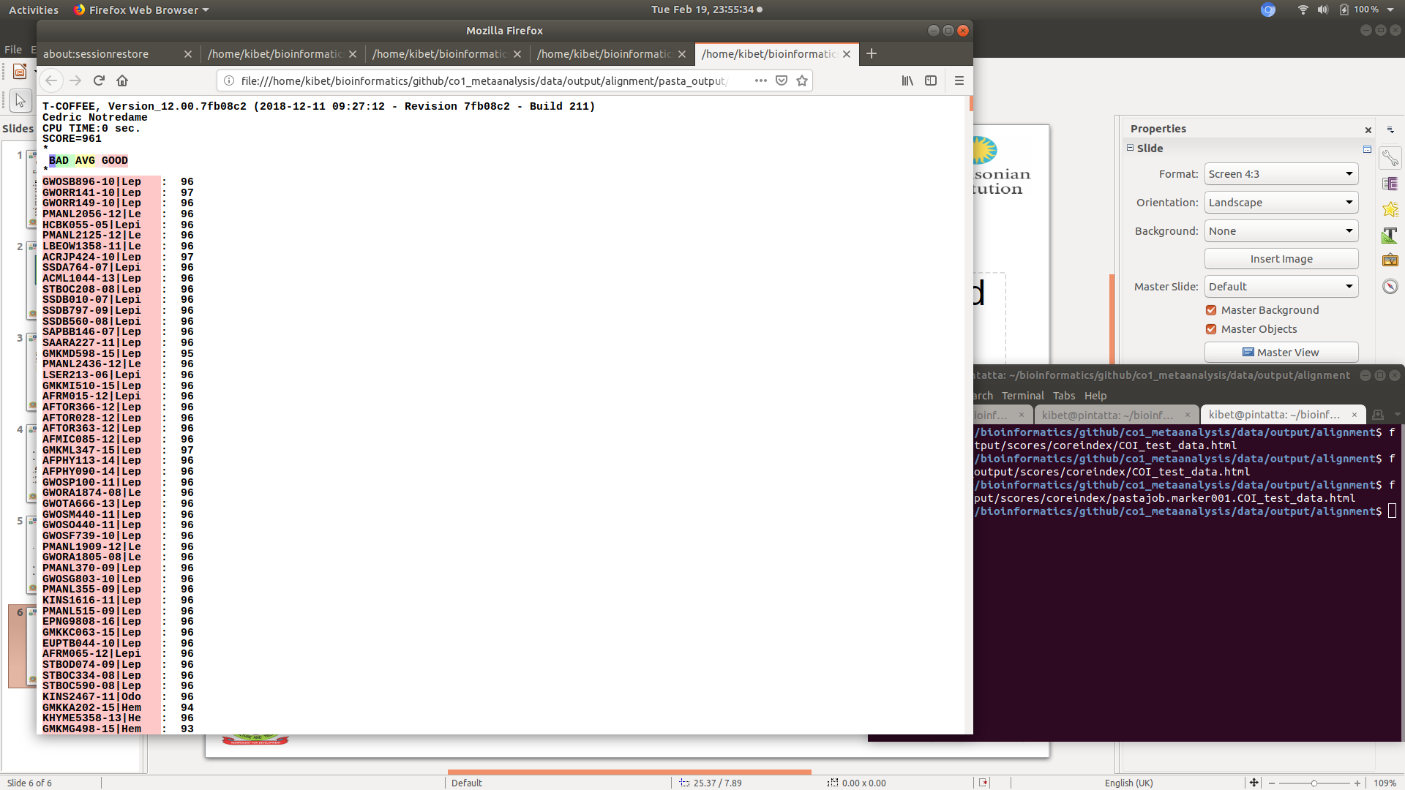
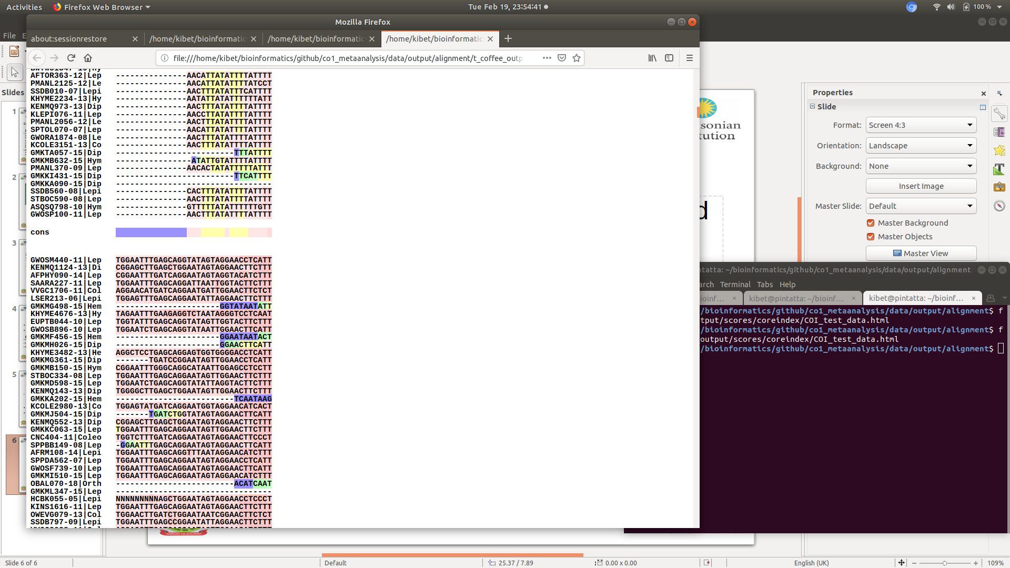
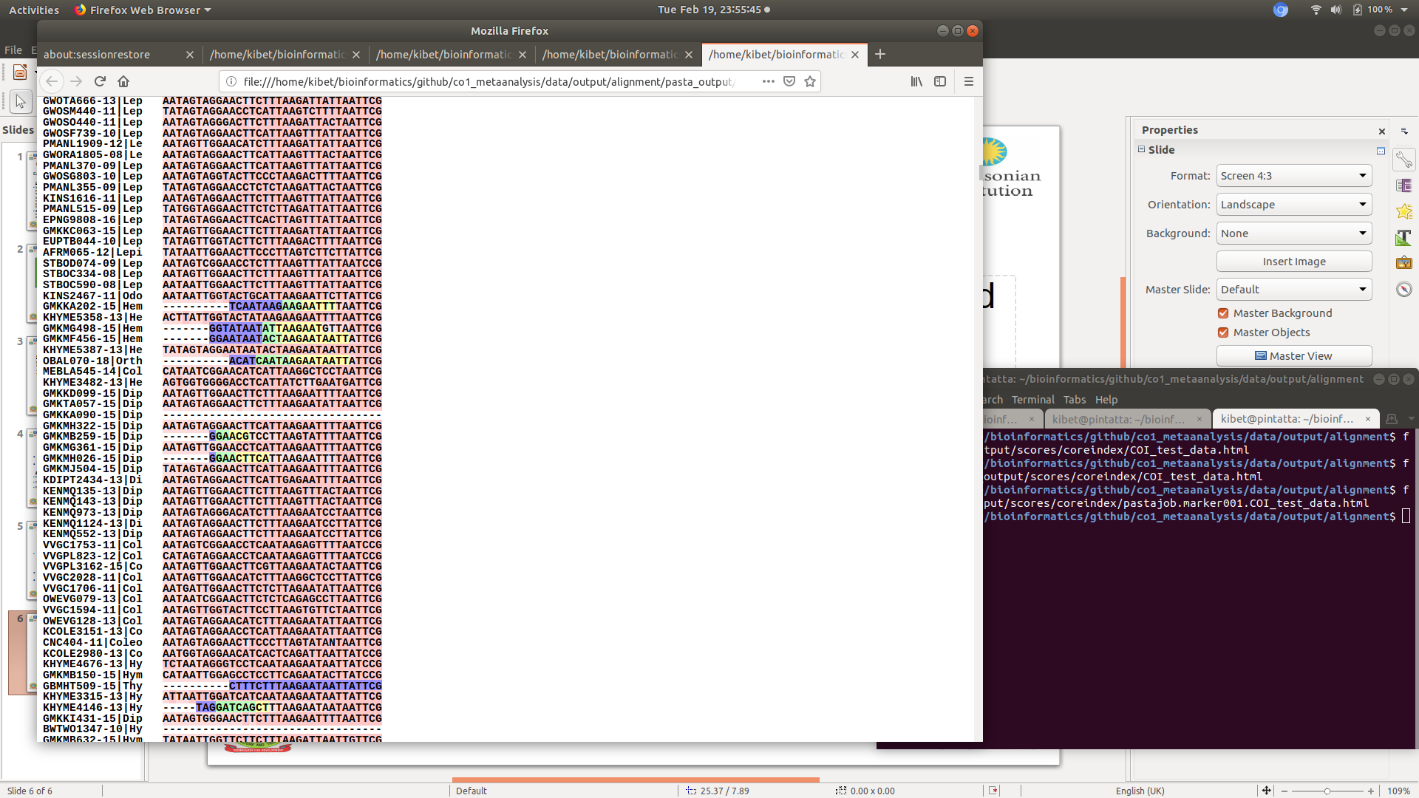
T_coffee consistency based
Multiple Sequence Alignment evaluation
MAFFT
MUSCLE
T_coffee
PASTA

Slide 9
Current progress...
Build my Data set
Setting up a RAxML8 and FastTree pipelines
Improve on alignments: translation-alignment-threading of DNA
High Performance Computing (HPC) analysis
Phylogeographic analysis

Slide 10
Timeline
Activity | Time in months (2018-2019)
 | July | Aug | Sept | Oct | Nov | Dec | Jan | Feb | March | April | May | June
Proposal writing and Literature Review
Data Mining and Sorting
Pipeline Development and Testing
Data Analysis on HPC
Manuscript Writing and submission
Thesis writing and Defence

Slide 11






Acknowledgement
Thank you for enabling a bioinformatics dream

